Slide 1

Clusterval: A Python package for determining number of clusters in a Longitudinal Dataset
Nuno Miguel Canhoto da Silva
80763 Prof. Susana Vinga Prof. Alexandra Carvalho
Master Thesis - Information and Software Engineering in MEIC 2020/2021
Notes:
Vou falar de
Vamos então perceber do que se trata

Slide 2
Introduction
AliClu
Identify methods to evaluate the clustering result
Work will provide numerous validation metrics for clusters based on two criteria:
External Validation
Internal Validation
Test the implemented tool
Notes:
É problema pq:
Surgem muitas estruturas possiveis dos algoritmos de clustering e é preciso escolher
Agglomerative clustering no AliClu
-

Slide 3
OBjectives
Gather and analyse existing metrics for cluster validation
Automize the visual representation of clusters from AliClu

Slide 4
Related Work
Overview of clustering
Overview of clustering evaluation metrics
AliClu

Slide 5
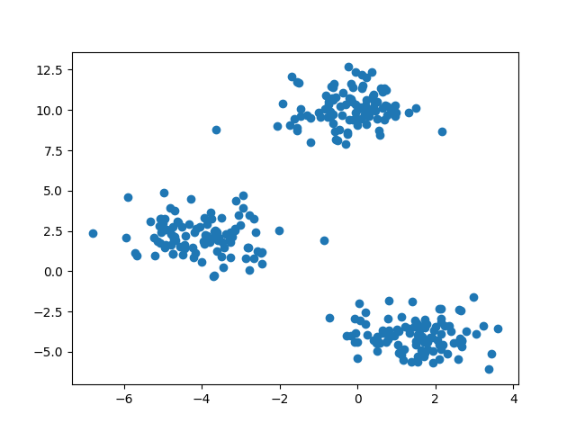
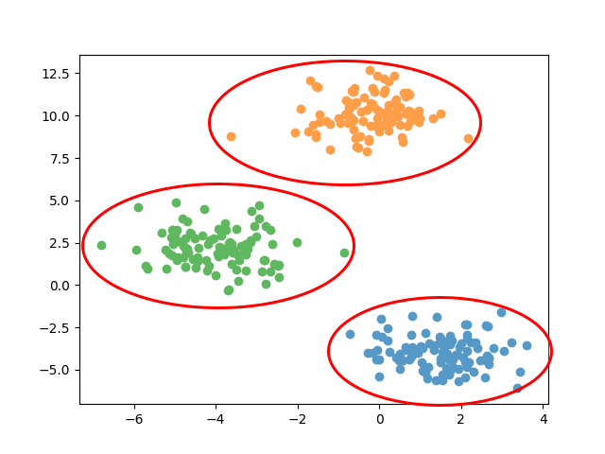
Overview of clustering
Starting with an unlabled set of points
detect
Cluster structure in the data

Slide 6
Overview of clustering
Starting with an unlabled set of points
Problem
No prior knowledge on the number of clusters
No other information on the clusters composition
detect
Cluster structure in the data

Slide 7
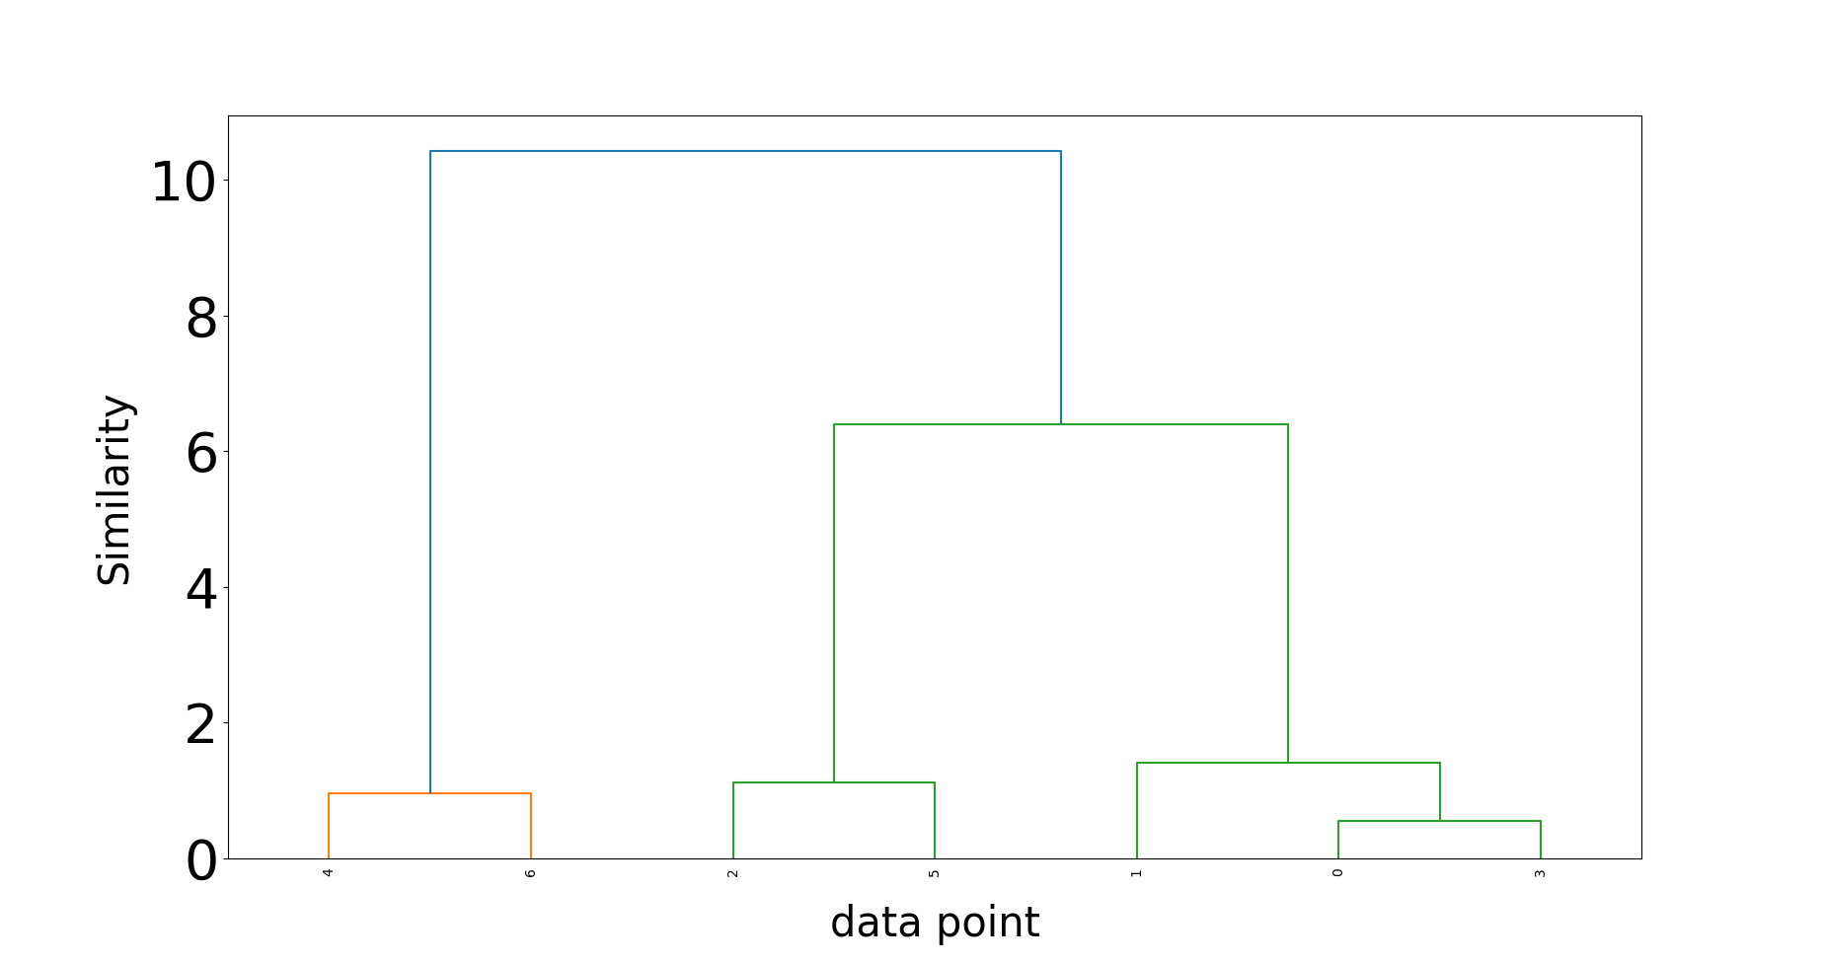
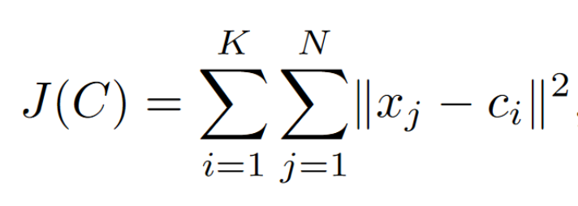
How to approach the problem
Partitional clustering: obtaining a single partition of the data.
Pros: Easy to implement and take insight
Cons: Requires input of the number of clusters
Hierarchical clustering: producing a nested series of partitions.
Pros: No input needed
Cons: Can be computationally demanding; Hard to read for a large dataset.

Slide 8
Related Work
Overview of clustering
Overview of clustering evaluation metrics
AliClu

Slide 9
Methods of evaluation
Comparison of two partitions:
Generated by the clustering algorithm
Generated from a subset of the data
Ext ernal
Calculates properties of the clusters, such as compactness and separation
Internal
Author(s):
C. Aggarwal and C. Reddy. DATA CLUSTERING Algorithms and Applications. 2013.

Slide 10
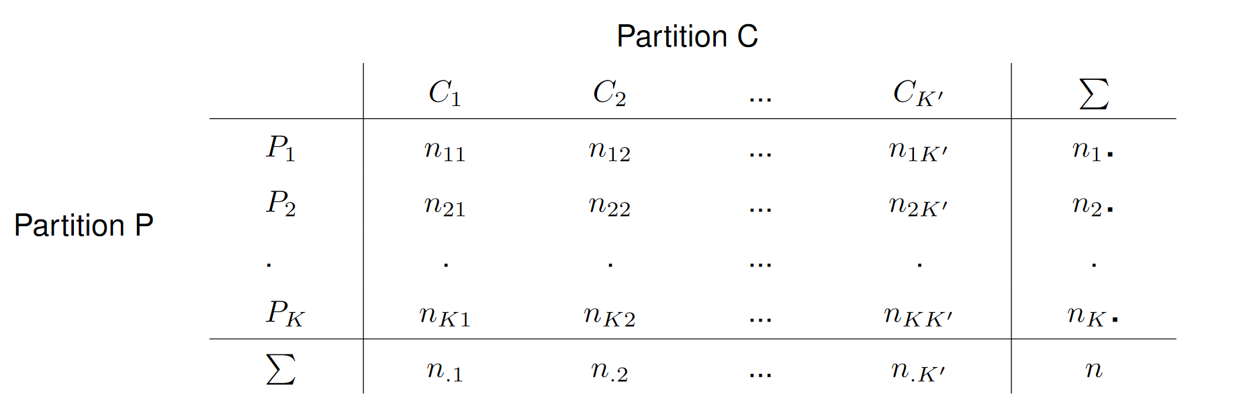
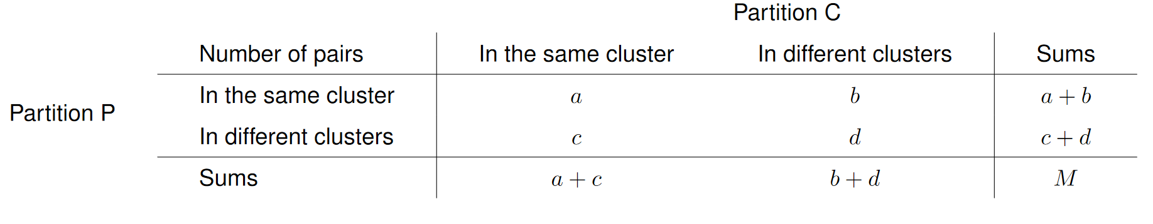



External clustering validation measures
Clustering Algorithm
Subset of the data
Repeat M times
generating a new subset
$$C= \left\{C_{1} … C_{m}\right\}$$
Consider $\left(x_{v}, x_{u}\right)$from the dataset
$$P= \left\{P_{1 }… P_{s}\right\}$$
Notes:
Comparando cada par do dataset, Podemos classificá-lo em 4 tipos, dependendo se pertence ao mesmo cluster e/ou à mesma partição.
Para ter um teste estatistico valido, devemos usar uma técnica Monte Carlo, repetindo M vezes o procedimento.

Slide 11
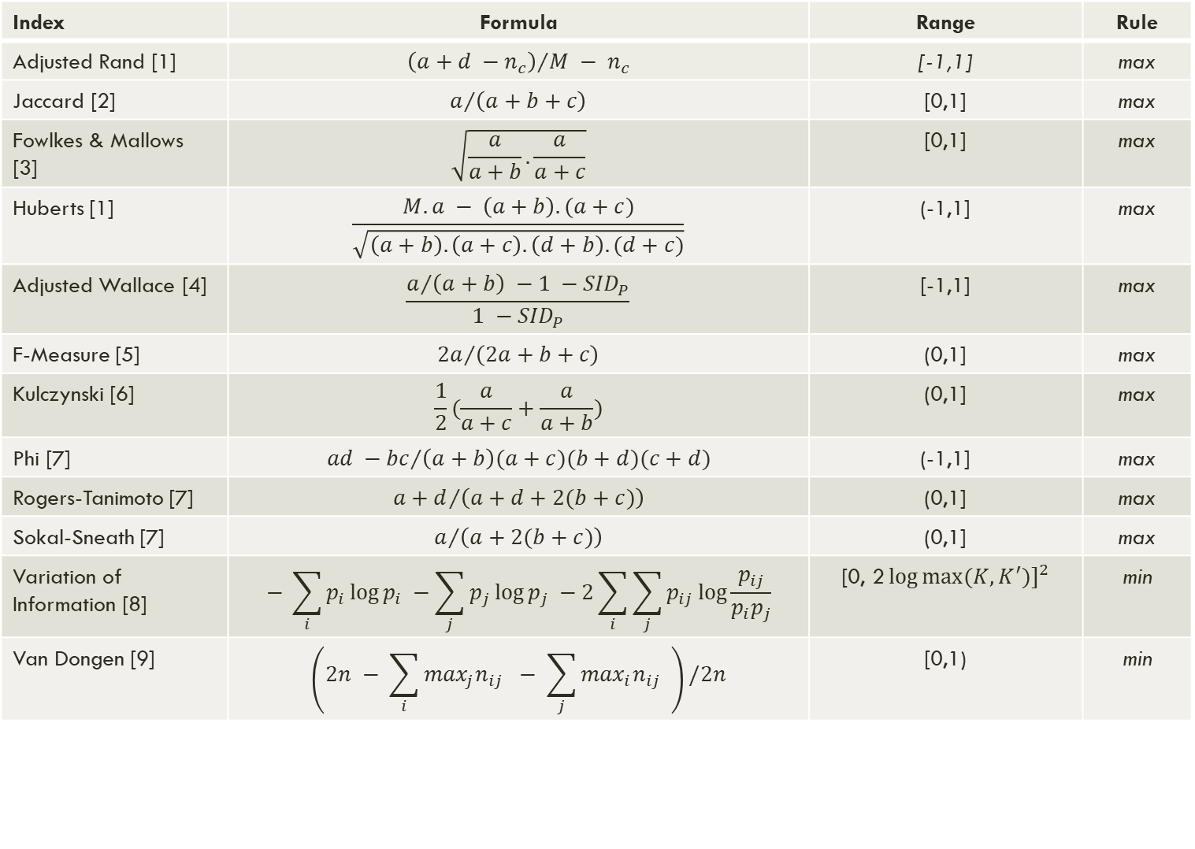
Index | Formula | Range | Rule
Adjusted Rand [1] | $${\left(a+d −n_{c}\right)}/{M − n_{c}}$$ | [-1,1] | max
Jaccard [2] | $$a/{\left(a+b+c\right)}$$ | [0,1] | max
Fowlkes & Mallows [3] | $$\sqrt{\frac{a}{a+b}.\frac{a}{a+c}}$$ | [0,1] | max
Huberts [1] | $$\frac{M.a − \left(a+b\right).(a+c)}{\sqrt{\left(a+b\right).\left(a+c\right).\left(d+b\right).(d+c)}}$$ | (-1,1] | max
Adjusted Wallace [4] | $$\frac{a/{\left(a+b\right) −1 −{SID}_{P}}}{1 −{SID}_{P}}$$ | [-1,1] | max
F-Measure [5] | $${2a}/{\left(2a+b+c\right)}$$ | (0,1] | max
Kulczynski [6] | $$\frac{1}{2}(\frac{a}{a+c}+\frac{a}{a+b})$$ | (0,1] | max
Phi [7] | $${ad −bc}/{\left(a+b\right)(a+c)(b+d)(c+d)}$$ | (-1,1] | max
Rogers-Tanimoto [7] | $${a+d}/{\left(a+d+2(b+c)\right)}$$ | (0,1] | max
Sokal-Sneath [7] | $$a/{\left(a+2(b+c)\right)}$$ | (0,1] | max
Variation of Information [8] | $$− \sum_{i}{p_{i}\log{p_{i} −\sum_{j}{p_{j}\log{p_{j} −2\sum_{i}{\sum_{j}{p_{ij}\log{\frac{p_{ij}}{p_{i}p_{j}}}}}}}}}$$ | [0, ${\text{2}\log{max⁡(K,K^{′})]}}^{2}$ | min
Van Dongen [9] | $$\left(2n − \sum_{i}{\max_{j}n_{ij}} − \sum_{j}{\max_{i}n_{ij} }\right)/2n$$ | [0,1) | min
[1] L. Hubert and P. Arabie. Comparing partitions. Journal of Classification, 1985; [2] M. Halkidi, Y. Batistakis, and M. Vazirgiannis. Cluster validity methods: Part i. SIGMOD Rec., 31 (2), 2002.
[3] E. B. Fowlkes and C. L. Mallows. A method for comparing two hierarchical clusterings. Journal of the American Statistical Association, 1983; [4] A. Severiano, et al,. Adjusted wallace coefficient as a measure of congruence between typing methods. Journal of Clinical Microbiology, 2011.
[5] E. Achtert, et al. Evaluation of clusterings – metrics and visual support. In 2012 IEEE 28th International Conference on Data Engineering. [6] S. Kulczynski. Die Pflanzenassoziationen der Pieninen. Mémoires de l’Académie polonaise des sciences et des lettres, 1928.
[7] B. Desgraupes. Clustering indices. 2017. [8] M. Meila. Comparing clusterings – an information based distance. Journal of Multivariate Analysis, 2007 [9] S. V. Dongen. Performance criteria for graph clustering and markov cluster experiments. 2000.
[1] L. Hubert and P. Arabie. Comparing partitions. Journal of Classification, 1985; [2] M. Halkidi, Y. Batistakis, and M. Vazirgiannis. Cluster validity methods: Part i. SIGMOD Rec., 31 (2), 2002.
[3] E. B. Fowlkes and C. L. Mallows. A method for comparing two hierarchical clusterings. Journal of the American Statistical Association, 1983; [4] A. Severiano, et al,. Adjusted wallace coefficient as a measure of congruence between typing methods. Journal of Clinical Microbiology, 2011.
[5] E. Achtert, et al. Evaluation of clusterings – metrics and visual support. In 2012 IEEE 28th International Conference on Data Engineering. [6] S. Kulczynski. Die Pflanzenassoziationen der Pieninen. Mémoires de l’Académie polonaise des sciences et des lettres, 1928.
[7] B. Desgraupes. Clustering indices. 2017. [8] M. Meila. Comparing clusterings – an information based distance. Journal of Multivariate Analysis, 2007 [9] S. V. Dongen. Performance criteria for graph clustering and markov cluster experiments. 2000.

Slide 12

Internal clustering validation measures
External
Statistical Tests
High Computational Resources
Internal
Produce many clustering.
Vary parameters, like algorithm and/or parameters.
Choose the clustering that gives the most compact and separated partitions.
Evaluate compactness and separation.
Notes:
-Medidas relativas são uma boa opção, muito porque os teste estatisticos nas medias externas e internas podem ser muito dispendiosos em termos computacionais

Slide 13
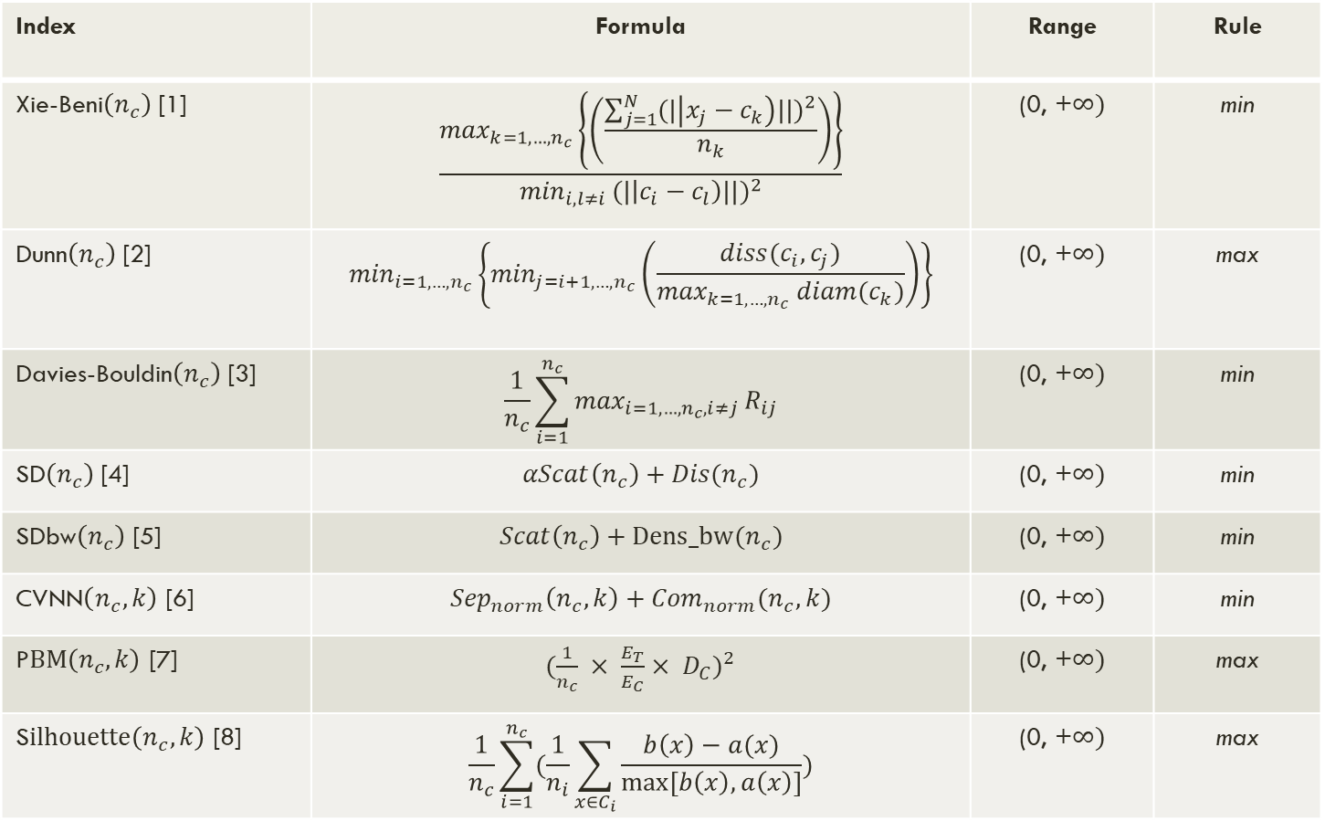
Index | Formula | Range | Rule
Xie-Beni$\left(n_{c}\right)$ [1] | $$\frac{\max_{k=1,…,n_{c}}\left\{\left(\frac{\sum_{j=1}^{N}{{(|\left|x_{j}−c_{k}\right)||)}^{2}}}{n_{k}}\right)\right\}}{\min_{i,l≠i }{(|\left|c_{i}−c_{l}\right)||)}^{2}}$$ | (0, +$∞)$ | min
Dunn$\left(n_{c}\right)$ [2] | $$\min_{i=1,…,n_{c}}\left\{\min_{j=i+1,…,n_{c}}\left(\frac{diss(c_{i}, c_{j})}{\max_{k=1,…,n_{c}} diam(c_{k})}\right)\right\}$$ | (0, +$∞)$ | max
Davies-Bouldin$\left(n_{c}\right)$ [3] | $$\frac{1}{n_{c}}\sum_{i=1}^{n_{c}}{\max_{i=1,…,n_{c}, i≠j}}R_{ij}$$ | (0, +$∞)$ | min
SD$\left(n_{c}\right)$ [4] | $$αScat\left(n_{c}\right)+Dis(n_{c})$$ | (0, +$∞)$ | min
SDbw$\left(n_{c}\right)$ [5] | $$Scat\left(n_{c}\right)+Dens_bw(n_{c})$$ | (0, +$∞)$ | min
CVNN$\left(n_{c},k\right)$ [6] | $${Sep}_{norm}\left(n_{c},k\right)+{Com}_{norm}(n_{c}, k)$$ | (0, +$∞)$ | min
P$BM\left(n_{c},k\right)$ [7] | ${(\frac{1}{n_{c}} × \frac{E_{T}}{E_{C}}× D_{C})}^{2}$ | (0, +$∞)$ | max
S$ilhouette\left(n_{c},k\right)$ [8] | $$\frac{1}{n_{c}}\sum_{i=1}^{n_{c}}{(\frac{1}{n_{i}}\sum_{x∈C_{i}}{\frac{b\left(x\right)−a(x)}{max⁡[b\left(x\right),a\left(x\right)]}})}$$ | (0, +$∞)$ | max
[1] X. L. Xie and G. Beni. A validity measure for fuzzy clustering. IEEE Transactions on Pattern Analysis and Machine Intelligence, 1991; [2] ; M. Halkidi, et al. Clustering validity checking methods: Part ii.. 2002;
[3] D. Davies and D. Bouldin. A cluster separation measure. Pattern Analysis and Machine Intelligence,IEEE Transactions.1979; [4] M. Ramze Rezaee, et al. A new cluster validity index for the fuzzy c-mean. Pattern Recognition Letters, 1998 ;
[5] M. Halkidi and M. Vazirgiannis. Clustering validity assessment: finding the optimal partitioning of a data set. 2001 ; [6] Y. Liu, et al. Understanding and enhancement of internal clustering validation measures. 2013 ;
[7] M. K. Pakhira, et al. Validity index for crisp and fuzzy clusters. Pattern Recognition. 2004; [8] P. J. Rousseeuw. Silhouettes: A graphical aid to the interpretation and validation of cluster analysis. Journal of Computational and Applied Mathematics. 1987;

Slide 14
Related Work
Overview of clustering
Overview of clustering evaluation metrics
AliClu

Slide 15
Work from aliclu by Kishan rama
Background
Application
Electronical Medical Records (EMR) are more available now
Data from EMR can help specialists
Structures or models can be extracted from the data
Use Temporal Needleman-Wunsch (TNW) to align data sequences and obtain a distance matrix
Hierarchical clustering is applied to the TNW sequences
Apply clustering validation
Author(s):
K. Rama, H. Canhão, A. Carvalho, and S. Vinga. Aliclu - temporal sequence alignment for clustering longitudinal clinical data. BMC Medical Informatics and Decision Making, 19, 12 2019.
Notes:
Projeto parte do que já foi feito pelo AliClu
Ponto de partida:
- Os dados do EMR podem ajudar os especialistas a melhor tratar os pacientes. Através das estruturas e modelos que podem ser extraidos dos dados.

Slide 16
Proposed Solution
Extend the cluster validation measurements in AliClu
Automatize the cluster representation through graphs
Contribute to the community with a Python library for cluster validation

Slide 17
Implementation
Evaluation procedure
Clusterval
AliClu – cluster visual representation

Slide 18
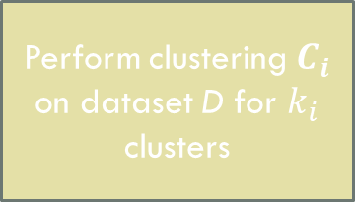
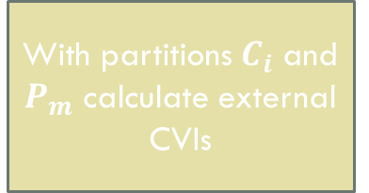



Evaluation Procedure
Repeat M times
Set k clusters to test and
bootstrap samples M to generate
Generate a random sample m from the dataset D
Perform clustering $P_{m}$ on the sample
With partitions $C_{i}$ and $P_{m}$ calculate external CVIs
Average all external CVIs
Perform clustering $C_{i}$ on dataset D for $k_{i}$ clusters
Calculate internal CVIs for structure $C_{i}$
Each index takes a vote on the number of clusters
Choose $n_{c}$ with the best results overall
Until i = max k

Slide 19
Implementation
Evaluation procedure
Clusterval
AliClu – cluster visual representation

Slide 20
Clusterval
Python package that performs clustering evaluation of any list-type dataset or distance matrix. Published in Pypi: https://pypi.org/project/clusterval/
Source code and other documents can be found at https://github.com/Nuno09/clusterval
How to obtain the package:
Pypi:
pip install clusterval
Github:
pip install git+https://github.com/Nuno09/clusterval.git
Load the package in a Python environment:
from clusterval import Clusterval

Slide 21
The Clusterval object can be initialized with default parameters or these can be explicitly set. Parameters are described in the next table.
Parameter | Description | Default value
min_k | Integer that sets the minimum number of clusters to test. | 2
max_k | Integer that sets the maximum number of clusters to test. | 8
algorithm | String that sets the clustering algorithm to use. | Hierarchical clustering with ward linkage.
bootstrap_samples | Integer that sets the number of bootstrap samples simulated | 250
index | String (or list of strings) containing the CVIs calculate. | All CVIs.

Slide 22
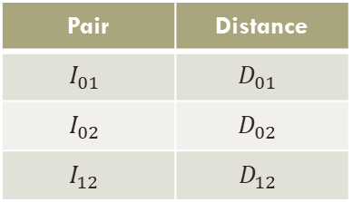
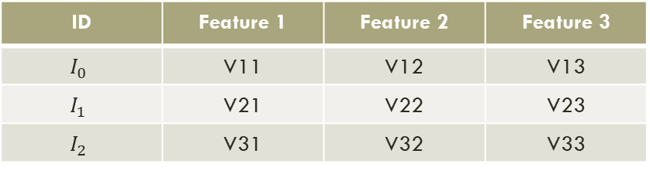
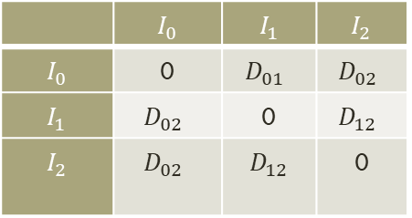
Create object:
c = Clusterval()
c =Clusterval(min_k=2, max_k=10, algorithm=kmeans, bootstrap_samples=500, index=‘F’,’CVNN’)
Perform clustering evaluation
c.evaluate(data)
Output will be the chosen number of clusters.
ID | Feature 1 | Feature 2 | Feature 3
$$I_{0}$$ | V11 | V12 | V13
$$I_{1}$$ | V21 | V22 | V23
$$I_{2}$$ | V31 | V32 | V33
Data
 | $$I_{0}$$ | $$I_{1}$$ | $$I_{2}$$
$$I_{0}$$ | 0 | $$D_{01}$$ | $$D_{02}$$
$$I_{1}$$ | $$D_{02}$$ | 0 | $$D_{12}$$
$$I_{2}$$ | $$D_{02}$$ | $$D_{12}$$ | 0
Pair | Distance
$$I_{01}$$ | $$D_{01}$$
$$I_{02}$$ | $$D_{02}$$
$$I_{12}$$ | $$D_{12}$$
or

Slide 23
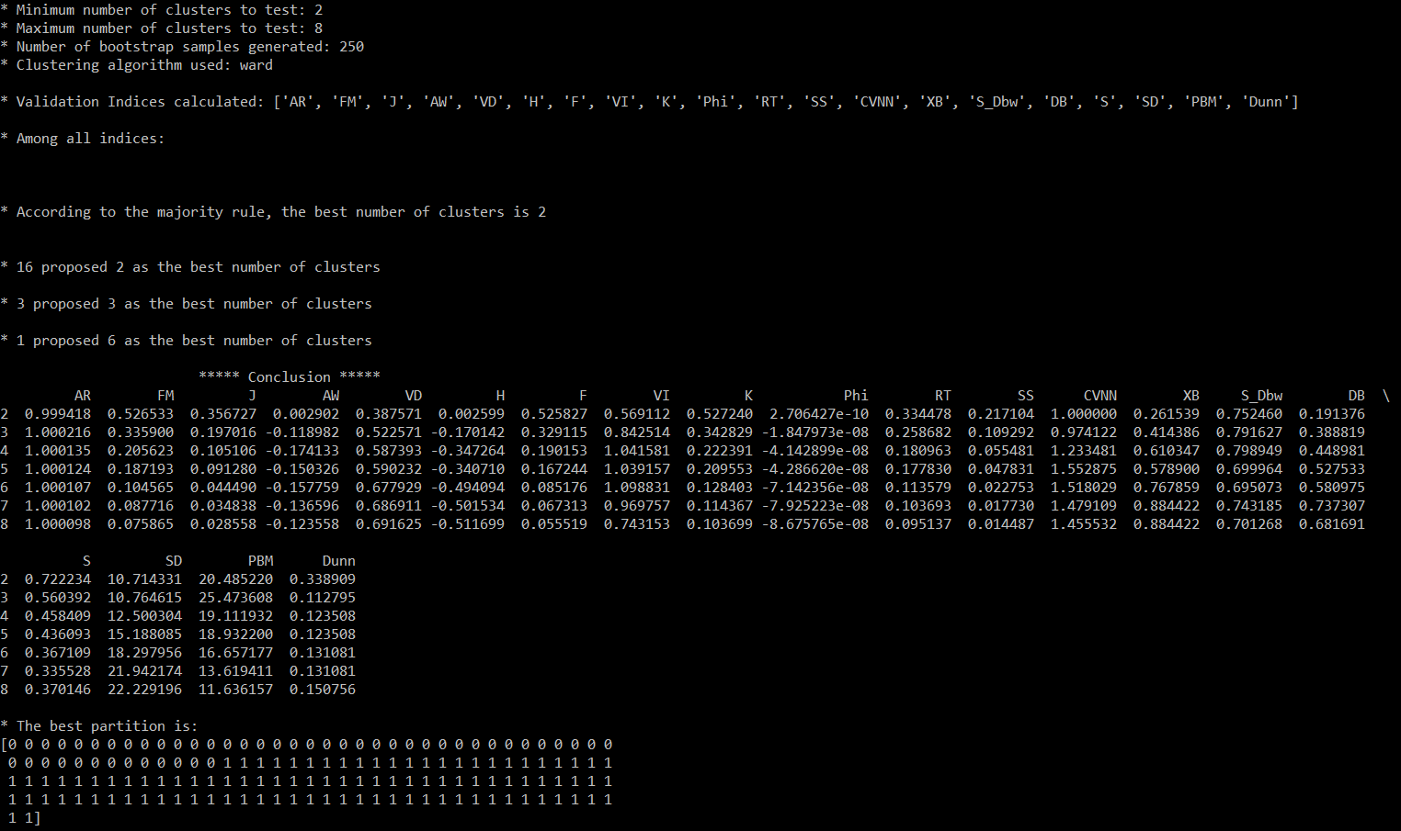
To see more information about the evaluation process and the resulting partition:
print(c.long_info)
To visualize the resulting dendrogram*:
c.plot()
help(clusterval)
*When applying hierarchical clustering

Slide 24
Implementation
Evaluation procedure
Clusterval
AliClu – cluster visual representation

Slide 25
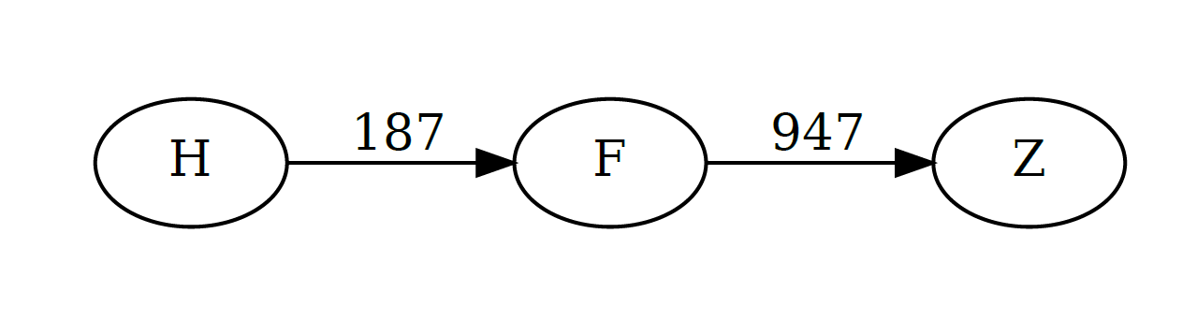
AliClu – cluster visual representation
Letters represent treatments.
Numbers represent the transistion time between treatments.
Nodes represent treatments.
Edges represent transitions between treatments.
id_patient | coded_sequence
3948652 | 0.H,187.F,785.Z
69331060 | 0.F.1109.Z
This information can be represented as a graph!
Python module - graphviz

Slide 26
Results
Synthetic datasets
Real-world datasets
Reuma.pt dataset

Slide 27
Synthetic Datasets
The datasets were generated by using the package sklearn make_blobs function
Five factors to cover:
Number of clusters
Dimensionality
Noise
Density
Overlapping
Plus 5 different clustering algorithms to test:
single-linkage hierarchical clustering
complete-linkage hierarchical clustering
ward-linkage hierarchical clustering
k-means partitional clustering
Configurations:
5 factors x 5 datasets (from each) x 4 clustering algorithms = 1440 different configurations

Slide 28
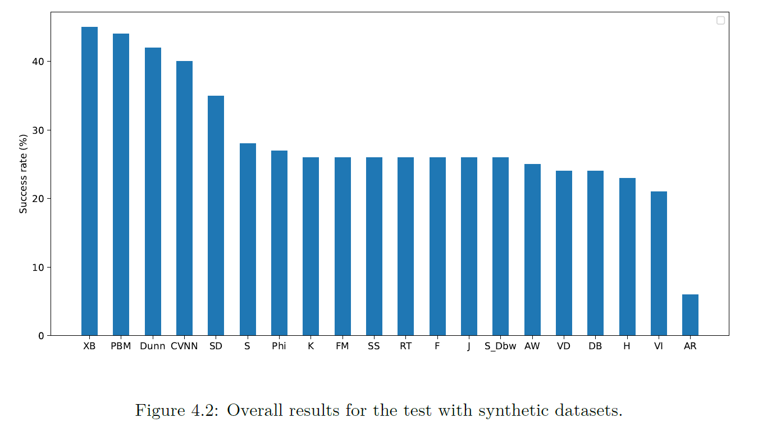
Synthetic datasets
Performance decreases with the increase in the number of clusters.
A higher number of atributes translated to slightly better results.
Introduction of noise had no significant impact.
Density also does not affect significantly the results.
K-means slightly better than other algorithms.

Slide 29
Results
Synthetic datasets
Real-world datasets
Reuma.pt dataset

Slide 30
Real-world datasets*
Dataset | Nº instances | Nº attributes | Classes
Breast tissue | 106 | 9 | 6
Ecoli | 336 | 7 | 8
Glass | 214 | 9 | 7
Haberman | 306 | 3 | 2
Iris | 150 | 4 | 3
Parkinsons | 195 | 22 | 2
Vehicle | 846 | 18 | 4
Vertebral column | 310 | 6 | 3
Wine | 178 | 13 | 3
Yeast | 1484 | 8 | 10
source: UCI repository - https://archive.ics.uci.edu/ml/index.php

Slide 31
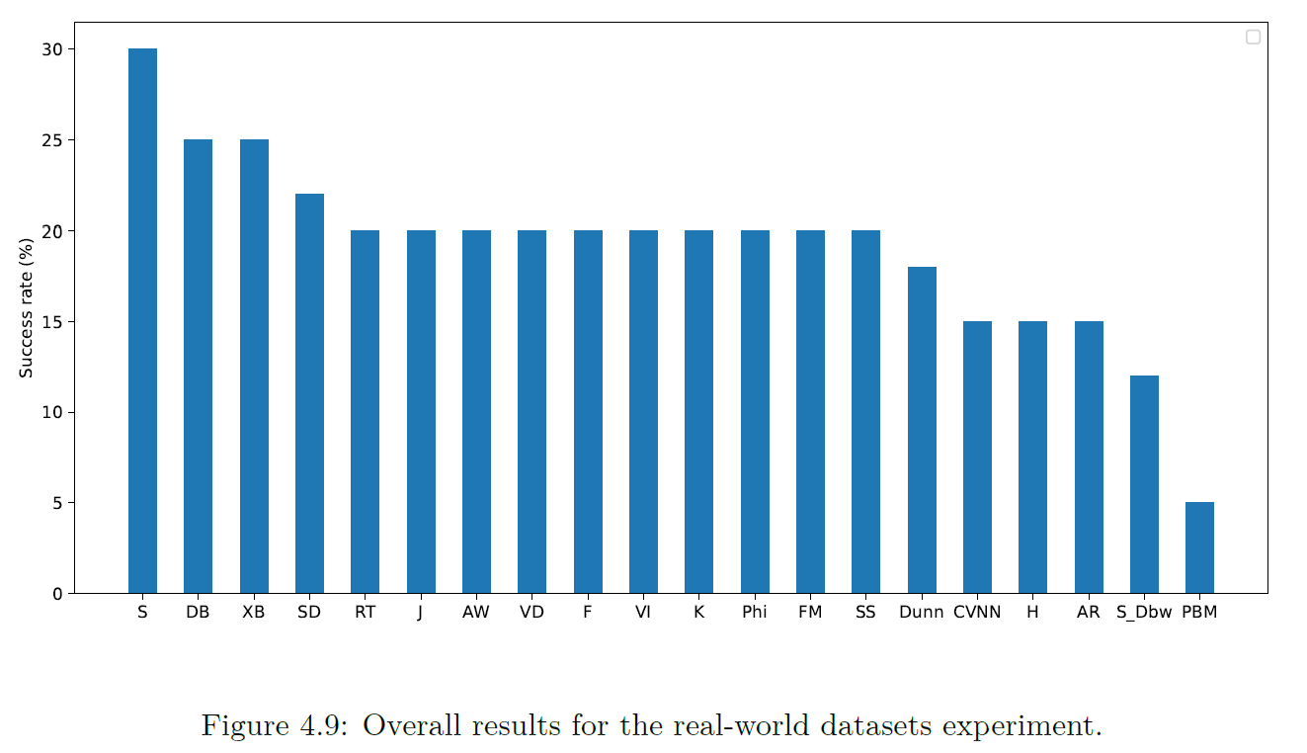
Synthetic vs Real-World
Synthetic results: 29.3% average success rate.
Real datasets: 20.1% average success rate.
Changes in ranking.
Internal indices achieve better results for both tests.

Slide 32
Insights from indices values
External validation indices tend to choose NC=2.
Internal validation indices come closer to true values.
Fully automatic prediction of the number of clusters in a dataset is not accurate due to similarity between different clusterings.

Slide 33
Results
Synthetic datasets
Real-world datasets
Reuma.pt dataset

Slide 34
Reuma.pt dataset
Dataset developed by the Portuguese Society of Reumatology (SPR).
Mostly patients with reumatoid arthritis, ankylosing spondylitis, psoriatic arthritis and juvenile idiopathic arthritis.
In total there is information about 426 patients and 9035 appointments.
The goal of AliClu is to find the partitions in the dataset that help predict the treatment for future patients.
Clusterval supports AliClu in the cluster analysis.

Slide 35
Parameters used in the tests
bootstrap_samples: 250
min_k: 2
max_k: 20
indices: all
clustering_algorithm: hierarchical (single, complete, average, ward)
AliClu parameters:
gap = [0.0,0.1]
Tp = {0.25,1.00,2.00}
We divide our experiment in two groups:
1) Automatic generation of results
2) Semi-automatic generation of results

Slide 36
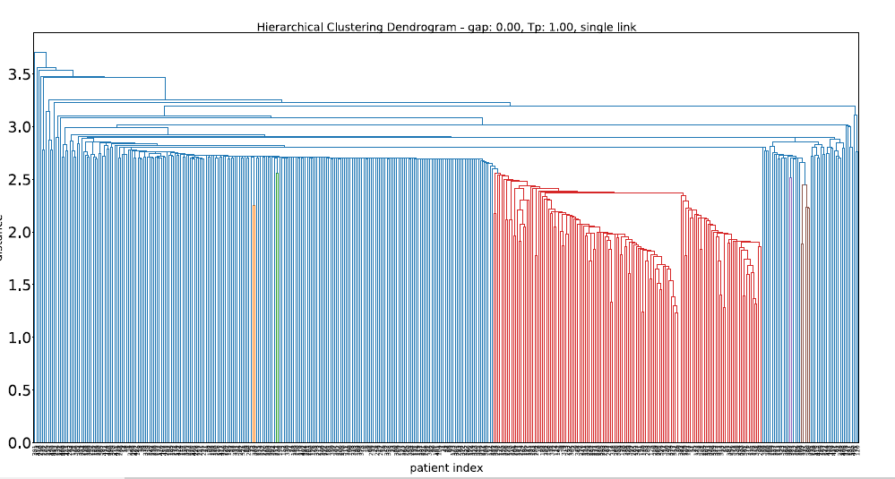
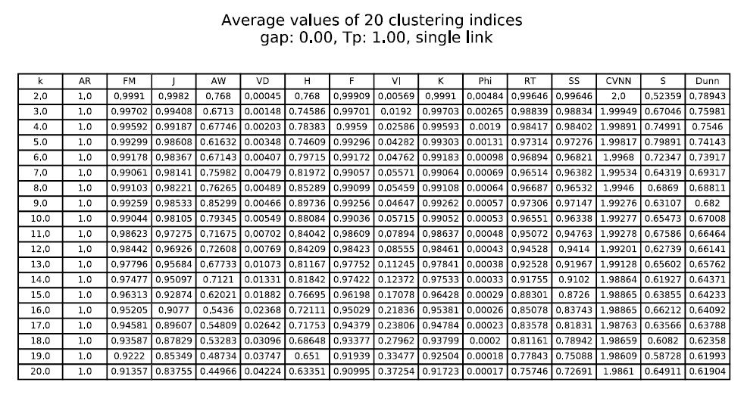
Automatic results – REUMA.pt
Average and Single linkage choose NC=2.
One partition is very small (1-8 elements) and the other very big (all other elements).

Slide 37
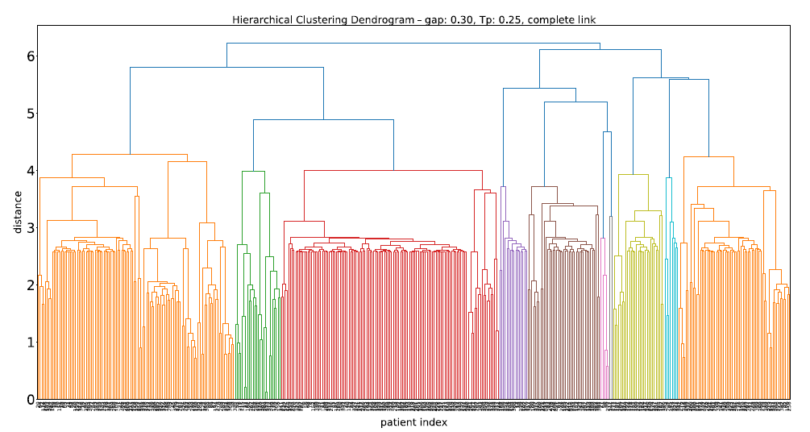
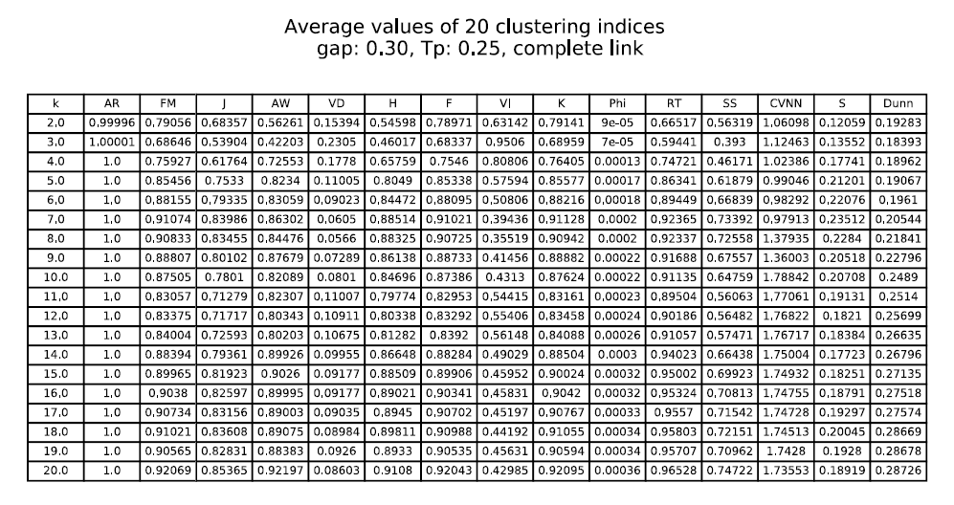
Automatic results – REUMA.pt
Complete linkage results seem more promising, considering the problem context.
Dendrogram better structured.
NC=20. Most CVIs follow this conclusion.

Slide 38
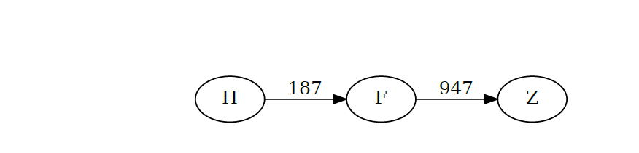
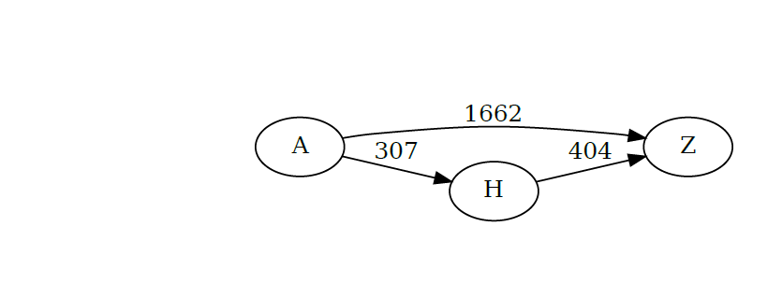
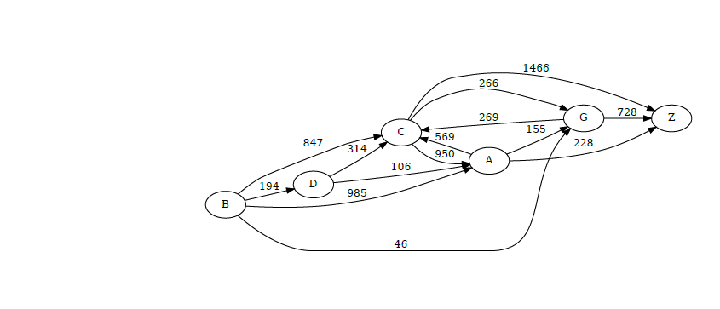
Automatic results – REUMA.pt
Most resulting clusters are distinct and containing information on one event or chain.
Exceptions for cluster 14, which is not so easy to read.

Slide 39
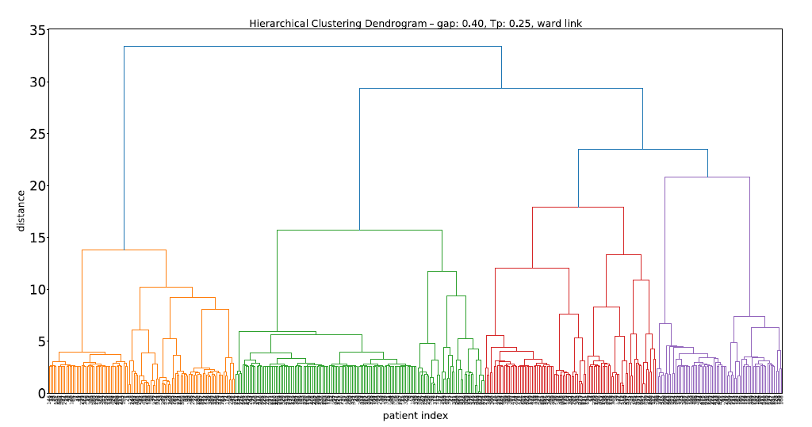
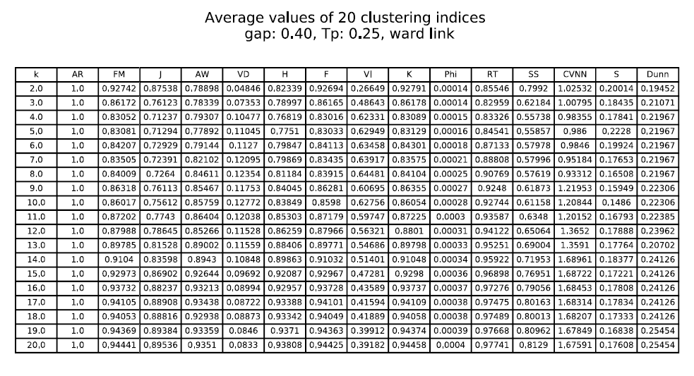
Automatic Results – Reuma.pt
Ward linkage also outputed NC=20.
Dendrogram with clear structure.
The majority of indices support the decision.

Slide 40
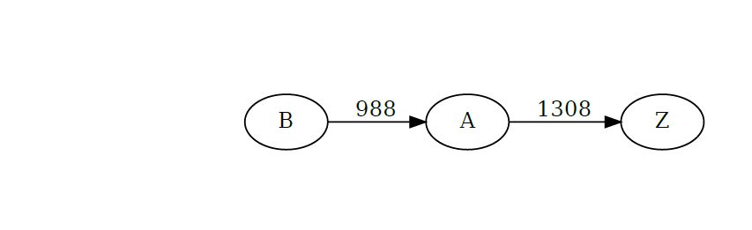
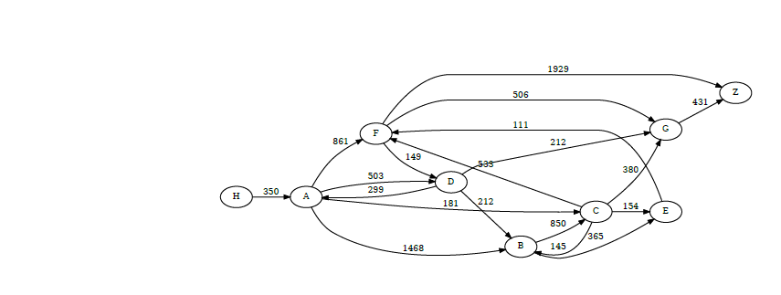
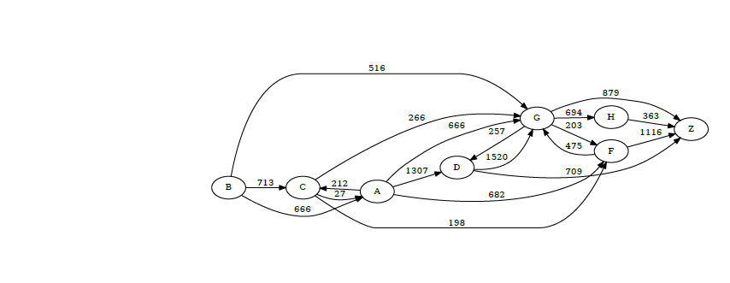
Automatic results – reuma.pt
Resulting clusters with good separation of events.
Cluster 5 and 14 with very long sequences.

Slide 41
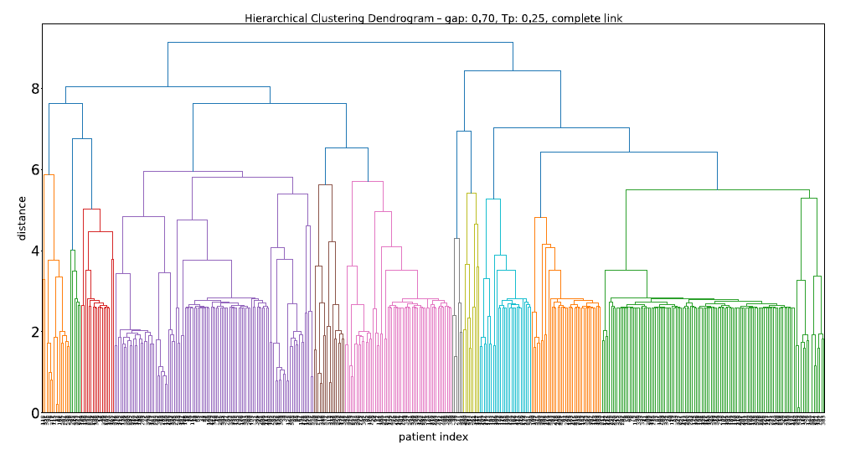
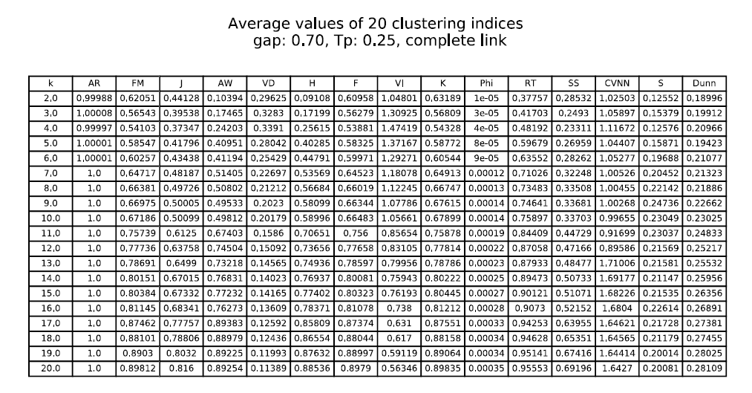
Semi-automatic results – Reuma.pt
For complete linkage the conclusion was NC=20.
Resulting sequences are longer than in automatic
Notes:
Like in the automatic approach, single, complete and average linkage algorithms do produce unstructured dendrograms, unclear insights from the CVIs and unbalaced resulting clusters.

Slide 42
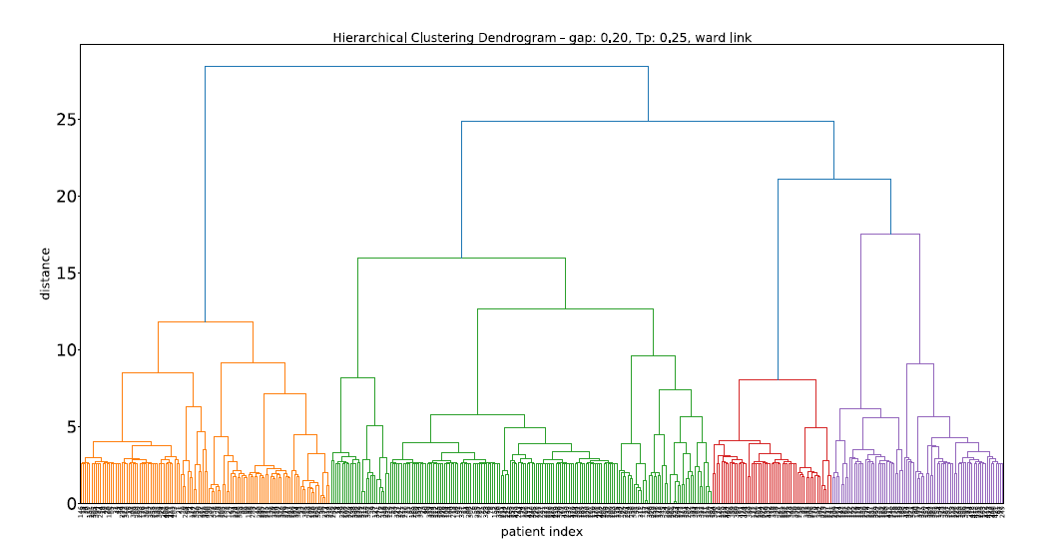
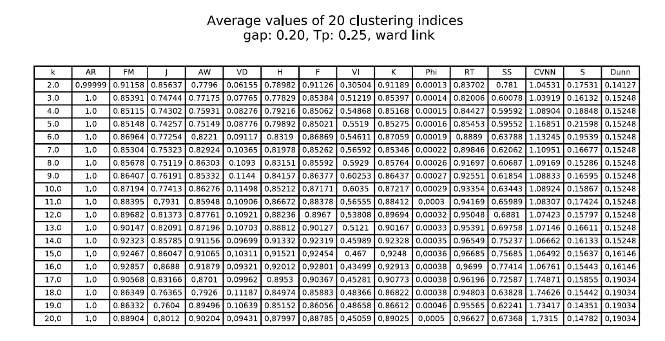
Semi-automatic results – Reuma.pt
For ward linkage the conclusion was NC=16.
Resulting sequences are bigger, due to lower NC.
Notes:
Like in the automatic approach, single, complete and average linkage algorithms do produce unstructured dendrograms, unclear insights from the CVIs and unbalaced resulting clusters.

Slide 43
Final Remarks and contributions
Clusterval was built with the goal of providing automatization and credibility to the clustering analysis performed in AliClu, by adding more ways to evaluate the results and a new way to visually represent those results.
Overall, the results are not satisfactory. The metrics fail to predict accurately for synthetic datasets (29,3%) and real-world datasets (20,1%).
Although, the performance metric used (% success rate) might have been to “cruel” for our tool. Sometimes a structure with a difference of one cluster to another is not a punishable act.
Regarding the tests for Reuma.pt, the results for complete and ward linkage were reasonable and supported by manual checking.

Slide 44
Conclusion and future work
The usefulness of a tool like Clusterval is undeniable. Nevertheless, the fully automatic approach taken in this work does not produce the desired results and the performance measures should be revisited.
To improve the results:
Take the problem context into account.
Varying the weights of the CVIs.
Finally, since internal validation metrics performed better, we could aim to add more of these type of indices.

