Slide 1

Clusterval: A Python package for determining number ofclusters in a Longitudinal Dataset
Nuno Miguel Canhoto da Silva
80763 Prof. Susana Vinga Prof. Alexandra Carvalho
Master Thesis - Information and Software Engineering in MEIC 2020/2021 - Instituto Superior Técnico
Notes:
Vou falar de
Vamos então perceber do que se trata

Slide 2
Introduction
Partition medical data into clusters
Identify methods to evaluate the clustering result
Work will provide numerous validation metrics for clusters based on two criteria:
External Validation
Internal Validation
Test the implemented tool
Notes:
É problema pq:
Surgem muitas estruturas possiveis dos algoritmos de clustering e é preciso escolher
Agglomerative clustering no AliClu
-

Slide 3
OBjectives
Gather and analyse existing metrics for cluster validation
Give the AliClu tool a validation support

Slide 4
Related Work
Overview of clustering
Overview of clustering evaluation metrics
AliClu

Slide 5
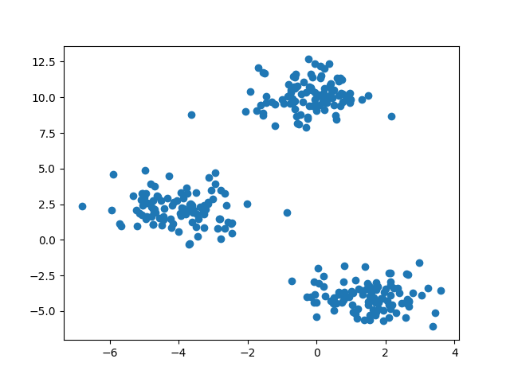
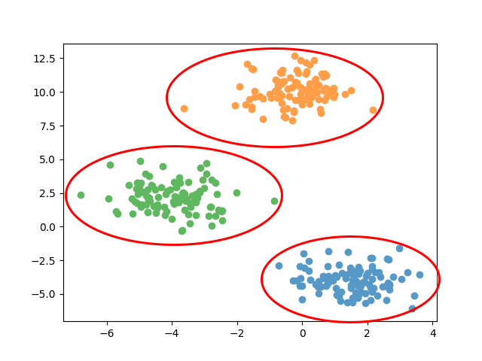
Overview of clustering
Starting with an unlabled set of points
detect
Cluster structure in the data

Slide 6
Overview of clustering
Starting with an unlabled set of points
Problem
No prior knowledge on the number of clusters
No other information on the clusters composition
detect
Cluster structure in the data

Slide 7
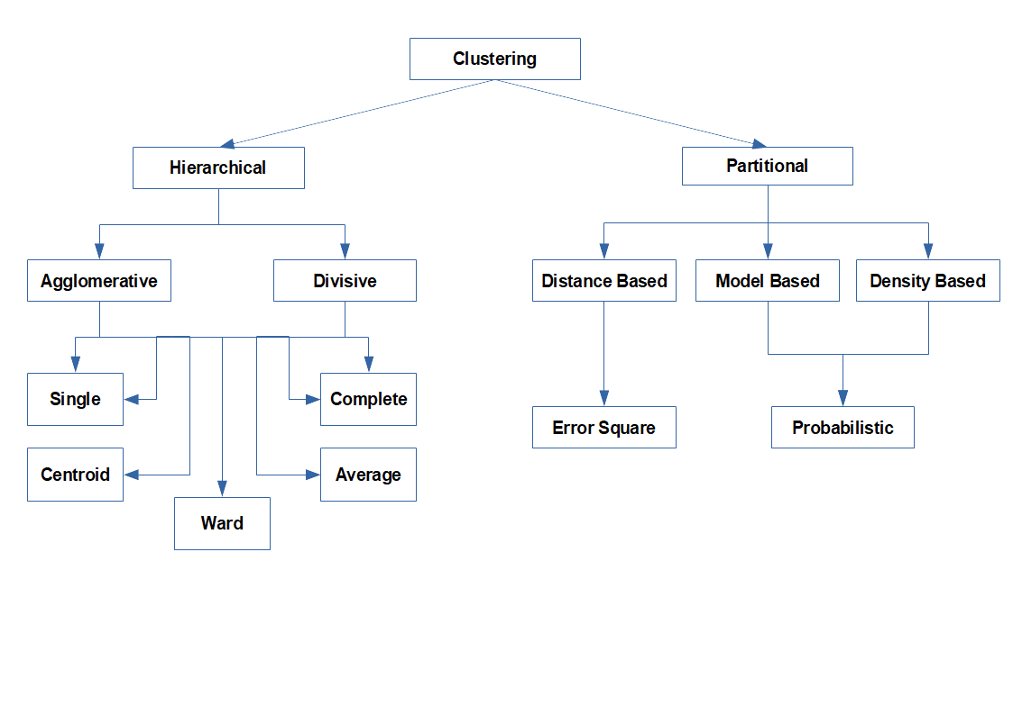
How to approach the problem
Hierarchical clustering: producing a nested series of partitions.
Pros: No input needed
Cons: Can be computationally demanding; Hard to read for a large dataset.
Partitional clustering: obtaining a single partition of the data.
Pros: Easy to implement and take insight
Cons: Requires input of the number of clusters

Slide 8
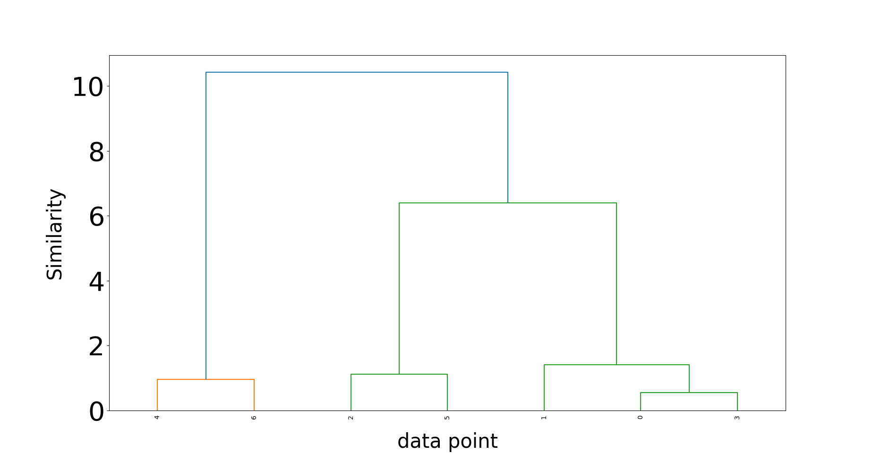
Hierarchical clustering
Represented by a dendrogram like the one on the image
Two approaches:
Agglomerative: Bottom-up approach
Divisive: Top-down approach
Idea is to measure distances between objects, i.e. data points, clusters.
Use any distance metric, e.g. Euclidean
For distance between clusters:
Single: minimum distance between all pairs
Complete: maximum distance between all pairs
Average: average distance between all pairs
Centroid: distances between clusters centroids
Ward: sum of squares variation

Slide 9
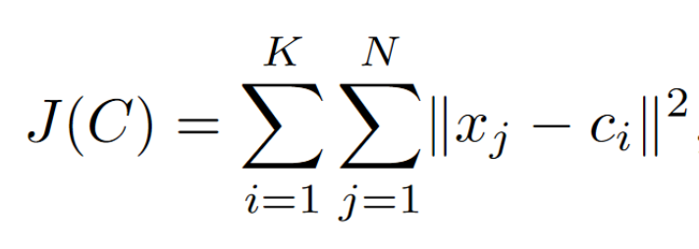
Partitional clustering
General idea is to minimize the square error:
K-means:Start with two random centroids and assign each data point to the closest. Next iterations will recalculate the centroids and re-assign the points. Stop until no changes happen or error function converges.

Slide 10
Related Work
Overview of clustering
Overview of clustering evaluation metrics
AliClu

Slide 11
Methods of evaluation
Comparison of two different partitions
Generated by the clustering algorithm
Generated from a subset of the data
External
Calculates properties of the clusters, such as compactness and separation
Internal
Author(s):
Sergios Theodoridis et al.

Slide 12
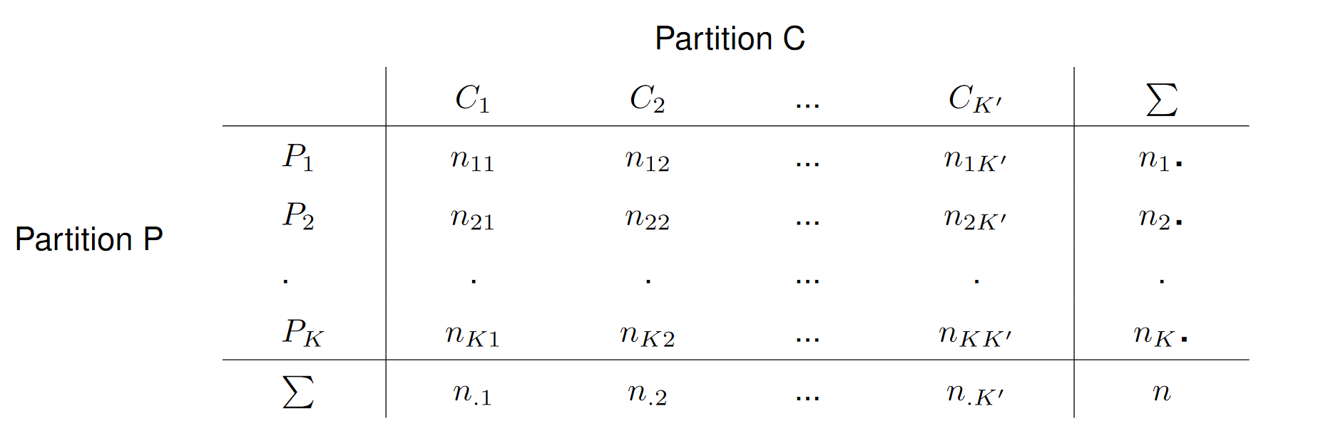
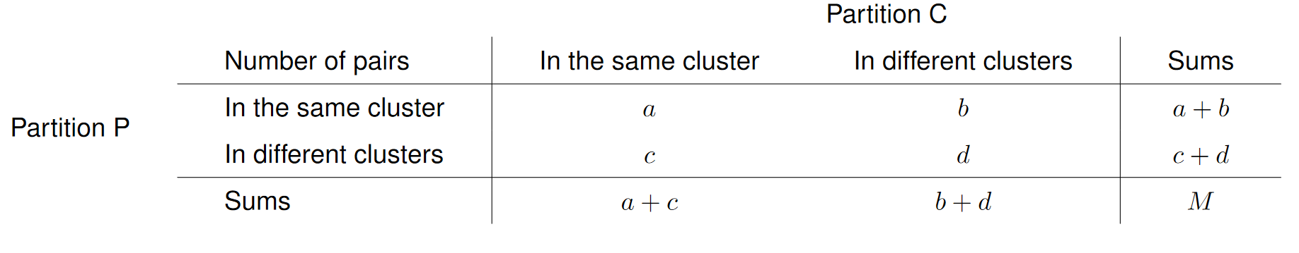



External clustering validation measures
Repeat M times
Clustering Algorithm
Subset of the data
$$C= \left\{C_{1} … C_{m}\right\}$$
Consider $\left(x_{v}, x_{u}\right)$from the dataset
$$P= \left\{P_{1 }… P_{s}\right\}$$
Notes:
Comparando cada par do dataset, Podemos classificá-lo em 4 tipos, dependendo se pertence ao mesmo cluster e/ou à mesma partição.
Para ter um teste estatistico valido, devemos usar uma técnica Monte Carlo, repetindo M vezes o procedimento.

Slide 13
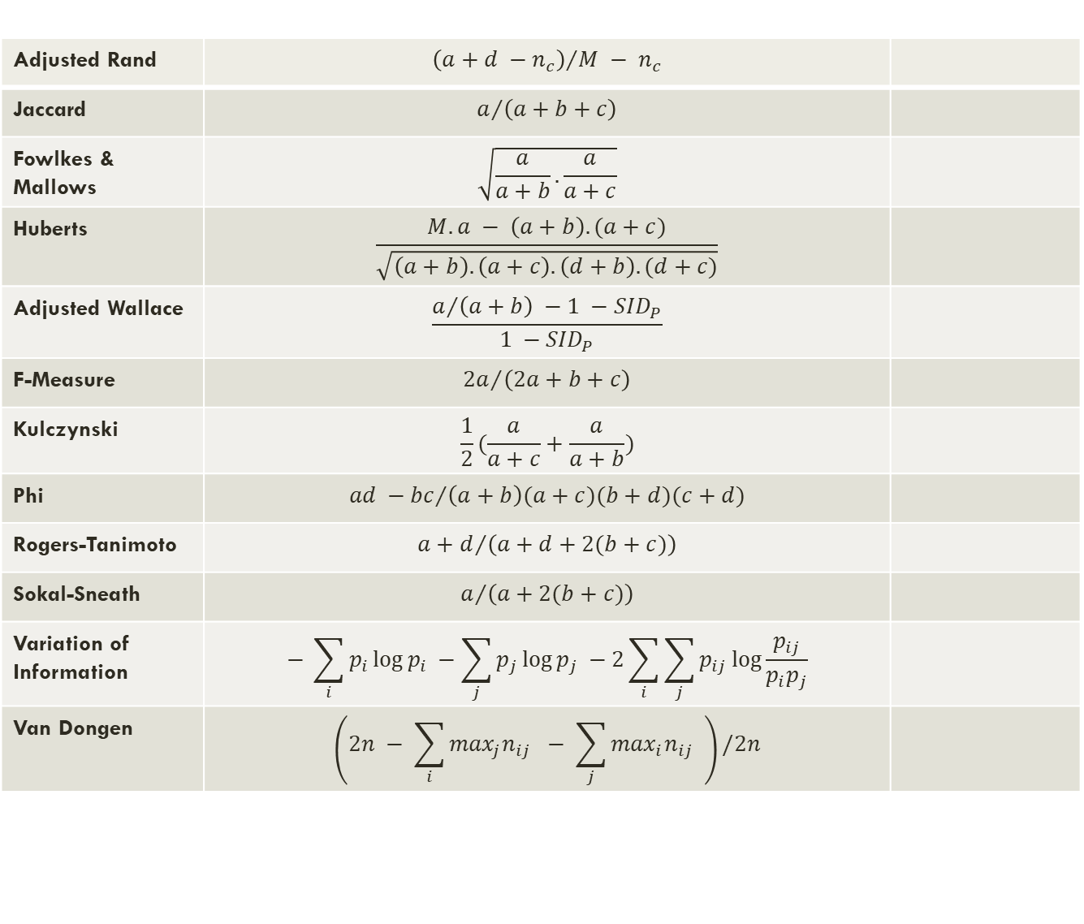
Adjusted Rand | $${\left(a+d −n_{c}\right)}/{M − n_{c}}$$
Jaccard | $$a/{\left(a+b+c\right)}$$
Fowlkes & Mallows | $$\sqrt{\frac{a}{a+b}.\frac{a}{a+c}}$$
Huberts | $$\frac{M.a − \left(a+b\right).(a+c)}{\sqrt{\left(a+b\right).\left(a+c\right).\left(d+b\right).(d+c)}}$$
Adjusted Wallace | $$\frac{a/{\left(a+b\right) −1 −{SID}_{P}}}{1 −{SID}_{P}}$$
F-Measure | $${2a}/{\left(2a+b+c\right)}$$
Kulczynski | $$\frac{1}{2}(\frac{a}{a+c}+\frac{a}{a+b})$$
Phi | $${ad −bc}/{\left(a+b\right)(a+c)(b+d)(c+d)}$$
Rogers-Tanimoto | $${a+d}/{\left(a+d+2(b+c)\right)}$$
Sokal-Sneath | $$a/{\left(a+2(b+c)\right)}$$
Variation of Information | $$− \sum_{i}{p_{i}\log{p_{i} −\sum_{j}{p_{j}\log{p_{j} −2\sum_{i}{\sum_{j}{p_{ij}\log{\frac{p_{ij}}{p_{i}p_{j}}}}}}}}}$$
Van Dongen | $$\left(2n − \sum_{i}{\max_{j}n_{ij}} − \sum_{j}{\max_{i}n_{ij} }\right)/2n$$

Slide 14

Internal clustering validation measures
External
Statistical Tests
High Computational Resources
Internal
Produce many clustering
Vary parameters, like algorithm and/or parameters
Choose the clustering that gives the most compact and separated partitions
Notes:
-Medidas relativas são uma boa opção, muito porque os teste estatisticos nas medias externas e internas podem ser muito dispendiosos em termos computacionais

Slide 15
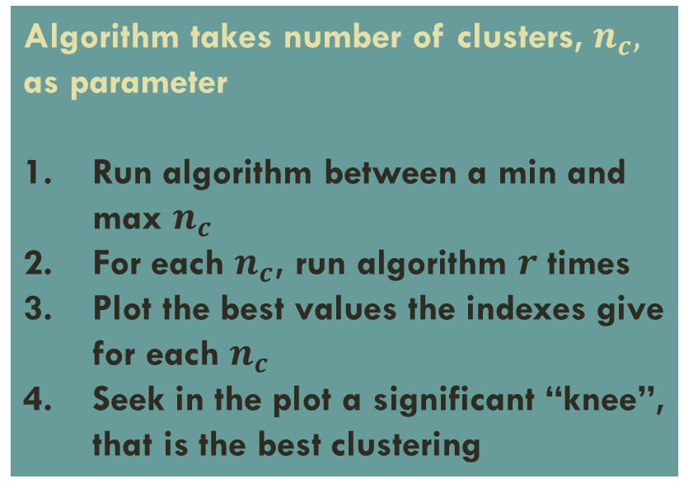
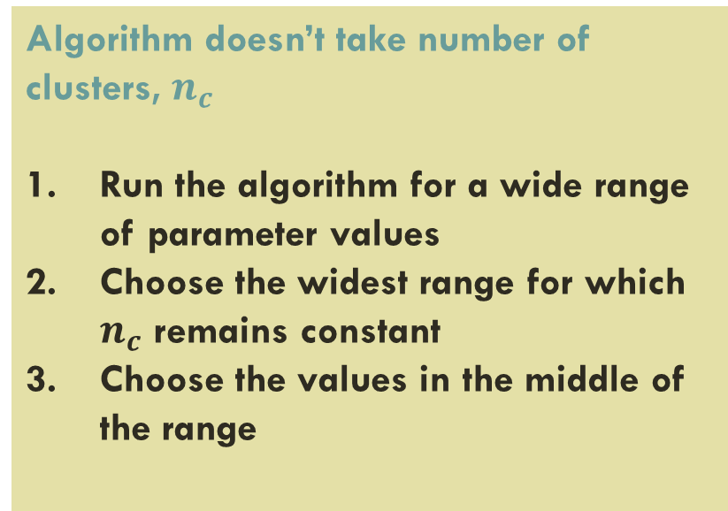
Internal clustering validation measures
Algorithm doesn’t take number of clusters, $n_{c}$
Run the algorithm for a wide range of parameter values
Choose the widest range for which $n_{c}$ remains constant
Choose the values in the middle of the range
Algorithm takes number of clusters, $n_{c},$ as parameter
Run algorithm between a min and max $n_{c}$
For each $n_{c}$, run algorithm $r$ times
Plot the best values the indexes give for each $n_{c}$
Seek in the plot a significant “knee”, that is the best clustering
Author(s):
Sergios Theodoridis et al.
Notes:
- Podemos considerar dois casos para medidas relativas

Slide 16
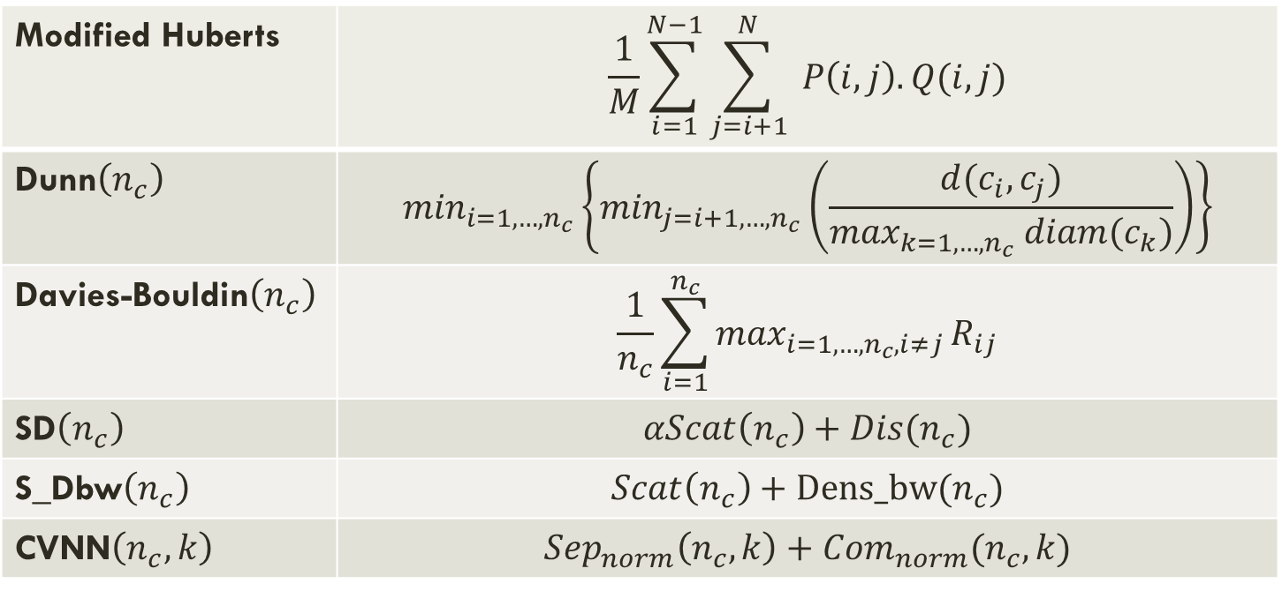
relative clustering validation measures
Modified Huberts | $$\frac{1}{M}\sum_{i=1}^{N−1}{\sum_{j=i+1}^{N}{ P\left(i,j\right).Q(i,j)}}$$
Dunn$\left(n_{c}\right)$ | $$\min_{i=1,…,n_{c}}\left\{\min_{j=i+1,…,n_{c}}\left(\frac{d(c_{i}, c_{j})}{\max_{k=1,…,n_{c}} diam(c_{k})}\right)\right\}$$
Davies-Bouldin$\left(n_{c}\right)$ | $$\frac{1}{n_{c}}\sum_{i=1}^{n_{c}}{\max_{i=1,…,n_{c}, i≠j}}R_{ij}$$
SD$\left(n_{c}\right)$ | $$αScat\left(n_{c}\right)+Dis(n_{c})$$
S_Dbw$\left(n_{c}\right)$ | $$Scat\left(n_{c}\right)+Dens_bw(n_{c})$$
CVNN$\left(n_{c},k\right)$ | $${Sep}_{norm}\left(n_{c},k\right)+{Com}_{norm}(n_{c}, k)$$
Author(s):
Yanchi Liu et al.

Slide 17
Related Work
Overview of clustering
Overview of clustering evaluation metrics
AliClu

Slide 18
Work from aliclu by Kishan rama
Background
Application
Electronical Medical Records (EMR) are more available now
Data from EMR can help specialists
Structures or models can be extracted from the data
Use Temporal Needleman-Wunsch (TNW) to align data sequences and obtain a distance matrix
Hierarchical clustering is applied to the TNW sequences
Apply clustering validation
Notes:
Projeto parte do que já foi feito pelo AliClu
Ponto de partida:
- Os dados do EMR podem ajudar os especialistas a melhor tratar os pacientes. Através das estruturas e modelos que podem ser extraidos dos dados.

Slide 19
Proposed Solution
Extend the validation measurements in AliClu
Apply extended metrics in the algorithm
Publish the measures in a public Python library

Slide 20
Implementation
Evaluation procedure
Available metrics
Available commands

Slide 21
New metrics
CVNN
S_Dbw
Van Dongen
Achieved good results and very new indexes
There was not any relative validation metric
Achieved good results
Comparison with other external metrics

Slide 22

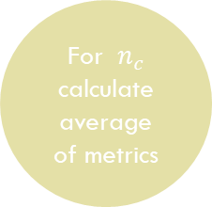
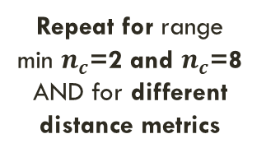
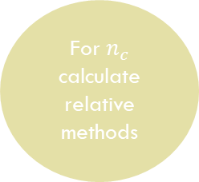
Procedure
Generate Synthetic Dataset
Generate M samples
Run clustering algorithm for each sample
For $n_{c}$ calculate average of metrics
Pre-Process Data
Run clustering algorithm
For $n_{c}$ calculate relative methods
Choose $n_{c}$ with the best results overall
Repeat for range min $n_{c}$=2 and $n_{c}$=8 AND for different distance metrics

Slide 23
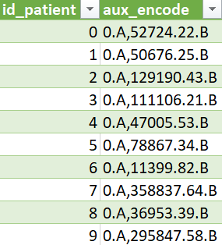
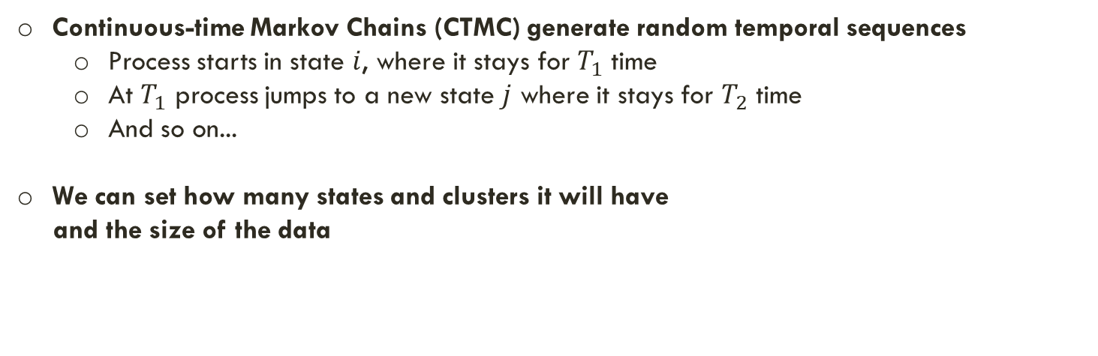
Synthetic Dataset Generation
Continuous-time Markov Chains (CTMC) generate random temporal sequences
Process starts in state $i$, where it stays for $T_{1}$ time
At $T_{1}$ process jumps to a new state $j$ where it stays for $T_{2}$ time
And so on...
We can set how many states and clusters it will have
and the size of the data
Experiment
30 observations
3 clusters
2 states (A, B)

Slide 24
How decision is made
In preliminary experiment, all indexes have the same weight
Consensus
Index 2
weight
Index 3
weight
Index 4
weight
Index 1 weight

Slide 25
Experiment
Synthetic datasets
Real-world datasets
Reuma.pt dataset

Slide 26
Results
Synthetic datasets
Real-world datasets
Reuma.pt dataset

Slide 27

Final notes
Results are not satisfctory.
Tests were not extensive, only one run for each distance was made
Algorithm was slower than expected, maybe because of operative system. In Linux runs much better than in Windows
For the future
Although not presented, i would like to point out that as of this moment algorithm is faster, dozens of tests have been made and the results, especially for long sequences with many observations, are better than before.
Progress is being made.

