Slide 1

Clusterval: A Python package for determining number ofclusters in a Longitudinal Dataset
Nuno Miguel Canhoto da Silva
80763 Prof. Susana Vinga Prof. Alexandra Carvalho
Master Thesis - Information and Software Engineering in MEIC 2020/2021
Notes:
Vou falar de
Vamos então perceber do que se trata

Slide 2
Introduction
Partition medical data into clusters
Identify methods to evaluate the clustering result
Work will provide numerous validation metrics for clusters based on two criteria:
External Validation
Internal Validation
Test the implemented tool
Notes:
É problema pq:
Surgem muitas estruturas possiveis dos algoritmos de clustering e é preciso escolher
Agglomerative clustering no AliClu
-

Slide 3
OBjectives
Gather and analyse existing metrics for cluster validation
Give the AliClu tool a validation support

Slide 4
Related Work
Overview of clustering
Overview of clustering evaluation metrics
AliClu

Slide 5
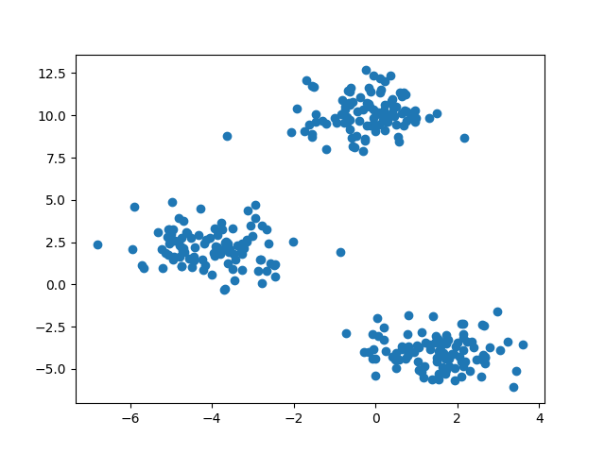
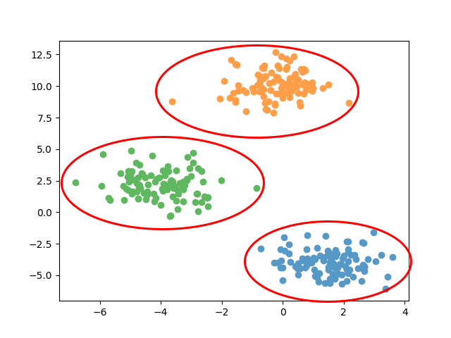
Overview of clustering
Starting with an unlabled set of points
detect
Cluster structure in the data

Slide 6
Overview of clustering
Starting with an unlabled set of points
Problem
No prior knowledge on the number of clusters
No other information on the clusters composition
detect
Cluster structure in the data

Slide 7
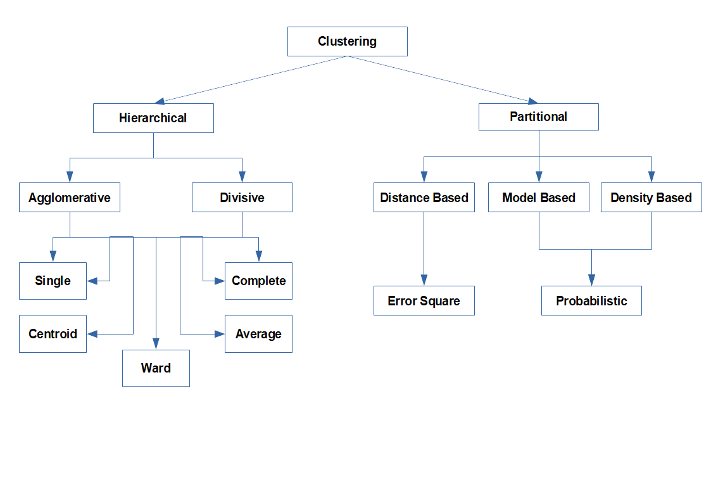
How to approach the problem
Hierarchical clustering: producing a nested series of partitions.
Pros: No input needed
Cons: Can be computationally demanding; Hard to read for a large dataset.
Partitional clustering: obtaining a single partition of the data.
Pros: Easy to implement and take insight
Cons: Requires input of the number of clusters

Slide 8
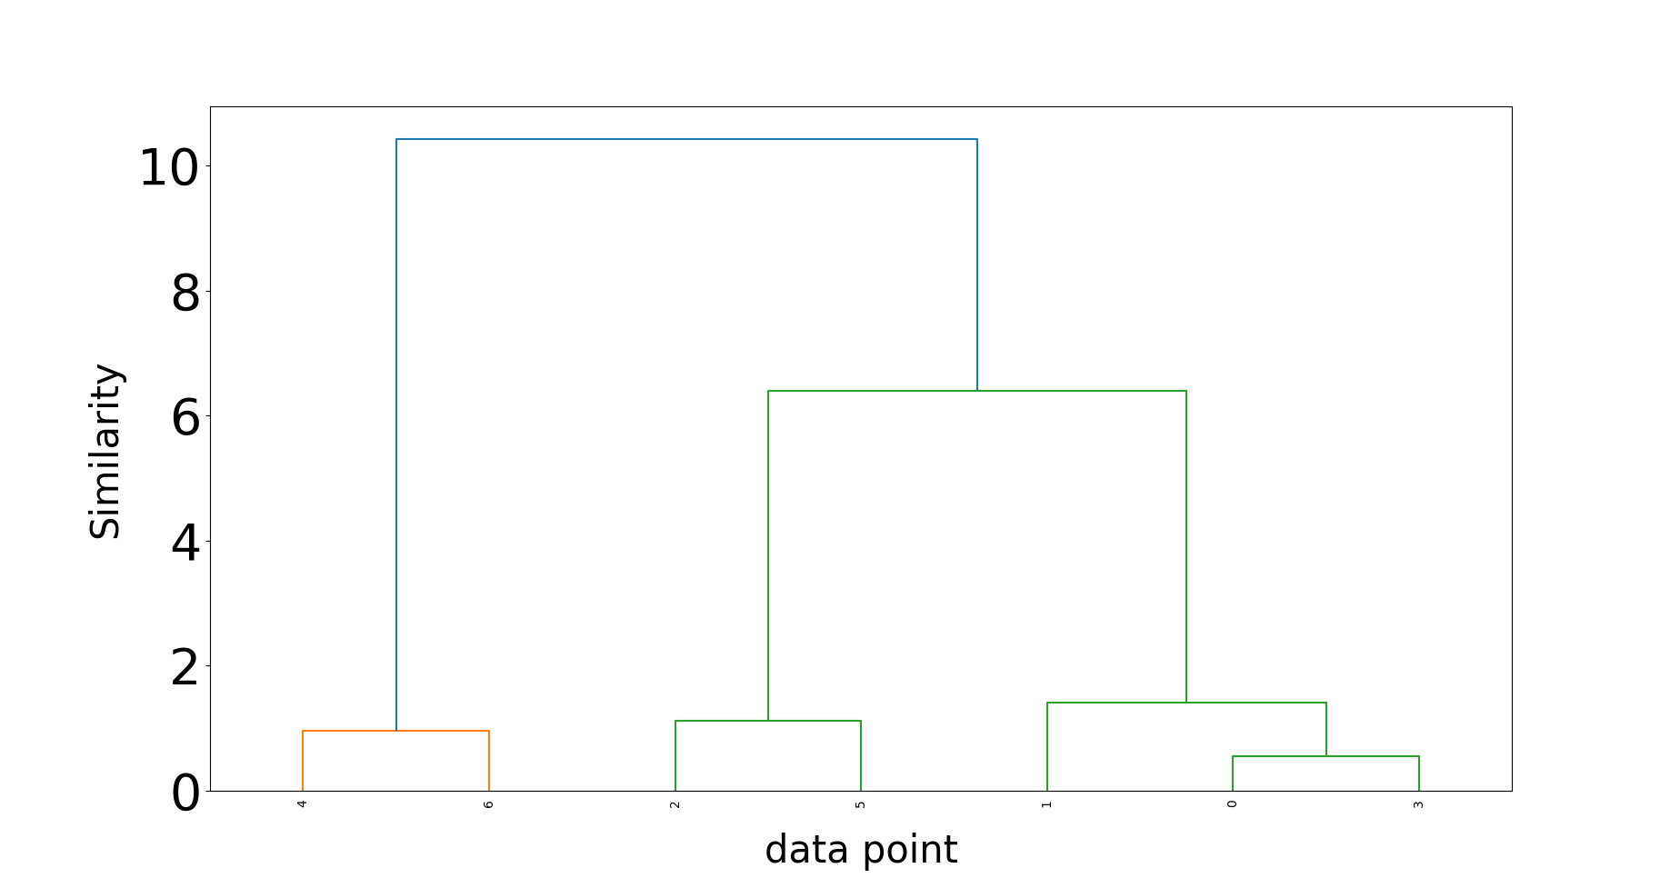
Hierarchical clustering
Represented by a dendrogram like the one on the image
Two approaches:
Agglomerative: Bottom-up approach
Divisive: Top-down approach
Idea is to measure distances between objects, i.e. data points, clusters.
Use any distance metric, e.g. Euclidean
For distance between clusters:
Single: minimum distance between all pairs
Complete: maximum distance between all pairs
Average: average distance between all pairs
Centroid: distances between clusters centroids
Ward: sum of squares variation

Slide 9
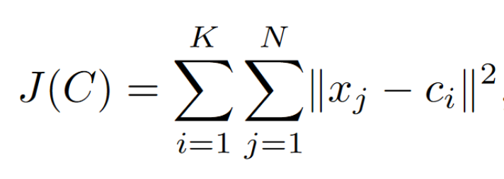
Partitional clustering
General idea is to minimize the square error:
K-means:Start with two random centroids and assign each data point to the closest. Next iterations will recalculate the centroids and re-assign the points. Stop until no changes happen or error function converges.

Slide 10
Related Work
Overview of clustering
Overview of clustering evaluation metrics
AliClu

Slide 11
Methods of evaluation
Comparison of two different partitions
Generated by the clustering algorithm
Generated from a subset of the data
External
Calculates properties of the clusters, such as compactness and separation
Internal
Author(s):
Sergios Theodoridis et al.

Slide 12
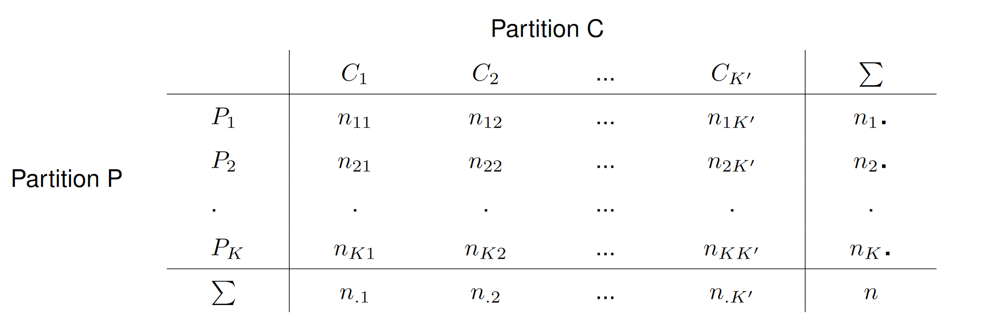
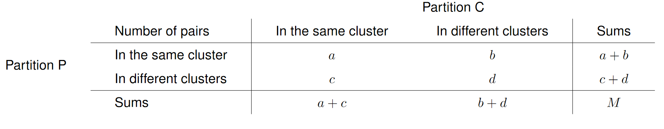



External clustering validation measures
Repeat M times
Clustering Algorithm
Subset of the data
$$C= \left\{C_{1} … C_{m}\right\}$$
Consider $\left(x_{v}, x_{u}\right)$from the dataset
$$P= \left\{P_{1 }… P_{s}\right\}$$
Notes:
Comparando cada par do dataset, Podemos classificá-lo em 4 tipos, dependendo se pertence ao mesmo cluster e/ou à mesma partição.
Para ter um teste estatistico valido, devemos usar uma técnica Monte Carlo, repetindo M vezes o procedimento.

Slide 13
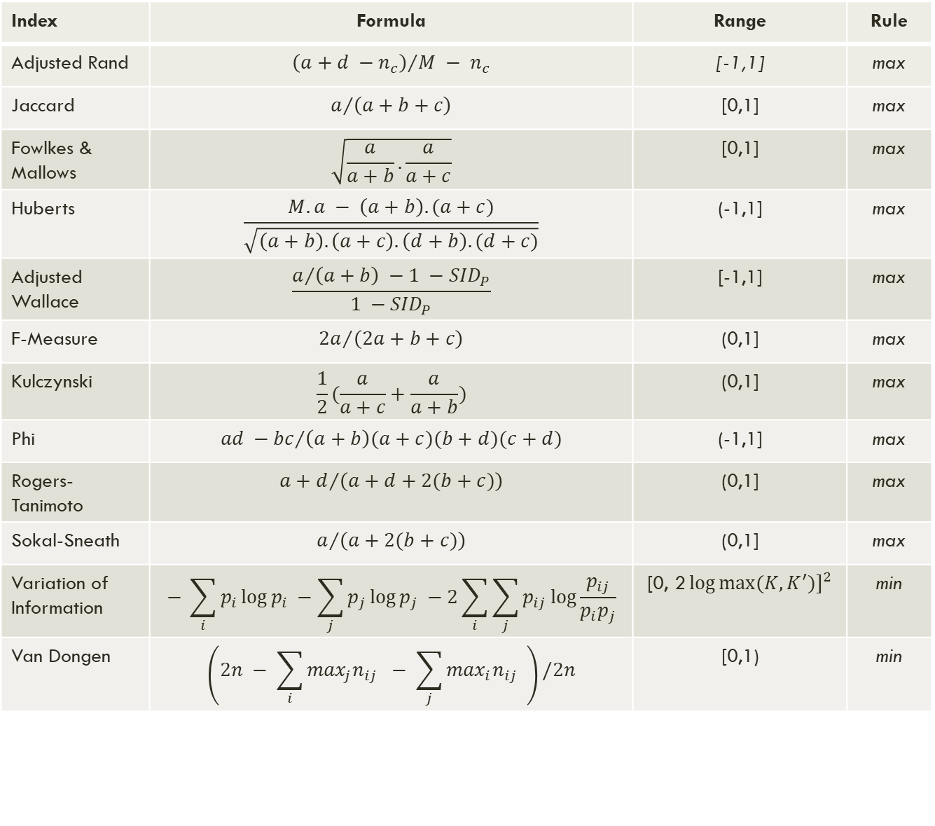
Index | Formula | Range | Rule
Adjusted Rand | $${\left(a+d −n_{c}\right)}/{M − n_{c}}$$ | [-1,1] | max
Jaccard | $$a/{\left(a+b+c\right)}$$ | [0,1] | max
Fowlkes & Mallows | $$\sqrt{\frac{a}{a+b}.\frac{a}{a+c}}$$ | [0,1] | max
Huberts | $$\frac{M.a − \left(a+b\right).(a+c)}{\sqrt{\left(a+b\right).\left(a+c\right).\left(d+b\right).(d+c)}}$$ | (-1,1] | max
Adjusted Wallace | $$\frac{a/{\left(a+b\right) −1 −{SID}_{P}}}{1 −{SID}_{P}}$$ | [-1,1] | max
F-Measure | $${2a}/{\left(2a+b+c\right)}$$ | (0,1] | max
Kulczynski | $$\frac{1}{2}(\frac{a}{a+c}+\frac{a}{a+b})$$ | (0,1] | max
Phi | $${ad −bc}/{\left(a+b\right)(a+c)(b+d)(c+d)}$$ | (-1,1] | max
Rogers-Tanimoto | $${a+d}/{\left(a+d+2(b+c)\right)}$$ | (0,1] | max
Sokal-Sneath | $$a/{\left(a+2(b+c)\right)}$$ | (0,1] | max
Variation of Information | $$− \sum_{i}{p_{i}\log{p_{i} −\sum_{j}{p_{j}\log{p_{j} −2\sum_{i}{\sum_{j}{p_{ij}\log{\frac{p_{ij}}{p_{i}p_{j}}}}}}}}}$$ | [0, ${\text{2}\log{max⁡(K,K^{′})]}}^{2}$ | min
Van Dongen | $$\left(2n − \sum_{i}{\max_{j}n_{ij}} − \sum_{j}{\max_{i}n_{ij} }\right)/2n$$ | [0,1) | min

Slide 14

Internal clustering validation measures
External
Statistical Tests
High Computational Resources
Internal
Produce many clustering.
Vary parameters, like algorithm and/or parameters.
Choose the clustering that gives the most compact and separated partitions.
Evaluate compactness and separation.
Notes:
-Medidas relativas são uma boa opção, muito porque os teste estatisticos nas medias externas e internas podem ser muito dispendiosos em termos computacionais

Slide 15
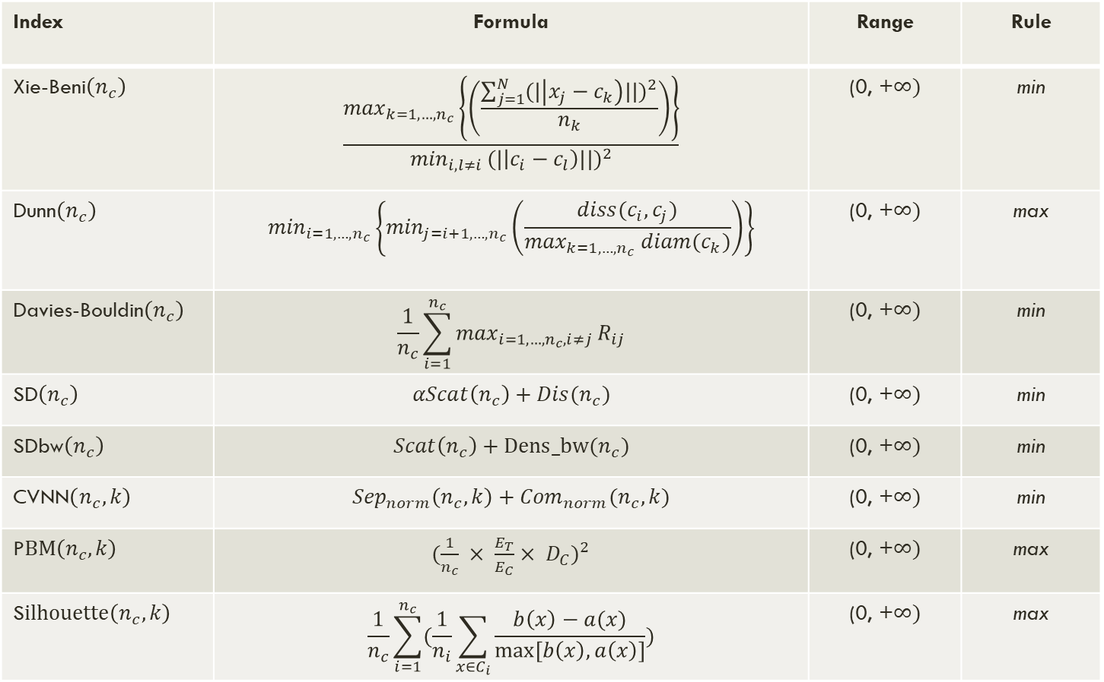
Index | Formula | Range | Rule
Xie-Beni$\left(n_{c}\right)$ | $$\frac{\max_{k=1,…,n_{c}}\left\{\left(\frac{\sum_{j=1}^{N}{{(|\left|x_{j}−c_{k}\right)||)}^{2}}}{n_{k}}\right)\right\}}{\min_{i,l≠i }{(|\left|c_{i}−c_{l}\right)||)}^{2}}$$ | (0, +$∞)$ | min
Dunn$\left(n_{c}\right)$ | $$\min_{i=1,…,n_{c}}\left\{\min_{j=i+1,…,n_{c}}\left(\frac{diss(c_{i}, c_{j})}{\max_{k=1,…,n_{c}} diam(c_{k})}\right)\right\}$$ | (0, +$∞)$ | max
Davies-Bouldin$\left(n_{c}\right)$ | $$\frac{1}{n_{c}}\sum_{i=1}^{n_{c}}{\max_{i=1,…,n_{c}, i≠j}}R_{ij}$$ | (0, +$∞)$ | min
SD$\left(n_{c}\right)$ | $$αScat\left(n_{c}\right)+Dis(n_{c})$$ | (0, +$∞)$ | min
SDbw$\left(n_{c}\right)$ | $$Scat\left(n_{c}\right)+Dens_bw(n_{c})$$ | (0, +$∞)$ | min
CVNN$\left(n_{c},k\right)$ | $${Sep}_{norm}\left(n_{c},k\right)+{Com}_{norm}(n_{c}, k)$$ | (0, +$∞)$ | min
P$BM\left(n_{c},k\right)$ | ${(\frac{1}{n_{c}} × \frac{E_{T}}{E_{C}}× D_{C})}^{2}$ | (0, +$∞)$ | max
S$ilhouette\left(n_{c},k\right)$ | $$\frac{1}{n_{c}}\sum_{i=1}^{n_{c}}{(\frac{1}{n_{i}}\sum_{x∈C_{i}}{\frac{b\left(x\right)−a(x)}{max⁡[b\left(x\right),a\left(x\right)]}})}$$ | (0, +$∞)$ | max

Slide 16
Related Work
Overview of clustering
Overview of clustering evaluation metrics
AliClu

Slide 17
Work from aliclu by Kishan rama
Background
Application
Electronical Medical Records (EMR) are more available now
Data from EMR can help specialists
Structures or models can be extracted from the data
Use Temporal Needleman-Wunsch (TNW) to align data sequences and obtain a distance matrix
Hierarchical clustering is applied to the TNW sequences
Apply clustering validation
Notes:
Projeto parte do que já foi feito pelo AliClu
Ponto de partida:
- Os dados do EMR podem ajudar os especialistas a melhor tratar os pacientes. Através das estruturas e modelos que podem ser extraidos dos dados.

Slide 18
Proposed Solution
Extend the cluster validation measurements in AliClu
Automatize the cluster representation through graphs
Contribute to the community with a Python library for cluster validation

Slide 19
Implementation
Evaluation procedure
How decision is made
Clusterval
AliClu – cluster visual representation

Slide 20

Evaluation Procedure
Repeat until limit of bootstrap samples is reached
Set range of k to be tested
Generate a random sample from the dataset
Perform clustering P on the sample
With partitions C and P, calculate external CVIs
Perform clustering C for k clusters
Calculate internal CVIs for structure C
Each index takes a vote on the umber of clusters
Choose $n_{c}$ with the best results overall
Repeat with new k, until max k is reached

Slide 21
Implementation
Evaluation procedure
How decision is made
Clusterval
AliClu – cluster visual representation

Slide 22
How decision is made
In our experiments, all indexes have the same weight
Consensus
Index 2
weight
Index 3
weight
Index 4
weight
Index 1 weight

Slide 23
Implementation
Evaluation procedure
How decision is made
Clusterval
AliClu – cluster visual representation

Slide 24
Clusterval
Python package that performs clustering evaluation of any list-type dataset or distance matrix.
Source code and other documents can be found at https://github.com/Nuno09/clusterval
How to obtain the package:
Pypi:
pip install clusterval
Github:
pip install git+https://github.com/Nuno09/clusterval.git
Load the package in a Python environment:
from clusterval import Clusterval

Slide 25
The Clusterval object can be initialized with default parameters or these can be explicitly set. Parameters are described in the next table.
Parameter | Description | Default value
min_k | Integer that sets the minimum number of clusters to test. | 2
max_k | Integer that sets the maximum number of clusters to test. | 8
algorithm | String that sets the clustering algorithm to use. | Hierarchical clustering with ward linkage.
bootstrap_samples | Integer that sets the number of bootstrap samples simulated | 250
index | String (or list of strings) containing the CVIs calculate. | All CVIs.

Slide 26
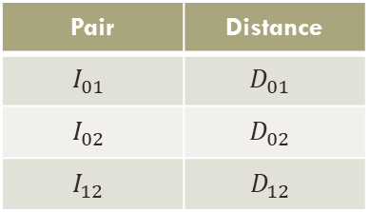
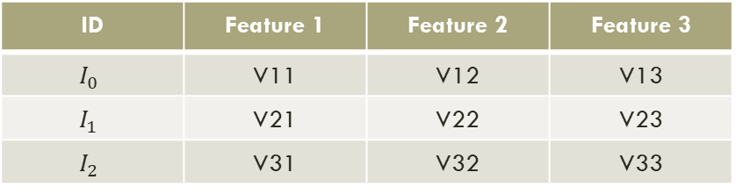
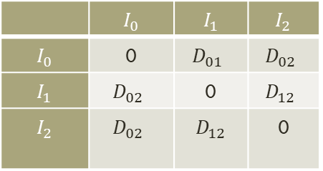
Create object:
c = Clusterval()
c =Clusterval(min_k=2, max_k=10, algorithm=kmeans, bootstrap_samples=500, index=‘F’,’CVNN’)
Perform clustering evaluation
c.evaluate(data)
Output will be the chosen number of clusters.
ID | Feature 1 | Feature 2 | Feature 3
$$I_{0}$$ | V11 | V12 | V13
$$I_{1}$$ | V21 | V22 | V23
$$I_{2}$$ | V31 | V32 | V33
Data
 | $$I_{0}$$ | $$I_{1}$$ | $$I_{2}$$
$$I_{0}$$ | 0 | $$D_{01}$$ | $$D_{02}$$
$$I_{1}$$ | $$D_{02}$$ | 0 | $$D_{12}$$
$$I_{2}$$ | $$D_{02}$$ | $$D_{12}$$ | 0
Pair | Distance
$$I_{01}$$ | $$D_{01}$$
$$I_{02}$$ | $$D_{02}$$
$$I_{12}$$ | $$D_{12}$$
or

Slide 27
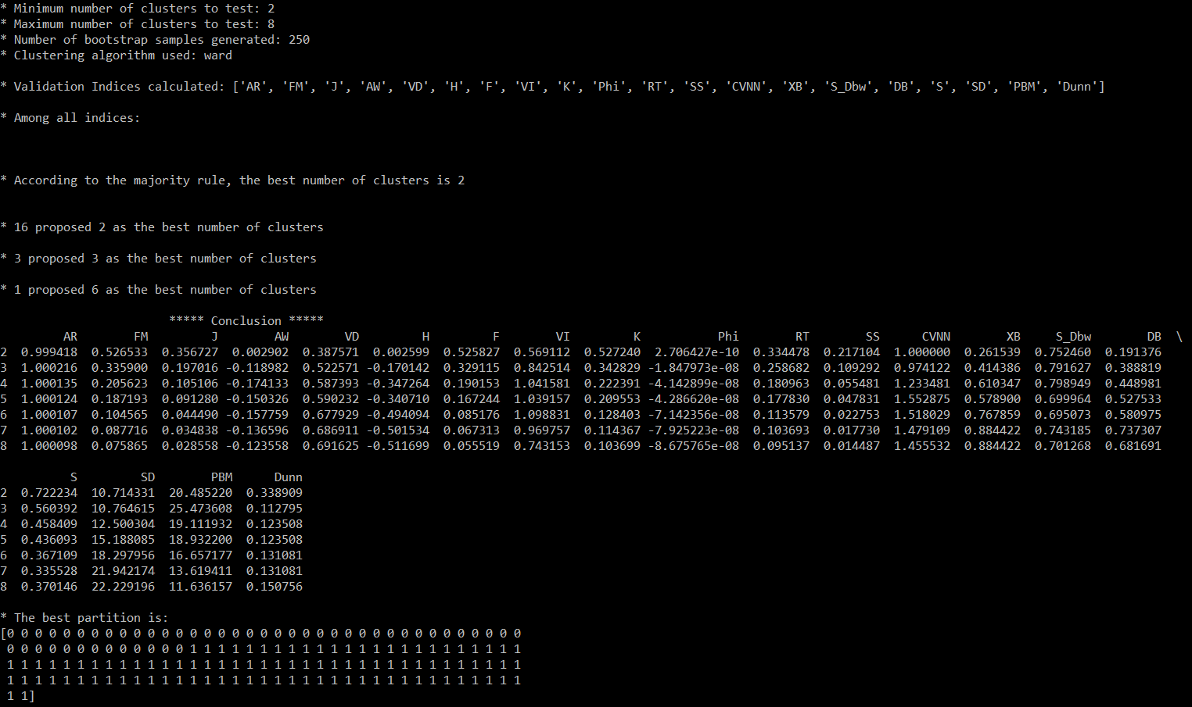
To see more information about the evaluation process and the resulting partition:
print(c.long_info)
To visualize the resulting dendrogram*:
c.plot()
*When applying hierarchical clustering

Slide 28
Implementation
Evaluation procedure
How decision is made
Clusterval
AliClu – cluster visual representation

Slide 29
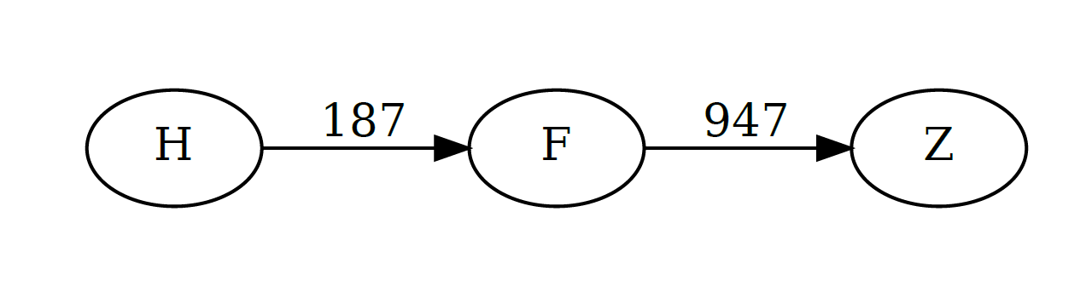
AliClu – cluster visual representation
Letters represent treatments.
Numbers represent the transistion time between treatments.
Nodes represent treatments.
Edges represent transitions between treatments.
id_patient | coded_sequence
3948652 | 0.H,187.F,785.Z
69331060 | 0.F.1109.Z
This information can be represented as a graph!
Python module - graphviz

Slide 30
Results
Synthetic datasets
Real-world datasets
Reuma.pt dataset

Slide 31
Synthetic Datasets
Five factors to cover
Number of clusters
Dimensionality
Noise
Density
Overlapping

Slide 32
Synthetic Datasets
Five factors to cover
Number of clusters
Dimensionality
Noise
Density
Overlapping
NC=2
NC=4
NC=8
Dim=2
Dim=4
Dim=8
Noise=0.0
Noise=0.1
Dens=1
Dens=4
Overlap=1.5
Overlap=5.0

Slide 33
Synthetic Datasets
Plus 5 different clustering algorithms to test:
single-linkage hierarchical clustering
complete-linkage hierarchical clustering
ward-linkage hierarchical clustering
k-means partitional clustering
Configurations:
5 factors x 5 datasets (from each) x 4 clustering algorithms = 1440 different configurations

Slide 34
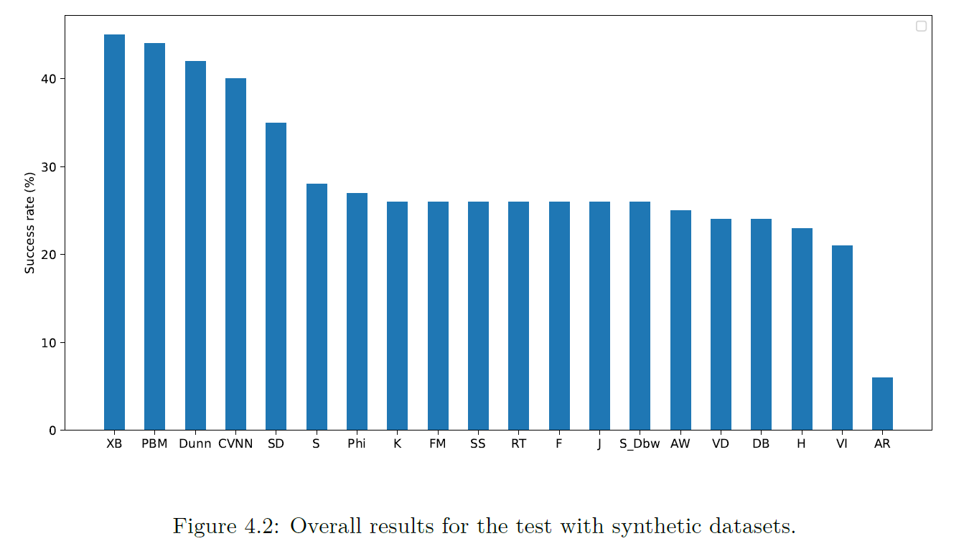
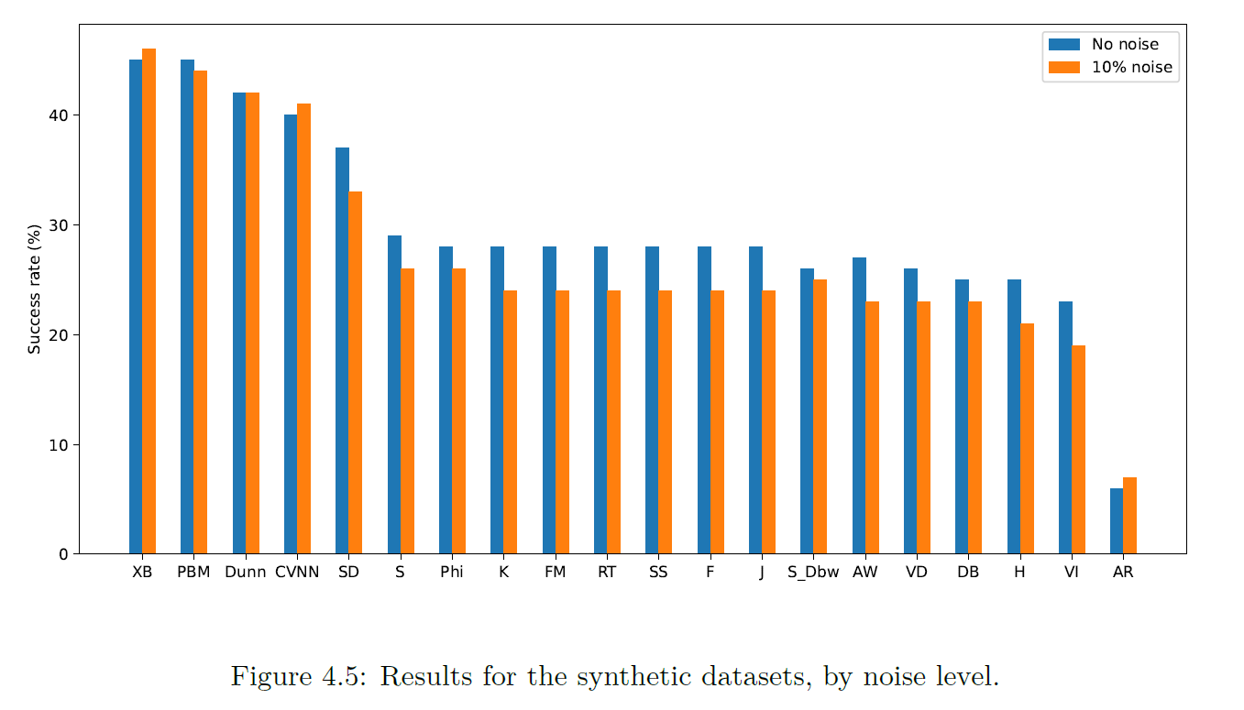
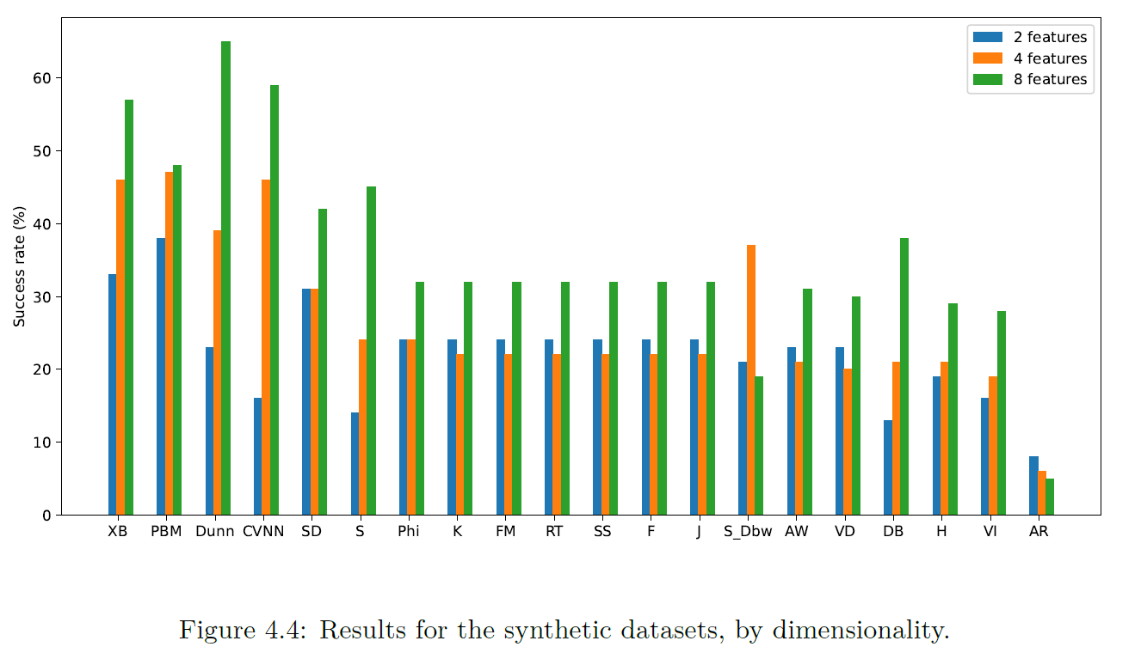
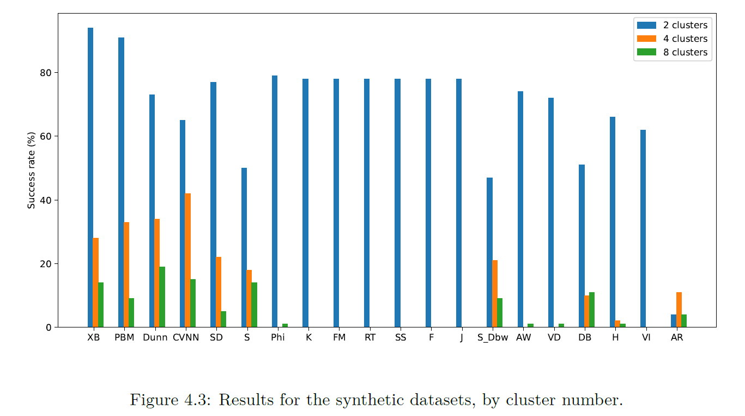
Synthetic datasets

Slide 35
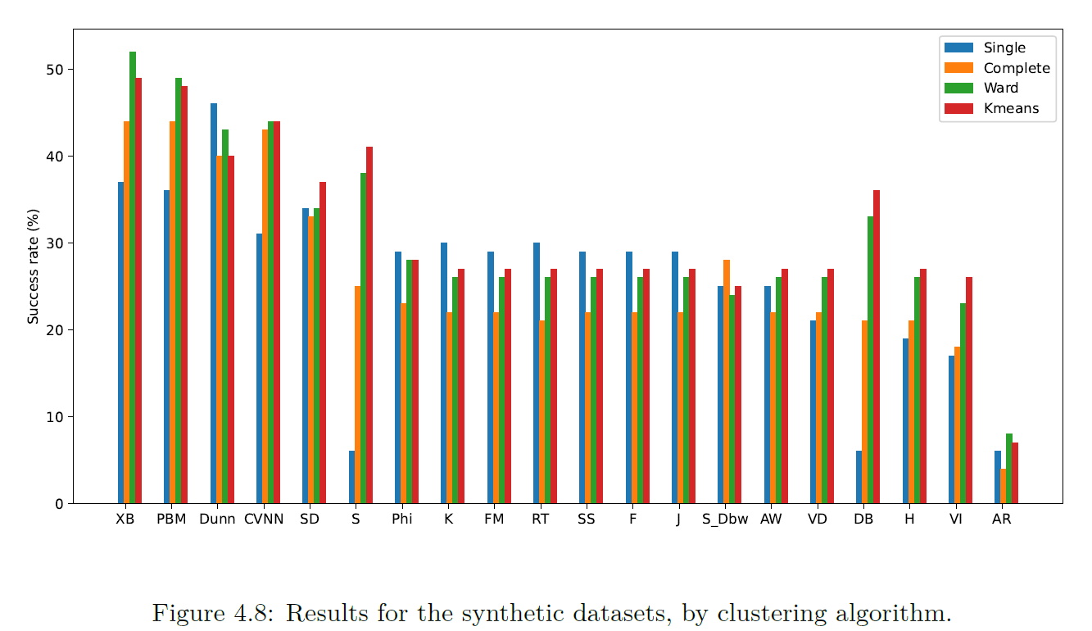
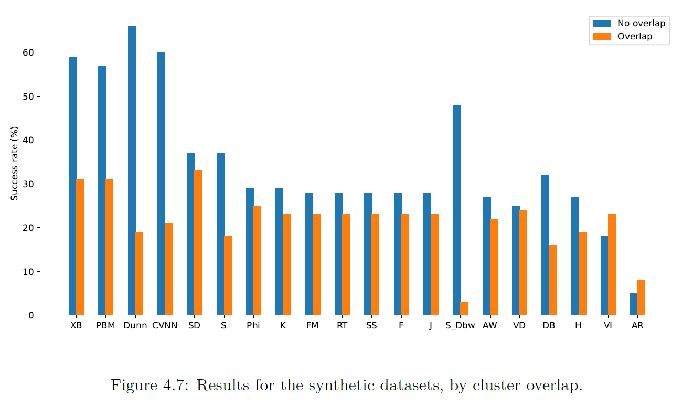
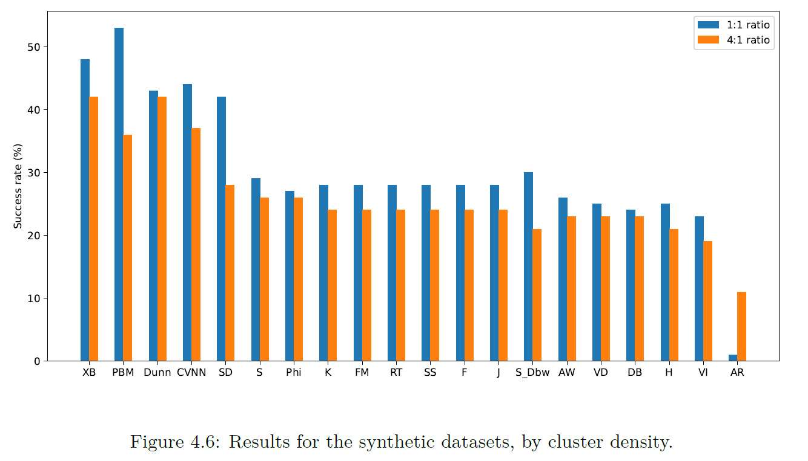
Synthetic datasets

Slide 36
Results
Synthetic datasets
Real-world datasets
Reuma.pt dataset

Slide 37
Real-world datasets*
Dataset | Nº instances | Nº attributes | Classes
Breast tissue | 106 | 9 | 6
Ecoli | 336 | 7 | 8
Glass | 214 | 9 | 7
Haberman | 306 | 3 | 2
Iris | 150 | 4 | 3
Parkinsons | 195 | 22 | 2
Vehicle | 846 | 18 | 4
Vertebral column | 310 | 6 | 3
Wine | 178 | 13 | 3
Yeast | 1484 | 8 | 10
*source: UCI repository

Slide 38
Real-world datasets*
Dataset | Nº instances | Nº attributes | Classes
Breast tissue | 106 | 9 | 6
Ecoli | 336 | 7 | 8
Glass | 214 | 9 | 7
Haberman | 306 | 3 | 2
Iris | 150 | 4 | 3
Parkinsons | 195 | 22 | 2
Vehicle | 846 | 18 | 4
Vertebral column | 310 | 6 | 3
Wine | 178 | 13 | 3
Yeast | 1484 | 8 | 10
Run for the 4 previously mentioned clustering algorithms
*source: UCI repository

Slide 39
Real-world datasets*
Dataset | Nº instances | Nº attributes | Classes
Breast tissue | 106 | 9 | 6
Ecoli | 336 | 7 | 8
Glass | 214 | 9 | 7
Haberman | 306 | 3 | 2
Iris | 150 | 4 | 3
Parkinsons | 195 | 22 | 2
Vehicle | 846 | 18 | 4
Vertebral column | 310 | 6 | 3
Wine | 178 | 13 | 3
Yeast | 1484 | 8 | 10
Run for the 4 previously mentioned clustering algorithms
40 different configurations
*source: UCI repository

Slide 40
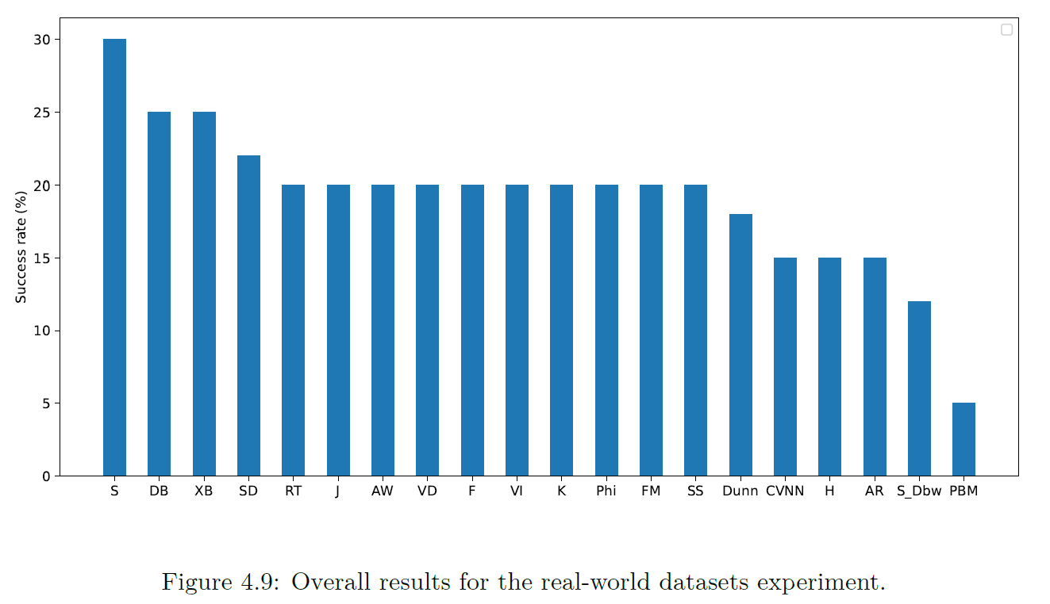
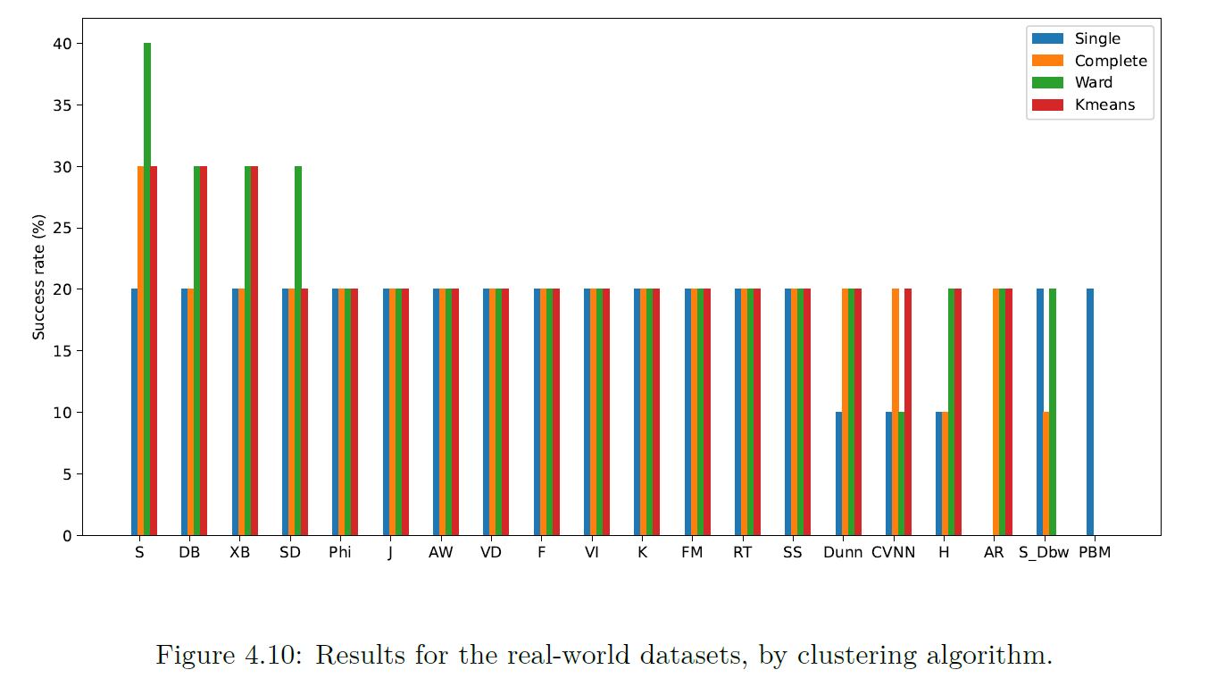
Real-world datasets

Slide 41
Synthetic vs Real-World
Synthetic results: 29.3% average success rate
Real datasets: 20.1% average success rate
Changes in ranking
Internal indices achieve better results for both tests

Slide 42
Insights from indices values
External validation indices tend to choose NC=2.
Internal validation indices come closer to true values.
Fully automatic prediction of the number of clusters in a dataset is not accurate due to similarity between different clusterings.

Slide 43
Results
Synthetic datasets
Real-world datasets
Reuma.pt dataset

Slide 44
Reuma.pt dataset
Dataset developed by the Portuguese Society of Reumatology (SPR).
Mostly patients with reumatoid arthritis, ankylosing spondylitis, psoriatic arthritis and juvenile idiopathic arthritis.
In total there is information about 426 patients and 9035 appointments.
The goal of AliClu is to find the partitions in the dataset that help predict the treatment for future patients.
Clusterval supports AliClu in the cluster analysis.

Slide 45
Parameters used in the tests
bootstrap_samples: 250
min_k: 2
max_k: 20
indices: all
clustering_algorithm: hierarchical (single, complete, average, ward)
AliClu parameters:
gap = [0.0,0.1]
Tp = {0.25,1.00,2.00}
We divide our experiment in two groups:
1) Automatic generation of results
2) Semi-automatic generation of results

Slide 46
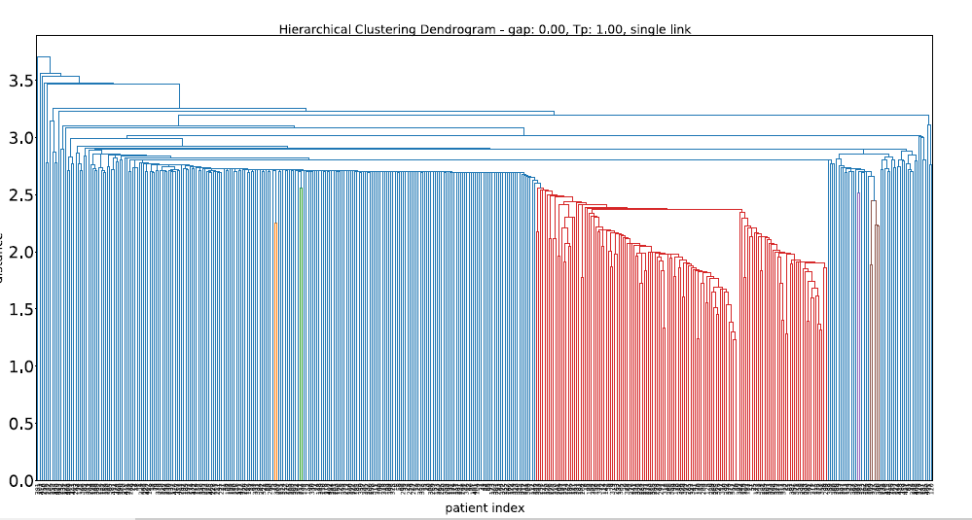
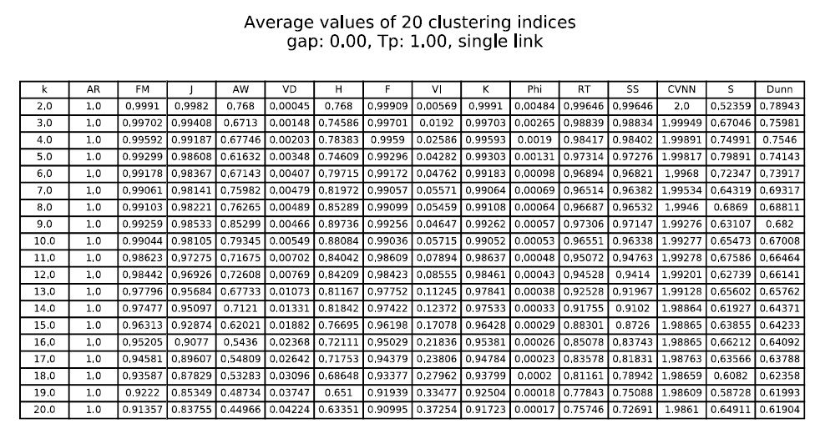
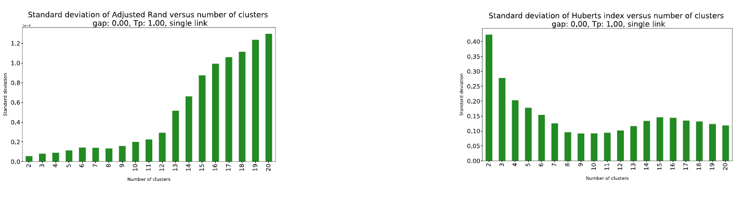
Automatic results – REUMA.pt
Average and Single linkage choose NC=2.
One partition is very small (1-8 elements) and the other very big (all other elements).

Slide 47
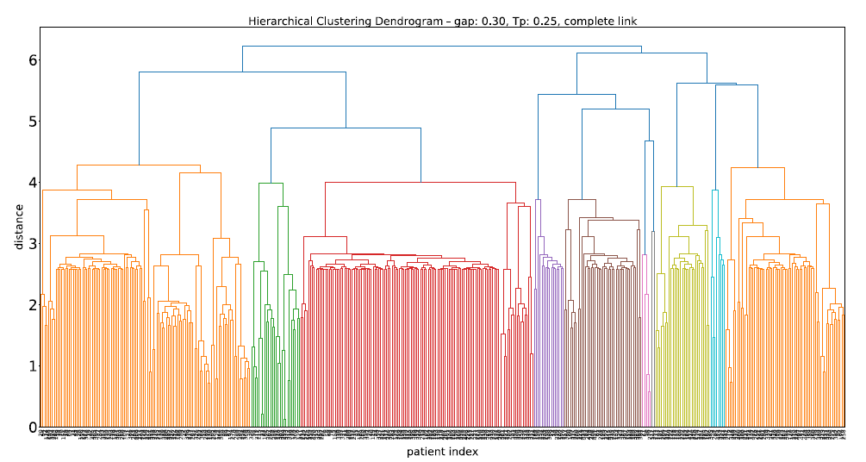
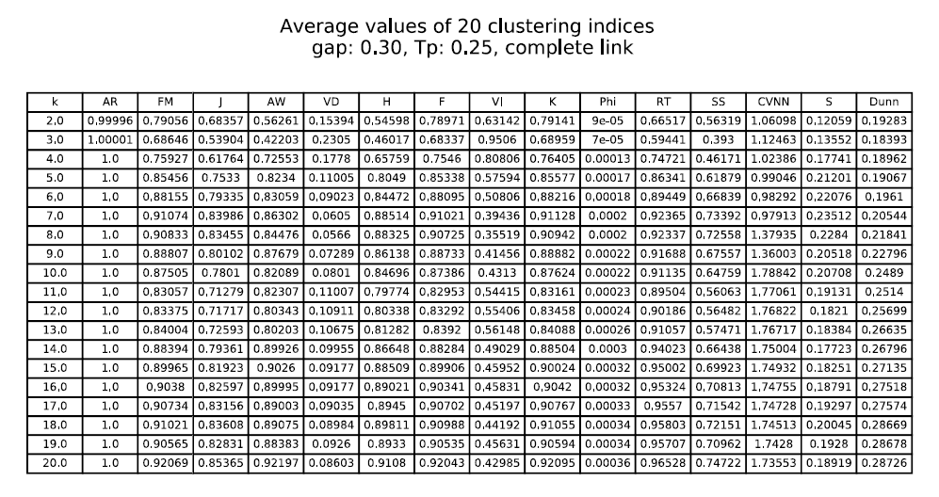
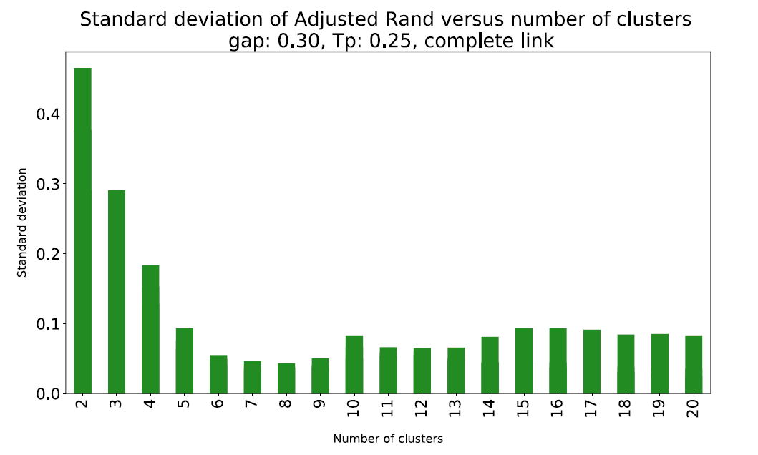
Automatic results – REUMA.pt
Complete linkage results seem more promising, considering the problem context.
Dendrogram better structured.
NC=20. Most CVIs follow this conclusion.

Slide 48
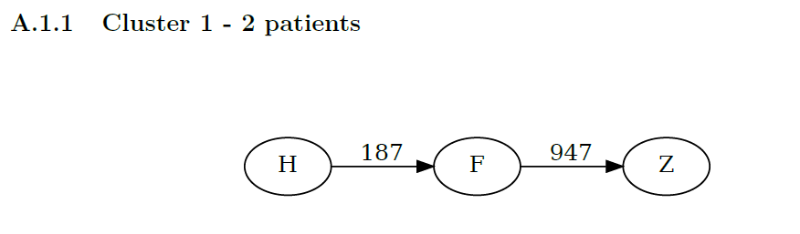
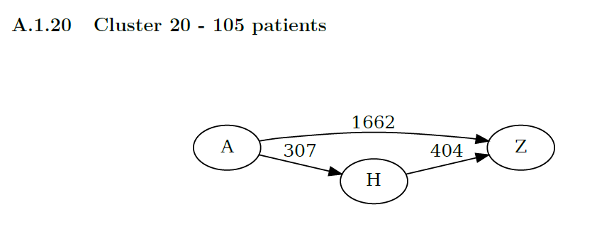
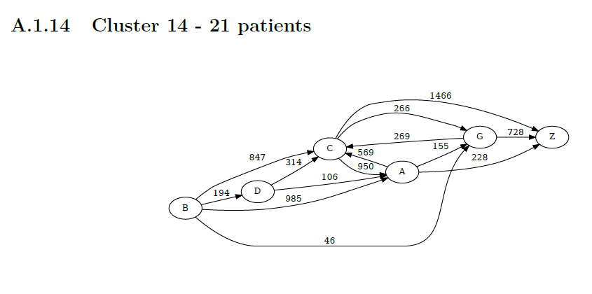
Automatic results – REUMA.pt
Most resulting clusters are distinct and containing information on one event or chain.
Exceptions for cluster 14, which is not so easy to read.

Slide 49
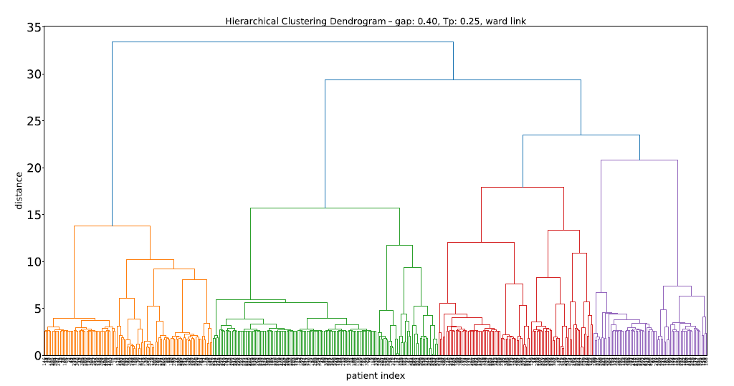
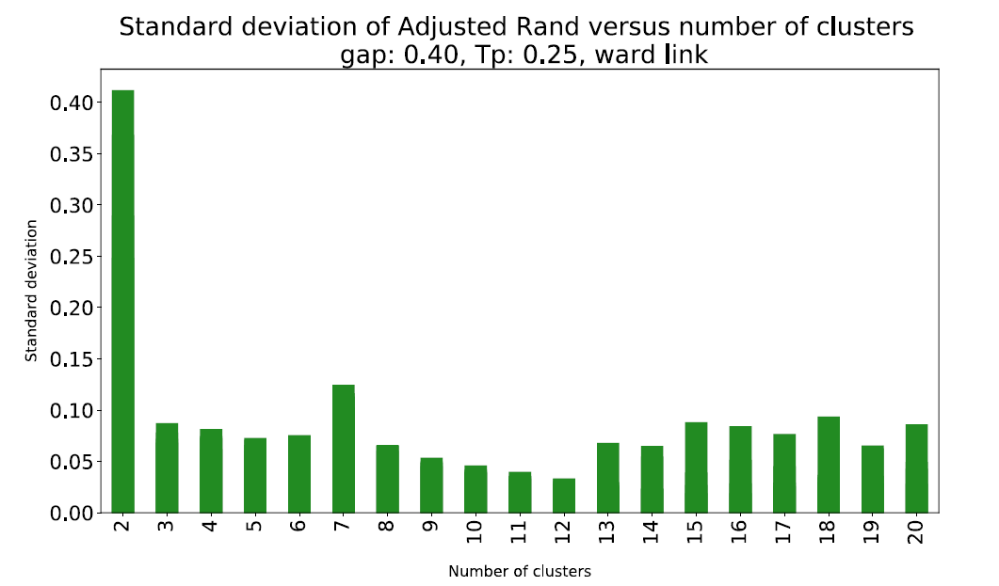
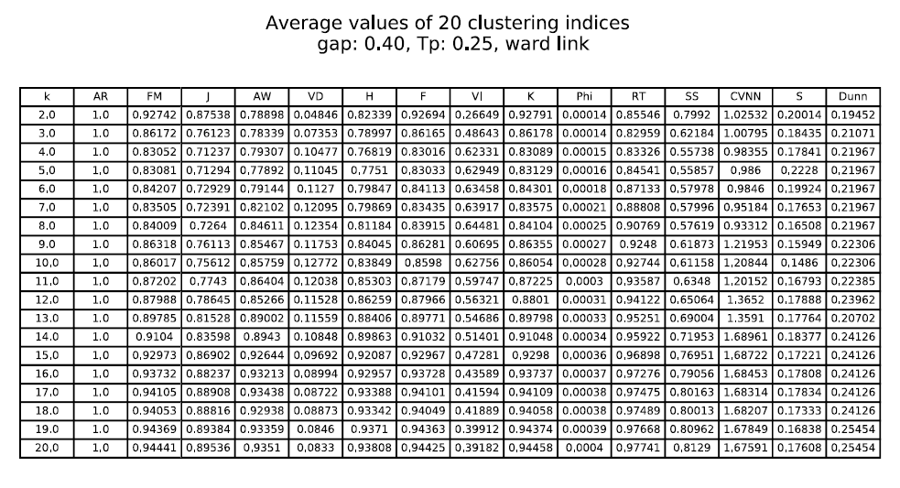
Automatic Results – Reuma.pt
Ward linkage also outputed NC=20.
Dendrogram with clear structure.
The majority of indices support the decision.

Slide 50
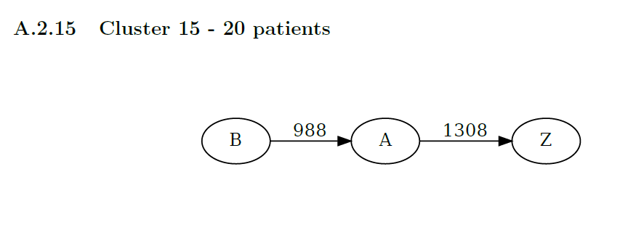
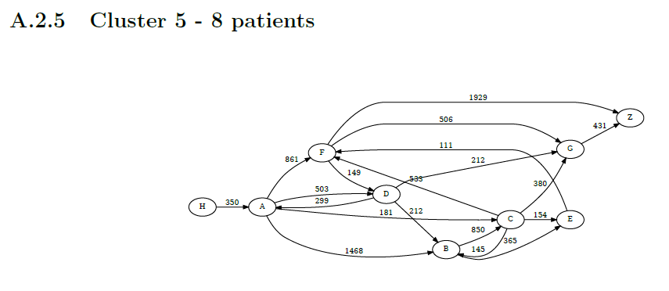
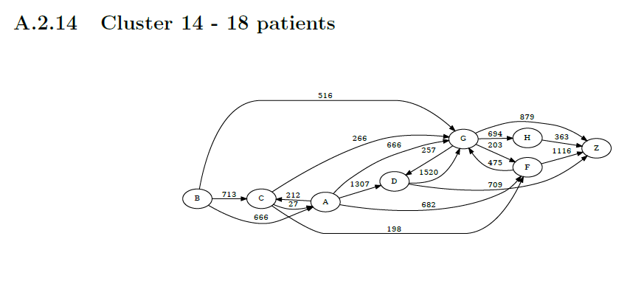
Automatic results – reuma.pt
Resulting clusters with good separation of events.
Cluster 5 and 14 with very long sequences.

Slide 51
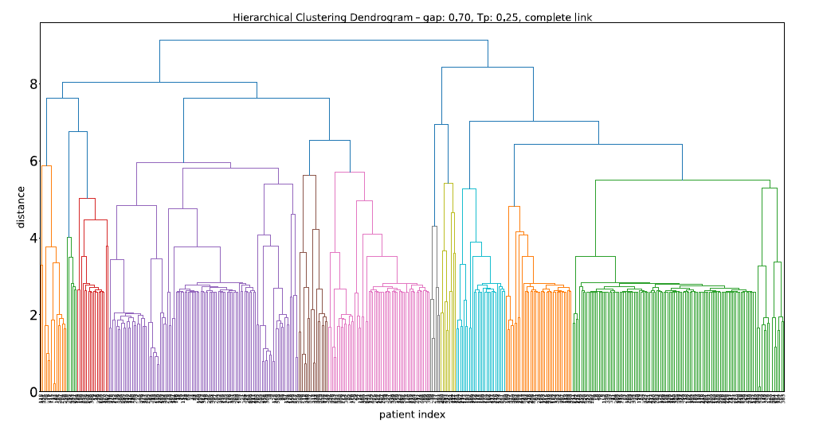
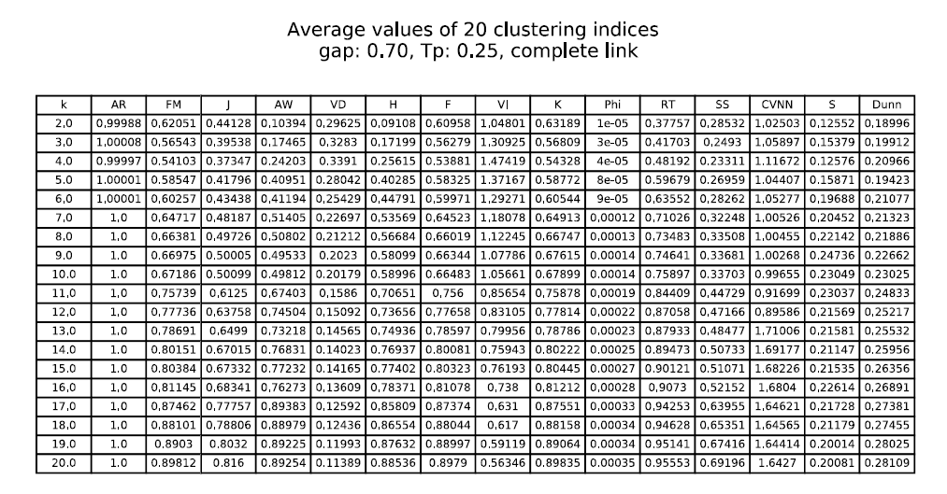
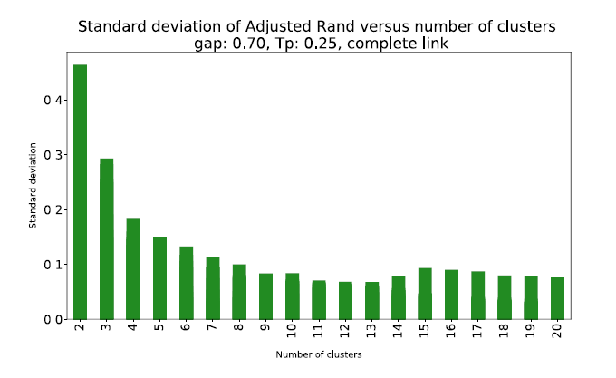
Semi-automatic results – Reuma.pt
For complete linkage the conclusion was NC=20.
Resulting sequences are longer than in automatic
Notes:
Like in the automatic approach, single, complete and average linkage algorithms do produce unstructured dendrograms, unclear insights from the CVIs and unbalaced resulting clusters.

Slide 52
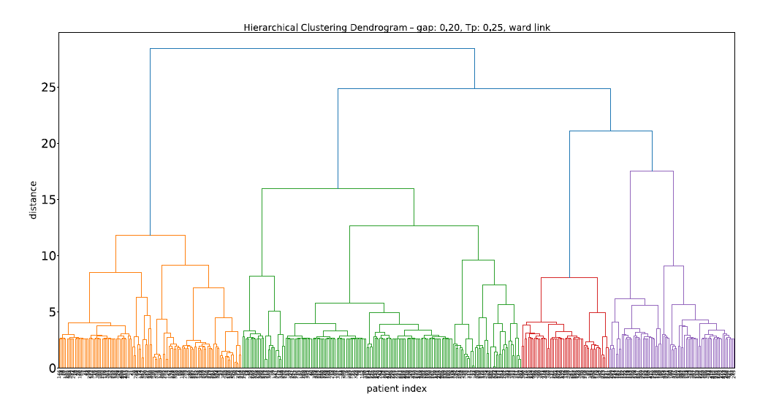
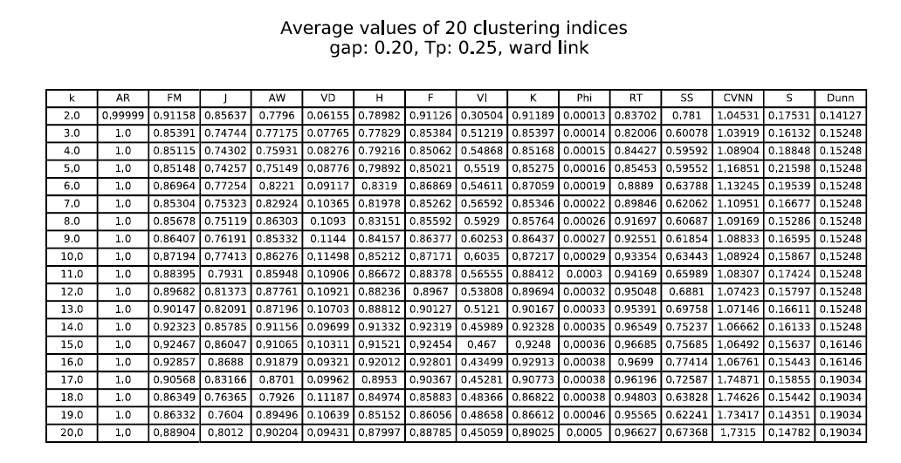
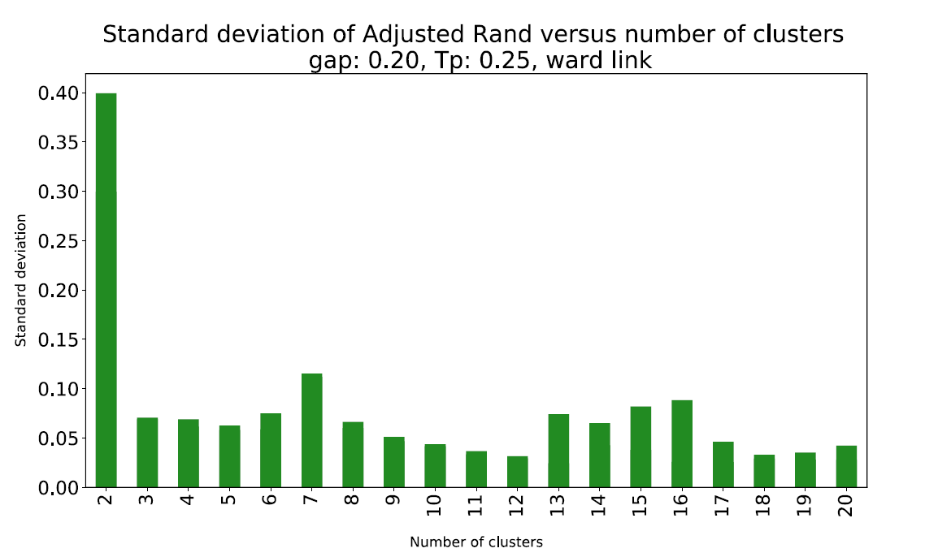
Semi-automatic results – Reuma.pt
For ward linkage the conclusion was NC=16.
Resulting sequences are bigger, due to lower NC.
Notes:
Like in the automatic approach, single, complete and average linkage algorithms do produce unstructured dendrograms, unclear insights from the CVIs and unbalaced resulting clusters.

Slide 53
Final Remarks
Clusterval was built with the goal of providing automatization and credibility to the clustering analysis.
Consisting of 20 cluster validation metrics.
The performance of these metrics was tested with synthetics datasets, real-world datasets and the Reuma.pt dataset, used by AliClu.
Overall, the results are not satisfactory. The metrics fail to predict accurately for synthetic datasets (29,3%) and real-world datasets (20,1%).
Although, upon checking the CVIs values for each NC, we could see that many times the best value was very similar to that of the correct NC.
Regarding the tests for Reuma.pt, the results for complete and ward linkage were reasonable, since the resulting clusters were well separated and containing, for the most part, a single event.

Slide 54
Conclusion and future work
The usefulness of a tool like Clusterval is undeniable. Nevertheless, the fully automatic approach taken in this work does not produce the desired results.
To improve the results, we could make the decision process not choose directly the best scores for the CVIs but also take the problem context into account.
Moreover, assigning different weights to the CVIs could lead to more accurate results.
Finally, since internal validation metrics performed better, we could aim to add more of these type of indices.

