Slide 1



modulo3
View in Power BI
Last data refresh:
15/09/2025 05:39:57 UTC
Downloaded at:
15/09/2025 05:41:59 UTC

Slide 2
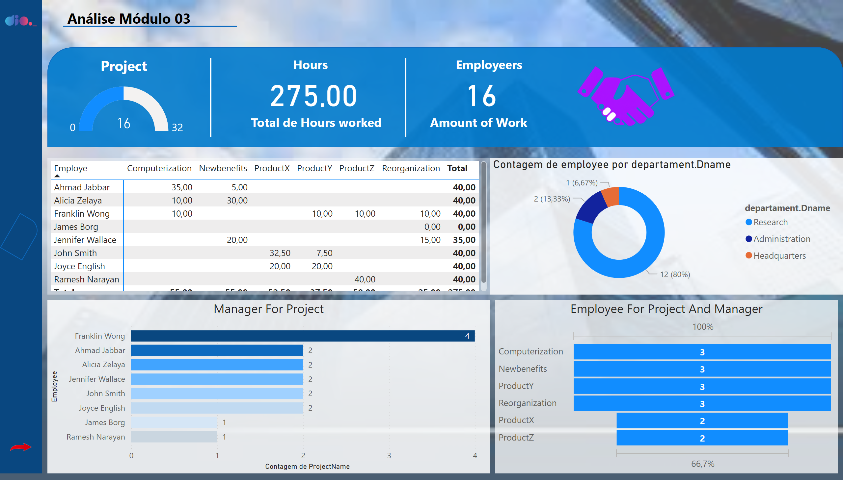
Página 1
Notes:
shape
No alt text provided
textbox
No alt text provided
shape
No alt text provided
Manager For Project
No alt text provided
pivotTable
No alt text provided
Employee For Project And Manager
No alt text provided
image
No alt text provided
Horas por departamento
No alt text provided
textbox
No alt text provided
shape
No alt text provided
shape
No alt text provided
textbox
No alt text provided
card
No alt text provided
textbox
No alt text provided
image
No alt text provided
shape
No alt text provided
textbox
No alt text provided
textbox
No alt text provided
card
No alt text provided
actionButton
No alt text provided
textbox
No alt text provided
textbox
No alt text provided
card
No alt text provided
shape
No alt text provided
donutChart
No alt text provided
image
No alt text provided
image
No alt text provided

Slide 3
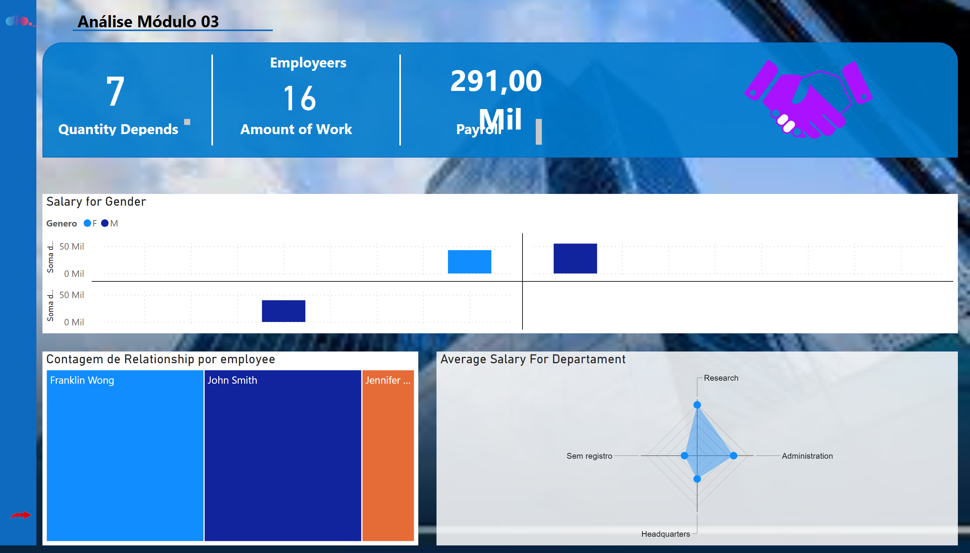
Página 2
Notes:
treemap
No alt text provided
shape
No alt text provided
textbox
No alt text provided
shape
No alt text provided
shape
No alt text provided
shape
No alt text provided
cardVisual
No alt text provided
textbox
No alt text provided
textbox
No alt text provided
textbox
No alt text provided
card
No alt text provided
shape
No alt text provided
Salary for Gender
No alt text provided
Average Salary For Departament
No alt text provided
image
No alt text provided
image
No alt text provided
image
No alt text provided
card
No alt text provided
textbox
No alt text provided

