Slide 1

TRUSTED STUDENT HOUSING / FINAL DESIGN
RoomMate
Haven
Choose the room. Understand the people.
Agree how to live.
DESN2000 Design Presentation
Liam · Dylan · Nicky · Pranav · Week 10
Deployed interactive HTML prototype
Notes:
Speaker: Liam · Target time: 15 seconds.
Opening: RoomMate Haven helps students make a safer shared-home decision before commitment.
Transition: To understand why this matters, start with the decision students actually face.

Slide 2
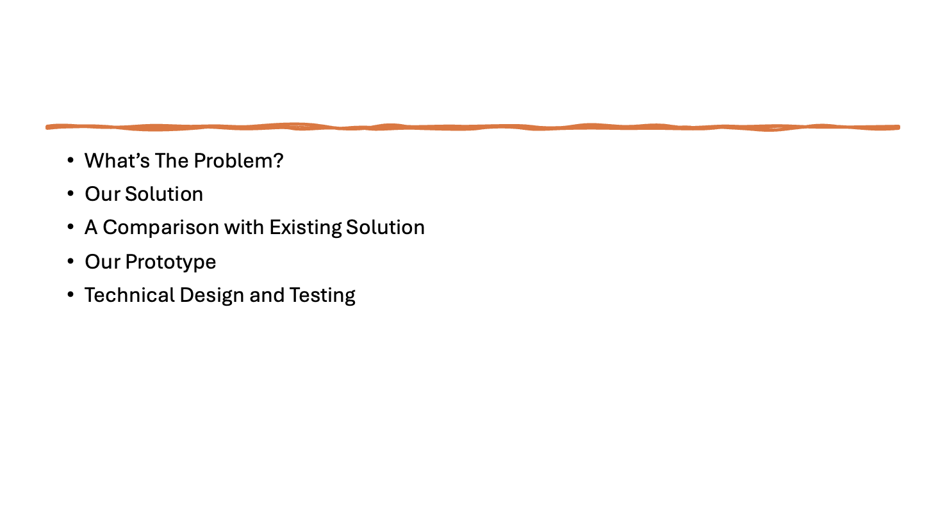

Slide 3
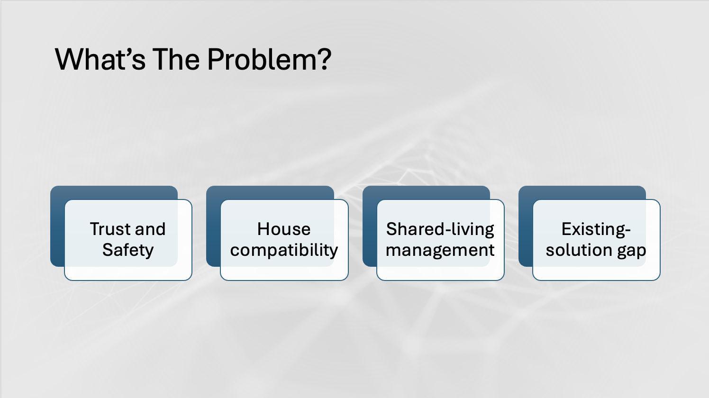
Notes:
- User
- User problem
- Why importent problem
- Why existing solutions not doing it well

Slide 4
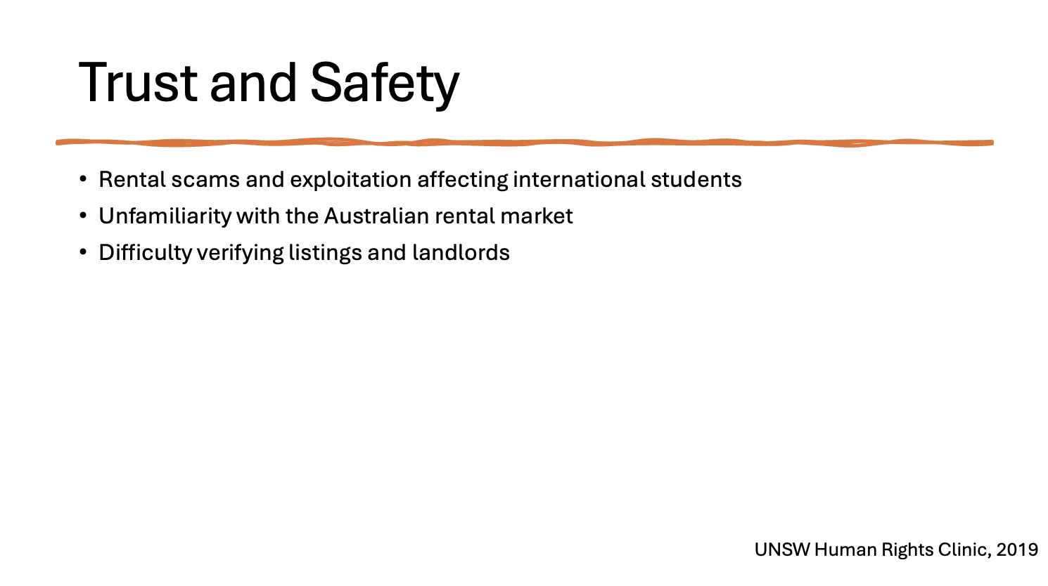
Notes:
100% interviewer were concerned about rental scams
43.75% encountered false housing information
Reliable evidence is widely needed
Students wanted:Realistic property photos
Clear location information
Reviews from previous tenants
Information about nearby facilities

Slide 5
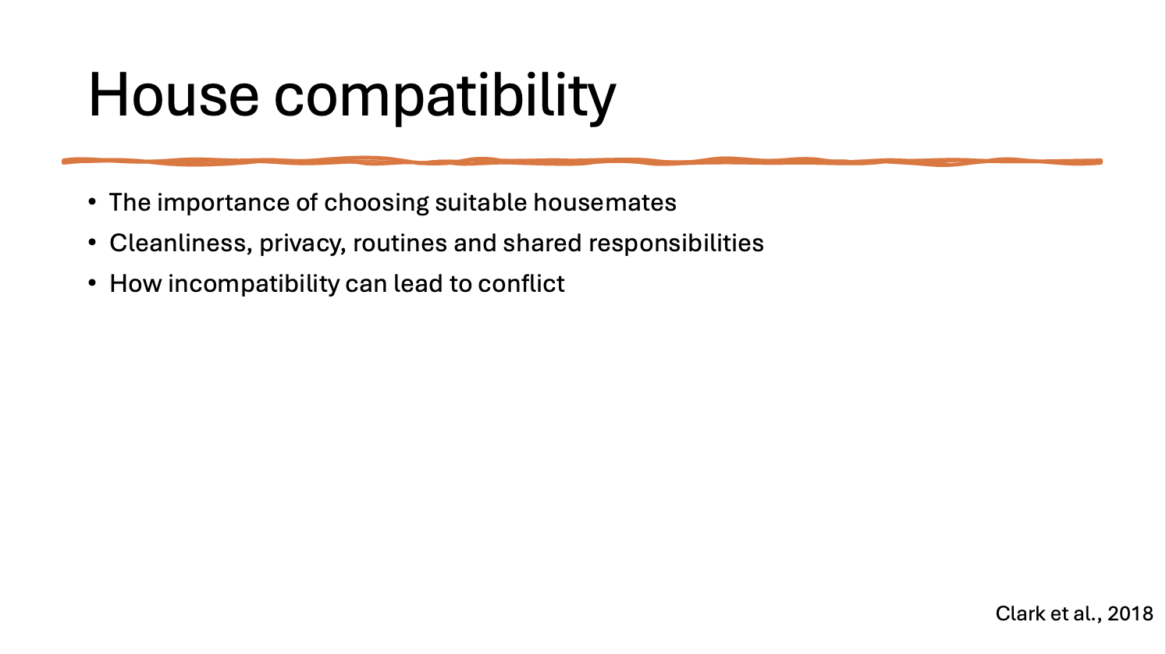
Notes:
87.5% rated as important
Keywords: Quiet, Respect, Similarity, Boundaries, Responsibility

Slide 6
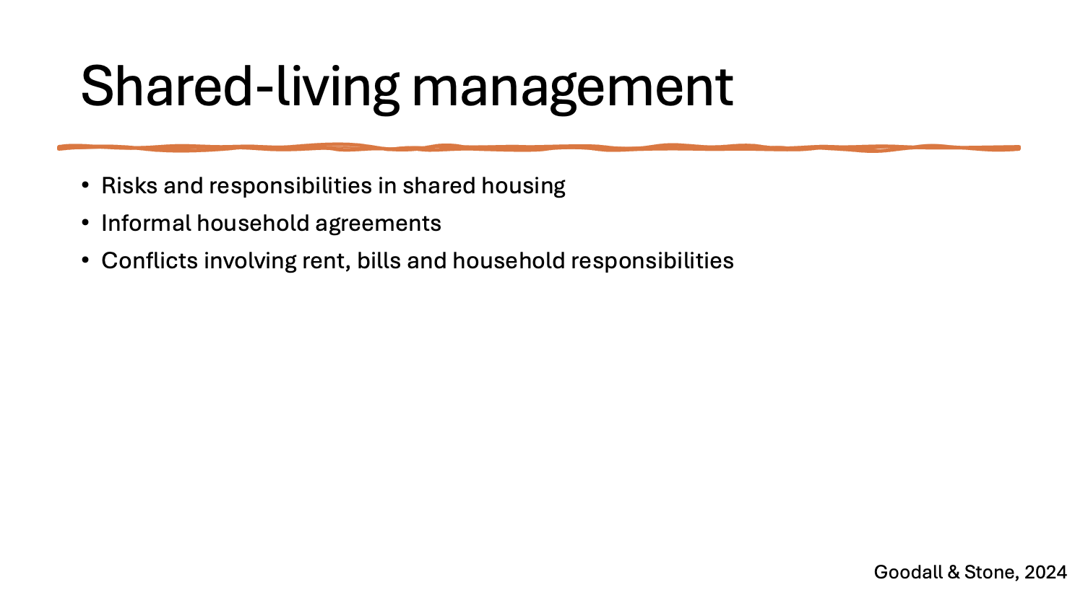

Slide 7

ROOMMATE HAVEN / SYSTEM VIEW
PROBLEM
02
A good room can still become the wrong home.
Find a real place
Is the listing genuine—and can I live with this person?
01
Price, location, verification
Understand the people
02
Trust signals, habits, fit
Agree before moving
03
Bills, chores, privacy, guests
Students must judge the property, the people and the shared rules—often before trust exists.
RoomMate Haven · Problem context
Notes:
Speaker: Liam · Target time: 35 seconds.
Keep the problem emotional and concrete: a room can fit the budget but fail as a shared home.
Transition: Our primary research shows that this is not an isolated concern.

Slide 8
ROOMMATE HAVEN / SYSTEM VIEW
RESEARCH EVIDENCE
03
Trust and compatibility shape the housing decision.
Survey of 16 international students currently studying in Australia.
100%
4.44/5
68.75%
concerned about scams
importance of compatibility
experienced housemate conflict
All respondents reported some concern
Average rating across respondents
Conflict continues after move-in
16 of 16 respondents
4.44 of 5 average rating
11 of 16 respondents
The design must address trust before contact and conflict before move-in.
RoomMate Haven · International student survey, n = 16
Notes:
Speaker: Liam · Target time: 35 seconds.
Meaning: the housing decision is both transactional and social; verification alone is not enough.
Transition: Existing products address parts of this decision, but not the connected journey.
[Sources]
- Team international student survey (n=16), 2026.

Slide 9
ROOMMATE HAVEN / SYSTEM VIEW
DESIGN GAP
04
Existing tools solve stages—not the whole journey.
Tool type | Example | Strong at | Still missing
Property portals | Domain / realestate.com.au | Property detail and inspections | Housemate fit and shared expectations
Social groups | Facebook Marketplace / groups | Reach and informal contact | Verification and safe communication
Housemate platforms | Flatmates | Profiles and introductions | Explainable fit and early agreements
Household apps | Splitwise / Tody | Bills and chores | Pre-move-in prevention and trust
Design opportunity: connect trust → preference-based fit → shared expectations before commitment.
RoomMate Haven · Competitive gap
Notes:
Speaker: Nicky · Target time: 35 seconds.
Treat this slide as the start of the solution section, not more background.
Transition: We generated three concepts to close that gap and selected them systematically.
[Sources]
- https://www.domain.com.au/
- https://www.realestate.com.au/
- https://flatmates.com.au/
- https://www.facebook.com/marketplace/

Slide 10
CONCEPT SELECTION
05
Compatibility leads; trust and agreement complete it.
Weighted by evidence fit, user value, feasibility, testability, innovation and privacy.
A
4.15
B
4.45
C
4.35
OUT OF 5
OUT OF 5
OUT OF 5
TRUST FLOW
COMPATIBILITY MATCHING
CO-LIVING AGREEMENT
Verified accommodation & housemate trust
Lifestyle comparison & explainable fit
Pre-move-in expectations & responsibilities
Reduce scam risk through clear verification signals and safer contact.
Compare cleanliness, noise, guests, schedules, chores and bills.
Clarify chores, bills, privacy and house rules before commitment.
SELECTED CORE
FINAL DIRECTION
Concept B as the core + trust indicators from A + agreement setup from C
The result is one focused, feasible and testable product journey.
RoomMate Haven · Weighted decision matrix
Notes:
Speaker: Nicky · Target time: 45 seconds.
State the three scores once: Trust 4.15, Compatibility 4.45, Agreement 4.35.
Transition: The selected direction becomes a five-step decision journey.
[Sources]
- Team weighted decision matrix and concept-development workshop materials.

Slide 11
ROOMMATE HAVEN / SYSTEM VIEW
SELECTED SOLUTION
06
Five connected decisions reduce risk before commitment.
Find home → verify → compare fit → talk safely → agree early.
1
2
3
4
5
Find home
Verify
Compare fit
Talk safely
Agree early
Price + location
Listings + people
Habits + gaps
Guided messages
Rules + consent
TRUST AND FIT ARE DIFFERENT SIGNALS
Verification reduces uncertainty; compatibility supports conversation—not a safety guarantee.
Notes:
Speaker: Nicky · Target time: 45 seconds.
Walk left to right and explain how each stage removes uncertainty from the previous stage.
Transition: The next slide demonstrates the same journey in the deployed prototype.
[Sources]
- Team Sprint 1 story map and selected RoomMate Haven concept.

Slide 12
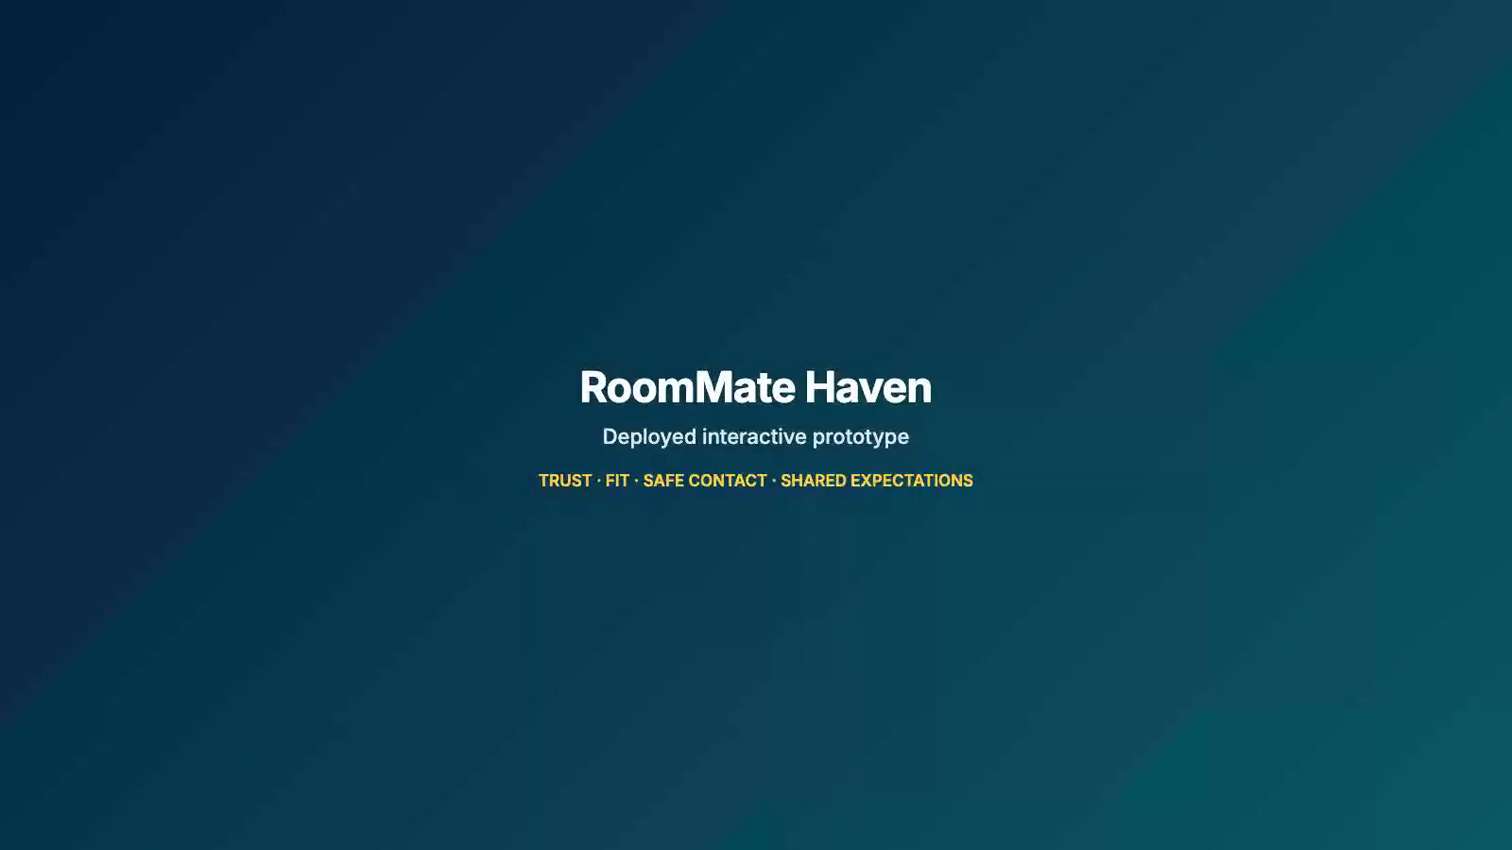
ROOMMATE HAVEN / SYSTEM VIEW
RECORDED PROTOTYPE DEMO
07
The deployed prototype connects the full decision journey.
Notes:
Speaker: Dylan · Target time: 75 seconds.
Before presenting: insert one 60–75 second MP4 across the three browser frames and set Playback to Automatically.
Demo path: property search → verification cues → compatibility explanation → safe messaging → house-rule agreement.
Plan B: if the embedded video fails, narrate the three still frames; if the network fails, use the embedded recording rather than the live site.
Transition: Behind this journey are modular subsystems that can be validated separately.
[Sources]
- http://roommate-haven-dev.eba-2h6p4mxq.ap-southeast-2.elasticbeanstalk.com/

Slide 13
ROOMMATE HAVEN / SYSTEM VIEW
TECHNICAL ARCHITECTURE
08
Connected subsystems make the concept feasible.
Each module maps to a Sprint task and can be validated independently.
Profile data
Compatibility engine
Guided messaging
Agreement builder
User interface
Preferences + history
Preference fit—not safety
Contact block + prompts
Proposal + approval state
Search + decisions
Verification
Privacy
Verified / pending / unverified
Consent / alert / block
Search recovery, score meaning and status feedback became the key iteration points.
RoomMate Haven · Technical architecture
Notes:
Speaker: Dylan · Target time: 50 seconds.
Explain data and decisions, not implementation jargon: preferences feed the fit engine; verification and privacy stay separate.
Transition: We then tested whether users understood those system states—not only whether they could click through them.
[Sources]
- Team subsystem analysis and Sprint 1 prototype mapping.

Slide 14
ROOMMATE HAVEN / SYSTEM VIEW
FINAL TESTING
09
Trust cues worked—but meaning gaps remained.
PASS
PARTIAL
FAIL
Verification cues
Compatibility meaning
Rule activation
↓
↓
↓
5/5 independent
2/5 separated fit from safety
AC-US10-02 failed
↓
↓
↓
No help · text + icon
Explain score limits
Clarify activation
The contact-detail warning improved from Fail → Pass after Iteration 2.
RoomMate Haven · Final usability testing
Notes:
Speaker: Dylan · Target time: 55 seconds.
Method: five participants, two iterations, tablet/laptop/mobile, moderated think-aloud.
Do not claim overall success. State clearly that verification passed, compatibility meaning remained partial, and rule activation failed.
Transition: The detailed results show where the revised design worked and where more development is needed.
[Sources]
- https://github.com/NuodiLiu/DESN2000/blob/main/part3/finalreport.tex
- https://github.com/NuodiLiu/DESN2000/blob/main/part3/tests/participant-findings.md

Slide 15
ROOMMATE HAVEN / SYSTEM VIEW
FINAL TESTING RESULTS
10
Two iterations produced measurable design changes.
Five participants · moderated think-aloud · tablet, laptop and mobile
Task | Observed result | Evidence | Status
Search recovery | 4/5 independent | 44 s median; 4/5 understood recovery | PASS
Verification cues | 5/5 independent | No help; text + icon cues | PASS
Compatibility meaning | 3/5 independent | Only 2/5 separated fit from safety | PARTIAL
Safe contact / rules | Contact warning improved | Contact: Fail → Pass; activation: Fail | MIXED
AUTOMATED QA
18 findings: 8 functional/test infrastructure · 9 accessibility · 1 responsive
Next: clarify fit limits and rule activation
RoomMate Haven · Final testing and QA
Notes:
Speaker: Dylan · Target time: 60 seconds.
Call out the exact method and the limits. The same five participants completed targeted Iteration 2 retests.
Automated Playwright review logged 18 independent findings; this supports the need for continued technical hardening.
Transition: These results clarify what is genuinely innovative about the final design.
[Sources]
- https://github.com/NuodiLiu/DESN2000/blob/main/part3/finalreport.tex
- https://github.com/NuodiLiu/DESN2000/blob/main/part3/tests/roommate-haven-qa-findings.md

Slide 16
ROOMMATE HAVEN / SYSTEM VIEW
INNOVATION
11
RoomMate Haven connects a fragmented housing journey.
Current experience
Search
Switch platform
Share contacts
Resolve conflict
RoomMate Haven
Verify options
Compare fit
Message safely
Agree expectations
The innovation is the integration:
trust + preference fit + early agreements
RoomMate Haven · Integrated innovation
Notes:
Speaker: Pranav · Target time: 50 seconds.
Frame innovation honestly: individual features exist elsewhere; the innovation is connecting them before commitment.
Transition: The final value is a clearer shared-home decision—not simply another listing platform.
[Sources]
- Team competitive analysis, concept selection and user-journey mapping.

Slide 17
ROOMMATE HAVEN / SYSTEM VIEW
RoomMate Haven
Trust.
Fit.
Clarity.
Students should be able to choose not only where they live,
but who they live with—and how they will live together.
Liam · Dylan · Nicky · Pranav
Questions?
Notes:
Speaker: Pranav · Target time: 45 seconds.
Close by resolving the opening problem. Invite the audience to try the deployed prototype.
Team rehearsal target: approximately 9 minutes 10 seconds, leaving a buffer below the 10-minute limit.
[Sources]
- http://roommate-haven-dev.eba-2h6p4mxq.ap-southeast-2.elasticbeanstalk.com/

