Slide 1

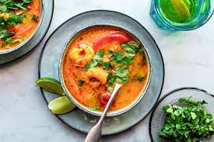
THE BATTLE OF NEIGHBOURHOODS
Thai Restaurants in Toronto

Slide 2
Introduction/PROBLEM STATEMENT
Finding the most suitable neighbourhood in Toronto, Canada to start a new Thai Restaurant venture. The most ideal location to open up this new restaurant will be found out with the help of all the Machine Learning and Data Science concepts learnt in the course so far. These concepts include segmentation , clustering etc. To be able to achieve our solution to the problem statement, we need to find the following information and observe the solutions obtained from them to be able to solve the ultimate problem statement:
Areas with Thai restaurants in Toronto
Neighbourhoods around Toronto that lack Thai restaurant

Slide 3
Background
Being a Thai food connoisseur, my idea is to spread the vibrant and rich taste of their cuisine across Toronto. With this idea, people would be introduced to this new flavour that they may or may not have tasted before, and most likely will open in a neighbourhood that has a lack of Thai based restaurants. This will definitely be a positive addition to the neighbourhood as now the people who are Thai food lovers like me will definitely be able to enjoy a Thai meal and for those people who have never tasted Thai cuisine before, this will be new cuisine for them to try and taste the rich Thai culture through their food.

Slide 4
DATA SECTION
To solve the problem of finding the best neighbourhood in Toronto to open up a new venture of a Thai Restaurant, we will need the following data:
List of neighbourhoods in Toronto, Canada:
Data source: Wikipedia
Description: Scrapping the data from Wikipedia as done in past week.
Latitude and Longitude:
Data source: Geocoder package
Description: Obtaining the latitude and longitude values of the neighbourhoods using this package
Venue of Thai Restaurants:
Data source: Foursquare API
Description: Getting the venue data that have Thai restaurants so we choose the best location for our new venture

Slide 5
Methodology
We begin by obtaining the list of neighbourhoods in Toronto, Canada as we did in the past weeks. From the Wikipedia page, we use web scraping that allows us to pull tabular data from the page into a data frame as required by us.
The link used is: https://en.wikipedia.org/wiki/List_of_postal_codes_of_Canada:_M
Here after, we will require the coordinates, that is, the latitude and longitude values of these neighbourhoods
Now the postcodes of these neighbourhoods are matched to the respective coordinates.
Next we will find out the number of neighbourhoods
Hereafter, we will find the Thai restaurants in Toronto,

Slide 6
Methodology(CONTD.)
Now using the Foursquare API, we will be able to obtain the names, coordinates, categories of the venues. Using this we find out the unique categories from the venues.
The last step is to perform the neighbourhood clustering.

Slide 7
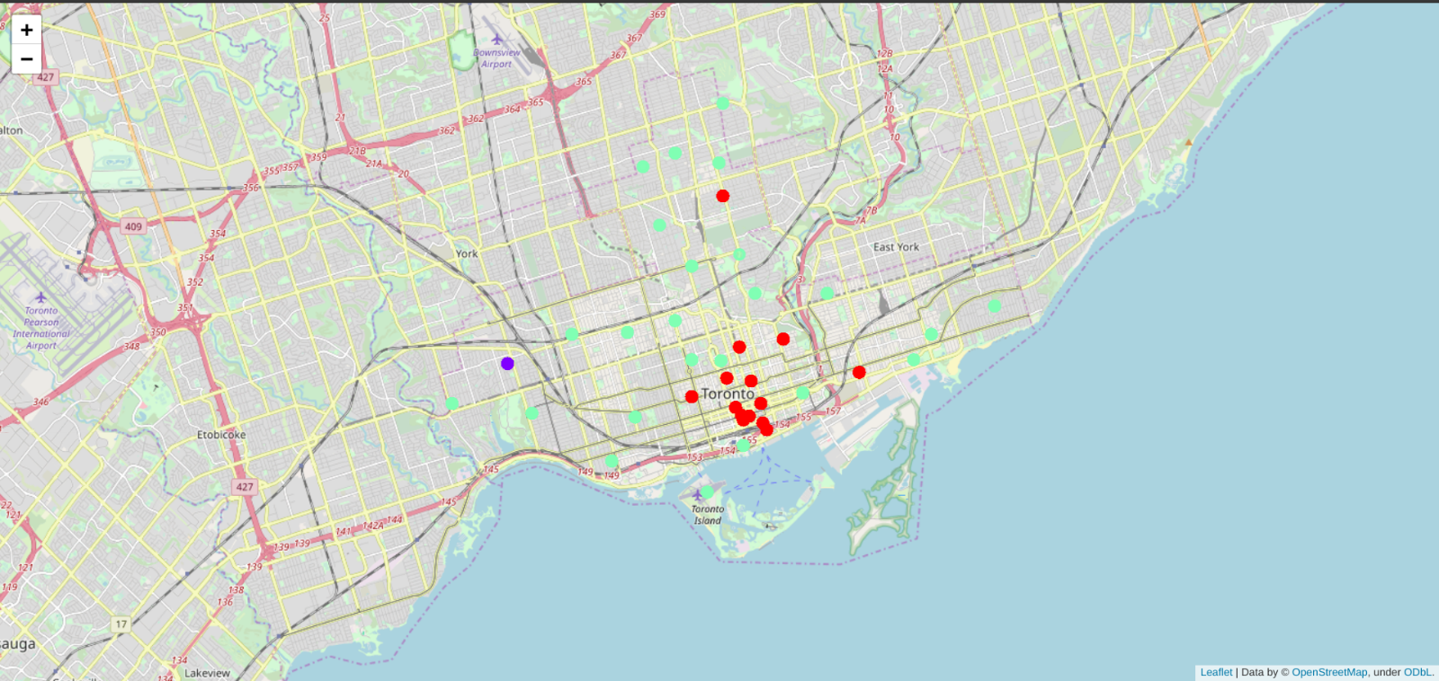
result

Slide 8
observation
Purple cluster: Shows neighbourhoods with no Thai restaurants.
Red cluster: Shows neighbourhoods with little or no Thai restaurants.
Green cluster: Shows neighbourhoods with high number of Thai restaurants

Slide 9
conclusion
After all the analysis performed, the information regarding the best location to set up a Thai Restaurant so as to have more people come in and make maximum profit has been found. Areas with little to no Thai based restaurants were found in this analysis which is a great place to start up our venture

