Slide 1


Department of Computer Engineering Mini-Project 2023-24 DIGIPOLLS - A Blockchain-based E-Voting System
Group Members:
Omkar Boralkar 16010121027
Aditya Patil 16010121028
Nupur Chaudhari 16010121033
Vignesh Iyer 16010121066
Faculty Advisor:
Prof. Swapnil Pawar

Slide 2
Outline
Introduction
Literature Survey
Problem Statement
Scope of the Project
Objectives of the Project
System Design
System Architecture
Hardware and Software for Development and Deployment
Screenshots of Implementation
Summary
References

Slide 3
Introduction
Just as contemporary electoral systems face challenges in maintaining trust and integrity, companies encounter similar issues in corporate governance. By embracing innovative solutions and prioritizing transparency and accountability, organizations can enhance the credibility of their decision-making processes and rebuild trust among stakeholders.
To address these concerns, our project aims to leverage blockchain technology in the realm of electronic voting (e-voting). The existing trust deficit in traditional voting systems necessitates a robust, secure, and transparent alternative. Blockchain, with its decentralized and immutable nature, emerges as a promising solution to mitigate the flaws plaguing current electoral processes. Our objective is to implement and test a blockchain-based e-voting application, utilizing the Ethereum platform and Solidity language, to ensure security, transparency, and the privacy of voters.
Distrust in Traditional Voting Systems
Instances of vote rigging, EVM hacking, and other malpractices have eroded confidence in the election process.
Importance of Elections in Democracy
Acknowledging the significance of a transparent and secure electoral process in upholding the principles of democracy
Motivation for Blockchain-based E-voting
Technological Solutions for Modern Challenges
Understanding that traditional methods fall short in ensuring the integrity, security, and transparency needed for a fair and reliable election
Blockchain's Potential in Enhancing Trust
The motivation to explore and harness blockchain's capabilities to create a secure, transparent, and tamper-resistant e-voting system

Slide 4
Literature Survey
Research Paper | Findings
Blockchain for Electronic Voting System—Review and Open Research Challenges [1] Uzma Jafar,* Mohd Juzaiddin Ab Aziz, and Zarina Shukur | In online voting solutions, a single vulnerability can lead to large-scale manipulations of votes. Blockchain technology avoids this and offers decentralized nodes for electronic voting and is used to produce electronic voting systems mainly because of its end-to-end verification advantages. For a sustainable blockchain-based e-voting system, the security of remote participation must be viable, and for scalability, transaction speed must be addressed. Due to these concerns, it was determined that the existing frameworks need to be improved to be utilized in voting systems. Eligibility, Unreusability, Privacy, Fairness, Soundness, Completeness are satisfied by a blockchain implementation of E-voting.
A secure end-to-end verifiable e-voting system using blockchain and cloud server [2] Somnath Panja, Bimal Roy | Instead of assuming a secure append-only public bulletin board, the authors modified the DRE-ip algorithm to make it tamper-evident and have proposed two methods (depending on how the election is arranged) to store the ballots using blockchain and cloud server. Depending on how the election is organized, the authors propose two methods to store the ballots on a public bulletin board. The authors prove that their scheme satisfies the eligibility verifiability property. They also provide security proofs to show that the proposed protocol is end-to-end verifiable as well as preserves each voter’s privacy and the integrity of the system.
Conceptual Architecture of a Blockchain Solution for E-Voting in Elections at the University Level [3] Simona-Vasilica Oprea, Adela Bâra, Anca-Ioana Andreescu and Marian Pompiliu Cristescu | The authors propose to identify the most critical specifications of an e-voting application, find a solution for elections in universities and compare their solution with others. The authors propose a conceptual architecture using encrypted functions and two stages: voting and validation, separating layers and roles, that is based on blockchain tables and innovative interactions between actors (voters and voting committee) and the two software components (web application and database). For replicability, the conceptual architecture is depicted and formalized using several Unified Modeling Language (UML) diagrams. Furthermore, in order to provide proof of concept, the initial steps in implementing the proposed solution are showcased.
Votereum: An Ethereum-Based E-Voting System [4] Linh Vo-Cao- Thuy; Khoi Cao-Minh; Chuong Dang-Le-Bao; Tuan A. Nguyen | Block chain can provide a mechanism for an open, fair and verifiable voting process globally. The authors propose an e-voting system ‘Votereum’ that uses blockchain technology. The proposed system is empowered by the Bep-20 platform, which includes a server that manages the entire system and the remaining server that handles all requests related to the block chain.

Slide 5
Problem Statement
To implement and test a blockchain-based e-voting application

Slide 6
Blockchain-Based E-Voting Application
The project focuses on the development of a complete e-voting application utilizing blockchain technology.
Potential for Future Scaling
Designing the system with scalability in mind, allowing for potential expansion and adaptation to larger-scale elections.
User-Friendly Interface: Designing the e-voting system with a user-friendly interface to encourage widespread participation.
Scope of the Project
Privacy-Preserving Design
Incorporating measures to protect voter privacy while maintaining transparency and traceability in the blockchain.
Ethereum Platform
The implementation specifically utilizes the Ethereum platform and the Solidity programming language for creating smart contracts.
Decentralized System
Leveraging the decentralized and tamper-resistant nature of blockchain to enhance the security and integrity of the voting process.

Slide 7
Objectives
Implementing a Blockchain-Based E-Voting System
Develop and deploy a functional e-voting system built on blockchain technology.
Enhancing Security and Transparency
Ensure the security of the voting process by leveraging the decentralized and tamper-resistant nature of blockchain. Integrate transparency measures to foster trust in the electoral system.
Utilizing Ethereum and Solidity
Implement the e-voting application using the Ethereum platform and the Solidity programming language, capitalizing on the capabilities of smart contracts
Addressing Trust Issues in Elections
Alleviate concerns related to vote rigging, hacking, and manipulation by providing a secure and transparent platform for voters
Preserving Voter Privacy
Design the system to safeguard the privacy of voters while maintaining the transparency required for a democratic process.
Verification and Validation
Conduct thorough testing to validate the functionality and security of the e-voting application.
Ease of Use
Ensure that the e-voting system is user-friendly, allowing voters to participate in the process with ease and convenience.
Documentation and Knowledge Transfer
Create comprehensive documentation for the implemented system to facilitate understanding and knowledge transfer.

Slide 8
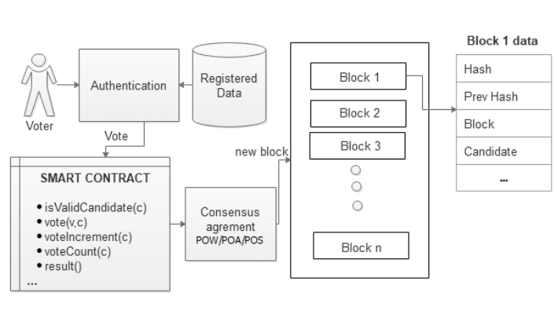
System Architecture
Detailed View

Slide 9
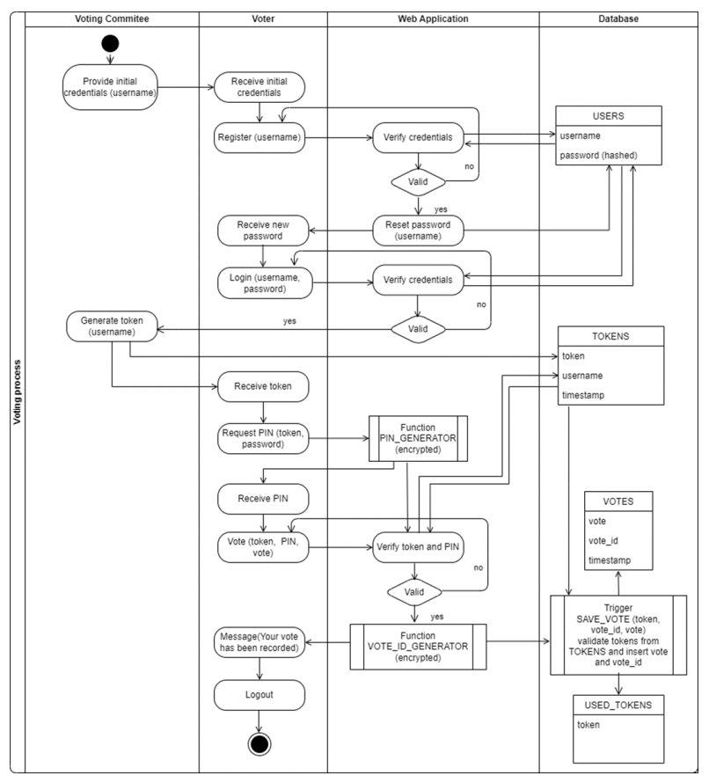
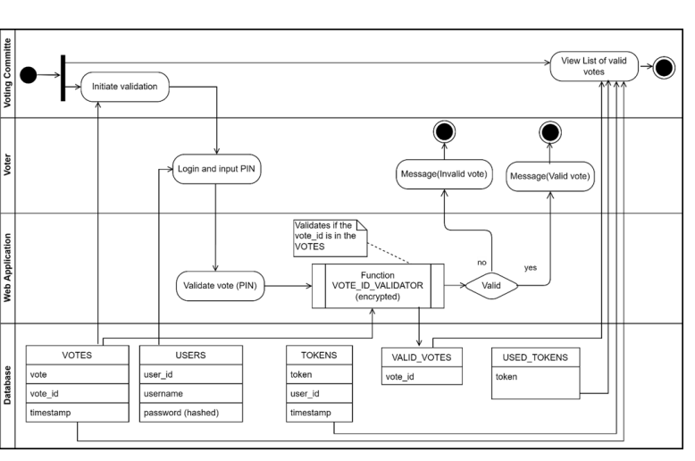
Validation System Architecture
Voting System Architecture

Slide 10
Hardware Requirements for Development
Processor: A processor with a minimum speed of 3.5 GHz is recommended to ensure efficient execution of the Ethereum development environment and associated tools. Solid processing power is essential for compiling and running complex smart contracts during development.
RAM: A minimum of 8 GB RAM is necessary to support the simultaneous operation of the development tools, Ethereum node, and other components. Ample RAM ensures smooth performance and responsiveness during the development and testing phases.
Storage: Adequate storage, preferably a 1TB HDD, is crucial for storing development tools, Ethereum blockchain data, and project files. Blockchain development involves substantial data storage requirements, and having sufficient space helps in maintaining a smooth workflow.
Development Environment: The hardware should be capable of supporting the development tools required for Ethereum and Solidity. This includes compilers, Ethereum nodes, and related software components. A robust development environment is essential for efficient coding, testing, and debugging.

Slide 11
Software Requirements for Development
Solidity / Web3
(for writing/connecting the Blockchain contract)
Next.js & Semantic UI React
(front-end)
MongoDB / ExpressJS / Node.js
(back-end)
IPFS
(file storage for images)
Solidity is specifically designed for writing smart contracts on the Ethereum blockchain. It provides the necessary tools and syntax for creating secure and decentralized applications.
Web3.js allows seamless interaction between the front-end application and the Ethereum blockchain, enabling the execution of smart contracts and retrieval of blockchain data.
Next.js is a React framework that facilitates the creation of server-side rendered and statically generated web applications. It enhances performance and provides a smooth development experience
Semantic UI React is a user interface framework that simplifies the design process by offering pre-designed components. It ensures a consistent and visually appealing front-end
MongoDB, a NoSQL database, is chosen for its scalability and flexibility. It allows the storage of diverse data types and supports rapid development
The Express.js framework, coupled with Node.js, provides a robust and scalable back-end infrastructure. It facilitates the creation of RESTful APIs, ensuring smooth communication between the front-end and the database.
IPFS (InterPlanetary File System) is employed for decentralized and distributed file storage. It ensures the availability and integrity of images used in the application, reducing reliance on a centralized server

Slide 12
Software Requirements for Deployment
Identity Management System
Smart Contracts
Frontend Application
An identity management system is essential for verifying the identity of voters and ensuring that each voter can cast only one vote. This system may integrate with government databases or use digital identity verification methods to authenticate voters before allowing them to participate in the voting process.
Smart contracts are self-executing contracts with the terms of the agreement directly written into code. In an e-voting system, smart contracts are deployed on the Ethereum blockchain to manage the voting process, including voter registration, ballot creation, vote casting, and tallying. These smart contracts ensure transparency and immutability of the voting process
It provides the user interface for voters to interact with the e-voting system. It could be a web or mobile application where voters can register, view the ballot, cast their votes, and verify their voting status. This application communicates with the Ethereum blockchain through APIs to interact with the smart contracts.
Backend Services
Ethereum Network Integration
Blockchain Explorer
Backend services handle various functionalities such as user authentication, data validation, and communication with the Ethereum blockchain. These services ensure the security and integrity of the e-voting system by implementing appropriate protocols for data handling and interaction with the blockchain.
Integration with the Ethereum network is crucial for deploying smart contracts, interacting with the blockchain, and managing transactions. This integration involves configuring nodes, monitoring network activity, and ensuring the reliability and scalability of the e-voting system.
A blockchain explorer is a tool that allows users to view and track transactions on the Ethereum blockchain. It provides transparency into the e-voting process by enabling stakeholders to verify that their votes have been recorded correctly and that the voting process is fair and tamper-proof.

Slide 13
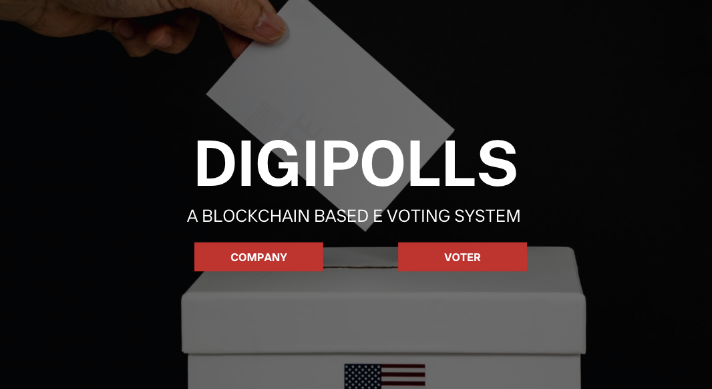
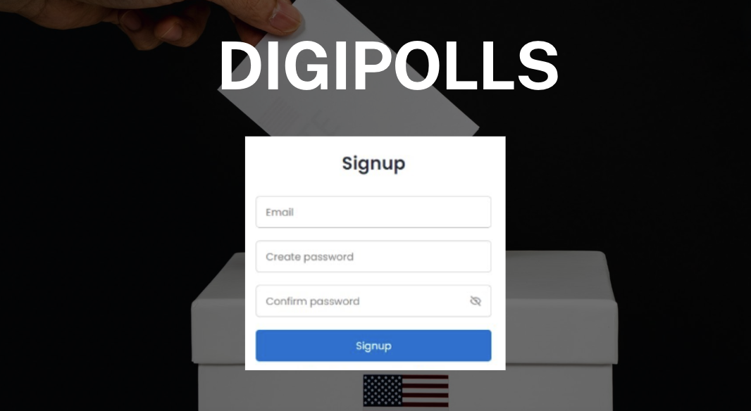
Screenshots of Implementation

Slide 14
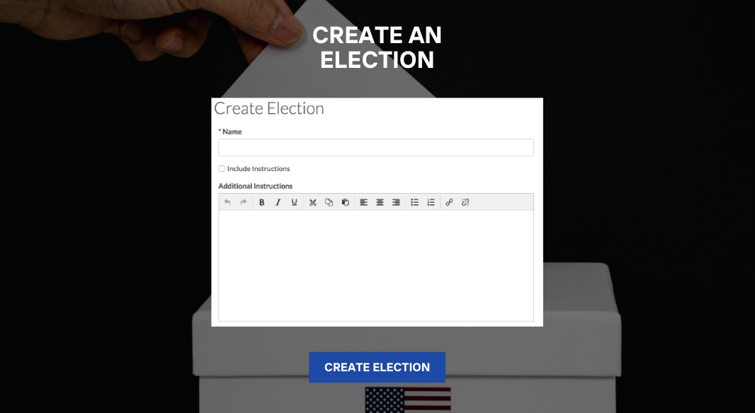
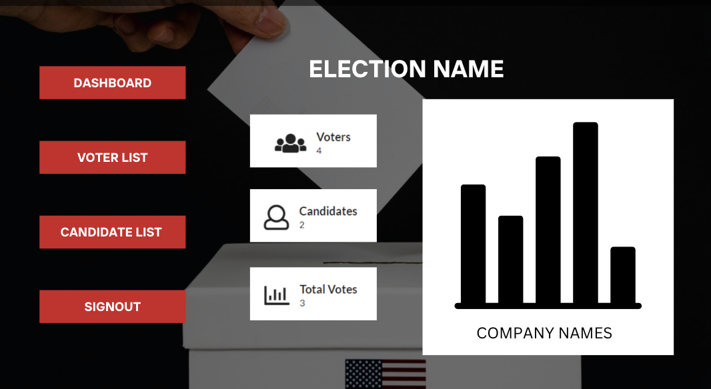
Screenshots of Implementation

Slide 15
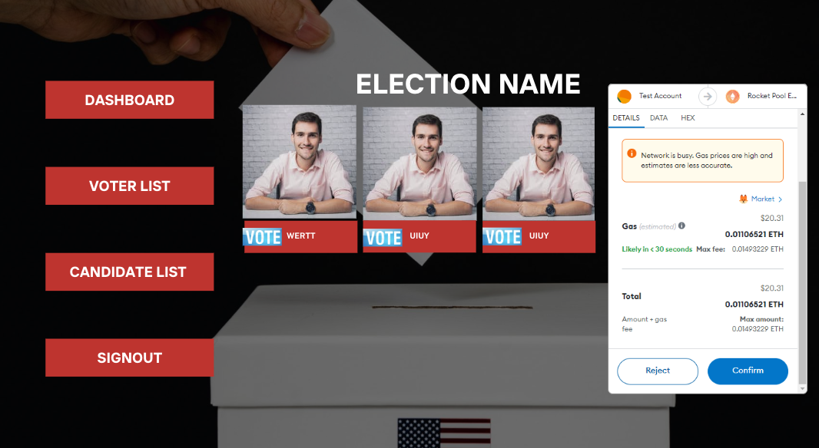

Screenshots of Implementation

Slide 16


Screenshots of Implementation

Slide 17
Screenshots of Implementation

Slide 18
Summary

Slide 19
References
Blockchain for Electronic Voting System—Review and Open Research Challenges Uzma Jafar,* Mohd Juzaiddin Ab Aziz, and Zarina Shukur https://www.ncbi.nlm.nih.gov/pmc/articles/PMC8434614/
A secure end-to-end verifiable e-voting system using blockchain and cloud server Somnath Panja, Bimal Roy https://www.sciencedirect.com/science/article/abs/pii/S2214212621000557
Conceptual Architecture of a Blockchain Solution for E-Voting in Elections at the University Level Simona-Vasilica Oprea, Adela Bâra, Anca-Ioana Andreescu and Marian Pompiliu Cristescu https://ieeexplore.ieee.org/stamp/stamp.jsp?arnumber=10049991
Votereum: An Ethereum-Based E-Voting System Linh Vo-Cao- Thuy; Khoi Cao-Minh; Chuong Dang-Le-Bao; Tuan A. Nguyen https://ieeexplore.ieee.org/document/8713661

Slide 20
Thank You

