Slide 1



Meshery Session
Meshery | The Service Mesh Management Plane | Meshery
July 5,2020

Slide 2





Microservices
Service Mesh
Layer5
Meshery
OpenSource

Slide 3
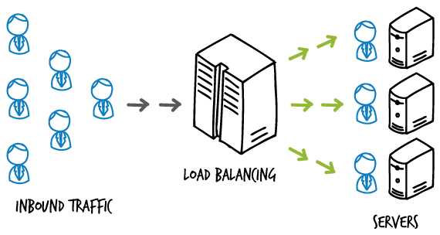
Prerequisite
Load Balancing

Slide 4
Monolithic Architecture
E.g. The softwares we are creating currently. TODO App
Microservices
E.g. Amazon,Netflix,Uber etc. uses Microservice Architecture
Service A
Service B
Service C
Service D
Service E
Service N
Notes:
Benefits of Microservices: Faster Delivery (Fast releases) Isolation Scaling

Slide 5
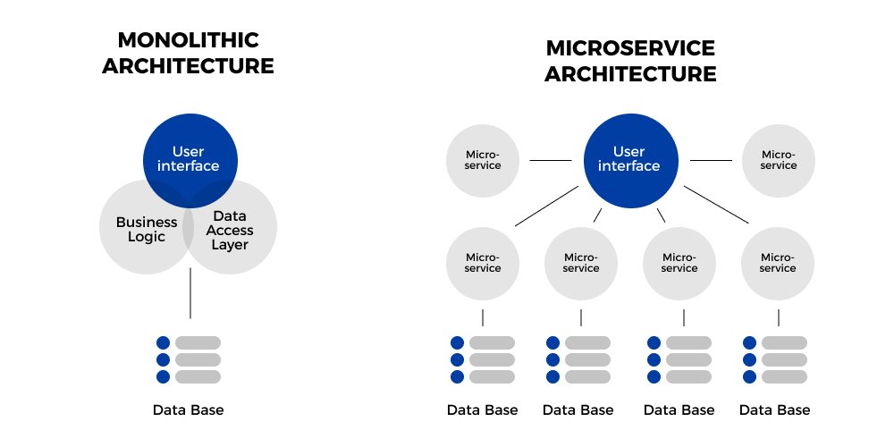
Monolithic Architecture
Microservices
Notes:
Benefits of Microservices: Faster Delivery (Fast releases) Isolation Scaling

Slide 6
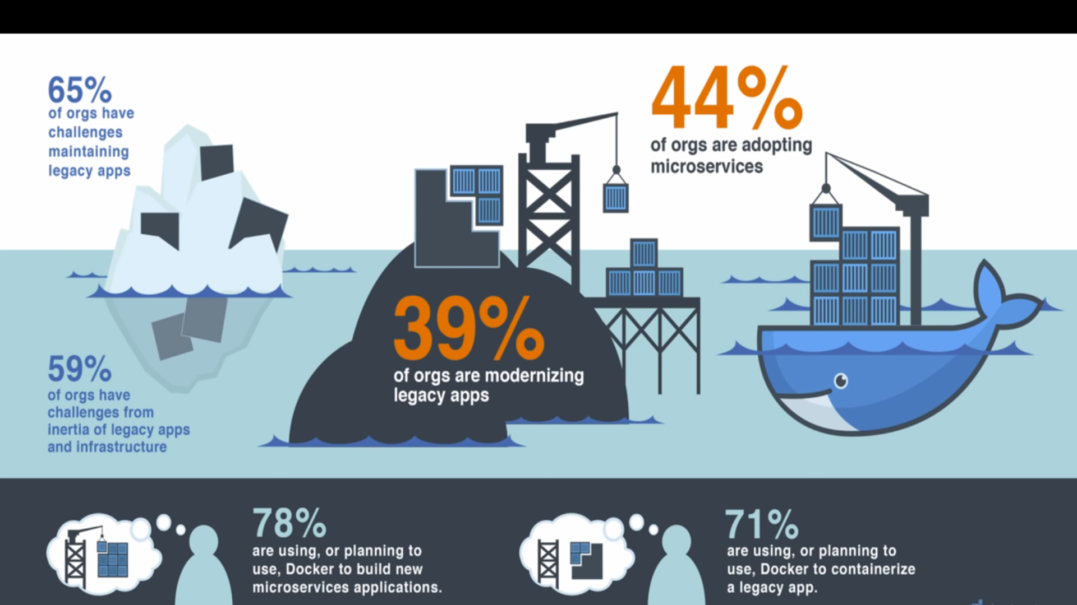

Slide 7
Service Mesh
Control Plane
Data Plane
Service A
Service B
Proxy A
Proxy B
Notes:
Challenges with Microservices: Service Discovery Load Balancing Security

Slide 8
LAYER5

Slide 9
MESHERY

Slide 10
Brief about Open Source Community.

Slide 11
Successful to answer the following? Why? How? What?

Slide 12
Resources
askmeegs/learn-istio: ⛵️ Istio resources 🕸
The Enterprise Path to Service Mesh Architecture
https://youtu.be/gfWr2_H39N0 (What is Microservices)
https://youtu.be/QiXK0B9FhO0 (What is service mesh)
Kubernetes Service Mesh: A Comparison of Istio, Linkerd and Consul
https://youtu.be/CFj1O_uyhhs

