Slide 1
BATTLE OF NEIGHBOURS

Slide 2
INTRODUCTION
The main aim of this Project is to help people in exploring better facilities around their neighborhood. It will help people making smart and efficient decision on selecting great neighborhood.
Lots of people are migrating to various states of Canada and needed lots of research for good housing prices and reputated schools for their children. This project is for those people who are looking for better neighborhoods. For ease of accessing to Cafe, School, Super market, medical shops, grocery shops,etc.
This Project aim to create an analysis of features for a people migrating to Scarborough to search a best neighborhood as a comparative analysis between neighborhoods. The features include median housing price and better school according to ratings, crime rates of that particular area, road connectivity, weather conditions, good management for emergency, water resources both freash and waste water and excrement conveyed in sewers and recreational facilities.
It will help people to get awareness of the area and neighborhood before moving to a new city, state, country or place for their work or to start a new fresh life.

Slide 3
PROBLEMS WHICH WERE AIMED TO SOLVED
The major purpose of this project, is to suggest a better neighborhood in a new city for the person who are shiffting there. Social presence in society in terms of like minded people. Connectivity to the airport, bus stand, city center, markets and other daily needs things nearby.
Sorted list of house in terms of housing prices in a ascending or descending order
Sorted list of schools in terms of location, fees, rating and reviews

Slide 4
LOCATION
Scarborough is a popular destination for new immigrants in Canada to reside. As a result, it is one of the most diverse and multicultural areas in the Greater Toronto Area, being home to various religious groups and places of worship. Although immigration has become a hot topic over the past few years with more governments seeking more restrictions on immigrants and refugees, the general trend of immigration into Canada has been one of on the rise.

Slide 5
WORK FLOW
Using credentials of Foursquare API features of near-by places of the neighborhoods would be mined. Due to http request limitations the number of places per neighborhood parameter would reasonably be set to 100 and the radius parameter would be set to 500.

Slide 6
LIBRARIES USED
1. Pandas
2.Folium
3.Scikit learn
4.XML
5.Geocoder
6.Matplotlib
7.Beautiful Soup and Requests

Slide 7
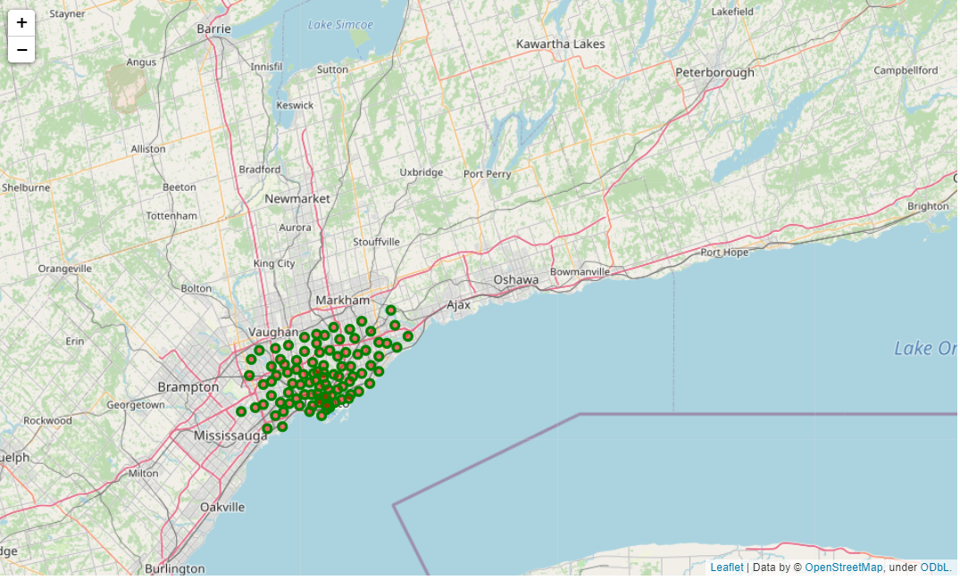
The neightbourhood of Toronto

Slide 8
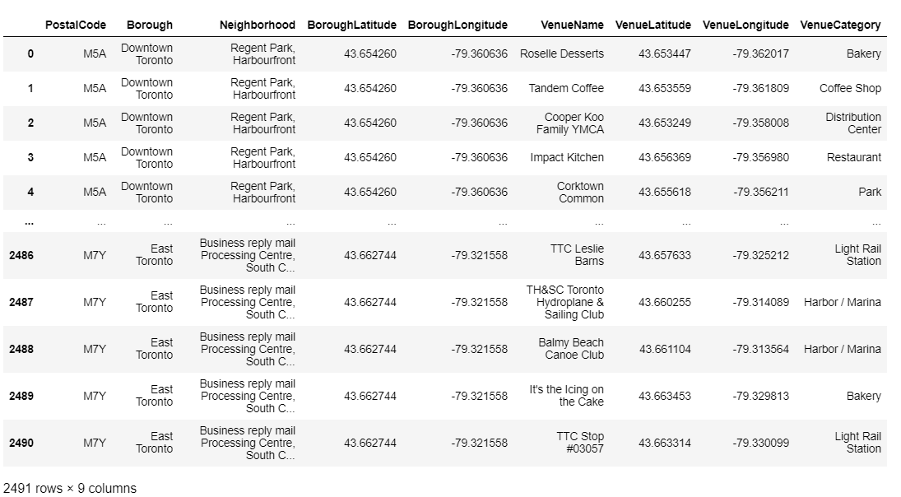
Top 150 locations with a radius of 700 meters

Slide 9
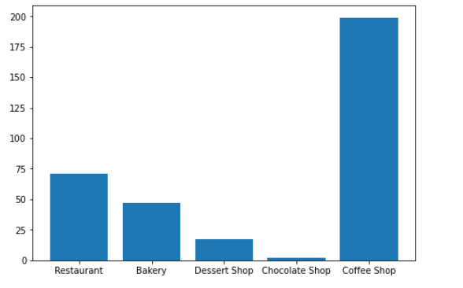
A BAR GRAPH TO CALCULATE THE NUMBER OF RESTAURANT,BAKERY,DESSERT SHOPS,COFFEE SHOPS,CHOCOLATE SHOPS ARE PRESENT IN THE NEIGHBOURHOOD

Slide 10
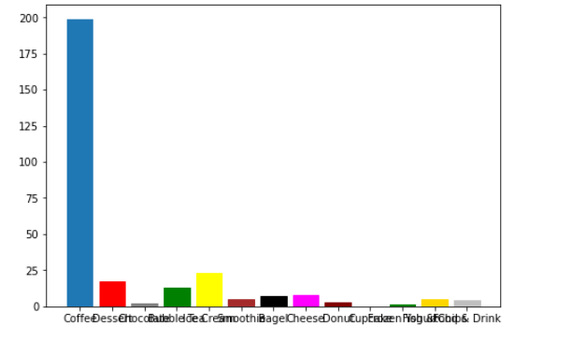
Find which food and drink shop is the most loved in the neigbourhood

Slide 11
CONCLUSION
From the above two graphs we can infer that coffee shop is the most loved shops as since there are about 200 coffee shops in the neighborhood which means that people in that neighborhood consume large amount of coffee.

Slide 12
FUTURE WORK
In future we can use this dataset and then try to calulate the number of robbery or theft incidents that took place in past few years in that neighbourhood in order to learn whether the neighbourhood is safe for a new family with children to settle or not.This is also help police to learn which neighbourhood has maximum crime rates and accordingly they can work specifically on those areas.

Slide 13
THANK YOU!

