Slide 1

THE
Chips
n
DIPS
STORY
Snack Lighter. Dip deeper.
Vacuum-fried veggie chips paired with a matching dip in one ready-to-eat combo pack — for snacks enthusiasts who want their crunch guilt-free.
REAL VEGGIES · VACUUM FRIED · BOLD DIPS
Notes:
1

Slide 2


WHY DOES BETTER-FOR-YOU
HAVE TO BE BORING?
Tasty. Fun. Exciting.
But loaded with palm oil, empty calories & post-snack guilt
Delivers the same bold flavors and craveable crunch - made with real ingredients, no additives & dip pairing.
INDULGENT SNACKS
BETTER-FOR-YOU SNACKS
PEOPLE DON'T WANT TO CHOOSE BETWEEN
FEELING GOOD AND HAVING FUN.
And dips? They're usually an afterthought.
Notes:
2

Slide 3


WE'RE MAKING BETTER-FOR-YOU
SNACKING FUN AGAIN.
+
=
THE COMPLETE SNACK
1 Chips Packet + 1 Dip + 1 Salt Sachet
→
→
→
REAL VEGGIES
VACUUM FRIED
CRISPY CRUNCH
BOLD DIPS
A SNACK WORTH CRAVING.
The combo meal, reimagined for better-for-you snacking.
Notes:
3

Slide 4

THE CRUNCH IS LIGHT.
THE FLAVOUR ISN'T.
01
02
03
VACUUM FRIED
NO PALM OIL
NO ARTIFICIAL ANYTHING
Real vegetables.
Light, crispy crunch.
A conscious choice in
how we make our snacks.
Simple, recognisable
ingredients.
BETTER-FOR-YOU WITHOUT THE BORING.
Notes:
4

Slide 5




THREE CRUNCHES. THREE BOLD DIPS.
CHIPS
DIPS
Beetroot Chips
KOREAN CHEESE
Jackfruit Chips
Cheese Jalapeno
Potato Sticks
Chilli Garlic
MIX. MATCH. DIP. REPEAT.
Notes:
5

Slide 6

FOR PEOPLE WHO WANT TO SNACK BETTER
— NOT SNACK LESS.
ACCESSIBLE PREMIUM SNACKING
COLLEGE STUDENTS +
YOUNG PROFESSIONALS
1 Chip + 1 Dip
₹200
  Health-conscious.
  Indulgence-driven.
  Love snacking.
  Want exciting flavours.
  Willing to pay for premium snacking.
₹400
2 Chips + 2 Dips
₹450
3 Chips
₹550
3 Chips + 2 Dips
₹600
3 Chips + 3 Dips
PREMIUM ENOUGH TO FEEL SPECIAL. ACCESSIBLE ENOUGH TO BECOME A HABIT.
Notes:
6

Slide 7
HEALTHY 28.5% GRoss margin across every unit sold
PER UNIT — ONE COMBO PACK
LINE | ₹ / UNIT
Landed cost (chips + dip, inward freight) | ₹65
Packaging | ₹25
Shipping to customer | ₹49
Payment gateway / COD fee (~2%) | ₹4
= TRUE COGS | ₹143
Selling price | ₹200
GROSS MARGIN / UNIT · % | ₹57 · 28.5%

Slide 8
GO-TO-MARKET
Own the chips + dip occasion.
TARGET
POSITIONING
ENTRY
GROWTH
18–32
LIGHTER × BOLDER
₹200
₹400–₹600
College Students +
Young Professionals
Real Veggies · Vacuum Fried
No Palm Oil · Bold Dips
1 CHIP + 1 DIP
Trial Combo
Mix & Match
Multi-pack Bundles
DON’T SELL HEALTHY CHIPS. SELL THE COMPLETE SNACK.
Snack Lighter. Dip Deeper.

Slide 9
LAUNCH ENGINE
Taste → Share → Buy → Repeat
01
02
03
04
TASTE
SHARE
BUY
REPEAT
500+
→
50+
→
₹200
→
₹400–₹600
Samples
Micro Creators
Trial Combo
Bundles
Colleges · Offices · Flea Markets
Taste tests · Rankings · UGC
Instagram → D2C → WhatsApp
Mix & Match · Reorders
THE GREAT DIP TEST
3 CHIPS × 3 DIPS = 9 PAIRINGS
Taste. Vote. Find India’s Favourite.
Launch targets: 500+ samples · 50+ micro creators
Mix. Match. Dip. Repeat.

Slide 10
90-DAY SCALE PLAN
Prove first. Scale what wins.
DAYS 1–30
DAYS 31–60
DAYS 61–90
TEST
LAUNCH
SCALE
Sampling
D2C
Quick Commerce + B2B
Find Hero Pairing
CAC + AOV
Repeat + Contribution
4 NUMBERS THAT MATTER
#1
HERO CHIP
#1
HERO DIP
#1
PAIRING
#1
CHANNEL
28.5%
GROSS MARGIN
D2C → SAMPLING → QUICK COMMERCE → RETAIL
Snack Lighter. Dip Deeper.

Slide 11
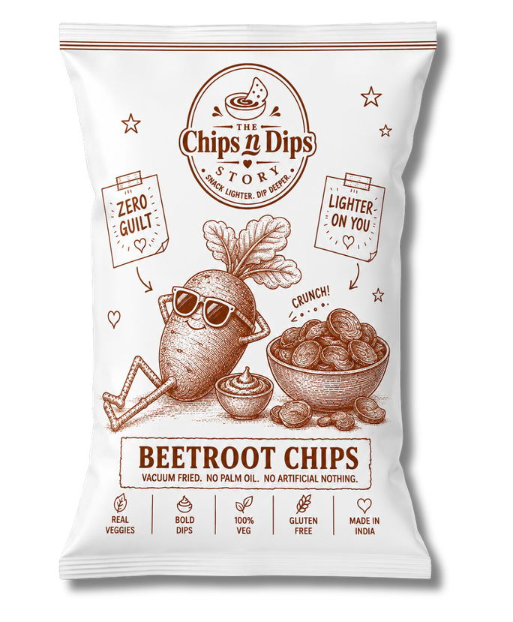
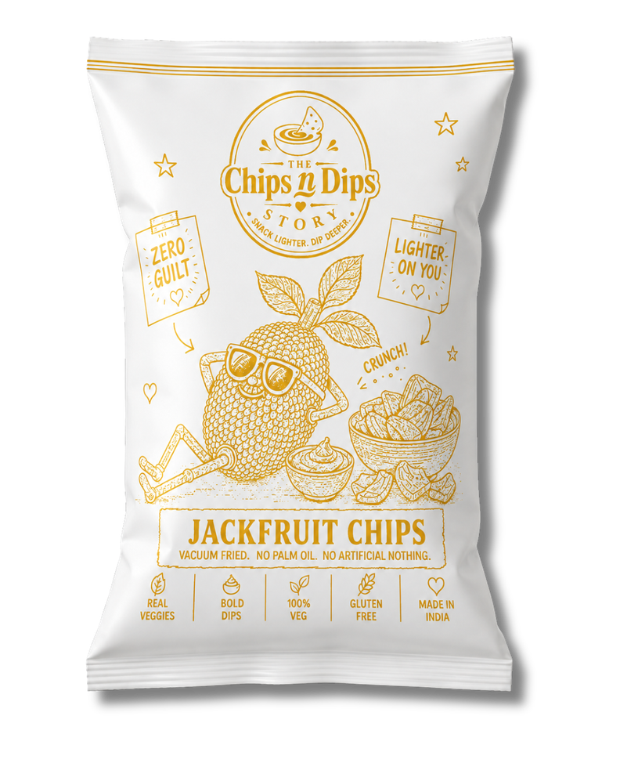
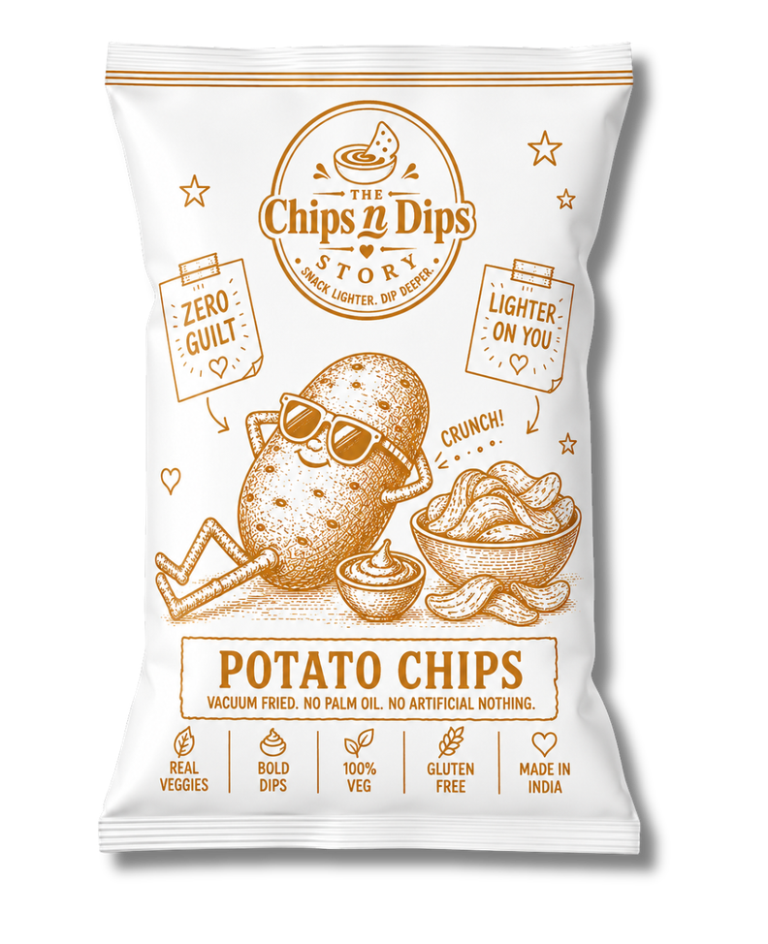
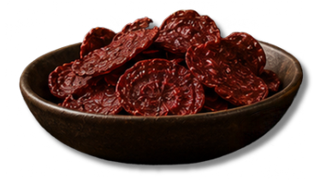
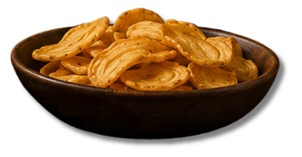
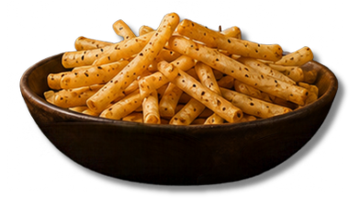
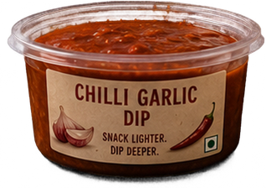
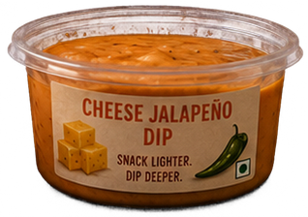

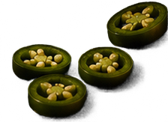
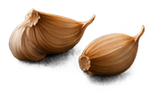
BUILD INDIA'S MOST EXCITING
BETTER-FOR-YOU SNACKING BRAND.
Snack Lighter. Dip deeper.
Notes:
7

