Slide 1
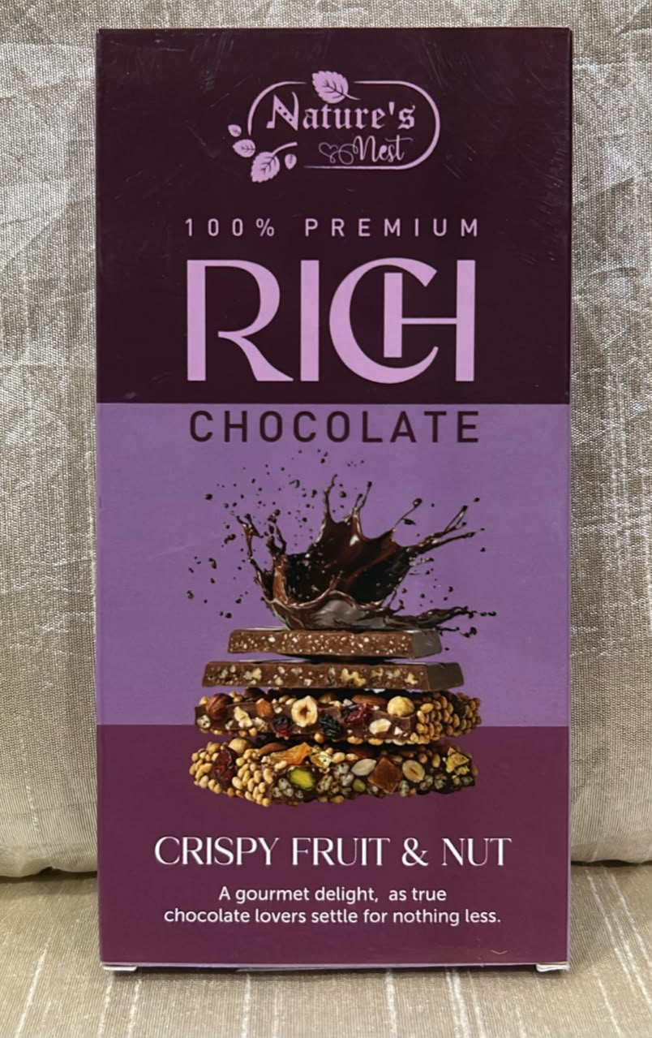
MESA · SESSION 1
Your Team's BYOB
Sales Update
Nature's Nest — fruit & nut chocolate you can actually see in the bar.
TEAM
Bhavesh Jain · Shreyas Suresh
Nanthakumar R · Aadit Jain
Cohort 4 · Team 38 · Review 30 July 2026

Slide 2
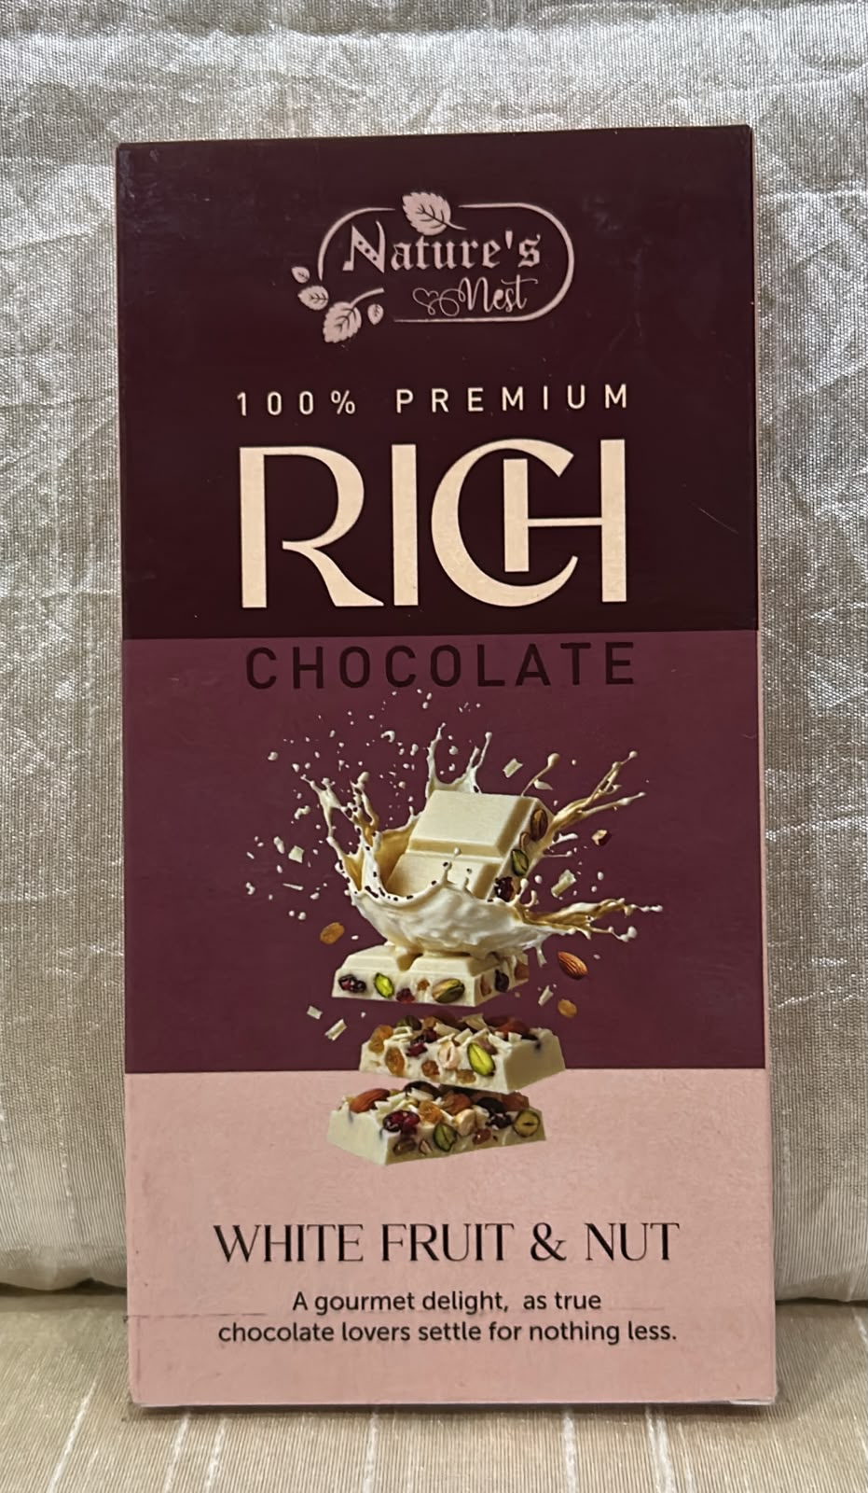
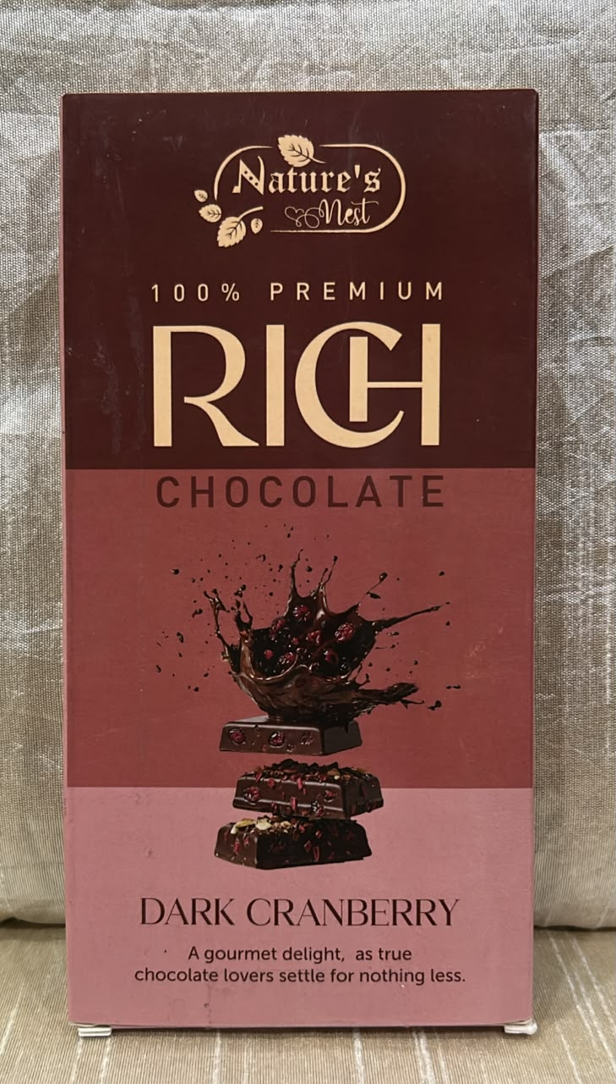
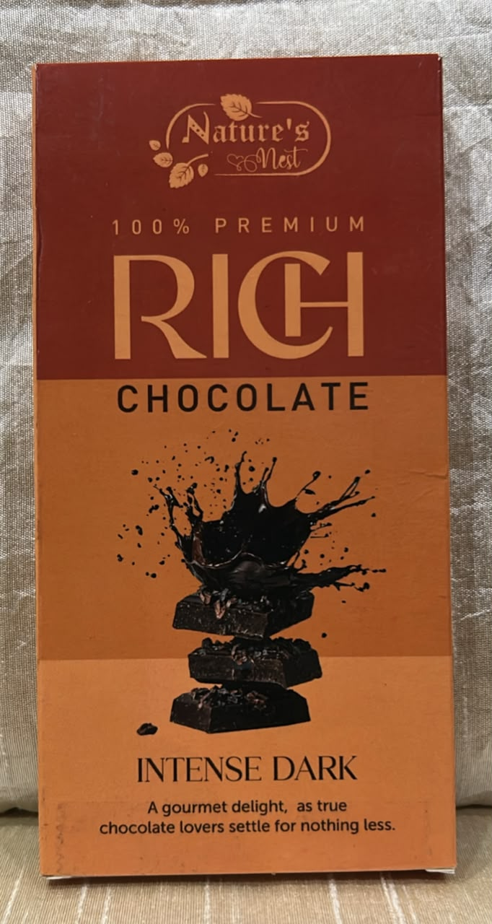
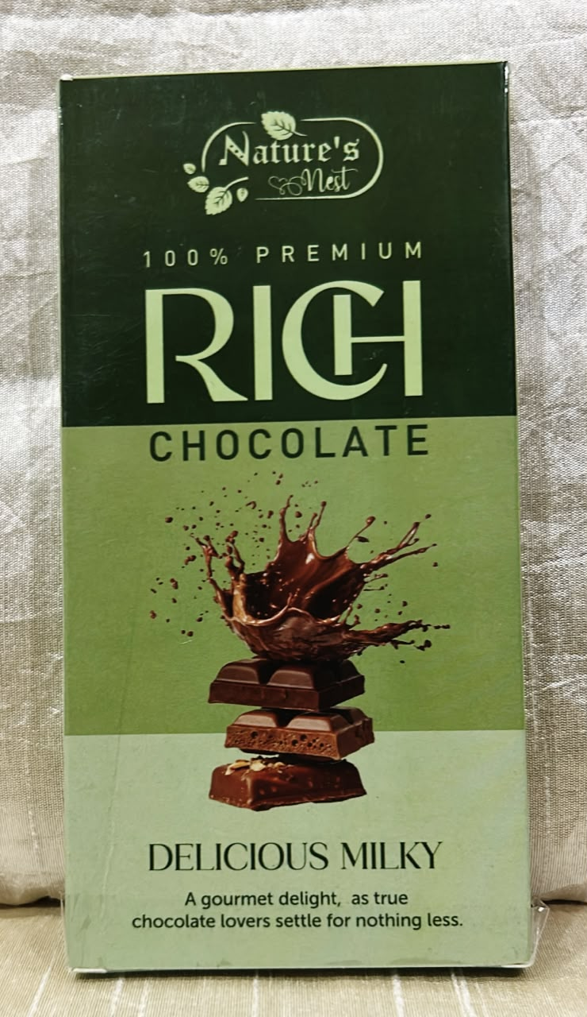
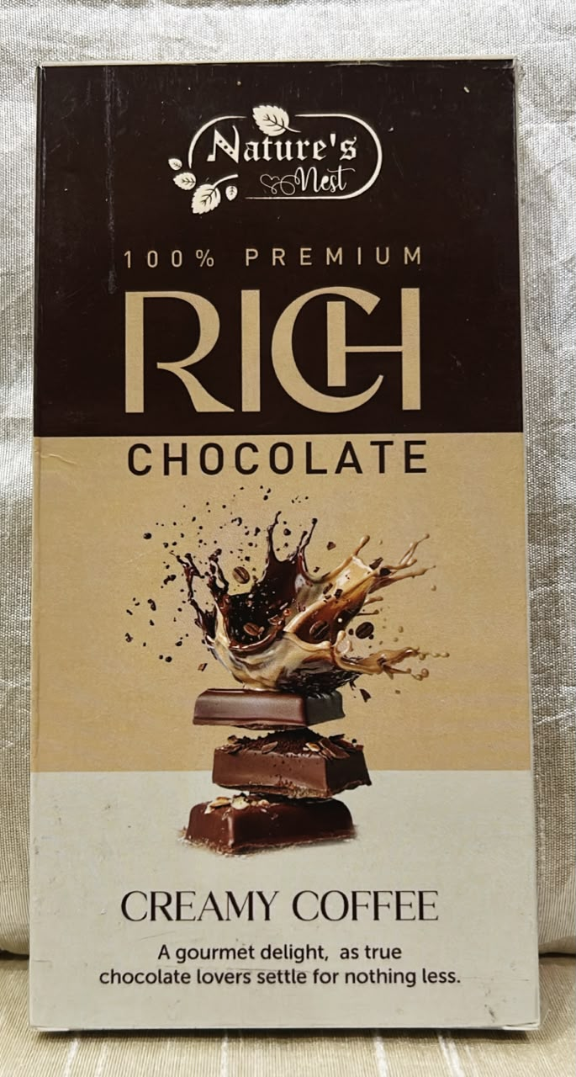
WHAT WE SELL
A bar where the fruit & nut
is in it, not just on it.
PRODUCT
100g rich chocolate bars across 6 flavours, ₹300 per bar. Sample already in hand.
USP
Real fruit & nut you can see and bite into — not just pictured on the wrapper.
02 / 05

Slide 3
THE MARKET WE'RE ENTERING
Who buys, and who we're
taking share from.
WHO BUYS
WHO WE'RE UP AGAINST
Age / stage
Cadbury Fruit & Nut
28–35, young working professional
₹150–180 · light on real fruit & nut
Where they are
Bangalore — office-goers, flea-market regulars
Amul Fruit & Nut
~₹120 · light on real fruit & nut
What they pay today
₹200 for Cadbury / Amul Fruit & Nut
Artisanal gifting bars
Why they'd switch
₹400+ · inconsistent quality
Tastes a free sample, notices real fruit & nut inside
03 / 05

Slide 4
WHERE WE SELL, WHAT WE'VE SOLD
Proof it's moving,
not just planned.
CURRENT REVENUE
CHANNEL
₹40,000
Flea-market pop-ups
Direct sampling, face-to-face conversion
booked, up till 15 Aug 2026
Corporate / B2B catalogue
Bulk gifting — client hampers, festival gifting, welcome kits
Every rupee logged is a rupee a stranger paid before we asked them to.
04 / 05

Slide 5
OUR BIGGEST ACTION
Push the B2B gifting
catalogue live.
This is the one move most likely to unlock corporate hamper orders — client hampers and festival gifting — the two use cases already built out in our wholesale catalogue.
“We sell it, we’ve sold it, here’s the number —
and here’s what moves it next.”
Nature's Nest · Bangalore, India · Cohort 4 · Team 38
05 / 05

