Slide 1
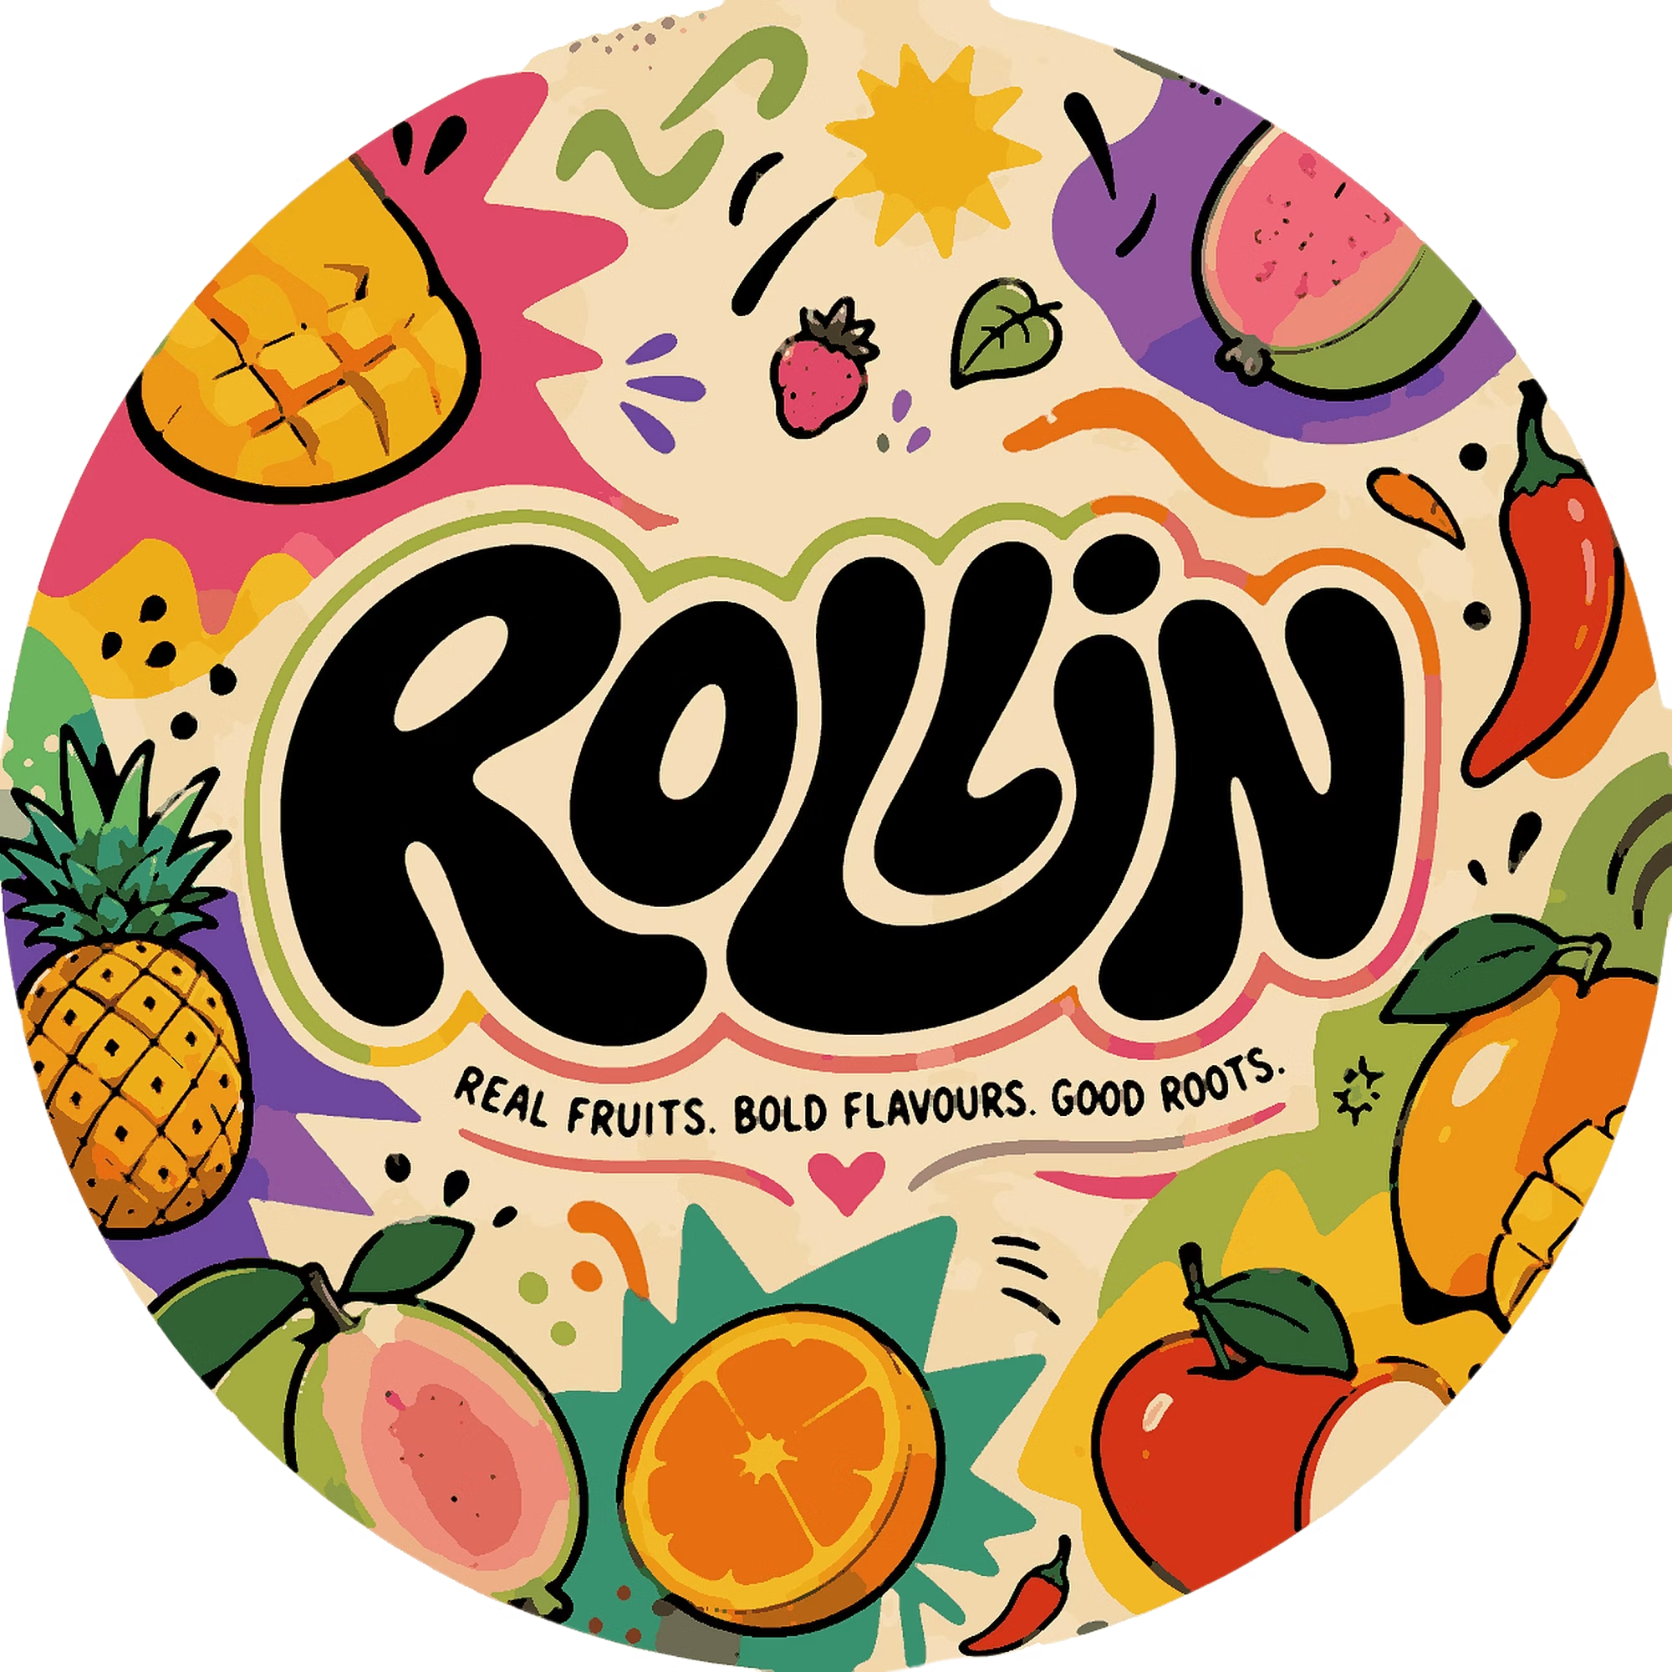
PARTNERSHIP & STOCKIST DECK
FRUIT, BUT
MAKE IT FUN.
Real fruit, rolled into clean, bold-flavoured snacks built for
snacking, gifting and grab-and-go occasions.
REAL FRUITS. BOLD FLAVOURS. GOOD ROOTS.
Made in Bengaluru • Serving India

Slide 2
THE OPPORTUNITY
Fruit is healthy. Snacking on it isn't easy.
TODAY'S SNACK AISLE
WHAT ROLLIN' DELIVERS
Fresh fruit means cutting, peeling and a short window before it spoils.
“Healthy” packaged snacks are often bland, or quietly full of added sugar.
Indulgent snacks taste bold, but bring little real nutrition.
None of it travels well — desks, bags, gym kits or gifting.
80% real fruit pulp — all of the fruit feeling, none of the cutting or peeling.
No artificial sugar, clean ingredient lists, easy to explain on-shelf.
Bold, spiced and tangy flavours — not just “healthy and boring.”
12-month shelf life and individually-wrapped slices built for on-the-go life.
REAL FRUITS. BOLD FLAVOURS. GOOD ROOTS.
02

Slide 3
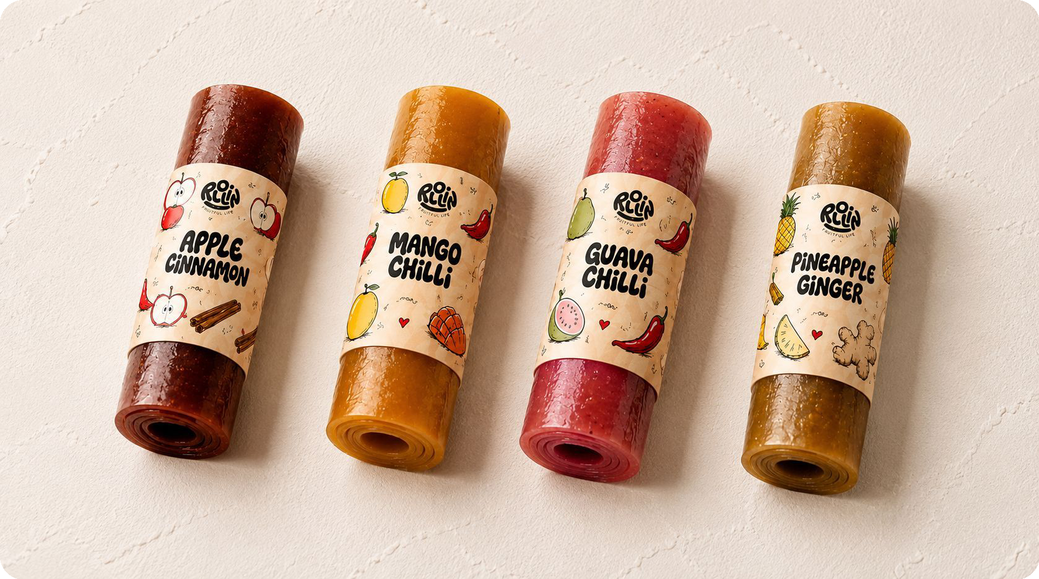
THE PRODUCT
Meet Rollin'.
Rollin' takes real fruit and turns it into clean roll-ups — individually wrapped, portable and designed for snacking, gifting and grab-and-go occasions.
Each pack holds four individually-rolled slices, so a pack is a snack for one, or a taste of four flavours to share.
“All of the fruit feeling. None of the cutting and peeling.”
REAL FRUITS. BOLD FLAVOURS. GOOD ROOTS.
03

Slide 4
PRODUCT AT A GLANCE
Built for real fruit, built for shelf.
80%
0g
4
12
REAL FRUIT PULP
ADDED / ARTIFICIAL SUGAR
SLICES PER PACK (40–48G)
MONTH SHELF LIFE
Pulp-first recipe, nothing fake
Clean, honest ingredients
Portable, shareable, grab-and-go
Stock confidently, gift easily
REAL FRUITS. BOLD FLAVOURS. GOOD ROOTS.
04

Slide 5
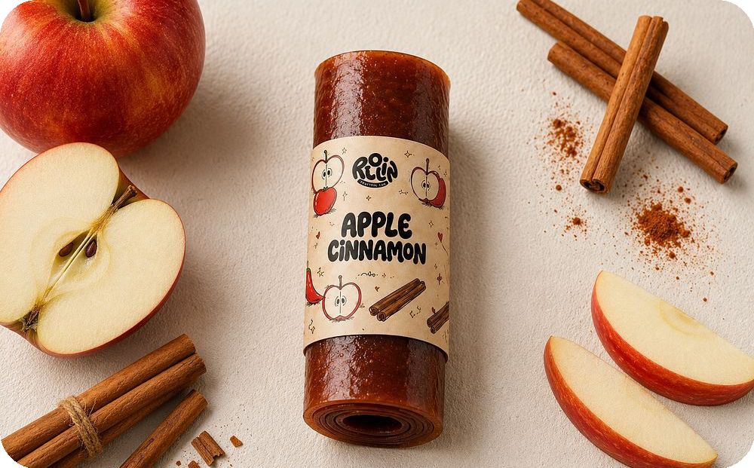
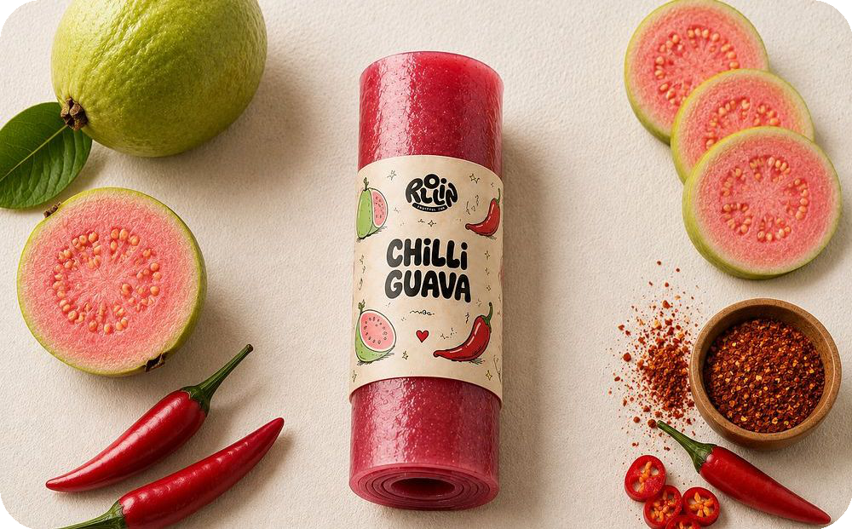
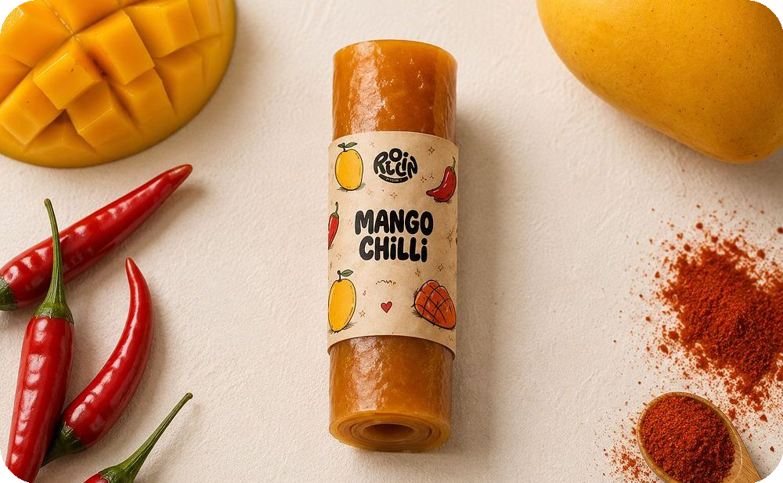
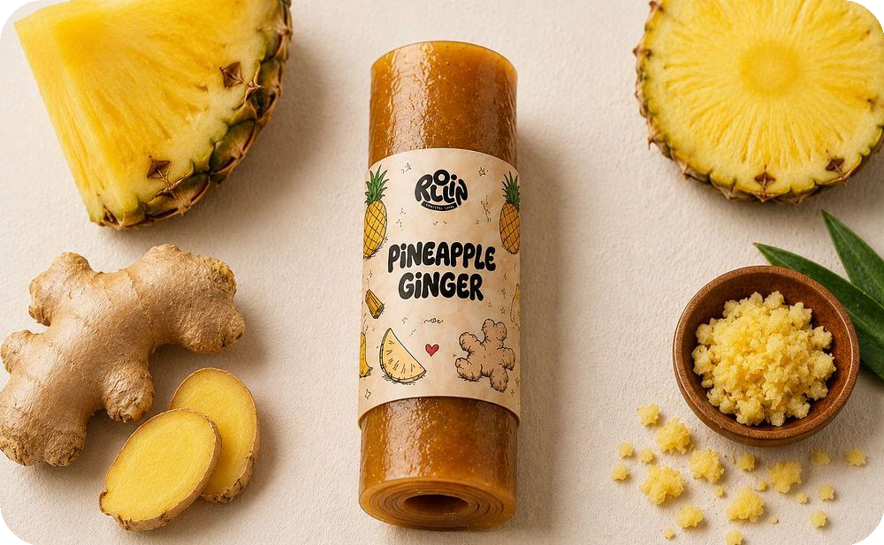
THE RANGE
Four flavours. One Rollin' format.
APPLE CINNAMON
GUAVA CHILLI
Sweet · Warm · Comforting
Bold · Bright · Bitin'
Rich in antioxidants · a traditional warming spice
High in vitamin C · good source of dietary fibre
MANGO CHILLI
PINEAPPLE GINGER
Sweet · Tangy · Nostalgic
Zesty · Bright · Sharp
Rich in vitamin A · may support digestion
Contains gingerols · known for soothing properties
REAL FRUITS. BOLD FLAVOURS. GOOD ROOTS.
05

Slide 6
HOW IT'S USED
Simple enough to need no instructions.
1
2
3
4
OPEN
→
PICK A ROLL
→
SNACK
→
REPEAT
Unwrap the individually-packed roll
Choose your flavour — or mix it up
Chewy, fruit-forward, ready in seconds
Four slices per pack, four flavours to explore
REAL FRUITS. BOLD FLAVOURS. GOOD ROOTS.
06

Slide 7
CHANNELS & OCCASIONS
Flexible for wherever people snack.
RETAIL
VENDING MACHINES
CAFÉS & COFFEE SHOPS
OFFICES
Shelf · checkout · impulse
Grab-and-go stocking
Counter add-on snacking
Pantry · counter · employee gifting
COLLEGES & CAMPUSES
HOTELS & HOSPITALITY
CORPORATE GIFTING
EVENTS
Canteens · student stores
Welcome kits · mini-bar · gifting
Team boxes · snack boxes
Attendee bags · sampling · on-site retail
REAL FRUITS. BOLD FLAVOURS. GOOD ROOTS.
07

Slide 8
WHY IT WORKS
Small snack. Huge flavour.
Designed for people on the go who have no time to cut, core and peel fruit — without compromising on taste.
COMPACT FORMAT
MULTI-FLAVOUR
A neat, individually-packed roll that fits counters, desks, bags and snack boxes.
Four distinct flavour profiles give customers variety and encourage trial across the range.
SHELF-READY
EASY TO UNDERSTAND
A 12-month shelf life makes Rollin' suitable for stocking and gifting formats.
A simple product story built around real fruit, bold flavours and clean ingredients.
REAL FRUITS. BOLD FLAVOURS. GOOD ROOTS.
08

Slide 9
PARTNER WITH US
Competitive pricing, flexible terms.
PRODUCT SKU | MRP (PER PACK) | B2B PRICE (PER PACK)
Mango Chilli | ₹249 | ₹190
Guava Chilli | ₹229 | ₹190
Pineapple Ginger | ₹229 | ₹190
Apple Cinnamon | ₹249 | ₹190
Assorted Pack | ₹249 | ₹190
TERMS
Case Pack
4 units
MOQ
150 packs / 600 units
Lead Time
4 days (Bengaluru) · 8 days (outside Bengaluru)
DTC bundle: Assorted Box of 10 packs available for direct-to-consumer and gifting orders.
REAL FRUITS. BOLD FLAVOURS. GOOD ROOTS.
09

Slide 10
LET'S GET
Rollin'.
Interested in stocking Rollin', bulk orders or partnerships? Let's talk.
EMAIL
hello@getrollin.in
INSTAGRAM
@hellorollin
WEBSITE
rollin-fruit-leather.lovable.app
Made in Bengaluru · Serving India

