Slide 1
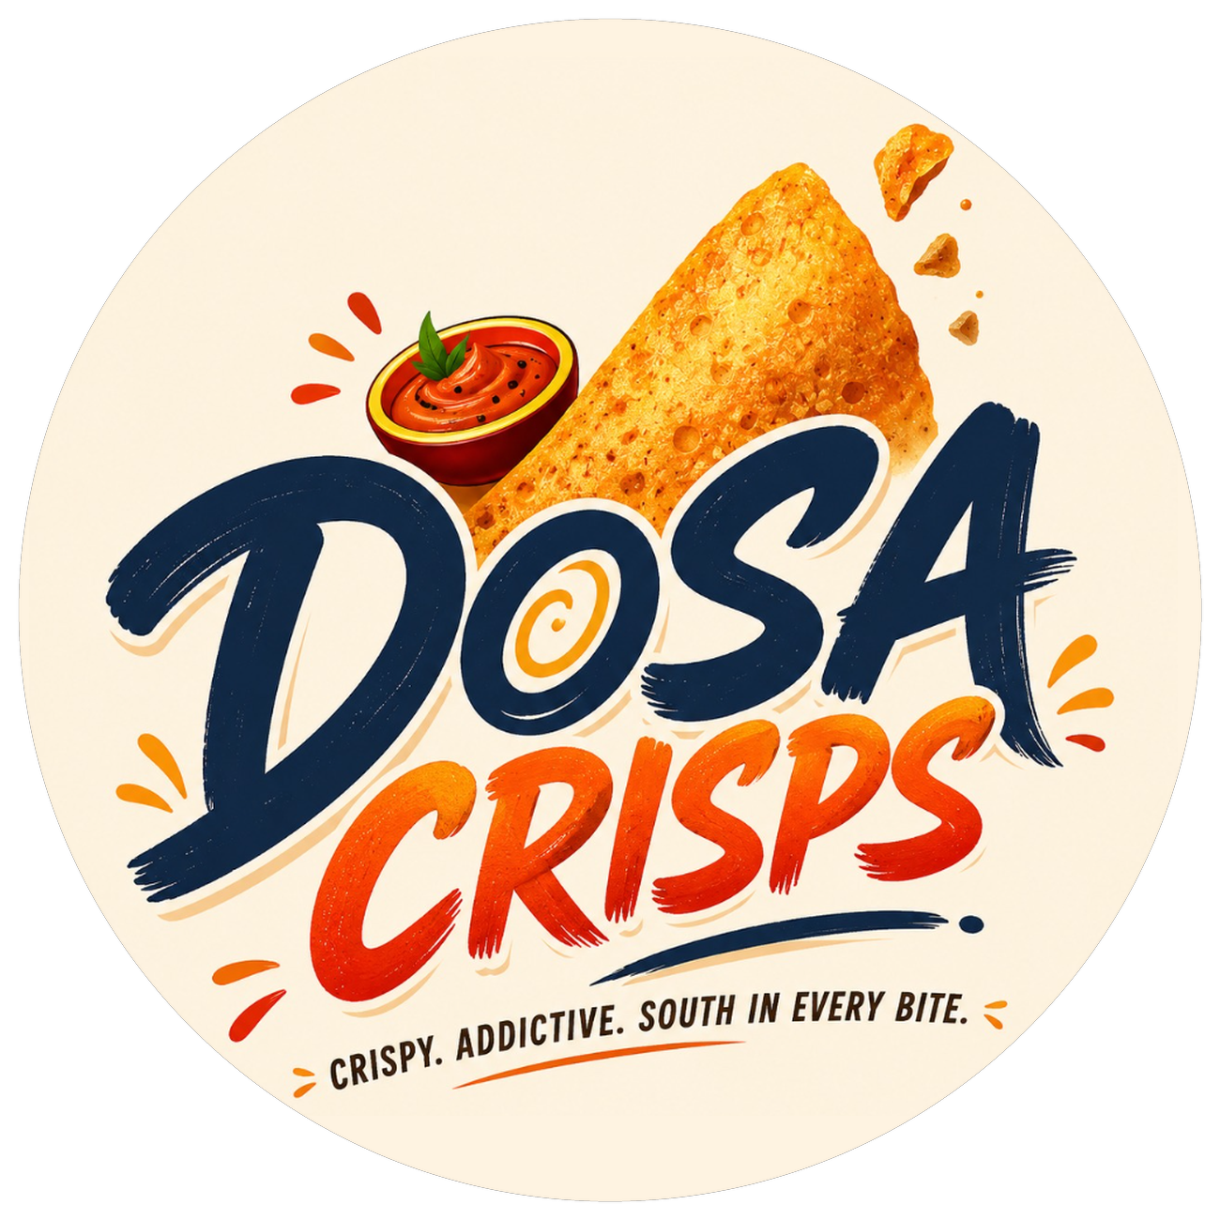
SESSION 1 — SALES UPDATE
Dosa Crisps
Roasted, flavoured paper dosas — our team's Session 1 sales update.
TEAM
Kanay Narang · Divya Bharti · Anmay Surie · Vyom Bhatnagar
COHORT
PGPSLE27 · 20 August 2026

Slide 2
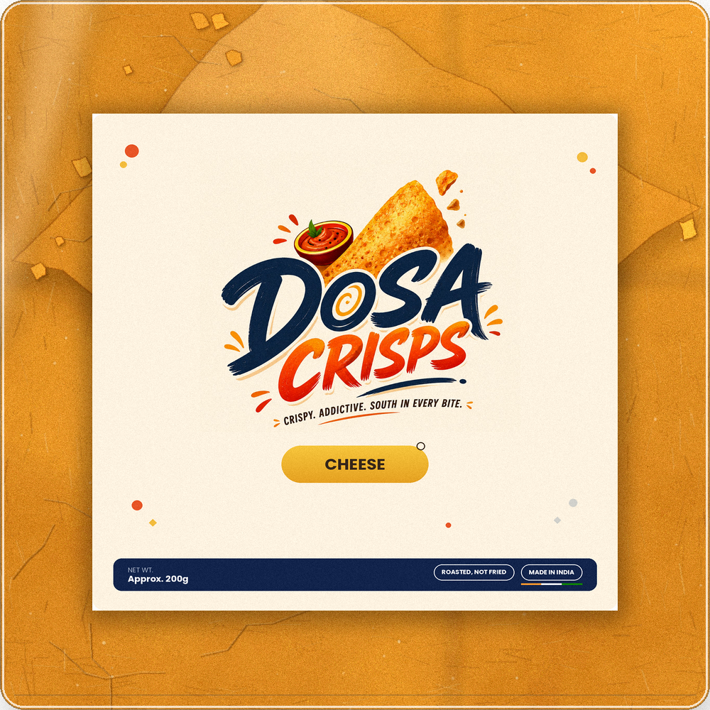
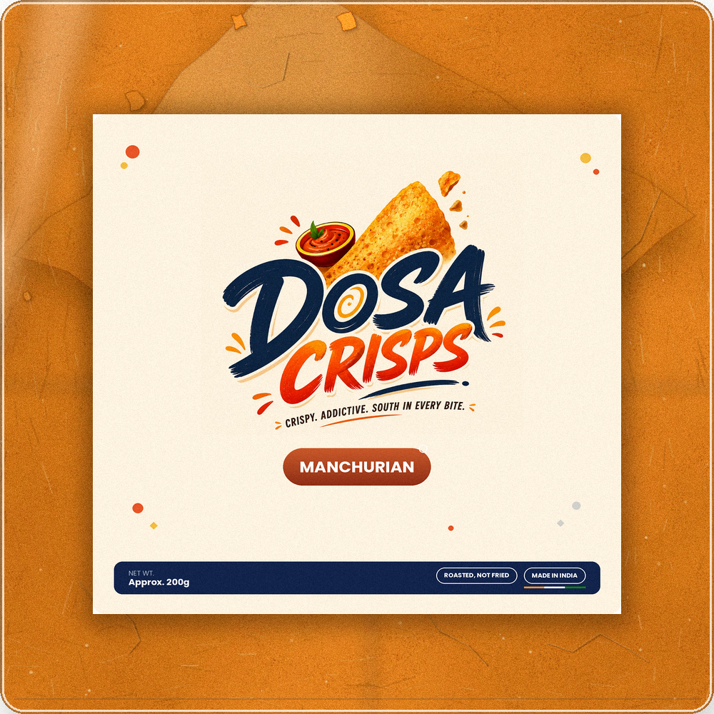
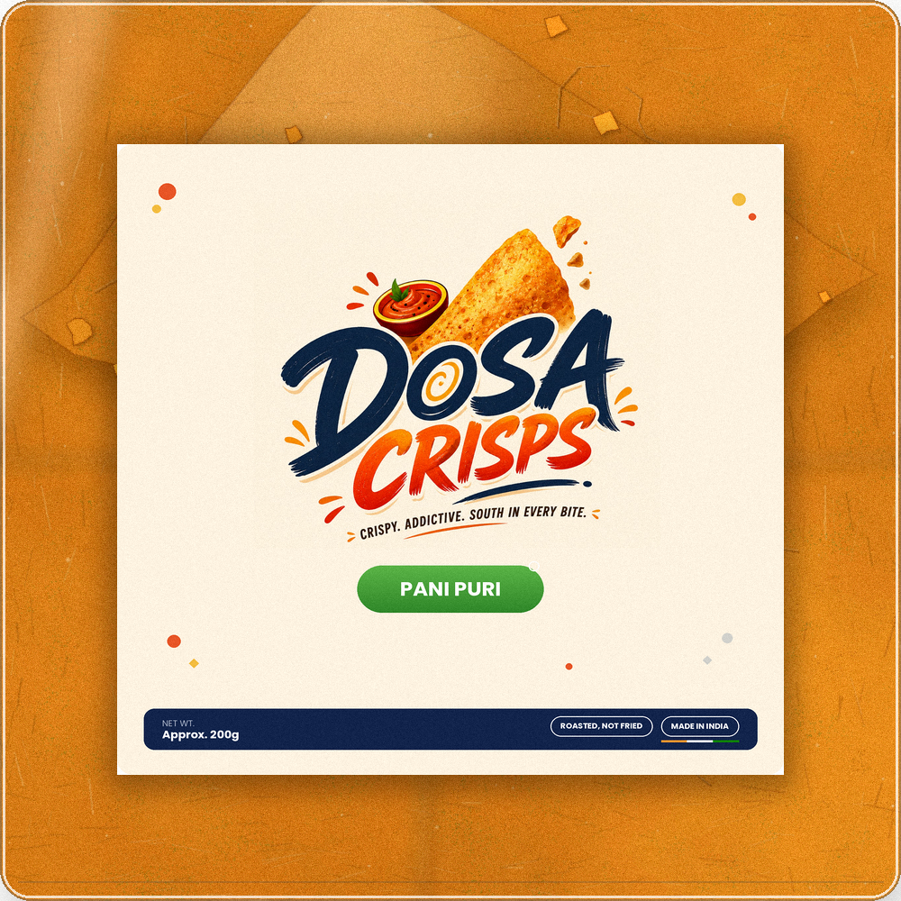
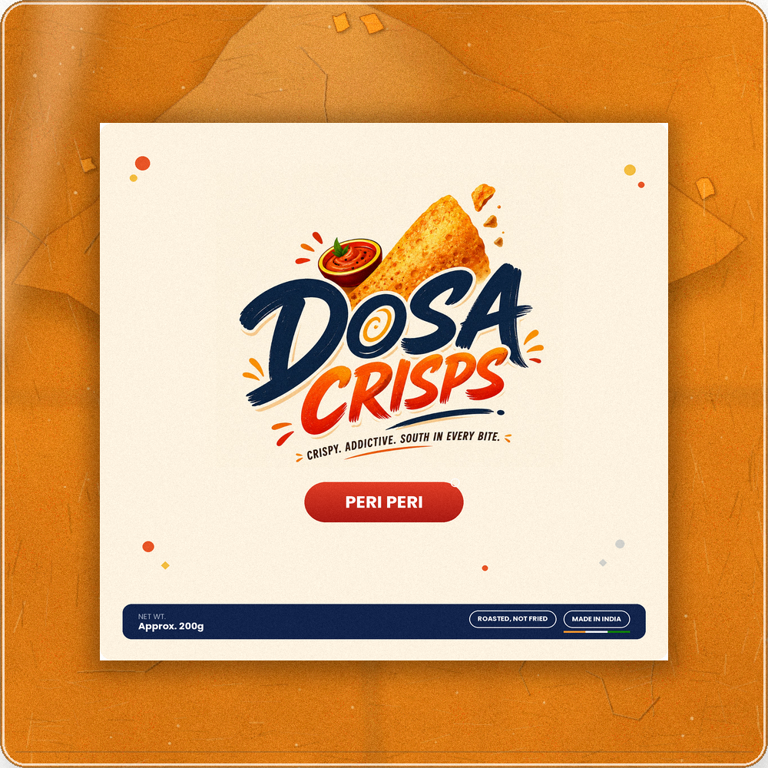
Who we sell to, and what we sell them
PRODUCT
Dosa Crisps — roasted (not fried), flavoured paper dosa snack packs. ₹250 for a 200g pack.
CUSTOMER
College students and working professionals in Bangalore who miss home-style regional snacks — stuck today between fried namkeen and bland “healthy” options.
FLAVOUR LINEUP
Cheese · Manchurian · Pani Puri · Peri Peri · You Pick We Roast It

Slide 3
What makes us different
THE USP
The only ready-to-eat, packaged paper dosas bringing dosa’s crunch beyond the traditional snack aisle — roasted, not fried.
RIGHT NOW WE'RE UP AGAINST
1
Traditional tea-time snack brands
Limited flavours, positioned as a tea-time snack, not a craveable anytime one.
2
Fried chips & namkeen
Highly flavourful, but a less healthy way to snack.
3
Healthy-snack players
Better nutrition, but competes on premium price, not regional flavour.

Slide 4
Where we sell, what we've done, what's next
CHANNEL
Main channel is D2C — via flea markets, college campuses, and office workspaces, as well as through our website and Instagram — plus B2B outreach now underway across Bangalore cafes, coworking spaces, and corporate gifting.
UNITS SOLD
REVENUE SO FAR
BIGGEST ACTION TO INCREASE SALES
248
₹62,000
Convert our Bangalore B2B prospect list into signed stockists.

