Slide 1
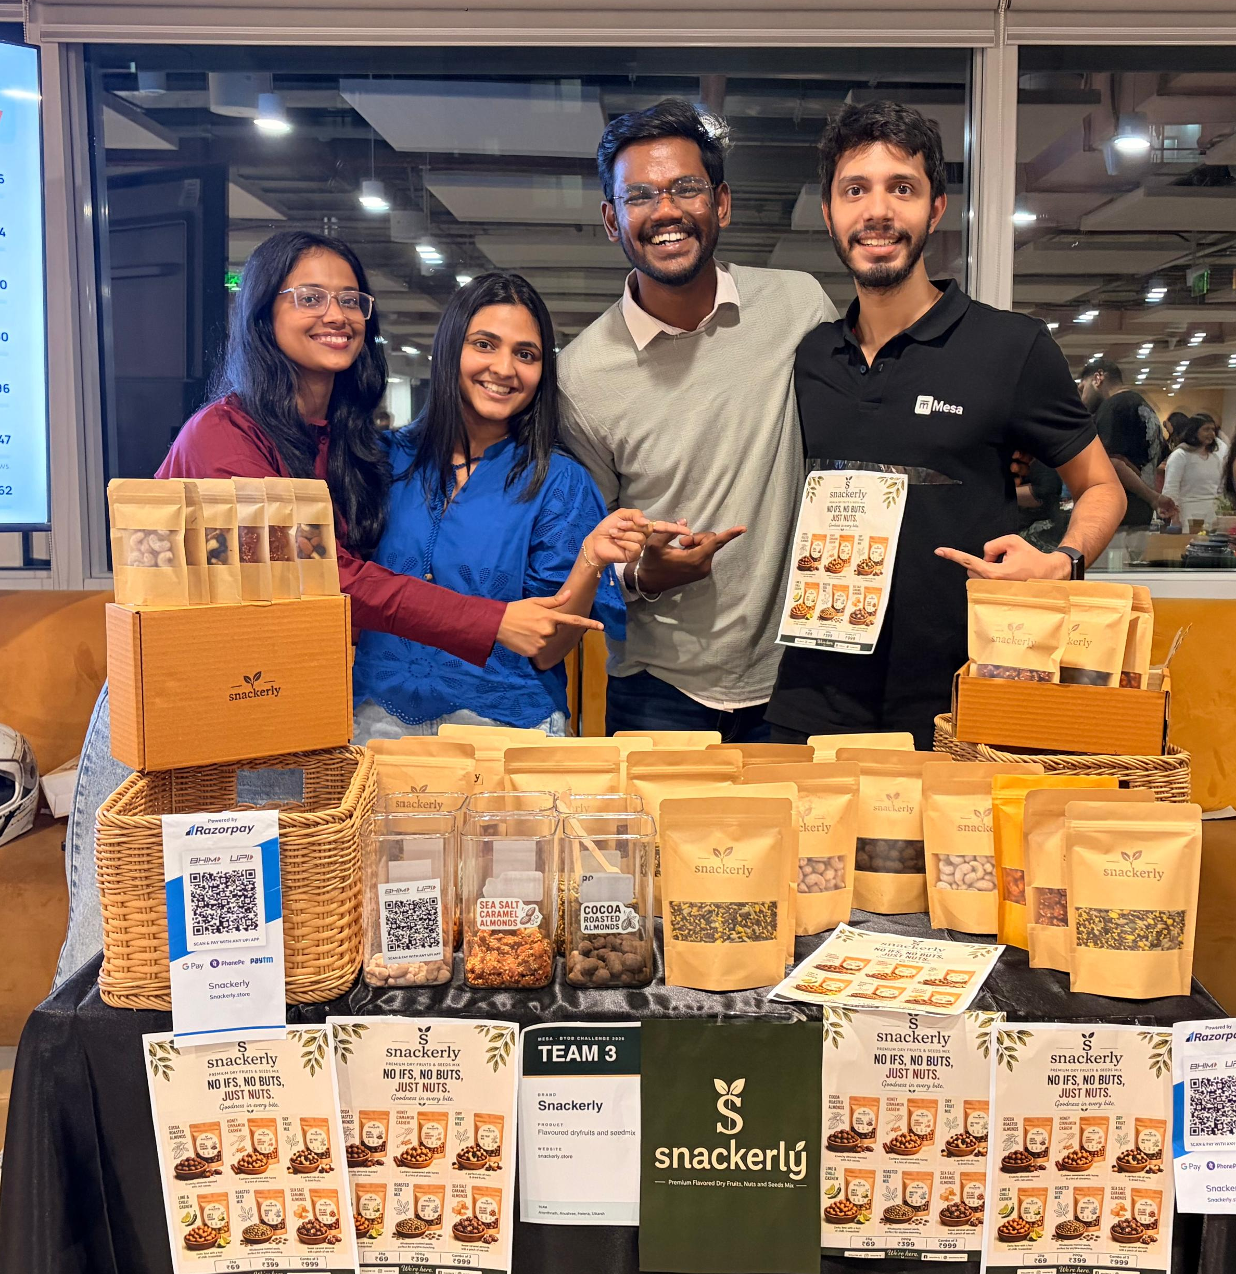
*
snackerly
Roasted nuts, seeds
and dry fruit,
portioned for a desk.
Founder pitch — Session 1, BYOB Sales Update
snackerly.store
Notes:
Cover. Tall portrait frame on the right for your hero shot.

Slide 2
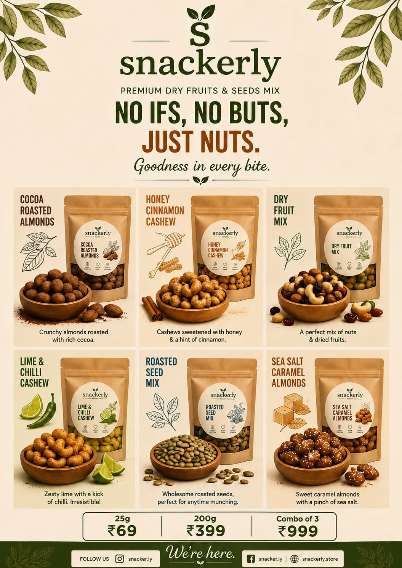
*
snackerly
02 / 08
what we sell
Roasted nuts, seeds and dry fruit — in portions that suit a working day.
01
Six roasts
200g pouches at ₹399 and sealed 25g sachets at ₹69. Sweet, spicy, everyday.
02
The Starter Set
Any three pouches for ₹999, against ₹1,197 bought singly. The low-friction way in — and it sets the repeat order.
03
Supplied by the carton
Sealed 25g portions for offices, gifting and events. No minimum on standard flavours, four working days, reorders on WhatsApp.
Notes:
Three product lines, with a portrait pack shot alongside.

Slide 3
*
snackerly
03 / 08
six roasts
Sweet, spicy, everyday — one range, three reasons to reach for it.
SWEET
SWEET
SWEET
Cocoa Roasted Almonds
Sea Salt Caramel Almonds
Honey Cinnamon Cashew
PACK
PHOTO
PACK
PHOTO
PACK
PHOTO
Dark cocoa over dry-roasted almonds.
Caramel, cut with salt. Not sticky.
Honey and cinnamon on whole cashews.
SPICY
EVERYDAY
EVERYDAY
Lime & Chilli Cashew
Dry Fruit Mix
Roasted Seed Mix
PACK
PHOTO
PACK
PHOTO
PACK
PHOTO
Sharp lime, real chilli heat.
Nuts and fruit, nothing coated.
Seeds only. The desk default.
Notes:
Six flavour cards — drop each pouch photo into the portrait frame on its card.

Slide 4
*
snackerly
04 / 08
our usp
“Roasted, never fried. Short lists, nothing that needs explaining.”
Roasted, never fried
Portioned, not poured
Short ingredient lists
Dry hot air, small batches, no oil bath.
25g sealed — one portion, one break, no decanting.
A nut, a seed, a fruit, and the one or two things that flavour it.
Hand-sorted kernels
Six roasts, three moods
₹69 to try it
Graded by hand; broken and undersized pieces set aside.
Sweet, spicy, everyday — a range dry fruit rarely gets.
A single sachet. Sealed, one serving, no commitment.
Notes:
Six proof points, one per flavour accent colour.

Slide 5
*
snackerly
05 / 08
who we're for
COMPETITION
25–40
Happilo, Farmley
Bigger, mass-market, built for the aisle.
DESK-BOUND, HUNGRY AT 4PM
People who want something real between meals rather than fried crisps — then buy it again for the office, and again as a gift.
The local dry fruit shop
Loose, unbranded, no portion, no seal.
We are smaller, sharper on flavour, and we sell a portion — not a kilo.
CHANNELS
D2C retail
Flea markets
The street
B2B
snackerly.store — pouches, sachets, Starter Set, delivered across India.
Where people taste first and buy on the spot.
Direct, on-ground selling — the cheapest customer we get.
Offices by the carton, wedding planners, gifting agencies.
Notes:
ICP, competition and the four channels.

Slide 6
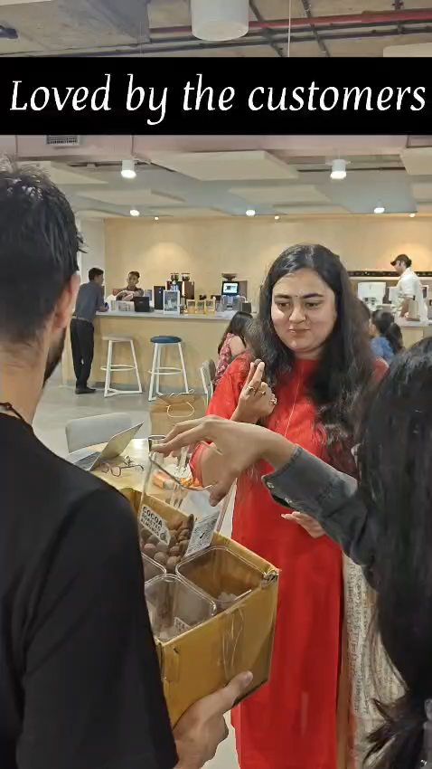
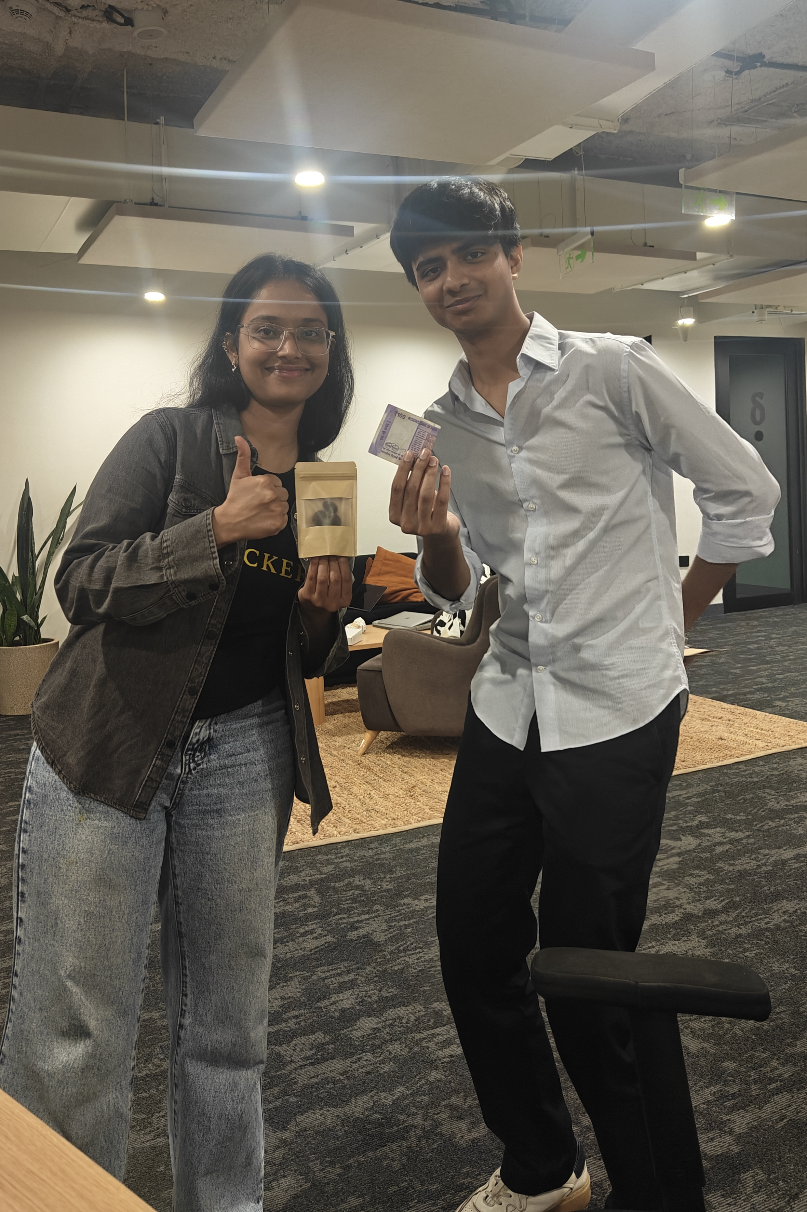
*
snackerly
06 / 08
what we've sold so far
₹1.19L
500+
Revenue generated
Units sold
06
02
Roasts live
Flea markets done & booked
In talks with wedding planners and gifting agencies. More fleas already lined up.
Notes:
Numbers on the left, two portrait on-ground photos on the right.

Slide 7
*
snackerly
07 / 08
biggest action to increase sales
1
GO ON GROUND
More fleas, more streets. One done, one finalised, more being booked — it is where people taste first and buy on the spot, and where every sale is a face we can sell to again.
2
GO BY THE CARTON
Turn tasting into repeat volume: offices, wedding planners and gifting agencies buying sealed 25g portions in bulk, reordering on WhatsApp every four days.
Notes:
Two plays: on-ground volume, then bulk repeat via offices and gifting.

Slide 8
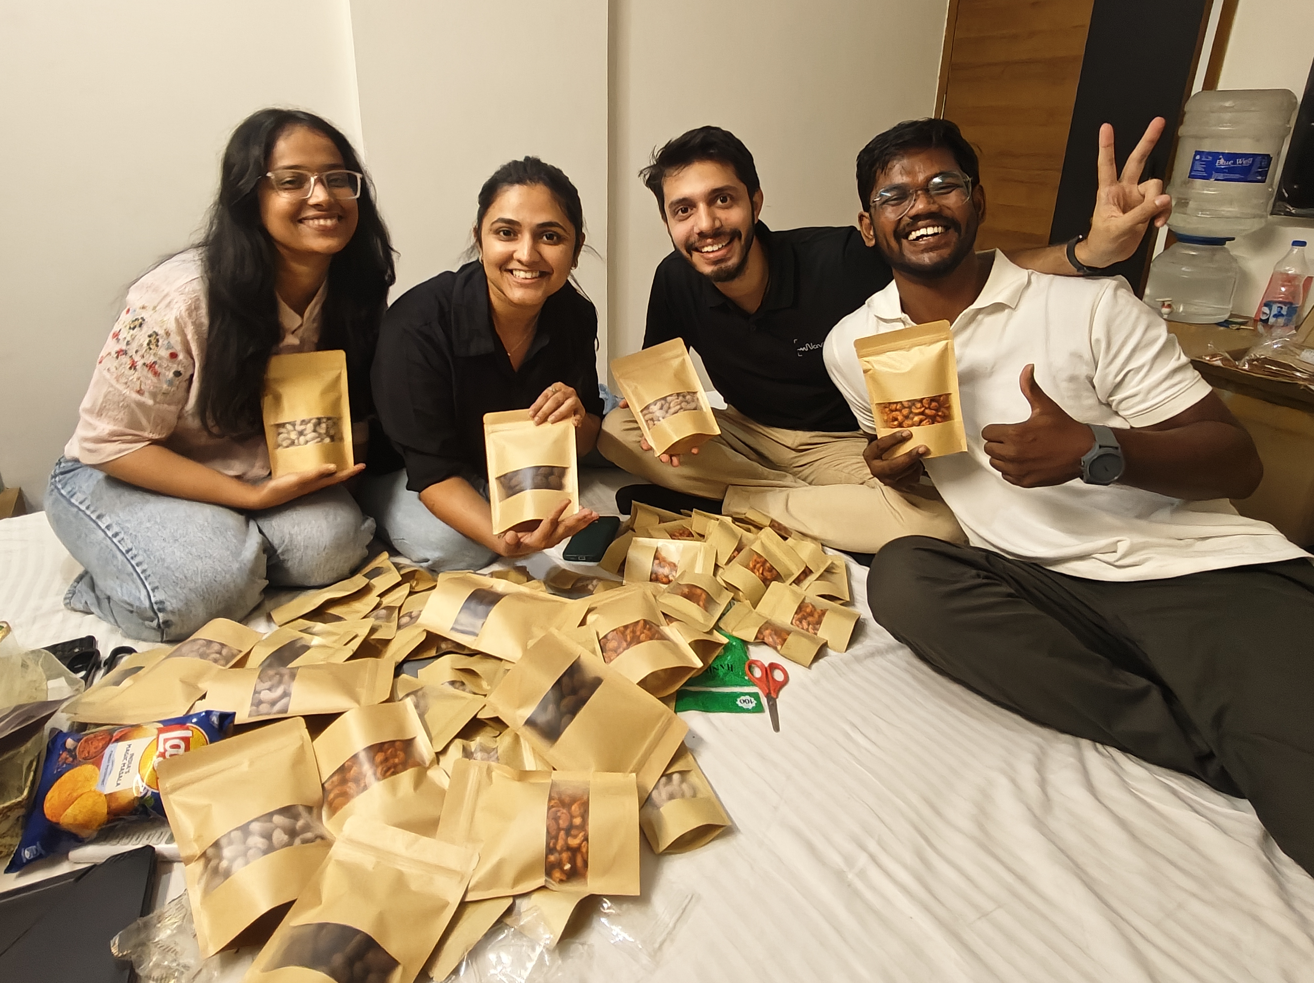
*
snackerly
No Ifs, No Buts,
Just Nuts!
snackerly.store
hello@snackerly.store · +91 93191 77010 · WhatsApp +91 99897 45016
Notes:
Closing slide with contact details.

