Slide 1


XOCO
cocoa, sent with love
BYOB SALES UPDATE
hasmitha · anantha · vasudeva · sushmitha

Slide 2
THE WHOLE UPDATE, IN ONE LINE
We sell hot cocoa sachets and gift hampers to people buying gifts, and to offices. what makes us different is it is a gift, not a drink. we are up against cadbury, country bean and generic hampers, selling on ground and at fleas, and we have done ₹1,21,885 so far. our biggest action is rakhi gift hampers.

Slide 3
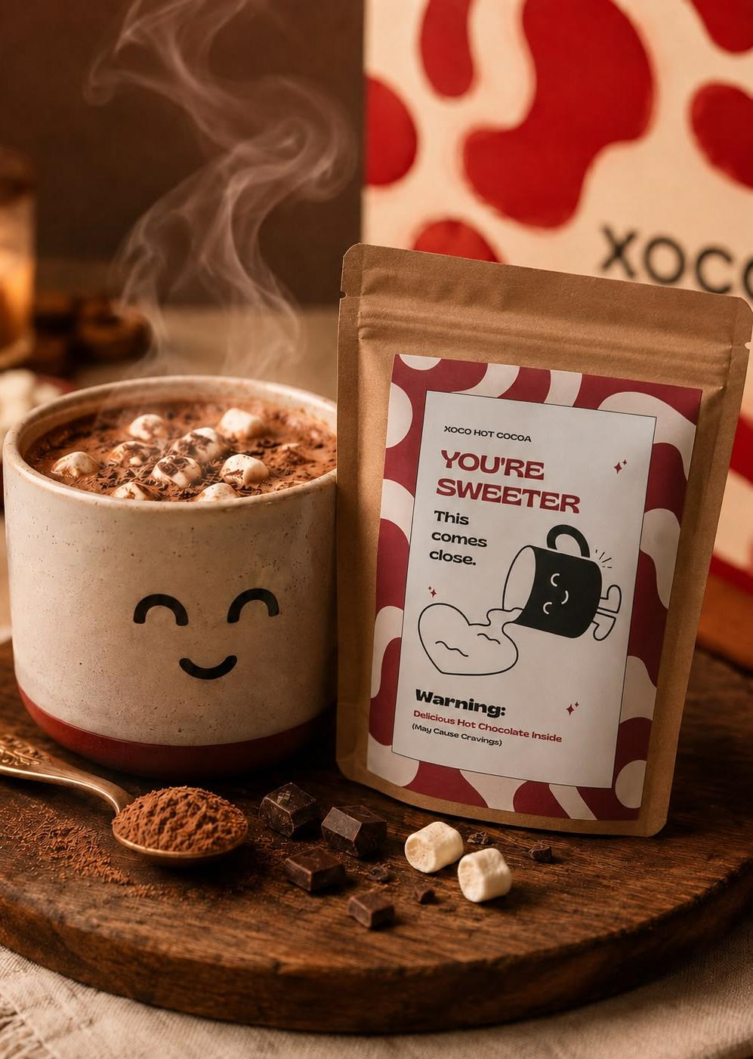
01
PRODUCT
Hot cocoa, sold as a gift
Real cocoa in a sachet. three ingredients.
it melts into hot milk in about sixty seconds.
₹149
one sachet
₹349
a pack of three
Bought by people giving gifts, and by offices

Slide 4

02
WHAT MAKES US DIFFERENT
Small enough to try, warm enough
that they mention it later
01 For everyone who skips tea and coffee
every pantry stocks two drinks. we are the third.
02 It arrives as a gift
a line printed on every pack. it gets opened, not just drunk.
03 Nothing hiding in it
cocoa, milk, sugar. that is the whole label.

Slide 5
03
COMPETITION
Who we are up against
Cadbury,
Bournvita
• cheaper a cup.
• nobody gifts it.
Country bean,
Christopher cocoa
• premium, but only online.
• never where we are standing.
Generic gift
hampers
• bought for the occasion.
• forgotten by the evening.

Slide 6
04
CHANNEL
Where the sales come from
The website
packs and hampers, already built,
shipped across india
MOSTLY THIS
On ground, and at fleas
Office pantries
one deal closed,
the pitch is working.
we hand it over ourselves. people taste it,
then they buy it.

Slide 7

05
WHERE WE ARE
₹3,02,934
booked so far, across 1500+ units
₹1,92,762
profit
63%
margin
₹234
average a unit
1
office deal closed

