Slide 1
NATURALLY SWEET · HONESTLY BETTER
HONEST SWEET
Brand & Business Update
August 2026
01

Slide 2
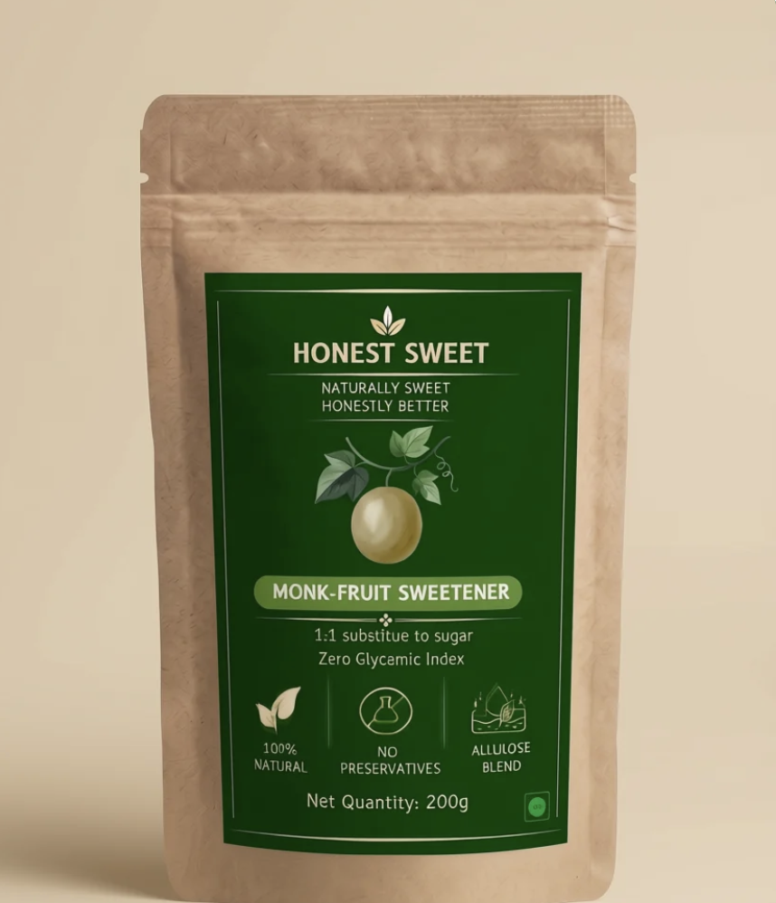



OUR STORY
Sugar, without the small print
Honest Sweet makes natural, 1:1 sugar substitutes sourced from monk-fruit, palm and coconut — no hidden syrups, no artificial fillers, no confusing labels. Just honest ingredients that behave exactly like sugar in your kitchen.
100% Natural
No Preservatives
1:1 Substitute
No artificial additives
Clean-label, always
Cooks & bakes like sugar
HONEST SWEET
02

Slide 3
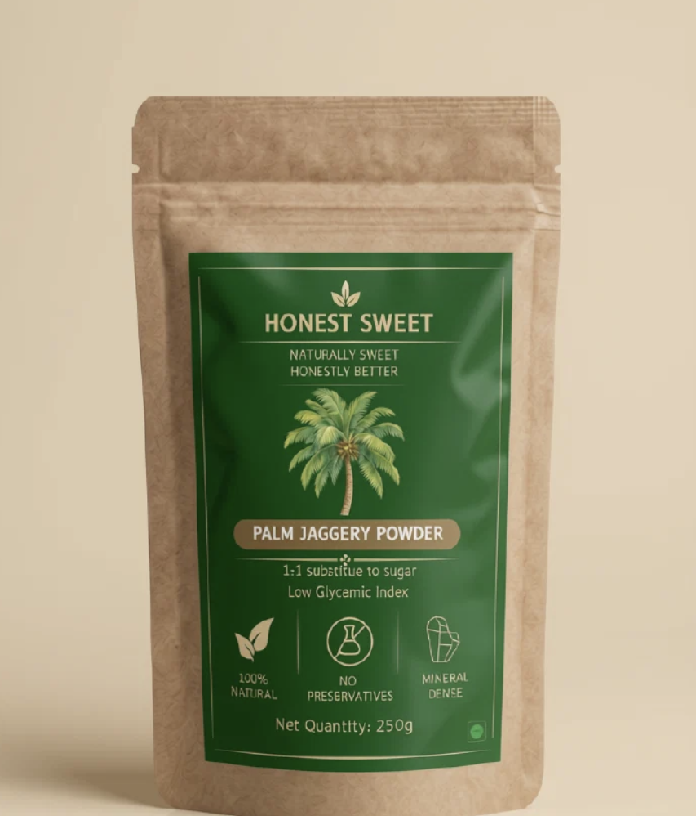
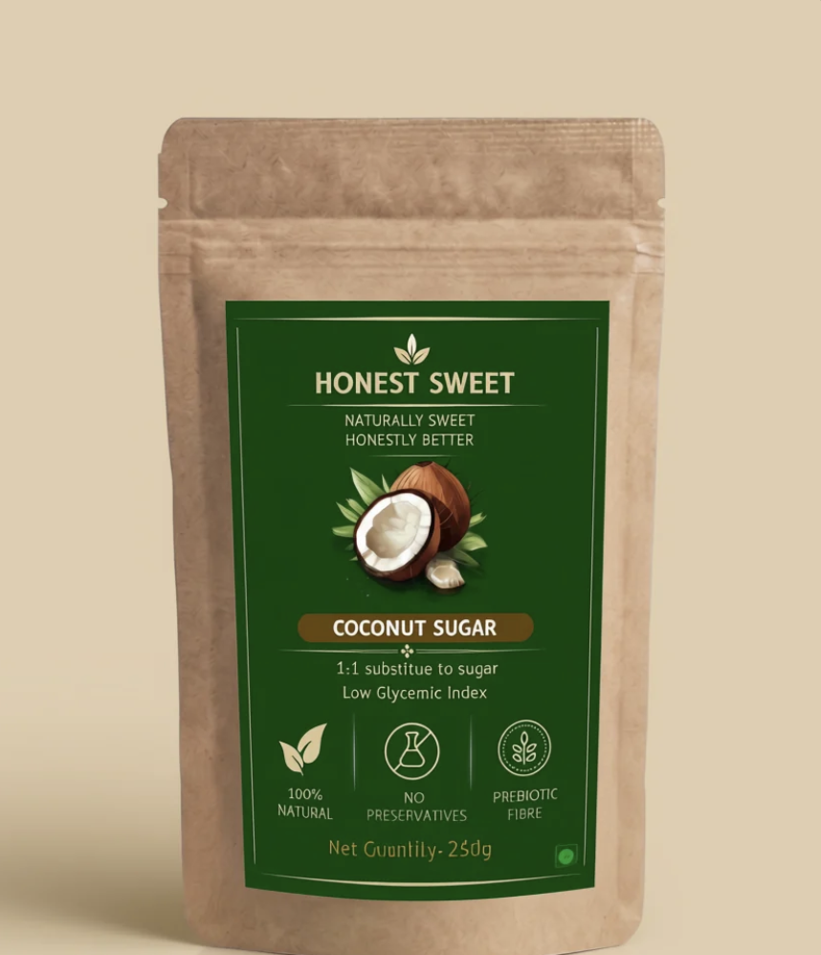
THE RANGE
Three ways to go sugar-honest
₹449
₹299
₹299
Monk-Fruit Sweetener
Palm Jaggery Powder
Coconut Sugar
Net Qty 200g · Zero Glycemic Index
Net Qty 250g · Low Glycemic Index
Net Qty 250g · Low Glycemic Index
Allulose Blend
Mineral Dense
Prebiotic Fibre
HONEST SWEET
03

Slide 4






WHY IT WORKS
Built for the honest label shopper
1:1 Substitute
100% Natural
No Preservatives
Swap it in at the same ratio as sugar — no recipe math.
Sourced from monk-fruit, palm sap and coconut blossom.
Clean-label formulations, every batch.
Low / Zero GI
Prebiotic Fibre
Mineral Dense
Kinder to blood sugar across the whole range.
Coconut Sugar retains natural gut-friendly fibre.
Palm Jaggery keeps its natural iron & potassium.
HONEST SWEET
04

Slide 5
TRACTION
Momentum booked so far
₹70K
₹19K
Total revenue booked
B2B revenue
across D2C + B2B
~27% of total booked
Early traction is split across direct-to-consumer sales and B2B accounts — a strong signal for repeatable wholesale demand as we scale.
HONEST SWEET
05

Slide 6

UP NEXT
Flea market — booked, both days
This weekend · Saturday & Sunday
Live sampling
Full product range on shelf
New face-to-face acquisition
HONEST SWEET
06

Slide 7
HONEST SWEET
Naturally Sweet · Honestly Better
07

