Slide 1


Popsmith & Co.
The Key to Your Cravings

Slide 2

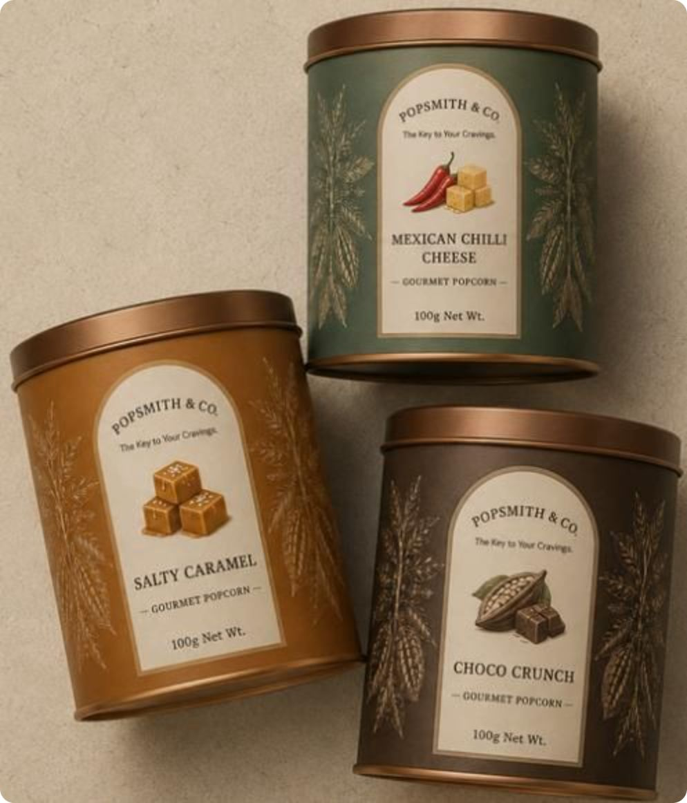
Product Line
Classic Collection
Premium Collection
₹149 / 70g box
₹199 / 100g tin
Say Cheese!
Peri Peri!
Tandoori Twist
Tomat-Oh!
Salty Caramel
Mexican Chilli Cheese
Choco Crunch
Gourmet Gift Hamper
Dynamic pricing
3 premium tins in a branded gift box - our flagship gifting format

Slide 3



Who We Sell To
Corporate Gifting Agencies & SME HR Teams
Individual Gifters
Flea Market Walk-ins
Weddings, birthdays, and employee appreciation premium tin format makes every occasion memorable.
Impulse and sampling-led purchases converts browsers into loyalists through taste.
Bulk, festive-driven order especially around Ganesh Chaturthi and Diwali.

Slide 4
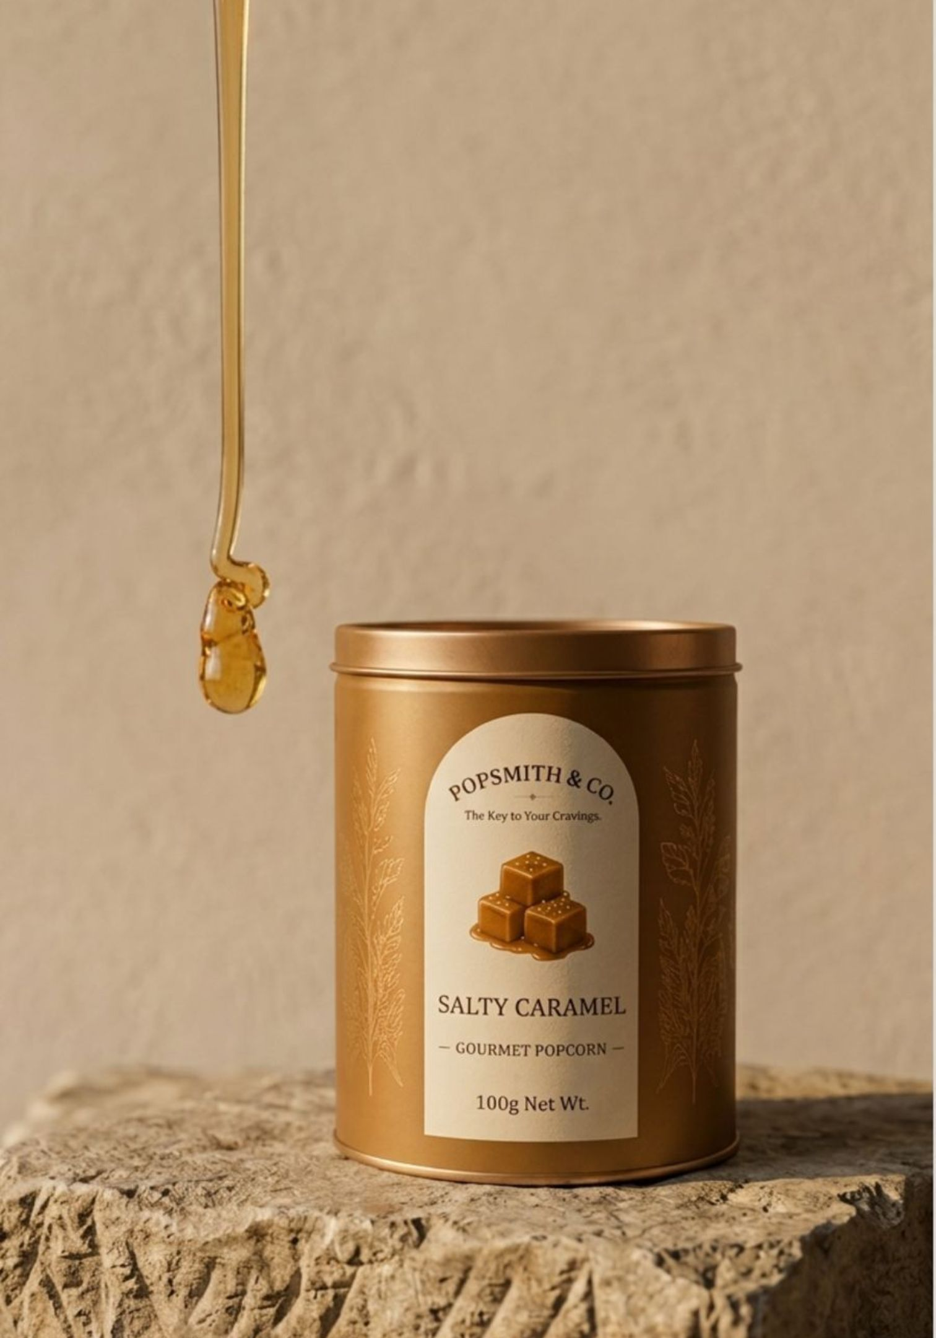

What Sets Us Apart
Built to Be Given
The Full Sensory Experience
Our premium tin was designed specifically for gifting - not a snack pouch with a bow slapped on it. The format signals intent, occasion, and care from the first glance.
Elevated flavour + slow-cooked texture + a tin format that earns its place on any gift table. Every element is considered from the crunch to the keepsake container.
We don't sell popcorn. We sell a gifting experience that happens to taste extraordinary.

Slide 5


Competition & Channels
Competitive Landscape
4700BC
Popcorn & Company
The Theatre Project
National. Loud premium branding. The benchmark everyone knows.
Delhi-based. Strong corporate gifting focus - our most direct competitor.
Cinema-style positioning. Regional, not gifting-first.
Our Channels
B2B Direct & Agency Partnerships
D2C — Website & Instagram
Offline Flea & Weekend Markets
Primary growth lever - gifting agencies and bulk corporate accounts
Direct-to-consumer via owned digital channels
Sampling, discovery, and impulse conversion

Slide 6
Revenue & Next Steps
₹98,359
3–5
Sep 30
Revenue Booked
Agency Targets
Diwali
Total sales confirmed to date
RidgeGap, GiveAwaySmiles,UrbanGifts
Hard deadline for bulk corporate closures
Close 3–5 gifting agency partnerships before Sep 30, Mesa flea, Sunday Soul Sante, weekend hackathons and private movie screenings.

Slide 7
Sources
Popsmith & Co. Catalogue pdf.pdf

