Slide 1
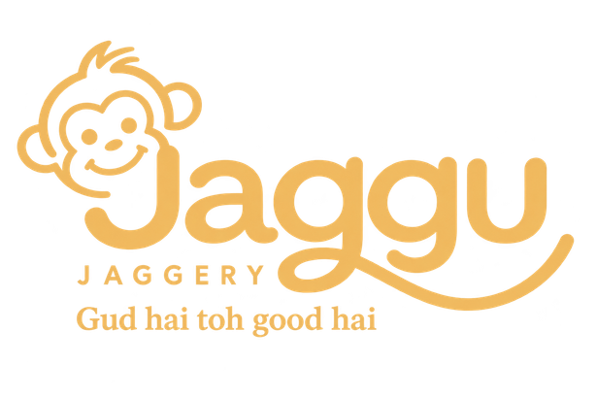
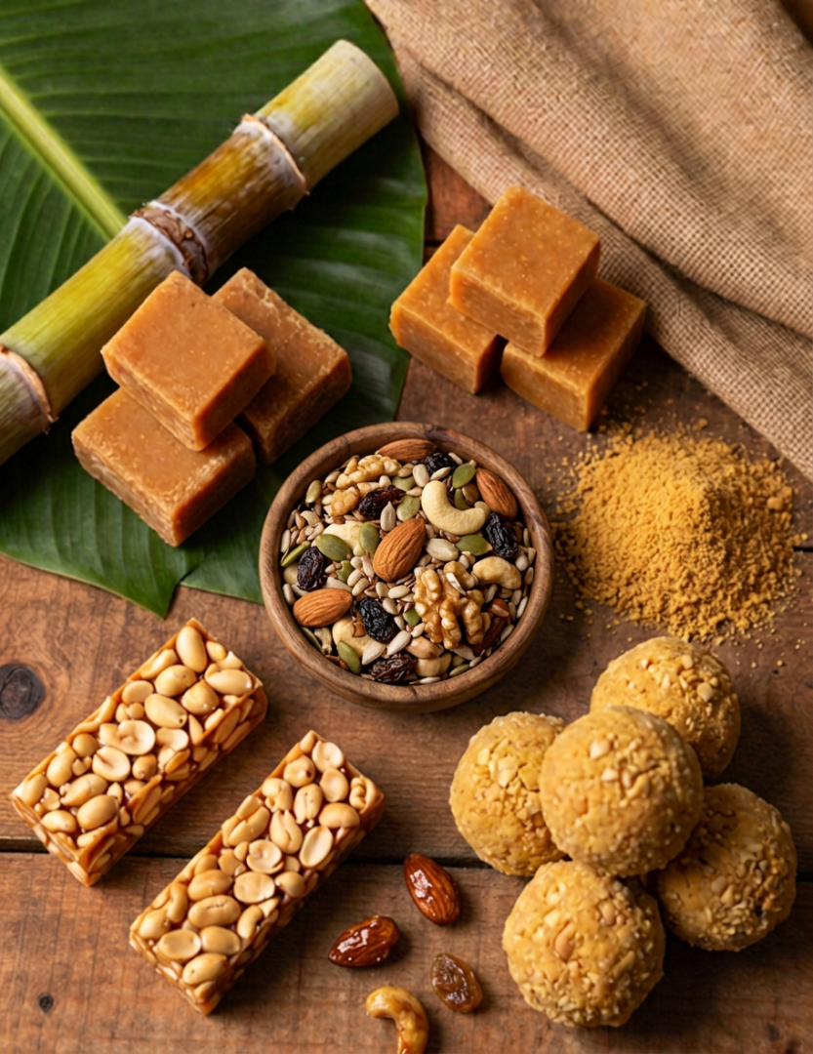

We sell good gud.
"Gud hai toh good hai."
Sulphur-free sugarcane jaggery, turned into four everyday snacks and the honesty to publish our own purity test on the website. Here's where we stand, twelve days in.
₹93,311 BOOKED
117 PRE-ORDERS
JAGGUJAGGERY.IN
Notes:
1

Slide 2
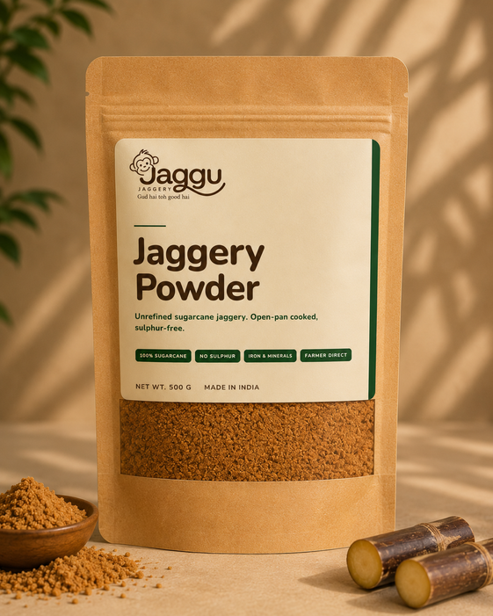
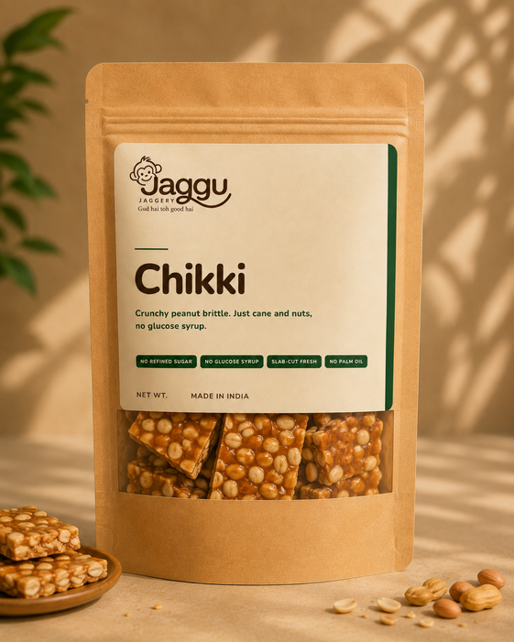
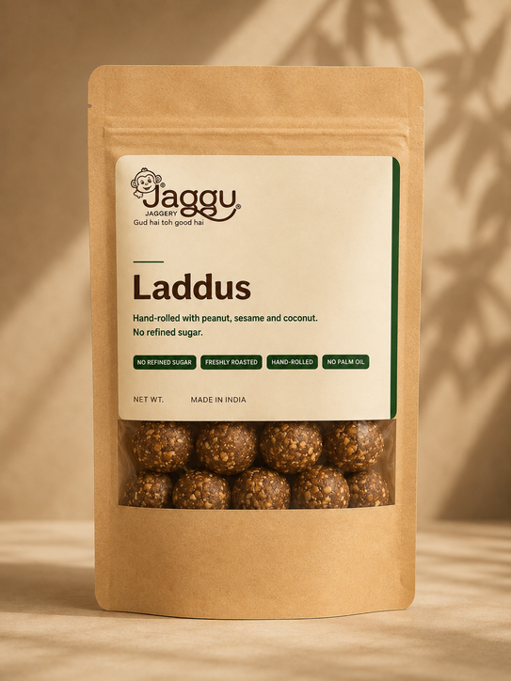
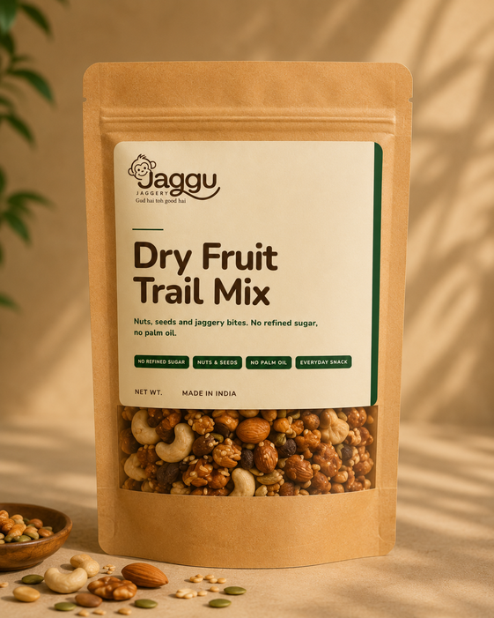
PRODUCTS & BUNDLES
Four everyday formats. Every product in 250g, 500g and 1kg.
Jaggery Powder
Chikki
Laddus
Dry Fruit Trail Mix
250g *
₹95
250g
₹149
250g
₹269
250g
₹389
500g
₹169
500g
₹269
500g
₹499
500g
₹749
1kg
₹299
1kg
₹549
1kg
₹949
1kg
₹1,399
Mid Combo
Hero Box
The Household Pack
The Family Pack
BUNDLES
₹459
₹809
₹869
₹1,189
750g · saves 10.5%
1,000g · saves 10.3%
1,250g · saves 11.0%
1,750g · saves 10.3%
Build Your Own Box — 10% off, minimum 3 packs, any combination of sizes.
Shipping — ₹50 flat, free at ₹1,000 and above.
* Powder 250g is box-only.
JAGGU JAGGERY
Notes:
Four formats, three sizes each. Every bundle saves about 10%.
3

Slide 3
WHY US
Every jaggery brand says “pure.” We're the one that hands you the test.
1
Sourced from the Muzaffarnagar belt - the region that earned India's Geographical Indication tag for jaggery in 2023 the same kind of protection that ties Champagne to Champagne.
2
No sulphur, no whitening agents - clarified the old way with okra pulp over a wood-fired kolhu, not a chemical shortcut.
3
No refined sugar, no glucose syrup, no palm oil -and that applies to the chikki and trail mix too, not just the raw jaggery.
4
Village sourcing, licensed facility - most brands only ever tell you one half of that story we're built on both.
5
We publish a one-minute home adulteration test - on our own website, and dare you to run it on our gud — or anyone else's.
JAGGU JAGGERY
Notes:
3

Slide 4
MARKET & COMPETITION
Jaggery brands stop at powder. Snack brands skip jaggery.
Almost nobody sits in the top-right box.
≈ ₹79,600 Cr
~12% CAGR
$3.13B
India packaged jaggery, 2025
projected growth this decade
India healthy-snacks market, 2025
BRANDED &
TRACEABLE
Jaggu
Commodity jaggery brands own the powder aisle. Mass mithai and general “healthy snacking” brands own the shelf space. Nobody owns the full jaggery snacking basket, honestly sourced. That's the box we're building in.
Dhampur Green /
B&B Organics
Open Secret / Wild Date
healthy-snacking D2C
Bikaji / mass
mithai brands
local mithai &
loose chikki sellers
OPAQUE /
UNBRANDED
JAGGERY ONLY
FULL SNACK RANGE
JAGGU JAGGERY
Notes:
4

Slide 5
CHANNEL
Direct to your door, on purpose.
Every order so far has come through jaggujaggery.in, running on pre-order while the first batch is made, pushed out through WhatsApp and our own network. No marketplace commission, no algorithm sitting between us and the first people who trusted us with real money.
₹0
1
90
10 DAYS
PAID AD SPEND
CHANNEL: OUR OWN SITE
UNIQUE BUYERS SO FAR
PRE-ORDER DISPATCH WINDOW
“We're just getting started deliveries take slightly longer for now. Thanks for being early.” - the banner on jaggujaggery.in, today.
JAGGU JAGGERY
Notes:
5

Slide 6
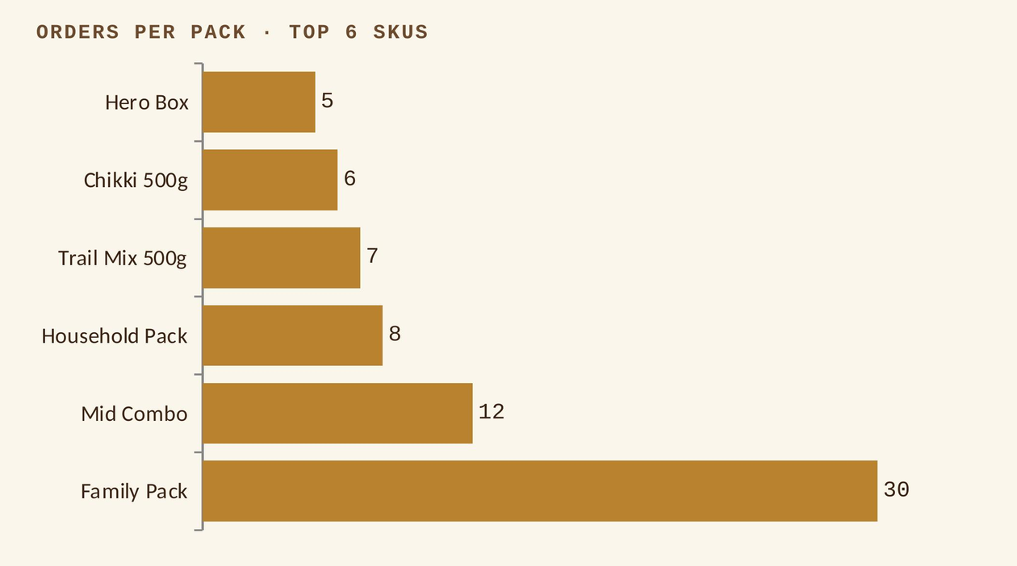
TRACTION
₹93,311 booked. 117 pre-orders. Zero ad spend.
More than half of all orders are for a bundle, not a single pack. Family Pack + Mid Combo + Household Pack + Hero Box alone account for 55 of ~103 logged orders. People want us to have already decided the box for them.
Average order value so far: ≈ ₹798. Look closer and 41.6% of all revenue rides on orders that include the Family Pack alone strong proof of what people want, and a reminder we're still leaning on one hero SKU.
Figures from the live order log through yesterday 103 named orders shown here reconcile to the ₹93,311 booked; the full pre-order count (117) includes guest checkouts not tied to a name.
JAGGU JAGGERY
Notes:
6

Slide 7
B2B
Cold outreach hasn't landed yet. One warm order just did.
WHERE WE ARE
WHAT JUST HAPPENED
B2B is still cold-lead territory for us nothing closed from outbound yet. Being upfront about that: it's the one box on this deck we haven't ticked. The B2B pair chases cafés and gift orders; the offline pair keeps weekend stalls running. The website stays live as a third channel, converting everyone we meet on either side.
₹50,000 party order, being fulfilled this weekend.
Our first real proof point for events and corporate gifting and it points straight at the sachet line we've scoped for cafés and offices.
WHAT IT UNLOCKS NEXT
Events & weddings
Corporate gifting
Café / office sachets
JAGGU JAGGERY
Notes:
7

Slide 8
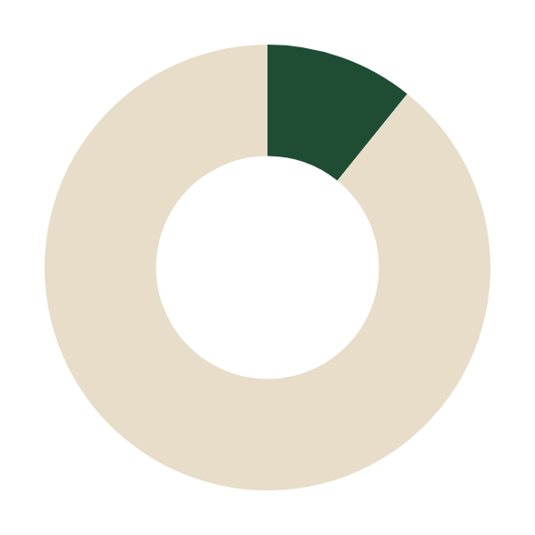
THE ACTION
The biggest lever isn't a bigger box.
It's a cheaper door in for strangers.
67.6% of our orders are already ₹700+, and the Family Pack alone drives 41.6% of revenue that's a warm, personal-network audience walking in ready to commit. Only 11 of 102 orders (11%) are a small trial pack. The moment we go cold, paid ads, outbound B2B that ratio works against us. Nobody buys a ₹1,189 box from a brand they've never heard of.
11/102
ORDERS UNDER ₹300
(TRIAL-SIZE)
The Family Pack sells itself to people who already trust us. Strangers need a cheaper door in so the plan is a dedicated ₹99–149 “first taste” offer, built for cold traffic, not our existing list.
1 · Price a ₹99–149 sampler
2 · Route cold traffic there first
3 · Upsell to Family Pack after
JAGGU JAGGERY
Notes:
8

Slide 9

Thank you.
Gud hai toh good hai
Jaggu Jaggery · SLE C-420
JJ’s Crew
Sagar Choudhary · Nirali Desai · Parth Chitkara · Antara Pusalkar

