Slide 1

PROGRESS UPDATE · AUGUST 2026 · MESA BYOB
Ashish Bajaj · Swapnil Bhatt · Shreya Malu · Siddhant Maheshwari
MixUp
1

Slide 2
I · WHERE WE ARE
PROOF
Last time we brought a plan.
This time we brought ₹60,704.
₹66,704
revenue, from a standing start
₹0 spent on paid advertising
₹30,000 capital taken from Mesa, already returned in revenue
63% gross margin, unchanged since day one
But the number is not the story. Where it came from is.
MixUp
2

Slide 3
I · WHERE WE ARE
₹13,000
one party, one evening, no ad spend
they bought after tasting, not after reading
the kit became the activity, not the drink
the people who don't drink bought too
That last one told us what we were actually selling.
MixUp
3

Slide 4
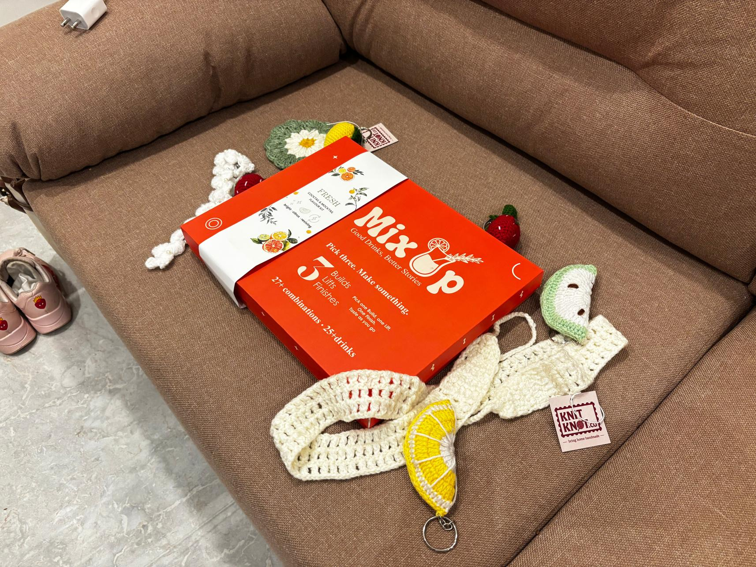
I · WHERE WE ARE
Nobody bought a kit.
They bought the evening.
6 bottles, 3 sachets, 2 stirrers — 25+ drinks from one box
Build, lift, finish — anyone can make something they like on the first try
₹1,499 — cheap enough to try, nice enough to gift
42% of people want cocktails and mocktails at the same table. One box serves both.
So we stopped asking who buys, and started asking where.
MixUp
4

Slide 5
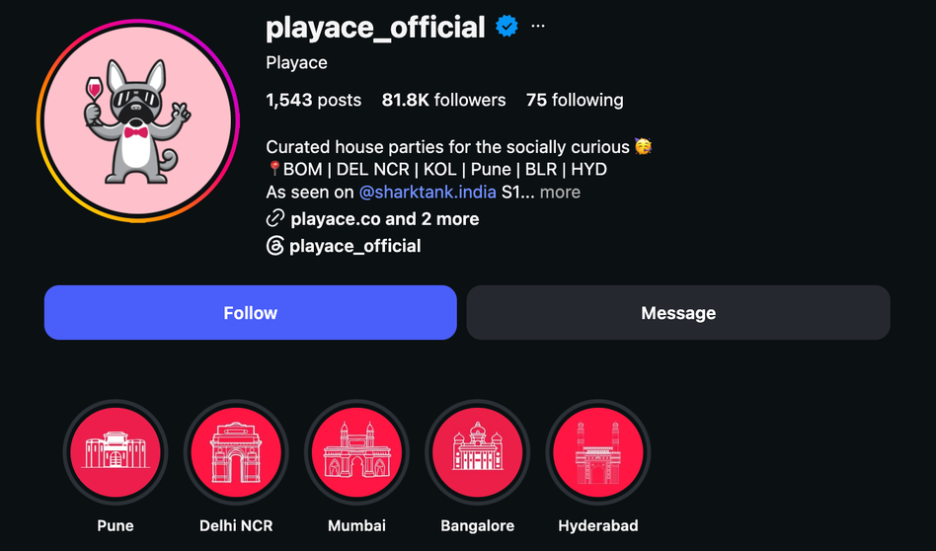
III · WHAT'S NEXT
PlayAce fills a room with strangers every weekend. Someone has to make the drinks.
The fit
The kit turns the drinks table into the icebreaker.
The placement
A MixUp box on every party table, sold on the spot.
The status
In conversation, pilot targeted.
PlayAce turns homes into hosted social rooms: strangers arrive, games break the ice, and the evening becomes the product. MixUp belongs naturally on that table - easy to try, easy to share, and just as welcoming for people who skip alcohol.
Not yet contracted.
MixUp
6

Slide 6
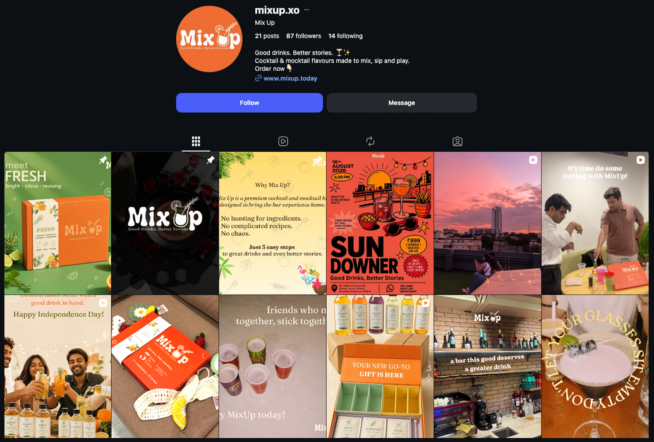
III · WHAT'S NEXT
Further moves we’ve planned for us
Rakhi Special
Sisters never know what to give.
Brothers never know what to give back.
Fleas
Our first flea enter this weekend.
B2B
Small office gifting conversations already open.
MixUp
7

Slide 7
III · WHAT'S NEXT
We have not paid for a single stall yet. That is the cheapest growth left on the table.
Why we waited
Why now
We wanted the product, the price and the pitch locked before renting floor space.
Festive footfall, impulse buyers, taste before you buy The stall pays for itself at 25 kits.
Stall cost
~5k
Break even 65 kits
Fleas targeted - Hiranandani and Happy & co
First flea - 22nd August
One more room, and nobody is serving it.
MixUp
8

Slide 8
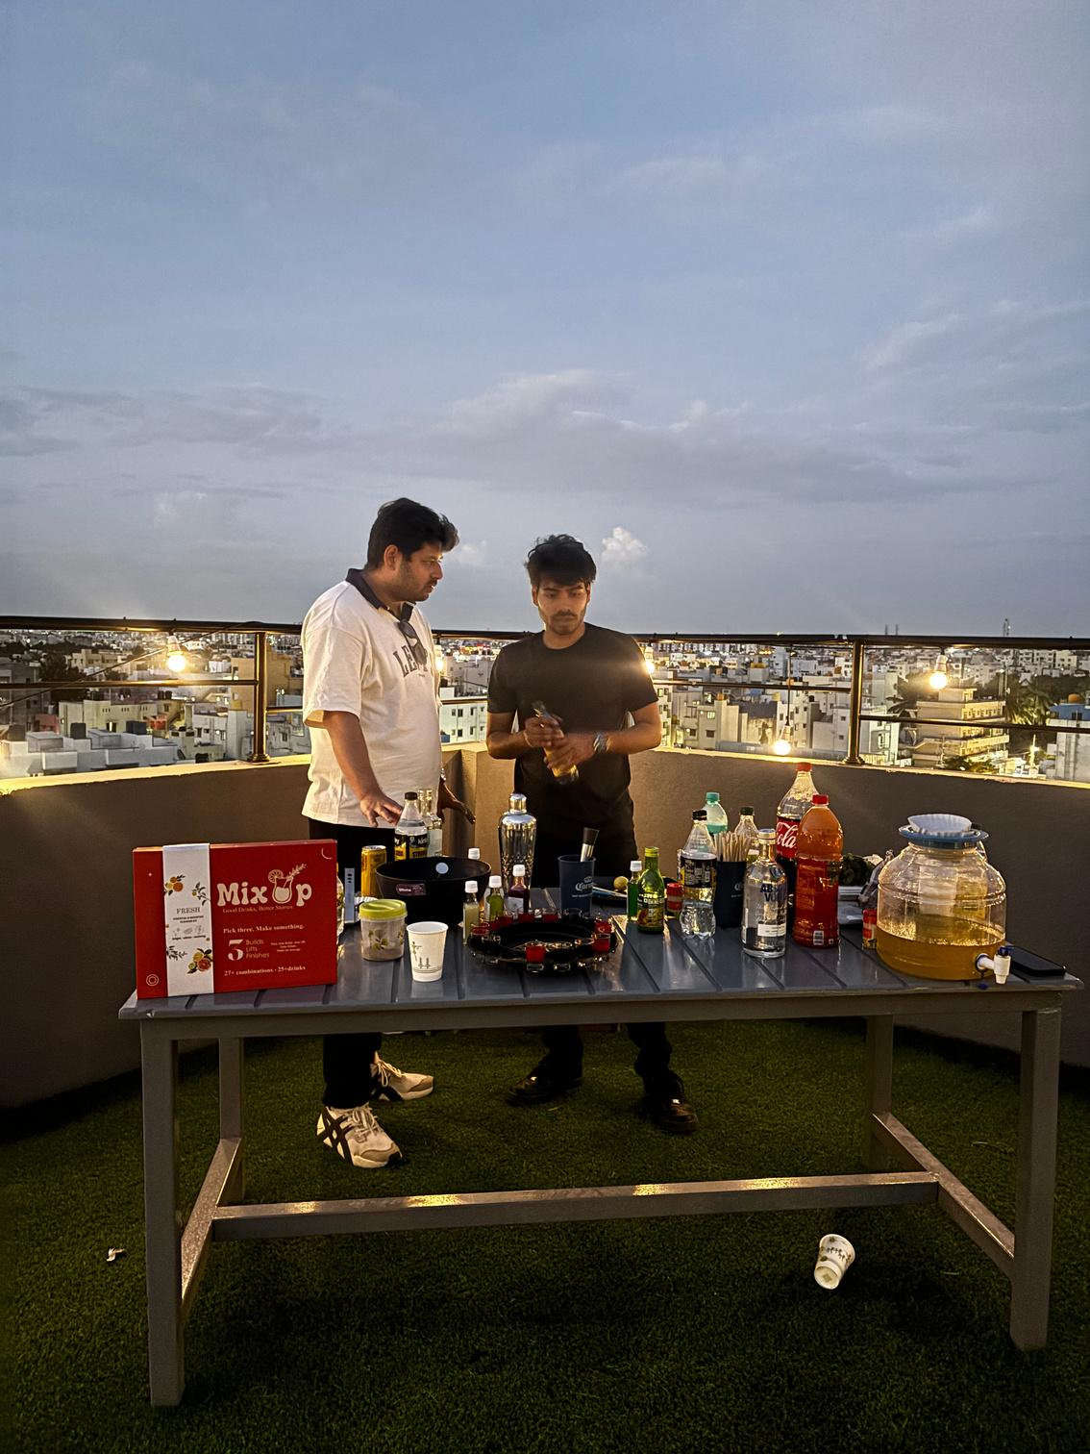
III · WHAT'S NEXT
The bar shuts at one.
The night doesn't.
1
Bars in Indiranagar shut. The crowd steps out.
2
Nobody is going to sleep. Everyone is heading to someone's flat.
3
We are on the street with kits, ready to hand over.
4
The house party starts with a MixUp box already open.
MixUp
9

Slide 9
IV · THE PLAN
₹392 stays with us on every single box, and selling harder did not change that.
Line
Value
%
₹392 gross profit per box
Selling price
₹1,499
100%
Landed cost
₹650
43%
Packaging
250
17%
26% gross margin
Transaction fee
₹37
2.5%
Shipping
₹70
4.7%
Total COGS
₹1107
74%
1.5× AOV against COGS
Events and street sales carry no shipping, so margin there is higher.
Which leaves exactly one question.
MixUp
10

Slide 10
Let's mix.
MixUp
12

