Slide 1
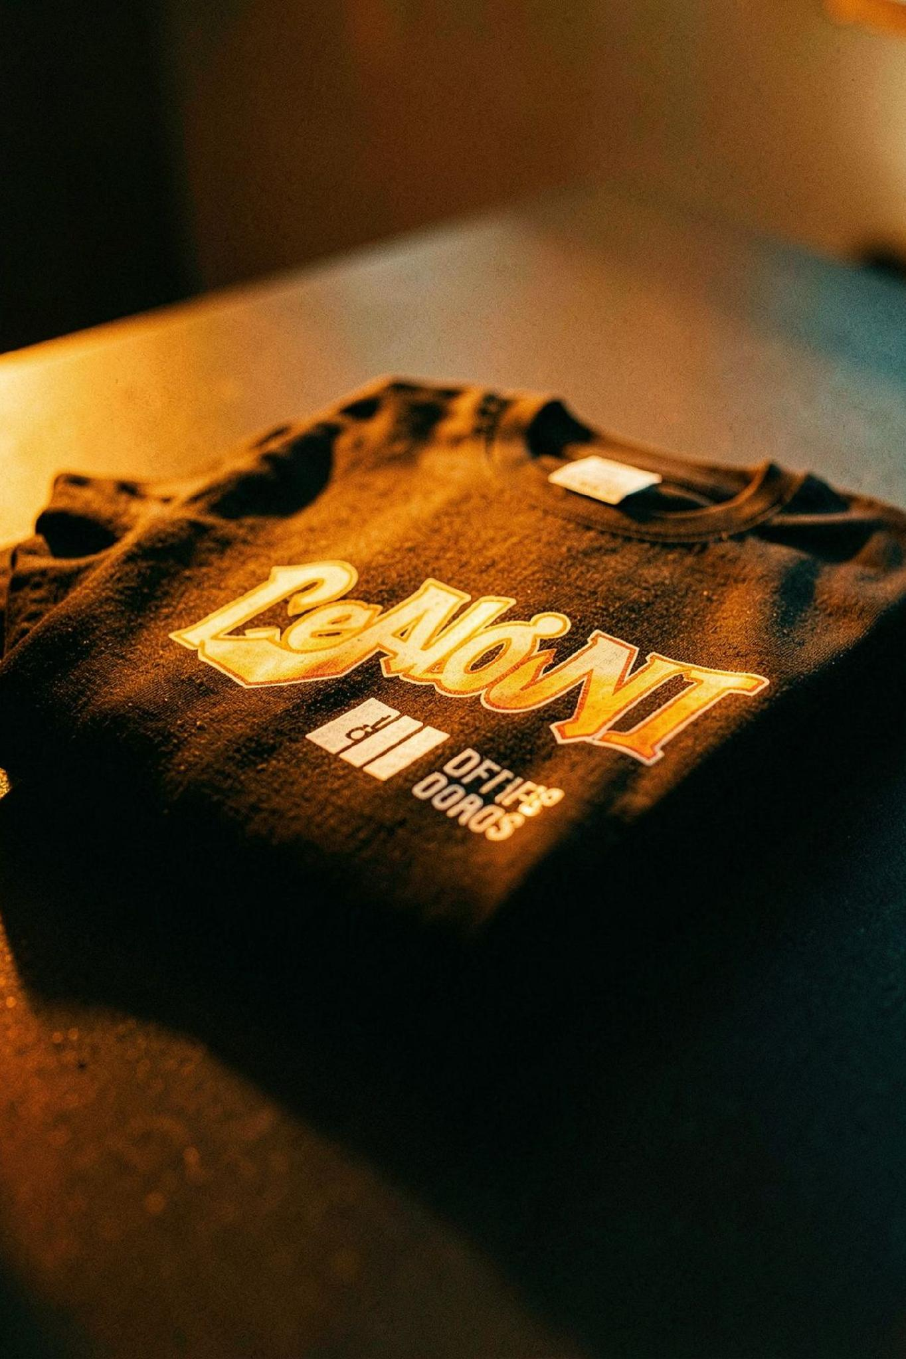
01
UNHINGED
COMFY APPAREL + CUSTOM MERCH
Premium comfort + customisation

Slide 2
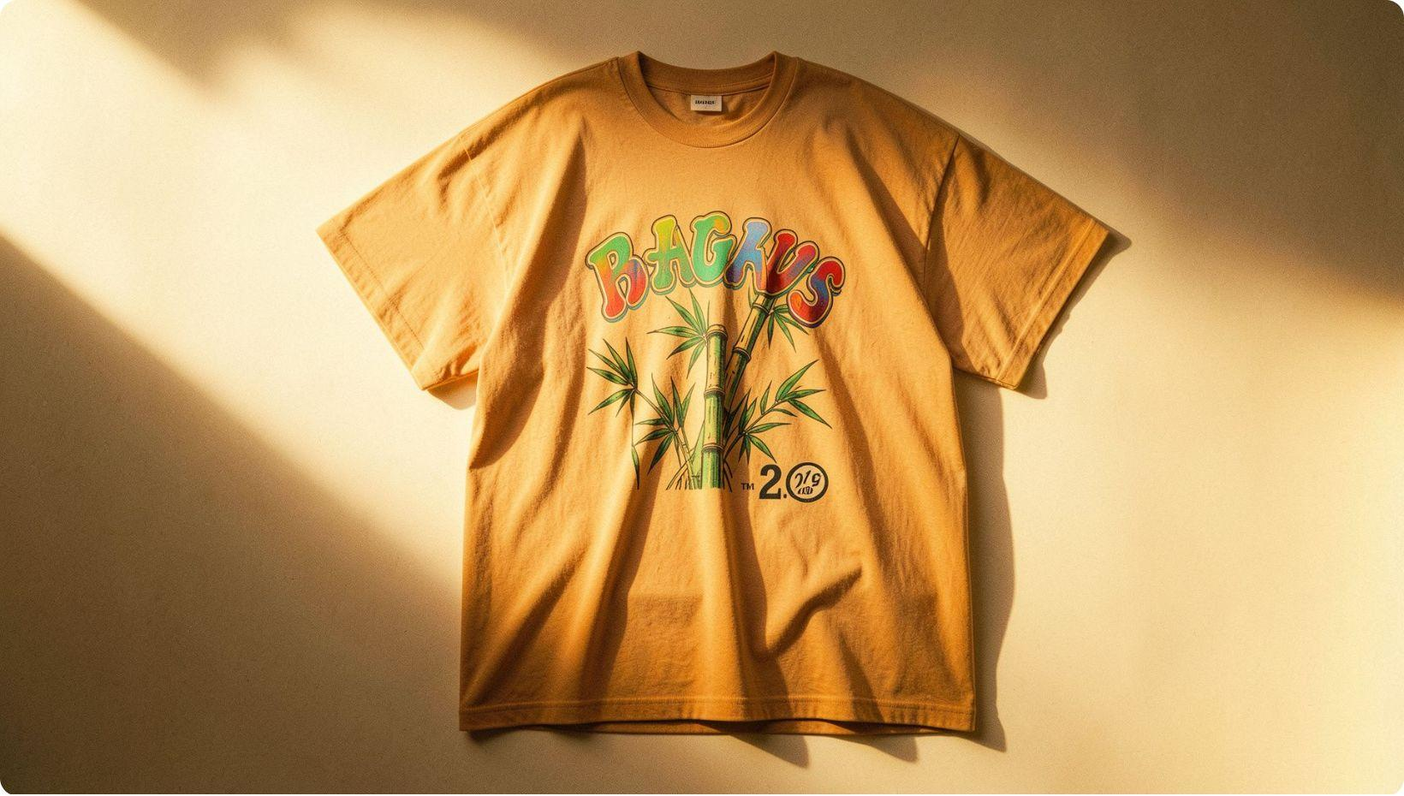
01 — PRODUCT
WHAT WE SELL
EVERYDAY WEAR
Lightweight T-shirts
Oversized T-shirts
Bamboo Cotton - super soft, breathable
Imported Mulberry Silk
Denims
CUSTOM MERCH
Custom T-shirts for brands
Design support
Merchandise for events & businesses

Slide 3
02 — TRACTION
WE'VE STARTED SELLING.
₹36,197
19
₹1,905
Revenue
Orders
Avg. Order Value
19 orders placed so far. UNHINGED has moved from an idea to actual sales.

Slide 4
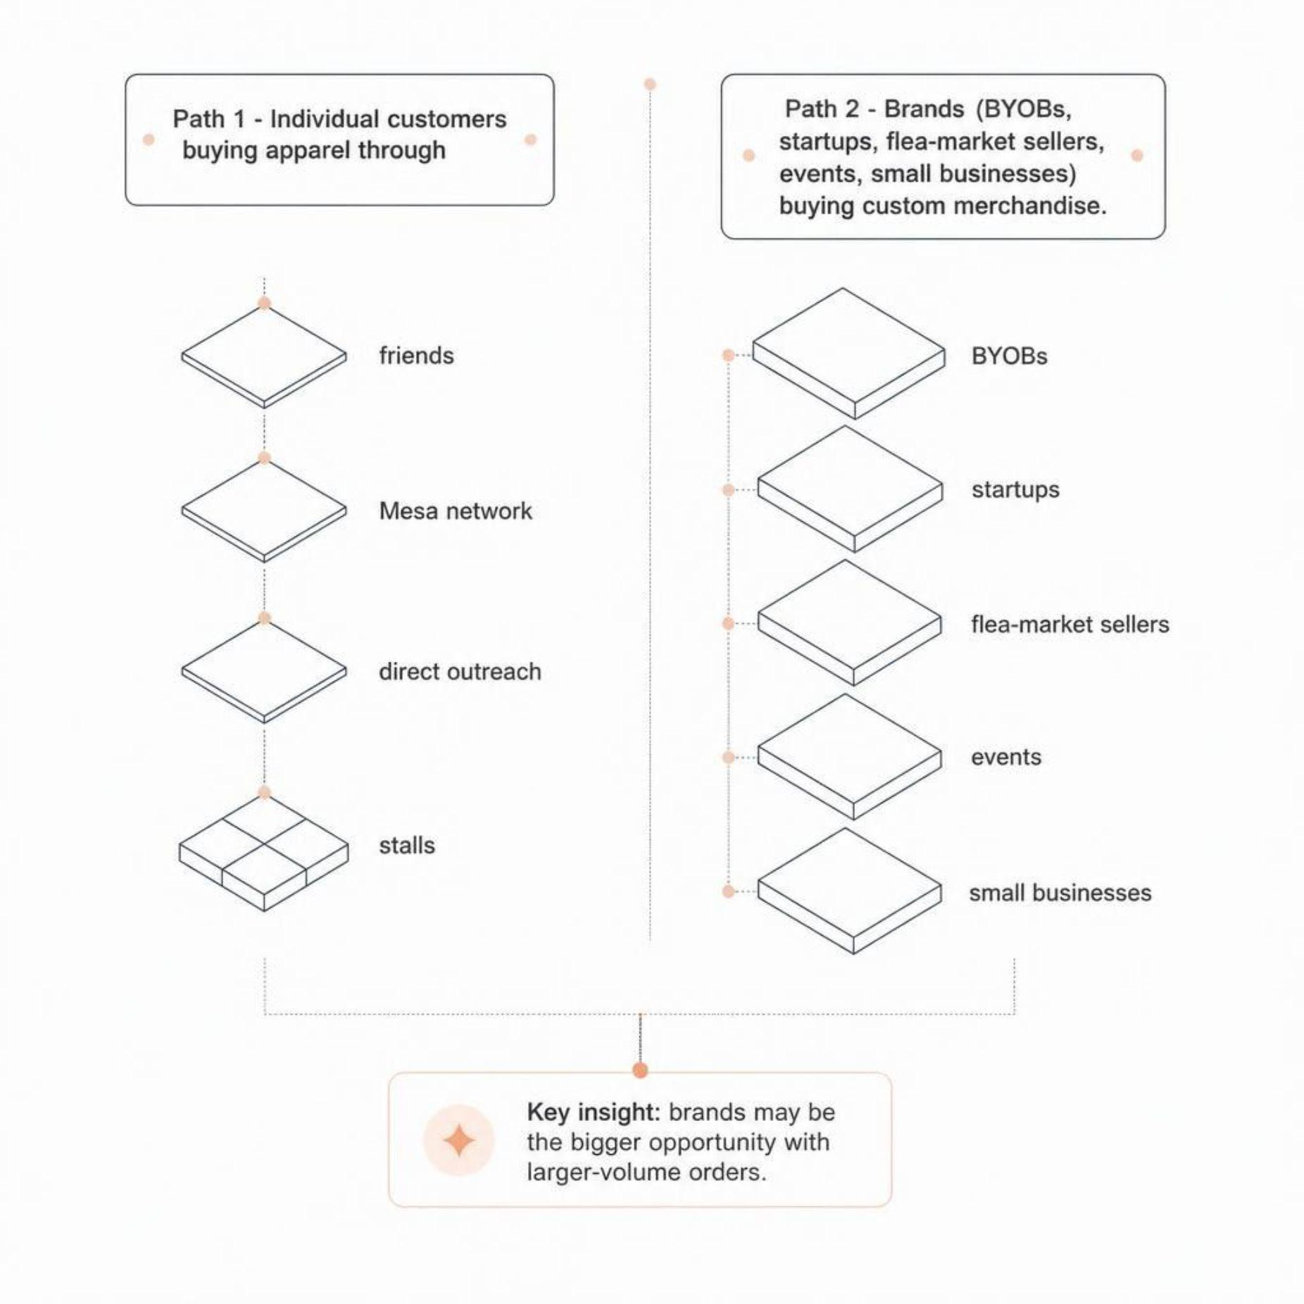
03 — LEARNING
WHAT WE'VE LEARNED
The Observation
People are buying the apparel — but brands may be the bigger opportunity. Custom merchandise can create larger-volume orders than individual sales.
Where We're Selling
Direct outreach • Mesa network • Stall • WhatsApp / Instagram
Competitive Landscape
Consumer apparel: The Souled Store • Bewakoof • Snitch
Custom merch: Local vendors

Slide 5
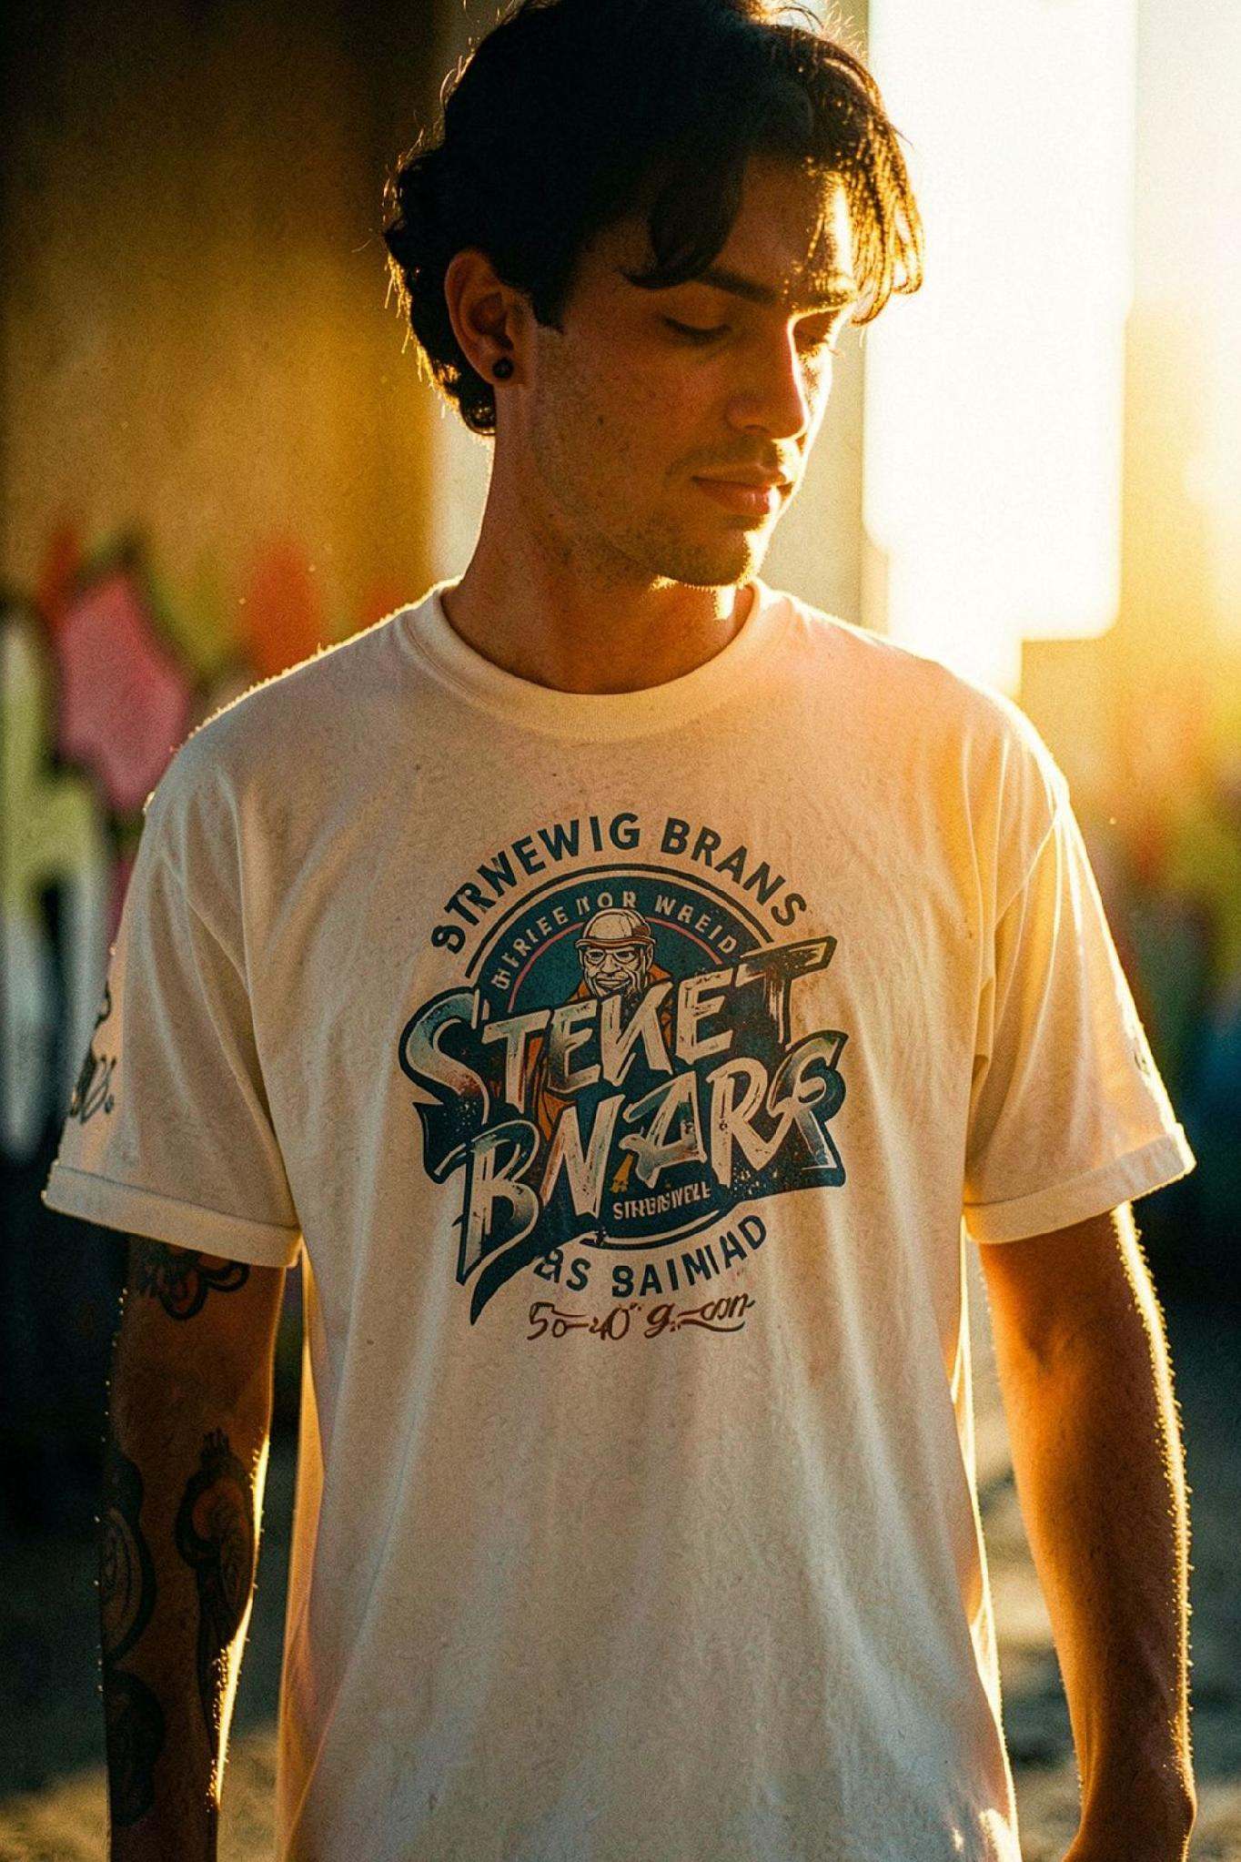

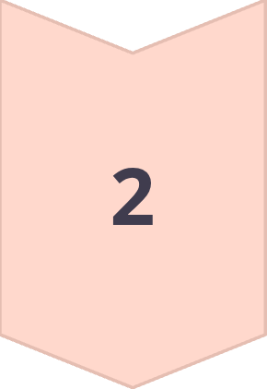
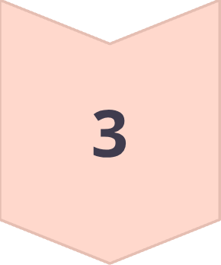
04 — WHAT'S NEXT
DOUBLE DOWN ON CUSTOM MERCH.
01 FIND BRANDS
Mesa BYOBs, startups, local businesses, events
02 SHOW THEM THEIR MERCH
Get their logo → create a T-shirt mockup → show them how their brand looks on apparel
03 CONVERT
Quote → Order → Deliver
Our next focus is turning brands around us into merchandise customers.

