Slide 1
Rossmann Pharmaceutical Store Sales and Customer Prediction with Time Series
1

Slide 2
Exploration of Customer Purchasing Behaviour(EDA)
Objective: understand sales, customer traffic, promotions, seasonality and competition.
Approach: data cleaning → feature engineering → exploratory analysis → business insights.
Datasets: Store, Train and Test merged using Store as the key.

Slide 3
Data Cleaning & Feature Engineering
Preparing reliable data before exploratory analysis
Merged store.csv with train.csv and test.csv using the Store column.
Removed the Id column because it is an identifier and not a predictive business feature.
Handled missing values using business-aware strategies:
  CompetitionDistance → training-set median
  Competition opening month/year → 0 when information is unavailable
  Promo2 week/year → 0 and PromoInterval → 'None'
  Missing Open values in test → training-set mode
Checked duplicate records and data types; converted Date to datetime.
Created Year, Month, Day, WeekOfYear, Quarter, IsWeekend and IsHoliday features.
Detected Sales and Customers outliers using the IQR method; genuine retail peaks were not blindly removed.
2

Slide 4
Customer & Promotion Behaviour
Key EDA questions: Do promotions increase sales and customer traffic?
Sales ↔ Customers
Promo → Sales
Promo → Customers
Strong positive relationship is expected: stores with more customer traffic generally generate higher sales.
Compare average sales during Promo = 1 versus Promo = 0 to measure promotional impact.
Customer counts reveal whether promotions attract additional traffic, not just higher revenue.
Business implication: evaluate promotions using both sales uplift and customer uplift.
Store-level promotional uplift can identify locations where campaigns are more effective.
Avoid applying one promotional strategy uniformly across all stores.
3

Slide 5
Seasonality, Holidays & Store Operations
Understanding when and under what conditions customers purchase
Monthly sales analysis identifies seasonal purchasing patterns and peak-demand periods.
Holiday analysis compares sales around StateHoliday and SchoolHoliday periods.
Weekday versus weekend analysis highlights differences in customer traffic and sales.
Open versus closed analysis confirms that customer traffic is meaningful only when stores are operating.
Day-of-week analysis helps identify consistently strong and weak trading days.
Seasonal findings can guide inventory planning, staffing and promotion timing.
Recommended plots: monthly sales line chart • holiday sales bar chart • weekday/weekend comparison
4

Slide 6
Store & Competition Analysis
Identifying location and store characteristics that influence performance
Assortment analysis compares average sales and customer traffic across assortment types.
CompetitionDistance is examined using scatter plots, correlation and distance bands.
Short competitor distance does not automatically imply lower sales; store type, customer traffic and location context also matter.
CompetitionOpenSinceMonth/Year can be used to study sales before and after a competitor opens.
Store-level analysis helps identify high-performing stores and stores with strong promotional uplift.
For city-centre interpretation, competition distance should be treated as a proxy rather than a direct city-centre indicator.
5

Slide 7
Business Insights & Recommendations
Turning EDA findings into actionable decisions
Use customer traffic as a key leading indicator of sales performance.
Target promotions toward stores with historically high promotional uplift.
Evaluate promotions on both sales and customer acquisition/traffic.
Plan inventory and staffing around seasonal, holiday and day-of-week demand patterns.
Consider store type, assortment and competitor proximity when designing local strategies.
Investigate competitor openings as potential changes in store performance rather than assuming a uniform effect.
Use store-level segmentation instead of a single strategy for every location.
6

Slide 8
Store Sales Prediction
Findings, Model Comparison & Business Insights
Machine Learning + LSTM time-series approach

Slide 9
Executive Summary
The notebook builds an end-to-end daily store-sales forecasting pipeline: preprocessing → feature engineering → modeling → evaluation → serialization → MLflow tracking.
Random Forest is the strongest reported model, outperforming Gradient Boosting on MAE, RMSE and R².
Gradient Boosting provides the feature-importance and prediction-diagnostic analysis shown in the notebook.
The LSTM experiment captures a time-series workflow but performs substantially worse than the tree-based models on the reported validation results.
A separate Gradient Boosting customer model reports MAE 0.32, RMSE 0.64 and R² 1.00.

Slide 10
Objective & Analytical Workflow
Objective: predict daily sales across stores using machine-learning and deep-learning approaches.
Target variable: Sales.
Data is chronologically ordered; the notebook then creates an 80% / 20% train-validation split after sorting by Year, Month, Day and Store.
Primary metric: MAE because it is directly interpretable in sales units. RMSE captures larger errors and R² measures explained variance.
Two modeling families are evaluated: tree-based regression (Random Forest and Gradient Boosting) and a two-layer LSTM time-series model.

Slide 11
Data Preparation & Feature Engineering
Numerical variables: median imputation followed by StandardScaler.
Categorical variables: most-frequent imputation followed by OneHotEncoder(handle_unknown='ignore').
Date features: day of week, weekend, year, month, day, week of year, quarter, month period, month-start and month-end.
Holiday features: state-holiday and school-holiday indicators plus days-to-holiday and days-after-holiday.
Competition features: opening date, competition age in months, distance bands and competition period.
Final preprocessing uses a Scikit-learn ColumnTransformer inside the model pipeline.

Slide 12
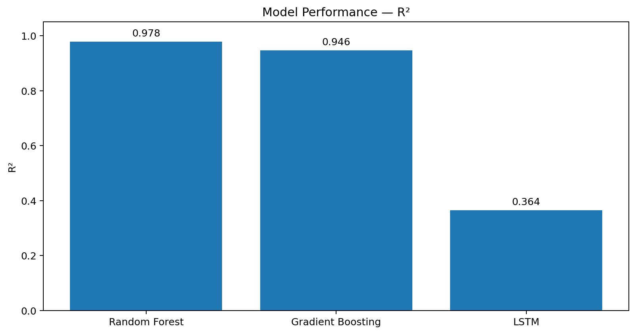
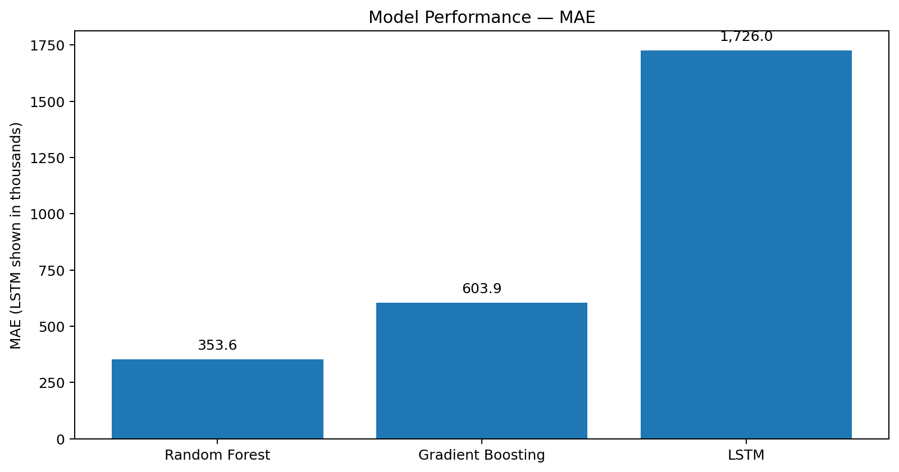
Model Performance Comparison
Model | MAE | RMSE | R²
Random Forest | 353.60 | 574.03 | 0.9779
Gradient Boosting | 603.92 | 897.64 | 0.9460
LSTM | 1,725,982.88 | 2,583,624.38 | 0.3642

Slide 13
Why Random Forest Wins
Lowest reported MAE: 353.60, indicating the smallest average absolute sales error.
Lowest reported RMSE: 574.03, indicating fewer / smaller large errors than the alternatives.
R² = 0.9779, meaning the model explains about 97.8% of validation variance according to the notebook's metric.
Gradient Boosting is still strong (R² 0.9460) but is weaker than Random Forest across all three reported metrics.
LSTM is not competitive in this implementation, with R² only 0.3642.

Slide 14
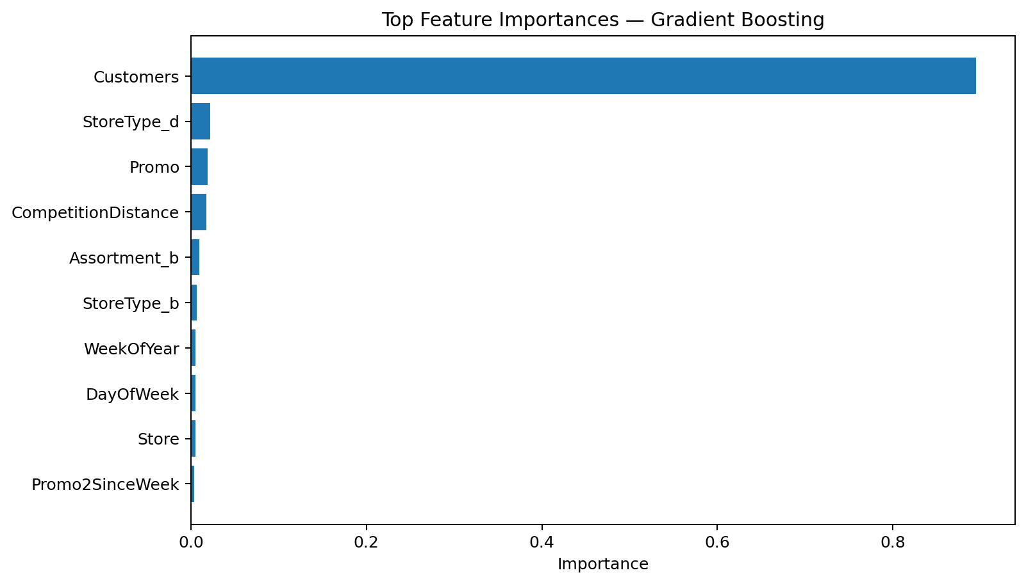
Feature Importance Findings
Customers dominates the Gradient Boosting importance ranking at ≈ 0.8945.
StoreType_d, Promo and CompetitionDistance are the next largest contributors.
WeekOfYear, DayOfWeek and Store provide additional temporal and store-level signal.
The reported model therefore relies heavily on observed customer traffic plus promotion, store and competition context.
Feature importance indicates predictive contribution, not causation.

Slide 15
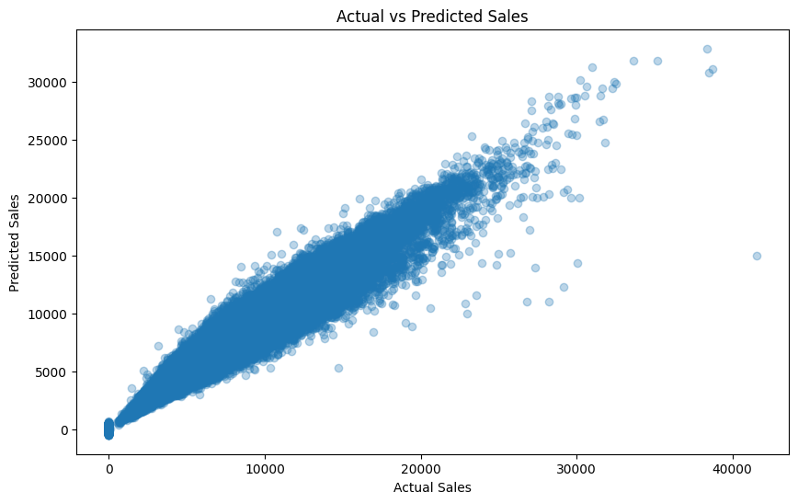
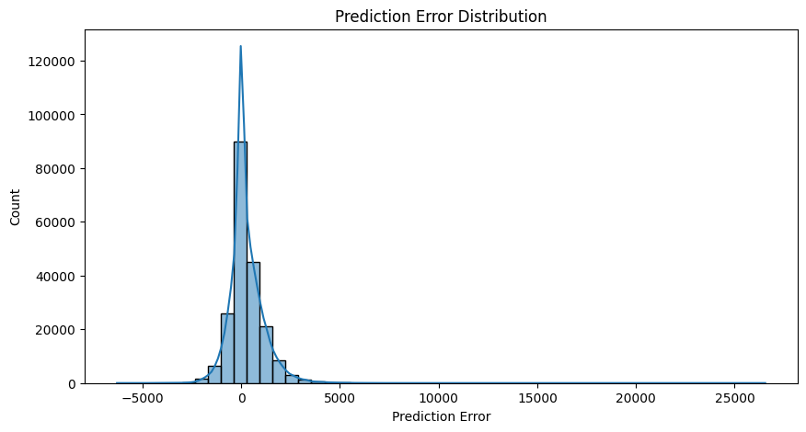
Prediction Diagnostics — Gradient Boosting
The notebook compares actual sales with Gradient Boosting predictions and visualizes prediction-error distribution.
These diagnostics are specifically for Gradient Boosting, not the best-performing Random Forest.
Example prediction intervals are estimated empirically from validation residuals.

Slide 16
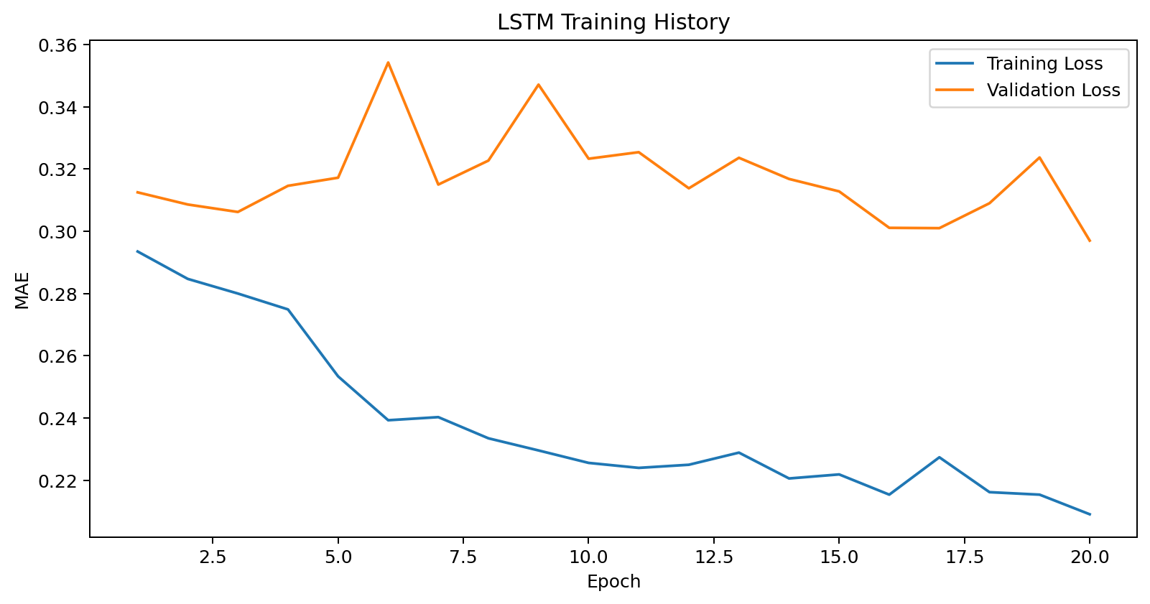
Time-Series & LSTM Findings
Daily sales were aggregated by date and examined with ADF, ACF and PACF analysis.
The LSTM uses a 14-day sliding window and scaled time-series inputs.
Despite the time-series workflow, the reported LSTM performance is far below the tree-based models.

Slide 17
Deployment, Tracking & Customer Forecasting
Trained models are serialized as timestamp-based .pkl files for reuse and version tracking.
MLflow is incorporated to log model parameters, evaluation metrics and model artifacts, improving reproducibility.
A Rossmann predictions CSV is generated and copied to the project Google Drive location.
A separate Gradient Boosting customer model is trained using the same preprocessing pipeline.
Reported customer-model metrics: MAE 0.32, RMSE 0.64 and R² 1.00.

Slide 18
Final Findings & Recommendations
Recommended model from the notebook: Random Forest, based on MAE 353.60, RMSE 574.03 and R² 0.9779.
Customer count is the dominant predictive feature in the Gradient Boosting importance analysis; promotion, store type and competition add further signal.
The current LSTM implementation should not replace the tree model because its reported R² is only 0.3642.
For production, preserve the complete preprocessing pipeline with the model to prevent training/inference feature mismatch.
Validate the selected model on a strictly future holdout and monitor MAE/RMSE after deployment.
The notebook establishes a complete workflow from preprocessing and forecasting through model persistence, experiment tracking and customer prediction.

Slide 19
Thank you

