Slide 1
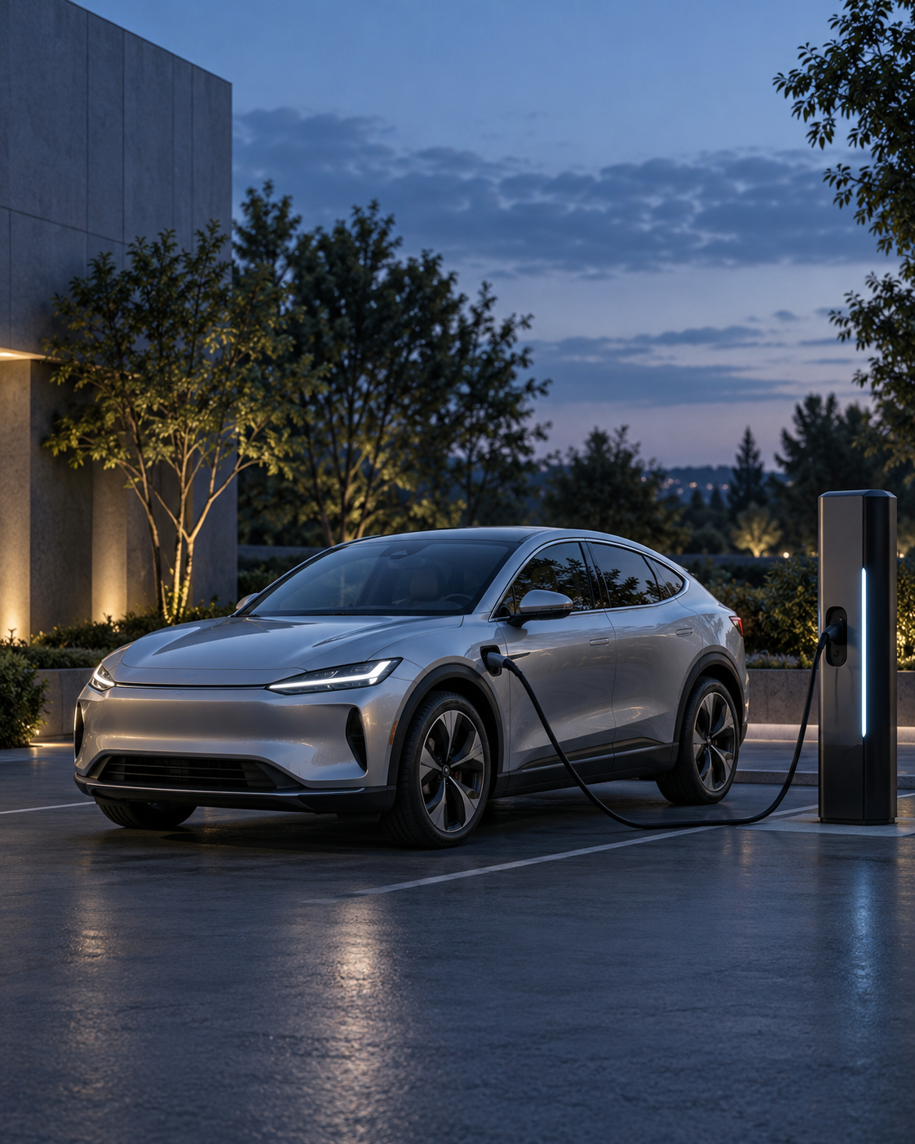
EV Customer
Prioritization
Final Project Proposal
Nu Quynh Chau Nguyen
MSBA265
MSBA265 / Final Project Proposal
01
Notes:
PRESENTATION SCRIPT
My final project will use the approved Kaggle dataset to build an EV customer prioritization prototype. The business question is which customer profiles a dealership should contact first when outreach capacity is limited. I have completed the initial data understanding and cleaning. Today I will explain the dataset, what I have learned so far, and my plan for modeling and an application.
SOURCES AND DEFINITIONS
https://www.kaggle.com/competitions/playground-series-s6e9
https://github.com/shylasolis/machine-learning-pathway/blob/main/syllabus.pdf
Cover image: AI-generated illustrative artwork. It does not depict a verified dealership, customer, or location.

Slide 2
The business decision
Which customer profiles
should receive outreach first?
Proposed user
Proposed decision
An EV dealership or marketing manager
with limited contact capacity.
Choose a contact limit K, then receive
a ranked shortlist of customer IDs.
Project goal: find more profiles with a Yes label within the same contact limit.
MSBA265 / Final Project Proposal
02
Notes:
PRESENTATION SCRIPT
I am proposing a dealership outreach use case. A manager cannot contact every customer, so the application will let the manager choose a contact limit, which I call K. The model will rank profiles by their estimated probability of the supplied Yes label and produce a shortlist. I will compare that shortlist with a random selection at the same capacity. The project evaluates how well the model identifies profiles with that label. Real sales impact would require real customer outcomes and a separate business study.
SOURCES AND DEFINITIONS
Proposed project use case, not a documented operational deployment.
https://www.kaggle.com/competitions/playground-series-s6e9

Slide 3
The approved Kaggle dataset
Predicting Electric Vehicle Purchases
File | Records | Purpose
train.csv | 668,665 | Profiles with Will_Buy_EV labels
test.csv | 286,571 | Profiles without outcome labels
sample_submission.csv | 286,571 | Template for predicted probabilities
13 candidate predictors
Synthetic customer profiles
7 numeric and 6 categorical fields
Customer ID stays outside the model.
Target: Will_Buy_EV (Yes/No)
Actual purchases and timing remain unverified.
MSBA265 / Final Project Proposal
03
Notes:
PRESENTATION SCRIPT
The professor approved Predicting Electric Vehicle Purchases from Kaggle Playground Series S6E9. The training file has 668,665 labeled profiles. The Kaggle test file has 286,571 profiles without labels, and the sample submission provides the output format. There are thirteen candidate predictors, covering demographics, finances, transportation, charging access, and attitudes. Customer ID is only an identifier. This is synthetic data. The target is the supplied Will_Buy_EV Yes or No label. I will describe the output as a prioritization prototype and avoid claiming verified purchases or a known purchase timeframe.
SOURCES AND DEFINITIONS
https://www.kaggle.com/competitions/playground-series-s6e9
/Users/nguyenchau/Documents/msba265/Predicting Electric Vehicle Purchases/reports/tables/file_summary.csv
/Users/nguyenchau/Documents/msba265/Predicting Electric Vehicle Purchases/reports/tables/data_dictionary.csv
13 predictors = 15 training columns minus ID and target. No outcome labels appear in the competition test file.

Slide 4
Initial audit and class balance
Completed data checks
0 missing values
0 duplicate IDs
0 rows removed
Cleaning actions
Lossless integer conversion
No = 0 and Yes = 1
No imputation needed
An always-No rule gets 82.54% accuracy and finds none of the Yes profiles.
MSBA265 / Final Project Proposal
04
Notes:
PRESENTATION SCRIPT
The initial audit found no missing values or duplicate IDs. The cleaning step retained all records. I converted appropriate numeric storage to integers without losing information and encoded the target as zero and one. The major issue is class imbalance. Only 17.46 percent of the training profiles have a Yes label. A rule that predicts No for everyone would look accurate at 82.54 percent, but it would identify none of the profiles we want to prioritize. That is why accuracy alone will not guide model selection.
SOURCES AND DEFINITIONS
/Users/nguyenchau/Documents/msba265/Predicting Electric Vehicle Purchases/reports/tables/data_quality_audit.csv
/Users/nguyenchau/Documents/msba265/Predicting Electric Vehicle Purchases/reports/tables/cleaning_log.csv
/Users/nguyenchau/Documents/msba265/Predicting Electric Vehicle Purchases/reports/tables/target_summary.csv
Training counts: No 551,886. Yes 116,779. Percentages use all 668,665 training records.

Slide 5
Early descriptive patterns
What this suggests
These fields may help
distinguish profiles.
A model can combine
multiple fields and test
whether ranking improves.
Descriptive associations in synthetic data do not establish cause and effect.
MSBA265 / Final Project Proposal
05
Notes:
PRESENTATION SCRIPT
Two early comparisons illustrate what the dataset contains. The share of Yes labels is 27.47 percent among profiles with a subsidy available and 0.58 percent among those without one. Profiles with home charging also have a higher observed Yes share than those without it. These are descriptive associations in this synthetic dataset. They do not prove that adding a subsidy or home charging causes interest to rise. The modeling stage will combine predictors and test whether they improve ranking on held-out records.
SOURCES AND DEFINITIONS
/Users/nguyenchau/Documents/msba265/Predicting Electric Vehicle Purchases/reports/tables/categorical_target_associations.csv
Subsidy_Available Yes: 115,347 Yes / 419,909 records. No: 1,432 Yes / 248,756 records.
Home_Charging_Possible Yes: 90,601 Yes / 462,677 records. No: 26,178 Yes / 205,988 records.

Slide 6
Planned modeling approach
Labeled train.csv split: 70% train, 15% validation, 15% internal holdout
Model | Role in the comparison
Dummy baseline | Reference performance with no learned signal
Logistic regression | An interpretable probability model
Decision tree | Nonlinear relationships and interactions
Preprocessing inside the training pipeline
Stratify the split to preserve class balance.
Encode categories and scale numeric inputs for logistic regression.
MSBA265 / Final Project Proposal
06
Notes:
PRESENTATION SCRIPT
I will freeze a stratified seventy, fifteen, fifteen split before comparing models. The full training data has already informed descriptive EDA, so I will clearly document that history. Model fitting and any learned preprocessing will use the training portion. Validation will guide model selection and tuning, and the final holdout will provide a later evaluation. I will compare a dummy baseline, logistic regression, and a decision tree. A random forest can be an extension if time permits. Initially, I will treat environmental concern codes as categories because their survey anchors and interval meaning are unclear.
SOURCES AND DEFINITIONS
https://github.com/shylasolis/machine-learning-pathway/blob/main/syllabus.pdf (classification and capstone requirements, pages 6–8)
https://scikit-learn.org/stable/modules/generated/sklearn.pipeline.Pipeline.html
Proposed split and model choices. No models have been trained for this presentation.
Competition test labels are unavailable. Internal validation comes from labeled train.csv.

Slide 7
Planned evaluation
Primary question: does the top-K shortlist beat random selection?
Evaluation | What it tells the manager
Precision@K | Share of shortlisted profiles with a Yes label
Lift@K | Improvement over the evaluation sample’s Yes rate
Recall@K | Share of all Yes profiles captured in the shortlist
Model diagnostics
ROC-AUC and average precision for ranking quality.
Calibration and confusion matrices for probability and threshold checks.
MSBA265 / Final Project Proposal
07
Notes:
PRESENTATION SCRIPT
The main evaluation will match the outreach decision. At a fixed contact limit K, precision tells me what share of the shortlist has a Yes label. Recall tells me how much of the total Yes population I captured. Lift compares shortlist precision with the Yes rate in the evaluation sample. I will compare the model with random selection at the same capacity. I will also report ROC-AUC, average precision, calibration, and confusion matrices at selected thresholds. I have not produced these model results yet, and I will not translate them into promised sales or revenue.
SOURCES AND DEFINITIONS
Planned evaluation. K will reflect a chosen contact capacity and use the same value for comparisons.
https://scikit-learn.org/stable/modules/model_evaluation.html
Average precision is the sklearn summary of the precision-recall curve. It is not automatically identical to trapezoidal PR-AUC.
Random selection has expected precision equal to evaluation prevalence and expected lift 1.0.

Slide 8
The proposed application
A browser tool for an outreach manager
1
Upload customer profiles
Planned implementation
Streamlit interface
FastAPI scoring service
Saved scikit-learn pipeline
Docker package for the demo
2
Choose a contact limit K
3
View ranked IDs and estimated Yes probabilities
4
Export the shortlist as a CSV file
Input checks will report
missing fields and
unsupported values.
Prototype scores refer to the supplied label. Real outreach needs real-world validation.
MSBA265 / Final Project Proposal
08
Notes:
PRESENTATION SCRIPT
Yes, I plan to turn the model into an application. The proposed interface is a small Streamlit browser tool that requests scores from a FastAPI service. The manager will upload a file, select a contact limit, view the ranked profiles, and export the shortlist. A saved scikit-learn pipeline will apply the same preprocessing during training and scoring. The app will check required fields and report unsupported values. I plan to package the demo with Docker and document a terminal workflow. The application remains a prototype until real data can validate its scores and usefulness.
SOURCES AND DEFINITIONS
https://docs.streamlit.io/develop/concepts/architecture/architecture
https://fastapi.tiangolo.com/
https://scikit-learn.org/stable/modules/generated/sklearn.pipeline.Pipeline.html
https://github.com/shylasolis/machine-learning-pathway/blob/main/syllabus.pdf (reproducibility, deployment, technical runbook)
Proposed application design. No deployed app exists yet. FastAPI is a class-aligned design choice.

Slide 9
Deliverables and next steps
Stage | Deliverable | Status
Data understanding | Cleaning notebook and EDA report | Complete
Model development | Pipeline and comparison on held-out data | Next
Application | Working prioritization demo | Planned
Final handoff | Git repository, runbook, executive presentation | Planned
Reproducibility and monitoring plan
Kaggle API download and Mac/Windows setup checks.
Monitor input errors and scoring failures. Simulate distribution drift.
MSBA265 / Final Project Proposal
09
Notes:
PRESENTATION SCRIPT
The first deliverable is complete: a notebook that explains the data and documents the cleaning decisions. Next I will compare models and evaluate ranking on labeled validation and holdout records. Then I will build the application demo. The final handoff will include a Git repository, programmatic download instructions, a technical runbook, and an executive presentation with business recommendations. I will verify Mac and Windows setup, monitor input and scoring failures, and demonstrate distribution checks with simulated drift because this dataset is static. The result should connect the statistical evaluation with the actual outreach decision.
SOURCES AND DEFINITIONS
https://github.com/shylasolis/machine-learning-pathway/blob/main/syllabus.pdf (final capstone and reproducibility requirements, pages 6–8)
/Users/nguyenchau/Documents/msba265/Predicting Electric Vehicle Purchases/notebooks/01_data_understanding_and_cleaning.ipynb
/Users/nguyenchau/Documents/msba265/Predicting Electric Vehicle Purchases/README.md
Windows setup verification remains planned. Monitoring with this static dataset will be a demonstration, not a live production claim.
Planned monitoring also includes latency and feature/score distributions. Performance monitoring needs new outcome labels.

Slide 10
Backup: predictor groups and definitions
Group | Candidate predictors
Demographics and area | Age, gender, city type
Finance | Annual income, subsidy availability
Transportation | Daily commute, cars owned, current car type
Charging access | Stations near home, stations near work, home charging
Attitudes | Environmental concern code, range anxiety
Environmental concern uses codes 1–5. Survey anchors and direction remain unclear.
Charging radius and the outcome timeframe also remain undocumented.
MSBA265 / Backup
10
Notes:
PRESENTATION SCRIPT
There are thirteen predictors across five groups. Environmental_Concern_Level contains numeric codes from one to five. I have not verified what each survey code means, so I will avoid describing one as low and five as high. I will also document uncertainties about the charging station radius and the outcome timeframe. These limits matter when explaining the model or proposing use with real customers.
SOURCES AND DEFINITIONS
/Users/nguyenchau/Documents/msba265/Predicting Electric Vehicle Purchases/reports/tables/data_dictionary.csv
Exact columns: Age, Gender, City_Type, Annual_Income_USD, Subsidy_Available, Daily_Commute_km, Number_of_Cars_Owned, Current_Car_Type, Charging_Stations_Near_Home, Charging_Stations_Near_Work, Home_Charging_Possible, Environmental_Concern_Level, Range_Anxiety_Level.
These are candidate predictors. The modeling stage will document final inclusion choices, including sensitivity to demographic fields.

Slide 11
Backup: ranking metric definitions
K is the number of profiles the manager can contact.
Metric | Definition
Precision@K | Yes labels among the top K / K
Recall@K | Yes labels among the top K / all Yes labels in evaluation
Lift@K | Precision@K / evaluation-set Yes rate
Comparison rule
Use the same evaluation sample and contact capacity for every model.
Random selection has expected lift of 1.0. Model results remain pending.
MSBA265 / Backup
11
Notes:
PRESENTATION SCRIPT
All three ranking metrics use the same evaluation sample and contact capacity. Precision is the share of Yes labels within the shortlist. Recall is the share of the sample’s Yes labels that appear in the shortlist. Lift divides shortlist precision by the Yes rate of the entire evaluation sample. A random shortlist has expected lift of one. That is a reference expectation, not a model result. I will choose capacity scenarios on validation data and keep the final holdout for later evaluation.
SOURCES AND DEFINITIONS
Metric definitions for the proposed top-K evaluation.
Use unrounded evaluation prevalence as the lift denominator.
No fabricated metric values or modeled sales impact appear in this deck.

