Slide 1

EV Customer
Prioritization
Stakeholder demonstration
Nu Quynh Chau Nguyen
MSBA265
EV Customer Prioritization
01
Notes:
The prototype helps a manager decide which profiles to review first when contact capacity is limited. It ranks the supplied synthetic profiles and keeps the final decision with the manager. This demonstration shows the working tool, the evaluation evidence and a proposed pilot.
Sources
docs/reports/modeling/holdout_ranking.csv
app.py
Cover artwork retained from the original proposal. AI-generated illustrative artwork, not a verified dealership, customer or location.

Slide 2
Limited contact capacity
Which customers should an EV dealership prioritize for contact when its outreach capacity is limited?
Illustrative scenario
The tool’s role
A team can review 50 profiles.
The manager sets the limit to match
the team’s available time.
Rank the supplied profiles and
return 50 IDs for staff review.
The manager approves any contact.
Goal: find more profiles with a Yes label within the same review limit
EV Customer Prioritization
02
Notes:
Business question: Which customers should an EV dealership prioritize for contact when its outreach capacity is limited?
The number 50 is an illustration of a manager’s capacity, not an observed outreach result. A manager can change this limit in the tool. The product returns ranked profile IDs and recorded fields so staff can review the shortlist before deciding whether contact is appropriate.
Sources
app.py
ev_project/scoring.py
Illustrative business scenario. No measured contact or sales outcome is claimed.

Slide 3
The approved profile data
Kaggle: Predicting Electric Vehicle Purchases
File | Profiles | Available information
train.csv | 668,665 | Profile fields and Yes / No labels
test.csv | 286,571 | Profile fields without outcome labels
13 input fields
Synthetic profiles with IDs
Travel, charging, finances and attitudes
Recorded demographics provide context.
No names, emails or phone numbers
Preferences and affordability remain unverified.
EV Customer Prioritization
03
Notes:
The approved dataset has 668,665 labeled synthetic profiles and 286,571 profiles without labels. Thirteen recorded profile fields support ranking. ID stays outside the model inputs and links the output back to each record. The supplied label is Will_Buy_EV, with Yes and No values. The dataset does not establish actual purchases, the purchase timing, personal preferences or affordability. Recorded demographics are context rather than proof of a customer’s needs.
Sources
https://www.kaggle.com/competitions/playground-series-s6e9
docs/reports/tables/file_summary.csv
docs/reports/tables/data_dictionary.csv

Slide 4
Customer Conversation Guide
A draft for staff to review and edit
1
Upload profiles and rank a shortlist
Five guide sections
Opening
Needs questions
Discussion topics
Concerns to explore
Optional visit or
test drive
2
Select a customer and review the facts
3
Edit the customer’s conversation guide
4
Download a script or guides for the list
Staff approve any contact
Bulk guide CSV: current shortlist, up to 1,000 profiles per batch
EV Customer Prioritization
04
Notes:
The Customer Conversation Guide starts after the manager creates a ranked shortlist and selects a customer. It provides an opening, questions about needs, discussion topics, concerns to explore and an optional appointment or test drive. Staff can edit the selected guide. They can download that script as a TXT file or export guides for the current top-K shortlist as a CSV, up to 1,000 profiles per batch. The guide uses recorded commute, charging context, range concerns and the current vehicle. Staff must verify those details. The ranking score stays unchanged and the app does not contact customers.
Sources
app.py
ev_project/customer_details.py
ev_project/conversation_guide.py
Conversation guide implementation and bulk guide export in the updated application.

Slide 5
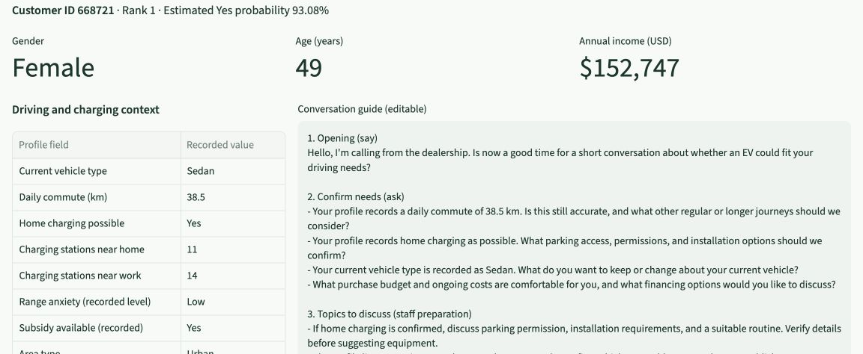
Staff can prepare an individual conversation
Synthetic profile example with an editable draft
EV Customer Prioritization
05
Notes:
The real app capture shows the Customer Conversation Guide for a synthetic selected profile. Staff can check the recorded context, edit the draft and prepare a suitable conversation. The guide does not invent offers, pricing, savings or subsidy eligibility. Recorded demographic details do not determine the suggested questions. Staff should verify the customer’s situation before using the script. The guide supports preparation and does not establish a purchase outcome.
Sources
app.py
ev_project/customer_details.py
ev_project/conversation_guide.py
Actual updated application screenshot: /Users/nguyenchau/Documents/Codex/2026-10-07/https-www-kaggle-com-competitions-playground/work/conversation_update_oct27/customer_conversation_guide.jpg

Slide 6
The top 10% contains more Yes labels
About 79 in 100 shortlisted profiles carry a Yes label
10,030
profiles selected from
100,300 evaluation profiles
4.51 times
the overall Yes-label share
Synthetic evaluation results. Actual outreach outcomes remain untested.
EV Customer Prioritization
06
Notes:
The ranking selected the top 10,030 of 100,300 held-out synthetic profiles. Of those selected, 78.783649% have a supplied Yes label. The overall evaluation sample has a 17.464606% Yes rate. Their ratio is 4.511046. The chart stores these two rates rounded to twelve decimal places and displays whole percentages. These figures measure the concentration of labels in this evaluation sample. They do not measure contact success, sales conversion or expected revenue. The model selection used a separate validation sample and excluded this holdout from fitting.
Sources
docs/reports/modeling/holdout_ranking.csv
docs/reports/modeling/holdout_metrics.csv
docs/reports/modeling/methodology.json

Slide 7
Capacity choices
The manager can trade a shorter list for broader coverage
Share reviewed | Profiles reviewed | Yes labels in list | All Yes profiles found
1% | 1,003 | 90% | 5%
5% | 5,015 | 85% | 24%
10% | 10,030 | 79% | 45%
20% | 20,060 | 66% | 76%
Larger lists find more Yes profiles, while their Yes-label share declines
EV Customer Prioritization
07
Notes:
All four choices use the same 100,300 held-out synthetic profiles. At 1%, 5%, 10% and 20% capacity, the selected counts are 1,003, 5,015, 10,030 and 20,060. The Yes-label shares are 90.129611%, 84.666002%, 78.783649% and 66.186441%. The shares of all Yes profiles captured are 5.160701%, 24.239310%, 45.110464% and 75.794942%. The slide rounds these percentages to whole numbers. A company can choose capacity based on staff time and the cost of review. No outreach outcome is implied.
Sources
docs/reports/modeling/holdout_ranking.csv

Slide 8
The data-to-action pipeline
Working prototype
Planned pilot
Planned feedback
Profile
data
Data
checks
Learn
patterns
Check
results
Rank
profiles
Manager
review
Customer
contact
Capture
outcomes
The tool supports staff review and downloadable conversation guides
A pilot would add approved contact and recorded real outcomes
EV Customer Prioritization
08
Notes:
The diagram uses native editable flowchart symbols and attached directional connectors. The working technical flow includes profile data, checks, learning from the labeled data, evaluation, scoring and a manager’s review. The shortlist and conversation-guide downloads support the handoff for staff review. Staff can edit a selected guide, download its TXT script, or export guides for the current shortlist as CSV. Contacting customers and capturing actual outcomes are planned pilot activities. The dashed return arrow shows that planned feedback would support future data checks and review before updates. Staff should review any updates based on that feedback before wider use.
Sources
ev_project/run_eda.py
ev_project/modeling.py
ev_project/scoring.py
app.py
docs/reports/modeling/methodology.json
Planned business pilot. Contact and feedback are not implemented as an operational campaign.

Slide 9
Recommendation: a reviewed pilot
Use the prototype to support shortlist review
Pilot scope
Evidence for the decision
Use approved customer profiles
with suitable permission.
Compare with the current selection
at the same review limit.
Set a review limit that matches
the team’s capacity.
Record actual contact and purchase
outcomes over an agreed period.
Have staff review every profile
before contact.
Check outcomes across customer
groups before expanding.
EV Customer Prioritization
09
Notes:
A small, reviewed pilot is the proposed next business step. The company should agree the review limit, suitable permissions, a comparison with its current process, the observation period and measures of success before contacting anyone. Staff should confirm the profile information. Real outcomes and subgroup checks are needed before deciding whether the tool should support broader use.
Sources
Project recommendation informed by docs/reports/modeling/holdout_ranking.csv
No operational pilot, conversion uplift or external validation has yet been measured.

Slide 10
Discussion: conversation guides
Question | Answer
How does the guide use a profile? | Draft sections use recorded travel, charging, range concerns and current vehicle. Staff confirm the details.
Can staff edit the guide? | The selected guide is editable. Staff verify facts and approve any contact. The app sends no messages.
What can staff download? | A selected script as TXT, or guides for the current shortlist as CSV, up to 1,000 profiles per batch.
Does this change the ranking? | Ranking scores stay the same. The guides support staff preparation. Actual sales outcomes need a pilot.
EV Customer Prioritization / Discussion
10
Notes:
Guides are draft conversation support based on recorded profile fields. Staff can edit a selected guide and download its TXT file. A bulk CSV contains guides for the current top-K shortlist, with a maximum of 1,000 profiles per batch. Staff verify facts and approve any contact. The app does not send messages or call customers. Ranking scores stay unchanged. Actual business outcomes still require a reviewed pilot.
Sources
app.py
ev_project/customer_details.py
ev_project/conversation_guide.py
Updated Customer Conversation Guide workflow and export controls.

Slide 11
Discussion: limits and next steps
Known limits
Planned before wider use
Synthetic data and unverified
purchase timing
No company sales outcomes
Fairness and real-world usefulness
remain untested
Some field definitions are unclear
Validate with approved real profiles
and measured business outcomes
Connect scoring to company systems
Package the tool for repeatable setup
Monitor input quality and failures
Decision today: agree a reviewed pilot and measures of success
EV Customer Prioritization / Discussion
11
Notes:
The limitations remain material. The source is synthetic, transaction timing is unverified, and no company outcome study or fairness audit has established suitability for deployment. A separate scoring service, a portable deployment package and monitoring are planned. In the implementation plan these correspond to API integration, Docker packaging and monitoring of input errors, scoring failures and changes in incoming data. These items are planned work, not completed product features.
Sources
docs/reports/tables/data_dictionary.csv
docs/reports/modeling/methodology.json
app.py
Project roadmap: API integration, Docker packaging, monitoring and external validation remain planned.

