Slide 1
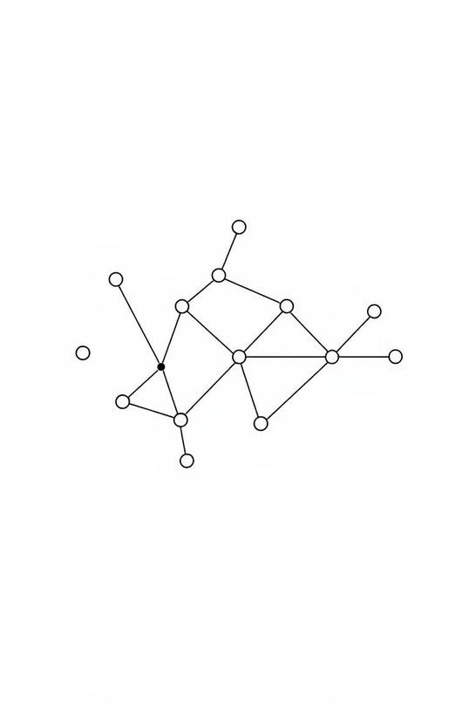
CSE106: DISCRETE MATHEMATICS
Mini Project 3 - Directed Graph
Presented by:
SM TanzimHassan(2025-1-60-184)
Sharmin Jahan Nijhum (2025-1-60-184) Nur Mohammad Mahi (2025-1-60-197)

Slide 2
Project Objective : What We Aimed To Achieve
1
Directed Grap Generatio
Creating a directed graph using an adjacency matrix from scratch.
2
Degree Calculation
Accurately computing in-degrees and out-degrees for all nodes.
3
Fudamental Property Verification
Confirming the mathematical principle : Sum(In-degree) = Sum(Out-degree).
4
Performance Measurement
Measuring the computational time for different graph sizes to analyze efficiency.
5
Scalability Analysis
Repeating experiments for increasing graph sizes (n = 1000 to 5000) to observe performance trends.

Slide 3

Code Overview: Essential Includes & Definitios
#include <stdio.h> #include <stdlib.h> #include <time.h> #define MAX_N 5000
Explanation
<stdio.h>: Standard Input/Output library for print statements.
<stdlib.h>: Standard library for general utilities,
including random number generation (`rand()`).
<time.h>: For time-related functions (`time()`,
`clock()`) used in performance measurement.
MAX_N = 5000: Defines the maximum graph
size our program can handle, ensuring sufficient
memory allocation.

Slide 4

Graph Contructio : Adjacency Matrix Creation
void generateGraph(int n, int graph[n][n]) {
Explanation
This function initializes the adjacency matrix for our directed graph:
for (int i = 0; i < n; i++) {
for (int j = 0; j < n; j++) {
if (i == j) {
It iterates through each cell graph[i][j] of the n x n
matrix.
No Self-Loops: For diagonal elements (i == j),
graph[i][j] is set to 0, meaning no node connects
to itself.
Random Edges: For all other connections, rand()
% 2 randomly assigns either 0 (no edge) or 1 (an
edge exists), simulating a random directed graph.
graph[i][j] = 0;
}else{
graph[i][j]=rand()%2;
}
}
}
}

Slide 5

Degree Computation : In-degrees & Out- degrees
Explanation
voidcomputeDegrees(intn,intgraph[n][n],intindegree[],int
outdegree[]) {
Thisfunction calculates the in-degree and out-
for(inti=0; i < n; i++) {
degree for each node in the graph:
indegree[i] = 0;
outdegree[i] = 0;
for(intj= 0; j < n; j++) {
For each node i, it initializes its in-degree and out-
degree to 0.
It then iterates through all possible connections
from node i to j:
if(graph[i][j] == 1)
outdegree[i]++;
if(graph[j][i] == 1)
If graph[i][j] == 1, it means there's an edge
from i to j, so outdegree[i] is incremented.
If graph[j][i] == 1, it means there's an edge
from j to i, so indegree[i] is incremented.
indegree[i]++;
}
}
}

Slide 6

Main Function : Setting Up the Experiment
int main(){
Explanation
srand(time(0));
srand(time(0)): Initializes the random number generator. Using time(0) as the seed ensures that
each run of the program generates a different set of random graphs, making the results more robust.
int sizes[] = {1000, ..., 5000};: Defines an array of
integers representing the different values of n
(number of nodes) for which the experiment will
be conducted. This allows us to test the
algorithm's performance across varying graph
sizes.
int sizes[] = {1000, 2000, 3000, 4000, 5000};
int numSizes = 5;
This setup prepares the environment for the core
experimental loop.

Slide 7

Main Function : The Core Experimental Loop
Explanation
for (int s = 0;s<numSizes;s++){
int n = sizes[s];
Iteration: Theloop runs for each specified graph
static int graph[MAX_N][MAX_N];
int indegree[MAX_N], outdegree[MAX_N];
size (n) from the sizes array.
Dynamic Arrays: graph, indegree, and outdegree
arrays are declared with MAX_N size to
accommodate the largest possible graph, reused
for each iteration.
Graph Generation: generateGraph populates the
adjacency matrix for the current n.
Time Measurement: clock() is used to capture
the start and end times around the
computeDegrees function call, allowing precise
measurement of its execution time.
clock_t start = clock();
computeDegrees(n, graph, indegree, outdegree);
clock_t end = clock();
double timeTaken = ((double)(end - start)) * 1000.0 /
CLOCKS_PER_SEC;
generateGraph(n, graph);
}

Slide 8

Main Function : Verification & Results Output
long long sumIn = 0, sumOut=0;
Explanation
for (int i = 0; i < n; i++) {
Summation: It calculates the total sum of all in- degrees and out-degrees.
Verification: Critically, it checks if Sum(In-
degree) equals Sum(Out-degree). This is a
fundamental property of any directed graph, as
every edge contributes exactly one to an in-
degree and one to an out-degree across the entire
graph.
Output: The program then prints the graph size
(n), the calculated sums, the verification status,
and the measured computational time for that
specific n.
sumIn += indegree[i];
sumOut += outdegree[i];
}
printf("For n = %d:\n", n);
printf(" Sum of In-degrees = %lld\n", sumIn);
printf(" Sum of Out-degrees = %lld\n", sumOut); if (sumIn == sumOut) {
printf(" Verified: Sum(In) == Sum(Out)\n");
} else {
}
printf(" ERROR: Sum(In) != Sum(Out)\n");
This section provides the concrete results and
validates the graph property.
printf(" Computational Time = %.3f ms\n\n", timeTaken);
}

Slide 9
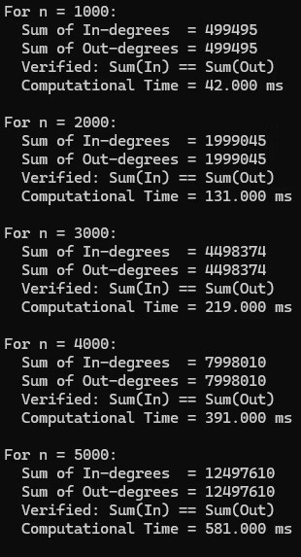
Experimental Result : Sample Output
Here are sample outputs demonstrating the program's execution for different graph sizes,confirming the degree sum
property and showing the computational time.
For n = 1000:
For n = 2000:
Sum of In-degrees = 499495 Sum of Out-degrees = 499495
Sum of In-degrees = 1999045 Sum of Out-degrees = 1999045
Verified: Sum(In) == Sum(Out)
Verified: Sum(In) == Sum(Out) Computational Time = 131.000 ms
Computational Time = 42.000 ms
Repeat the steps for n = 3000, 4000, 5000

Slide 10
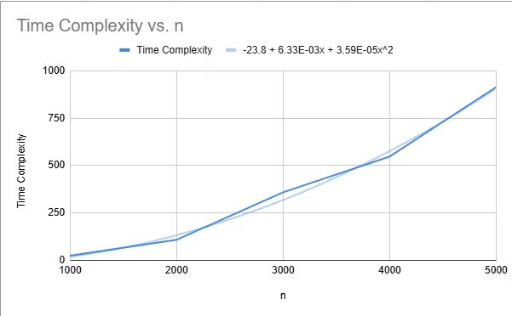
Time Complexity: Theory Meets Experiment
Theoretical Analysis
Experimental Validation
The computeDegrees function involves nested loops.
The outer loop runs n times (for each node i).
The inner loop runs n times (for each possible
connection j).
Each operation inside the inner loop is constant time.
Therefore, the total time complexity is proportional to n * n, which is O(n²).
The line graph clearly shows that as n increases, the computational time grows quadratically, precisely matching the O(n²) theoretical prediction. This confirms the efficiency of our algorithm.

Slide 11

conclusion
The program verifies Sum(In-degree) = Sum(Out-degree).
Time complexity:O(n²).
Experimental results agree with theoretical analysis. Scales correctly up to n = 5000.

