Slide 1
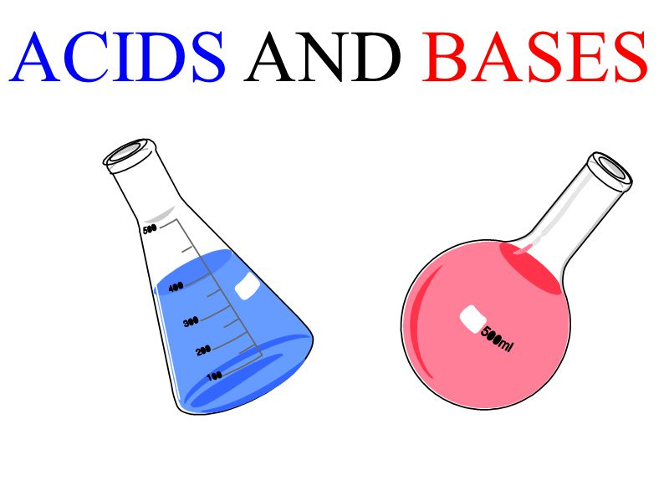
Arrhenius Acids and Bases
Subject: Engineering Chemistry-I
Course Code: CHE109
M.Nura Alam Naim
ID:2022-3-60-123

Slide 2
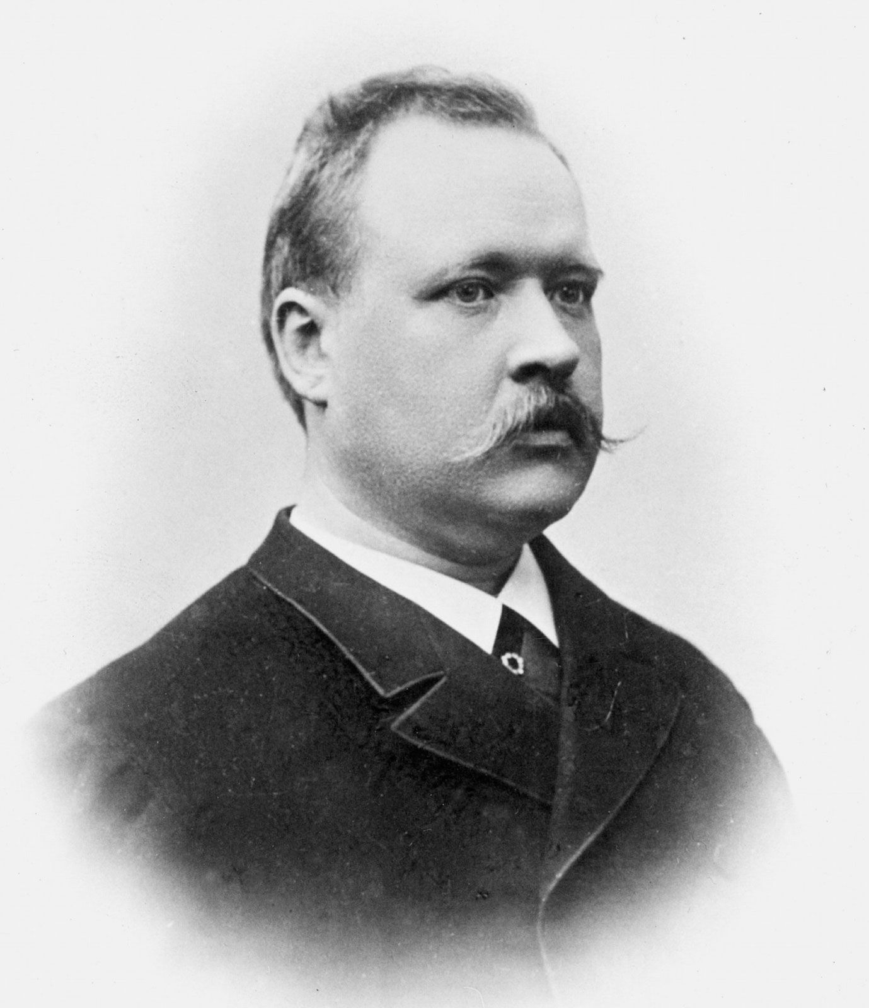
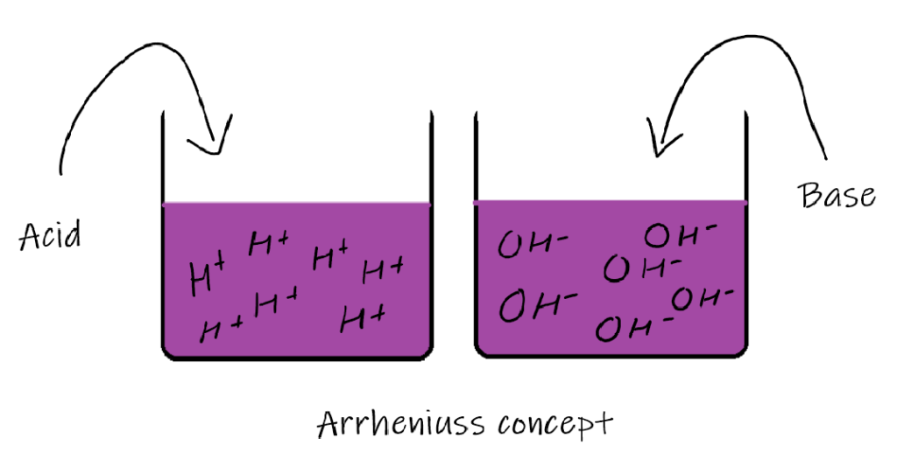
Introduction
First proposed by Swedish chemist Svante Arrhenius in 1884.
Acids produce H+ ions in aqueous solution .
Bases produce OH- ions in aqueous solution.

Slide 3
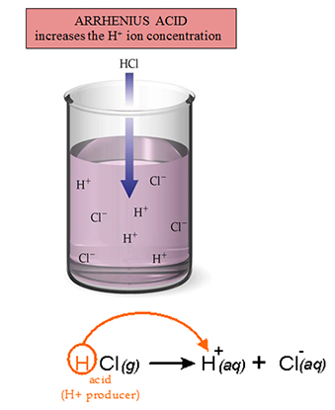
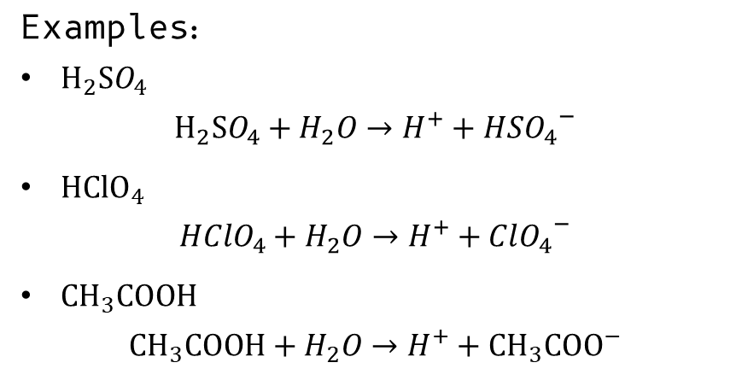
Arrhenius Acid:
Acids are defined as a compound or element that releases hydrogen (H⁺) ions into the solution which increases the concentration of H+ or proton in an aqueous solution.
Examples:
$H_{2}SO_{4}$
$$H_{2}SO_{4}+H_{2}O→H^{+}+HS{O_{4}}^{−}$$
$HClO_{4}$
$$HClO_{4}+H_{2}O→H^{+}+{ClO_{4}}^{−}$$
$CH_{3}COOH$
$$CH_{3}COOH+H_{2}O→H^{+}+{CH_{3}COO}^{−}$$

Slide 4

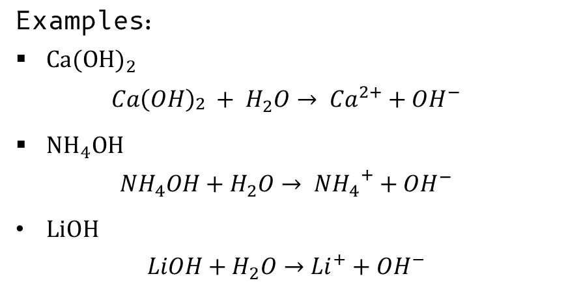
Arrhenius Base:
Acids are defined as a compound or element that releases hydroxyl (OH-) ions into the solution which increases the concentration of OH- in an aqueous solution.
Examples:
$Ca{(OH)}_{2}$
$$Ca{\left(OH\right)}_{\begin{aligned}2 \\ \end{aligned}}+ H_{2}O→ {Ca}^{2+}+{OH}^{−}$$
${NH}_{4}OH$
$${NH}_{4}OH+H_{2}O→ {NH_{4}}^{+}+{OH}^{−}$$
$LiOH$
$$LiOH+H_{2}O→{Li}^{+}+{OH}^{−}$$

Slide 5
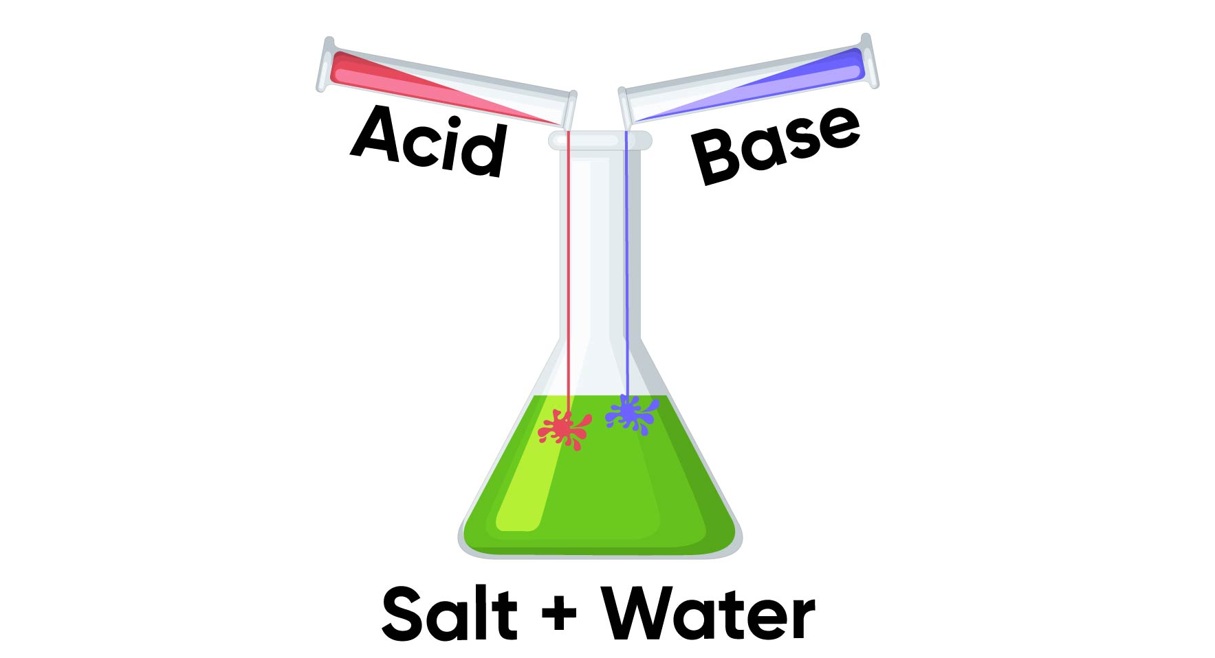
Neutralization Reaction:
Arrhenius acid and Arrhenius base react, salt and water are formed as products, the reaction is known as a neutralization reaction
$$HCl+NaOH →NaCl+H_{2}O$$

Slide 6
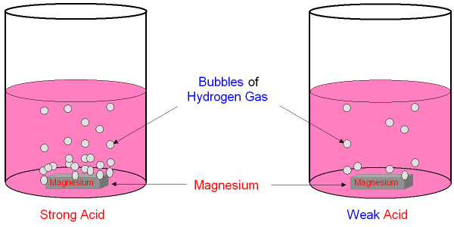
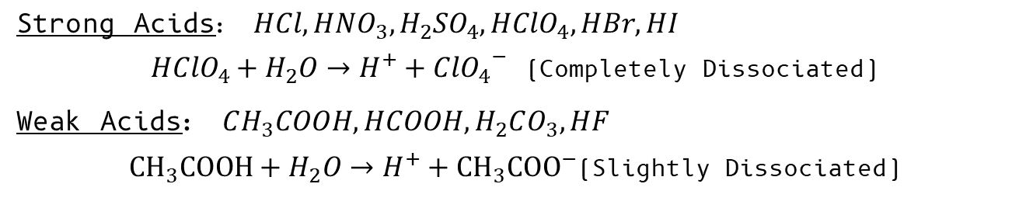
Utilities of Arrhenius Theory:
The strength of Acid or base:
Strength depends on dissociation in water of ions
Strong Acids: $HCl, HNO_{3}, H_{2}SO_{4},HClO_{4}, HBr, HI$
$HClO_{4}+H_{2}O→H^{+}+{ClO_{4}}^{−}$ (Completely Dissociated)
Weak Acids: $CH_{3}COOH, HCOOH, H_{2}CO_{3}, HF$
$CH_{3}COOH+H_{2}O→H^{+}+{CH_{3}COO}^{−}$(Slightly Dissociated)

Slide 7
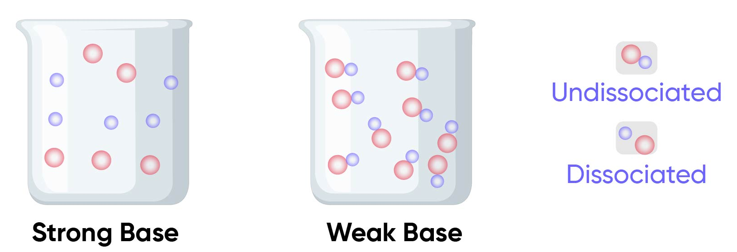
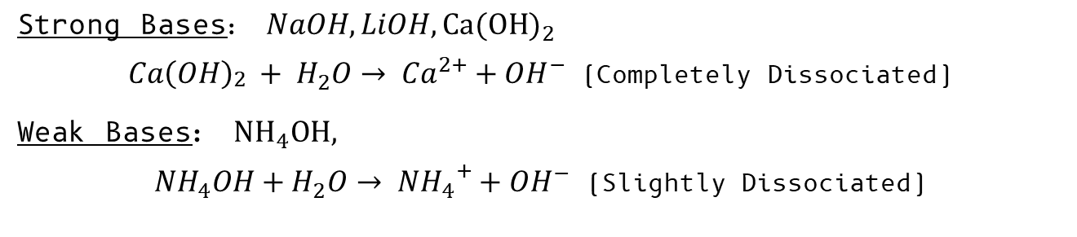
Strong Bases: $NaOH, LiOH,Ca{(OH)}_{2}$
$Ca{\left(OH\right)}_{\begin{aligned}2 \\ \end{aligned}}+ H_{2}O→ {Ca}^{2+}+{OH}^{−}$ (Completely Dissociated)
Weak Bases: ${NH}_{4}OH,$
${NH}_{4}OH+H_{2}O→ {NH_{4}}^{+}+{OH}^{−}$ (Slightly Dissociated)

Slide 8
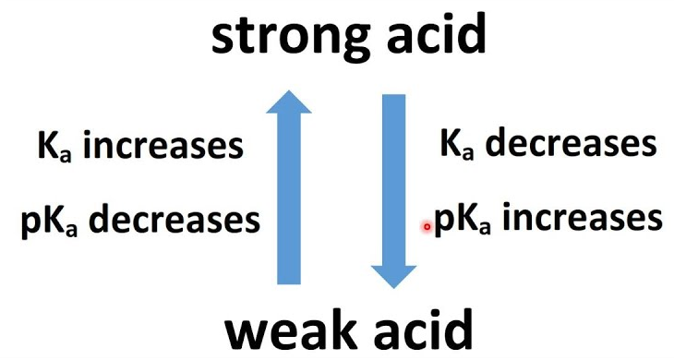
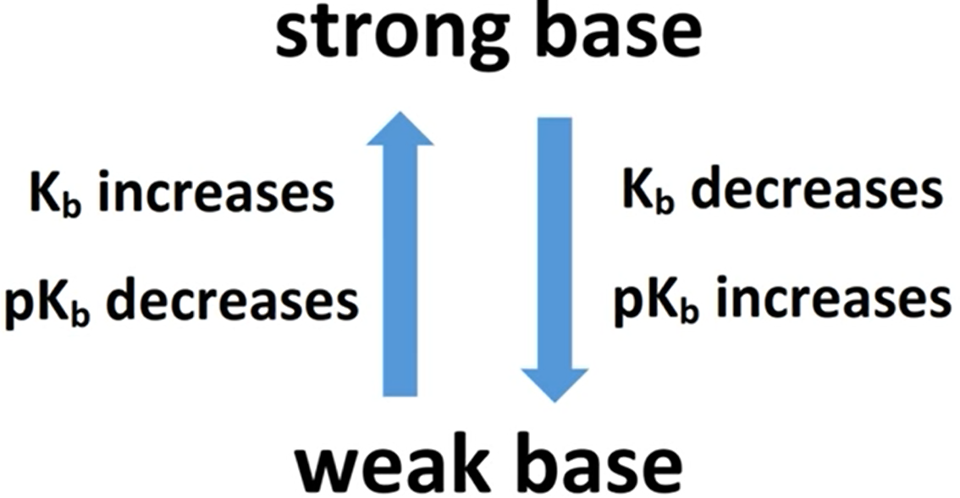
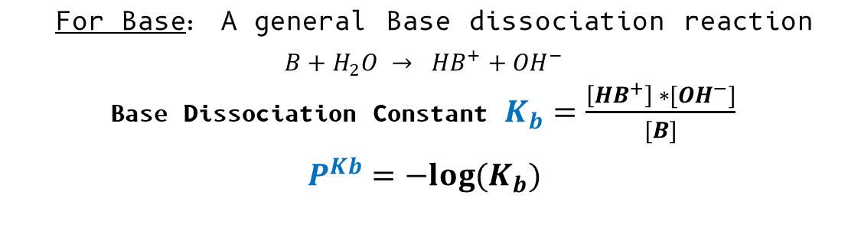
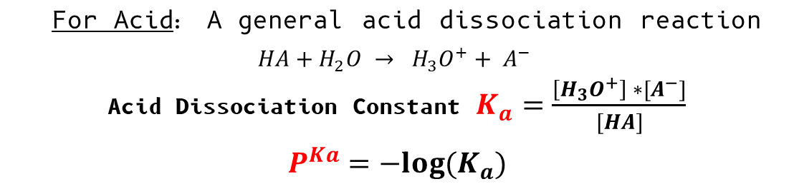
The strength can be determined by dissociation constant in a solution.
For Acid: A general acid dissociation reaction
$$HA+H_{2}O → {H_{3}O}^{+}+ A^{−}$$
Acid Dissociation Constant $K_{a}=\frac{\left[{H_{3}O}^{+}\right] ∗[A^{−}]}{[HA]}$
$$P^{Ka}=−log⁡(K_{a})$$
For Base: A general Base dissociation reaction
$$B+H_{2}O → {HB}^{+}+{OH}^{−}$$
Base Dissociation Constant $K_{b}=\frac{\left[{HB}^{+}\right] ∗[{OH}^{−}]}{[B]}$
$$P^{Kb}=−log⁡(K_{b})$$

Slide 9


Power of Hydrogen ($P^{H}$):
$P^{H}$ is a measure of the acidity or basicity of a solution
$$P^{H}=−log⁡({[H}^{+}])$$

Slide 10
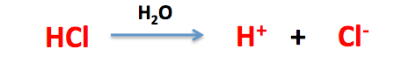
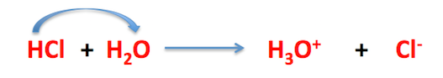

Limitations of Arrhenius Theory:
Free $H^{+}$ions do not exists in water
Only limited to water solvent
Other Bases without ${OH}^{−}$ can not be classified. For examples- $CaO, {NH}_{3}$

Slide 11
Conclusion:
It can be concluded that The Arrhenius Theory of Acids and Bases played an important role in physical chemistry. Though this theory is not sufficient enough to discuss all the acids and bases, this theory introduced so many properties of acids and bases which opened the way to discovering more about chemical compounds.

Slide 12
Thanks!
Does anyone have any questions?

