Slide 1
VEHICLE MANAGEMENT SYSTEM
A simple step to change the life at work

Slide 2
Mini Project Details:
Course Code: CSE 103
Course Title: Structured Programming.
Section: 12
Date: 02-01-2023
Submitted by: Group 3
Manoshi Ghosh Pushpita | 2022-3-60-135
Aysha Ferdous Anika | 2022-3-60-142
M. Nura Alam Naim | 2022-3-60-123

Slide 3

INTRODUCTION
“Vehicle Management System” is a program where a user can store any vehicle’s information such as the vehicle’s unique ID, name, manufacturer name, and manufacturer date. Users can also access the information easily and change the information.

Slide 4
CONCEPTS OF PROGRAM
Intellegent
Modern
Efficient
Fast
This program can store vehicles data in memory
This program helps the users to come out from the traditional way of data entry
This program can have an infinite number of information
The program serves information very fastly to the user

Slide 5
—EDMUND BURKE
“Good order is the foundation
Of all things.”

Slide 6
OVERVIEW

Slide 7
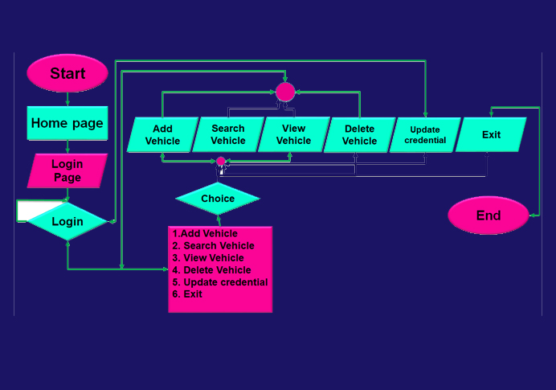
FLOW CHART

Slide 8
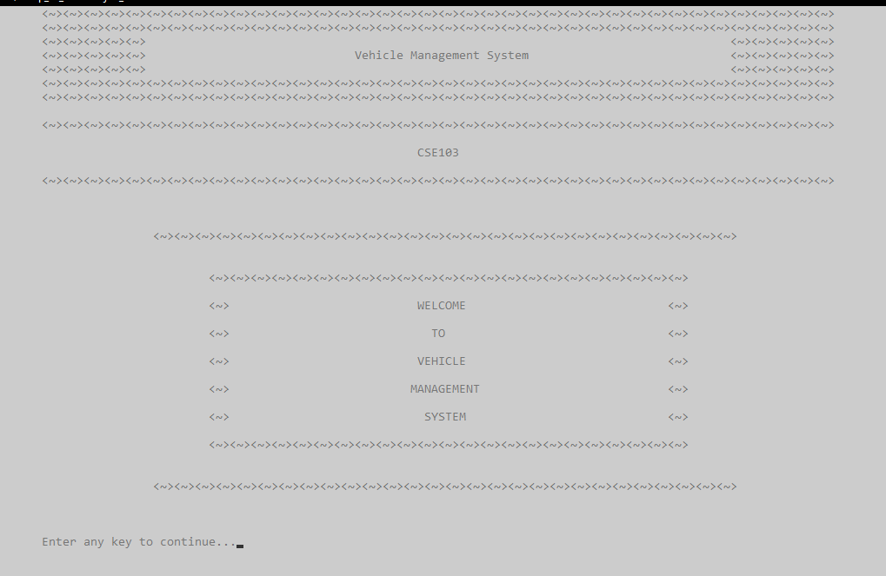
At first, this interface will be shown to the user. After pressing enter, the user can go to the next page.

Slide 9
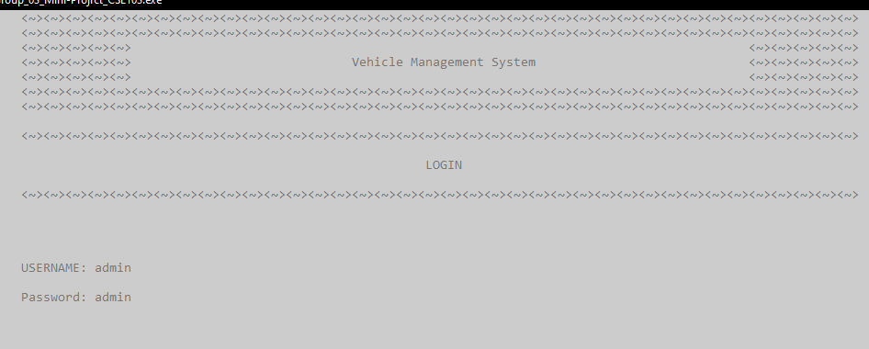
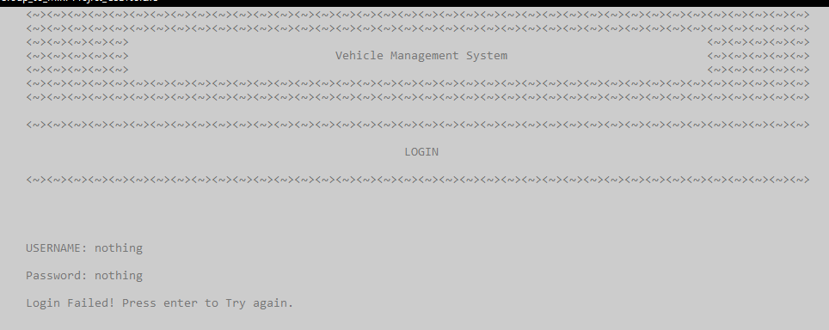
For security purposes, The user has to log in to get access to the program.
If someone tries to access the program with an invalid username and password, this will be shown until the user enters the right credentials

Slide 10
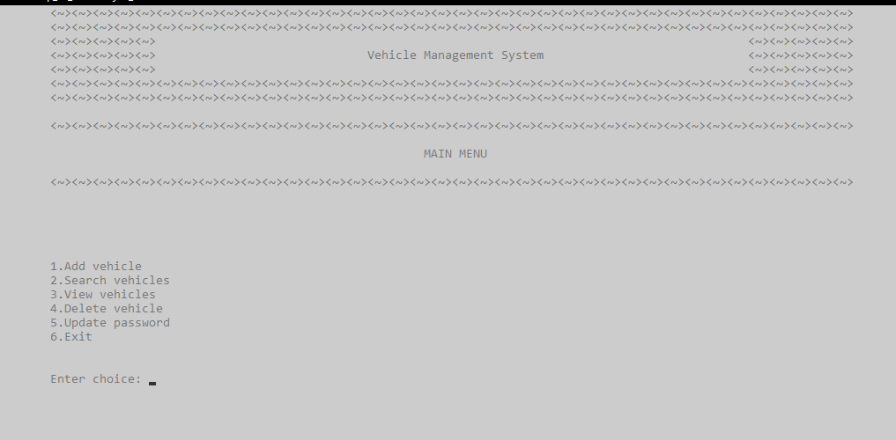
After logging in successfully, the user will find the tasks he or she can do what this program. He just has to press the choice number to begin the task.

Slide 11
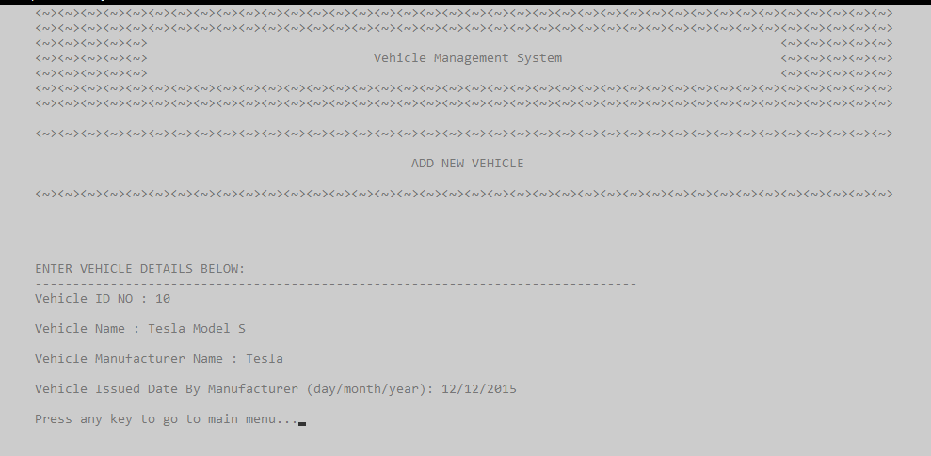
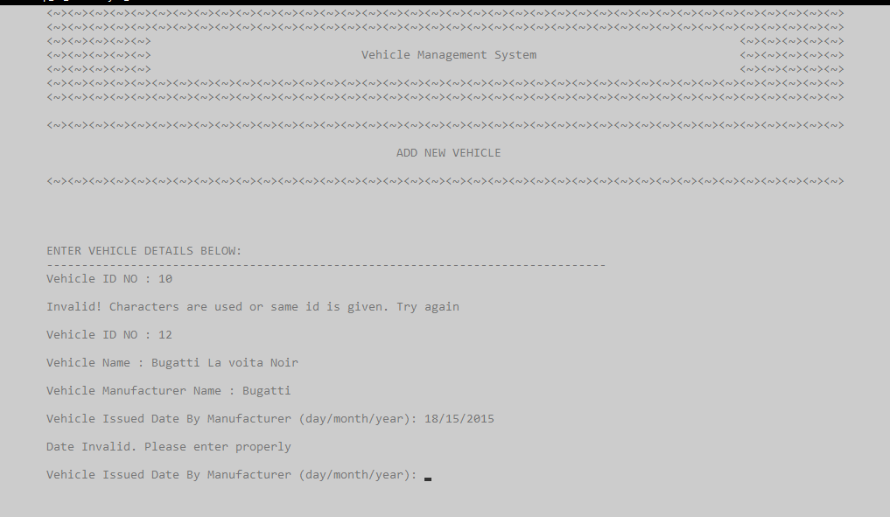
If the user enters choice number 1, he od she can add vehicle details. These details will be necessary for the user to do other tasks
The user has to enter a unique id for every vehicle and a valid manufacturer date to store data.

Slide 12
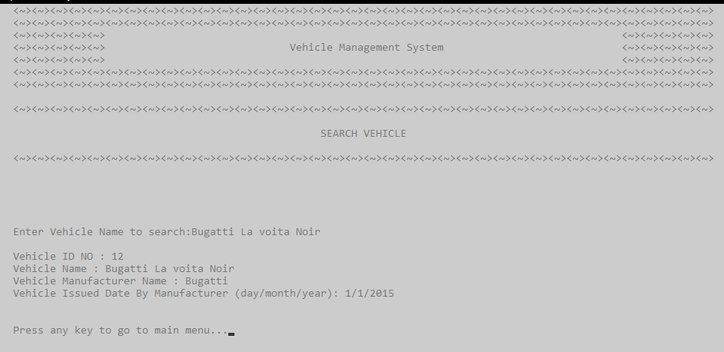
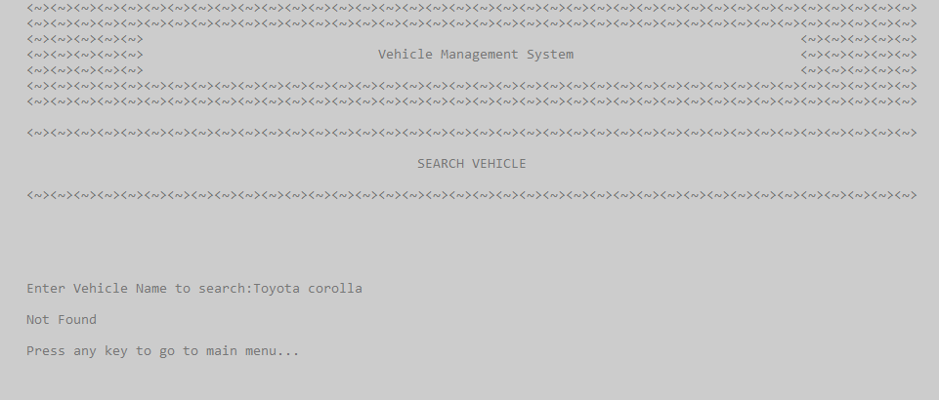
To search for any vehicle, the user needs to choose number 2 from the menu. Then the user will be asked to enter the vehicle name. If the vehicle is in the memory, details will be shown. Otherwise, the program will show no records and tell the user to go to the main menu.

Slide 13
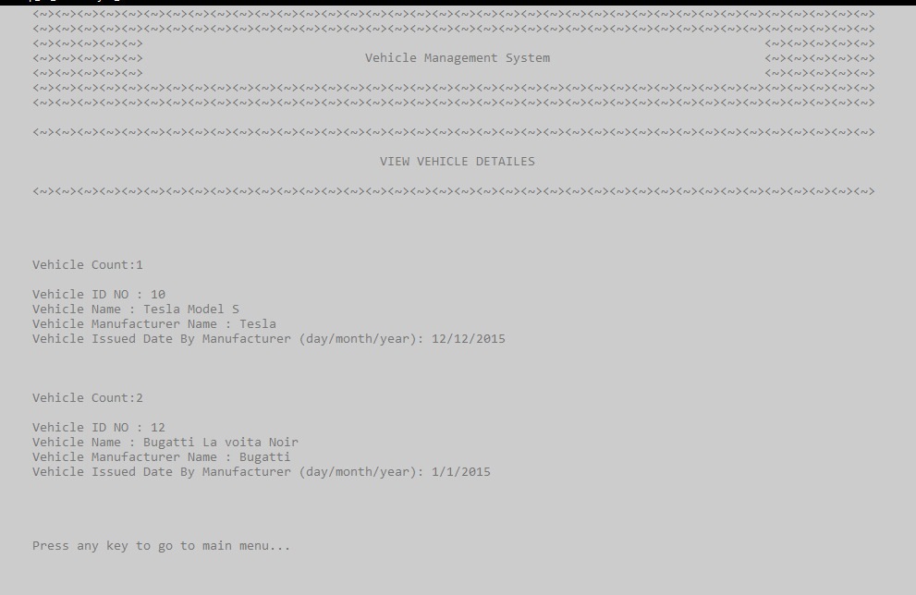
Choice number 3 will take the user to details of every vehicle at a time. There is also a count number that will tell the user to see how many vehicles have been entered.

Slide 14
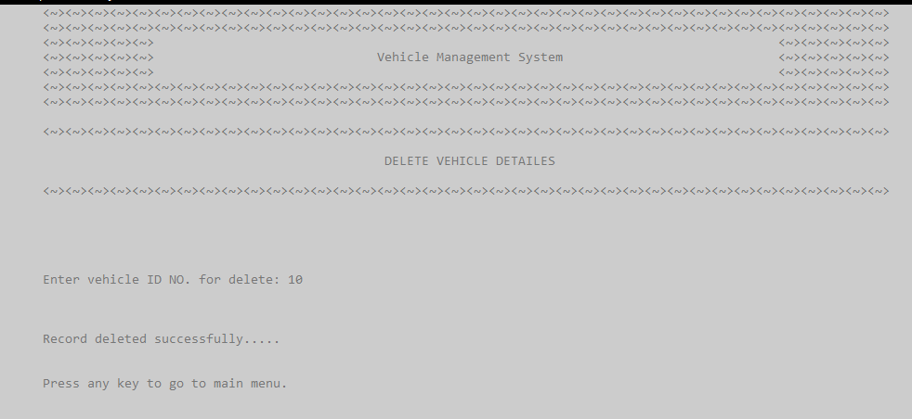
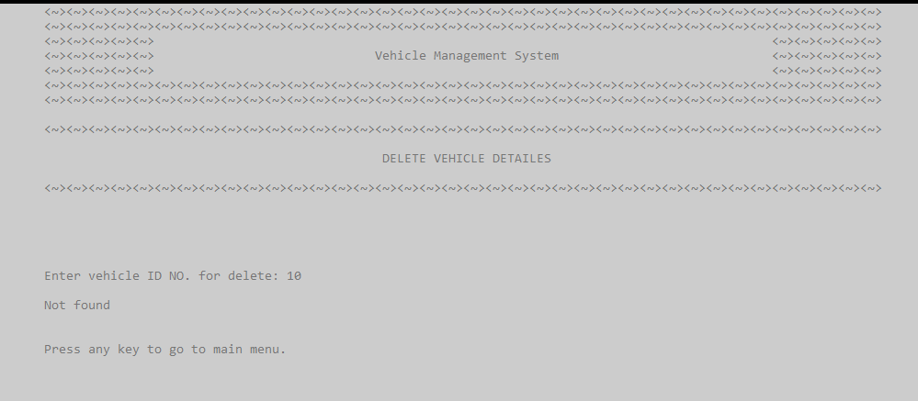
To delete details of any vehicles, the user will need to select choice number 4. If the enters the right id number of the vehicle, details will be deleted.
If the program does not find the entered id number in the memory, this message will be shown.

Slide 15
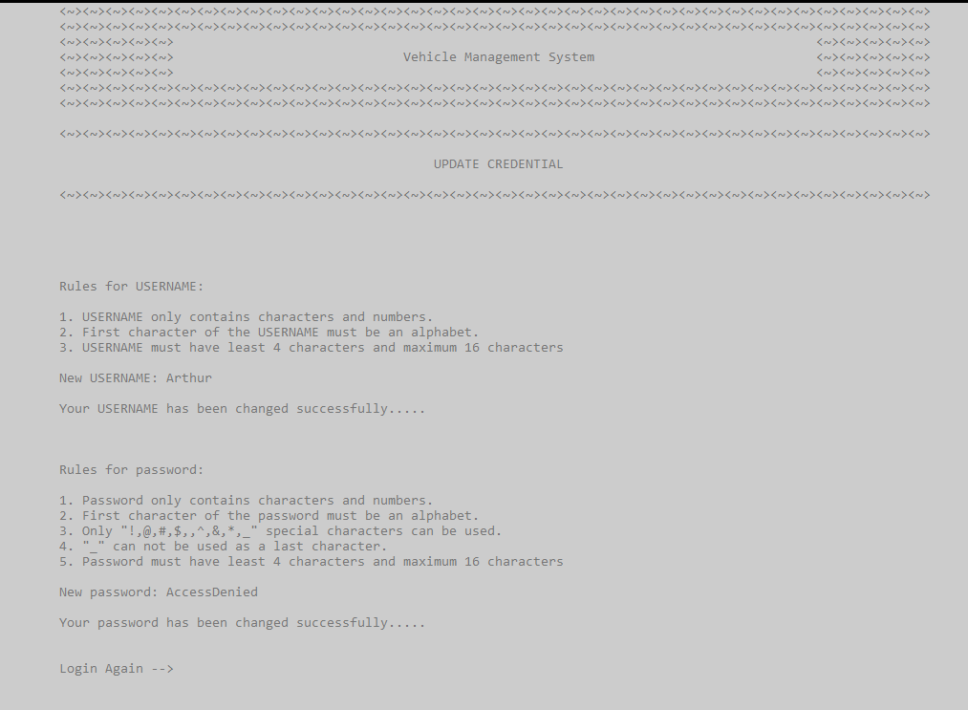
To update and password, the user will select choice number 5. Then he or she can set his own username and password according to the rules. After that, he will need to log in again.

Slide 16
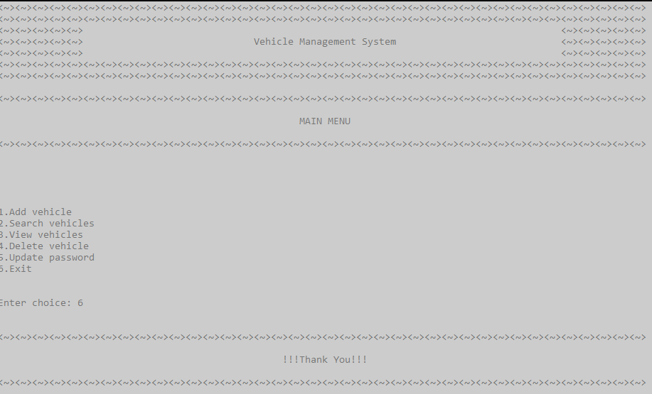
To exit the program, the user will have to select 6 from the main menu. There will be a thank you message when the user exits the program.

Slide 17
FEATURES OF THE PROGRAM
Security
Productivity
Accessibility
The Users will have very secure way to store his information
All information about vehicles can be stored digitally and accurately
The users can have any information in a short period of time

Slide 18
THANKS!
Created By: Team 3

