Slide 1
Can metadata identify highly rated apps?
Existing US App Store apps
Class 1: rating ≥ 4.5
Class 0: rating < 4.5
2,029
eligible apps
Seven metadata inputs · Four classifiers · Fixed holdout
APP STORE ML / MIDTERM • 01 / 09
Notes:
0:00–0:50. Introduce binary classification among existing apps with 50+ ratings. We are not predicting app success before launch. Explain label threshold.

Slide 2
Data source and collection conditions
Apple iTunes Search API · US storefront
17 requests used; 132 keywords planned
Pause ≥3.2 seconds; cache raw responses privately
Latest observation per trackId; at least 50 ratings
robots.txt disallows /search* • Raw JSON/descriptions stay private
APP STORE ML / MIDTERM • 02 / 09
Notes:
0:50–1:50. Describe instructor conditions and the robots.txt discrepancy. Do not say robots.txt allows collection. Explain keyword sampling and overlap. Sources: https://performance-partners.apple.com/search-api and https://itunes.apple.com/robots.txt. Raw data stays private.

Slide 3
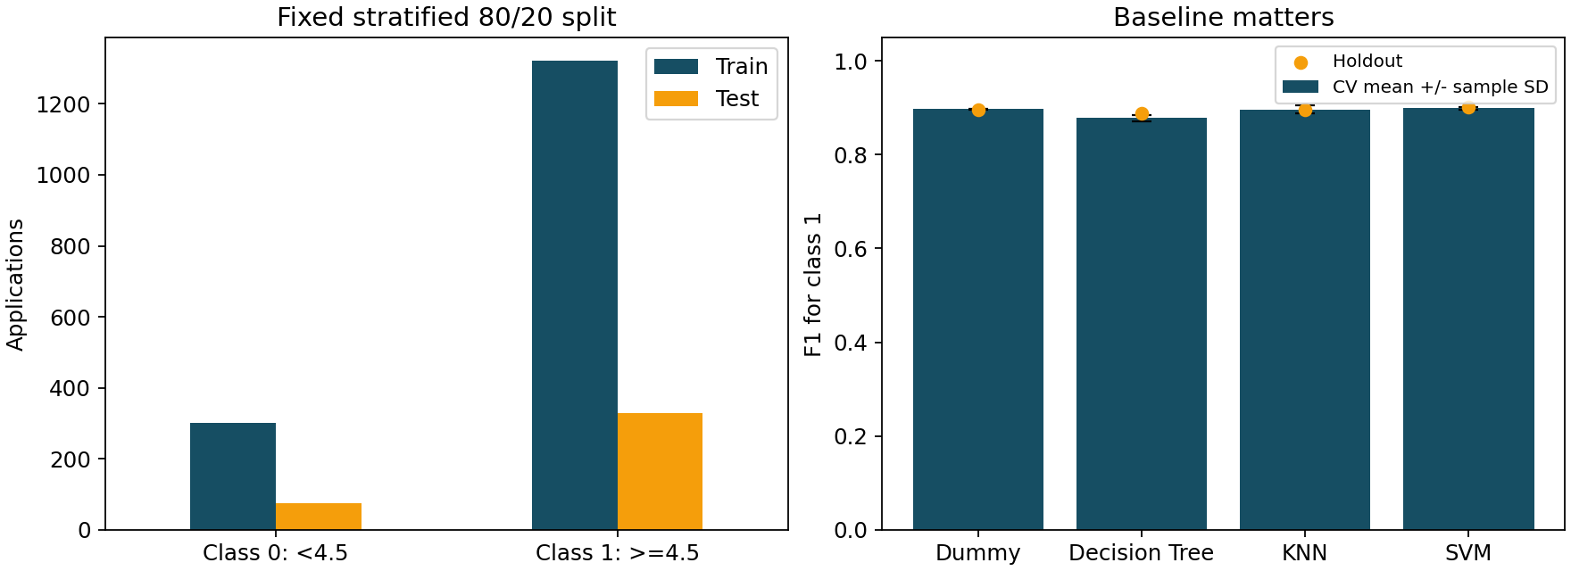
Cleaning and class balance
Raw rows: 2,763 → eligible unique apps: 2,029
APP STORE ML / MIDTERM • 03 / 09
Notes:
1:50–2:50. Explain minimum sample size, invalid values, duplicates and class imbalance. The right chart previews comparison with a baseline; detailed metrics follow.

Slide 4
Seven inputs; rating fields are excluded
price_usd · size_mb · primary_genre
content_advisory_rating · language_count
release_year · update_recency_days
averageUserRating → target only
userRatingCount → ≥50 eligibility filter only
APP STORE ML / MIDTERM • 04 / 09
Notes:
2:50–3:40. Explain age content category versus user rating. Dates are measured at collection. Descriptions are captured only for the later text-analysis phase.

Slide 5
Validation without data leakage
Stratified 80/20 split · random_state = 42
Five-fold stratified CV within train
Fold-local imputation → encoding/scaling → model
Dummy · Decision Tree · KNN · SVM
Selected by mean CV F1: SVM
APP STORE ML / MIDTERM • 05 / 09
Notes:
3:40–4:40. Explain the permanent 80/20 split and five folds within train. Model choice uses mean CV F1. No tuning against test. Fixed hyperparameters were declared in advance. Reference: https://scikit-learn.org/stable/modules/cross_validation.html

Slide 6
Results: F1 needs a baseline
Model | CV F1 ± SD | Test F1 | AUC | Precision | Recall
Dummy | 0.897 ± 0.001 | 0.897 | 0.500 | 0.813 | 1.000
Decision Tree | 0.878 ± 0.007 | 0.888 | 0.678 | 0.842 | 0.939
KNN | 0.896 ± 0.009 | 0.896 | 0.639 | 0.833 | 0.970
SVM | 0.899 ± 0.003 | 0.901 | 0.620 | 0.826 | 0.991
SVM: holdout F1 0.901 vs Dummy 0.897 (gain +0.004); ROC-AUC 0.620. It detected 7/76 lower-rated apps. The F1 gain is descriptive; no statistical significance is claimed.
APP STORE ML / MIDTERM • 06 / 09
Notes:
4:40–5:50. Compare CV mean/SD and fixed-test metrics. SD is fold variation, not a confidence interval. Explain why majority prediction can have high F1. SVM: holdout F1 0.901 vs Dummy 0.897 (gain +0.004); ROC-AUC 0.620. It detected 7/76 lower-rated apps. The F1 gain is descriptive; no statistical significance is claimed.

Slide 7
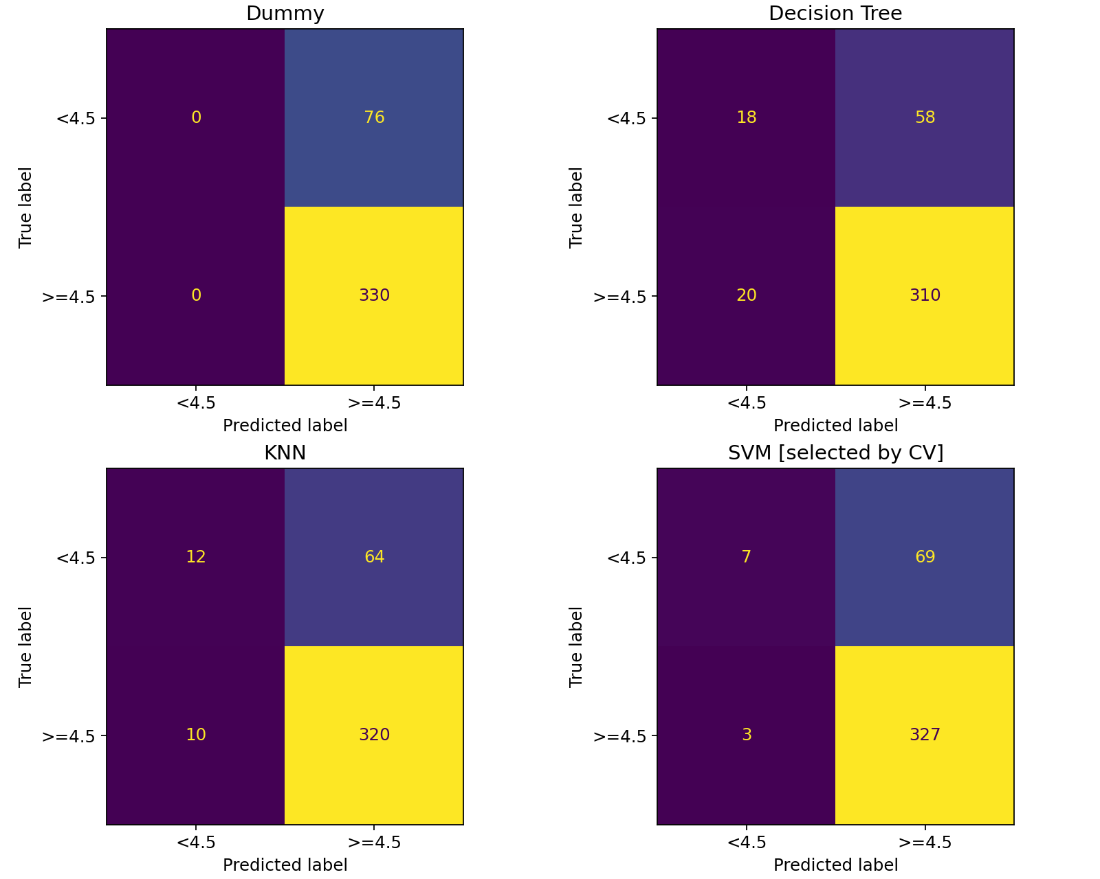
Where predictions fail
APP STORE ML / MIDTERM • 07 / 09
Notes:
5:50–6:50. Rows are actual classes, columns predictions. Explain FP and FN. Compare majority-class behavior to the selected model. Use ROC-AUC alongside F1.

Slide 8
Real cases, anonymized
Case 1 · FP · true 0, predicted 1
True rating is within 0.1 of the 4.5 boundary
Case 4 · FN · true 1, predicted 0
Metadata alone does not explain the observed rating
Full private audit is generated locally; public cases omit IDs, names and exact ratings.
APP STORE ML / MIDTERM • 08 / 09
Notes:
6:50–7:50. These are actual test errors with identifying raw fields removed. Cases nearest the 4.5 boundary are selected deterministically within FP and FN. Discuss plausible limitations, not unproven causes.

Slide 9
Conclusion and next steps
SVM: holdout F1 0.901 vs Dummy 0.897 (gain +0.004); ROC-AUC 0.620. It detected 7/76 lower-rated apps. The F1 gain is descriptive; no statistical significance is claimed.
Limits: search-ranking bias, one snapshot, developer overlap
No evidence for pre-launch success prediction
Final: neural network · text analysis · Streamlit
APP STORE ML / MIDTERM • 09 / 09
Notes:
7:50–9:00. State the numerical finding honestly, including when baseline wins. Limit claims to existing US apps with 50+ ratings. Discuss future developer-group and temporal splits. Neural networks, text features and Streamlit are for Final.

