Slide 1
BatchFence
Contain the right stock.
Know what to ask next.
Source evidence, reviewed decisions and exact containment plans in one web and Windows workbench.
0.2.0 · Working public app · Synthetic records · Agent-operated review
Notes:
Intended user: quality manager at a small manufacturer. Fictional decorative housings, no safety certification. Integration of cause diagnosis, evidence planning and causal revisions is a positioning hypothesis, not a world-first claim.

Slide 2
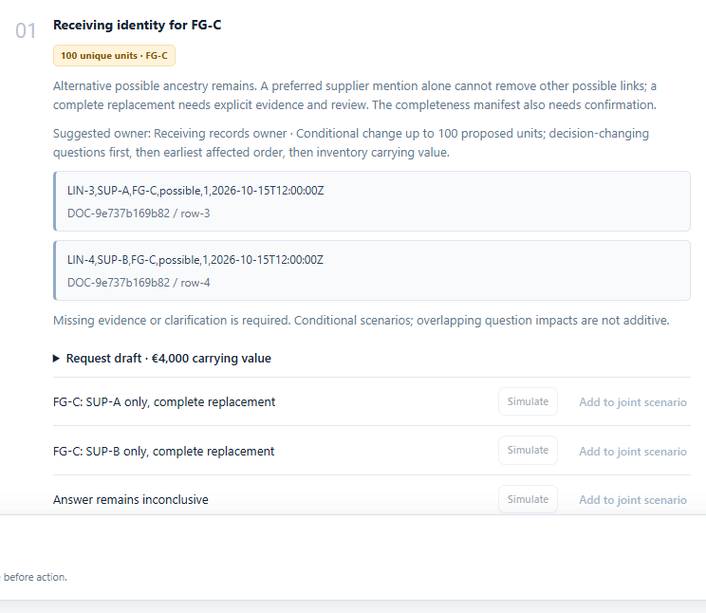
The next evidence question
A source-linked receiving gap
FG-C has 100 units with two possible parents. The question names the exact unresolved relationship.
Each question points to its source, affected pools and suggested owner.
Saved fresh AMD case · synthetic records · source-linked question
Notes:
Source: docs/release-0.2.0/upgrade-browser-final/results.json and tests/test_upgrade.py. Synthetic UI check. A shared unconfirmed boundary holds 1,200; only FG-C has actual ambiguous receiving identity. Complete ancestry is not falsely described as missing.

Slide 3
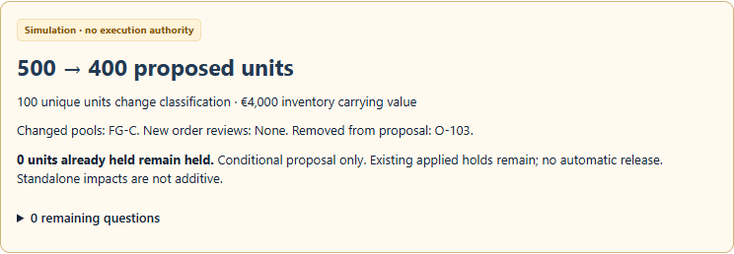
Conditional evidence impact
500 → 400 proposed units
If a complete record confirms
SUP-B-only ancestry for FG-C.
€4,000 of inventory value changes classification. Existing holds remain.
Simulation · no approval authority · carrying value is not savings
Notes:
Source: test_readonly_complete_identity_impact; scripts/upgrade-browser.cjs. Synthetic immutable scenario: FG-C100 at EUR40, SUP-B-only complete record changes500 to400. CompleteSUP-A or inconclusive keeps500. Standalone impacts are not additive.

Slide 4
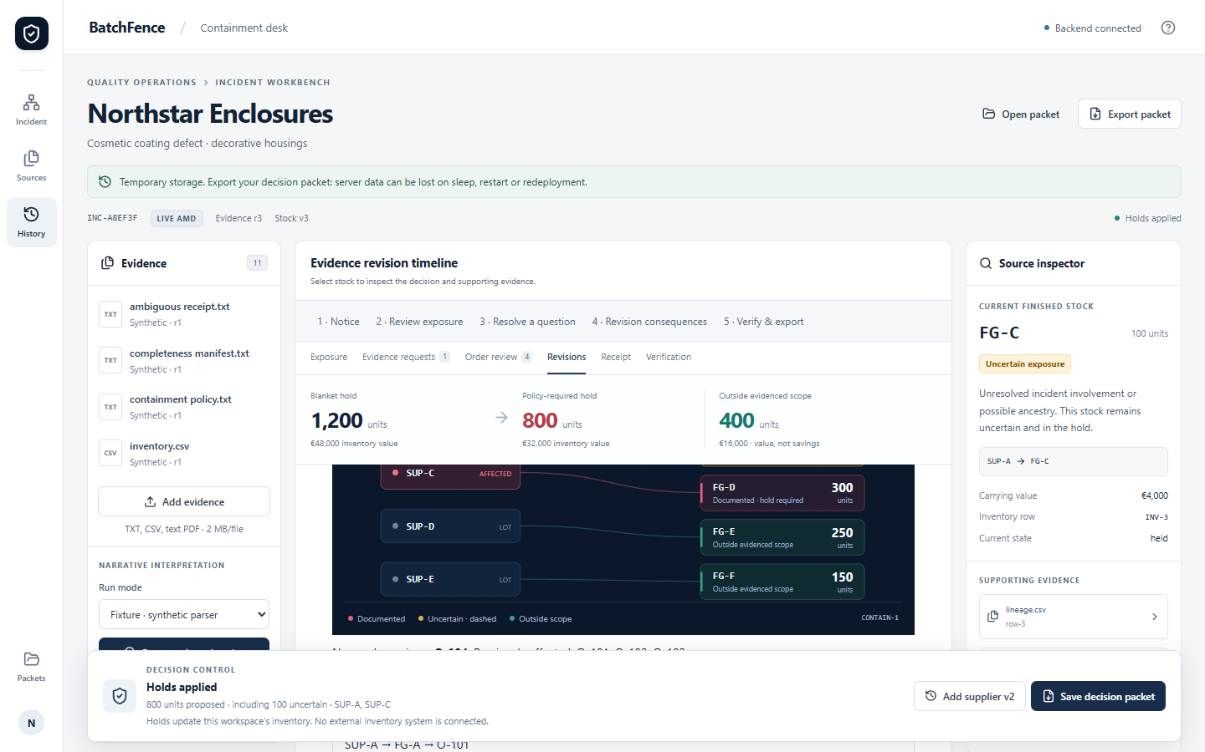
Why the revision adds 300 units
SUP-C → FG-D → O-104
The revised supplier notice
expands the proposal to 800.
The earlier approval is stale.
Recorded view of fresh AMD evidence · synthetic data · agent review
Notes:
Source: docs/release-0.2.0/live/notice2-raw-run.json, review2-packet.json, causal-comparison.json. Actual fresh configured AMD response; agent-operated source review. SUP-C toFG-D300 toO-104,500to800 and3to4orders. No independent human validation.

Slide 5
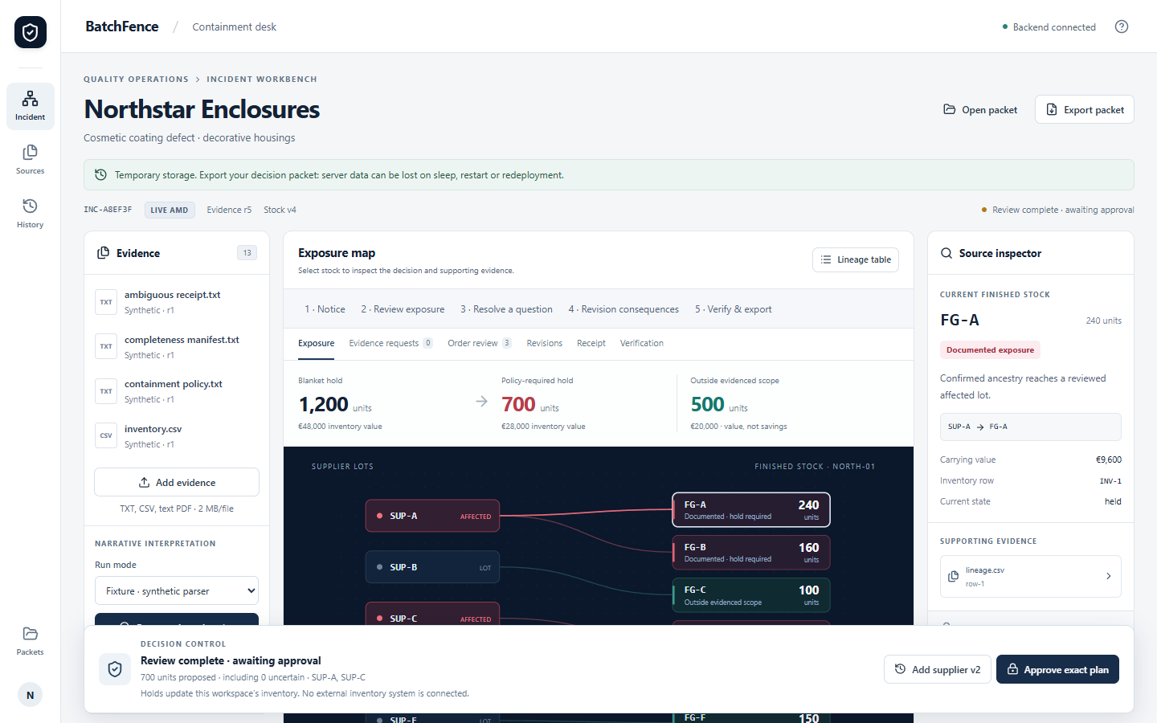
A reviewed answer changes the proposal
700 proposed · 800 still held
A clearer receiving reply
supports reviewed FG-C identity.
No stock is automatically released.
Recorded fresh AMD reply · exact source review · workspace inventory only
Notes:
Source: docs/release-0.2.0/live/reply2-raw-run.json, review-reply-preview.json and final-packet.json. Source candidate from fresh AMD response, explicit complete receiving-record review. Proposed700; all800previouslyappliedremainheld. The first fresh reply omitted SUP-B and the app rejected narrowing (422); a clearer separately preserved reply returned SUP-B plus three non-lot IDs. Review selected only the source-backed supplier identity. Format is bounded; unclear prose stays unresolved.

Slide 6
Verification and release boundaries
65 regression tests
30 frozen domain cases
Free hosting uses temporary storage. Export packets.
Unsigned Windows installer; physical dialog check remains.
Independent manufacturing validation is still needed.
Web and installed Windows workflows.
Six executable boundary challenges.
Source-backed raw AMD runs preserved.
batchfence.onrender.com
Repository and release evidence are public on GitHub.
Notes:
Sources: docs/release-0.2.0/pytest-results.xml,domain-results.json,installed-upgrade/results.json,installer.json,public-release.json and live evidence. Tests are synthetic, not model accuracy measurements. No customer research or independent domain/operator validation. No paid resources.

