Slide 1
BatchFence
Evidence-backed lot containment
Web and Windows
Project presentation
18 October 2026
01
Notes:
BatchFence is an engineering-verified hackathon project for reviewing supplier evidence and controlling lot containment. Introduce the quality-manager use case. The release remains a preview with explicit review and sandbox execution. Do not claim independent customer validation or production readiness.
Sources:
https://github.com/NuraliKuzhagaliev/BatchFence/blob/c641897c28e484f2968868b404460ba4e3e0e71a/HANDOFF.md
https://github.com/NuraliKuzhagaliev/BatchFence/blob/c641897c28e484f2968868b404460ba4e3e0e71a/README.md

Slide 2
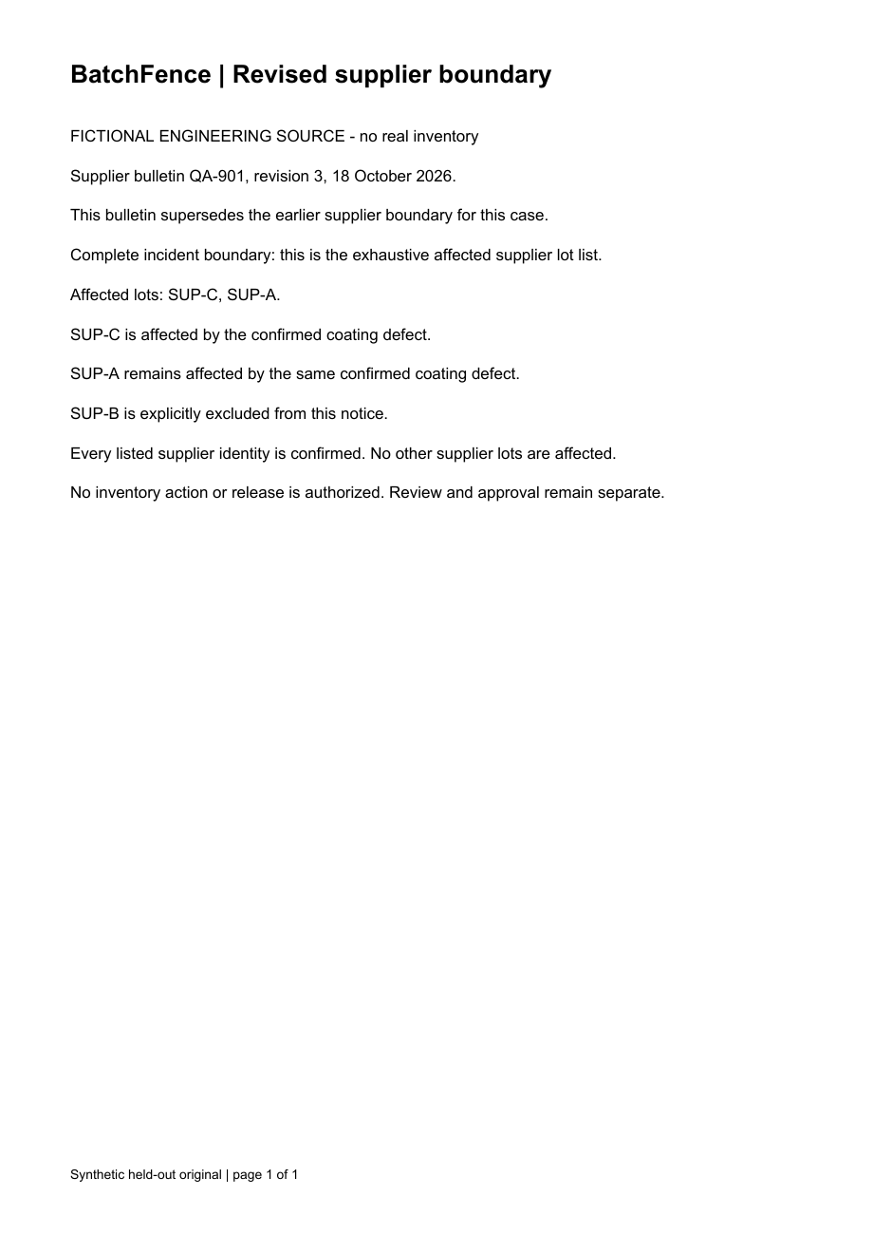
Which stock should we hold now?
A revised supplier notice
Changes which lots the incident includes
Incomplete receiving records
Leave some finished stock uncertain
An approval tied to old evidence
Cannot authorize the revised decision
Fictional engineering scenario. The original document remains available for review.
02
Notes:
The fictional decorative-housing scenario represents the quality-manager decision supported by BatchFence. A supplier notice, current inventory and uncertain receiving lineage must agree before an operator narrows scope. The scenario is illustrative, not customer validation. Show the retained original notice and the explicit exclusions it contains.
Sources:
https://github.com/NuraliKuzhagaliev/BatchFence/blob/c641897c28e484f2968868b404460ba4e3e0e71a/README.md
https://github.com/NuraliKuzhagaliev/BatchFence/blob/c641897c28e484f2968868b404460ba4e3e0e71a/evals/identity-rag-v1/manifest.json
https://github.com/NuraliKuzhagaliev/BatchFence/blob/c641897c28e484f2968868b404460ba4e3e0e71a/evals/identity-rag-v1/notice-heldout.pdf

Slide 3
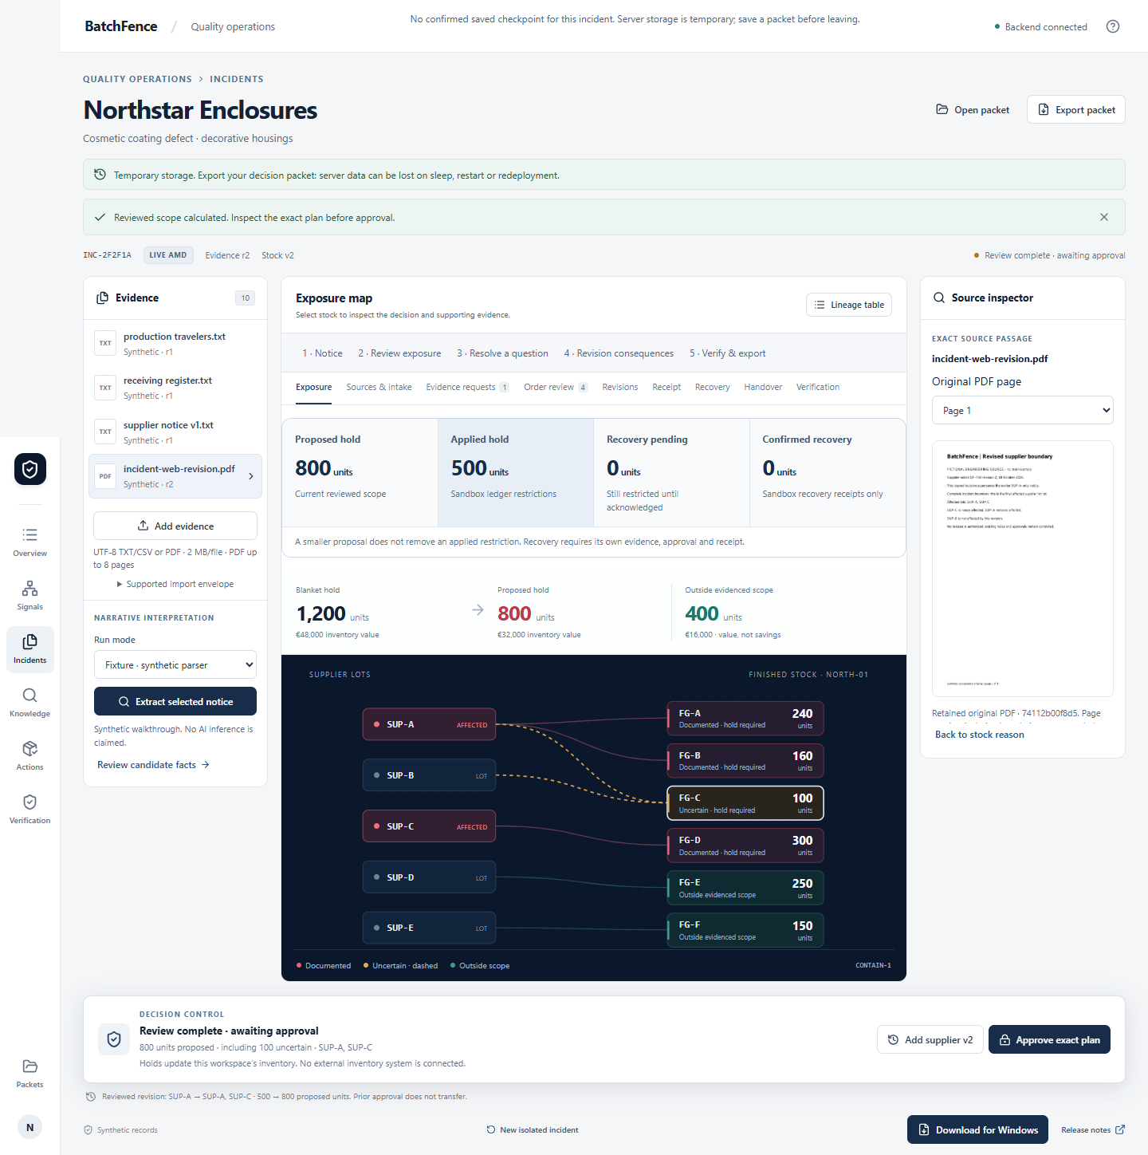
The incident workflow
01
Retain original evidence
02
Inspect model proposals
03
Review lots and scope
04
Approve the calculated plan
05
Apply sandbox holds and export
Original evidence, reviewed facts and approved actions retain separate authority.
03
Notes:
Walk through the actual workflow in order. Models create proposals only. The operator inspects originals and confirms critical facts, lot exclusions and incident scope. The deterministic engine calculates current stock exposure. Approval binds the exact reviewed version. Sandbox execution creates a receipt. Current live engineering runs used fictional sources and agent-operated review, not an independent human operator.
Sources:
https://github.com/NuraliKuzhagaliev/BatchFence/blob/c641897c28e484f2968868b404460ba4e3e0e71a/HANDOFF.md
https://github.com/NuraliKuzhagaliev/BatchFence/blob/c641897c28e484f2968868b404460ba4e3e0e71a/backend/assist_routes.py
https://github.com/NuraliKuzhagaliev/BatchFence/blob/c641897c28e484f2968868b404460ba4e3e0e71a/backend/domain.py
https://github.com/NuraliKuzhagaliev/BatchFence/blob/c641897c28e484f2968868b404460ba4e3e0e71a/docs/identity-rag-fix/clients/web/result.json

Slide 4
The supplier revision changes the hold
800
units in the revised scope
100 uncertain units
remain included
Synthetic inventory scenario. Fresh revised PDFs drove the 800-unit result after explicit review.
04
Notes:
Native editable chart. Values come from the frozen fictional decorative-housing scenario. A blanket policy holds1200 units. The initial reviewed scope totals500:400 documented plus100 uncertain. The revised scope totals800:700 documented plus100 uncertain. SUP-C adds FG-D300 units. The recent corrective client runs use explicitly fixture500 baselines, with genuine fresh PDF processing driving the800 proposal and explicit review/approval. The400 outside scope is not a cash savings claim.
Sources:
https://github.com/NuraliKuzhagaliev/BatchFence/blob/c641897c28e484f2968868b404460ba4e3e0e71a/README.md
https://github.com/NuraliKuzhagaliev/BatchFence/blob/c641897c28e484f2968868b404460ba4e3e0e71a/docs/claims-to-evidence.md
https://github.com/NuraliKuzhagaliev/BatchFence/blob/c641897c28e484f2968868b404460ba4e3e0e71a/docs/identity-rag-fix/clients/web/result.json
https://github.com/NuraliKuzhagaliev/BatchFence/blob/c641897c28e484f2968868b404460ba4e3e0e71a/docs/identity-rag-fix/clients/windows-corrective/result.json

Slide 5
A smaller proposal does not release a hold
Decision state | Proposed | Applied | Required authority
Initial approval | 500 | 500 | Containment receipt
Supplier revision | 800 | 500 | New exact approval
Revised approval | 800 | 800 | Second receipt
Receiving correction | 700 | 800 | Separate recovery review
Recovery approval | 700 | 700 | Recovery receipt
Units. Containment and recovery are separate decisions. The recovery rows show a preserved synthetic scenario.
05
Notes:
Native editable table, in units. The500 and800 scenario derives from the core incident. The700 receiving correction and100 recovery example is a separate preserved synthetic scenario from the enterprise controlled-recovery evidence. Do not describe this as fresh rc6 live recovery. A source/model answer or reduced proposal never automatically releases an already applied hold. Separate reviewed recovery authority and a new receipt are required.
Sources:
https://github.com/NuraliKuzhagaliev/BatchFence/blob/c641897c28e484f2968868b404460ba4e3e0e71a/docs/claims-to-evidence.md
https://github.com/NuraliKuzhagaliev/BatchFence/blob/c641897c28e484f2968868b404460ba4e3e0e71a/docs/enterprise/release-0.3.0.md
https://github.com/NuraliKuzhagaliev/BatchFence/blob/c641897c28e484f2968868b404460ba4e3e0e71a/docs/enterprise/release-ui/modules/03-recovery-confirmed-1366.png
https://github.com/NuraliKuzhagaliev/BatchFence/blob/c641897c28e484f2968868b404460ba4e3e0e71a/backend/domain.py

Slide 6
Missing lot identities stay unresolved
Historical model proposal
Application review proposal
SUP-A affected
SUP-A affected
SUP-B uncertain
SUP-C uncertain
Complete scope claimed
Unknown scope
Historical omission replay. Missing evidence cannot justify an exclusion or a narrowed approval.
06
Notes:
The left side recreates the substance of a retained historical interpretation failure, not a new model output. The source inventory contains SUP-A,SUP-B,SUP-C but the old interpretation retained only SUP-A and claimed complete scope. New assembly retains grounded extractor identities plus independent exact recorded references, marks missing annotations uncertain and forces unknown scope. Human/source review must resolve exclusions and completeness. Current fresh responses retained all three lot labels; this small sample does not establish universal recall.
Sources:
https://github.com/NuraliKuzhagaliev/BatchFence/blob/c641897c28e484f2968868b404460ba4e3e0e71a/evals/evolus-focused-v1/retained-omission.json
https://github.com/NuraliKuzhagaliev/BatchFence/blob/c641897c28e484f2968868b404460ba4e3e0e71a/evals/evolus-focused-v1/retained-windows-omission.json
https://github.com/NuraliKuzhagaliev/BatchFence/blob/c641897c28e484f2968868b404460ba4e3e0e71a/backend/identity_annotations.py
https://github.com/NuraliKuzhagaliev/BatchFence/blob/c641897c28e484f2968868b404460ba4e3e0e71a/tests/test_identity_rag_fix.py
https://github.com/NuraliKuzhagaliev/BatchFence/blob/c641897c28e484f2968868b404460ba4e3e0e71a/docs/identity-rag-fix/raw-quality.json

Slide 7
AMD and Evolus in the workflow
Component | Responsibility | Authority
Evolus document reader | Read the retained original PDF | Unreviewed source output
Extractor and Gemma agent | Propose identities and incident labels | Unreviewed proposals
BatchFence review engine | Check sources and calculate scope | Reviewed evidence
Explicit approval and ledger | Bind exact actions and retain receipts | Sandbox actions only
Configured own/gemma-4-31b-it on managed AMD access. Evolus does not expose runtime model identity.
07
Notes:
This is a native editable architecture responsibility table rather than a claim of self-hosted AMD Developer Cloud hardware. Existing managed AMD shared endpoint exposes Gemma-4-31B-IT. The saved Evolus own-model connection is configured as own/gemma-4-31b-it. The workflow includes native-preferred reading, extractor and compact annotation agent. Evolus does not return runtime model identity. Earlier direct AMD returned self-dploy/Gemma-4-31B-IT, which is distinct evidence. Provider credentials remain server-side.
Sources:
https://github.com/NuraliKuzhagaliev/BatchFence/blob/c641897c28e484f2968868b404460ba4e3e0e71a/docs/identity-rag-fix/reconciled-workflow.json
https://github.com/NuraliKuzhagaliev/BatchFence/blob/c641897c28e484f2968868b404460ba4e3e0e71a/docs/identity-rag-fix/RESULTS.md
https://github.com/NuraliKuzhagaliev/BatchFence/blob/c641897c28e484f2968868b404460ba4e3e0e71a/backend/evolus_api.py
https://github.com/NuraliKuzhagaliev/BatchFence/blob/c641897c28e484f2968868b404460ba4e3e0e71a/backend/identity_annotations.py
https://github.com/NuraliKuzhagaliev/BatchFence/blob/c641897c28e484f2968868b404460ba4e3e0e71a/backend/domain.py

Slide 8
RAG cites the complete approved original
“Before release or recovery, recorded receiving evidence must resolve the relevant ancestry and the applicable quality condition. A separate authorized approver is required. A source citation, model answer or narrower proposed hold never releases existing applied holds.”
SOP-FOCUSED-EN
Revision 1
Recovery passage
Exact source hash
Identified remote chunks
Full original caveat
Application-verified indexed sources. Provider-native citation annotations remain empty.
08
Notes:
The quote is the complete recovery passage in the approved fictional SOP, not generated prose. Fresh public and installed Evolus-mediated RAG selected versioned source keys. BatchFence independently read identified Evolus chunks and checked document/version/source hash against the original. Chunks C001/C002 and body SHA256 proofs are retained in client reports. Evolus native citations remained empty. Label the output application-verified indexed-source citations. Consultation did not change receipts or holds. Retrieval selection is not approval authority.
Sources:
https://github.com/NuraliKuzhagaliev/BatchFence/blob/c641897c28e484f2968868b404460ba4e3e0e71a/evals/evolus-focused-v1/sops.json
https://github.com/NuraliKuzhagaliev/BatchFence/blob/c641897c28e484f2968868b404460ba4e3e0e71a/docs/identity-rag-fix/clients/web/rag-raw-job.json
https://github.com/NuraliKuzhagaliev/BatchFence/blob/c641897c28e484f2968868b404460ba4e3e0e71a/docs/identity-rag-fix/clients/windows-corrective/rag-raw-job.json
https://github.com/NuraliKuzhagaliev/BatchFence/blob/c641897c28e484f2968868b404460ba4e3e0e71a/backend/evolus_rag.py

Slide 9
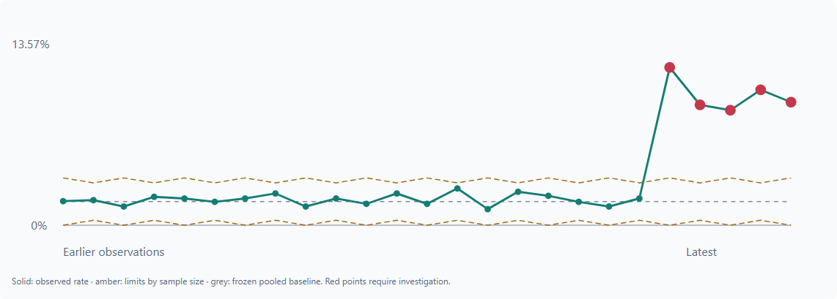
Connected quality workflows
Quality signals
Review patterns without creating incidents automatically
Approved knowledge
Consult versioned procedures in source context
Controlled recovery
Separate release evidence and approval
Corrective action
Review effectiveness against recorded outcomes
Synthetic signal panel: v0.3.0 engineering evidence. Current release preserves these workflows.
09
Notes:
Four implemented connected modules are Quality Signals, Approved Knowledge, Controlled Recovery and Corrective Action with Effectiveness. Current code preserves those features; rc6 fresh live scope focused on PDF interpretation and RAG citation evidence. The screenshot is an earlier0.3.0 engineering capture retained as historical evidence, not a newly captured rc6 run. Avoid claiming independent operational acceptance of all modules.
Sources:
https://github.com/NuraliKuzhagaliev/BatchFence/blob/c641897c28e484f2968868b404460ba4e3e0e71a/docs/enterprise/release-0.3.0.md
https://github.com/NuraliKuzhagaliev/BatchFence/blob/c641897c28e484f2968868b404460ba4e3e0e71a/docs/claims-to-evidence.md
https://github.com/NuraliKuzhagaliev/BatchFence/blob/c641897c28e484f2968868b404460ba4e3e0e71a/docs/enterprise/release-ui/modules/media-signals.png
https://github.com/NuraliKuzhagaliev/BatchFence/blob/c641897c28e484f2968868b404460ba4e3e0e71a/HANDOFF.md

Slide 10
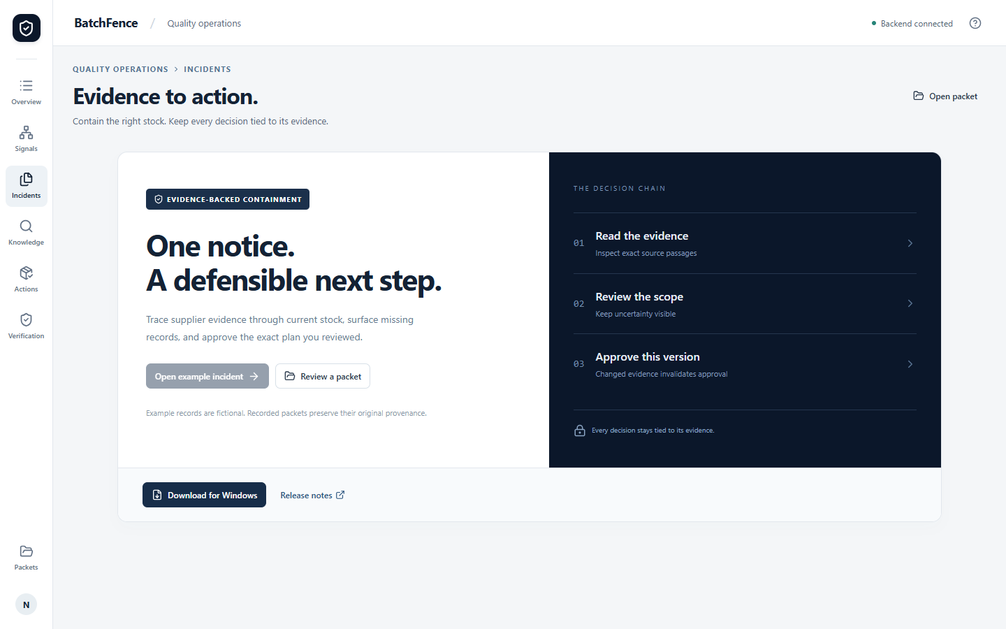
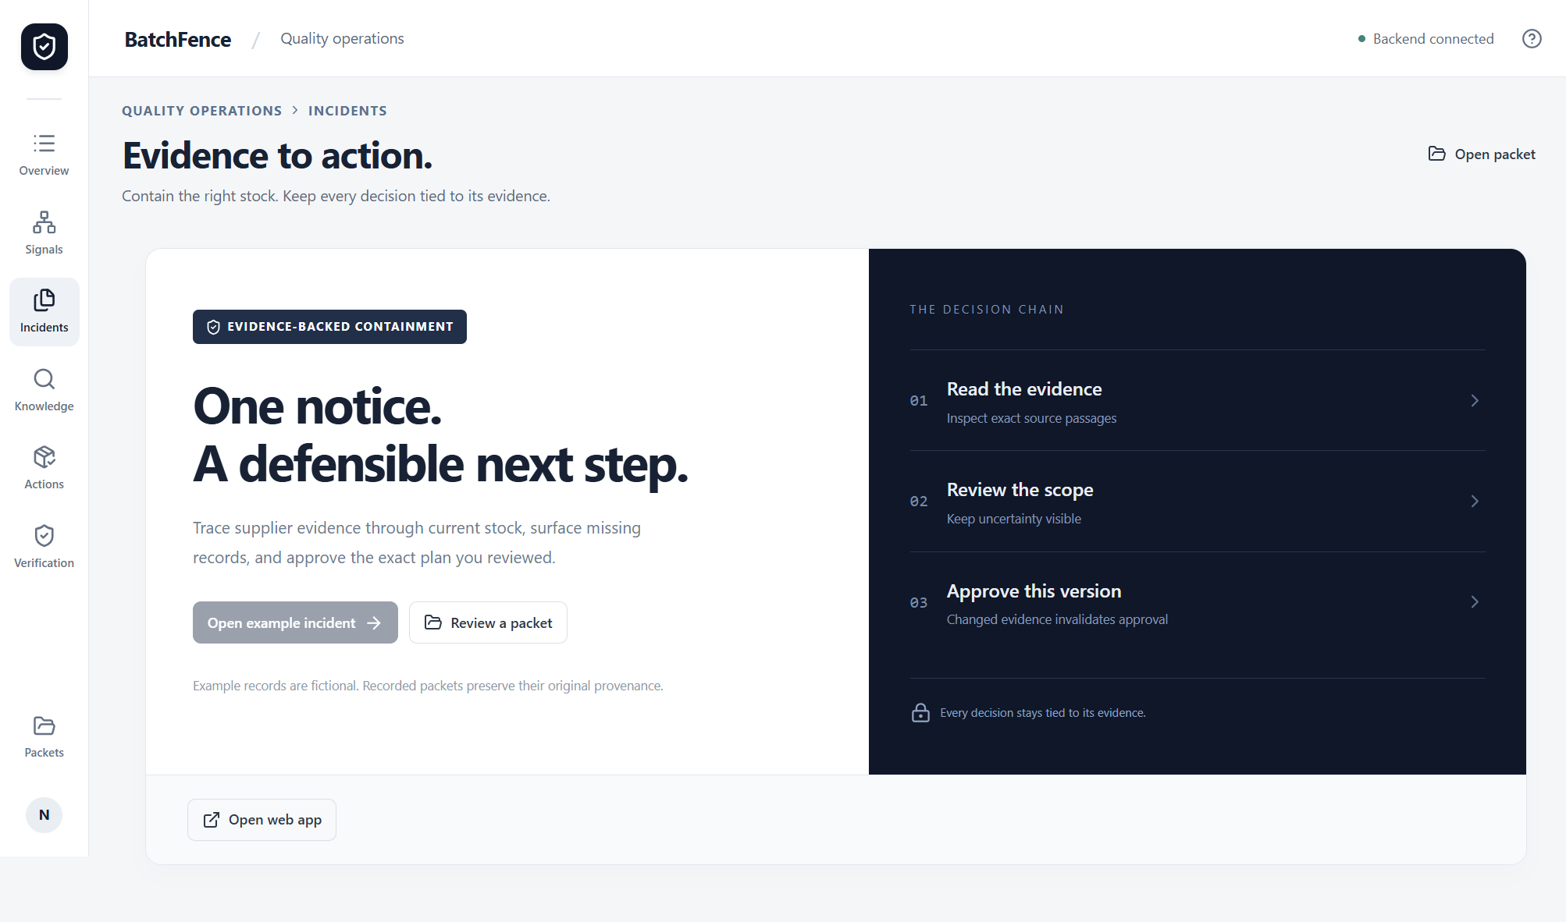
One workbench on web and Windows
Public web application
Installed Windows client
Shared source review and approval controls. Exported packets reopen as historical, read-only evidence.
10
Notes:
Actual current rc6 publication screenshots. Public page has the Windows download link and no redundant Open web app control. Installed Windows has Open web app and no installer download. Both clients use shared frontend/domain behavior. Packets reopen read-only and convey no approval authority. No provider key is stored in frontend assets. Free hosted storage remains ephemeral; export before restart. Current installer is unsigned.
Sources:
https://github.com/NuraliKuzhagaliev/BatchFence/blob/c641897c28e484f2968868b404460ba4e3e0e71a/docs/identity-rag-fix/publication-smoke.json
https://github.com/NuraliKuzhagaliev/BatchFence/blob/c641897c28e484f2968868b404460ba4e3e0e71a/docs/identity-rag-fix/publication.json
https://github.com/NuraliKuzhagaliev/BatchFence/blob/c641897c28e484f2968868b404460ba4e3e0e71a/desktop/main.cjs
https://github.com/NuraliKuzhagaliev/BatchFence/blob/c641897c28e484f2968868b404460ba4e3e0e71a/desktop/packet.cjs

Slide 11
Verification evidence
491
30
passing regression tests
deterministic domain scenarios
Fresh PDF and Evolus RAG processing in both clients
Two receipts retained. Stale approval rejected.
Five release assets verified. Public and installed bytes match.
Agent-operated engineering with fictional records. Independent human acceptance remains pending.
11
Notes:
These are engineering checks and do not establish independent human or field acceptance. 491 pytest regressions and30domain scenarios passed in mainCI39106687601. Eight Linux container/restart/isolation checks and five packaged Windows checks passed. Fresh PDF/RAG processing ran through both actual clients with explicit agent review,800/two receipts and stale rejection. Recent500baselines were synthetic fixtures. All five public assets matched SHA256;2185source files matched actual tag archive; frontend bytes match public/local/installed.
Sources:
https://github.com/NuraliKuzhagaliev/BatchFence/blob/c641897c28e484f2968868b404460ba4e3e0e71a/docs/identity-rag-fix/main-ci.json
https://github.com/NuraliKuzhagaliev/BatchFence/blob/c641897c28e484f2968868b404460ba4e3e0e71a/docs/identity-rag-fix/final-platform-ci.json
https://github.com/NuraliKuzhagaliev/BatchFence/blob/c641897c28e484f2968868b404460ba4e3e0e71a/docs/identity-rag-fix/clients/web/result.json
https://github.com/NuraliKuzhagaliev/BatchFence/blob/c641897c28e484f2968868b404460ba4e3e0e71a/docs/identity-rag-fix/clients/windows-corrective/result.json
https://github.com/NuraliKuzhagaliev/BatchFence/blob/c641897c28e484f2968868b404460ba4e3e0e71a/docs/identity-rag-fix/publication.json

Slide 12
Release boundaries
Review still matters
Metadata format errors remain visible and require original review
Citation provenance stays explicit
The application verifies sources while native annotations remain absent
Deployment has practical limits
Unsigned installer, temporary hosted storage and pending independent acceptance
A new live demo needs a current allowance
The engineering evaluation is complete at 18 of 18 reserved equivalents
Verified for a controlled hackathon demonstration. Production enterprise readiness remains unestablished.
12
Notes:
State limitations before inviting a demo. Native Evolus annotations remain absent, so application-verified source citations must be labelled accordingly. Two Windows raw extractor outputs had a metadata enum error even though all three lot incident labels were correct. The fix contains this as unresolved metadata and unknown scope pending explicit review; it does not make raw extraction universally correct. Installer unsigned; Free Render storage ephemeral and may sleep. Phase18/18 conservative equivalents complete. Existing proof expires18October2026 at16:00UTC/21:00Qyzylorda. Do not run new inference for the presentation. A fresh live demo needs a distinct finite free allowance verified without rotation/purchases. No independent operator/domain/photo acceptance or production-readiness claim.
Sources:
https://github.com/NuraliKuzhagaliev/BatchFence/blob/c641897c28e484f2968868b404460ba4e3e0e71a/HANDOFF.md
https://github.com/NuraliKuzhagaliev/BatchFence/blob/c641897c28e484f2968868b404460ba4e3e0e71a/docs/identity-rag-fix/RESULTS.md
https://github.com/NuraliKuzhagaliev/BatchFence/blob/c641897c28e484f2968868b404460ba4e3e0e71a/docs/identity-rag-fix/raw-quality.json
https://github.com/NuraliKuzhagaliev/BatchFence/blob/c641897c28e484f2968868b404460ba4e3e0e71a/docs/identity-rag-fix/phase-ledger.json

Slide 13
BatchFence
A reviewed decision with an evidence trail
Web application
batchfence.onrender.com
Windows installer and source
github.com/NuraliKuzhagaliev/BatchFence/releases
0.4.0-rc.6 Runtime d6fa31f Evidence c641897
13
Notes:
Public links identify the existing authorized project destinations. Current release0.4.0-rc.6 runtime/tag/source d6fa31f7d321b0e0c51dad5afcb577b6e31e8130; evidence checkpoint c641897c28e484f2968868b404460ba4e3e0e71a. Before a live demonstration, review the bounded allowance requirement and export any existing case. The next product acceptance step is independent operator/domain evaluation, not a claim that it has already happened.
Sources:
https://github.com/NuraliKuzhagaliev/BatchFence/blob/c641897c28e484f2968868b404460ba4e3e0e71a/HANDOFF.md
https://github.com/NuraliKuzhagaliev/BatchFence/blob/c641897c28e484f2968868b404460ba4e3e0e71a/docs/identity-rag-fix/publication.json

