Slide 1
BatchFence
Evidence-backed lot containment
Supplier evidence stays attached to the exact decision a reviewer approves.
Web and Windows prototype
Synthetic walkthrough. Live AMD verification remains open.
Notes:
Prototype for small-manufacturer quality managers. All data are synthetic. This presentation reflects a local build with live AMD and public deployment still pending.

Slide 2
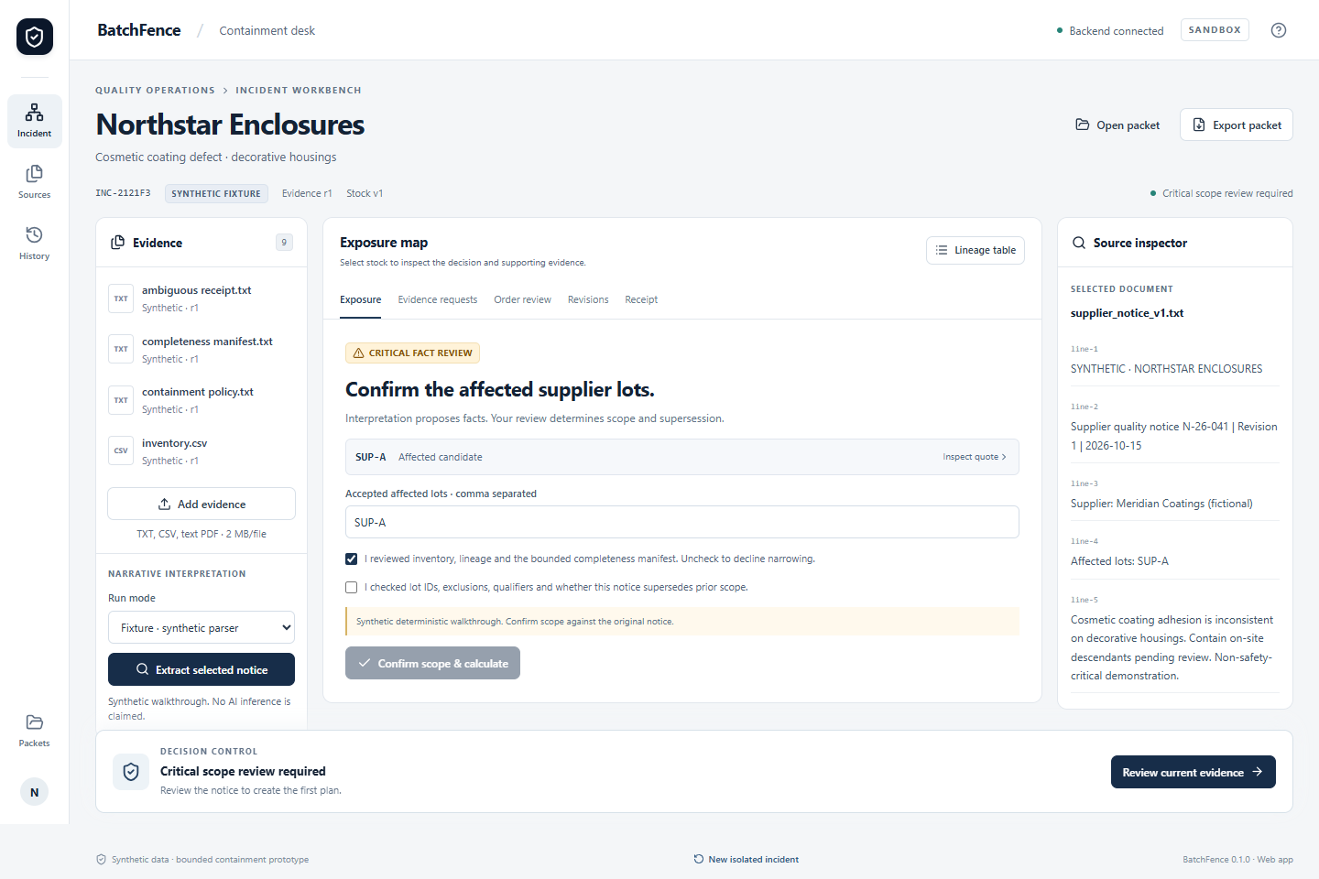
The quality manager’s incident
A supplier flags a cosmetic coating lot.
The manager must reconcile stock exports, production lineage and an unresolved receiving identity before deciding what to contain.
Fictional Northstar Enclosures. No safety or compliance certification.
Notes:
The user and pain are a product hypothesis, not validated customer research. Source: supplied master prompt and docs/data_provenance.md.

Slide 3
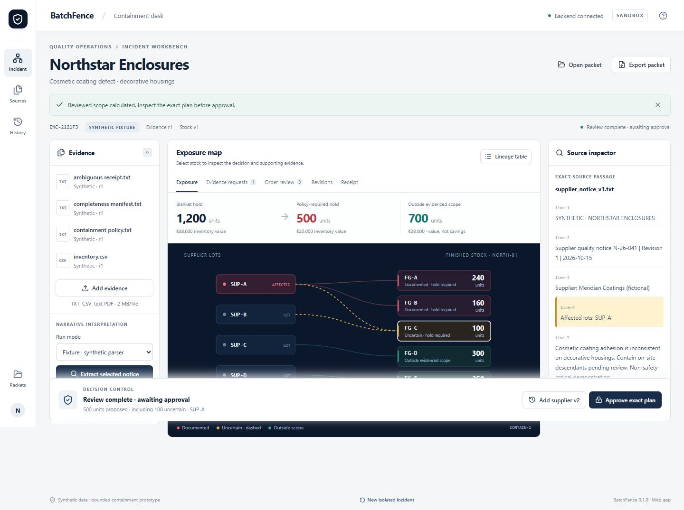
The reviewed containment plan
500 units require a hold
400 documented
100 uncertain
The source quote and the reason for each stock classification remain inspectable.
Notes:
Actual application screenshot. Fixture truth: 400 documented plus100 uncertain equals500 held units, from1200 current units at4000c each. €28,000 is carrying value outside the proposed broad hold, not savings. See docs/evaluation.md.

Slide 4
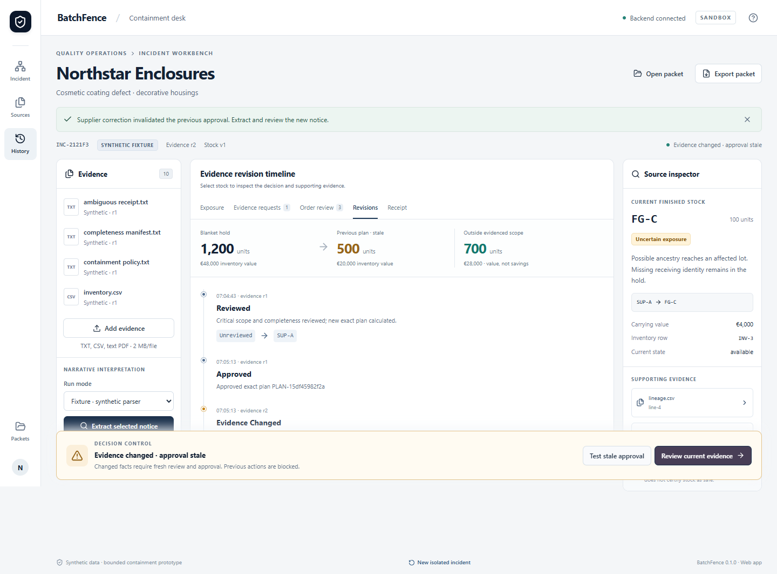
Changed evidence invalidates approval
500 to 800 proposed units
SUP-C adds the FG-D branch.
The earlier approval cannot execute.
Review the revised scope, then approve its new exact plan.
Notes:
Actual stale-state screenshot. Supplier correction adds SUP-C. Domain and UI tests show500 to800 held units and three tofour allocated open orders. Old approval is rejected server-side. See docs/browser-results.json and docs/desktop-results.json.

Slide 5
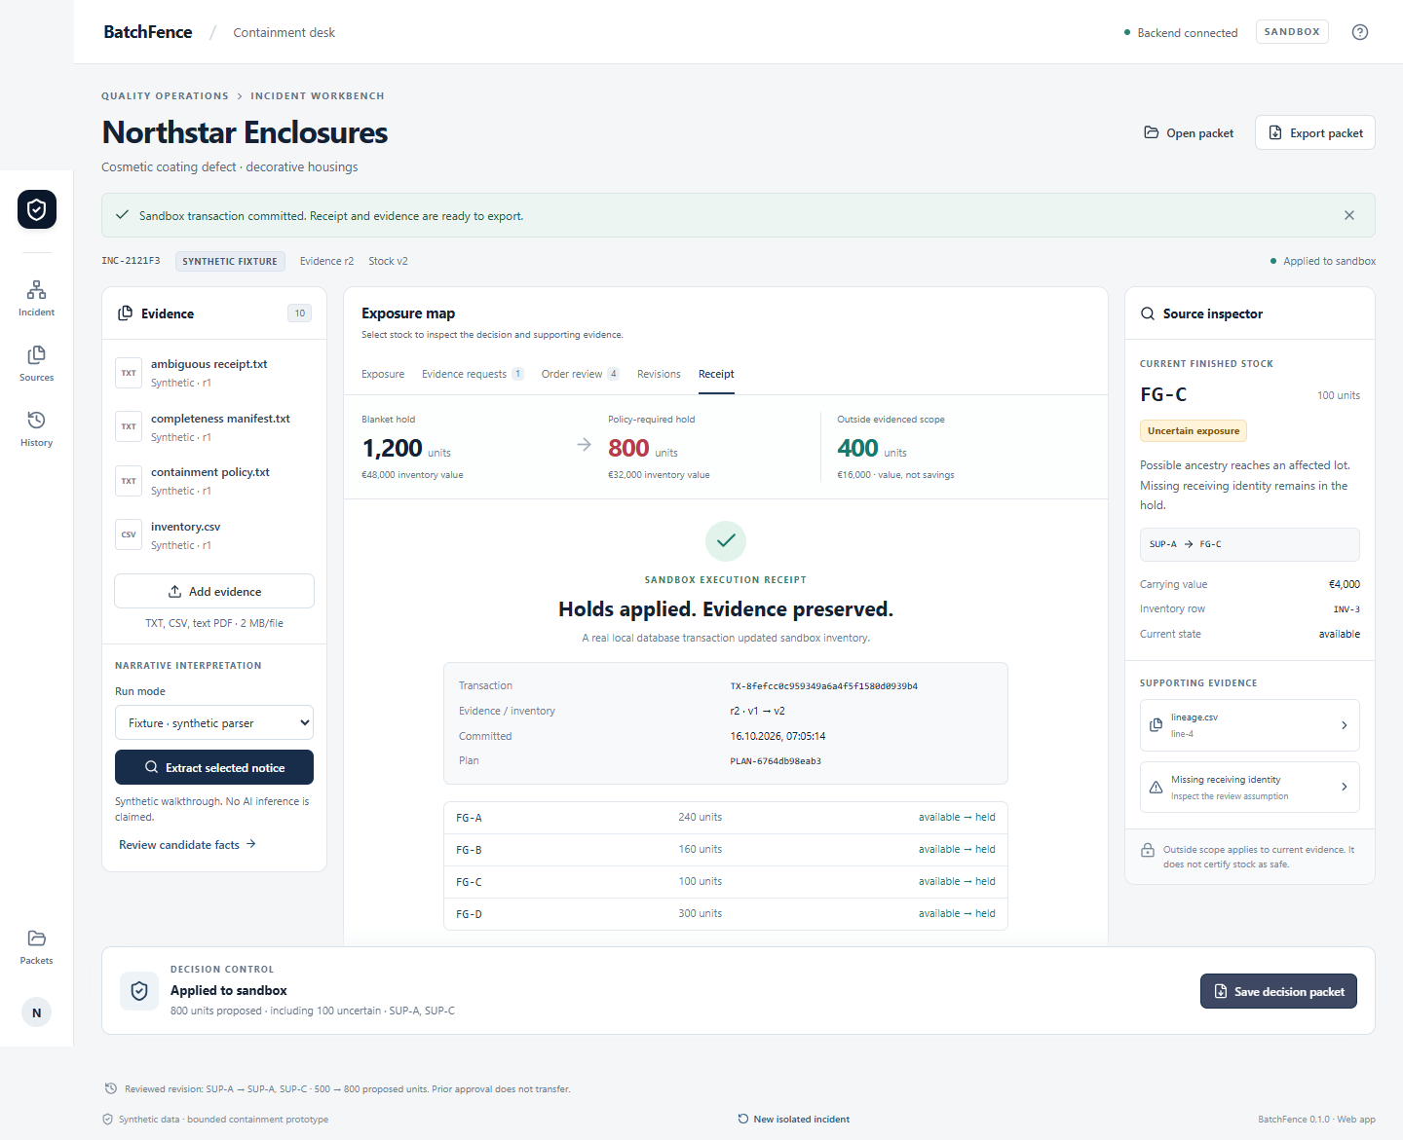
Verification and technology
30 / 30 domain cases
18 development and 12 held out
Web and installed Windows flows completed sandbox transactions and packet handoff.
AMD live inference: blocked by missing private configuration
Notes:
Sources: docs/evaluation-results.json, docs/browser-results.json, docs/desktop-results.json, docs/amd-probe.json. All observed counts are synthetic. The AMD provider adapter exists but zero live HTTP calls have occurred. No Gemma or physical GPU claim.

Slide 6
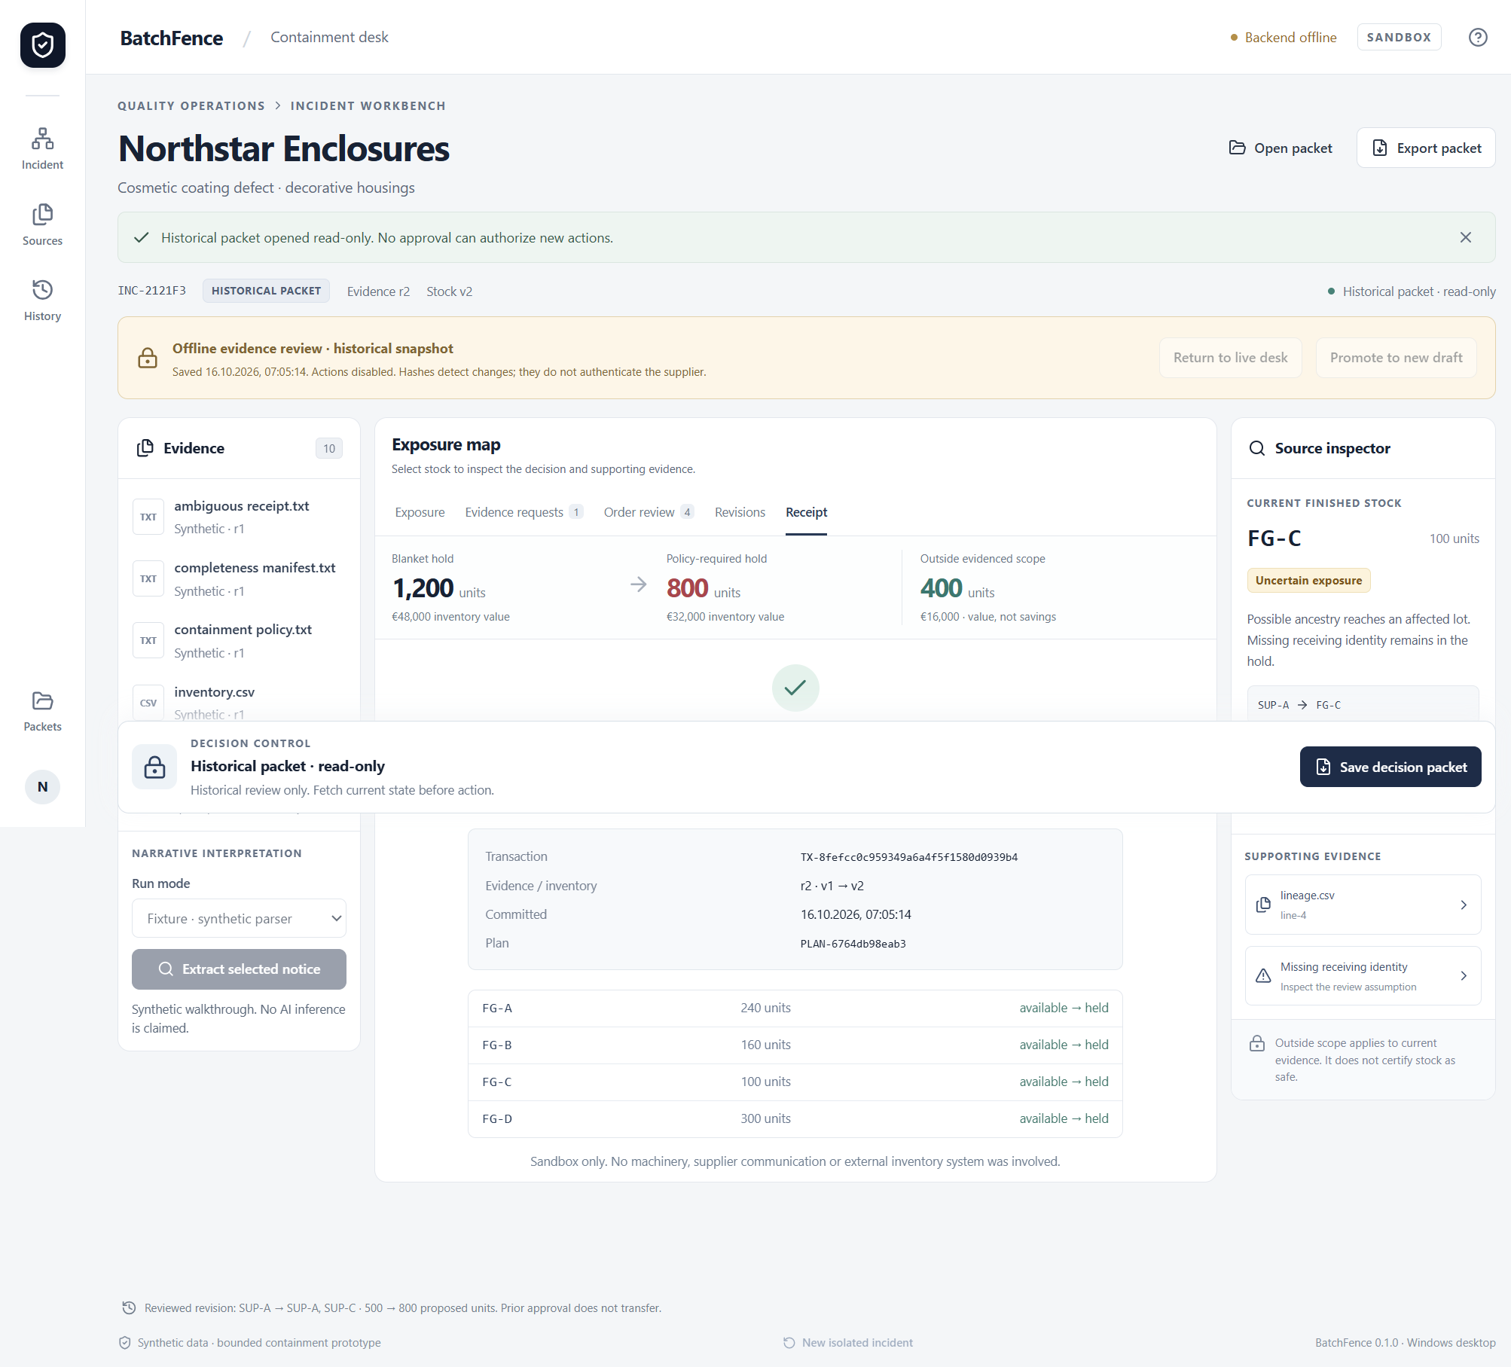
A bounded manufacturing pilot
Proposed buyer: a quality manager using exported production records
Pilot with redacted exports.
Measure time to an accepted plan and unsupported exclusions.
Next gates: live AMD, distribution and independent user review.
Notes:
Proposed business validation only. No customer interviews, revenue or validated ROI. Desktop offline screenshot is a real installed package. Native dialog result stubs verified bytes; actual OS dialog selection remains unverified. Public deployment and submission are pending user authorization.

