Slide 1
BatchFence
Evidence-backed lot containment
Supplier evidence stays attached to the exact decision a reviewer approves.
Web and Windows prototype
Live AMD on synthetic data · agent-operated review
Notes:
BatchFence 0.1.1 local prototype. All data synthetic. AMD service provenance is documented in docs/live-verification/provider-documentation.md. Current requested model MiMo-V2.6-Flash, returned self-dploy/MiMo-V2.6-Flash. Explicit selection followed three Gemma failures (two typed timeouts; first cause untyped), all retained. No independent human/customer validation.

Slide 2
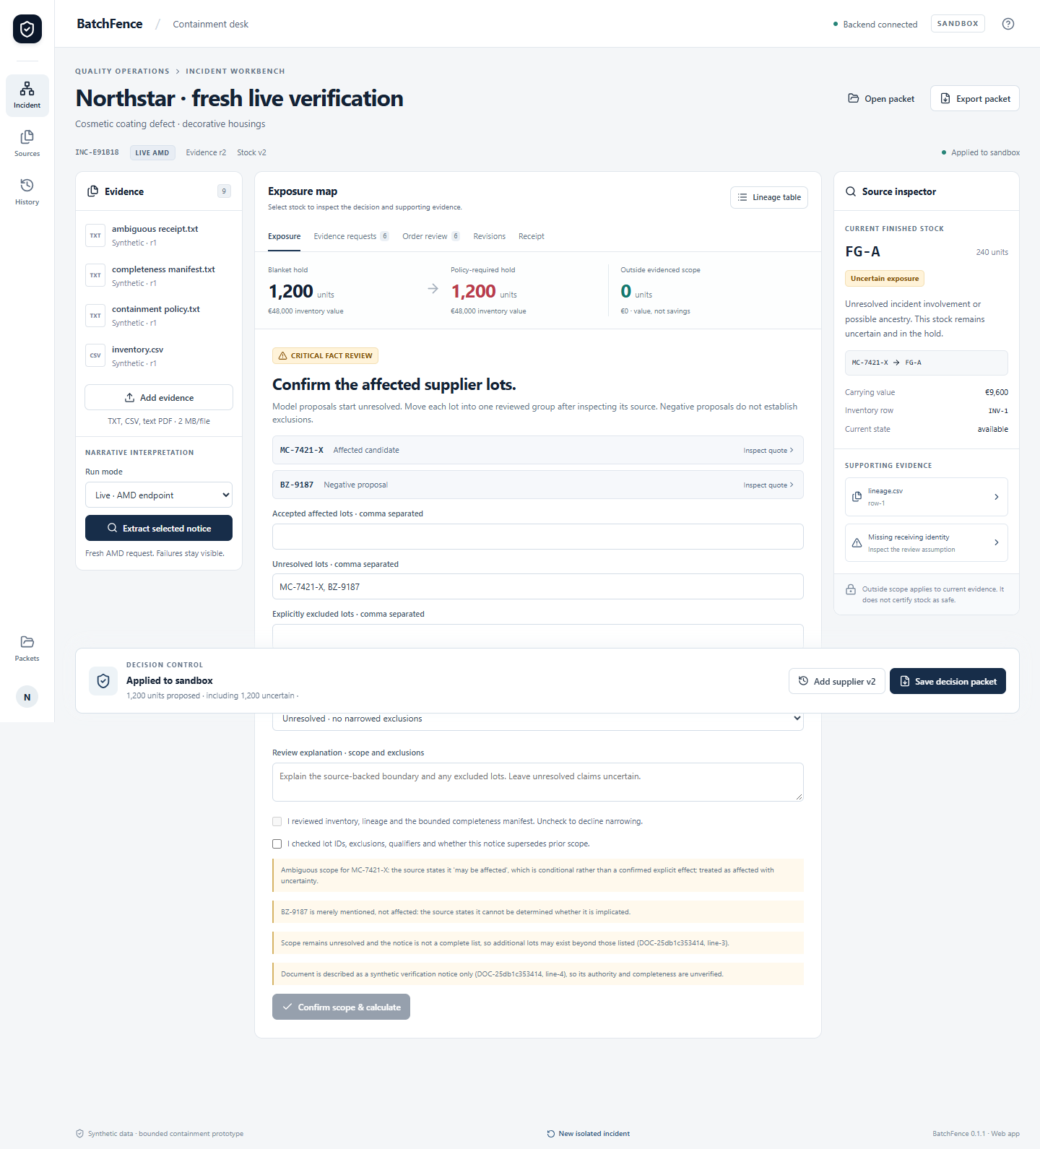
Review model proposals before action
Every candidate starts unresolved.
Review affected, unresolved and excluded lots separately. Narrowing needs an exact source quote and an explicit incident boundary.
Actual live AMD evidence. Synthetic records; review operated by Codex.
Notes:
Actual historical live ambiguity review screenshot. Original Gemma failure was replayed exactly; its false SUP-S proposal previously permitted an unsupported exclusion. New controls separate model output from reviewed affected/unresolved/excluded dispositions. Explicit unresolved source blocks narrowing. See docs/ambiguity-fix/before-regression.json and live-ambiguity.json. Bounded English source rules are conservative, not general semantic proof.

Slide 3
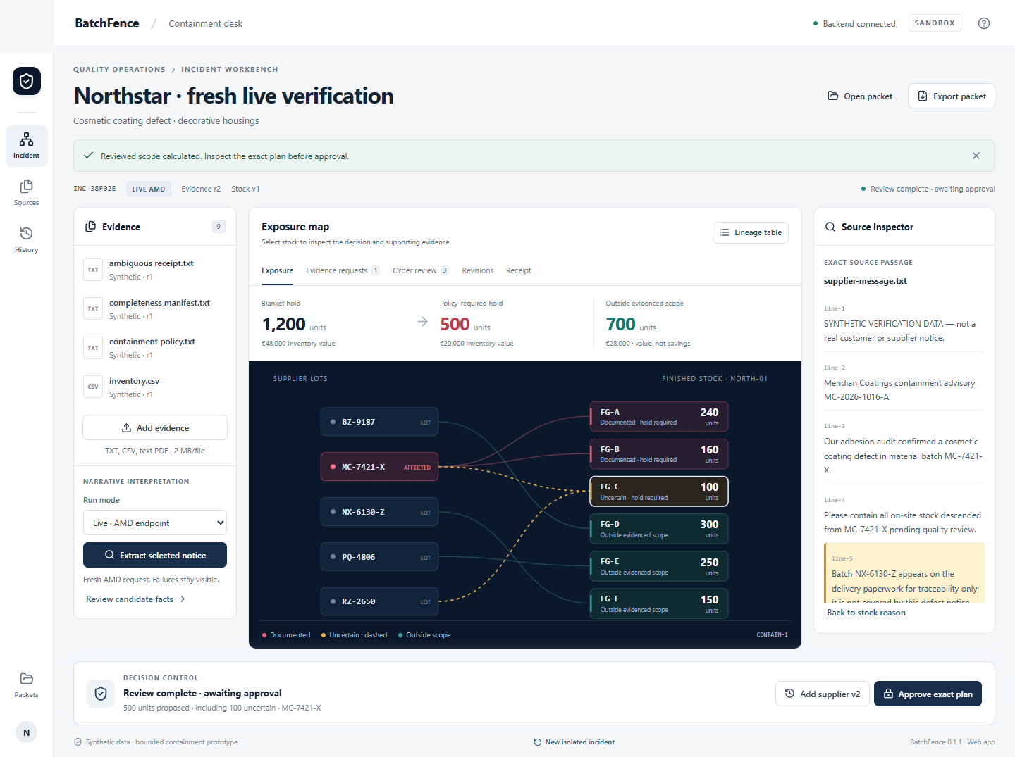
The reviewed containment plan
500 units require a hold
400 documented
100 uncertain
The source quote and the reason for each stock classification remain inspectable.
Notes:
Fresh live MiMo response drove this 500-unit plan: 400 documented and 100 uncertain. Zero lot-ID correction; agent explained why the complete supplier boundary does not resolve warehouse ancestry. No financial savings or real customer benefit is claimed. See docs/ambiguity-fix/clear-live/browser-results.json and packet-1.json.

Slide 4
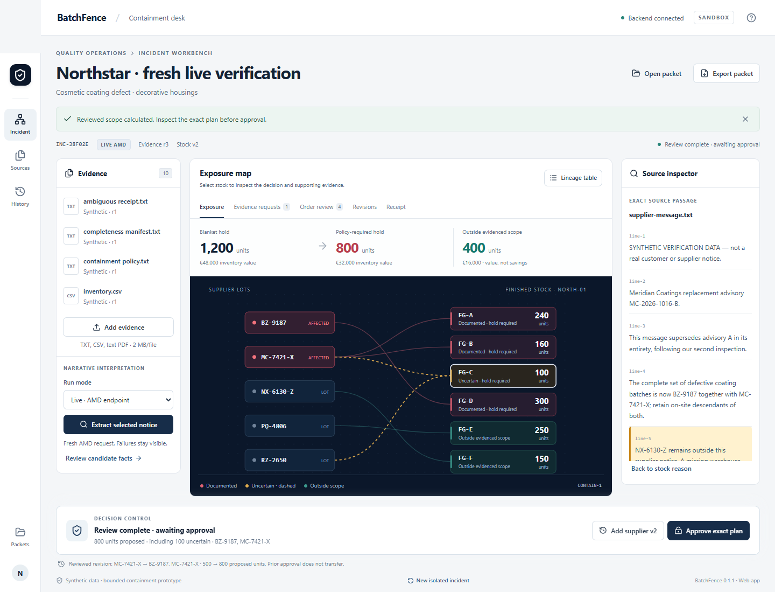
Changed evidence invalidates approval
500 to 800 proposed units
BZ-9187 adds the FG-D branch.
The earlier approval cannot execute.
Review the revised scope, then approve its new exact plan.
Notes:
The revised live response adds BZ-9187. A new exact plan holds 800 units, preserving the uncertain 100. Two actual receipts persisted; reuse of the old approval was rejected with 409 STALE_APPROVAL. See docs/ambiguity-fix/clear-live/browser-results.json and packet-2.json.

Slide 5
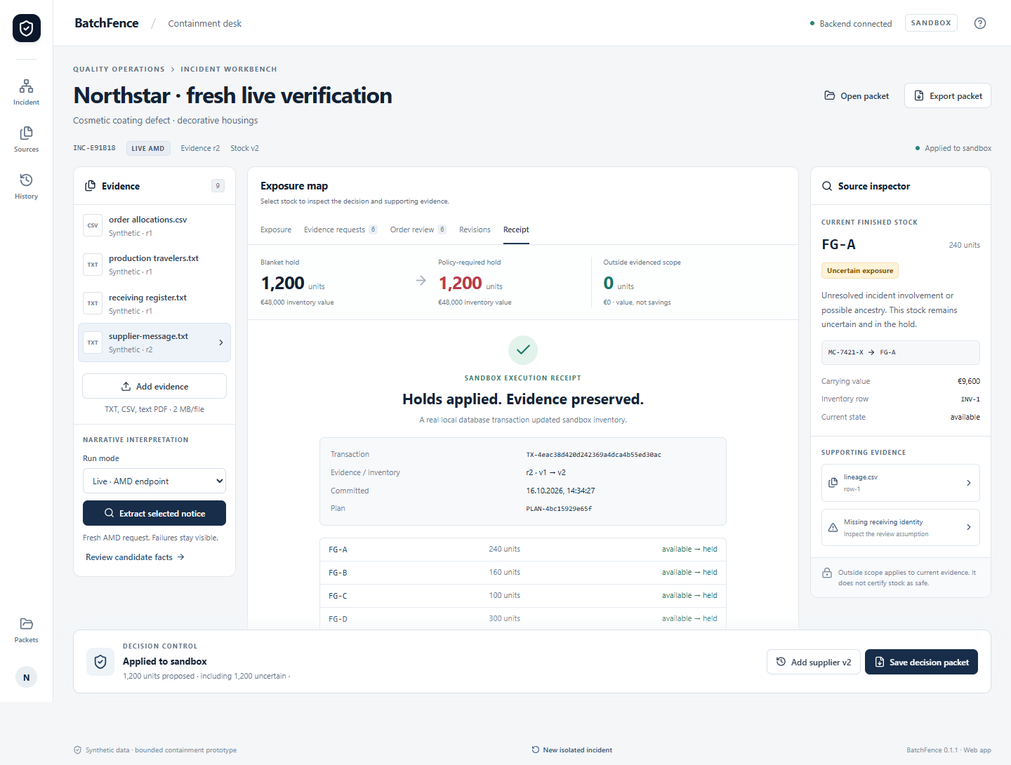
Ambiguity is contained before execution
40 / 40 regression checks
30 frozen domain cases also passed
Unresolved scope holds all 1,200 units. A separate citation failure blocks review and execution.
Model booleans remain fallible. Source review is still required.
Notes:
40 pytest checks, 30 frozen graph cases, 12 browser checks and seven installed desktop checks passed. Raw live quality remains imperfect: one ambiguity result required both booleans reviewed as unresolved; a different response failed citation validation and could not proceed. Three Gemma failures are retained (two typed timeouts; first cause untyped), not scored as semantic errors. Cross-runtime packet hashing was fixed for small AMD usage costs; original failed exports remain preserved. See docs/ambiguity-fix. Agent review is not independent human validation.

Slide 6
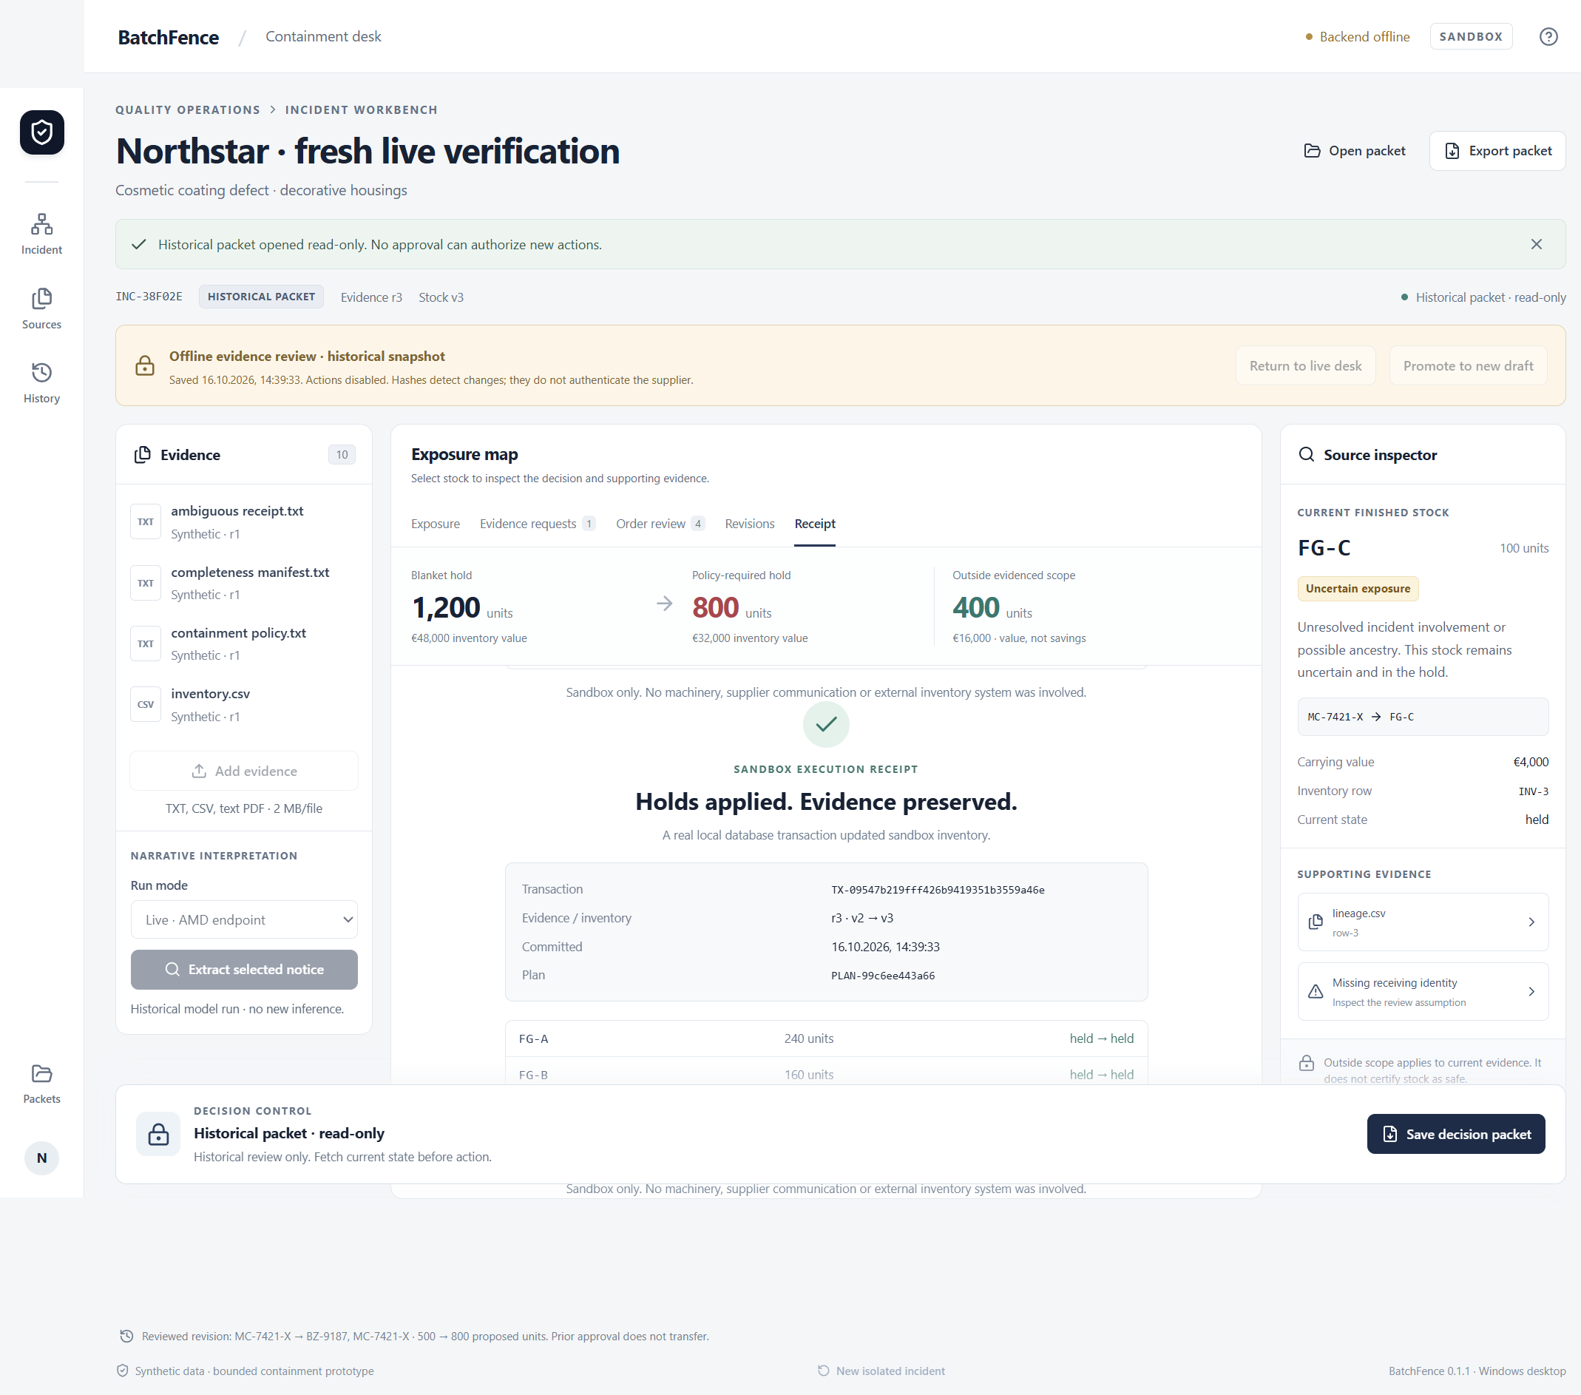
Local prototype; release gates remain
Proposed buyer: a quality manager using exported production records
Pilot with redacted exports.
Measure time to an accepted plan and unsupported exclusions.
Next gates: Docker repair, distribution and independent review.
Notes:
Actual installed Windows 0.1.1 read-only packet from the live walkthrough, backend unreachable. Dialog selection supplied by the test harness for this recording; real dialogs were separately exercised at prior checkpoint ed6a2b0. Current installer is unsigned. Docker startup is blocked by AF_UNIX reparse error 1920 at sailor-ingest.sock; no blanket permissions/reset/data deletion performed. Hosted publication and event submission require authorization and eligibility review. Buyer/pilot are hypotheses, not validated customer research.

