Slide 1
BatchFence
Evidence for the next
quality decision
Source review, useful evidence requests, release prerequisites and a factual shift handover.
Web and Windows Preview. Synthetic engineering evidence. 0.4.0-rc.1.
Notes:
0.4.0-rc.1 engineering preview. Six connected extensions preserve the existing incident, review, approval and receipt architecture. No independent customer, manufacturing or language acceptance.

Slide 2
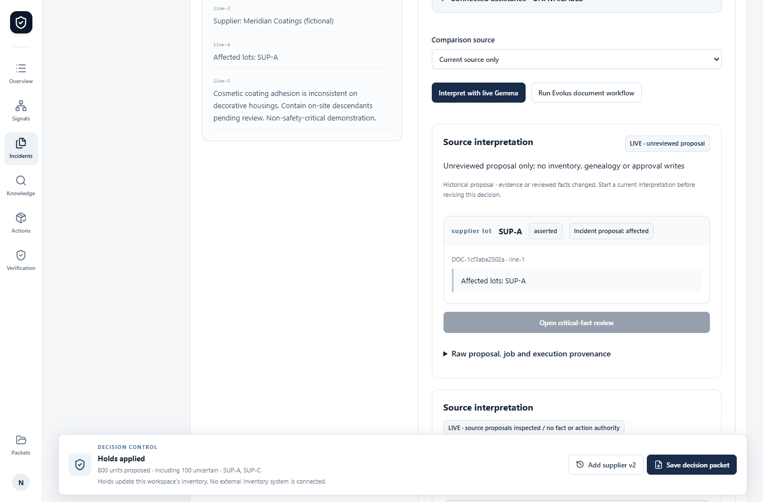
Real Evolus extraction and Gemma interpretation
500, then 800 held
The extractor and agent return source-linked proposals. Explicit review drives the deterministic scope and two receipts.
An invented document ID failed validation. The original error stays visible after correction.
Stored genuine Evolus result. Synthetic records. Agent-operated review.
Notes:
Sources: docs/continuation/live/evolus-product-flow.json, evolus-configuration.json, evolus-reviewed-revision-case.json and ui/capture.json. Three actual provider workflow executions. Own-model configured own/gemma-4-31b-it maps to Gemma-4-31B-IT; runtime model ID not returned by Evolus. Original final-output configuration failed. Revised notice returned an invented metadata ID and was rejected. Explicit agent correction and separate critical review produced800 and two receipts. Agent review is not independent human validation.

Slide 3
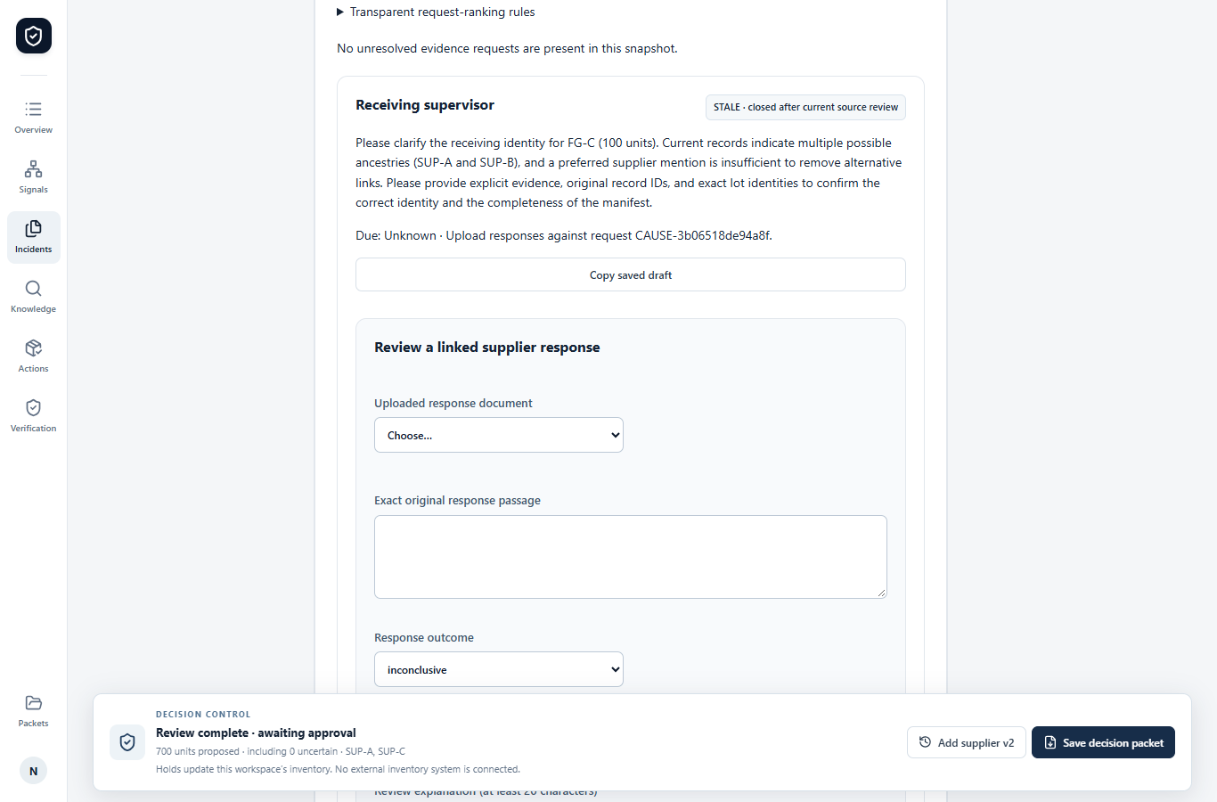
Ask for the missing fact
A specific next request
Rank known gaps with visible rules. Keep conditional impact separate from applied restrictions.
Original-linked English, Russian and Italian evidence requires qualified critical review.
Stored direct AMD result. No inference during recording. No messages sent.
Notes:
Sources: docs/continuation/live/product-flow.json, flow-model-request.json where present, tests/test_continuation.py and ui/gemma-requests.png. Existing cause planner computes distinct conditional units. Gemma drafts a request from gaps. Ambiguous response keeps800 applied. Italian complete response is original-linked and explicitly reviewed by the agent. No independent language acceptance or external message.

Slide 4
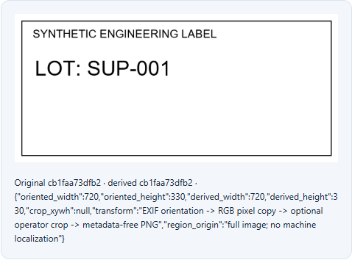
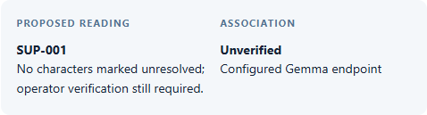
Inspect identity before association
Exact spelling matters
Preserve the original and crop. Review the proposed reading against the document identity before association.
Five synthetic image responses passed their transcription checks. Physical-photo testing is still pending.
Stored genuine Gemma reading of a synthetic label. Physical-photo acceptance pending.
Notes:
Sources: docs/continuation/live/vision-capability.json, product-flow.json, IMG-01.json through IMG-05.json and windows/new-results.json. Five successful actual Gemma image responses on synthetic rendered labels. SUP-001 cannot associate with document SUP-B, HTTP422. O/0 spelling retained but model did not flag ambiguity. No physical photographs or barcode acceptance.

Slide 5
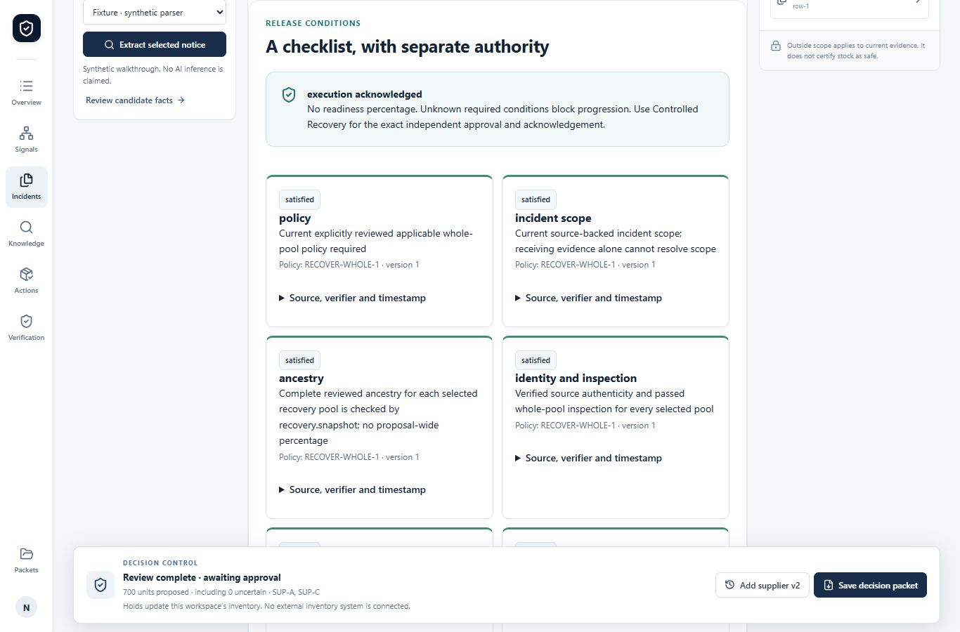
A smaller proposal needs separate recovery
800 applied, 700 proposed
A source change blocks stale authority. Conditions, approval and acknowledgement remain distinct.
Separate acknowledgement recovers 100. Original receipts remain intact.
Stored actual workflow. Synthetic inventory and simulated engineering roles.
Notes:
Sources: docs/continuation/live/product-flow.json, decision-packet.json and ui/gemma-recovery.png. Actual direct AMD response drives reviewed scope700 while800 remain applied. Relevant source revision rejects stale recovery approval. Separate engineering-role approval and sandbox acknowledgement recover100, retain two original receipts and leave700. Source graph and handover staleness verified locally and across container restart.

Slide 6
Model quality and remaining failures
Original frozen comparison
Matched new cases
Gemma exact: 5 of 12
Historical MiMo exact: 6 of 12
Original labels and errors retained
Each model: lot statuses 2 of 2
Each model: scope labels 1 of 2
Conflict remained uncertain.
Consequential review stays mandatory.
Small synthetic sample. No model superiority or productivity claim. Full original rerun pending.
Notes:
Sources: docs/continuation/evaluation/twelve-case-audit.md and README.md; live/heldout-v3-results.json. Original frozen12 remains unchanged. Gemma5/12 versus historical MiMo6/12, different wrappers/token limits. After fixes, two matched held-out cases per model: lot statuses2/2, scope1/2. Both call conflicting revision partial. No full post-fix12 rerun because48-reservation cap exhausted. No superiority claim.

Slide 7
Verified engineering preview
171 regression tests passed
30 domain cases passed
Remaining acceptance
Professional and language review.
Physical label photographs.
Three unfamiliar operators.
New live budget and cloud activation.
Owned ADC eligibility unverified.
Web and installed Windows checks.
Owner-operated native dialogs.
Actual Linux restart persistence.
Offline dated handover and receipts.
batchfence.onrender.com
github.com/NuraliKuzhagaliev/BatchFence
Notes:
Sources: docs/continuation/pytest-release.xml, domain-results.json, native/native-dialog-results.json, windows/, container/ and scope-map.md.171 pytest,30 domain cases; installed shared workflows, actual owner Windows dialogs, SQLite restart and existing PostgreSQL pilot checks.48/48 model reservations exhausted. Evolus3 workflows reported0 credits. No owned AMD Cloud/vLLM verified. New cloud live configuration remains gated. Quality/language/photo/operator acceptance pending.

