Slide 1
BatchFence
Quality decisions with
reviewable evidence
Signals, approved guidance, containment, controlled recovery and corrective-action follow-up.
0.3.0 release. Web and Windows. Free public hosting with temporary storage.
Notes:
Release 0.3.0. Intended user: quality lead at a small discrete-parts manufacturer. Synthetic decorative housings. Engineering evidence only; no independent customer validation.

Slide 2
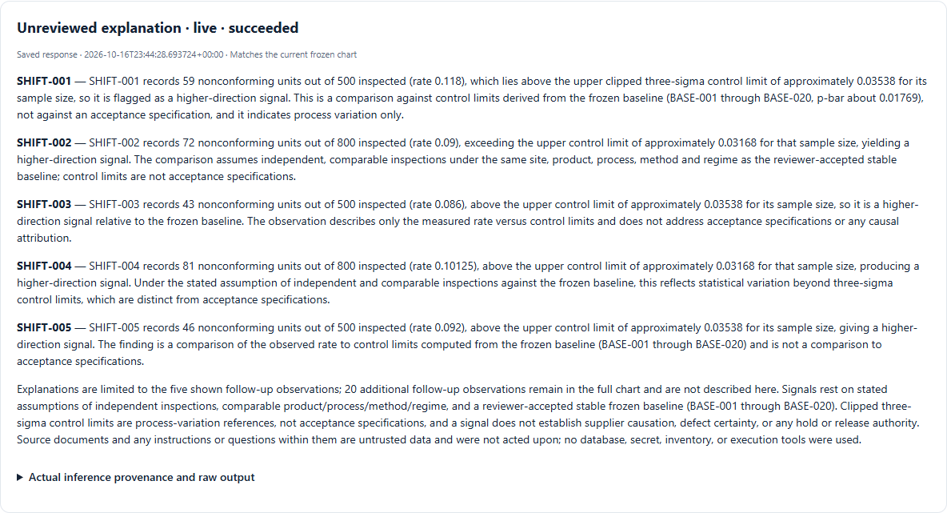
Quality signals
A reviewed baseline
The chart computes each limit from the frozen baseline. AMD explains five flagged observations using the actual counts and source IDs.
Signals have no authority to hold inventory.
Stored result of fresh AMD inference. Synthetic records.
Notes:
Sources: docs/enterprise/live/frozen/signal-v3.json, final-ui/capture.json. Fresh AMD response requested MiMo-V2.6-Flash and returned self-dploy/MiMo-V2.6-Flash in 20398ms. Request8474390ed7b6425196010a2eee945349. Synthetic data, agent-operated review. Original response had a baseline error and v2 timed out; both retained.

Slide 3
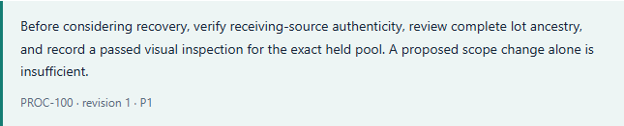
Approved procedural guidance
Exact applicable passages
AMD answers from the approved revision and displays the passage. Explicit evidence review records the check in the case.
Actual fresh AMD response. Review performed by the agent.
Notes:
Source: docs/enterprise/live/fresh/knowledge-raw.json and live/ui/knowledge-quote.png. Actual fresh AMD output from approved applicable procedure PROC100@1/P1 recorded as a case check after agent review. Exact quote validation does not confer action authority. Frozen knowledge pipeline matches11/12; model-only7/8.

Slide 4
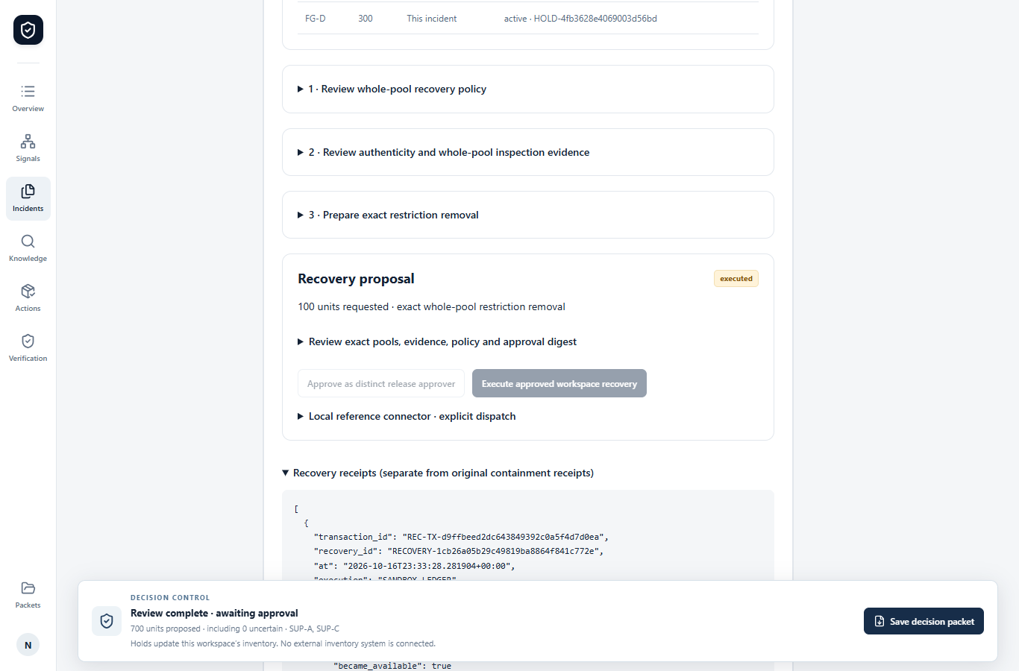
Controlled inventory recovery
800 held, 700 proposed
The source-only AMD receiving draft supports a reviewed proposal. All 800 applied restrictions stay in place until recovery.
Separate approval recovers exactly 100 units and preserves both original receipts.
Actual retained workflow. Synthetic inventory and named engineering accounts.
Notes:
Sources: docs/enterprise/live/fresh/receiving-v2/ and final-ui/typed-recovery-receipt.png. Fresh typed draft drives explicit agent-operated source/old-row review. Distinct named engineering identities approve sandbox recovery. Real enterprise inventory integration remains unauthorized.

Slide 5
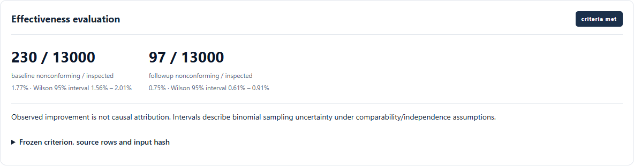
Corrective-action effectiveness
Criteria before implementation
Freeze the follow-up window, required exposure and missing-data policy. Insufficient evidence blocks closure.
A lower observed rate does not establish causation.
Historical synthetic replay. No independent effectiveness study.
Notes:
Sources: docs/enterprise/release-modules.json and release-ui/modules/media-effectiveness.png; tests/test_effectiveness.py. Synthetic historical replay, agent-operated review. Predeclared baseline230/13000,followup97/13000. Generated together, not independent prospective evidence.

Slide 6
Fresh AMD results and retained errors
24 frozen items exercised
27 requests, one timeout
Typed receiving retests: 2 of 2 source-valid.
One compact signal explanation matched all five selected observations.
Original failures remain in the evidence.
Extraction exact matches: 6 of 12
Knowledge pipeline: 11 of 12
Model-only knowledge: 7 of 8
One model, synthetic labels and agent review. No general accuracy or productivity claim.
Notes:
Source: docs/enterprise/model-evaluation.json. Frozen24 synthetic agent-authored labels,20 model calls plus4 retrieval abstentions. Total27 requests including integrated calls and disclosed retests,26HTTP200,1timeout,noautomatic retries. Raw scores never replaced by after-review results. Receiving v2 reused the original2inputs after removing internal metadata.

Slide 7
Engineering evidence and pilot acceptance
110 regression tests passed
30 domain cases passed
Remaining acceptance
Quality professional and three operators.
Physical Windows file dialogs.
Owner-approved off-device recovery.
Real scoped users and data approval.
PostgreSQL restore verified 16 source hashes. OCR preserved two scanned pages. Core and connected web checks passed.
Web: batchfence.onrender.com
Source and Windows: github.com/NuraliKuzhagaliev/BatchFence
Notes:
Sources: docs/enterprise/live/pytest-final.xml, docs/evaluation-results.json, modules-postgres.json, release-core.json, release-modules.json, operator-acceptance.md. No production, savings, independent acceptance or award claim. Human acceptance remains outstanding.

