Slide 1
BatchFence
Quality decisions with
reviewable evidence
Signals, approved guidance, containment, controlled recovery and corrective-action follow-up.
Engineering candidate 0.3.0-rc.1. Public release remains 0.2.0.
Notes:
Engineering candidate 0.3.0-rc.1. Intended user: quality lead at a small discrete-parts manufacturer. Synthetic decorative housings; no field customer validation.

Slide 2
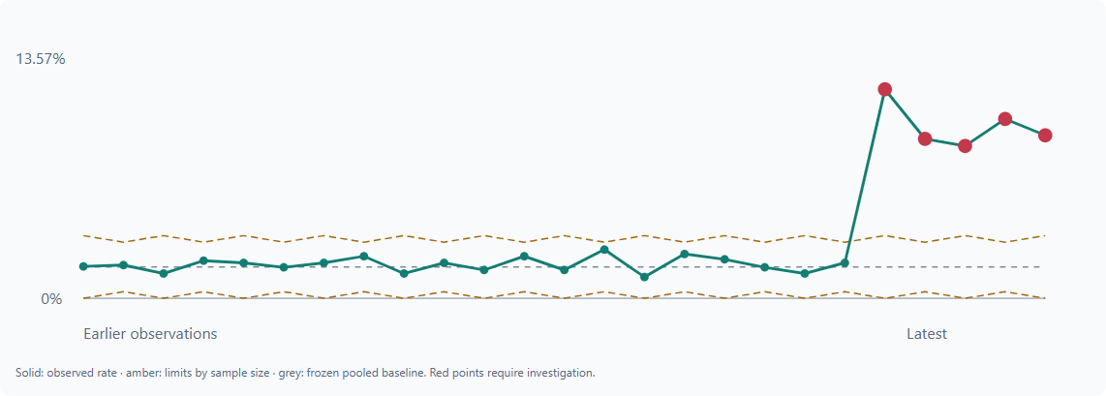
Quality signals
A reviewed baseline
Unequal sample sizes retain their own control limits. A signal opens an investigation with its source observations.
Signals have no authority to hold inventory.
Actual candidate screen. Synthetic inspection records.
Notes:
Source: docs/enterprise/browser-modules.json, statistical-evaluation.json, tests/test_signals_knowledge.py. Actual UI; synthetic records. Frozen weighted p-chart baseline has230/13000 nonconforming units. Five synthetic shift observations trigger signals. No manufacturing-performance claim.

Slide 3
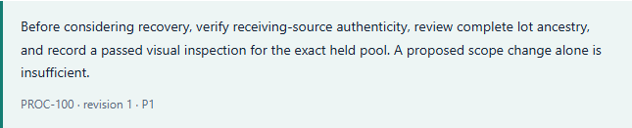
Approved procedural guidance
Exact applicable passages
Reviewers see the approved revision and source text. A suggested check becomes a case fact only after explicit evidence review.
Synthetic answer. Fresh AMD verification of this task remains open.
Notes:
Source: docs/enterprise/ui/modules/media-knowledge.png and tests/test_signals_knowledge.py. Candidate fixture-mode answer; no AMD inference in this segment. Approved/effective/product/process scoped retrieval, exact passage validation, conflicting versions abstain.

Slide 4
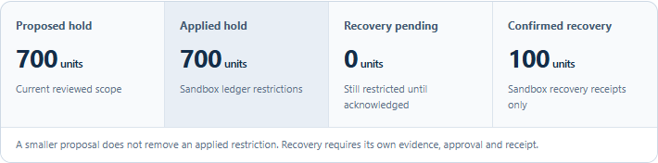
Controlled inventory recovery
800 held, 700 proposed
Receiving review changes the proposal. It leaves all existing restrictions in place.
Separate evidence and approval recover exactly 100 units. Another incident’s hold survives.
Workspace inventory only. Simulated UI roles are explicitly disclosed.
Notes:
Sources: docs/enterprise/browser-modules.json and modules-postgres.json. Actual candidate screen, synthetic data, agent-operated review. Browser uses simulated roles. Separate PostgreSQL run used two named test accounts, connector failure/retry/restart and idempotent ack. No independent humans or ERP action.

Slide 5
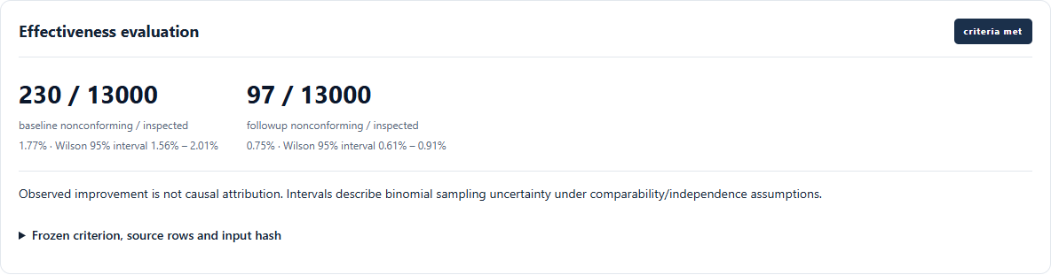
Corrective-action effectiveness
Criteria before implementation
Freeze the follow-up window, required exposure and missing-data policy. Insufficient evidence blocks closure.
A lower observed rate does not establish causation.
Historical synthetic replay. No independent effectiveness study.
Notes:
Sources: docs/enterprise/ui/modules/media-effectiveness.png; test_effectiveness.py. Synthetic historical replay, agent-operated review. Predeclared baseline230/13000, followup97/13000; source rows were generated together, not independent prospective observation.

Slide 6
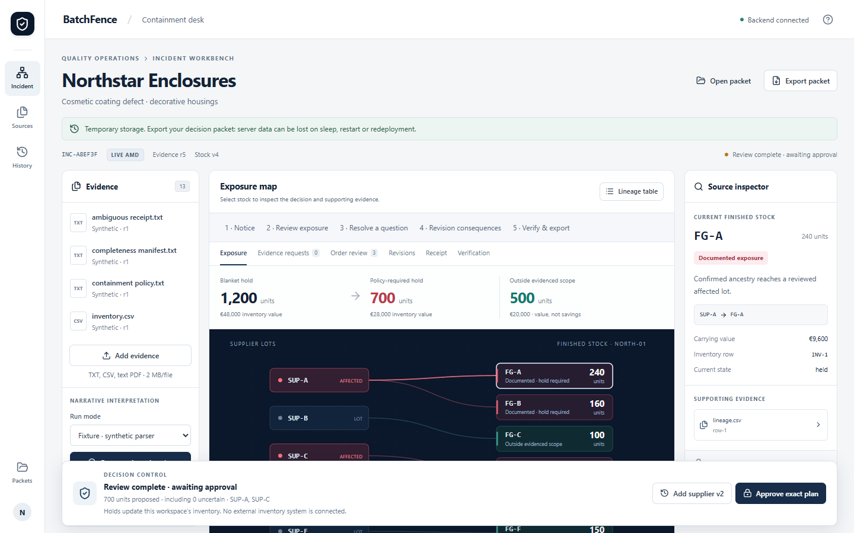
Historical AMD evidence
Real responses, retained errors
The 0.2.0 AMD run powered reviewed 500 and 800 unit plans. One reply omitted a parent and narrowing failed.
New-task fresh evaluation: 0 of 24 items. Zero-cost account allowance is unresolved.
Historical AMD screen. Synthetic data and agent-operated source review.
Notes:
Sources: docs/release-0.2.0/live/summary.json, final-packet.json and final-exposure.png. Preserved real responses requested MiMo-V2.6-Flash, returned self-dploy/MiMo-V2.6-Flash. Four calls 16026/12791/19718/32413ms. One receiving response omitted SUP-B; rejection422, reviewed inconclusive outcome preserved800. This is historical0.2.0, not a new candidate run.

Slide 7
Engineering evidence and pilot acceptance
102 regression tests passed
30 frozen domain cases passed
Remaining acceptance
Fresh AMD tasks within confirmed free access.
Quality professional and three operators.
Physical Windows file dialogs.
Owner-approved off-device recovery.
Actual PostgreSQL restore verified 16 source hashes. Actual OCR preserved two scanned pages. Web workflow checks passed.
Public: batchfence.onrender.com
Source and Windows: github.com/NuraliKuzhagaliev/BatchFence
Notes:
Sources: docs/enterprise/pytest-rc.xml, domain-results.json, modules-postgres.json, ocr/actual-ocr.json, model-evaluation.json, operator-acceptance.md. No claim of production readiness, savings, independent human acceptance or award likelihood. Live new-task gate blocks promotion.

