Slide 1
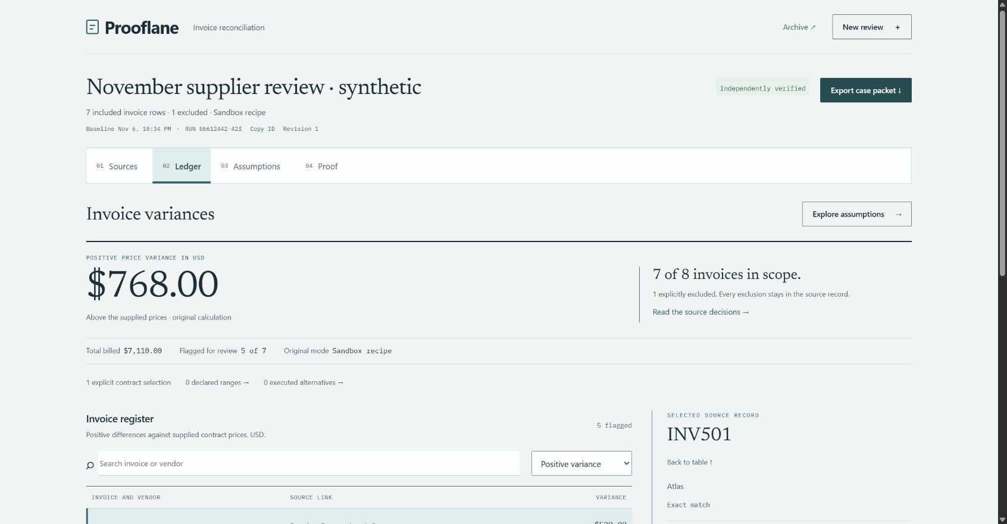
Prooflane
01
Which contract price
supports this invoice?
Prooflane gives accounts payable reviewers a way to trace a price dispute and hand it over with the evidence intact.
Live demo · https://45.76.92.198/
VULTR AGENT RUSH · BLAST RADIUS ZERO · NOVEMBER 2026
Notes:
The screenshot shows the public HTTPS application on the Vultr VM with the fictional case and a fixed Docker recipe. Source: artifacts/vultr-prooflane-ledger.jpg and TESTING.md.

Slide 2
Prooflane
02
The review records which invoices count
Eight invoices arrive with two unresolved contract matches.
INV504
Two effective contract versions overlap. The reviewer selects C2R.
INV506
No supplied contract covers the invoice date. The reviewer records the reason for exclusion.
7 of 8 included
The exported packet keeps both decisions and their sources.
VULTR AGENT RUSH · BLAST RADIUS ZERO · NOVEMBER 2026
Notes:
Fictional data. The source match uses exact vendor and item keys and inclusive contract dates. On INV504 choose C2R; on INV506 enter a reason for exclusion. Prooflane retains the excluded record without a calculated amount. Source: artifacts/vultr-release/sandbox-multi-range-case.json.

Slide 3
Prooflane
03
A disputed price changes three invoices
Case | Inputs | Positive variance
Original | Supplied contract prices | $768.00
Shared price | C1 at $80 | $368.00
Price and volume | C1 at $80, INV501 at 80 units | $568.00
Declared bounds put the total between $148.00 and $1,993.00.
Confirming C1 removes at least $645 of that range, given these bounds.
VULTR AGENT RUSH · BLAST RADIUS ZERO · NOVEMBER 2026
Notes:
The signed scope is seven included invoices. C1 is used by normalized records 2, 3 and 8. To reproduce the range, set C1 to 65–85 and INV501 quantity to 20–80. The $645 guaranteed reduction follows only under these declared bounds. Amounts are fictional and express positive price variance. Source: artifacts/vultr-release/case-http-smoke.json and sandbox-multi-range-case.json.

Slide 4
Prooflane
04
The Vultr VM controls each execution
Public HTTPS and Docker verified. Live Inference verified.
Browser
Vultr VM
Disposable Docker
Reconcile source rows
Review results
FastAPI and SQLite
Independent Decimal checks
Executes bounded Python
Returns output, then is removed
Vultr Serverless Inference
The server requests a Python plan. Invoice rows go to the offline container.
VULTR AGENT RUSH · BLAST RADIUS ZERO · NOVEMBER 2026
Notes:
Caddy terminates public HTTPS. The application and data store run on a dedicated Vultr VM. Agent mode sends a fixed task and row count to Vultr Inference for Python. The server validates returned JSON and can request one bounded repair. Sandbox mode executes the fixed recipe. Source: prooflane/provider.py, prooflane/sandbox.py, deploy/prooflane.service, TESTING.md. Live Inference verified.

Slide 5
Prooflane
05
The evidence survives the demo
Evidence | What the independent verifier reconstructs
Sources | Dated contract matches, selections and exclusions
Calculations | Original and alternative results, exact ranges and priorities
Integrity | Receipt links and packet hashes
A false priority value was rejected even after its hash was recomputed.
python scripts/verify_receipt.py prooflane-case.json
VULTR AGENT RUSH · BLAST RADIUS ZERO · NOVEMBER 2026
Notes:
Public smoke reproduced the negative control by changing the stated information value to 99999.00 and recomputing the top-level hash. The verifier independently reconstructed the evidence and rejected it. Verification covers content integrity and supported arithmetic. It does not authenticate the issuer, establish contract truth or attest to the host. Source: scripts/smoke_case.py and artifacts/vultr-release/case-http-smoke.json.

Slide 6
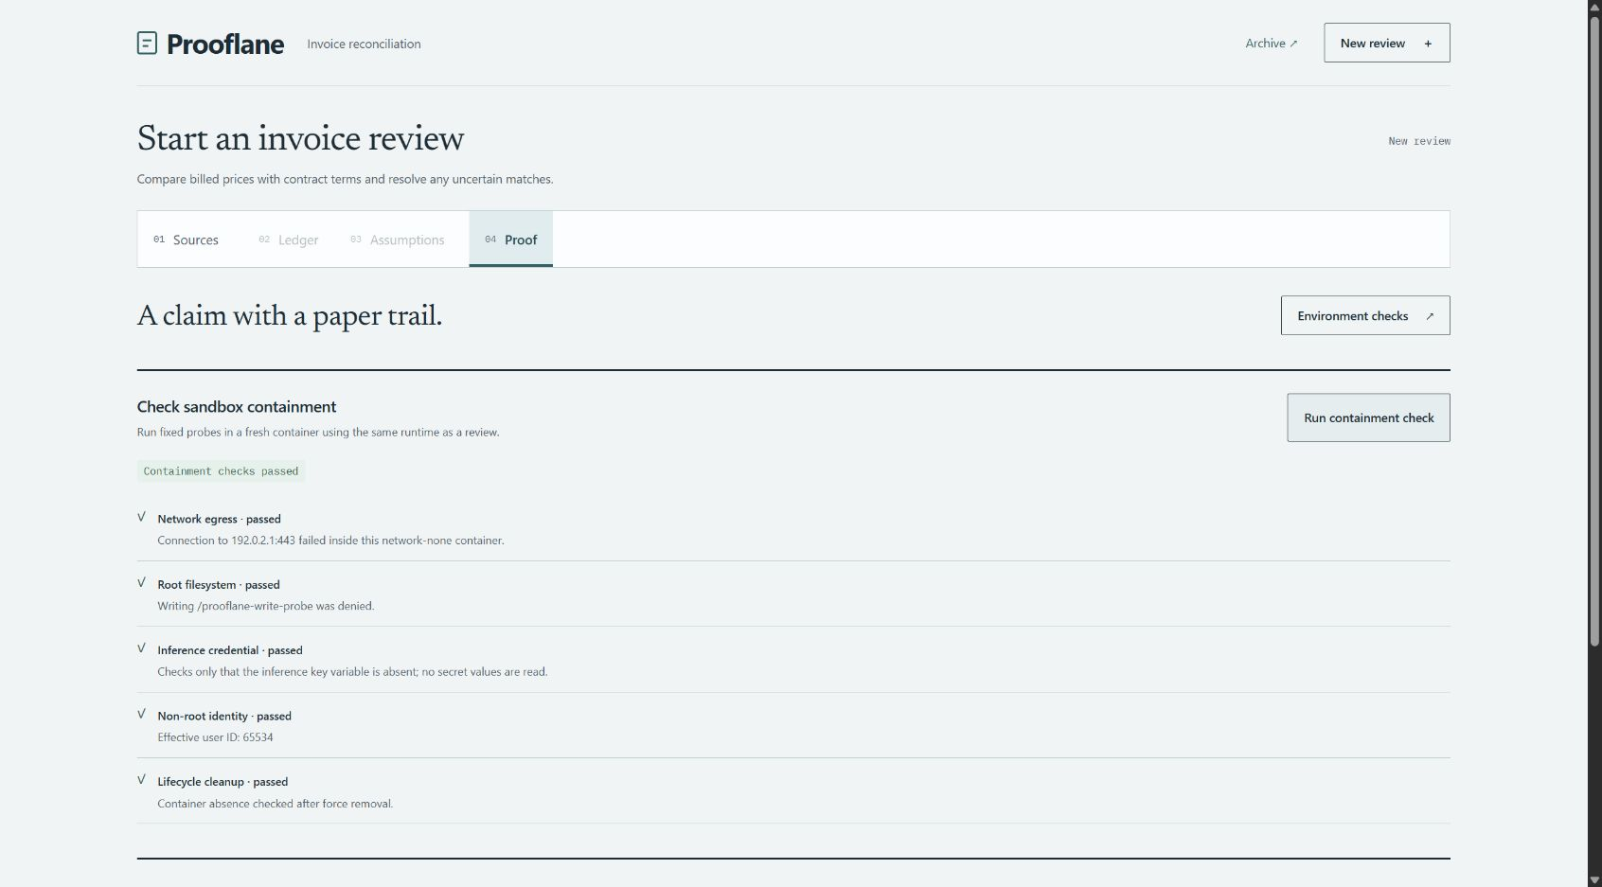
Prooflane
06
Prooflane fits disputed supplier prices
Start with AP teams that already export invoice and contract tables.
Reviewers can prioritize which contract to confirm and send the case to procurement.
Next validation: time how long a second reviewer takes to reproduce an exception using a spreadsheet or a Prooflane packet.
Vultr containment check: 5 observed checks passed
VULTR AGENT RUSH · BLAST RADIUS ZERO · NOVEMBER 2026
Notes:
Business value is a hypothesis for existing accounts payable and procurement workflows. No customer adoption, time saved or recovered cash was measured. A team subscription for repeat exception review is a pricing hypothesis. During the recorded demo run Proof → Run containment check and read the observed filesystem and cleanup results. Source: docs/AGENT_RUSH_READINESS.md and artifacts/vultr-release/containment.jpg.

