Slide 1
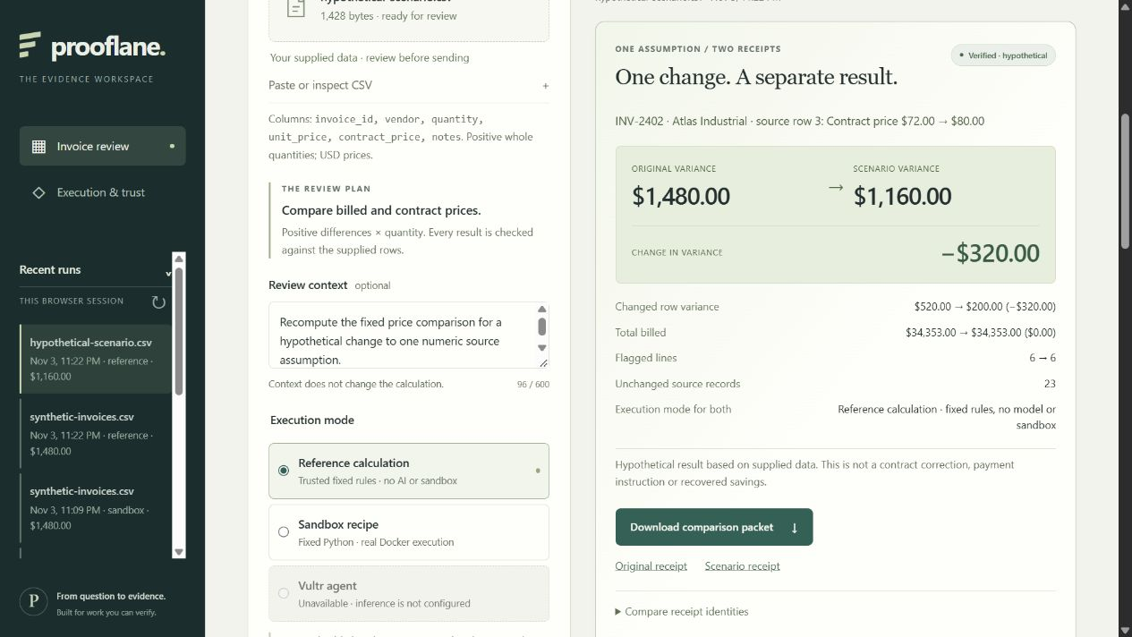
prooflane.
01
Test one assumption.
Keep both receipts.
An invoice review. One proposed change.
Both results, with exact source-linked deltas.
Vultr Agent Rush · Blast Radius Zero
LOCAL PROTOTYPE / VULTR VALIDATION PENDING
Notes:
Prooflane helps accounts-payable and procurement analysts investigate invoice price differences. The implemented workflow preserves the original review, changes exactly one numeric source assumption, reruns the inherited execution mode, and exports both receipts plus exact deltas. The screenshot is a real local reference-mode comparison on fictional invoices. It is not model-generated output or evidence of customer adoption. No cloud deployment or live inference is claimed.
Sources: artifacts/optimization-review/frontend/reference-comparison.png and reference-comparison.json; docs/SCENARIO_CONTRACT.md; https://lablab.ai/ai-hackathons/vultr-hackathon (project research reviewed 2026-11-03).

Slide 2
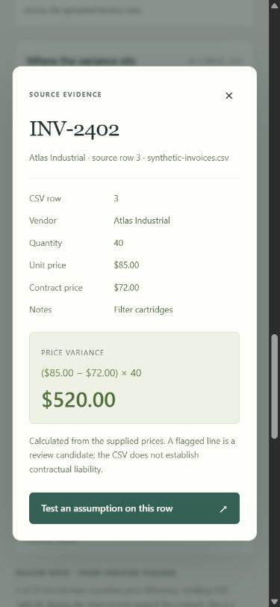
prooflane.
02
Inspect the source. Propose one change.
INV-2402 · source row 3
Supplied contract price
$72.00 → $80.00
Original row variance: ($85 − $72) × 40 = $520
Scenario row variance: ($85 − $80) × 40 = $200
The original row and its receipt stay unchanged.
The proposed price is a hypothetical assumption.
LOCAL PROTOTYPE / VULTR VALIDATION PENDING
Notes:
Demo: inspect INV-2402, then select Test an assumption on this row. Propose contract_price80.00 while keeping billed unit price85.00 and quantity40. Original row variance is520.00 and hypothetical row variance is200.00. This is not a correction to a real contract, a payment instruction, or recovered savings. The original receipt remains available. The screenshot is the actual mobile source dialog with fictional data.
Sources: artifacts/optimization-review/frontend/mobile-source.png; artifacts/optimization/sandbox-comparison.json comparison.change and both receipts. The UI supports any source row and one of quantity, unit price or contract price.

Slide 3
prooflane.
03
The effect of one changed assumption
Measure | Original | Scenario | Change
Total price variance | $1,480.00 | $1,160.00 | −$320.00
Source row 3 variance | $520.00 | $200.00 | −$320.00
Total billed | $34,353.00 | $34,353.00 | $0.00
Flagged lines | 6 | 6 | 0
23 other source records unchanged
Both runs used the fixed Docker recipe locally. Fictional inputs; this is a hypothetical change in variance, not savings.
LOCAL PROTOTYPE / VULTR VALIDATION PENDING
Notes:
Figures are read directly from artifacts/optimization/sandbox-comparison.json; the builder invokes scripts/verify_receipt.py on that packet before export. Original run dbc6b4fd-b34f-4569-815f-955165f87297; scenario run 5eccc9f5-fb6d-4957-8318-a16fe71042bf. Contract price72→80 on row3; total variance1480→1160; signed delta-320. Both total billed34353, six flagged lines,24rows,23unchanged records. Both receipts report actual local Docker execution and cleanup. The independent CLI checks arithmetic, exact one-cell change, mode and parent linkage. Hashes do not attest to the execution host or truth of contract prices. No model call was made.

Slide 4
prooflane.
04
Planned Vultr deployment
Local controller and Docker verified. Vultr deployment and inference pending.
Browser
Vultr VM
Docker sandbox
Review source rows
Propose one assumption
Original + scenario control plane
Independent Decimal verifier
Execute bounded Python
Return output; remove container
Vultr Serverless Inference
Agent mode writes code through the server.
Credentials stay outside the sandbox.
No network or host mounts · non-root · read-only root · memory, process, time and output limits · cleanup
LOCAL PROTOTYPE / VULTR VALIDATION PENDING
Notes:
This is the planned deployment architecture. FastAPI and SQLite currently orchestrate runs locally; the intended host is a dedicated Vultr VM. Reference mode uses trusted fixed arithmetic with no model or sandbox. Sandbox recipe mode executes fixed Python in Docker, with no model call. Vultr agent mode is implemented but not live-validated. It calls Vultr Serverless Inference, sends generated code and task data to disposable Docker, and checks returned output independently. The sandbox receives no credentials or host mounts. Docker is not a perfect security boundary.
Sources: prooflane/sandbox.py, prooflane/provider.py, artifacts/optimization/scenario-smoke.json, artifacts/optimization/sandbox-comparison.json. Vultr VM and live inference: NOT_RUN.

Slide 5
prooflane.
05
Both receipts, one verifiable comparison
Evidence | What is checked | Boundary
Original receipt | Input, code, output hashes Recomputed row arithmetic | Preserves the original Does not prove prices are true
Scenario + original | Exactly one declared cell change Parent receipt and same mode | Checked together in packet Hypothetical assumption
Comparison packet | Both receipts and every delta Offline independent verifier | Integrity and arithmetic No issuer or host attestation
python scripts/verify_receipt.py comparison.json
A reviewer can check the downloaded packet without an account or access to the running application.
LOCAL PROTOTYPE / VULTR VALIDATION PENDING
Notes:
The download embeds the full original and scenario receipts, declared source change, exact signed deltas, and bundle hash. The CLI verifies each receipt, reruns the trusted arithmetic, checks the original identity and hash, compares source records to reject undeclared edits, checks mode inheritance, and recalculates every delta. Cross-receipt lineage is checked by check_bundle using both receipts; standalone check_receipt does not establish a parent-child relationship. A rehashed false delta was rejected in the real HTTP smoke suite. Server access is session-owned; an exported packet can be checked offline independently of server retention. Because the format is unkeyed, an attacker can author a new internally consistent packet; hashes do not establish provenance, issuer authenticity, execution host, or the truth of the supplied invoice.
Sources: scripts/verify_receipt.py, prooflane/comparison.py, artifacts/optimization/scenario-smoke.json (36 assertions), artifacts/optimization/sandbox-comparison.json.

Slide 6
prooflane.
06
Local evidence and remaining gates
Verified locally
Still to prove
83 Python tests passed
24 synthetic HTTP cases passed
36 scenario smoke assertions passed
Real Docker runs and cleanup
Live Vultr Inference behavior
Dedicated Vultr VM deployment
Public judge access
Customer need and workflow value
Next demonstration
Repeat the original → assumption → comparison flow on Vultr; verify the exported packet independently.
LOCAL PROTOTYPE / VULTR VALIDATION PENDING
Notes:
This is a local prototype, not a completed contest submission. Evidence read for this build: 83 passing Python tests in artifacts/optimization/windows-cycle1.txt; 24 HTTP corpus cases in artifacts/optimization/evaluation.json; 36 scenario smoke assertions in artifacts/optimization/scenario-smoke.json. These overlap in scope and are not a statistical estimate of accuracy. Real local reference and fixed Docker workflows were exercised; live model calls:0. Browser implementation evidence covers exact comparisons, source detail, immutable baseline return, stale draft guards and mobile history; see artifacts/optimization-review/frontend-implementation.md. Public Vultr deployment, live inference, actual user research and final demo recording remain unverified. No customer adoption, revenue, time-saving or competition-win claims are made.

