Slide 1
Payment
Gateway
Nuran Tarlan / nurantrlan@gmail.com
2022

Slide 2
TABLE OF CONTENTS
01
03
What is Payment Gateway
Difference between Gateway and Processor
02
04
How Payment Gateways Work
Benefits of Payment Gateway
2022

Slide 3
*TIP* on the topic
Did you know that 44.5 percent of the world population uses Digital/Mobile wallet to do transactions during e-commerce shopping? While only 3.3 percent of the population opts for cash on delivery. Well, it isn’t hard to believe given the secure way of online payment, which became possible due to Payment Gateway.
2022

Slide 4
01
What is Payment Gateway
Definitions of PG, Key Takeaways
2022

Slide 5
Definitions
Payment Gateway is a method for business owners to collect money from their customers.
A payment gateway is a platform that supports the transactions of online payments. Its primary job is to authorize the payment between a merchant and a customer.
A payment gateway is a technology used by merchants to accept debit or credit card purchases from customers. The term includes not only the physical card-reading devices found in brick-and-mortar retail stores but also the payment processing portals found in online stores. However, brick-and-mortar payment gateways in recent years have begun accepting phone-based payments using QR codes or Near Field Communication (NFC) technology.
2022

Slide 6
Key Takeaways
01
Payment gateways are the consumer-facing interfaces used to collect payment information.
02
In physical stores, payment gateways consist of the point of sale (POS) terminals used to accept credit card information by card or by smartphone.
03
In online stores, payment gateways are the “checkout” portals used to enter credit card information or credentials for services such as PayPal.
04
Payment gateways are distinct from payment processors, which use customer information to collect payments on behalf of the merchant.
05
There are also payment gateways to facilitate payment in cryptocurrencies, such as Bitcoin.
2022

Slide 7
02
How PGs Works
Working principle of PG, architecture
2022

Slide 8
The payment gateway is a key component of the electronic payment processing system, as it is the front-end technology responsible for sending customer information to the merchant acquiring bank, where the transaction is then processed.
2022

Slide 9
Working Principle
Payment gateway technologies are always evolving to reflect new consumer tastes and technical capacities. In the past, terminals would accept credit cards using magnetic strips and required paper signatures from the customer. With the development of chip technologies, the signature phase could be removed in favor of a personal identification number (PIN) entered directly into the payment gateway hardware.
Today, contactless purchases are also available, with many customers now using their phones as a payment device instead of plastic credit cards.
2022

Slide 10
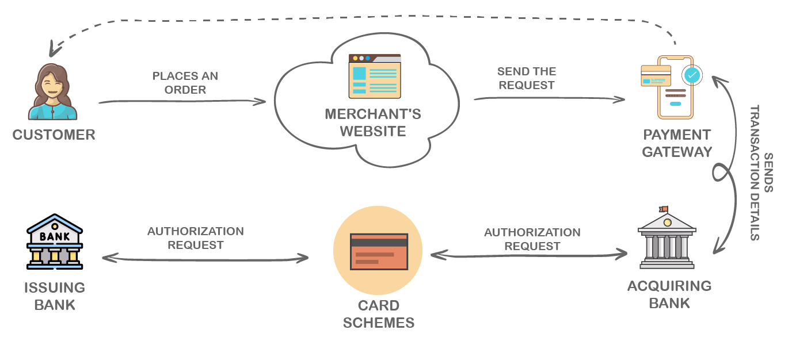
Architecture
The architecture of a payment gateway will differ depending on whether it is an in-store gateway or an online payment portal.
Online payment gateways will require application programming interfaces (APIs) that allow the website in question to communicate with the underlying payment processing network. In-store payment gateways will utilize a POS terminal that connects to the payment processing network electronically using either a phone line or an Internet connection.
2022

Slide 11
03
Difference between PG & Payment Processor
2022

Slide 12
Payment Gateway & Payment Processor
A payment gateway is distinct from a payment processor, a service that connects the customer's bank to the merchant account and facilitates the actual movement of money. You can think of these like two halves of the transaction: a payment gateway collects customer information for payment, and a payment processor uses that information to contact the customer's bank and the merchant account, debiting one account and crediting the other.
Payment Gateway
A payment gateway collects customer card information and encrypts it for later processing.
Payment Processor
A payment processor uses that information to charge the customers' bank or credit card provider.
2022

Slide 13
04
Benefits of Payment Gateway
2022

Slide 14
Some benefits are
Seamless Transaction
Prevents online malicious activities
Encourages Impulse Buying
Provide different Payment Modes to Customers
2022

Slide 15
THANKS
and I'm waiting for your appreciation for this work, I guess you learned something new..
nurantrlan@gmail.com
2022

