Slide 1
STUDENT PLANNER · FRONTEND PROJECT
Student Planner
A shared workspace for academic planning
Nurbolat Otep · Student 2 · Frontend
Student 1 · Backend owner · name to be confirmed
Current frontend build · 12 November 2026
Notes:
Project presentation for the Student Planner frontend. Team member name for Student 1 was not supplied, so it is left for confirmation.

Slide 2
Problem Statement
Academic planning is split across separate tools and lists.
01
Important details are scattered
Students switch between course information, assignment deadlines, calendars and grade records.
02
Priorities are hard to see together
A deadline list alone does not show how current work connects to course progress or grades.
03
Updates can become stale
Duplicated or static summaries can fall out of sync after an assignment or grade changes.
02
Notes:
The problem statement comes from the project brief: Dashboard, Assignments, Courses, Calendar and Grades had separate data and needed a shared frontend state.

Slide 3
Aim & Objectives
Aim
Give students one clear place to plan coursework and review progress.
01
Use shared contracts
Keep Student, Course, Assignment, Grade and ScheduleEvent outside page markup.
02
Connect the pages
Use frontend service interfaces so changes read from one shared scoped state.
03
Make summaries useful
Calculate assignment counts, deadlines, active courses and GPA from service data.
03
Notes:
Objectives are scoped to the frontend. Backend persistence and database behavior are owned by Student 1 and remain outside the current implementation.

Slide 4
Project Plan
1
2
3
4
DONE
DONE
NEXT
AFTER MERGE
Frontend UI
Shared state
Backend merge
Final QA
Preserve the existing look and routed pages.
Use domain contracts, service interfaces and mock implementations.
Connect real services and agree the database schema.
Repeat build, tests, browser checks and screenshots.
The backend merge and final evidence are planned work; they are not claimed as completed.
04
Notes:
The first two phases describe the current frontend worktree. Backend integration and final post-merge screenshots remain planned.

Slide 5
Existing Technologies Comparison
Technology | UI approach | Fit for this project
Blazor | C# and Razor components in the ASP.NET Core app. | Fits the .NET 10 project and allows the frontend to share C# contracts with the planned backend.
React | JavaScript or TypeScript components with JSX. | A strong UI library; routing and data-fetching structure are selected separately.
Angular | TypeScript components within a broad web framework. | A structured option, with a separate TypeScript frontend stack alongside .NET.
Comparison is about the current project fit, not a universal ranking.
05
Notes:
Sources for the comparison:
Blazor components and Razor: https://learn.microsoft.com/en-us/aspnet/core/blazor/?view=aspnetcore-10.0
React components, JSX, and its library scope: https://react.dev/learn and https://react.dev/
Angular framework overview: https://angular.dev/overview
.NET release and support details: https://learn.microsoft.com/en-us/dotnet/core/releases-and-support

Slide 6
Technology Stack
.NET 10
Frontend service contracts
Web application target and SDK used for the verified build.
IStudentService, ICourseService, IAssignmentService, IGradeService and IScheduleEventService.
Blazor Interactive Server
Mock data + local preferences
Razor pages and reusable components for the interactive UI.
Scoped mock services for domain data; browser localStorage for user preferences.
C# + Razor + CSS
bUnit + xUnit
Page logic, shared models and the existing visual design.
Component and service tests run with the .NET 10 solution.
SQLite and EF Core are not part of this frontend implementation.
06
Notes:
The source project targets net10.0. The current checked build used SDK 10.0.401. The database layer is reserved for the Backend owner.

Slide 7
Architecture
Current: scoped mock services
In-memory sample data
→
Blazor pages
Dashboard · Assignments
Courses · Calendar · Grades · Settings
Frontend service interfaces
IStudentService · ICourseService
IAssignmentService · IGradeService
IScheduleEventService
→
After merge: Backend services
Replace mock implementations
→
same contracts
↓
↓
IUserPreferencesService
Browser localStorage
Database design + persistence
Pending Backend agreement
Database tables, keys and relationships are intentionally not specified here.
07
Notes:
Solid green path shows the current page-to-mock-service implementation. Orange path shows the planned backend replacement after merge. Browser localStorage currently stores frontend preferences. No database or EF Core behavior is claimed.

Slide 8
Database Design
Pending Backend agreement
The frontend does not create a database or define EF Core mappings.
SHARED MODEL NAMES IN THE CURRENT CONTRACT
Student
Course
Assignment
Grade
ScheduleEvent
To agree after Backend merge: tables, keys, relationships, constraints, migrations and SQLite/EF Core setup.
Owner: Student 1 · Backend
08
Notes:
Only the shared domain model names are shown. This slide deliberately does not infer a database schema or persistence behavior.

Slide 9
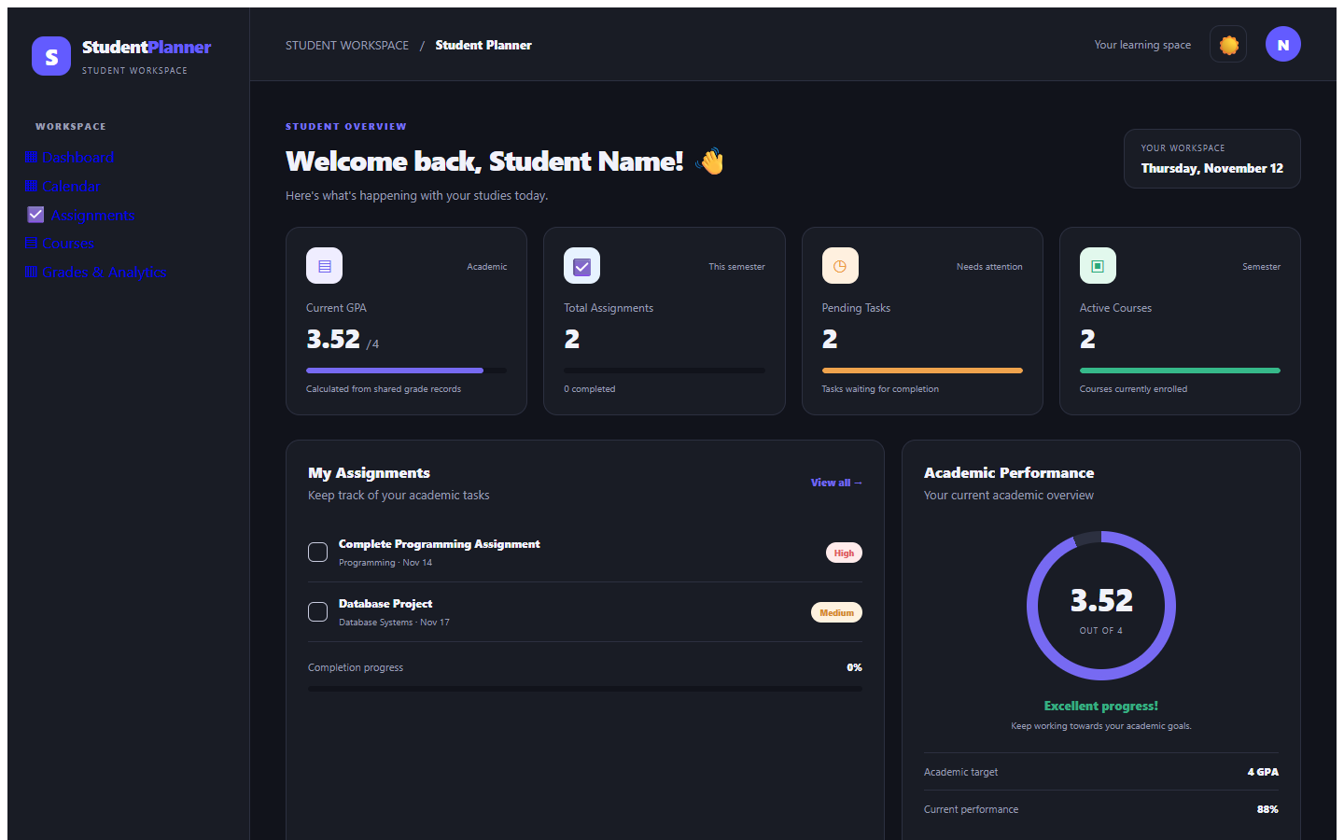
UI Mockups
The current dashboard keeps workload and progress visible in one view.
DESKTOP REFERENCE
Dashboard
• GPA is calculated from grade records.
• Assignment totals and progress use shared assignment data.
• Deadlines, course summaries and calendar activity are derived from the same services.
Screenshot uses mock service data; labels and layout are editable in the app.
09
Notes:
This is a screenshot from the current frontend running locally with mock services. It is included as a current UI reference, not as a post-merge backend result.

Slide 10
Core Features
Dashboard
Grades
Live counts, upcoming deadlines, active courses and weighted GPA from shared service data.
Record scores, sort grades and calculate GPA using the selected scale.
Assignments
Calendar
Create, edit, search, filter by status and priority, sort and confirm deletion.
View schedule events by month and date, with keyboard-dismissable forms.
Courses
Shared state
Create, edit, search, sort and update active course status.
Pages read and write the same scoped service instances during a user session.
10
Notes:
CRUD pages use the common model types and the service interfaces already present in the working tree. The mock service implementations provide sample data only.

Slide 11
Advanced Features
01
Settings persist locally
Theme, GPA scale, timezone, academic year and preference flags are stored in browser localStorage.
02
GPA scale flows through the UI
Dashboard and Grades use the selected scale when calculating and displaying GPA.
03
Safer forms and deletion
Email validation, labeled dialogs, Escape-to-close behavior and confirmation before deletes.
04
Backend-ready contracts
Pages depend on service interfaces so the mock implementations can be replaced after merge.
Notification preferences are saved; notification delivery is not implemented.
11
Notes:
The settings page persists preference values locally. Stored notification flags do not send notifications. Server-side profile persistence depends on the real Backend service after merge.

Slide 12
Testing
AUTOMATED
BROWSER CHECKS
Build: passed
Homepage: HTTP 200
Stylesheet: HTTP 200
Blazor error notice: hidden
.NET SDK 10.0.401
dotnet build StudentPlanner.slnx
9 / 9 tests passed
Start from the project root:
dotnet run --project StudentPlanner/StudentPlanner.csproj --launch-profile http
bUnit checks cover navigation, shared assignment updates, sorting, accessible dialogs, email validation and local settings.
NuGet audit still reports a moderate advisory in transitive test dependency AngleSharp 1.2.0.
12
Notes:
The solution was built and the test project passed 9 tests in the current worktree. The audit warning refers to the test dependency graph. Re-run build, tests and screenshots after the Backend merge.

Slide 13
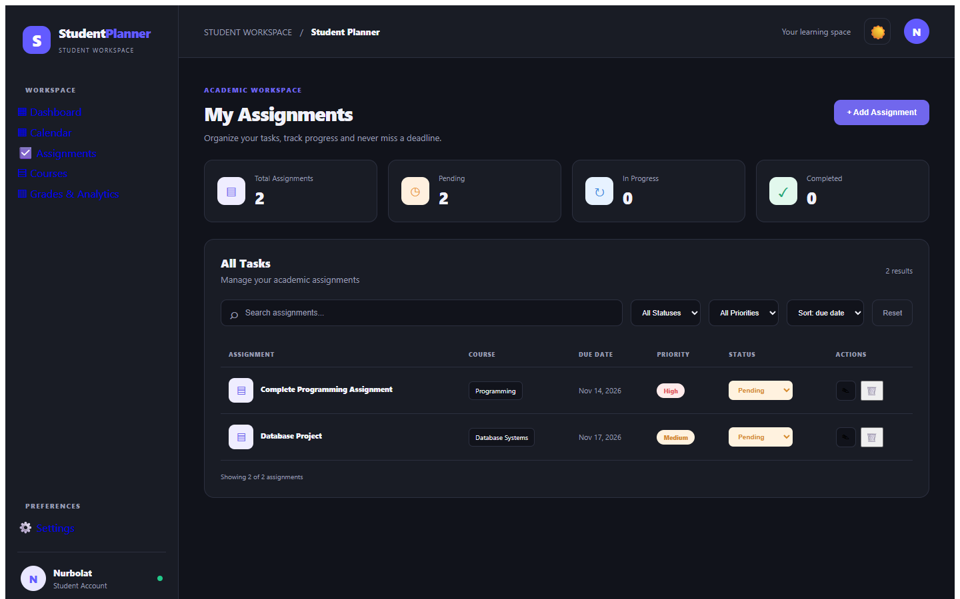
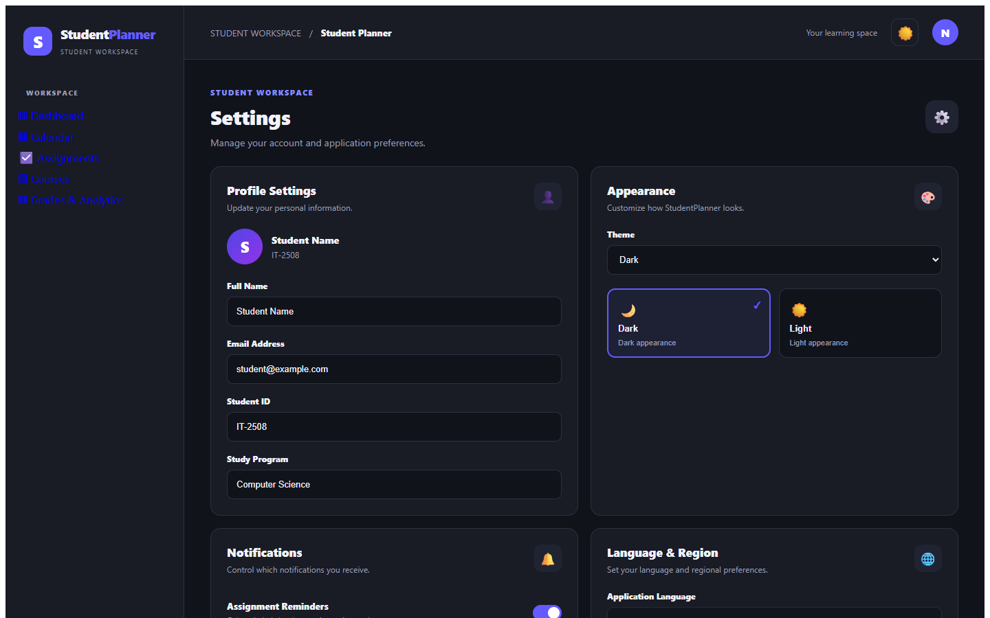
Actual Application Screenshots
Current frontend build · localhost:5048 · mock service data
Assignments · filters, sort and status
Settings · profile, appearance and preferences
Refresh these screenshots after Backend integration.
13
Notes:
Screenshots were captured from the current frontend worktree using the local mock services. They are not evidence of completed Backend functionality. Replace or update them after merge.

Slide 14
Challenges & Solutions
01
.NET version mismatch
Build and test the actual net10.0 solution with SDK 10.0.401.
02
Static assets missing when launched from bin
Run the project with dotnet run from the project path so wwwroot is resolved correctly.
03
Pages held separate data
Route reads and writes through shared scoped frontend service interfaces.
04
Backend schema is not merged yet
Keep the database slide explicitly pending; use agreed model names only.
14
Notes:
The launch fix addresses the user screenshot where the application was started from its compiled binary under bin/Debug and could not find the project wwwroot folder.

Slide 15
Conclusion
The frontend is ready for Backend integration.
Shared models
Student · Course · Assignment · Grade · ScheduleEvent
Service interfaces
IStudentService · ICourseService · IAssignmentService · IGradeService · IScheduleEventService
Next: connect backend implementations, agree the database design, then repeat full QA.
15
Notes:
Do not present the database or backend as complete. The frontend will continue to consume these contracts when the Backend owner is ready to merge.

