Slide 1

S&P 500 Stock Data Analysis (2013-2018 Historical Stock Data)
Data Analyst
Nurcan Cetinbas

Slide 2

Note for the class
Our finding are not based on our knowledge of financial analysis
They are based on our research:
https://www.investopedia.com/technical-analysis-4689657
https://www.fool.com/investing/how-to-invest/stocks/how-to-research-stocks/
https://towardsdatascience.com/statistical-analysis-of-a-stock-price-e6d6f84ac2cd
The recommendations might not be accurate
Unnecessary financial definitions in presentation
Notes:
- Our findings are based on the research that we have done for this project
- As we are not a financial analyst, our findings might not be accurate
- In real world as would present our findings to the CFO, you may find some of the financial definitions unnecessary. However, because we present them in class, we add them for more clarification by whom might not familiar with the definitions.

Slide 3

Agenda
Assumptions
Objective
Stock analysis methodologies
Analysis outcome and findings
Recommendations
Future work

Slide 4

Assumptions
S&P 500 Stock Data
Data Period: 2013-2018
Data Source: https://www.kaggle.com/camnugent/sandp500
Financial Analysis Tools: Microsoft Excel

Slide 5

Objectives
Have there any spikes or specific events happened in any stocks?
If yes, do they really matter for our decision on our company's portfolio?
Which stocks seem to be more attractive for our investment?
Which stocks should we be in our portfolio to minimize our risk?
To have a reliable answer to the above questions, we have chose S&P 500 stock data for the past five years.
Notes:
Any correlation between the stocks?
Any other factors that matter?

Slide 6
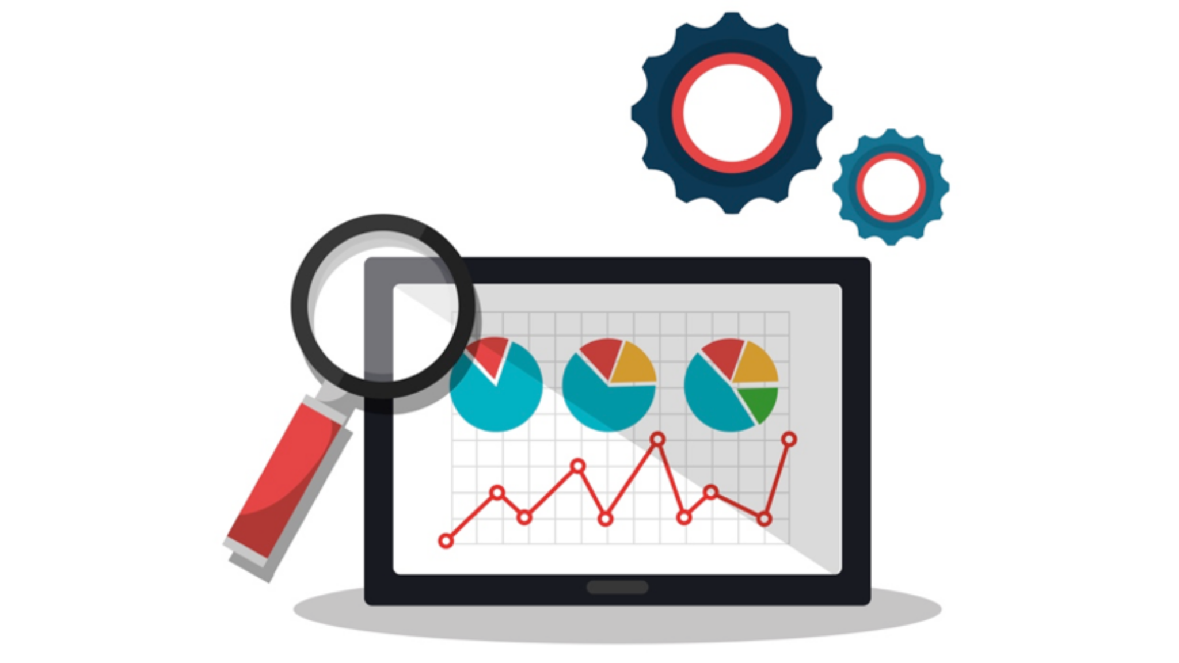
Stock Analysis Methodologies
Fundamental Analysis
Based on valuation metrics and other information
For long-term investment opportunities
Technical Analysis
Based on the stock price history
For short-term investment opportunities
Our findings and recommendations are based on Technical Analysis methodology

Slide 7
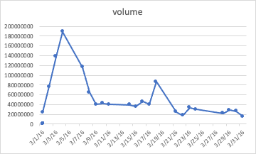

Chesapeake Energy Corporation.
High increase in the CHK opening and closing price on March 2, 2016
Finding: Aubrey McClendon, former chief executive of Chesapeake Energy, was indicted on march 1st after a federal investigation into price-fixing, bid-rigging and other anticompetitive conduct in the oil and natural gas industry.

Slide 8
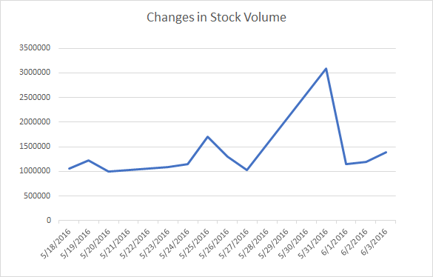

Alliant Energy Corporation Two-for-one stock Split
High decrease in opening price and closing price of the LNY stock on May 19, 2016
Finding: the company’s board of directors declared a two-for-one stock split
https://alliantenergy.gcs-web.com/static-files/2436d22a-ac9c-48ca-bb06-0ad9cd4afecd

Slide 9
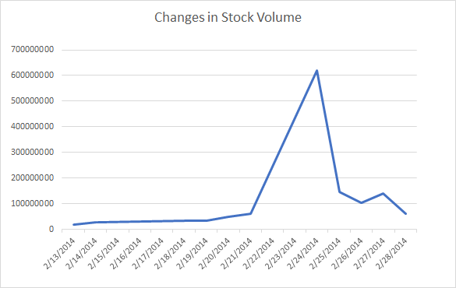

VODAFONE Group Plc.
The VZ had the greatest trading volume on Feb 24, 2014
Finding: Verizon Communications Inc. announced that it had completed its acquisition of Vodafone Group Plc’s 45 percent indirect interest in Verizon Wireless in a transaction valued at approximately $130 billion. Which led to an increase in their stock value.

Slide 10


Church & Dwight Co.
High decrease in the CHD closing and opening price on May 16, 2014 and May 19, 2014 (during the weekend)
Finding: one of the main shareholder (Dwight) passed away
But, the price adjusted itself in the next business day

Slide 11
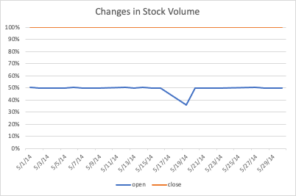

Slide 12
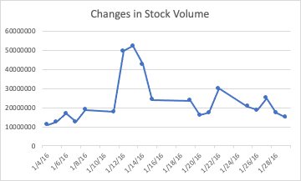

Williams Cos.
High increase in the WMB opening and closing price on Jan 14, 2016
Finding: WMB had a merger agreement with Energy Transfer Equity (ETE) that was terminated due to “failure of conditions under the merger agreement”.
Purchase not recommended

Slide 13
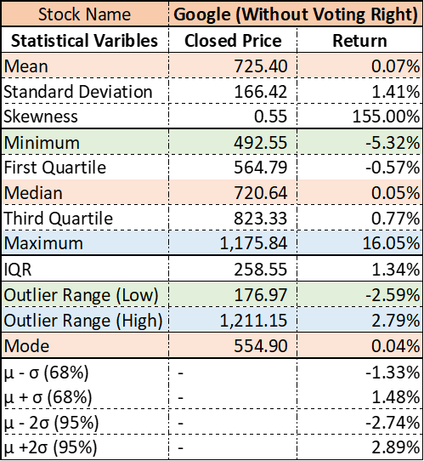

Google Stock Analysis

Slide 14
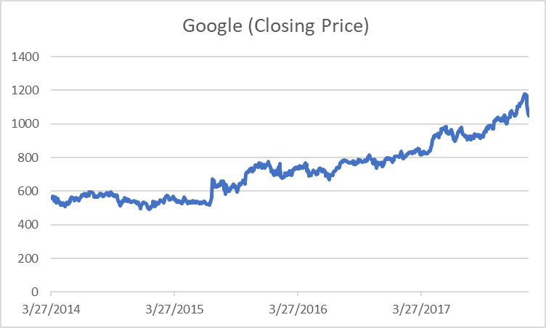

Slide 15
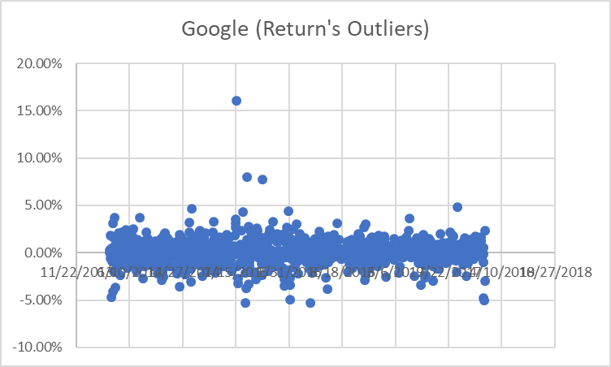
Stock Soared 21.8% on July 17, 2015
The new CFO proposed traditional business strategy keeping experimental projects at 10% budget.

Slide 16
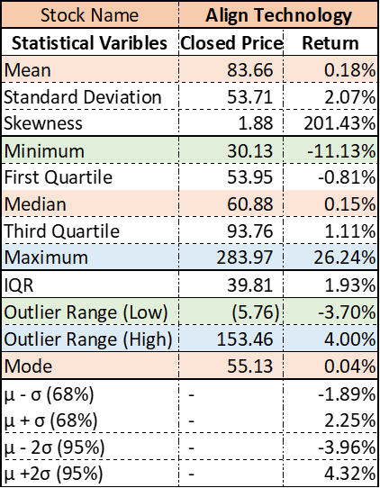

Align Technology Stock Analysis

Slide 17
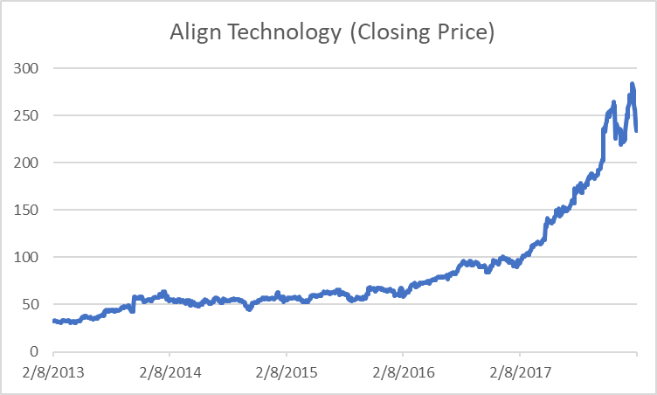

Slide 18
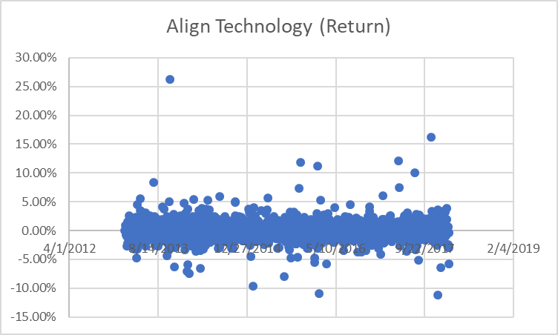
This company owns Invisalign, shipments of Invisalign increased 15 percent while the gross margin increased by 250 points
giving investors confidence on its competitive position in the market.

Slide 19
Future Research and Final Recommendation
Comparing 500 stocks in Python to find out choosing which stocks would reduce the risk of our portfolio
As this team are not familiar with Python programming yet

