Slide 1

#100DaysOfCode Challenge and Umbraco V9
by Nurhak Kaya

Slide 2

Who am I?
I’m a Senior Software Developer and an Umbraco Certified Expert.
I’ve been developing Umbraco websites since 2014. I have had a chance to work on many projects with many different Umbraco versions (many versions of v6, v7, v8 and finally v9).
I’m based in Bristol/UK and work for a software company, namely Felinesoft.
If you want to contact me, you can do it via Twitter (https://twitter.com/nurhakkaya14) or Linkedin (https://www.linkedin.com/in/nurhak-kaya-53825051/)

Slide 3
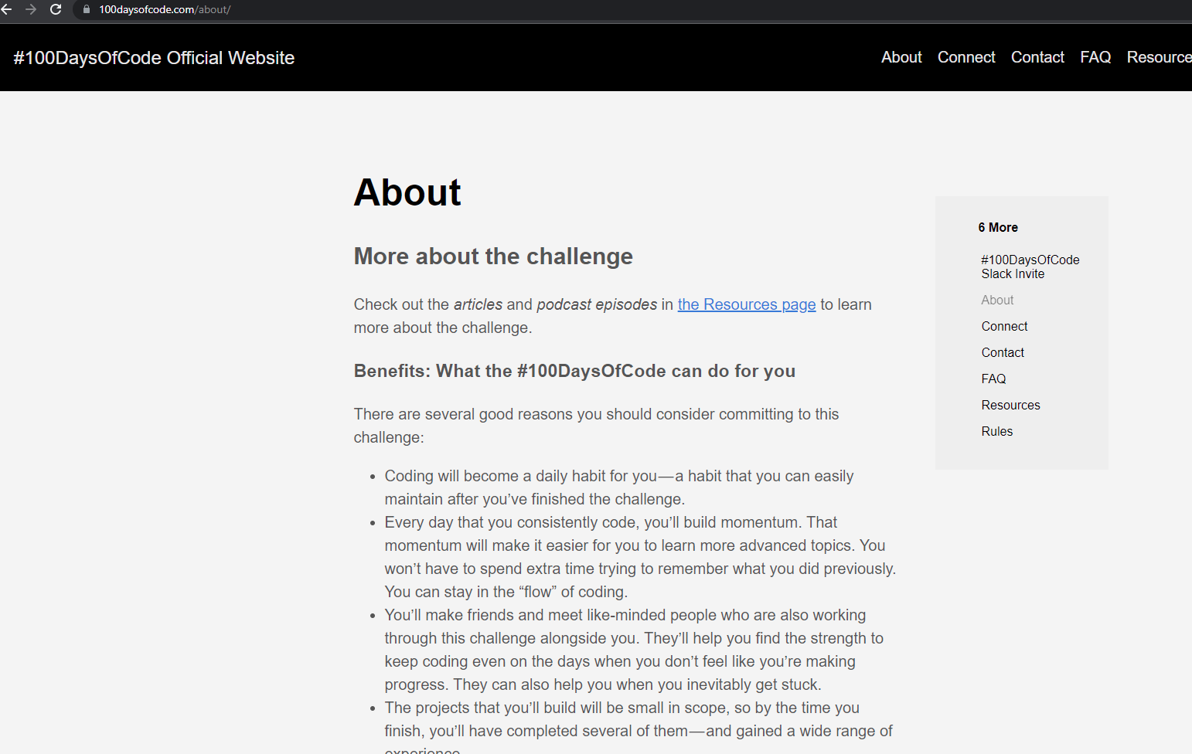
What is #100DaysOfCode challenge?
It’s a daily coding challenge that you can take up for 100 consecutive days!
The idea is that you set up some programming related goals before you start and then spend some time every day to achieve your goals.
Ideally you should spend min 1 hour, but this is completely up to you – so you spend as much as you can.
I have ended up spending a few hours pretty much every day!
This challenge can hopefully create some nice habits, so that you will hopefully continue your daily progress after 100 days of coding/leaning!

Slide 4
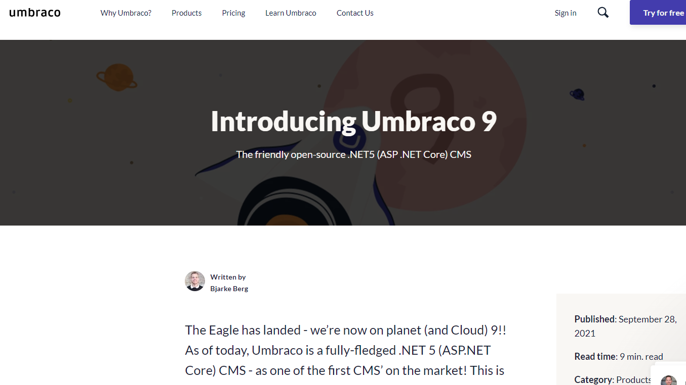
How has this challenge helped me with Umbraco v9?
I have spent a lot of hours checking the Umbraco v9 related news, blogs, attended meet-ups.
I have checked the Umbraco v9 source code and had a chance to understand / compare some breaking changes.
I have developed quite a few Umbraco v9 websites, which has helped me to plan my real-world projects better at work.
I have also spent a lot of time to understand different architectural options for an Umbraco v9 website and eventually architected a few Umbraco v9 solutions.
I’ll share some of these experiences with you today.

Slide 5
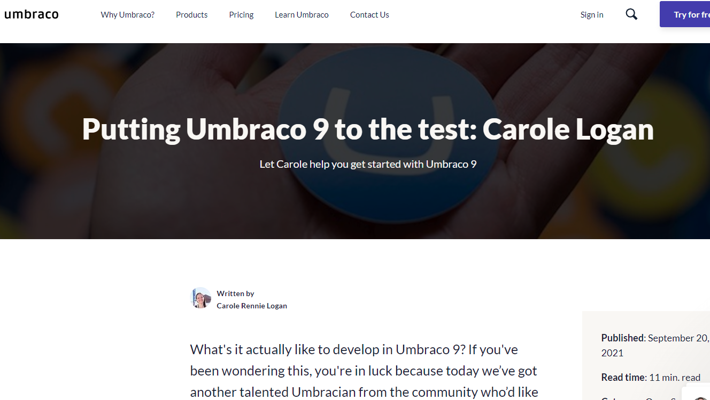
Architecting a new Umbraco v9 solution
First step is to get your IDE ready to implement .NET 5 projects.
If you are using VS 2019, make sure you have got .NET 5 SDK installed and you have done your VS 2019 upgrades. Also make sure you install your SDK and run your VS 2019 as Administrator!
You can see details here: https://our.umbraco.com/documentation/UmbracoNetCoreUpdates#umbraco-9-net-5
Paul Seal has got some nice videos, like this one: https://www.youtube.com/watch?v=3QSwL2n9LO4&t=195s
And finally Carole has nicelly created this blog, which has got pretty much all you might need to make a start! https://umbraco.com/blog/putting-umbraco-9-to-the-test-carole-logan/

Slide 6
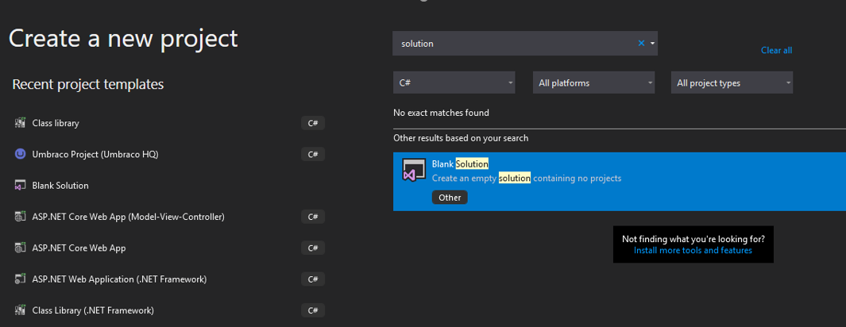
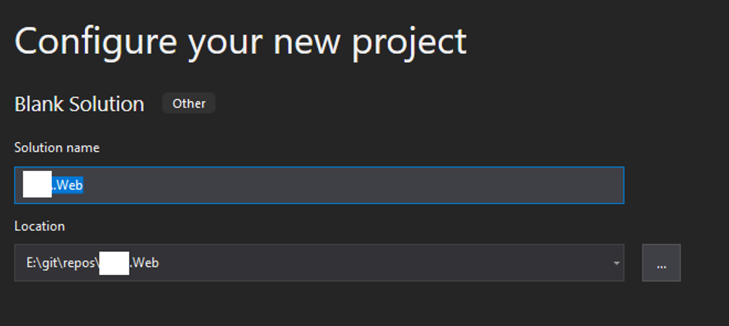
Architecting a new Umbraco v9 solution
When you are ready, I think it is best to start with a blank solution.
I name my solution as PROJECTNAME.Web
If you already have got a project in your git repo, you might want to create a new folder and create your new solution in it. When things are ready and you don’t need your old code, you can simply delete the old code from the root and move your v9 project files into the root!

Slide 7
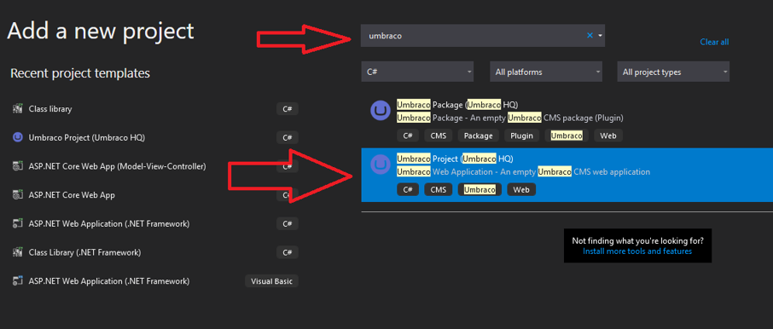
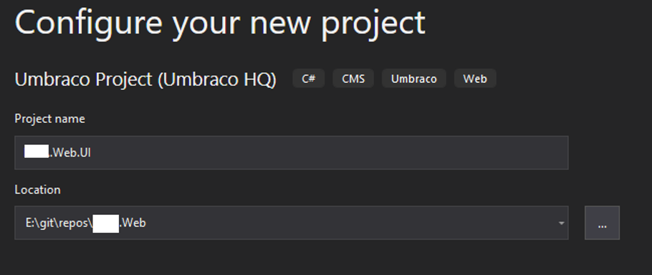
Architecting a new Umbraco v9 solution
Now is time to create your Umbarco project.
There are multiple ways to do this, but what I prefer is to use the Umbraco Project template.
I name my Umbraco project as PROJECTNAME.Web.UI
There are different naming convensions that people follow, some are PROJECTNAME.Web.Site, PROJECTNAME.Web.Website, PROJECTNAME.Web.Presentation
The idea is this project is where you’ll have all of your code to only display the data!
After adding the project, you can hit Ctrl+F5 to build your project and complete your Umbraco v9 installation.

Slide 8
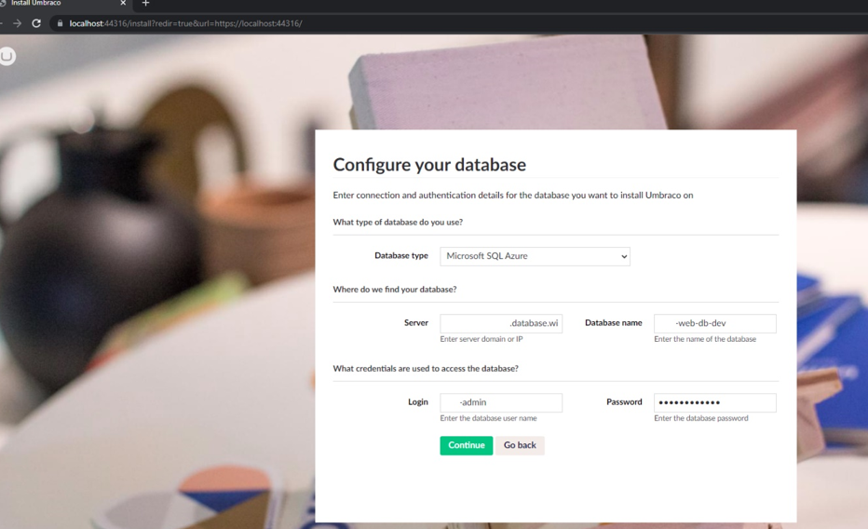
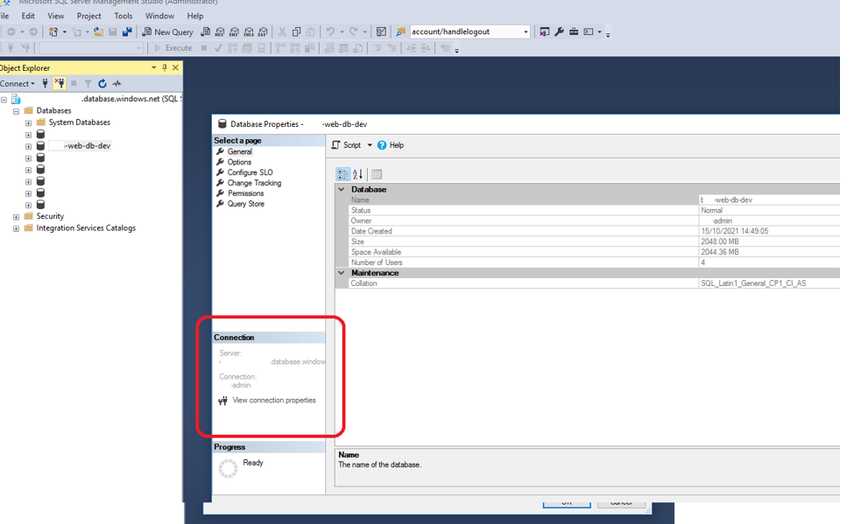
Architecting a new Umbraco v9 solution
If you are going to use a database for your installation, remember that all connection string details are in the database.

Slide 9
Architecting a new Umbraco v9 solution
When implementing your Umbraco v9 templates, please keep the Accessibility rules in mind, so that your websites will be also available for more people!
A quick course could be found here: https://www.freecodecamp.org/learn/responsive-web-design/#applied-accessibility

Slide 10
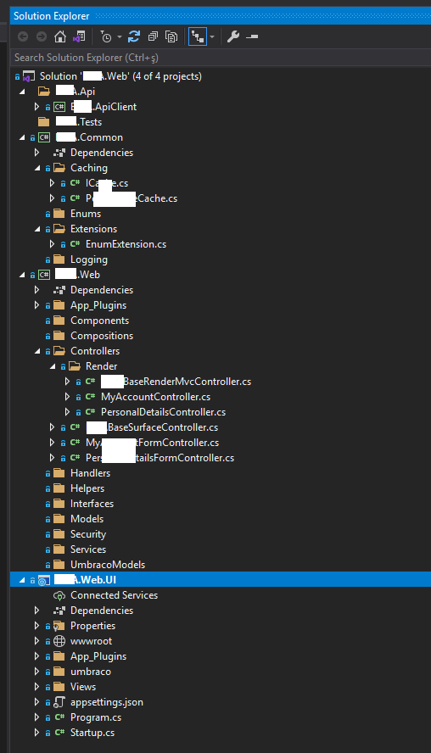
Architecting a new Umbraco v9 solution
Full picture for the Umbraco v9 solution with initial setup done.
More class libraries could be added to the solution as required.

Slide 11
Thank you!
Thank you for joining me today!

