Slide 1


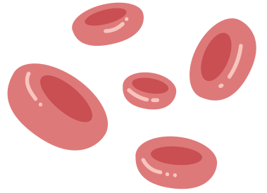



SLEEP STAGE CLASSIFICATION USING HEART RATE PHYSIOLOGICAL SIGNAL
Under Superviosion of:
DR. Ibrahiem Sadek
Eng. Veronica

Slide 2



DONE BY
Nurhan Mohamed Reyad
Manar Hamdy
Git hub link
git@github.com:NurhanGhonim/sleep-stage-classification.git

Slide 3
MAIN FOCUS:
Automated sleep stage classification
Deep learning approach
Heart-related biosignals

Slide 4
INTRODUCTION
What is Sleep Stage Classification?
Automatic identification of sleep stages
Important for sleep quality analysis
Used in healthcare and monitoring systems

Slide 5


WHY HEART RATE WAS CHOSEN
Main Reasons
Major Advantage
Practical Importance
Strong correlation with sleep stages
Lower computational complexity
Easier real-world deployment
Can be collected using:
Smartwatches
Fitness bands
Wearable devices
Non-invasive monitoring
Portable solution
No hospital setup required

Slide 6
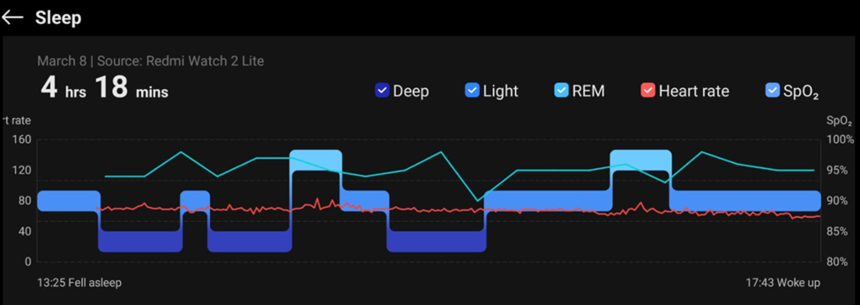
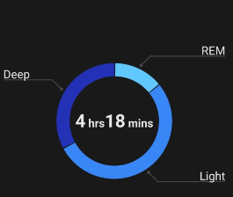

Slide 7
WHY HEART-RELATED SIGNALS?
Heart signals provide:
Cardiovascular activity information
Autonomic nervous system behavior
Physiological state monitoring
Strong relationship with:
Wake state
REM sleep
Deep sleep stages

Slide 8

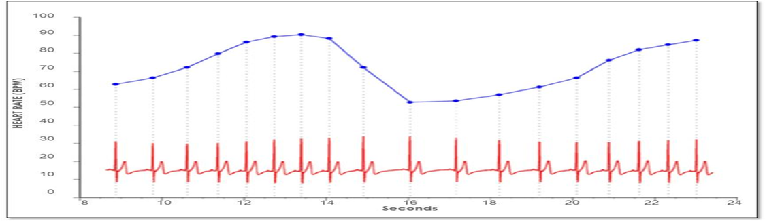
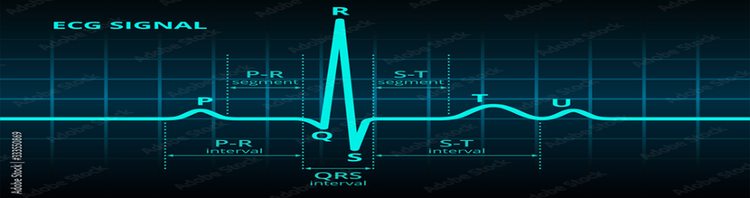



ECG VS HEART RATE
ECG (Electrocardiogram)
Raw electrical activity of the heart
Contains:
P-wave
QRS complex
T-wave
Rich and detailed signal
Heart Rate (HR)
Derived from ECG
Calculated using R-peak detection
Represents beats per minute (BPM)

Slide 9
Feature Extraction

Slide 10

ANNOTATION PARSING
XML Parsing Extracts
Sleep stage label
Start time
Duration
Selected Sleep Stages
Wake
N1
N2
N3
REM

Slide 11

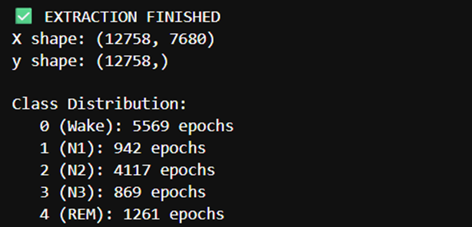
EPOCH SEGMENTATION
Epoch Length
30-second windows
Why 30 seconds?
Standard sleep scoring protocol
Fixed-length input generation
1

Slide 12
FEATURE EXTRACTION
Let’s examine how blood flows through the heart.
Instead of using raw physiological signals directly, this model first converts each signal segment into handcrafted statistical features..
Why this step exists?
Raw signals are:
High dimensional
Noisy
Computationally heavy
Feature extraction:
Compresses information
Keeps physiological meaning
Improves learning stability

Slide 13

WHY THESE FEATURES MATTER
Physiological interpretation:
Sleep stages affect:
heart stability
variability
autonomic nervous system activity
Example:
Deep sleep → low variability
REM → high variability

Slide 14

DATA SPLIT
We Splittd Data to:
(70%, 15%, 15%)

Slide 15

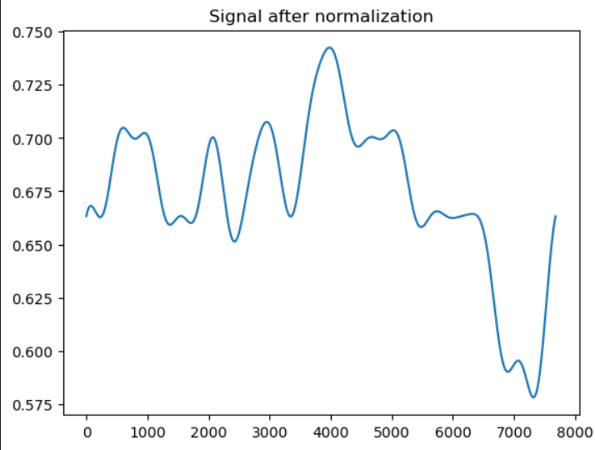
NORMALIZATION
Each feature becomes:
centered around 0
with standard deviation ≈ 1

Slide 16
BiGRU Model
“Bidirectional Gated Recurrent Unit”

Slide 17
BIGRU
Bi (Bidirectional)
Means the model reads the sequence in two directions:
Forward → past → present
Backward → future → present
GRU “Gated Recurrent Unit”
A type of Recurrent Neural Network (RNN)
Designed to learn from sequential / time-series data
Has a “memory” to remember previous time steps

Slide 18
EXTRACTED FEATURES
Each signal is converted into an 8-dimensional feature vector:
Mean → baseline physiological level
Standard deviation → variability
Range → amplitude spread
RMSSD →Root Mean Square of Successive Differences
“ heart rate variability (very important for sleep)”
MAD → Mean Absolute Difference
“Average size of changes between consecutive points”
_High MAD → more irregular activity (often REM or wake)
_Low MAD → stable sleep (deep sleep)
Energy → signal intensity
Skewness → distribution asymmetry
Slope → overall trend

Slide 19
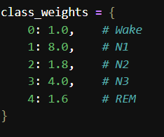
USING CLASS WEIGHTS INSTEAD OF AUGMENTATION
Physiological data is NOT easy
Class weights preserve real distribution
Better for sequence models (GRU)

Slide 20


SEQUENCE CONSTRUCTION
Instead of treating each sample independently, this model builds temporal sequences.

Slide 21
WHY SEQUENTIAL MODELING IS NEEDED
Sleep is NOT independent per sample.
Sleep is:
Continuous
Transition-based
Time-dependent
Example:
Wake → N1 → N2 → REM
Therefore:
This model learns:
transitions
temporal patterns
stage evolution

Slide 22
CNN Model vs BiGRU Model (Core Difference)

Slide 23
CNN + Dep CNN Model (First Model)
BiGRU Feature-Based Model
“Learns from “how the signal looks”
Input:
Raw signal
Architecture:
Conv1D layers
MaxPooling
Dense layers
What it learns:
Local patterns in waveform
Shape-based features
Short-range dependencies
Learns from “how signal behavior changes over time”
Input:
Handcrafted statistical features
Architecture:
Bidirectional GRU layers
Dense layers
What it learns:
Temporal evolution
Feature transitions
Long-range dependencies

Slide 24

WHY GRU INSTEAD OF CNN HERE?
GRU advantages:
Designed for sequential data
Captures memory over time
Efficient compared to LSTM
Why not CNN here?
CNN is spatial/local pattern-based
This model needs temporal memory, not just local patterns

Slide 25

WHY GRU INSTEAD OF CNN HERE?
Bidirectional GRU Concept
Uses past + future context
Sleep stages depend on surrounding states

Slide 26
Model Layers

Slide 27

INPUT LAYER
Purpose:
Defines the input shape of the model
Organizes data into sequences of 15 epochs × 8 features
Enables learning of temporal sleep patterns and transitions

Slide 28

FIRST GRU LAYER
Purpose:
Extract full temporal sequence representation
Keep sequence structure for next layer

Slide 29

SECOND GRU LAYER
Purpose:
Compress sequence into single representation
Prepare for classification

Slide 30

DENSE LAYER
Purpose:
Learn nonlinear relationships between features
Improve classification separability

Slide 31
WHY GRU INSTEAD OF CNN HERE?
Bidirectional GRU Concept
Uses past + future context
Sleep stages depend on surrounding states
Regularization Strategy
Batch Normalization
Stabilizes learning
Reduces internal covariate shift
Dropout
Prevents overfitting
Forces robust feature learning

Slide 32

OUTPUT LAYER
Meaning:
5 sleep stages
Probability distribution output

Slide 33

LOSS FUNCTION
Why?
Multi-class classification
Works with integer labels

Slide 34
LEARNING RATE
0.0015

Slide 35

OPTIMIZER
Why Adam?
Adaptive learning rate
Stable convergence
Gradient clipping:
Prevents instability in GRU training

Slide 36
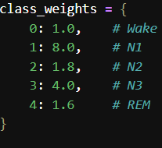
CLASS IMBALANCE HANDLING
Model is forced to pay attention to minority classes that it has less numbers of data than other according to the weights

Slide 37
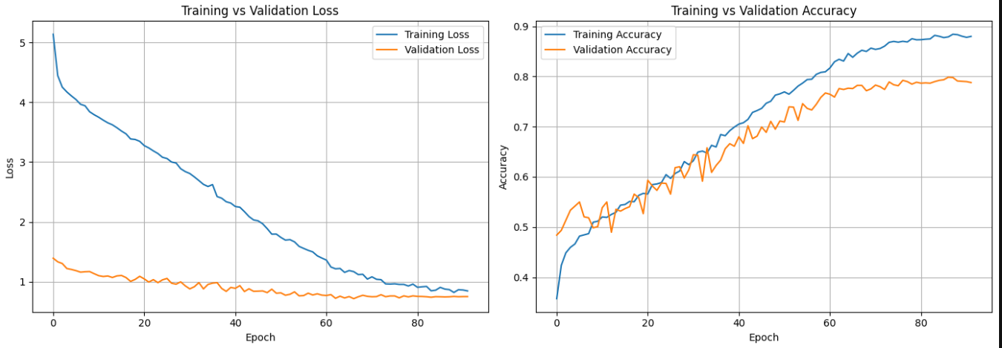
FINAL EVALUATION RESULTS

Slide 38
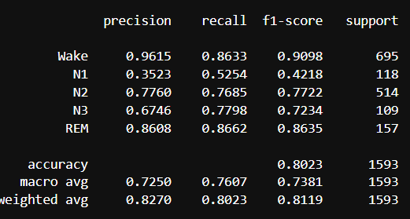
FINAL EVALUATION RESULTS

Slide 39
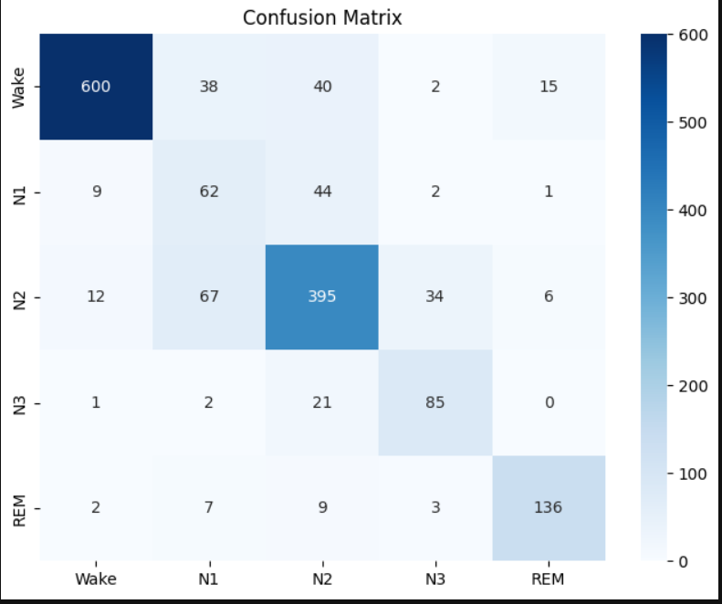
FINAL EVALUATION RESULTS

Slide 40



WHY TWO MODELS WERE USED
Reason:
Compare raw-signal learning vs feature-based learning
Benefit:
GRU captures high-level physiological dynamics

Slide 41
FINAL CONCEPTUAL INSIGHT
Combined understanding:
CNN model:
extracts features automatically
GRU model:
uses engineered physiological features
focuses on temporal transitions

Slide 42
Thank You

