Slide 1
Mice Protein Expression Dataset
CSE 4063
Fundamentals of Data Mining
Project 2
Fall 2020
Diala Jubeh
Nurhande Akyüz
Münevver Sueda Kocatürk

Slide 2
Glossary
1
Problem definition
2
Data preprocessing
Frequent pattern modelling
3
4
Clustering analysis modelling
5
Comparison between models

Slide 3
Problem Definition
In this project, using mice protein expression data, we construct frequent pattern mining models and clustering analysis models, and implement them above on the data, and analyze the performance of each classification model.

Slide 4
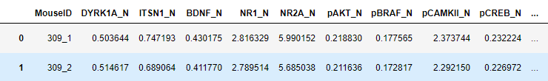
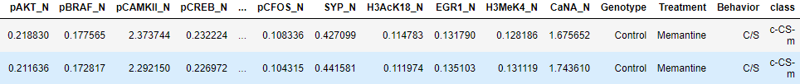
Dataset Description
Mice protein expression data is formed of expression levels of 77 proteins/protein variations that generated detectable signals inside the nuclear fraction of cortex. Totally, there are 72 mice. 38 of them are control mice and 34 of them for trisomic (Down syndrome) mice. In the tests, for each protein per sample/mouse, 15 measurements were recorded. Thus, there are 38x15 (570) tests for control mice and for trisomic mice, there are 34x15 (510) tests. Totally, 1080 tests per protein included in the dataset and each test can be considered as an independent sample/mouse. Finally, dataset contains 8 classes.
Notes:
Mice protein expression data is formed of expression levels of 77 proteins/protein variations that generated detectable signals inside the nuclear fraction of cortex. Totally, there are 72 mice. 38 of them are control mice and 34 of them for trisomic (Down syndrome) mice. In the tests, for each protein per sample/mouse, 15 measurements were recorded. Thus, there are 38x15 (570) tests for control mice and for trisomic mice, there are 34x15 (510) tests. Totally, 1080 tests per protein included in the dataset and each test can be considered as an independent sample/mouse. Finally, dataset contains 8 classes.

Slide 5


Attributes of Dataset
Numerical Attributes (MouseID, 77 values of expression levels of proteins).
Categorical Attributes (Genotype,Treatment, Behavior, Class)
Class column:
One protein type column:

Slide 6
Preprocessing Data
Preprocessing data is a must step in each data mining project; where data is normalized and cleaned.
We normalized our numerical attributes into range of 0 to 1.
We changed our categorical attributes to hold a value between 0 to 1 by Ordinal encoder class.
We used the mode function to replace all our missing values in each corresponding attribute.
We cleaned all our infinite and NANs values.

Slide 7
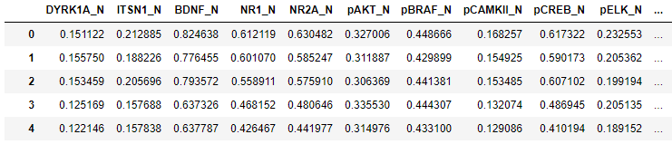
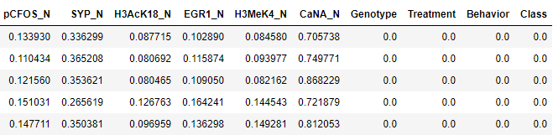
Data after preprocessing:

Slide 8
MISSION STATEMENT
Frequent pattern models
We implement 3 frequent patterns models: Apriori, Fpgrowth and ECLAT.
As a result we got 3 set of rules.

Slide 9
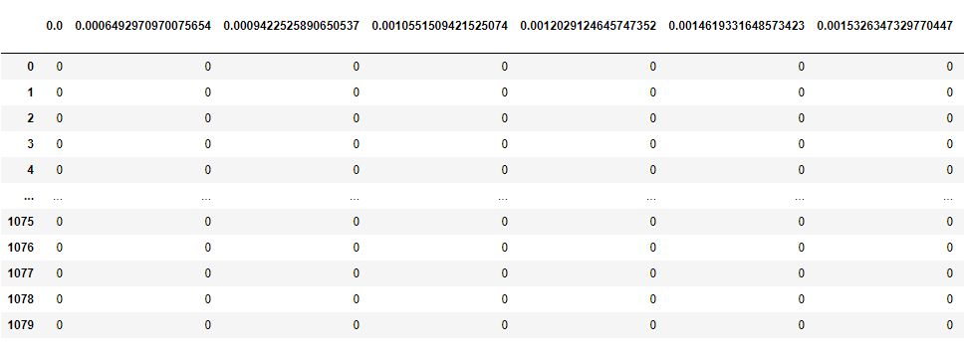
Data should be changes into a transaction dataframe.
Each row is a transaction and each column is a value type from each column in data. Each index shows whether this specific type is in the transaction or not.

Slide 10
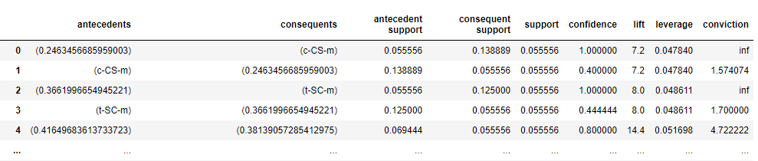
Apriori Algorithm
Apriori Algorithm: proceeds by identifying the frequent individual items in a dataset with the help of a support parameter (how popular an itemset is), mainly used for large datasets.
Some of the rules we got after applying the Apriori model:

Slide 11
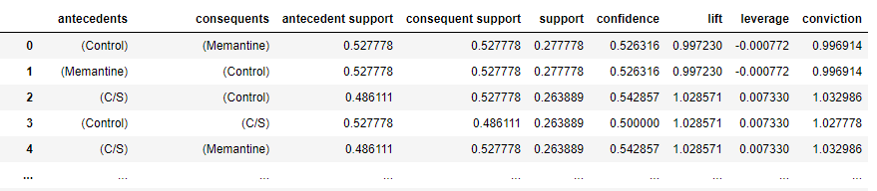
Fpgrowth Algorithm
Fpgrowth Algorithm: it does mining a complete set of frequent patterns by using an extended tree for storing information about frequent patterns. also used for large datasets.
The rules we got after applying the Fpgrowth model:

Slide 12
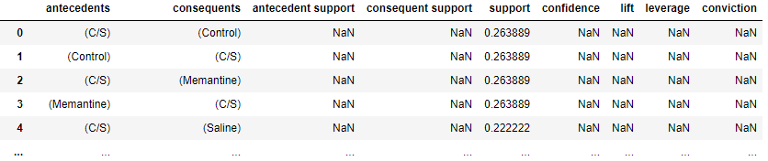
ECLAT Algorithm
ECLAT algorithm: it is a better version of the Apriori algorithm; where it uses the Depth-First Search to do mining of frequent patterns; which makes it faster than apriori.
NOTE: it uses only the support value in mining for patterns
The rules we got after applying the ECLAT model:

Slide 13
MISSION STATEMENT
Analysis clustering models
We implement 3 clustering models: K-means, AGNES and DBSCAN.

Slide 14
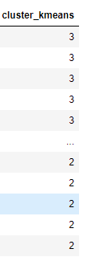

K-means clustering
K-means algorithm is an iterative algorithm; it defines k subgroups and performs repetitive calculations (on data points to decide which cluster they should be in ), it stops when data points don't change location.
Applying K-means:
Clusters assigned
for each row:

Slide 15
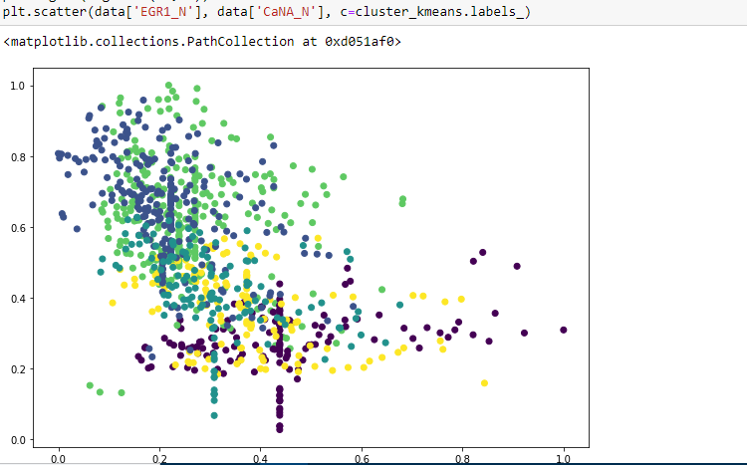
Showing the clustering between 2 proteins by K-means clustering:

Slide 16
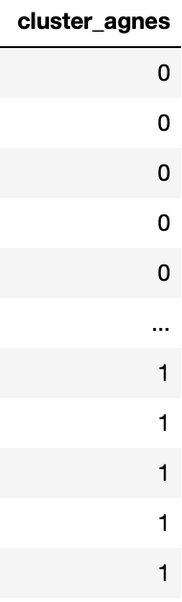
Agnes clustering
Agnes algorithm: The algorithm clusters data points by taking each object as a singleton cluster. sooner, it pairs clusters upon their similarity until they become one big cluster containing all objects.
this results in a tree called a dendrogram.
Applying AGNES:
Clusters assigned
for each row:

Slide 17
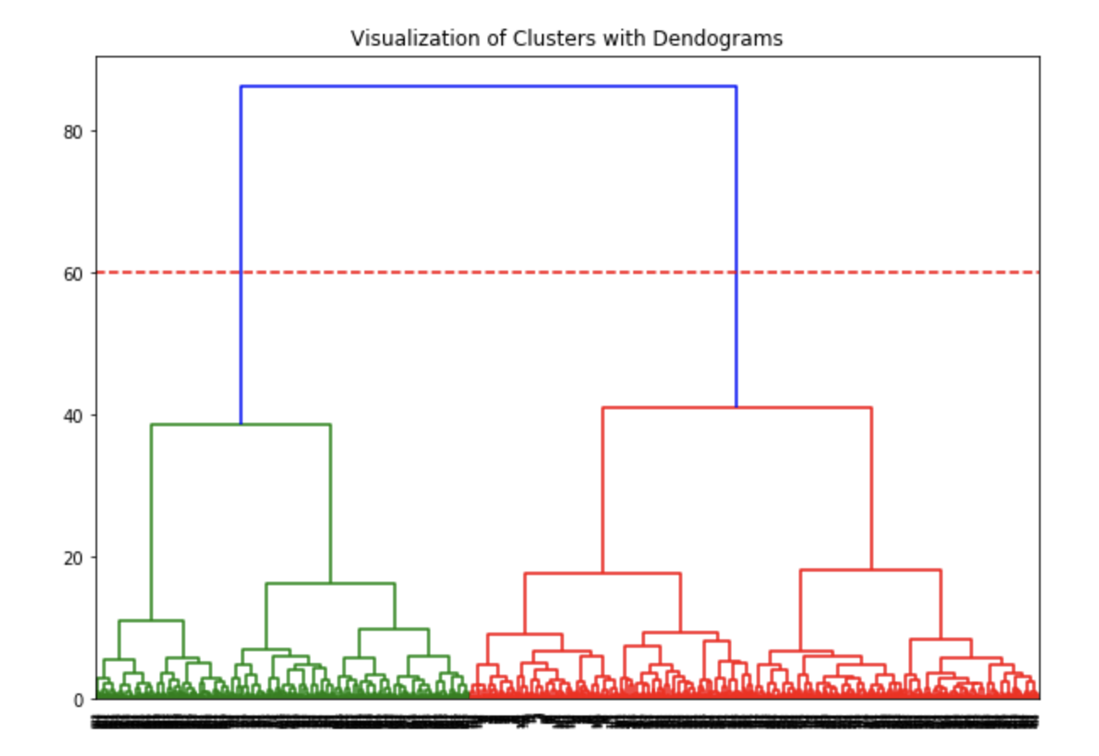
The resulted dendogram by AGNES clustering:

Slide 18
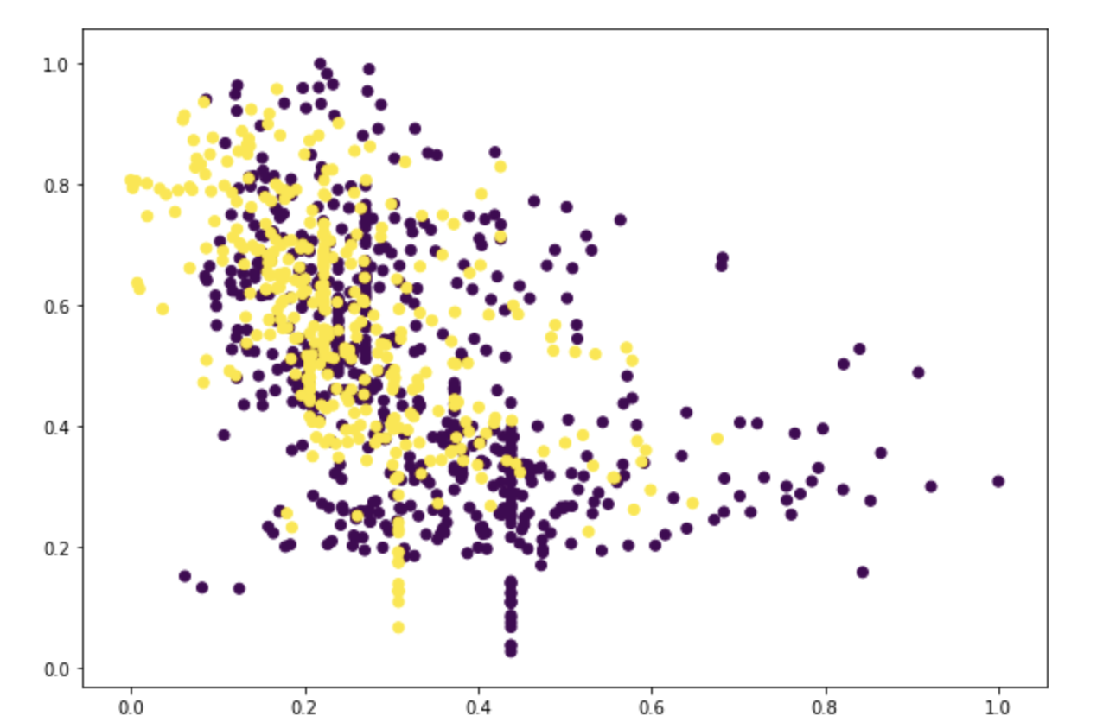
Showing the clustering between 2 proteins by AGNES clustering:

Slide 19

Agnes clustering
Agnes algorithm: The algorithm clusters data points by taking each object as a singleton cluster. sooner, it pairs clusters upon their similarity until they become one big cluster containing all objects.
this results in a tree called a dendrogram.
Applying AGNES:
Clusters assigned
for each row:

Slide 20
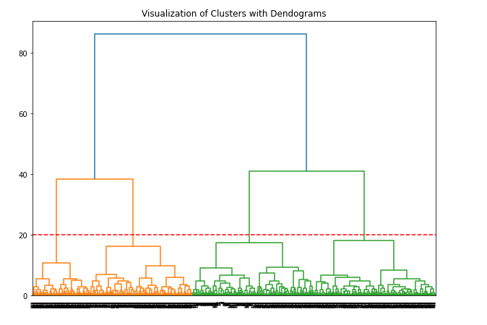
The resulted dendogram by AGNES clustering:

Slide 21
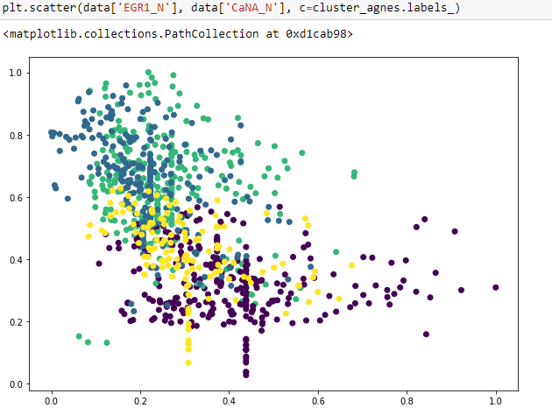
Showing the clustering between 2 proteins by AGNES clustering:

Slide 22

DBSCAN clustering
DBSCAN algorithm: it works depending on density-based clustering, it groups data points that are closely packed together, marking the data that are far from others (outliers) as noise.
it takes 2 important parameters:
1- eps: it specifies how close points should be to each other so they can be in the same cluster.
2- min_samples: for specifying the core point, there should be a number of samples in the neighborhood.
Clusters assigned
for each row:
Applying DBSCAN:

Slide 23
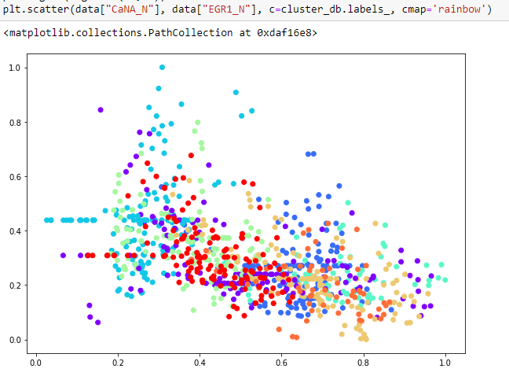
Showing the clustering between 2 proteins by DBSCAN clustering:

Slide 24

MISSION STATEMENT
Comparing between
models

Slide 25
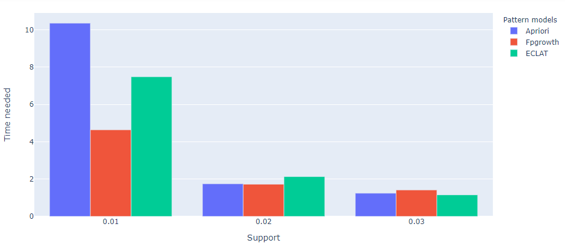
Comparing between frequent pattern models
Comparing the time needed for frequent pattern mining models:

Slide 26
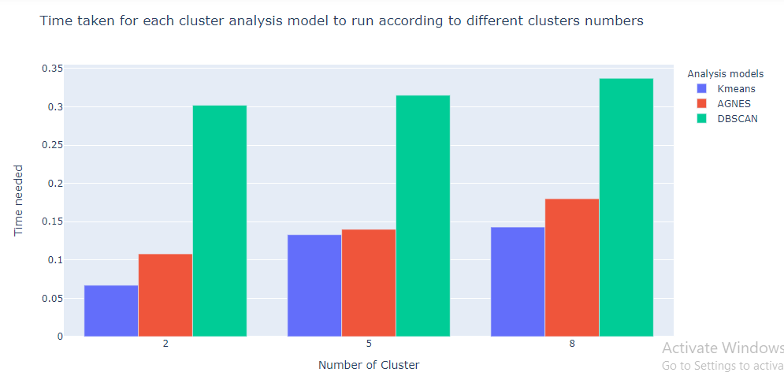
Comparing between clustering analysis models
Comparing the time needed for clustering analysis models:

Slide 27
Thank you!
Do you have any questions?

