Slide 1
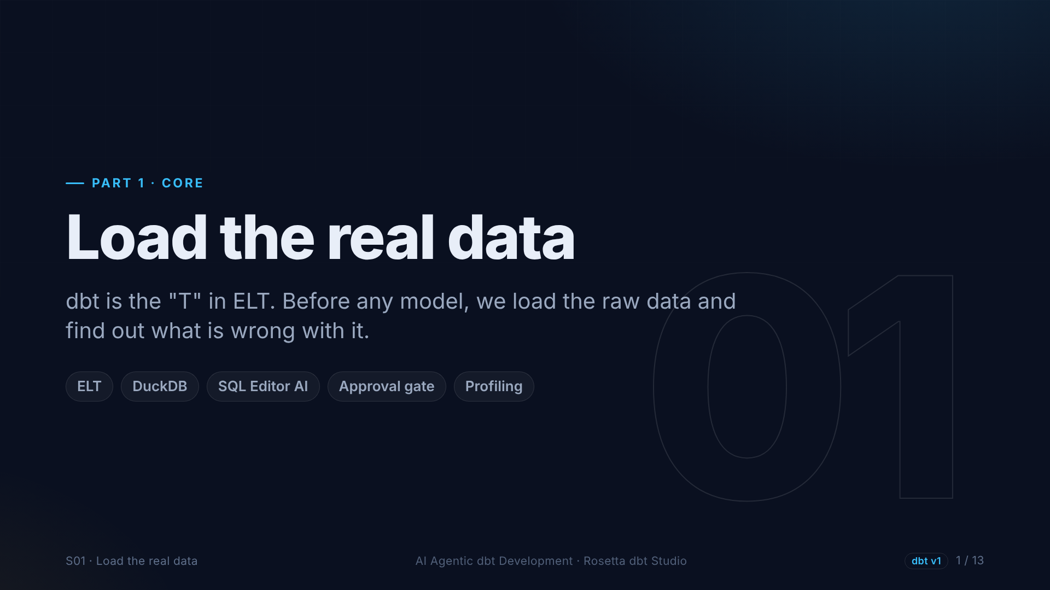
Notes:
Section one. Before writing any dbt model, we need data in the database, and we need to understand it. We load two months of real taxi trips into DuckDB with the agent, and then we find out what is wrong with the data.

Slide 2
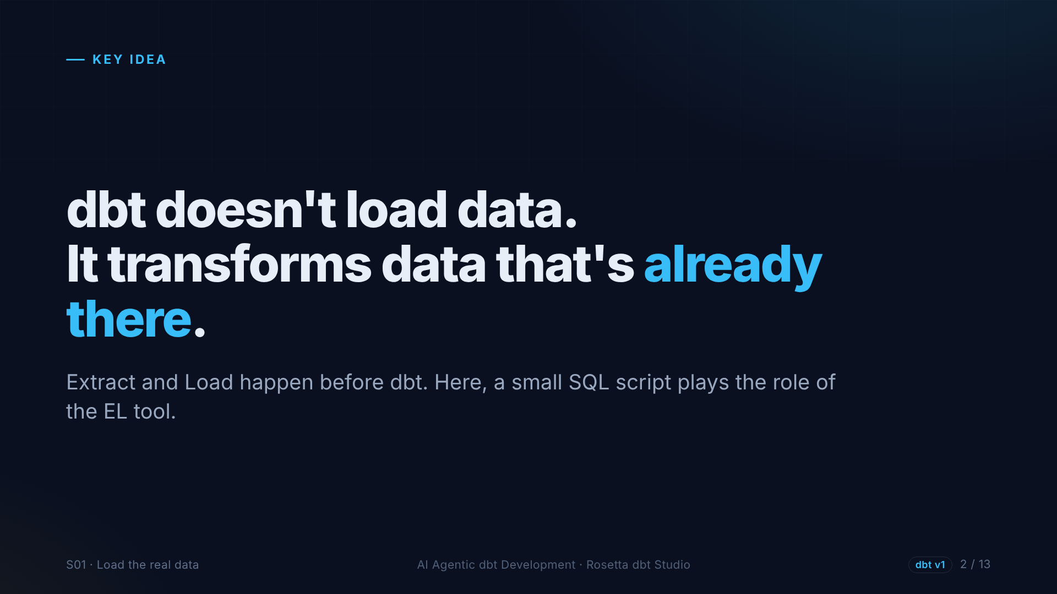
Notes:
Here is something that surprises many beginners. dbt does not load data. It does not download files or call APIs. It transforms data that is already in your database. Loading is done by other tools, before dbt starts.

Slide 3
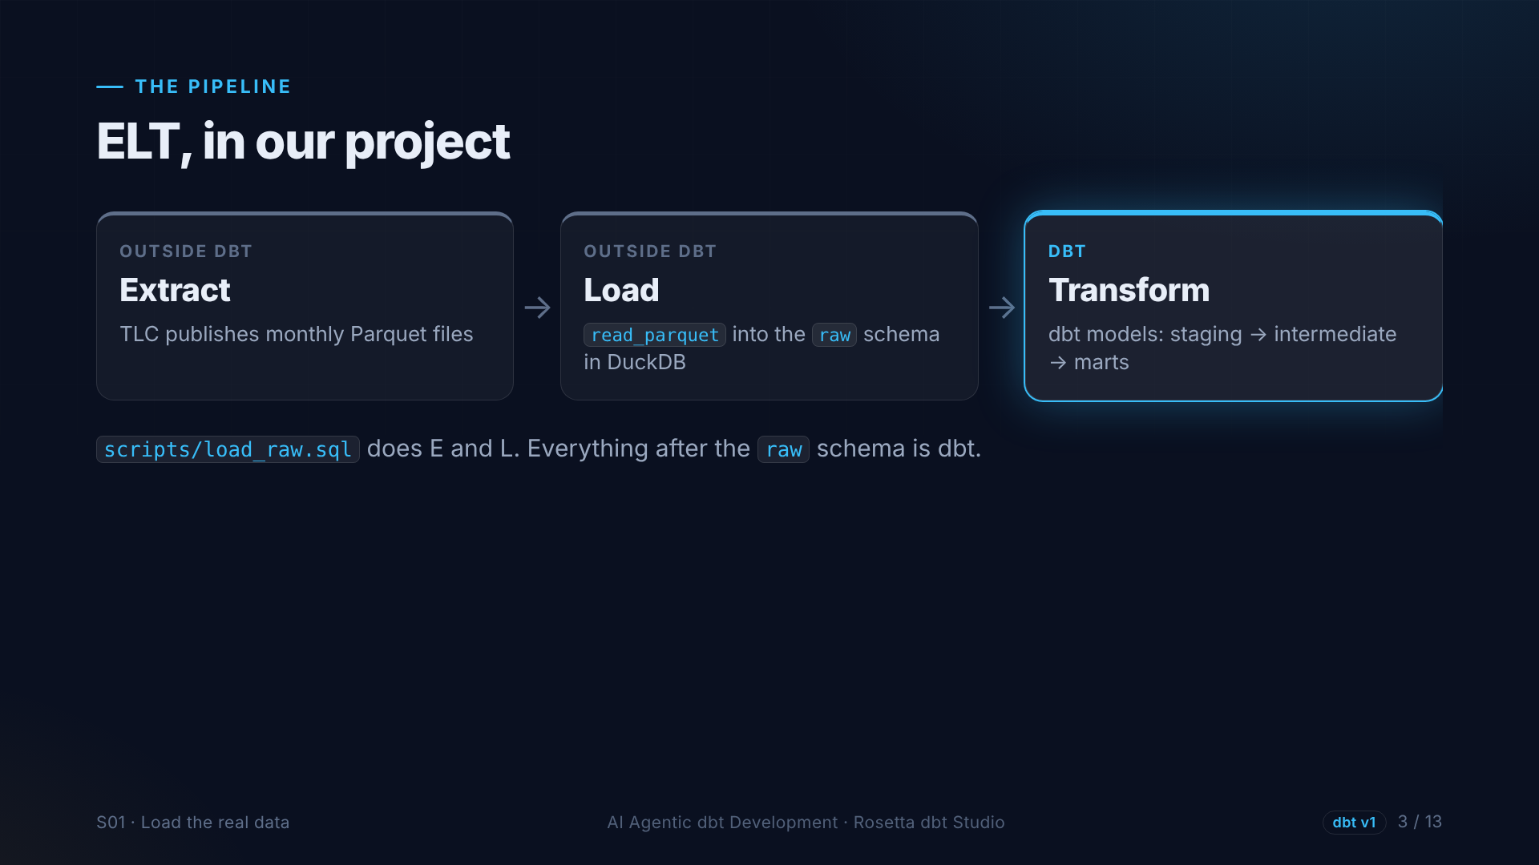
Notes:
Extract: the Taxi Commission publishes Parquet files. Load: DuckDB reads them into a schema called raw. Transform: that is dbt, and the rest of this course. We keep the loading SQL in a script, outside dbt, so we can run it again when a new month arrives.

Slide 4
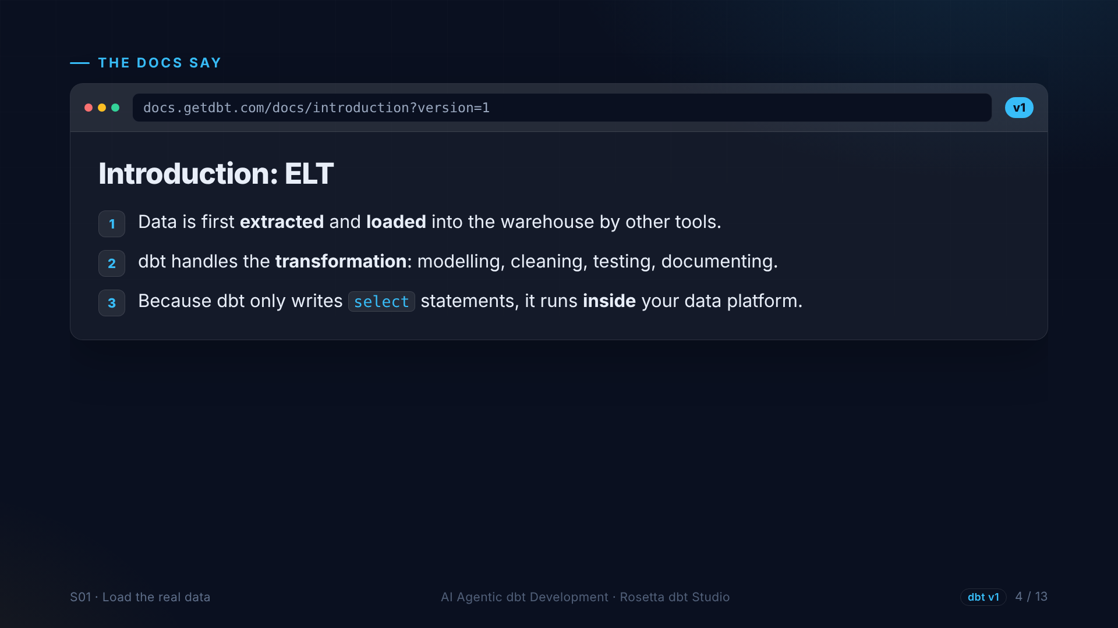
Notes:
The dbt introduction says the same thing. Data is extracted and loaded by other tools. dbt handles the transformation: modelling, cleaning, testing and documenting. And because dbt only writes select statements, the database does the heavy work.

Slide 5
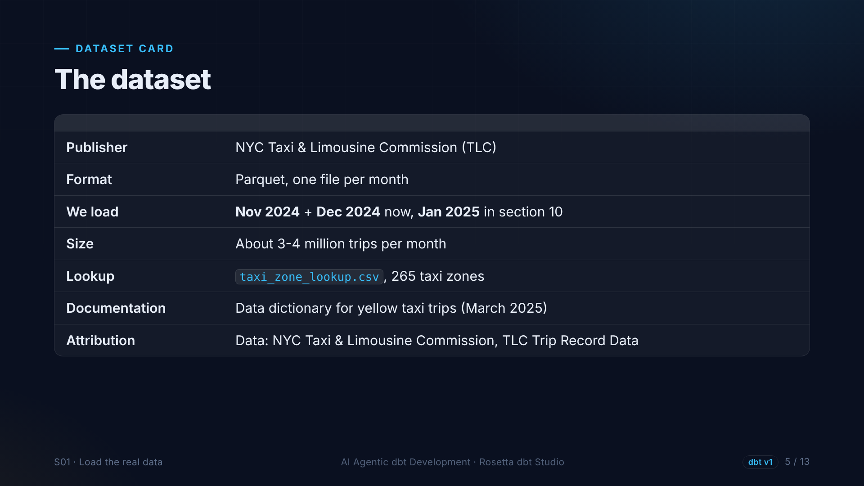
Notes:
The dataset. Parquet files, one per month, around three to four million trips each. We start with November and December twenty twenty-four, and add January twenty twenty-five later, on purpose. There is also a zone lookup file and an official data dictionary.

Slide 6
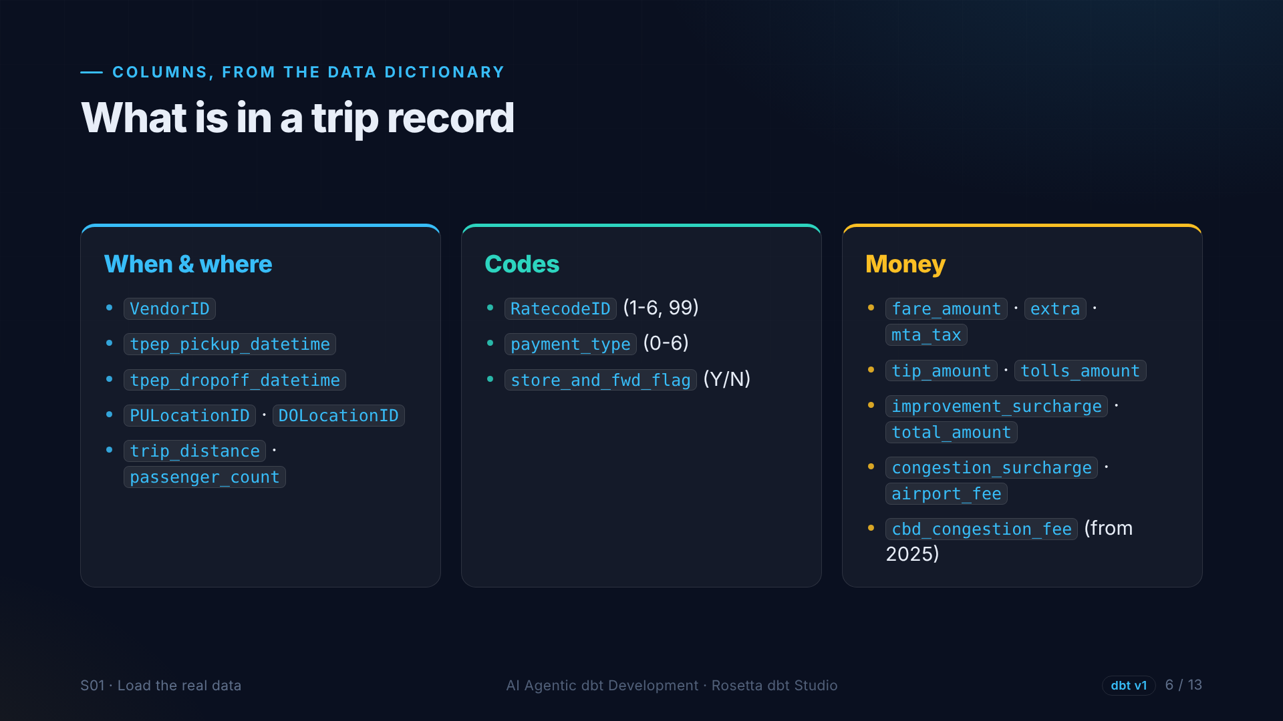
Notes:
Each row is one taxi trip. When and where: pickup and dropoff times and zones, distance and passengers. Codes, like rate code and payment type, that only make sense with the dictionary. And money columns. The last one, the congestion fee, only exists from January twenty twenty-five.

Slide 7
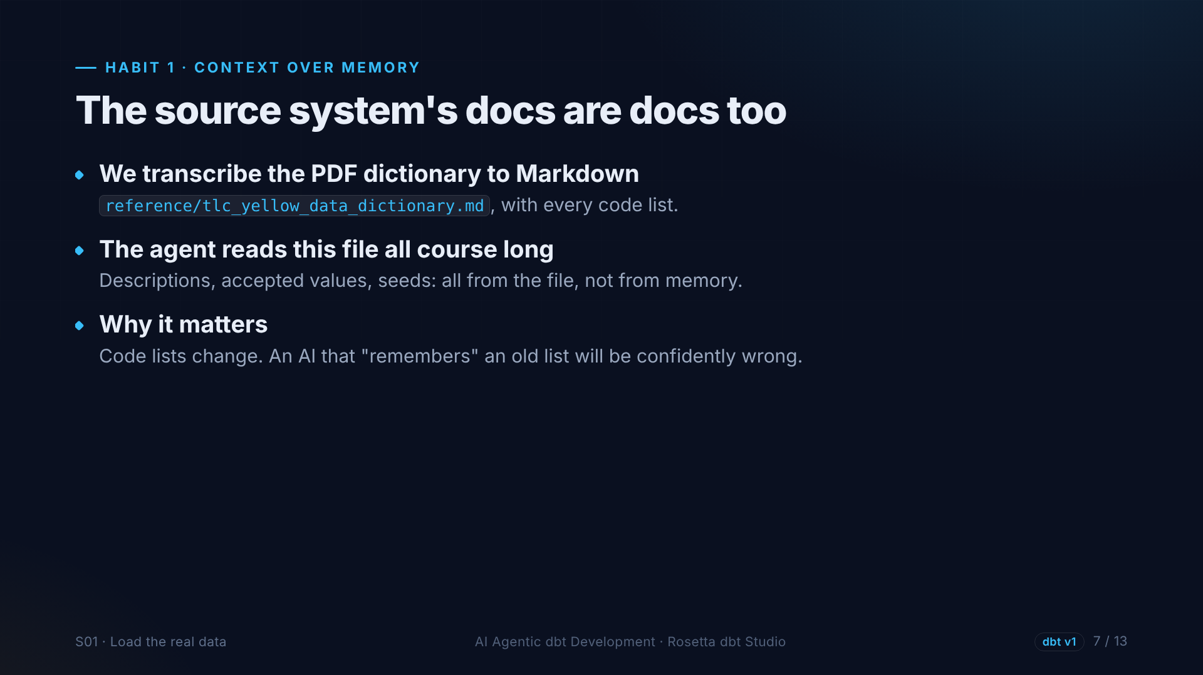
Notes:
Our first habit in action. We transcribe the official data dictionary into a Markdown file inside the project. From now on, the agent reads code lists and descriptions from that file, not from memory, because lists like these change over time.

Slide 8
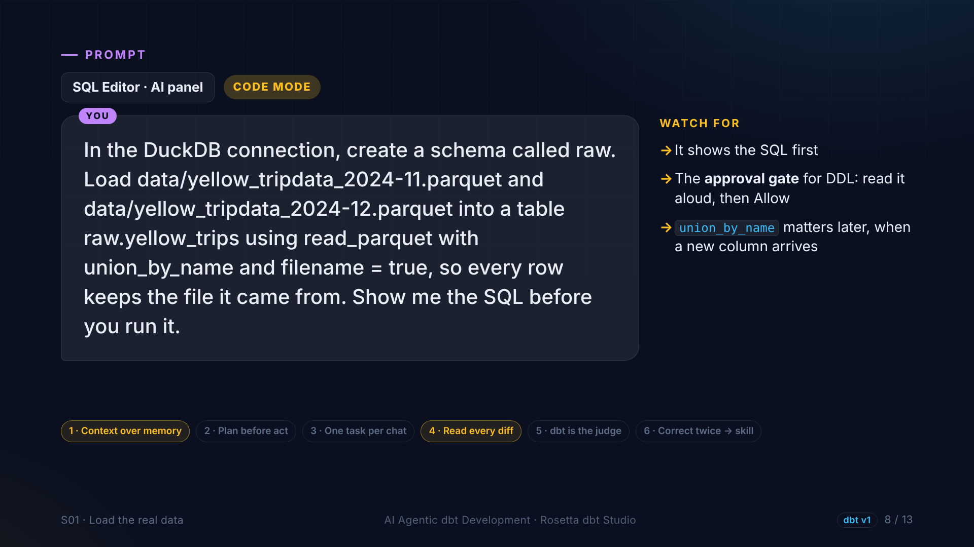
Notes:
This is the first prompt for the demo. In the SQL editor, the agent creates a raw schema and loads both monthly files into one table, keeping the file name on every row. We ask to see the SQL first, and Rosetta stops at an approval gate before anything runs.

Slide 9
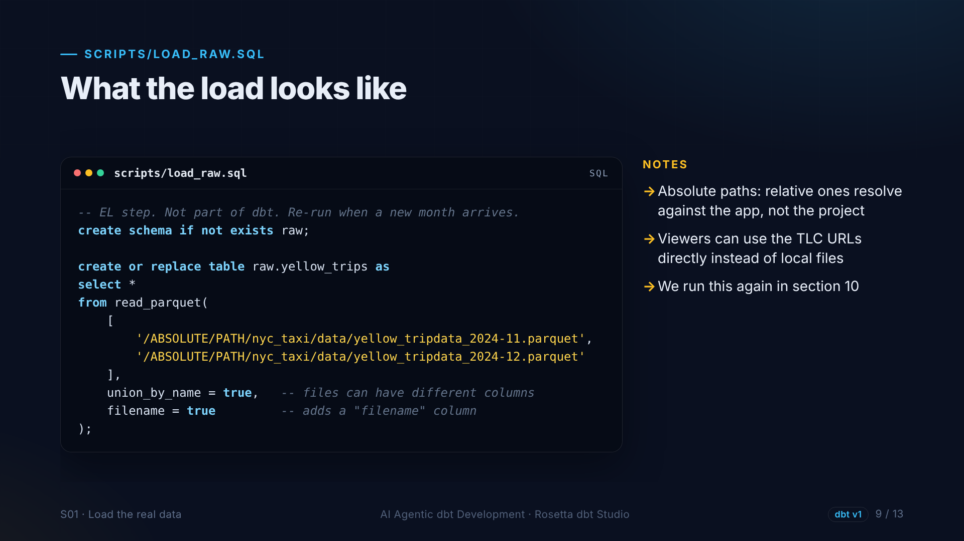
Notes:
This is roughly the SQL the agent writes, and we save it as the load script. One create table statement that reads both Parquet files. Union by name lets files with different columns combine, which matters later when a new column arrives.

Slide 10
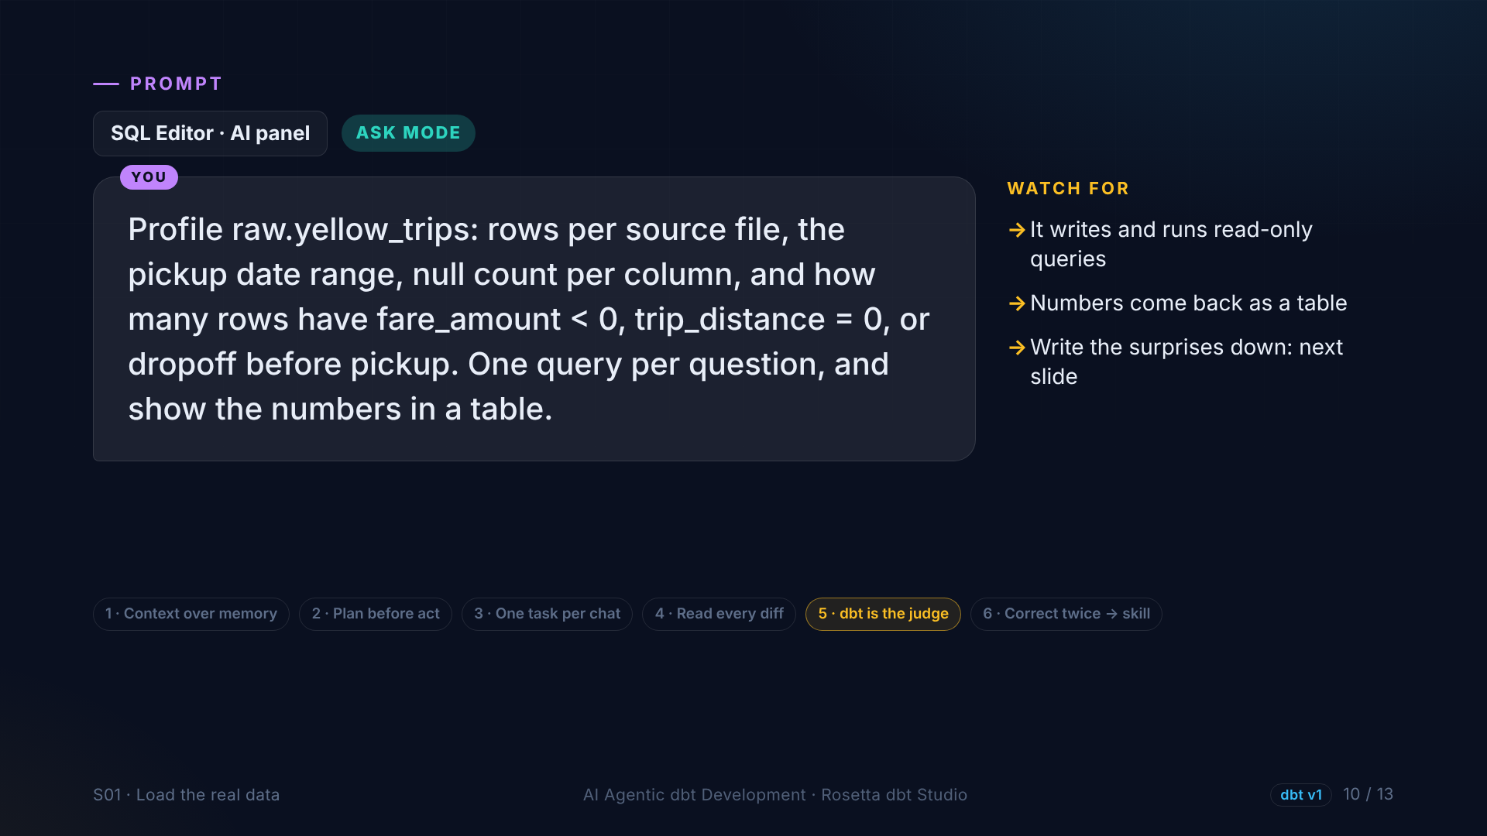
Notes:
Next, in Ask mode, the agent profiles the table: rows per file, the date range, empty values per column, and three suspicious things. Negative fares, trips with zero distance, and trips that end before they start. We look at the data before we write rules about it.

Slide 11
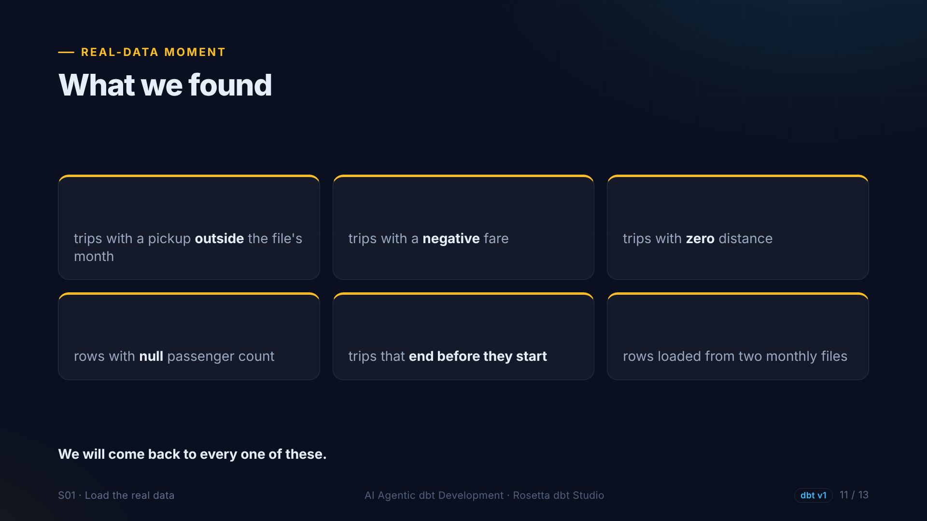
?
?
?
?
?
≈ 7M
Notes:
Here is what real data looks like. Trips picked up outside the month of their file. Negative fares. Trips with zero distance. A block of rows with no passenger count. And trips that end before they start. This is not our bug. This is the source.

Slide 12
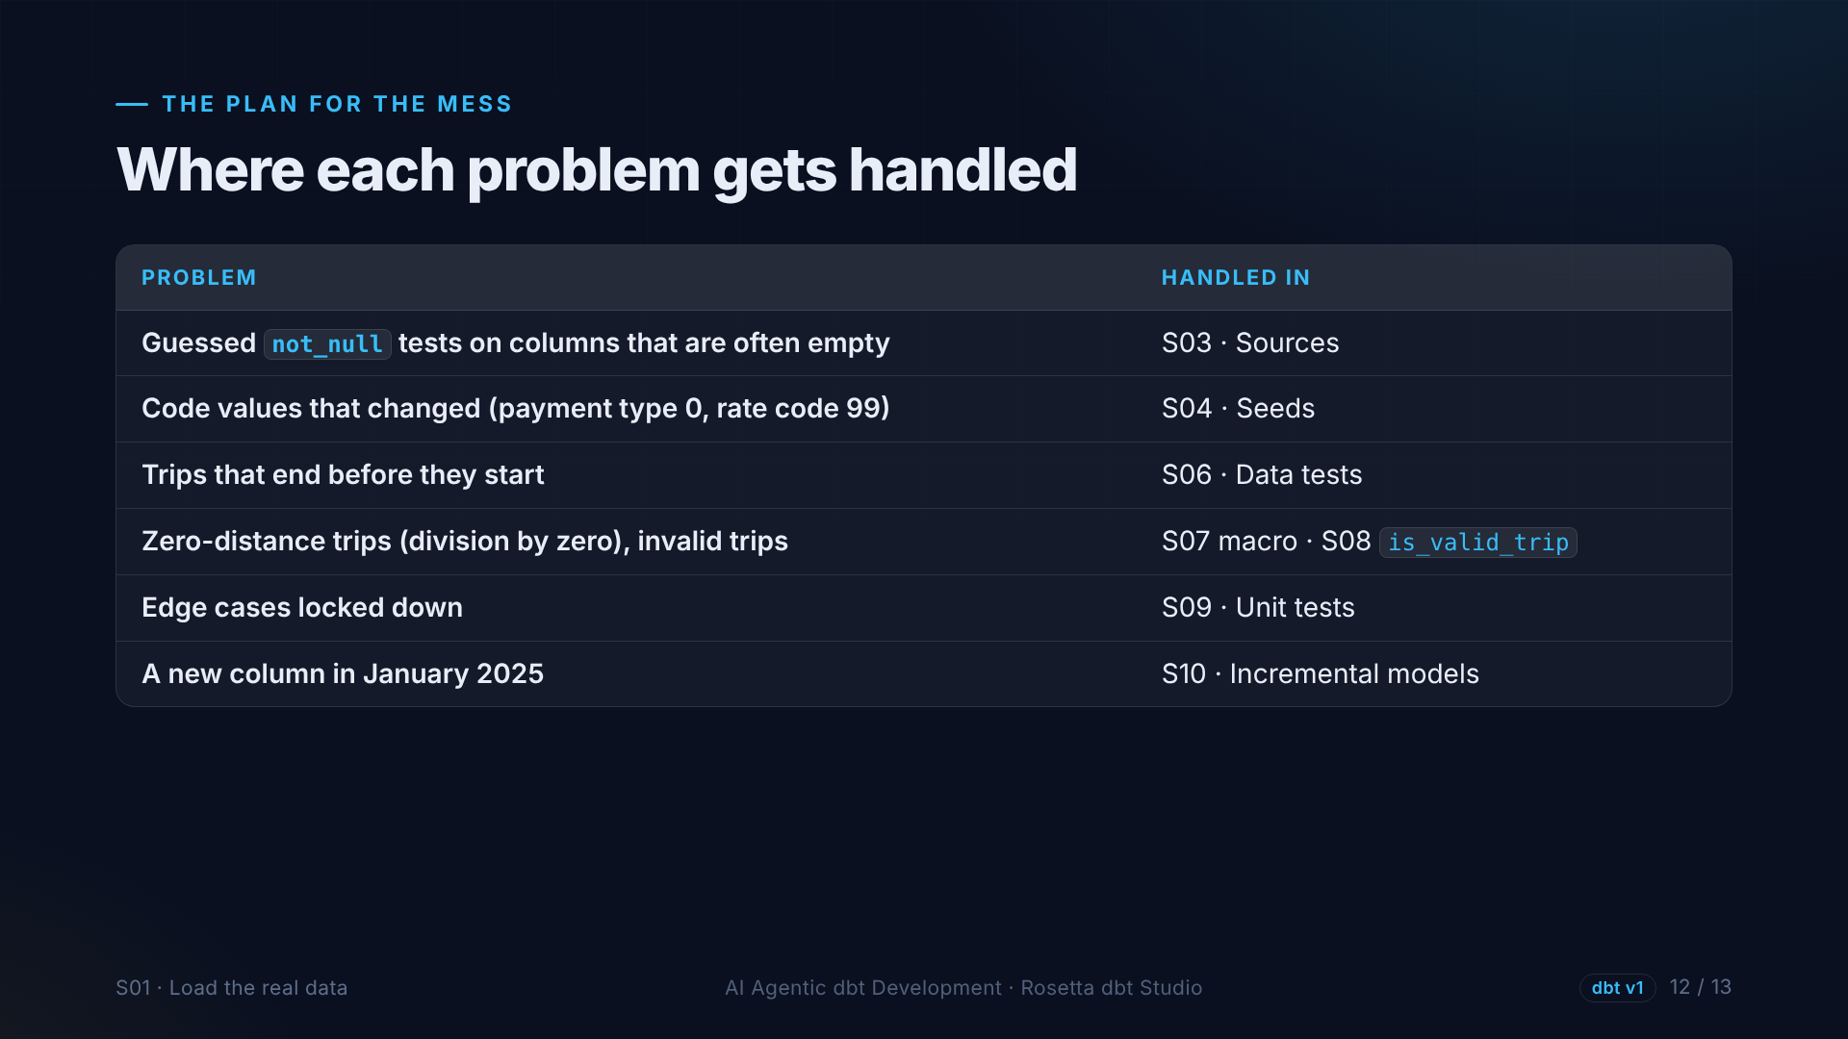
Notes:
Every one of these problems has a home in this course. Guessed tests in the sources section. Changed code lists in seeds. Backwards trips in data tests. Zero distance and invalid trips in the intermediate model. And the new January column in incremental models.

Slide 13
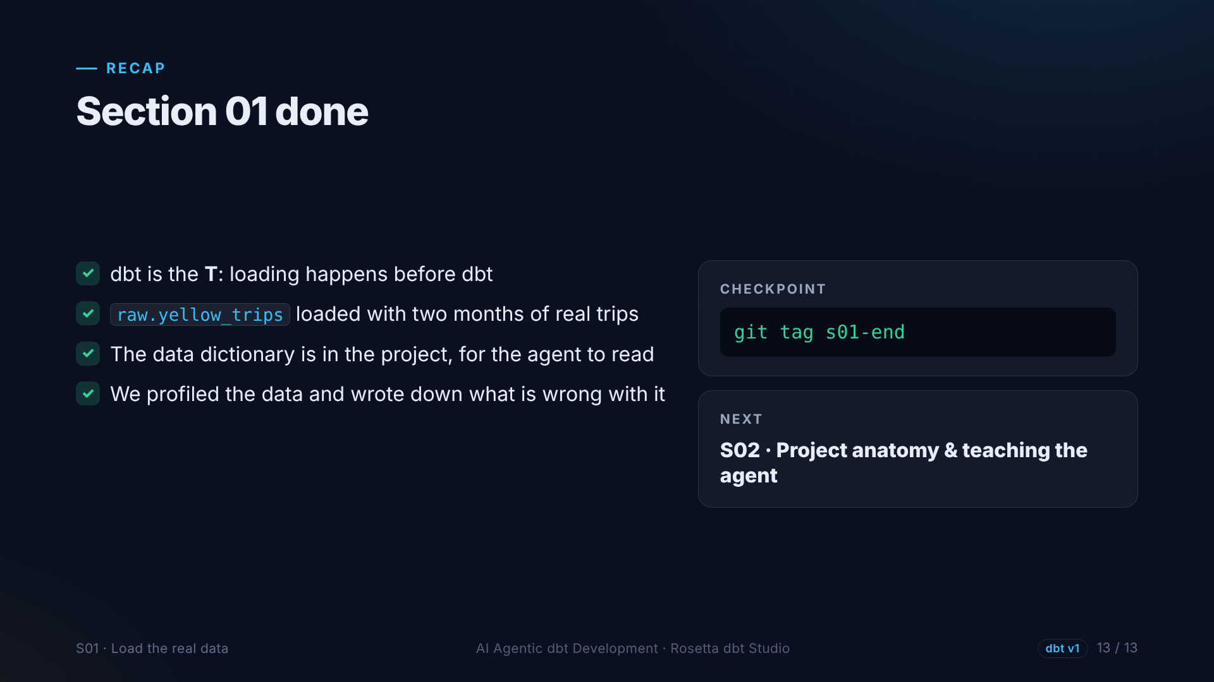
Notes:
That is section one. dbt is the T in E L T. Two months of real trips are loaded, the data dictionary is in the project, and we know what is wrong with the data. Next: what a dbt project is made of, and how we teach the agent our rules.

