Slide 1
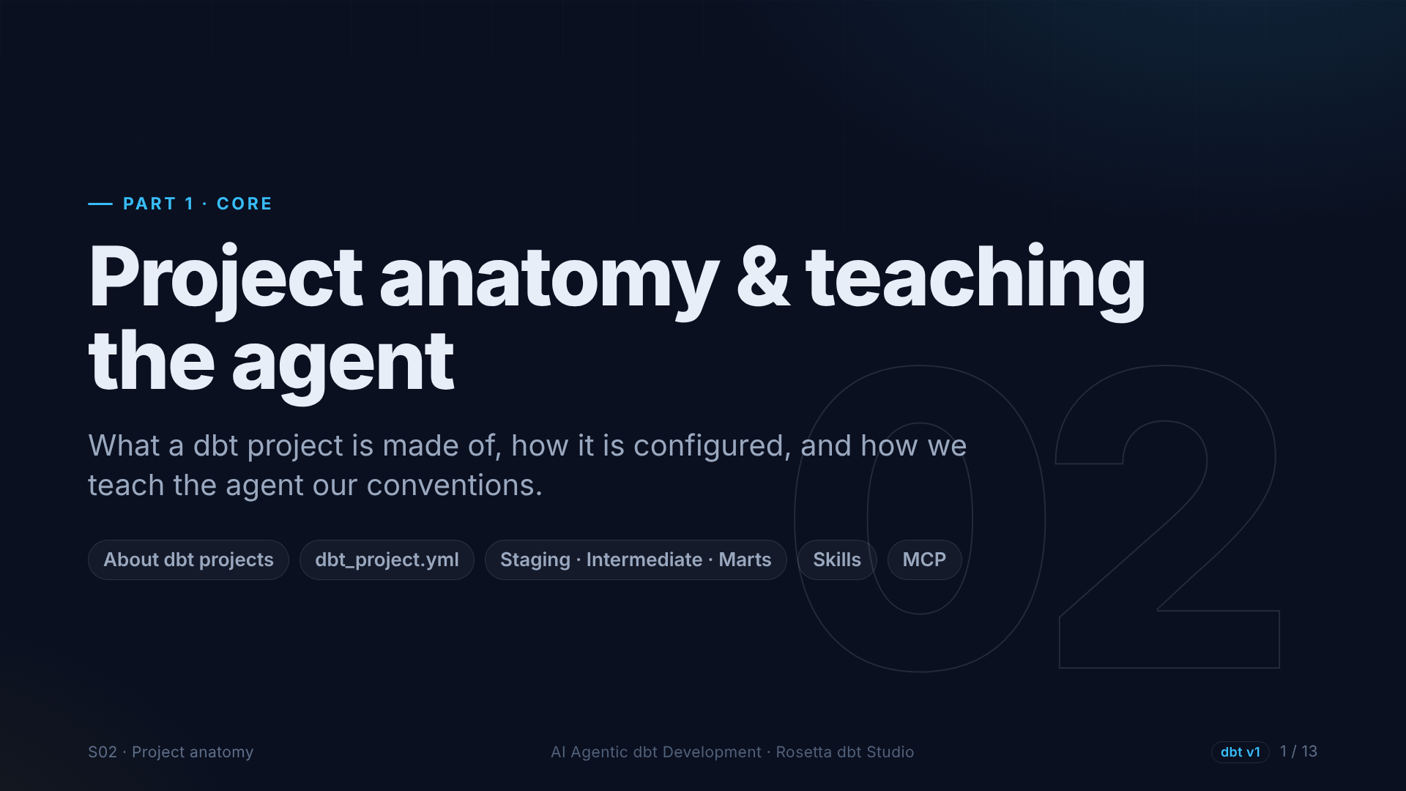
Notes:
Section two. We look inside a dbt project: its building blocks, the one configuration file every project has, and the folder structure we follow. Then we teach the agent those rules with a skill.

Slide 2
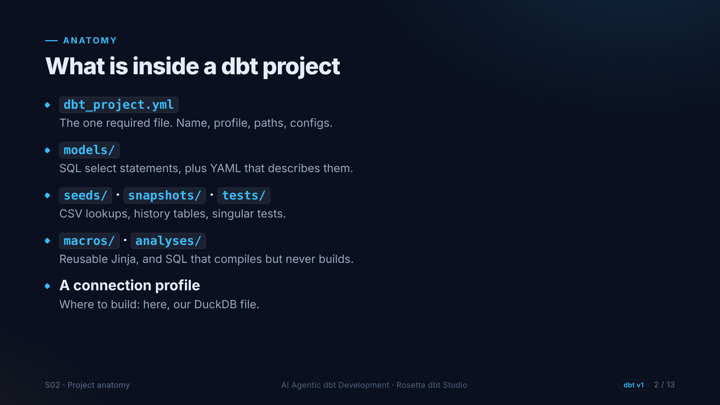
Notes:
A dbt project is just a folder. The only required file is dbt project dot yml. Models live in the models folder, with YAML files that describe and test them. Seeds, snapshots, tests, macros and analyses each have their own folder. A connection profile says where to build.

Slide 3
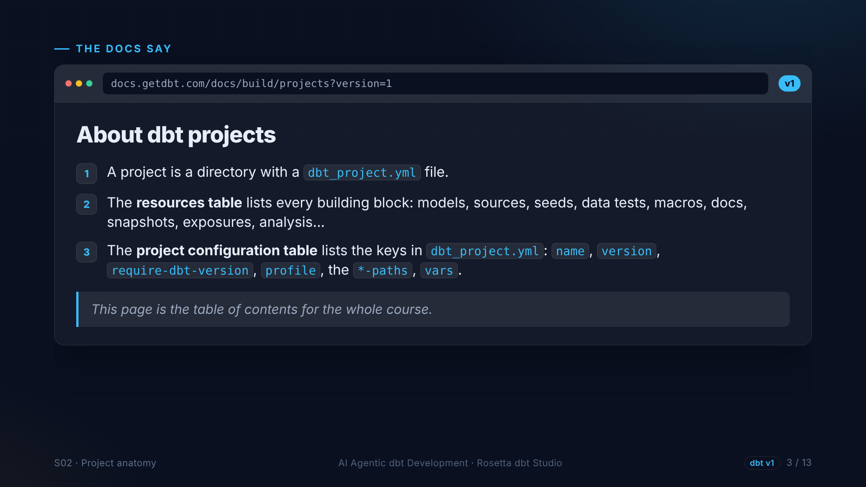
Notes:
The page About dbt projects, version one, is the map of this course. Its resources table lists every building block a project can have. Its project configuration table lists the settings we put in dbt project dot yml.

Slide 4
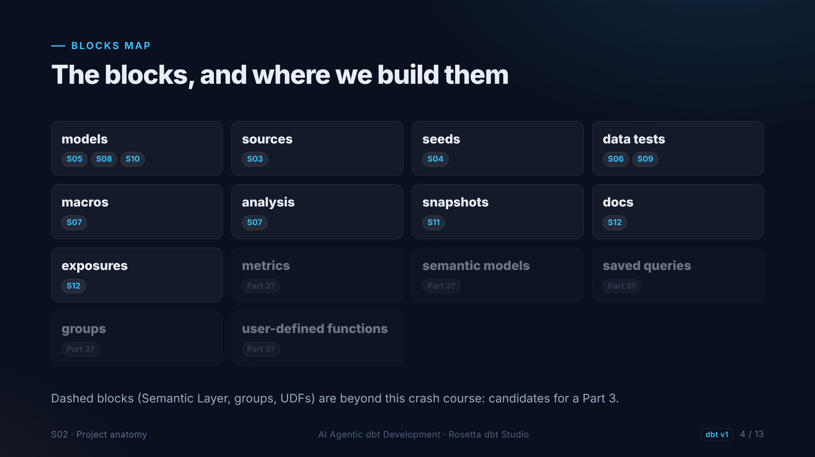
Notes:
Here is every block from that page, with the section that builds it. Models, sources, seeds, tests, macros, analyses, snapshots, docs and exposures. The dashed blocks, like metrics and the semantic layer, are beyond this crash course.

Slide 5
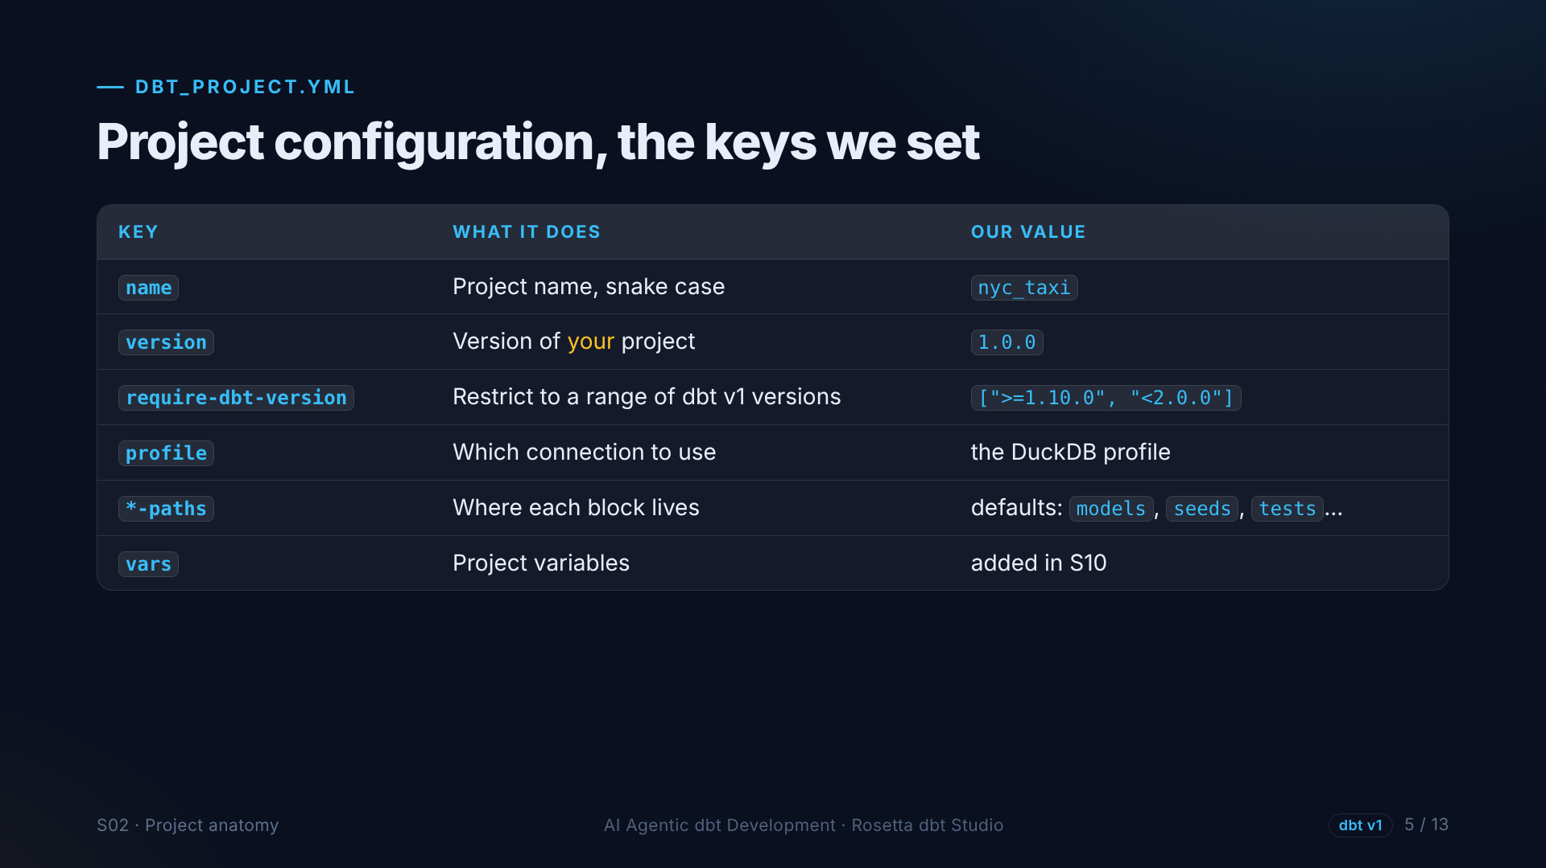
Notes:
The settings we use. The project name. Our own version number. A required dbt version range, so the project only runs on dbt version one. The connection profile. And the folder paths, which we keep at their defaults. Variables come later, in section ten.

Slide 6
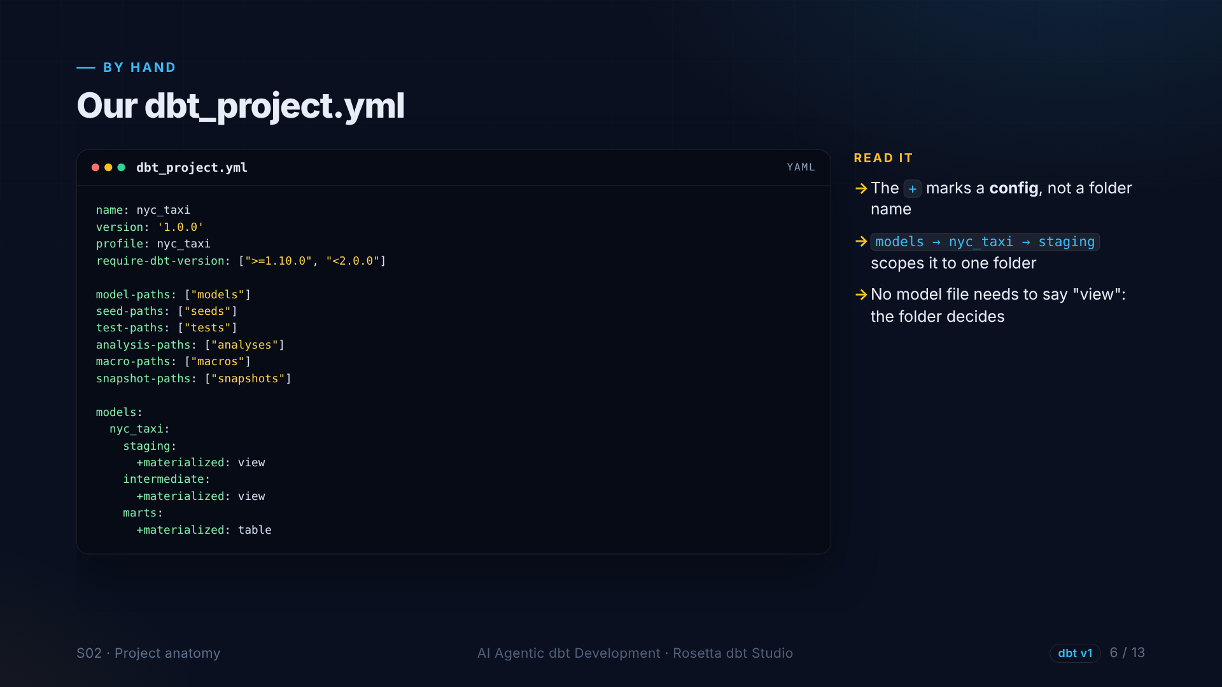
Notes:
We write this file by hand. The interesting part is at the bottom: settings per folder. Staging and intermediate models become views. Marts become tables. The plus sign means this is a setting, not a folder name. From now on, the folder decides how a model is built.

Slide 7
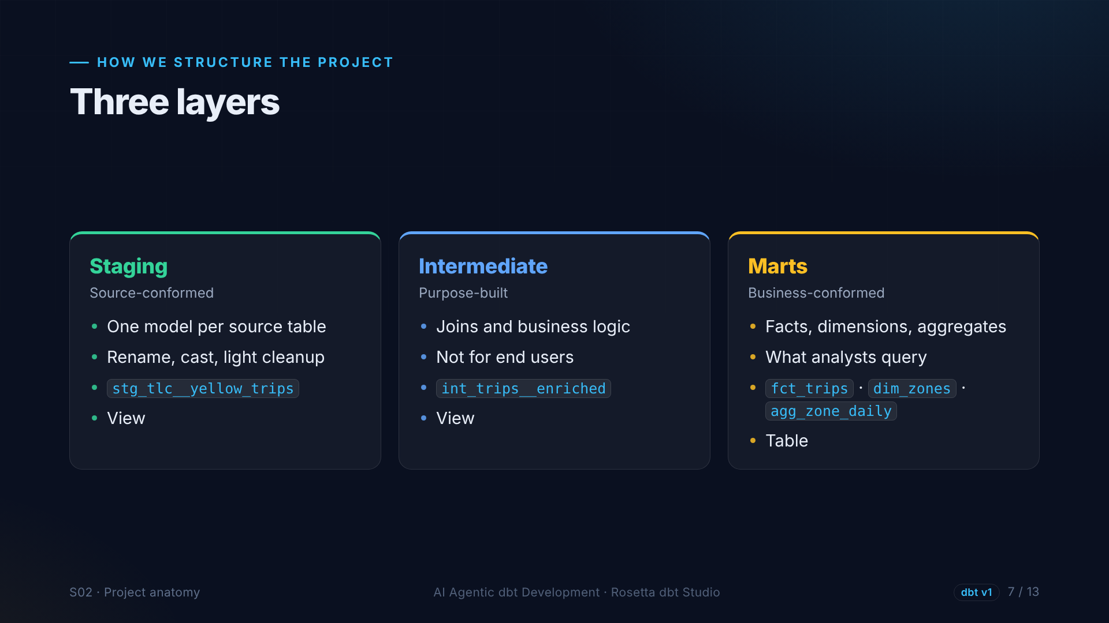
Notes:
dbt Labs recommends three layers. Staging is shaped like the source: one model per table, renamed and typed. Intermediate holds business logic. Marts are shaped like the business, and they are what analysts query.

Slide 8
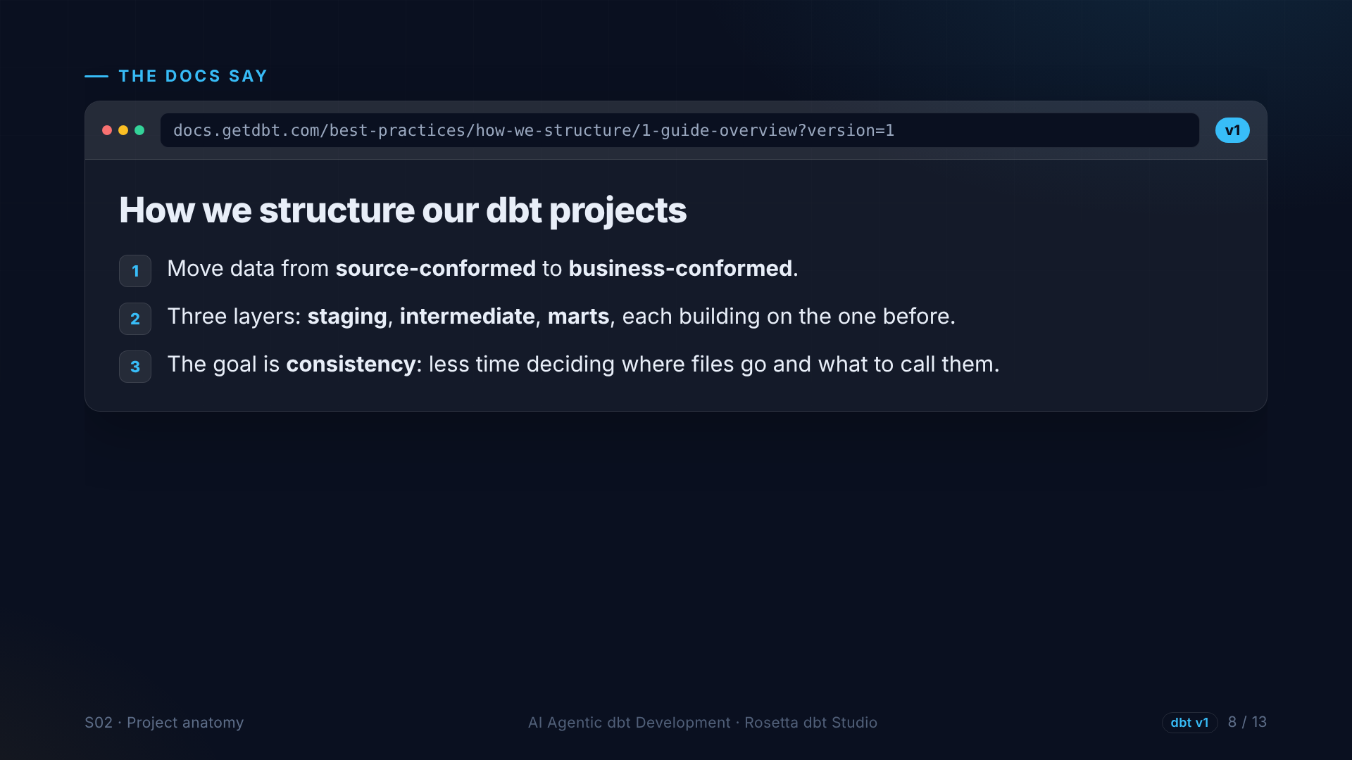
Notes:
The structure guide puts it simply: move data from source-conformed to business-conformed. And the goal is consistency, so nobody wastes time deciding names and folders. That is exactly what we want the agent to follow.

Slide 9
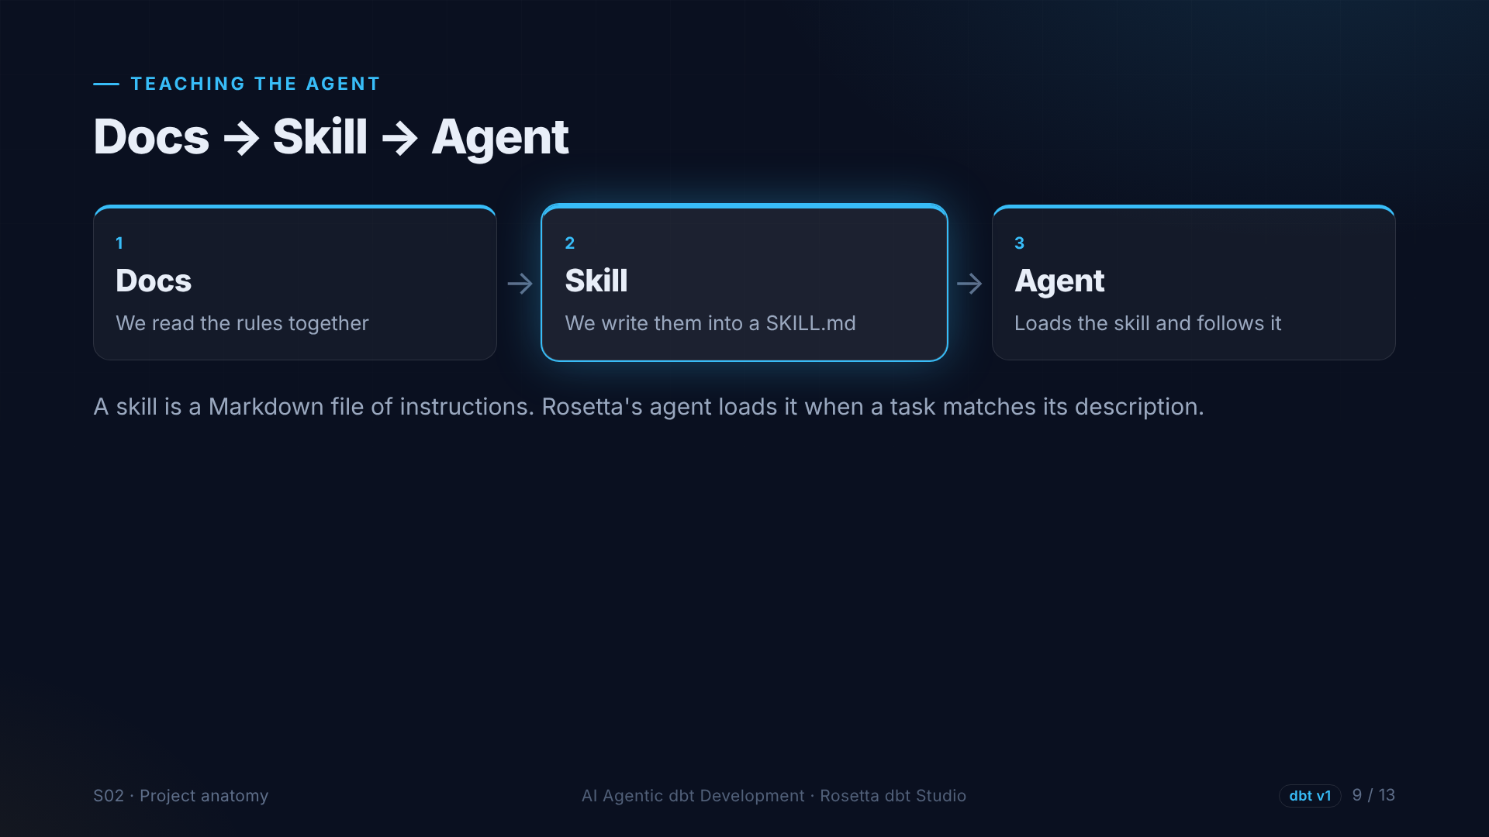
Notes:
How does the agent learn these rules? With a skill: a Markdown file of instructions with a short description. What we read in the docs, we write into the skill, and the agent loads it whenever a task matches.

Slide 10
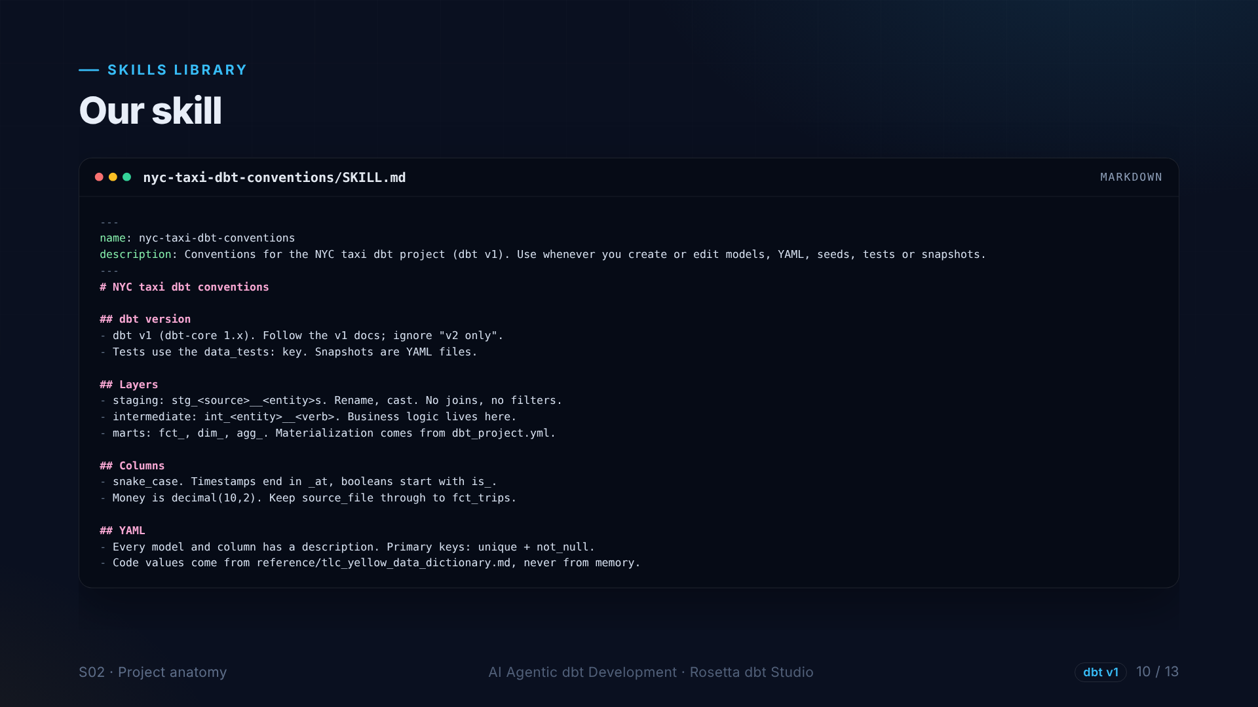
Notes:
This is our skill, shortened. The dbt version. Naming for each layer. Column conventions, like timestamps ending in at, and booleans starting with is. And the key rule: code values come from the dictionary file, never from memory.

Slide 11
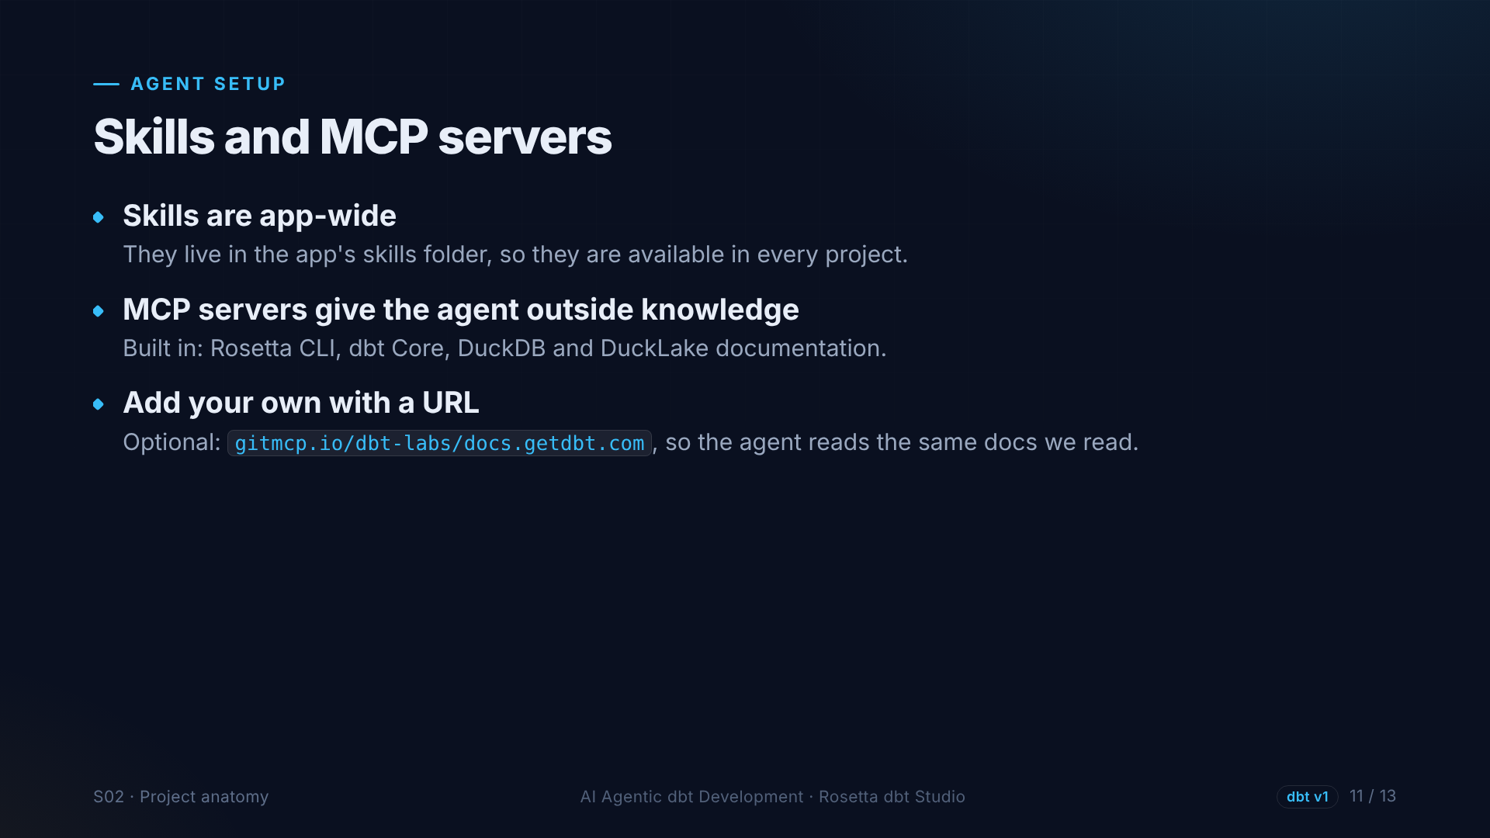
Notes:
Skills are app-wide, so every project can use them. M C P servers give the agent extra knowledge, like the dbt, DuckDB and Rosetta documentation. You can add your own with one link, for example the dbt documentation site.

Slide 12
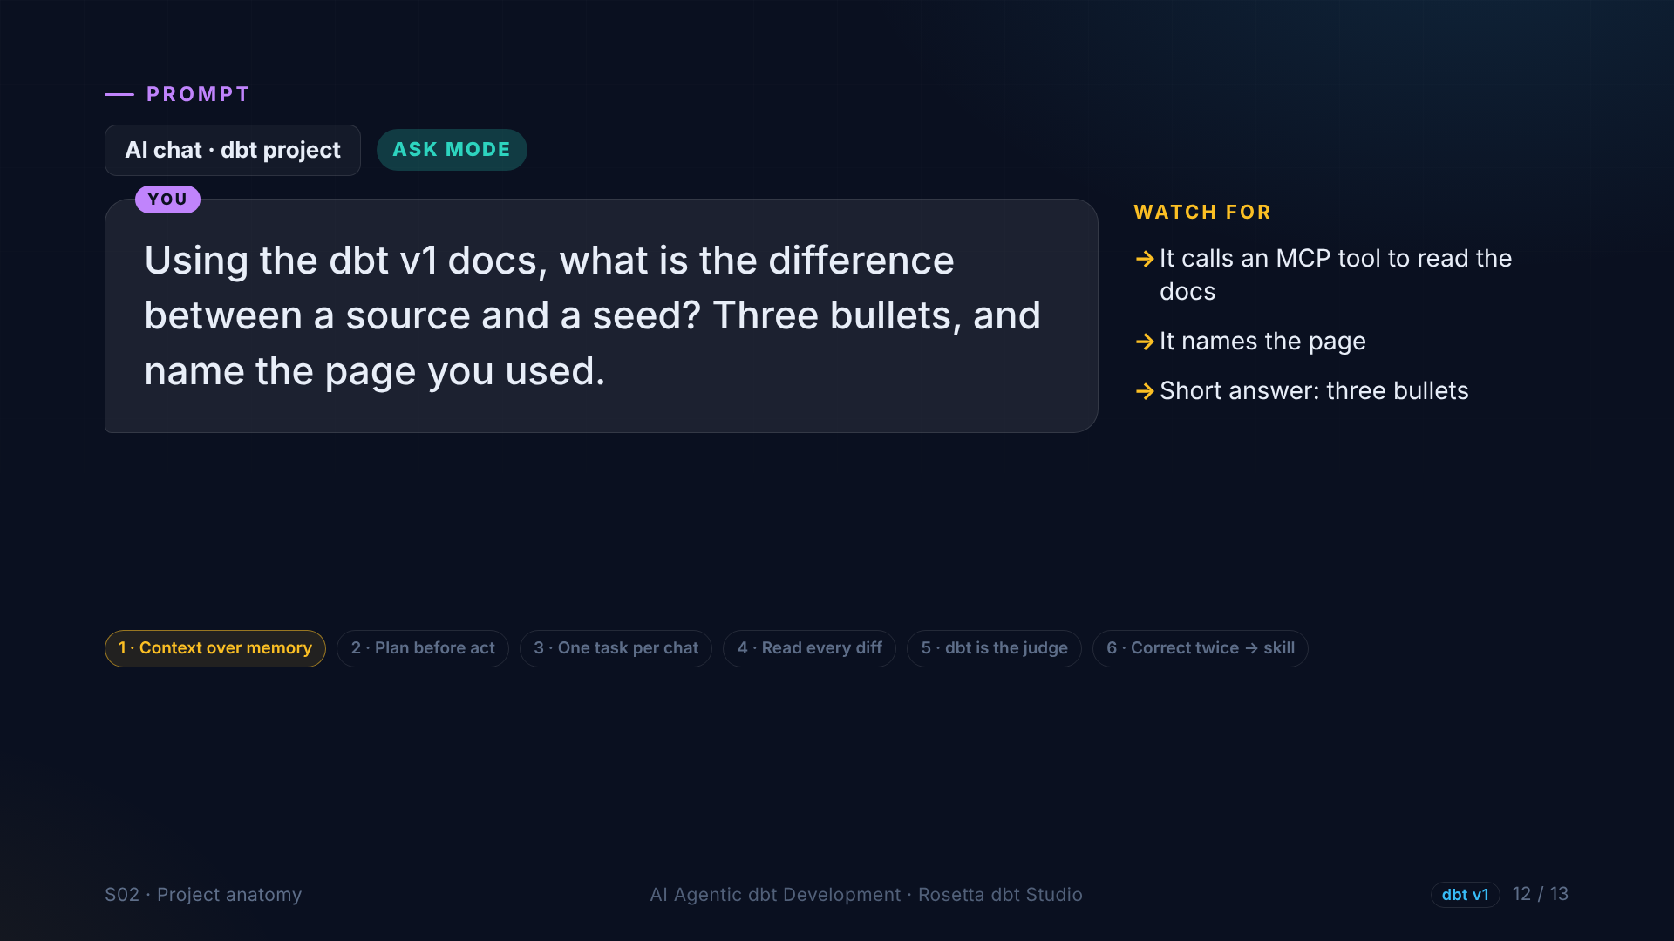
Notes:
In the demo, we test the setup with an Ask mode question: what is the difference between a source and a seed, using the dbt version one docs. The agent should look it up, and tell us which page it used.

Slide 13
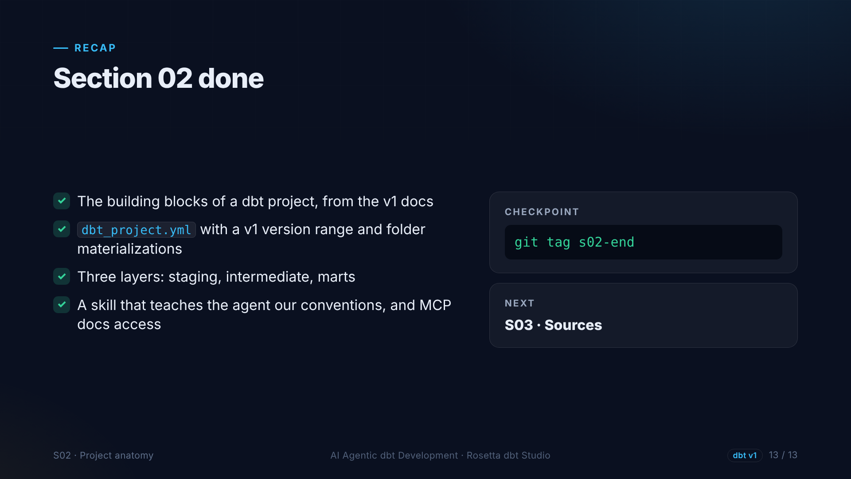
Notes:
That is section two. We know the building blocks, we configured the project file, we know the three layers, and the agent has a skill with our rules. Next: our first block, sources.

