Slide 1
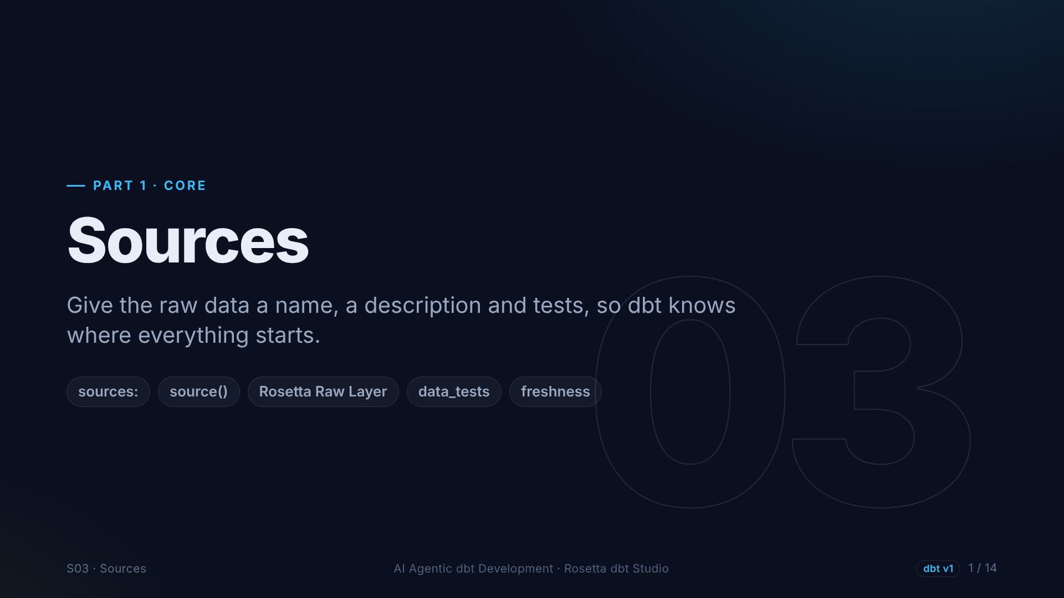
Notes:
Section three: sources. This is how we tell dbt about data that already exists in the database, data that dbt did not build.

Slide 2
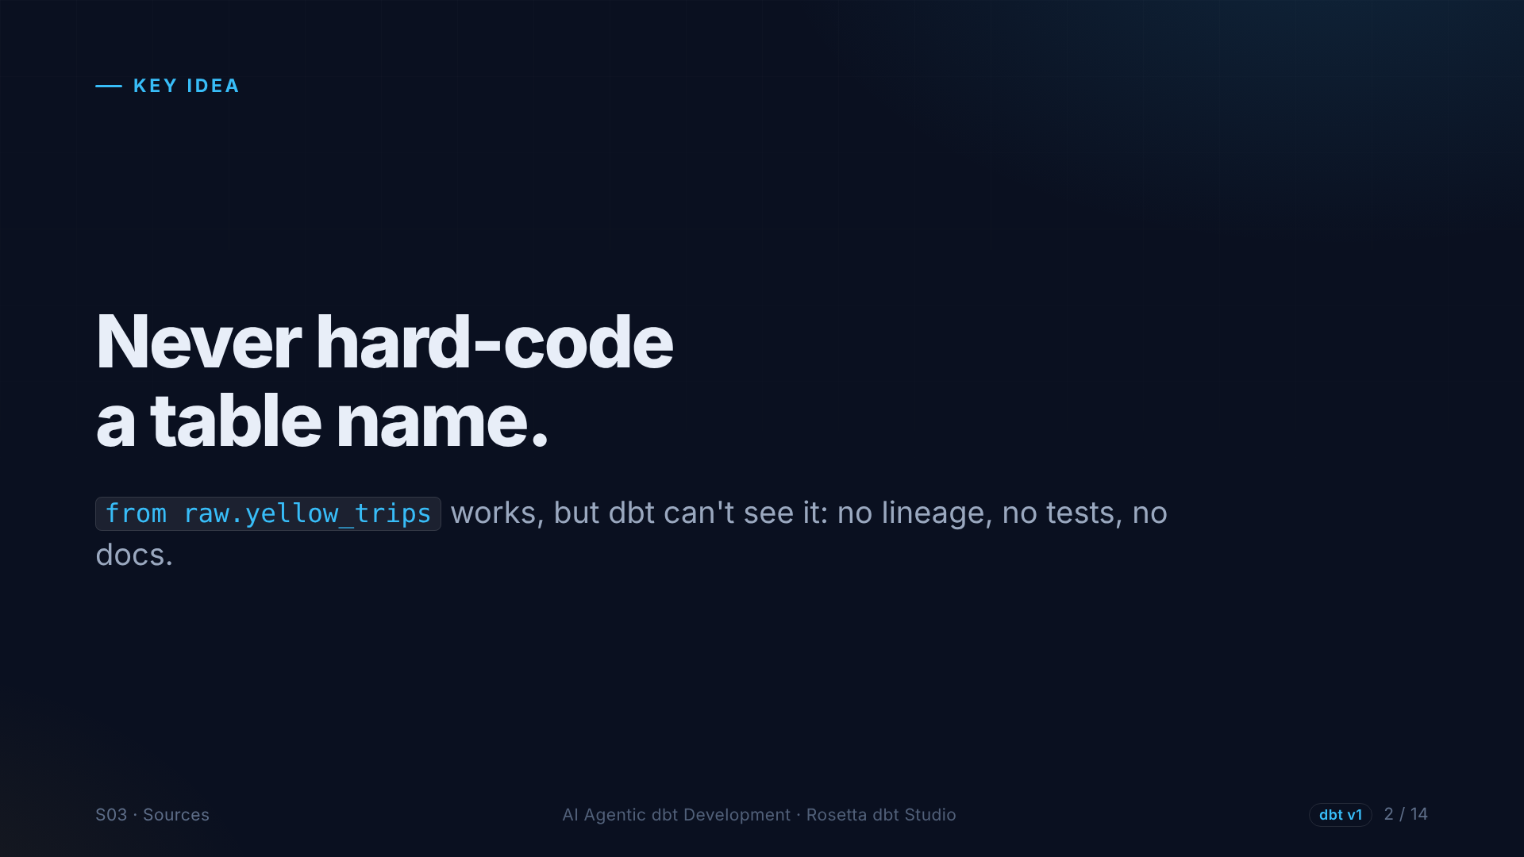
Notes:
One rule: never hard-code a table name in a model. It works, but dbt cannot see the dependency. It cannot draw it in the lineage, test it, or document it, and if the schema changes, every model breaks.

Slide 3
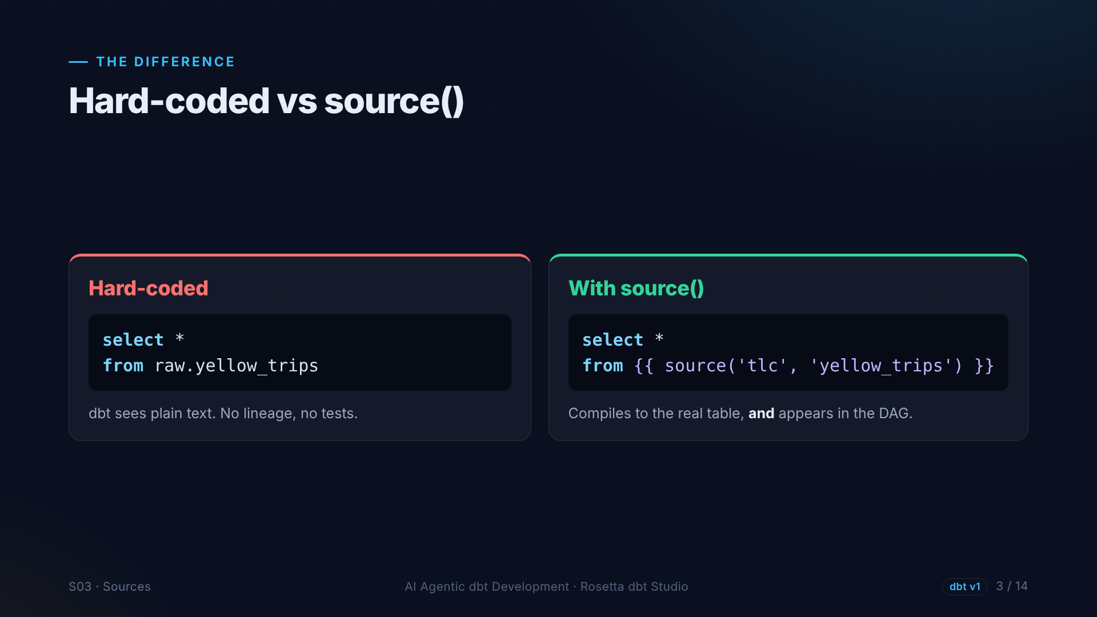
Notes:
On the left, a hard-coded table. On the right, the source function, with the source name and the table name. Both compile to the same SQL, but only the right one appears in the lineage graph, with tests and descriptions attached.

Slide 4
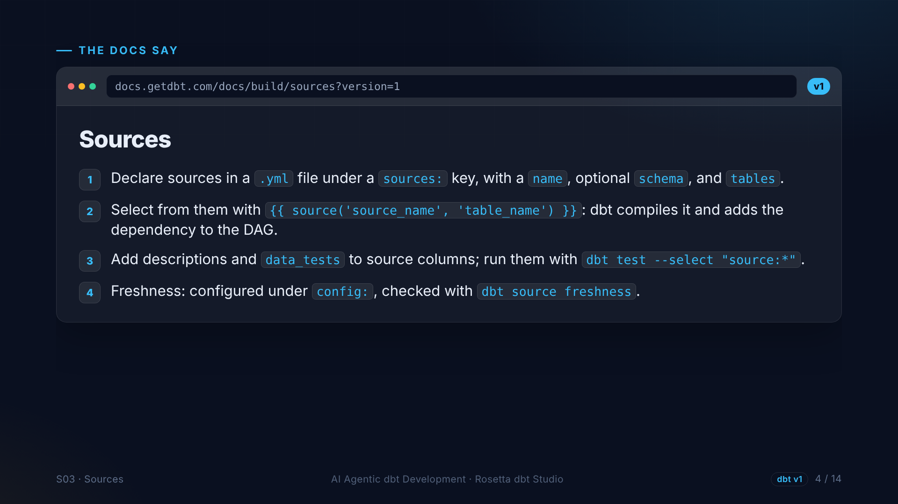
Notes:
The sources page, version one. Declare sources in YAML, with a name, the schema, and the tables. Select from them with the source function. Add tests and descriptions to source columns. And freshness can warn you when a loader stops delivering data.

Slide 5
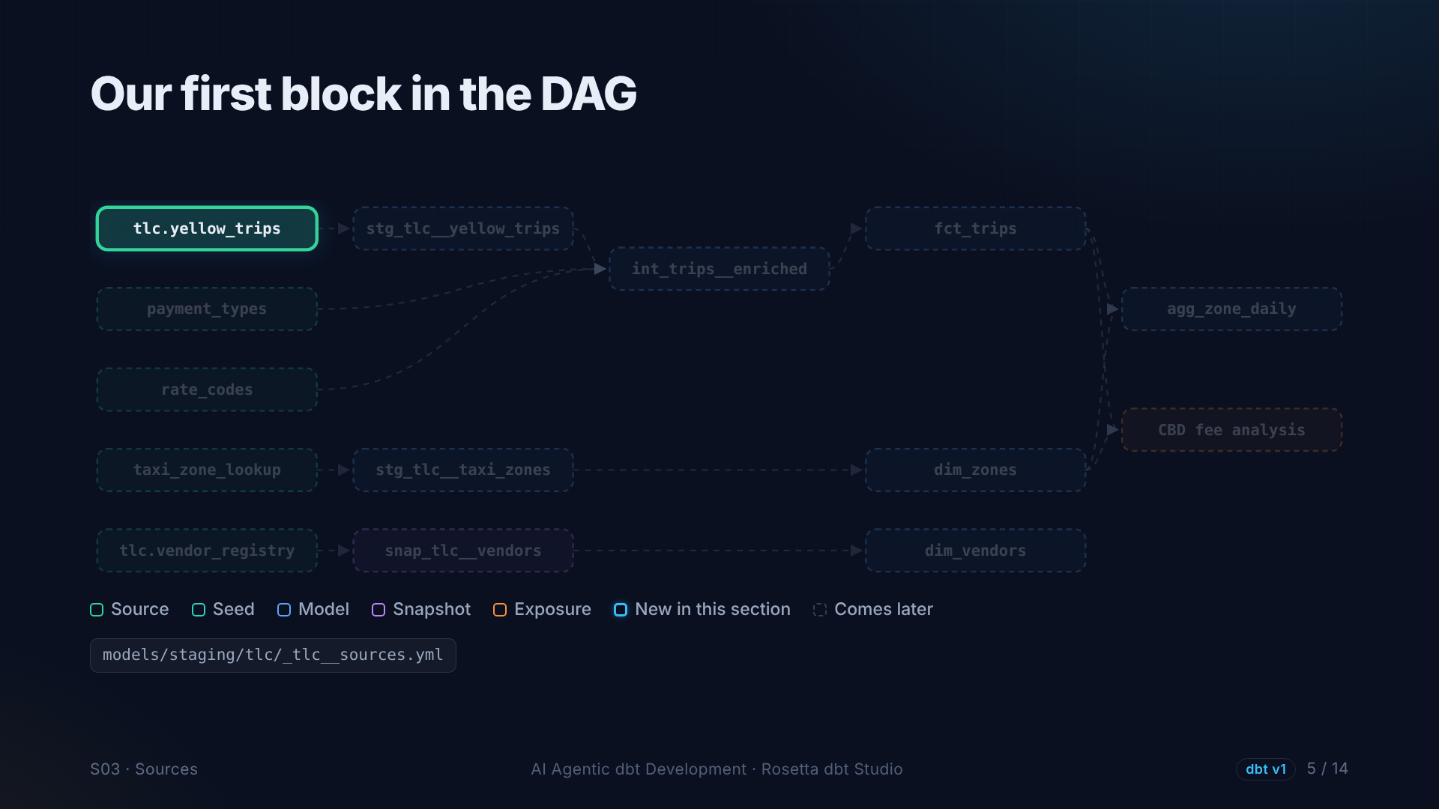
Notes:
On our lineage graph, the first node lights up: the source for yellow taxi trips. Everything else in the project will be built on top of it.

Slide 6
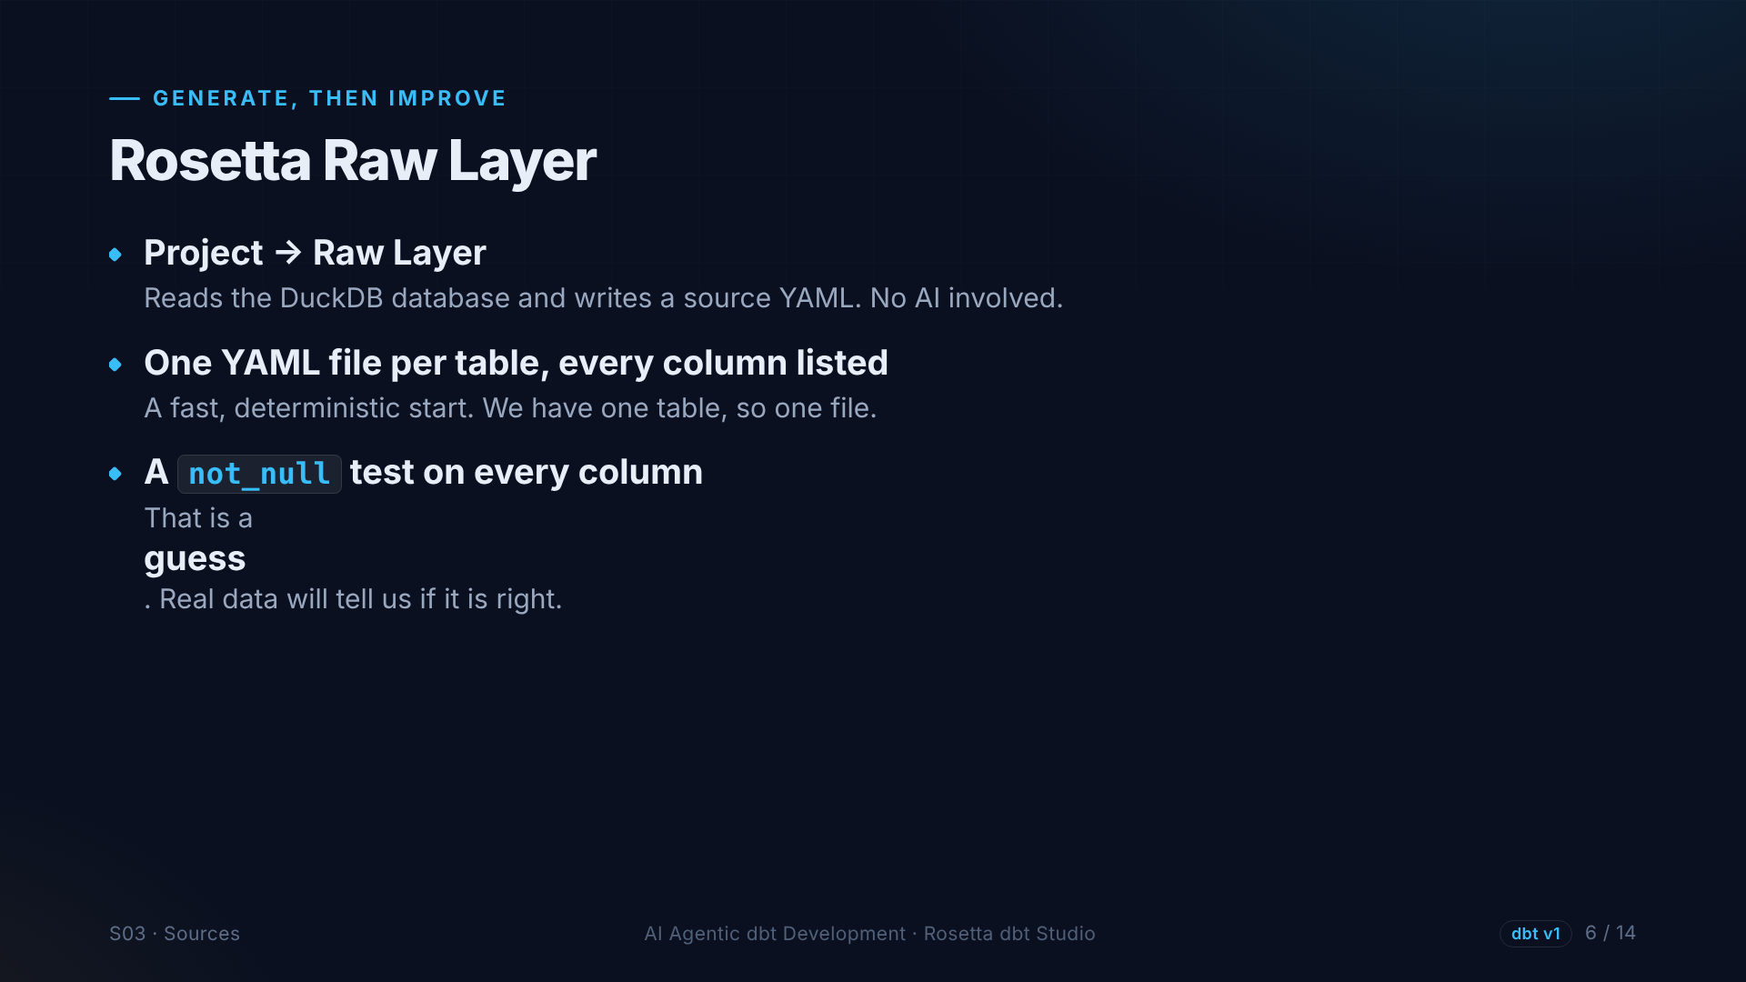
Notes:
Rosetta can generate the source file for us. The Raw Layer option reads the database and writes a YAML file with every column. No AI involved. It also adds a not null test to every column. That is a guess, and real data will test it.

Slide 7
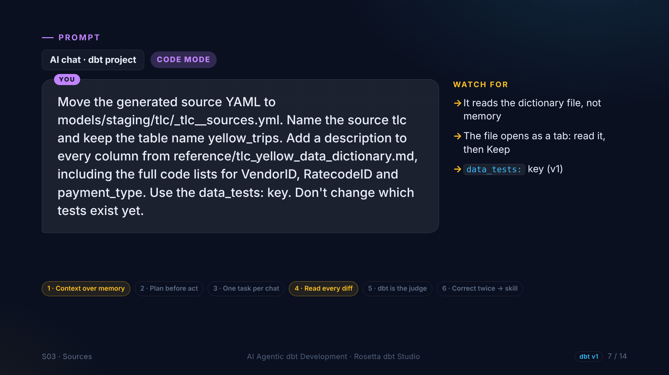
Notes:
In the demo, the agent moves that file into our staging folder, names the source T L C, and adds a description to every column from the dictionary file. We tell it not to change the tests yet.

Slide 8
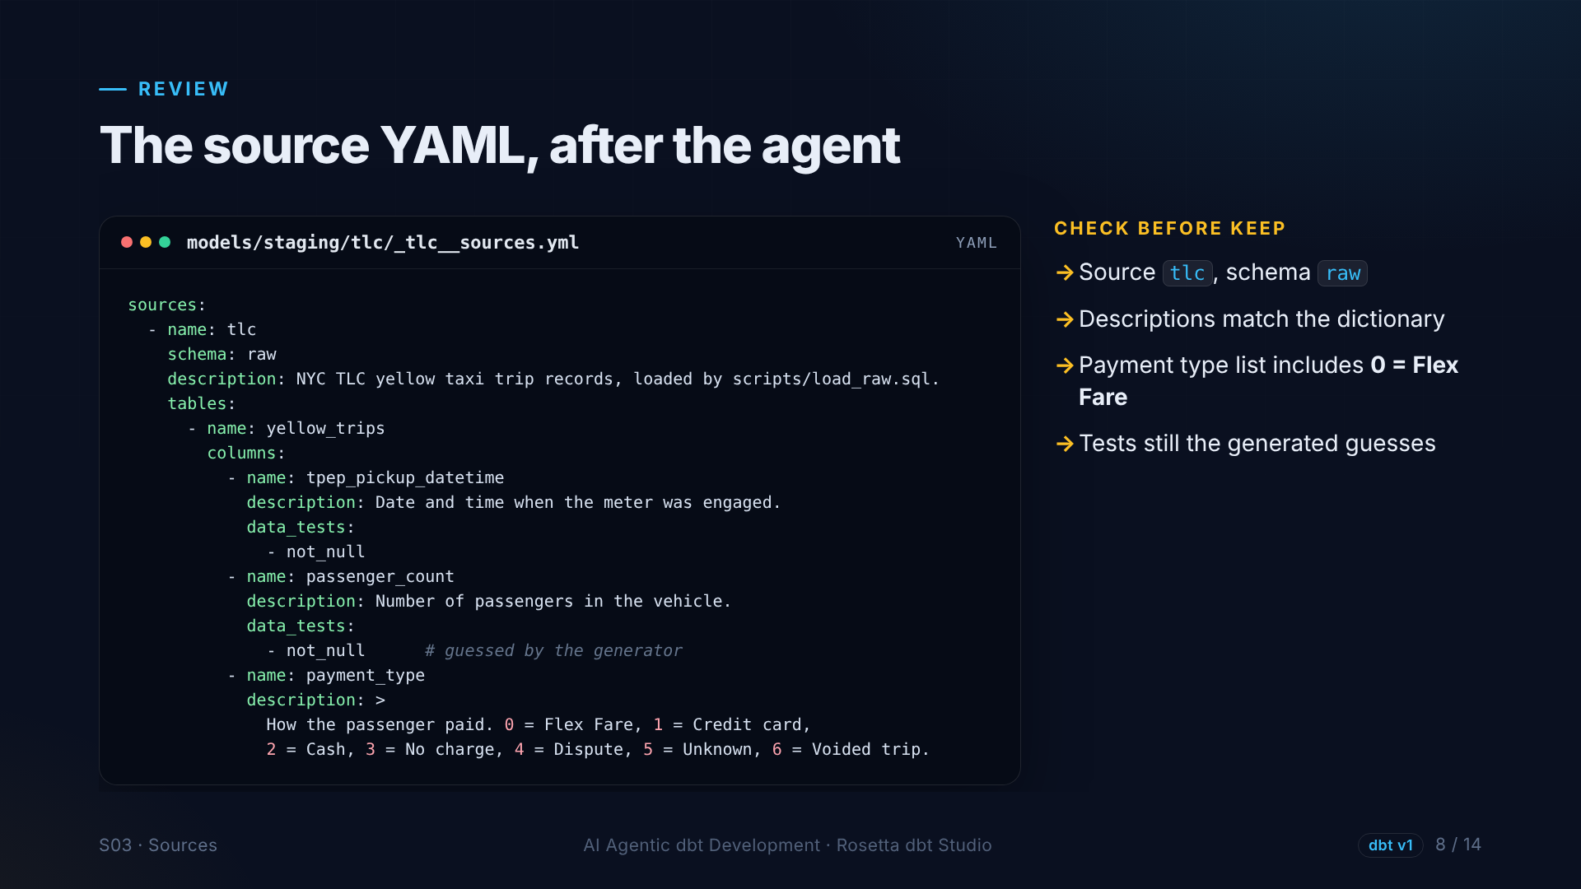
Notes:
This is what we review before keeping it. The source name and schema. Descriptions that match the dictionary. Notice payment type starts at zero, Flex Fare, from the current dictionary. And the tests are still the generated guesses.

Slide 9
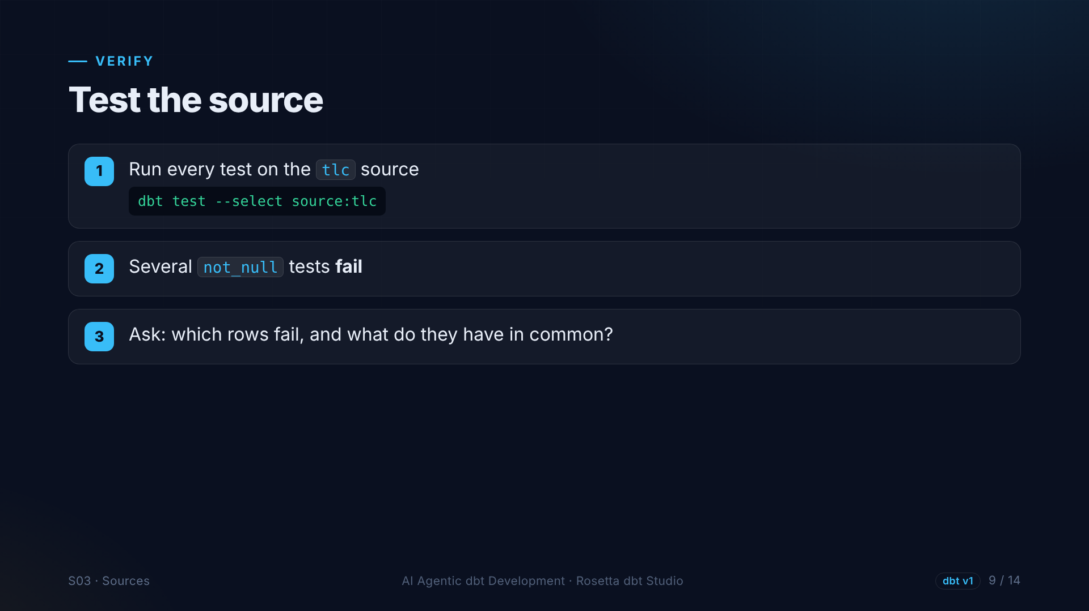
Notes:
Then we run the source tests. Several not null tests fail: passenger count, rate code, the store and forward flag, and some surcharges. That is real data pushing back on a guess.

Slide 10
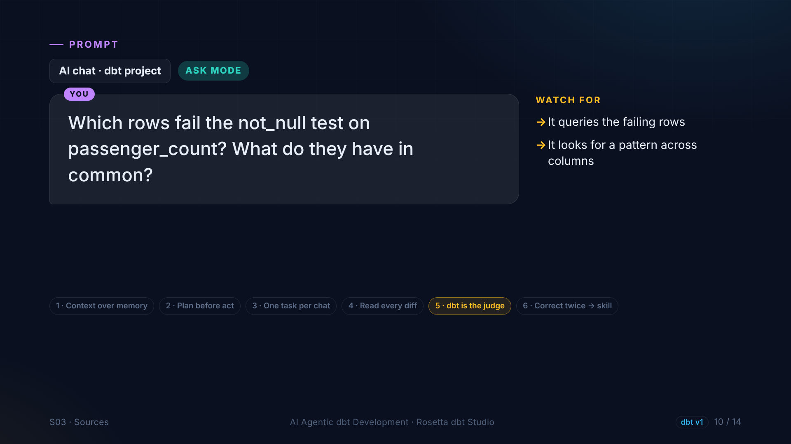
Notes:
Instead of deleting the tests, we ask why. In Ask mode: which rows fail, and what do they have in common?

Slide 11
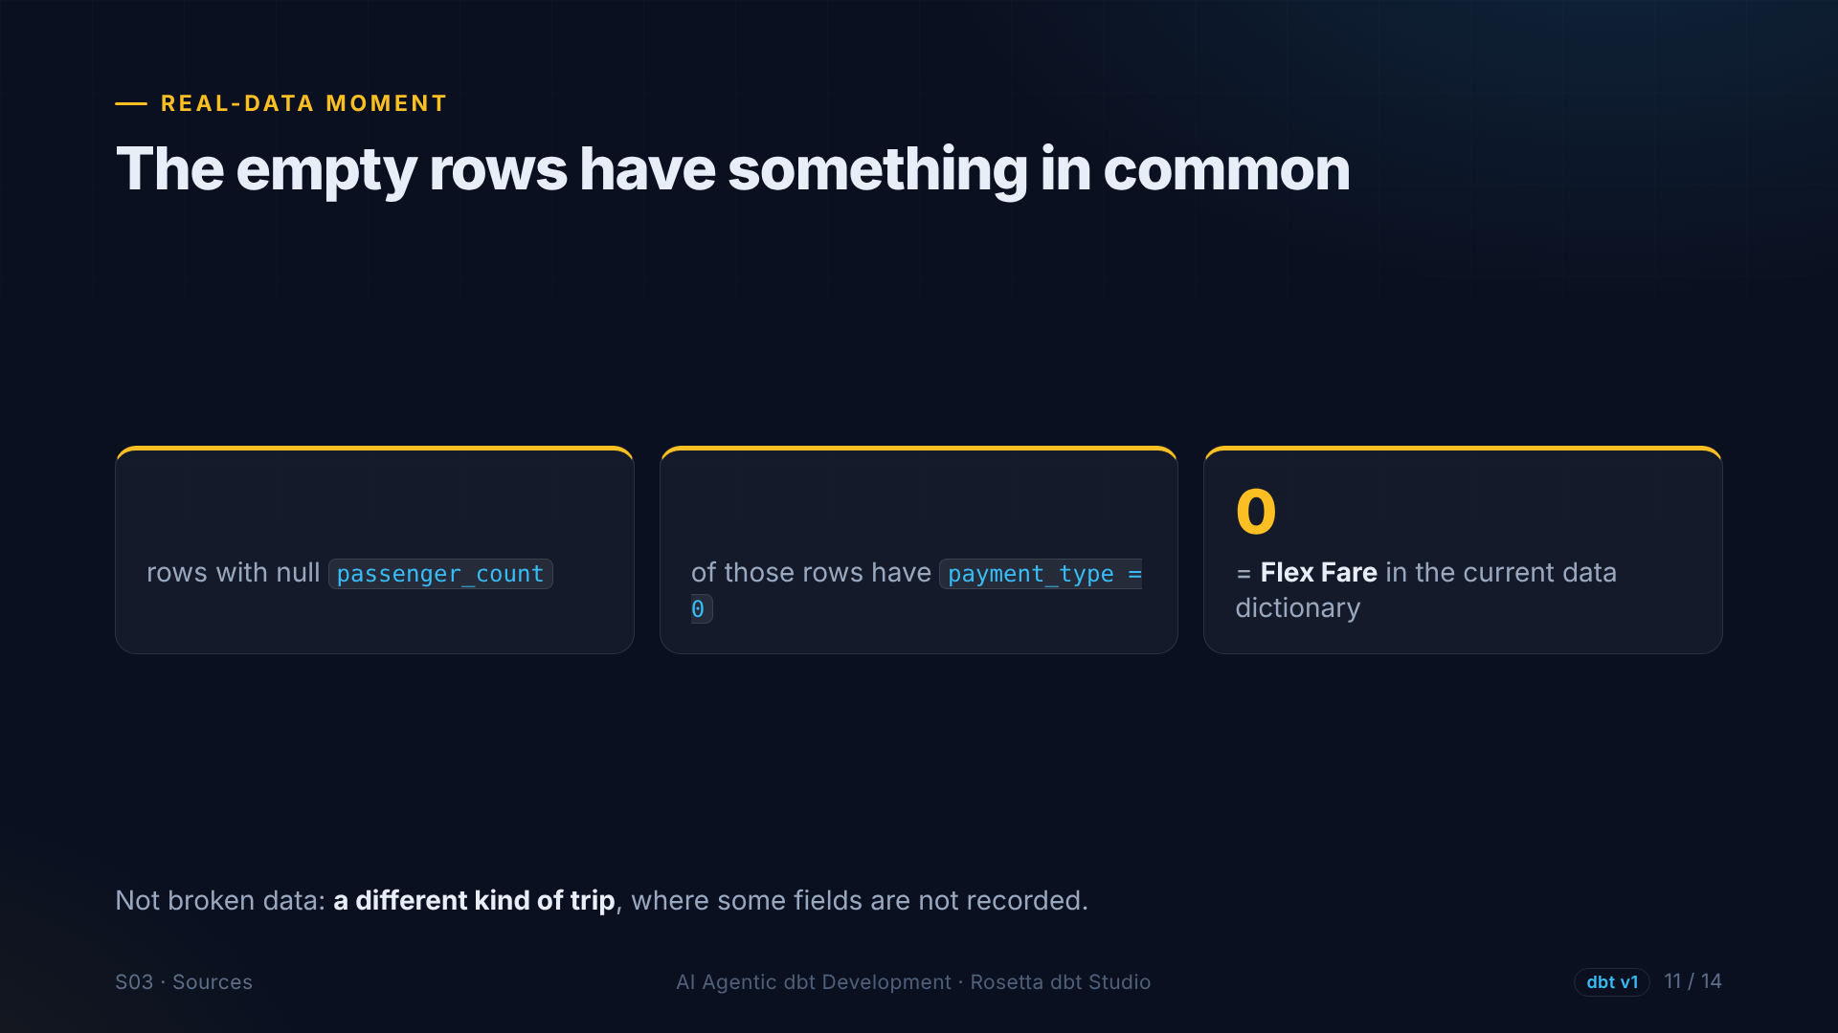
?
?
Notes:
In our data, the rows with an empty passenger count are the rows with payment type zero, which the dictionary calls Flex Fare. So these are not broken rows. They are a different kind of trip, where some fields are not recorded.

Slide 12
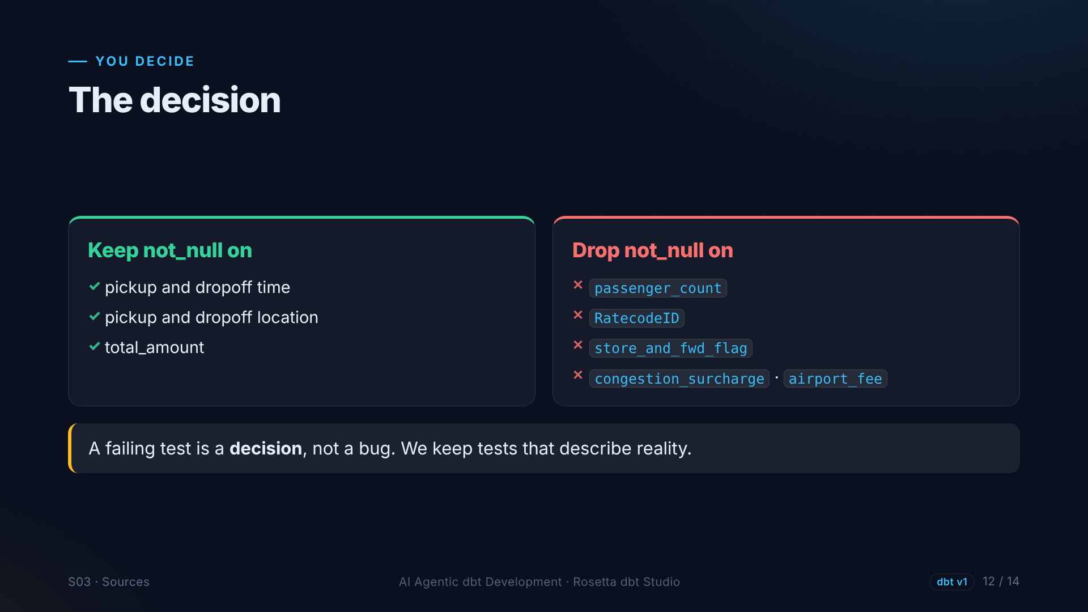
Notes:
So we decide. We keep not null where a trip cannot exist without a value: the times, the locations and the total. We drop it where the source legitimately leaves values empty. A failing test is a decision, not a bug.

Slide 13
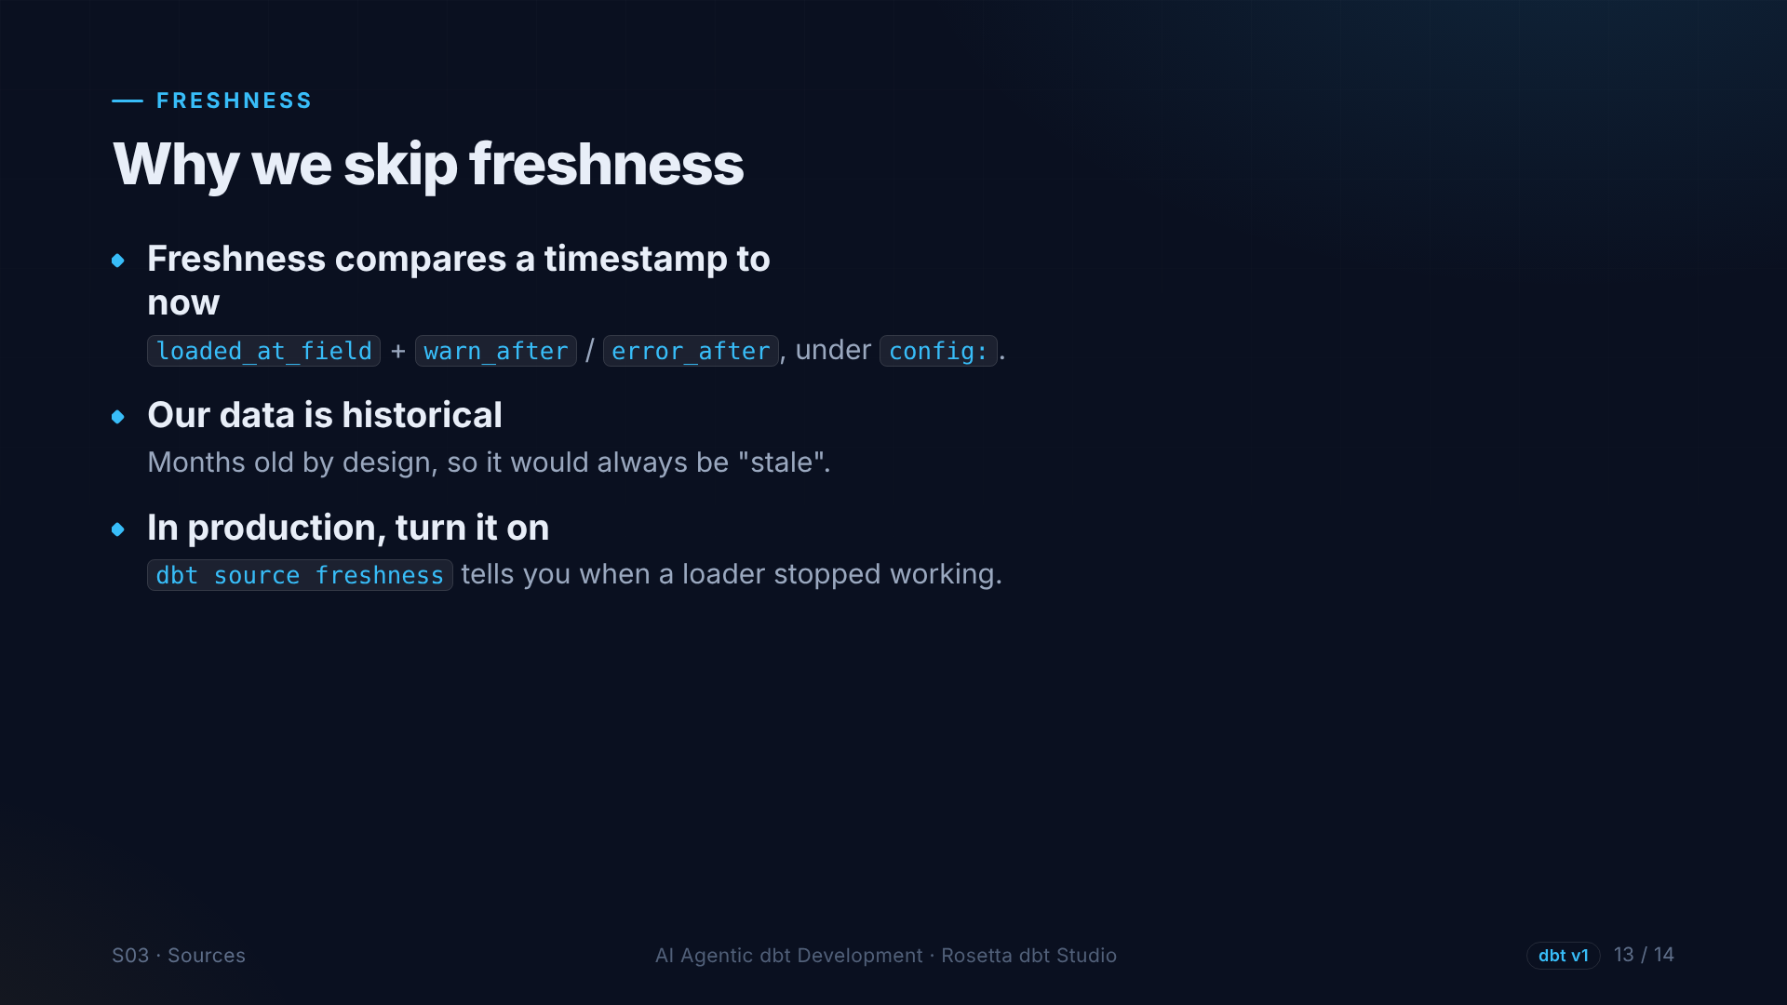
Notes:
One last thing: freshness. It compares a timestamp with the current time. Our data is historical, so it would always look stale, and we skip it. In a real project with daily data, you turn it on. It tells you when a loader stopped working.

Slide 14
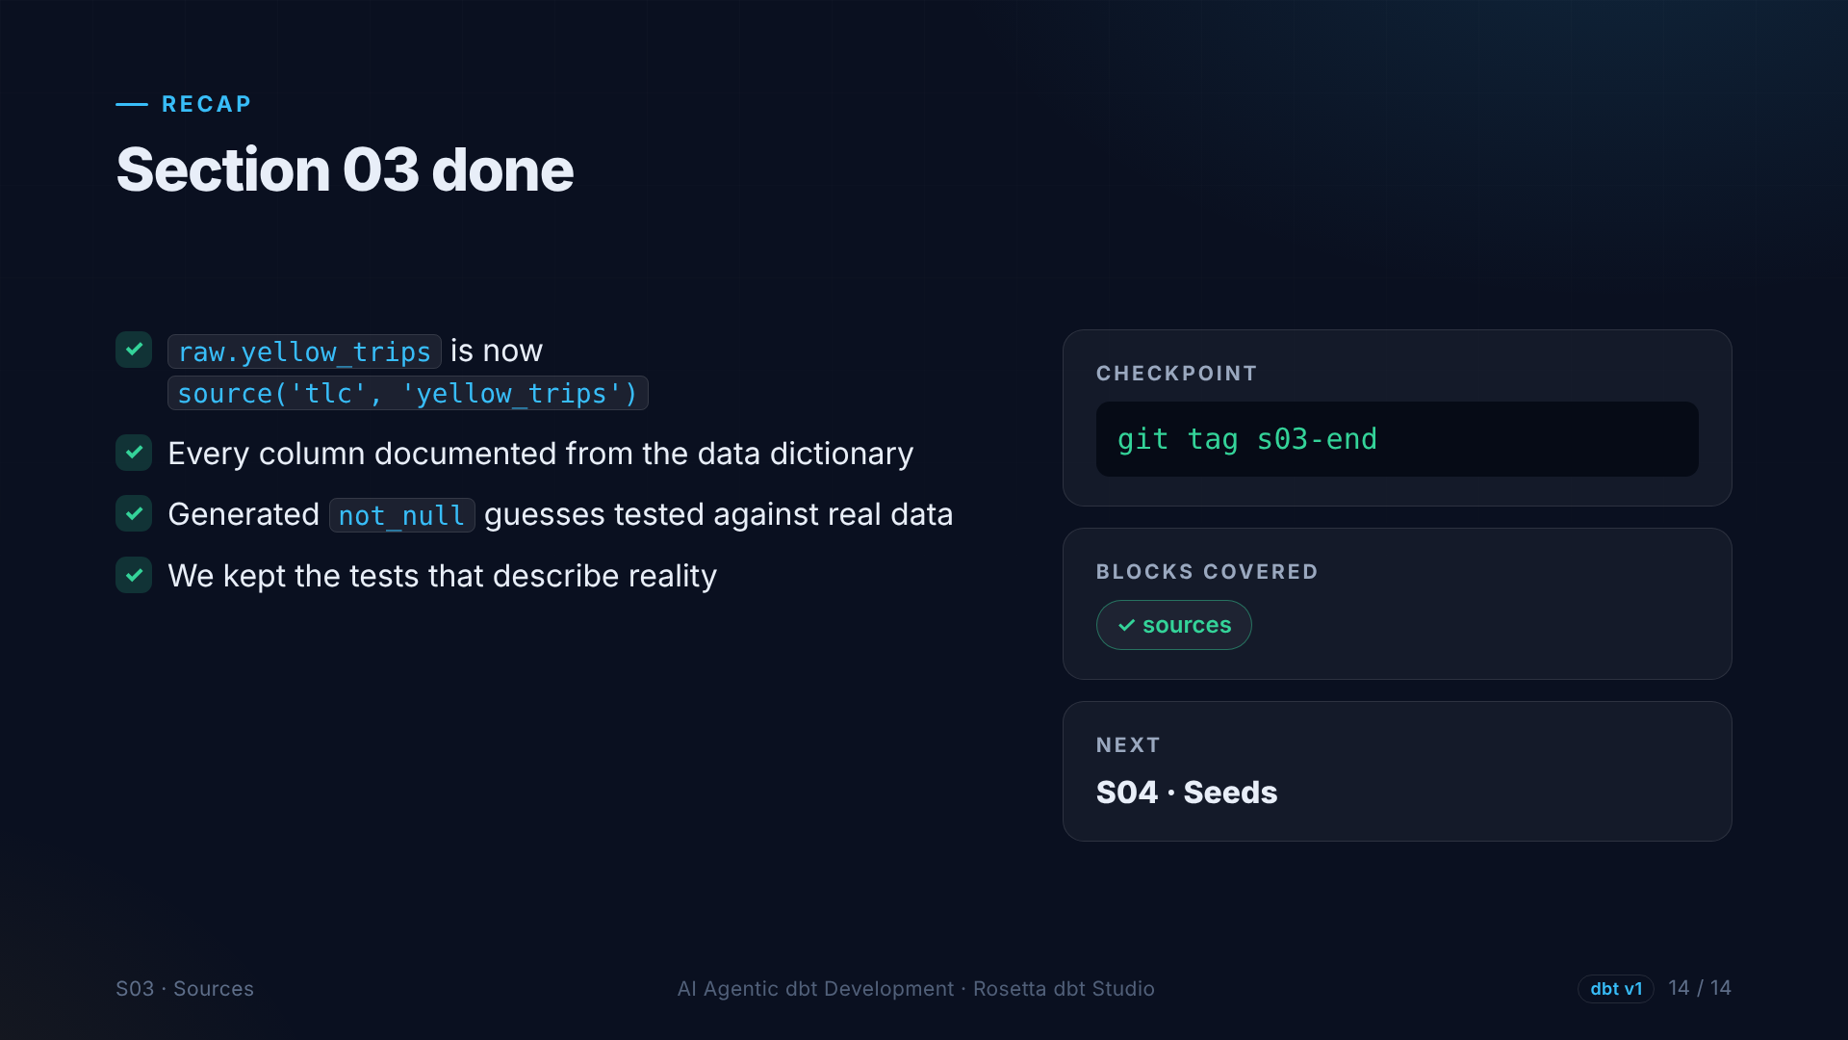
Notes:
That is section three. Our raw table is now a documented source, and its tests describe reality instead of a guess. First block ticked: sources. Next: seeds.

