Slide 1
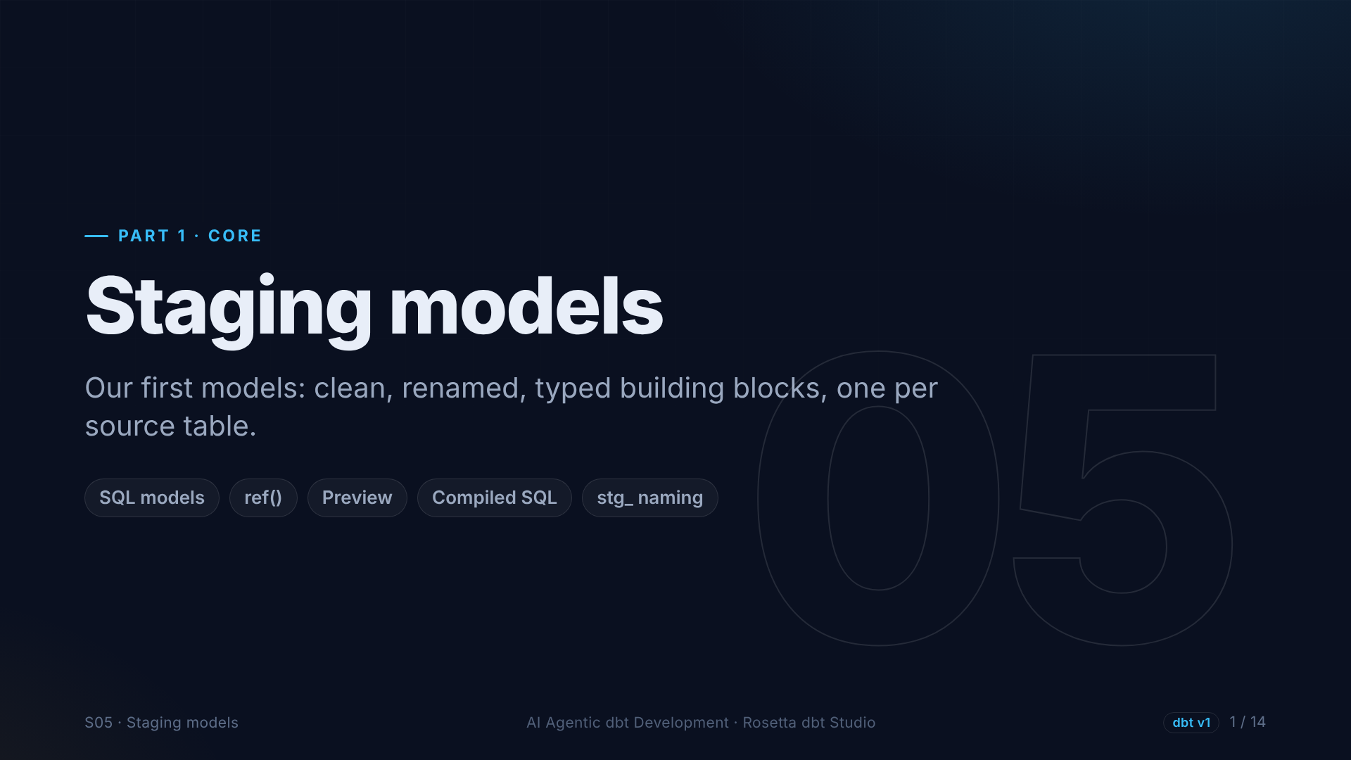
Notes:
Section five: staging models. They take a source and make it clean and consistent. We write the first one by hand, so you see exactly what a model is, and the agent writes the big one.

Slide 2
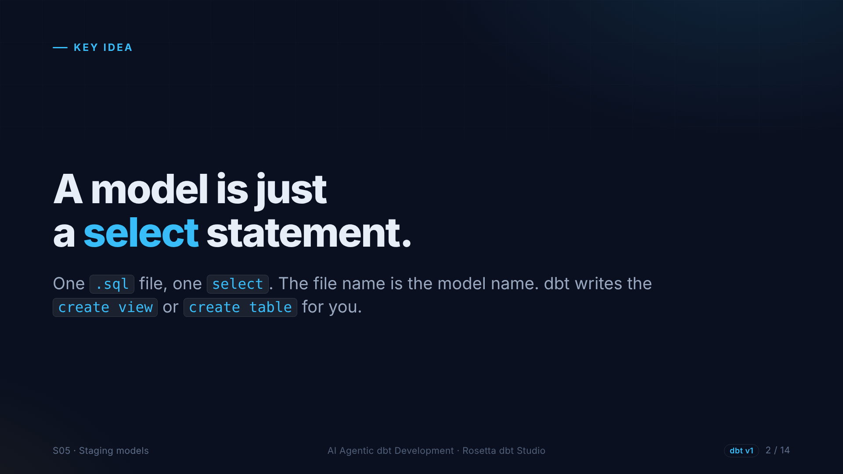
Notes:
If you remember one thing: a dbt model is just a select statement in a file. You never write create table. The file name becomes the model name, and dbt adds the right create statement for you.

Slide 3
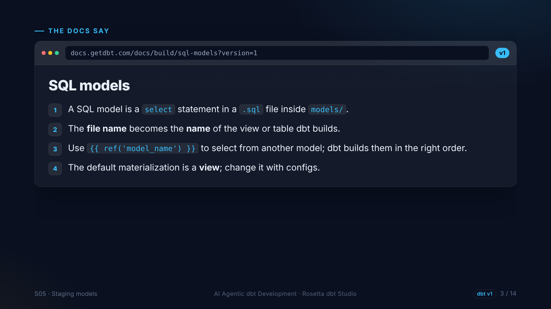
Notes:
The SQL models page, version one. A model is one select in a SQL file. The file name is the name of the view or table. To use another model, you use ref, and dbt works out the order. The default is a view.

Slide 4
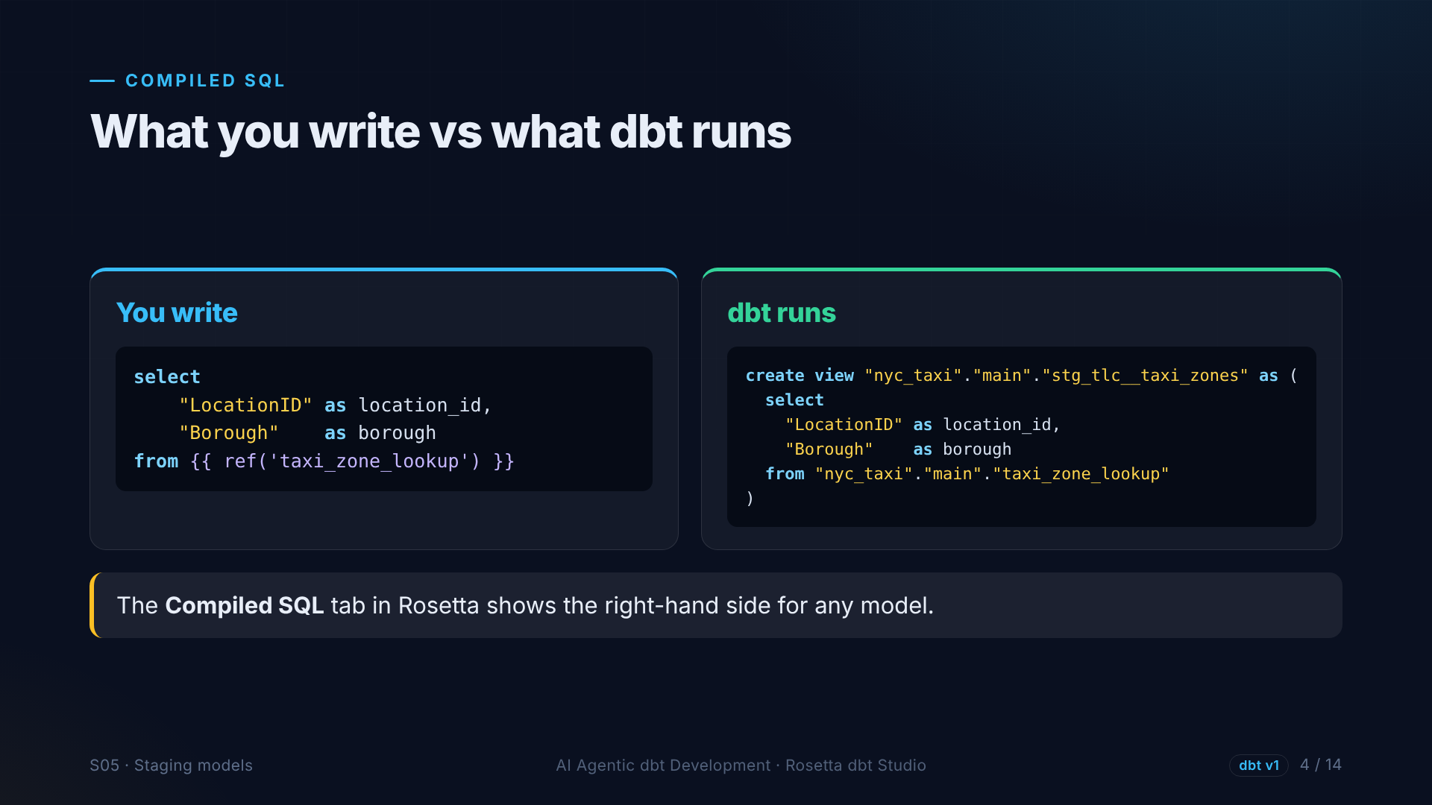
Notes:
On the left, what we write: a select, with ref to the zone seed. On the right, what dbt sends to the database: a create view, with ref replaced by the real table name. The Compiled SQL tab in Rosetta shows this for any model.

Slide 5
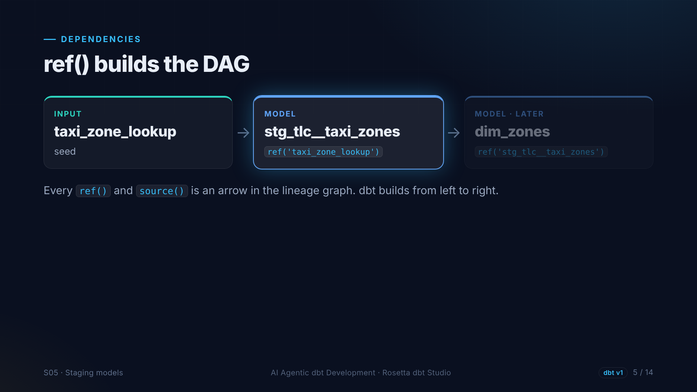
Notes:
Every ref is an arrow in the lineage graph. The staging model uses the seed, so the seed is built first. Later, a dimension uses the staging model. dbt reads all these references and builds from left to right.

Slide 6
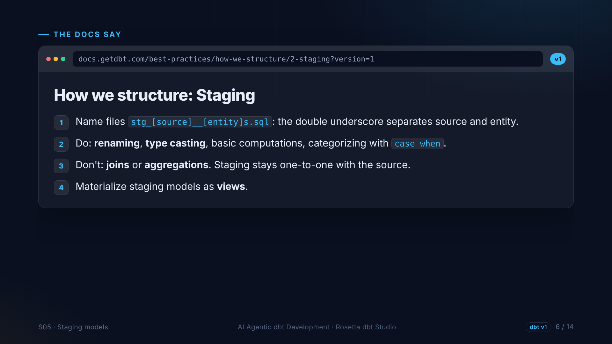
Notes:
The structure guide on staging. Name files S T G, then the source, two underscores, then the entity. Do renaming, type casting and simple calculations. Do not join or aggregate. Staging models are views.

Slide 7
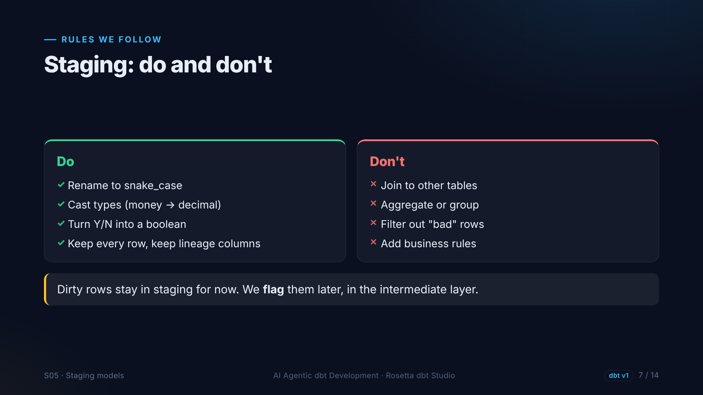
Notes:
Our checklist. Rename to snake case, cast types, turn the yes or no flag into a boolean, and keep every row. No joins, no aggregations, and no filtering. The strange trips stay in staging. We flag them later, where the business rule belongs.

Slide 8
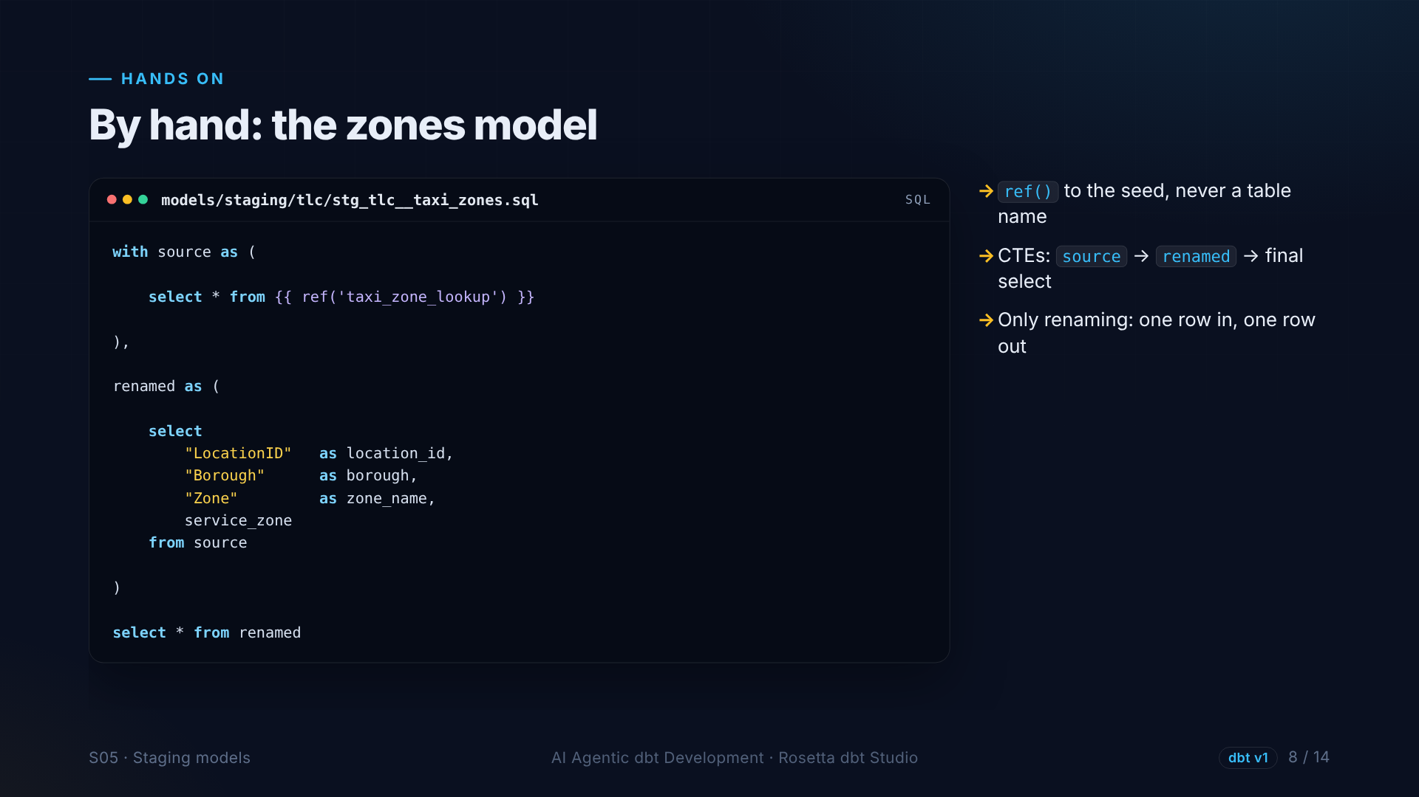
Notes:
Our first model, written by hand. A source step that selects from the seed with ref. A renamed step that gives every column a clean name. And a final select. The agent will follow the same pattern.

Slide 9
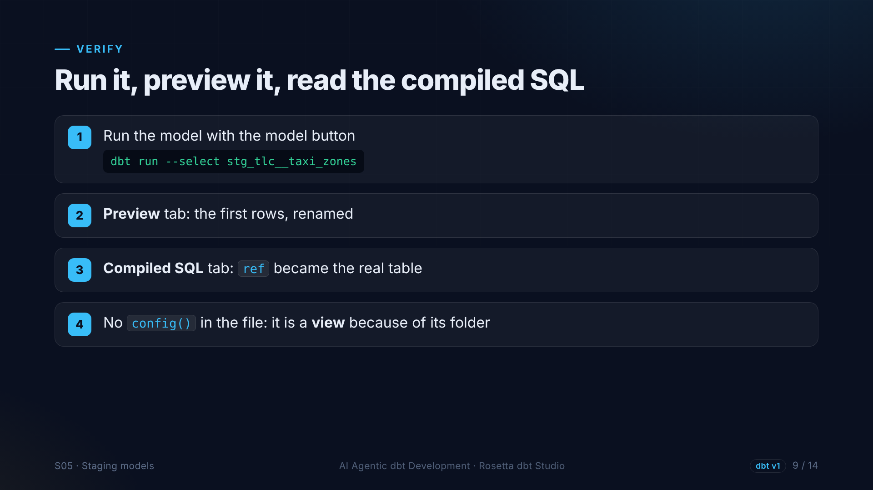
Notes:
We run it with the model button, open Preview to see the renamed zones, and open Compiled SQL to see ref replaced by the table. We never wrote view in the file. The folder setting from section two decided it.

Slide 10
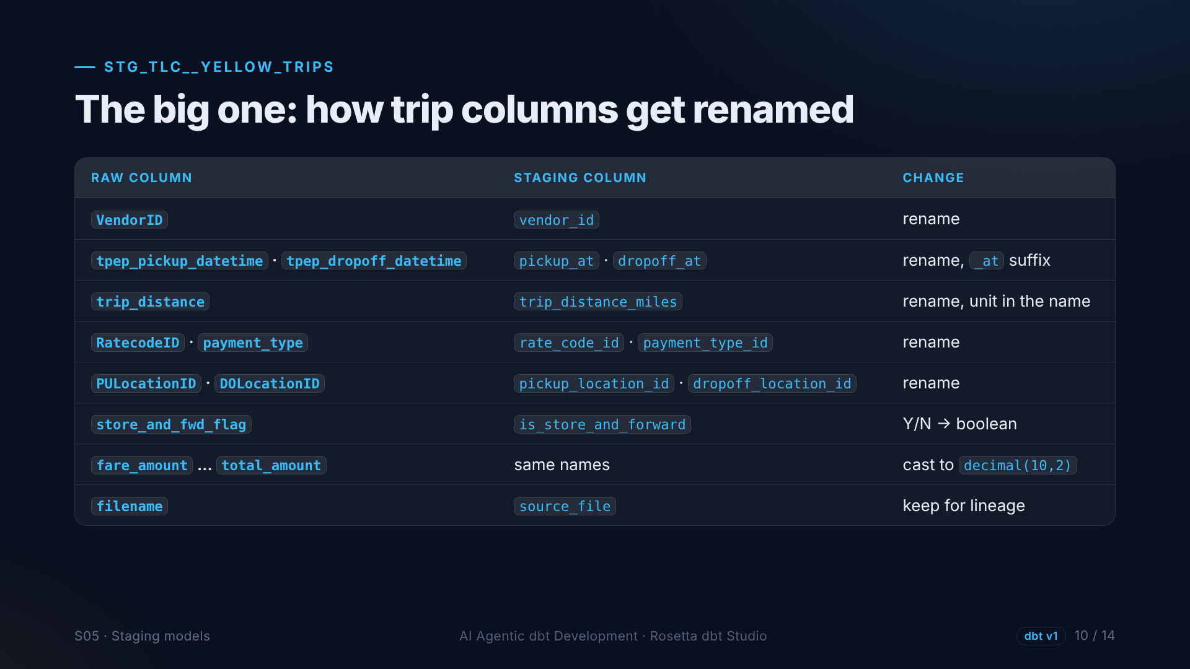
Notes:
The trips model is bigger: twenty columns. Timestamps end in at. Distance gets its unit. IDs become snake case. The flag becomes a boolean. Money becomes a decimal. And the file name is kept as source file. Repetitive work, perfect for the agent.

Slide 11
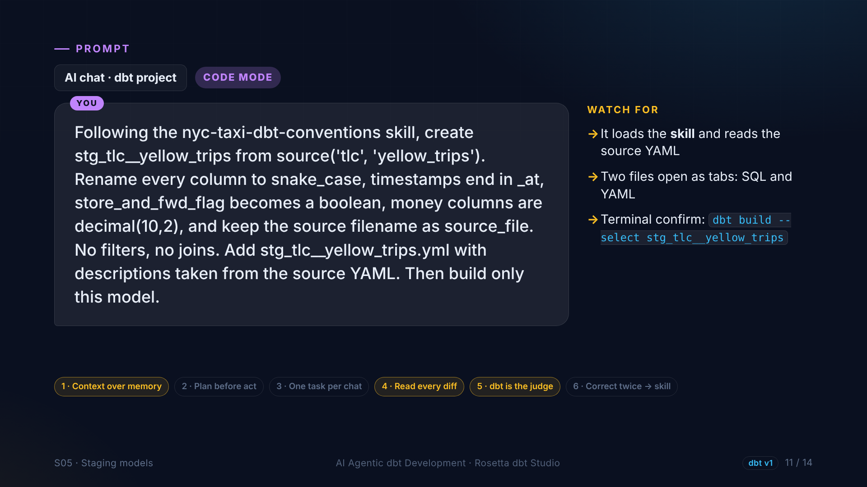
Notes:
In the demo, the agent creates the staging model for yellow trips, following our skill: snake case, the at suffix, a boolean, decimals, and source file. No filters, no joins. Plus a YAML file with descriptions. Then it builds only this model.

Slide 12
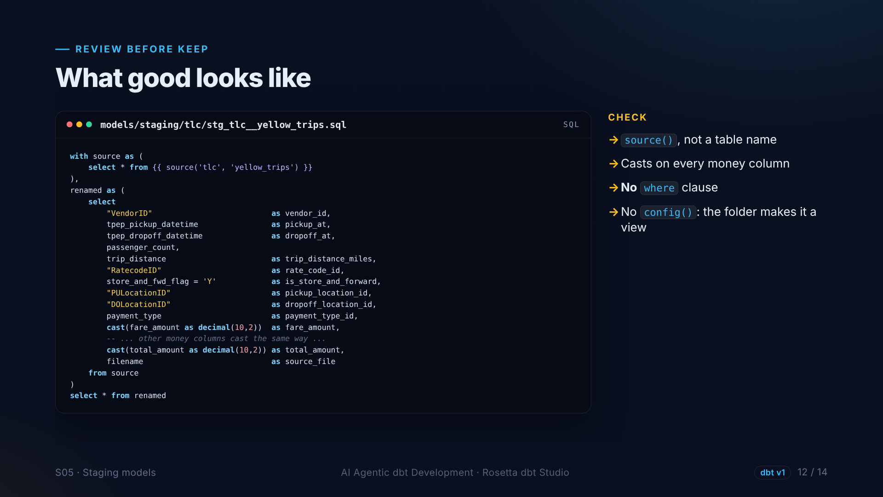
Notes:
This is the shape we expect, and how we review it. It uses source, not a table name. Every money column is cast. And two things must not be there: a where clause, and a config block. If either appears, we ask the agent to remove it before keeping the file.

Slide 13
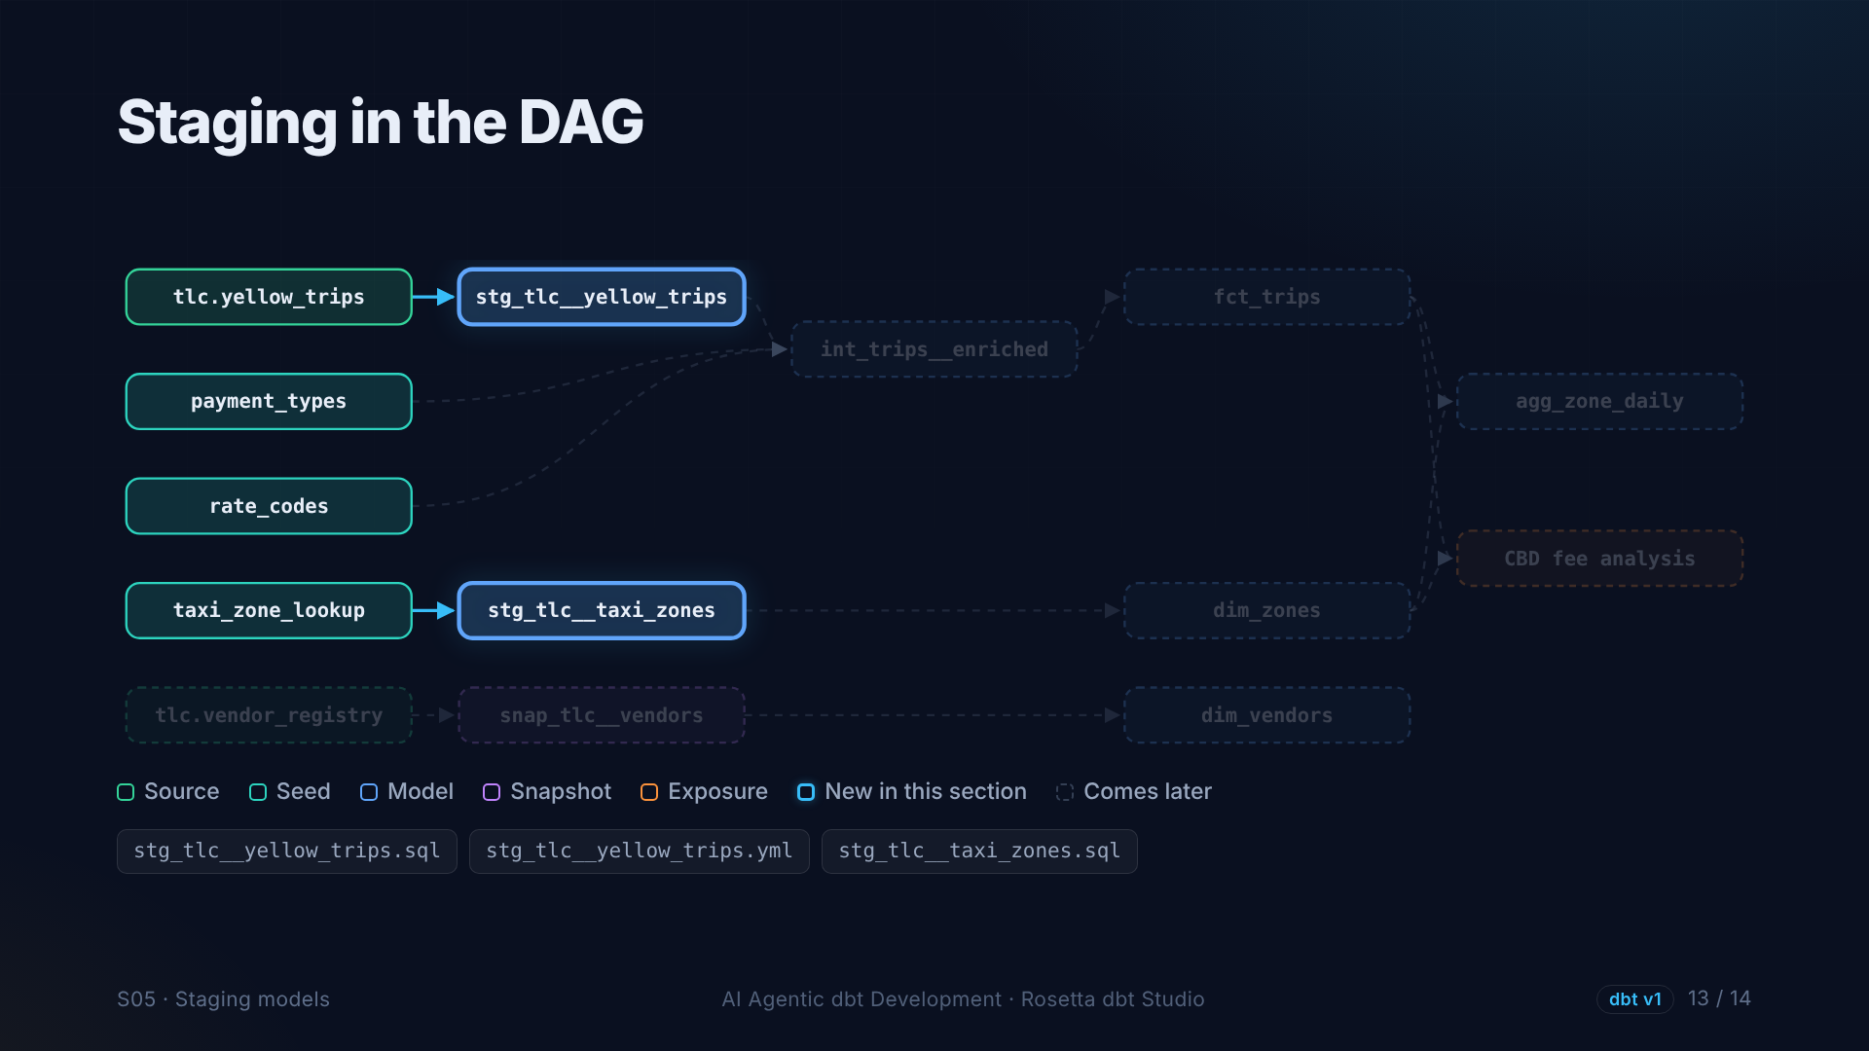
Notes:
Two new nodes in the lineage: our staging models, each fed by exactly one input. One to one, just as the guide says.

Slide 14
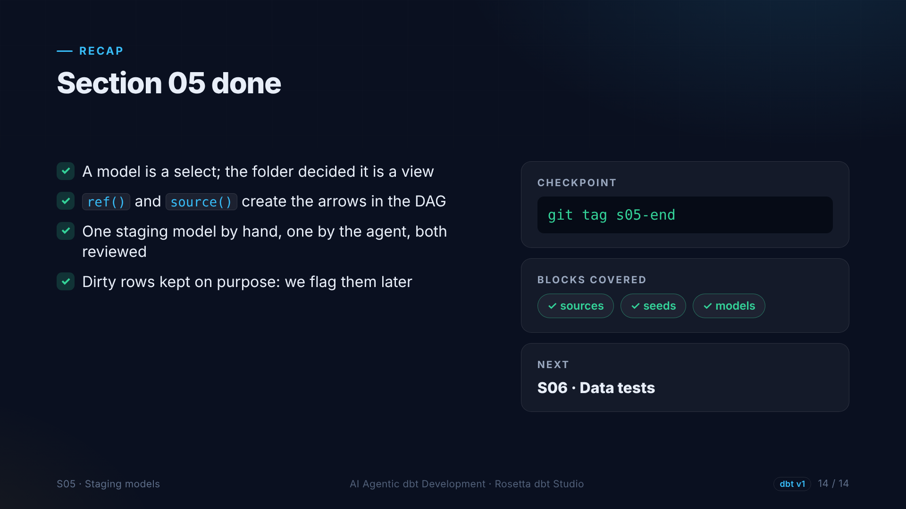
Notes:
That is section five. Models are select statements, ref and source build the graph, and we have two staging models, one by hand and one by the agent. Next: we write down what we expect from the data, with tests.

