Slide 1
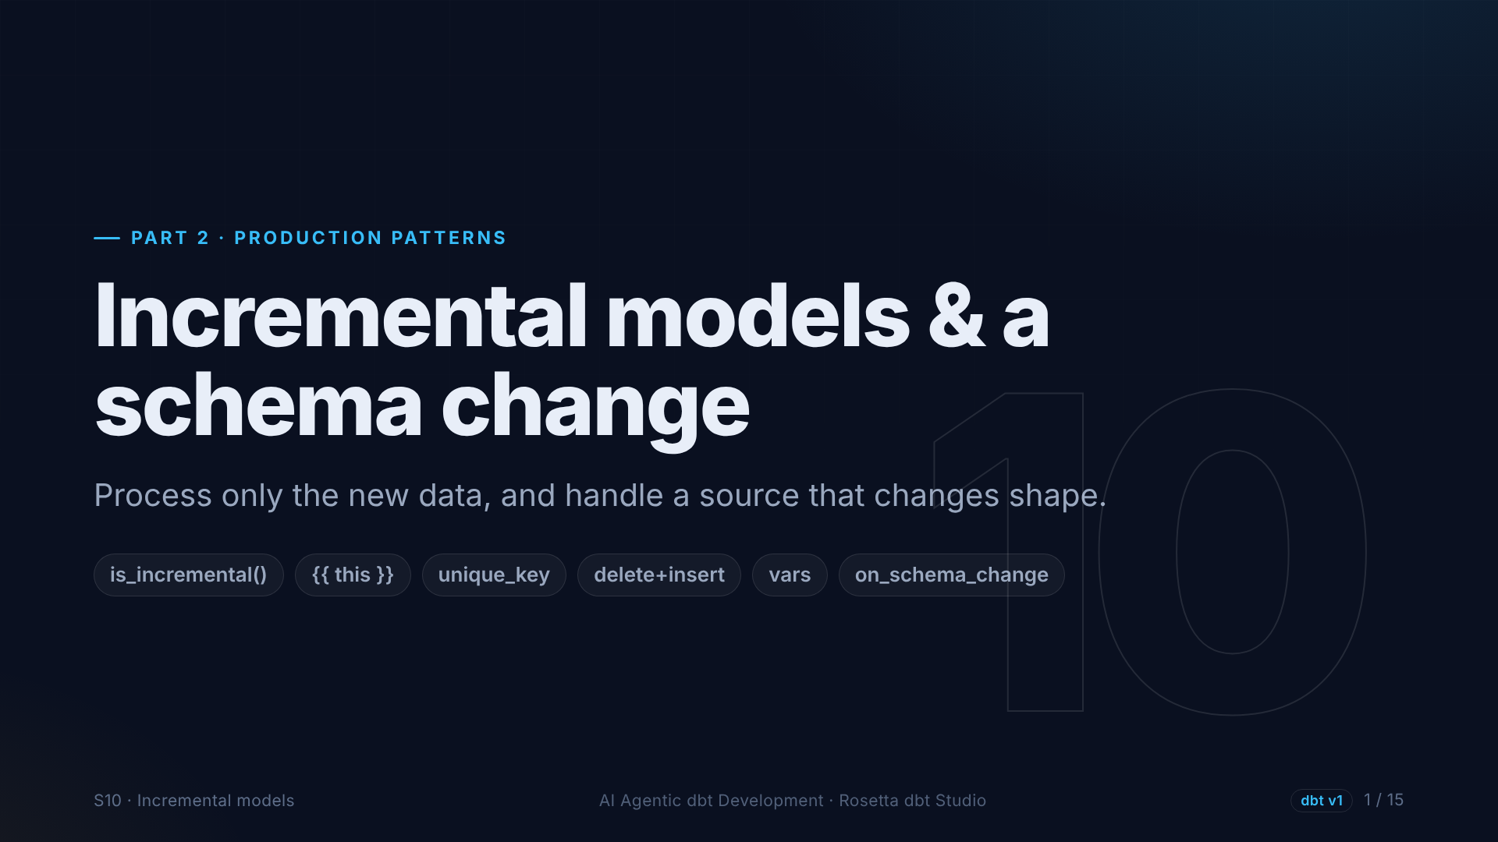
Notes:
Section ten. Today the fact table is rebuilt from all trips on every run, and that gets slow. We make it incremental, so only new trips are processed. Then a new month arrives, with a surprise.

Slide 2
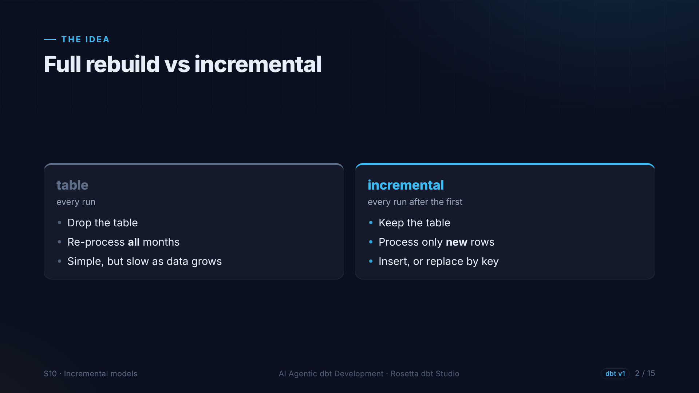
Notes:
A table is thrown away and rebuilt on every run. An incremental model keeps the existing table and processes only new rows, inserting them, or replacing rows with the same key.

Slide 3
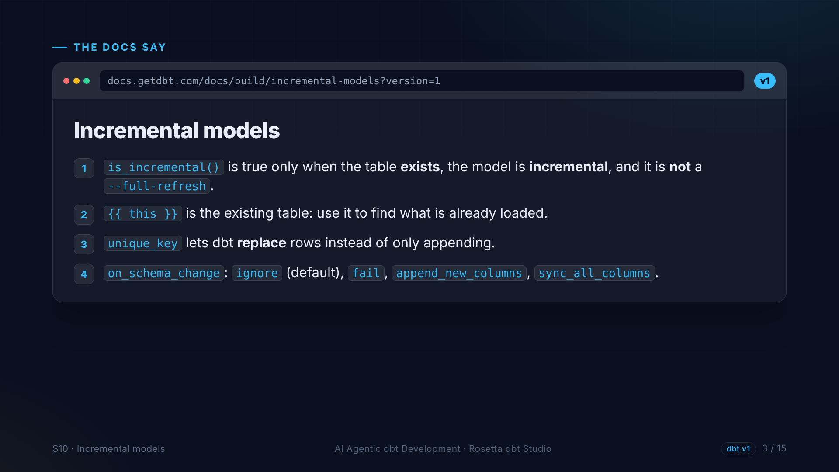
Notes:
The incremental models page, version one. The is incremental function is true only on a normal run against an existing table. The word this refers to the existing table. A unique key lets dbt replace rows. And on schema change decides what happens when columns change.

Slide 4
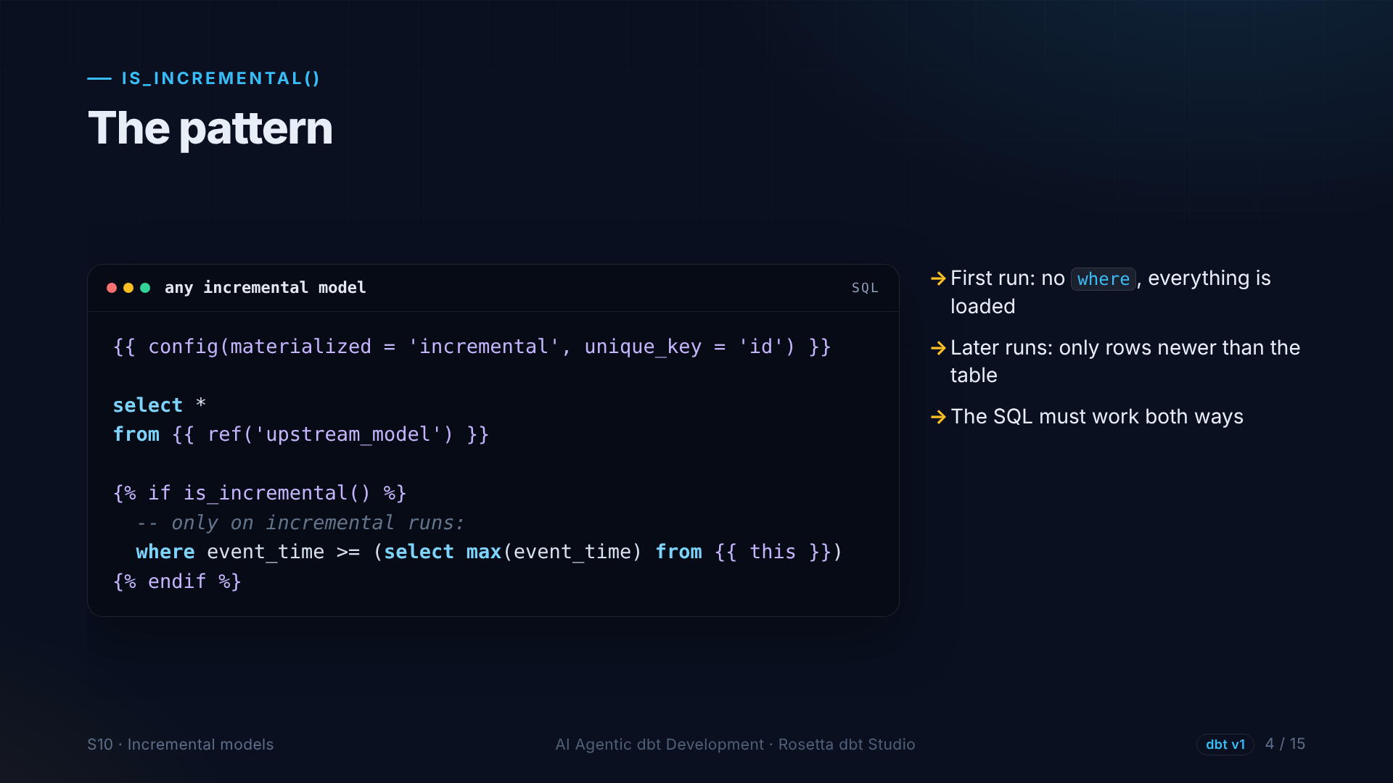
Notes:
The whole pattern. A config block that says incremental. Then an if block that adds a filter. On the first run, or a full refresh, everything loads. On later runs, only rows newer than what is already in the table.

Slide 5
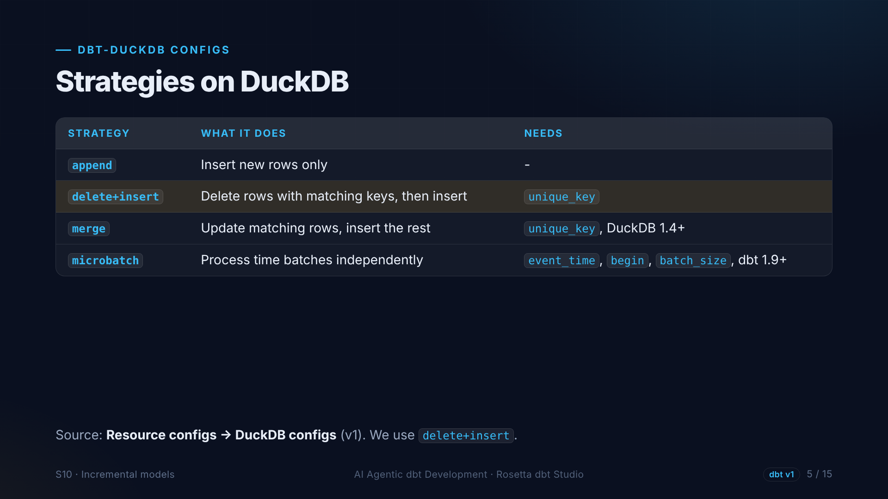
Notes:
How are new rows written? The DuckDB configs page lists four strategies. Append, delete and insert, merge, and microbatch. We use delete and insert with our trip ID: simple, and safe when the same trip arrives twice.

Slide 6
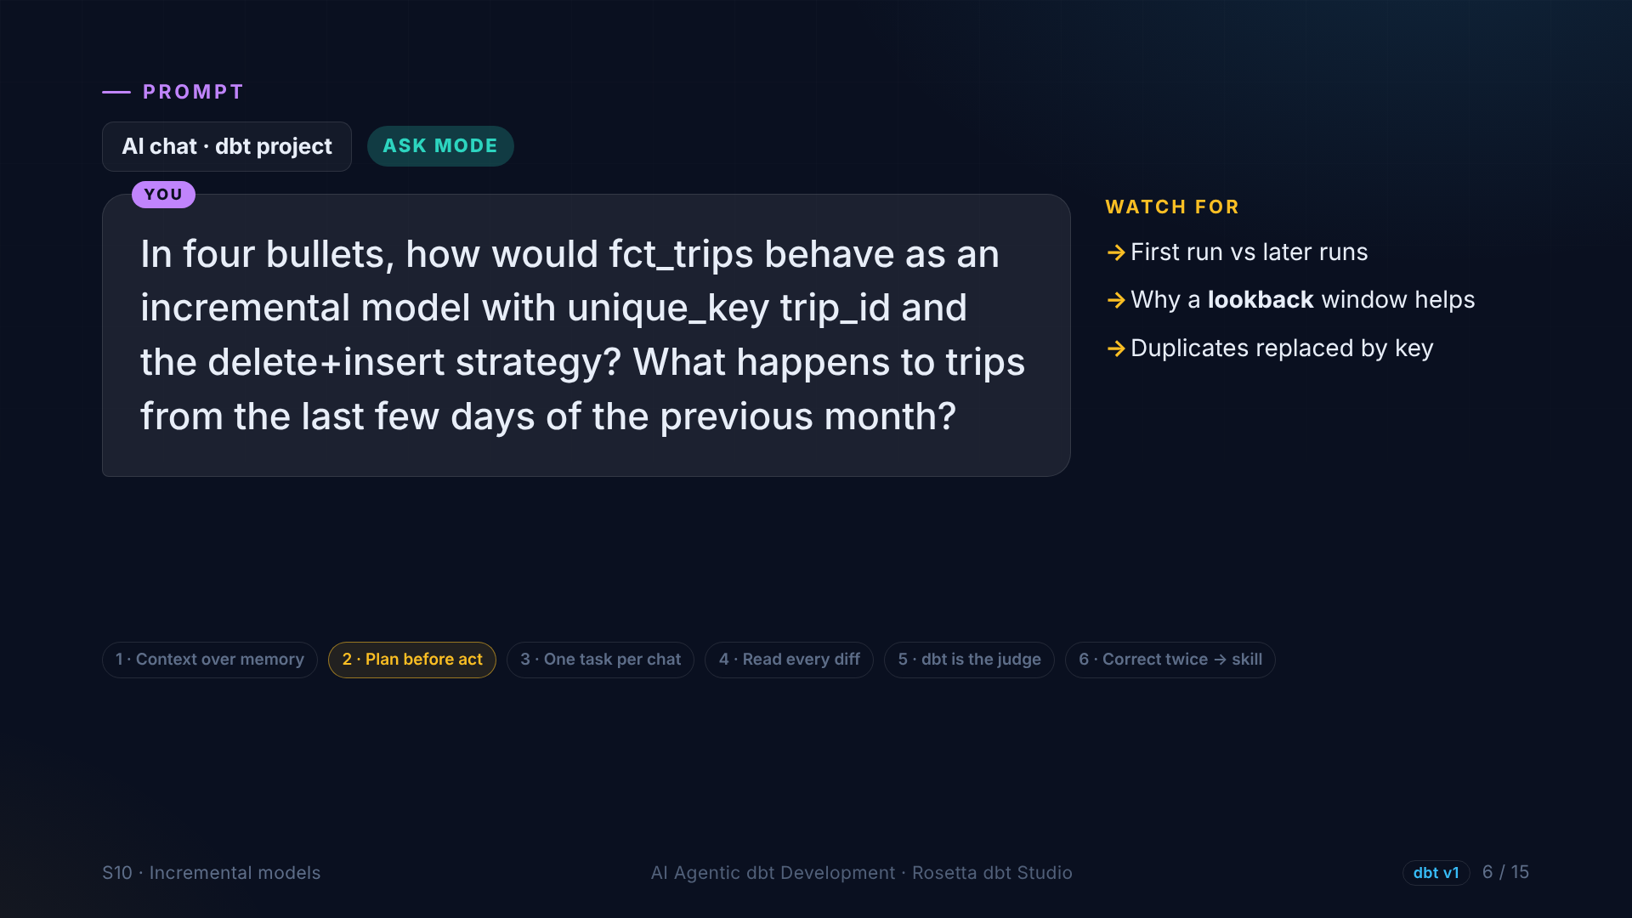
Notes:
Before changing anything, we ask in Ask mode how this would behave. A trip from the last days of the previous month could be missed, so we look back a few days, and the unique key replaces anything we see twice.

Slide 7
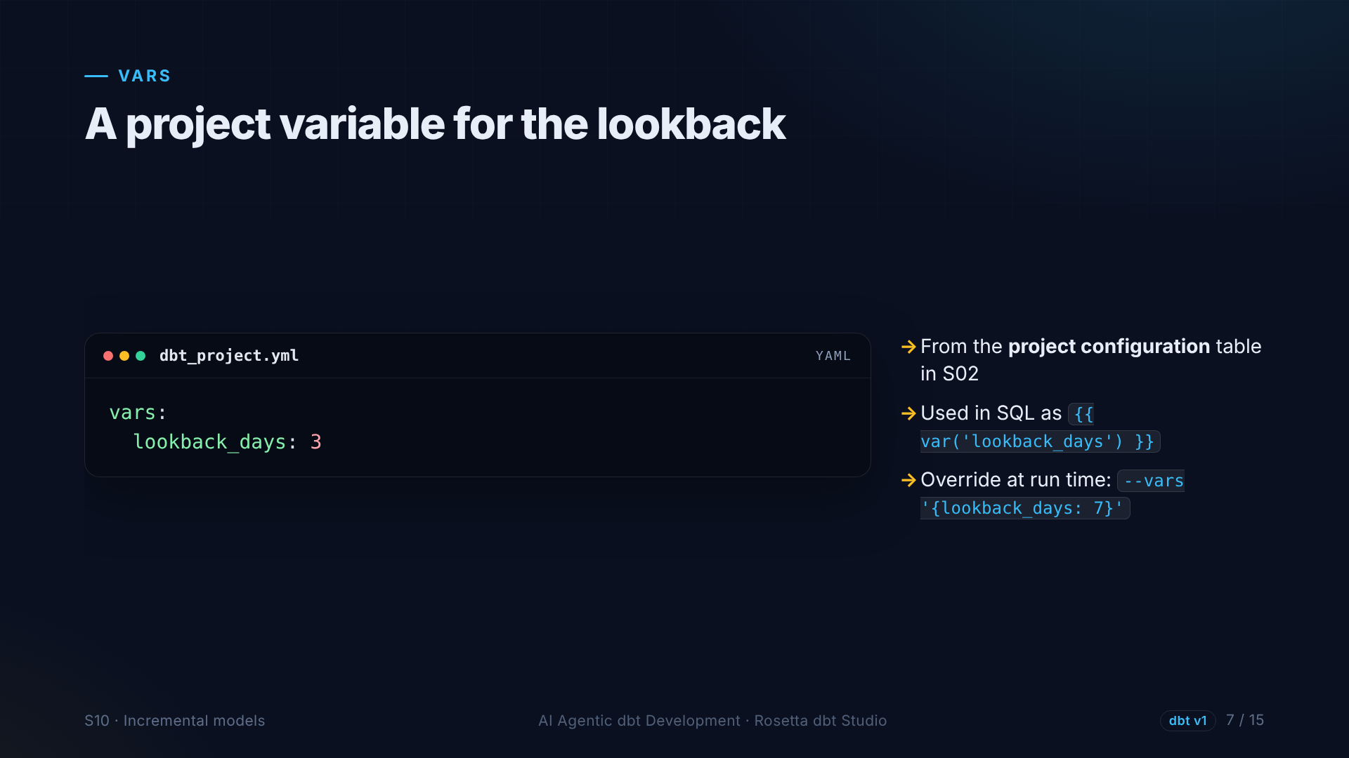
Notes:
How many days back is a setting, not code. So it becomes a project variable, the vars key from section two. We can override it on the command line for a single run.

Slide 8
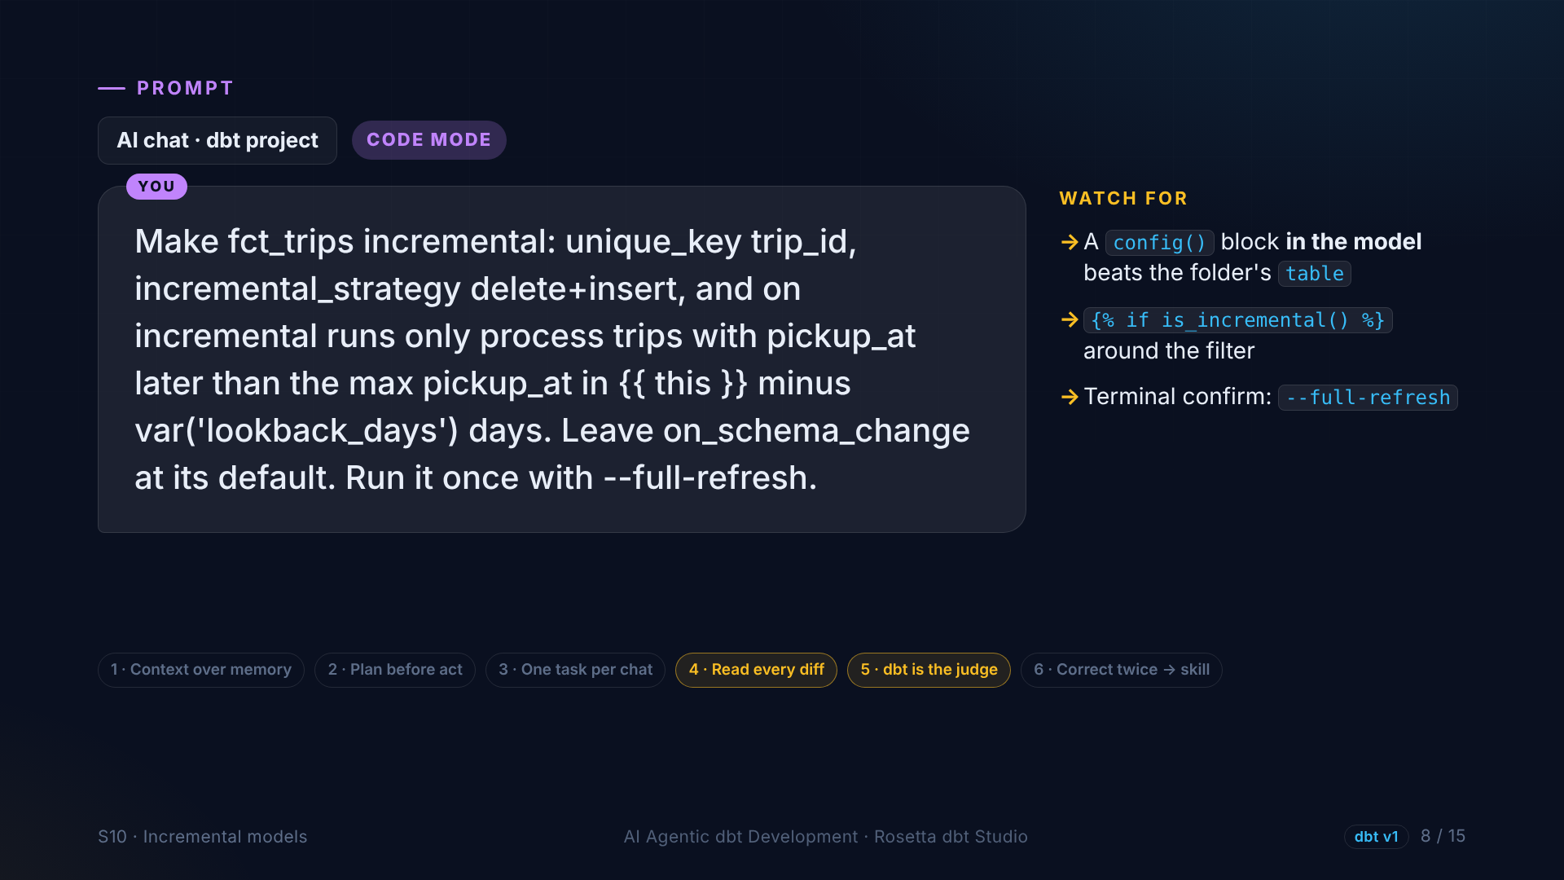
Notes:
In the demo, the agent makes the fact table incremental: the trip ID as unique key, delete and insert, and a filter that uses our lookback variable. We leave on schema change at its default, and run it once with a full refresh.

Slide 9
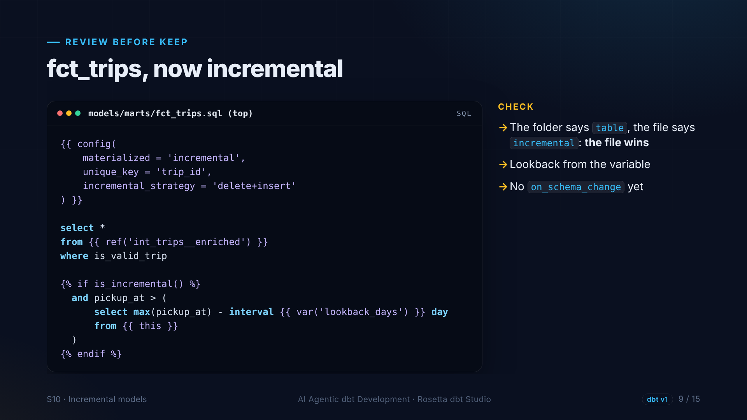
Notes:
We review it. The folder says table, but the config in the file says incremental, and the file wins because it is more specific. The validity filter, the lookback from the variable, and no on schema change yet.

Slide 10
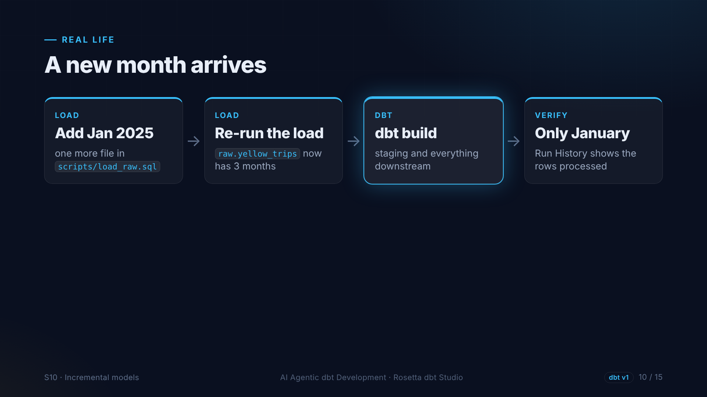
Notes:
Now real life happens. January twenty twenty-five is published. We add the file to our load script and run it again. Then dbt build for staging and everything downstream, and Run History shows that only the new rows were processed.

Slide 11
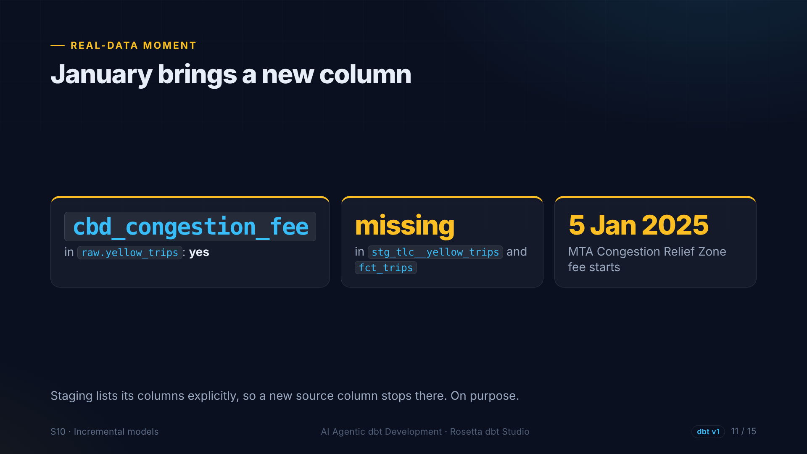
Notes:
The surprise. January brings a new column: the C B D congestion fee, for the Manhattan Congestion Relief Zone that started on January fifth. It is in the raw table, but not in staging or the fact table. Nothing changes downstream without our decision.

Slide 12
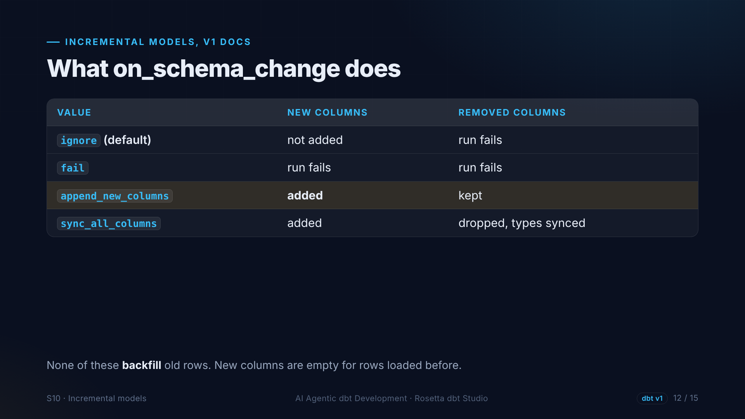
Notes:
Back to the docs. The default, ignore, does not add new columns. Append new columns adds them. And none of the options fill in old rows. That needs a full refresh.

Slide 13
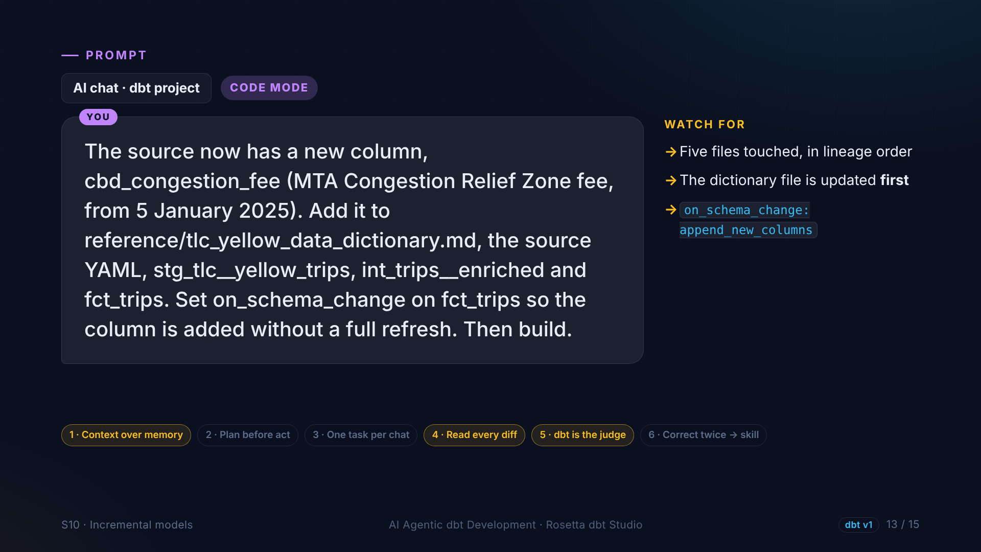
Notes:
In the demo, the agent carries the new column through every layer: the dictionary file, the source, staging, intermediate and the fact table, and sets on schema change so the column is added without a full refresh. Updating the dictionary keeps the agent's context current.

Slide 14
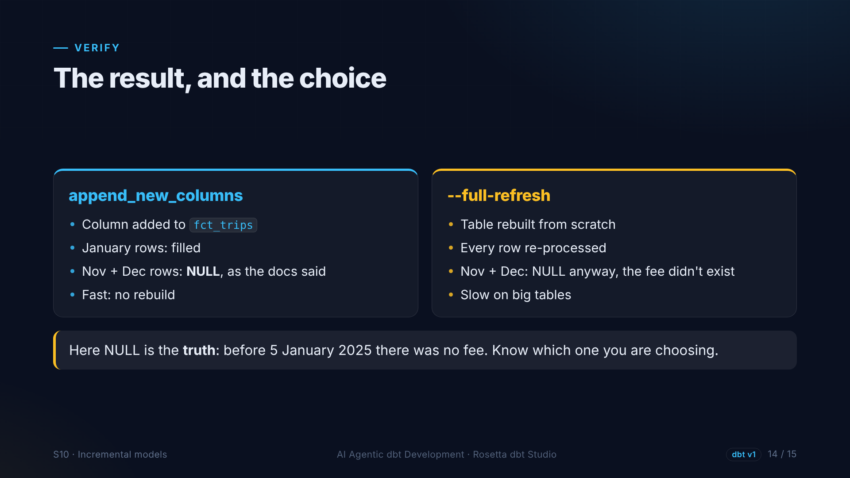
Notes:
The column appears. January rows have values, November and December are empty, exactly as the docs said. Here empty is actually correct, because the fee did not exist before January. Know which option you are choosing.

Slide 15
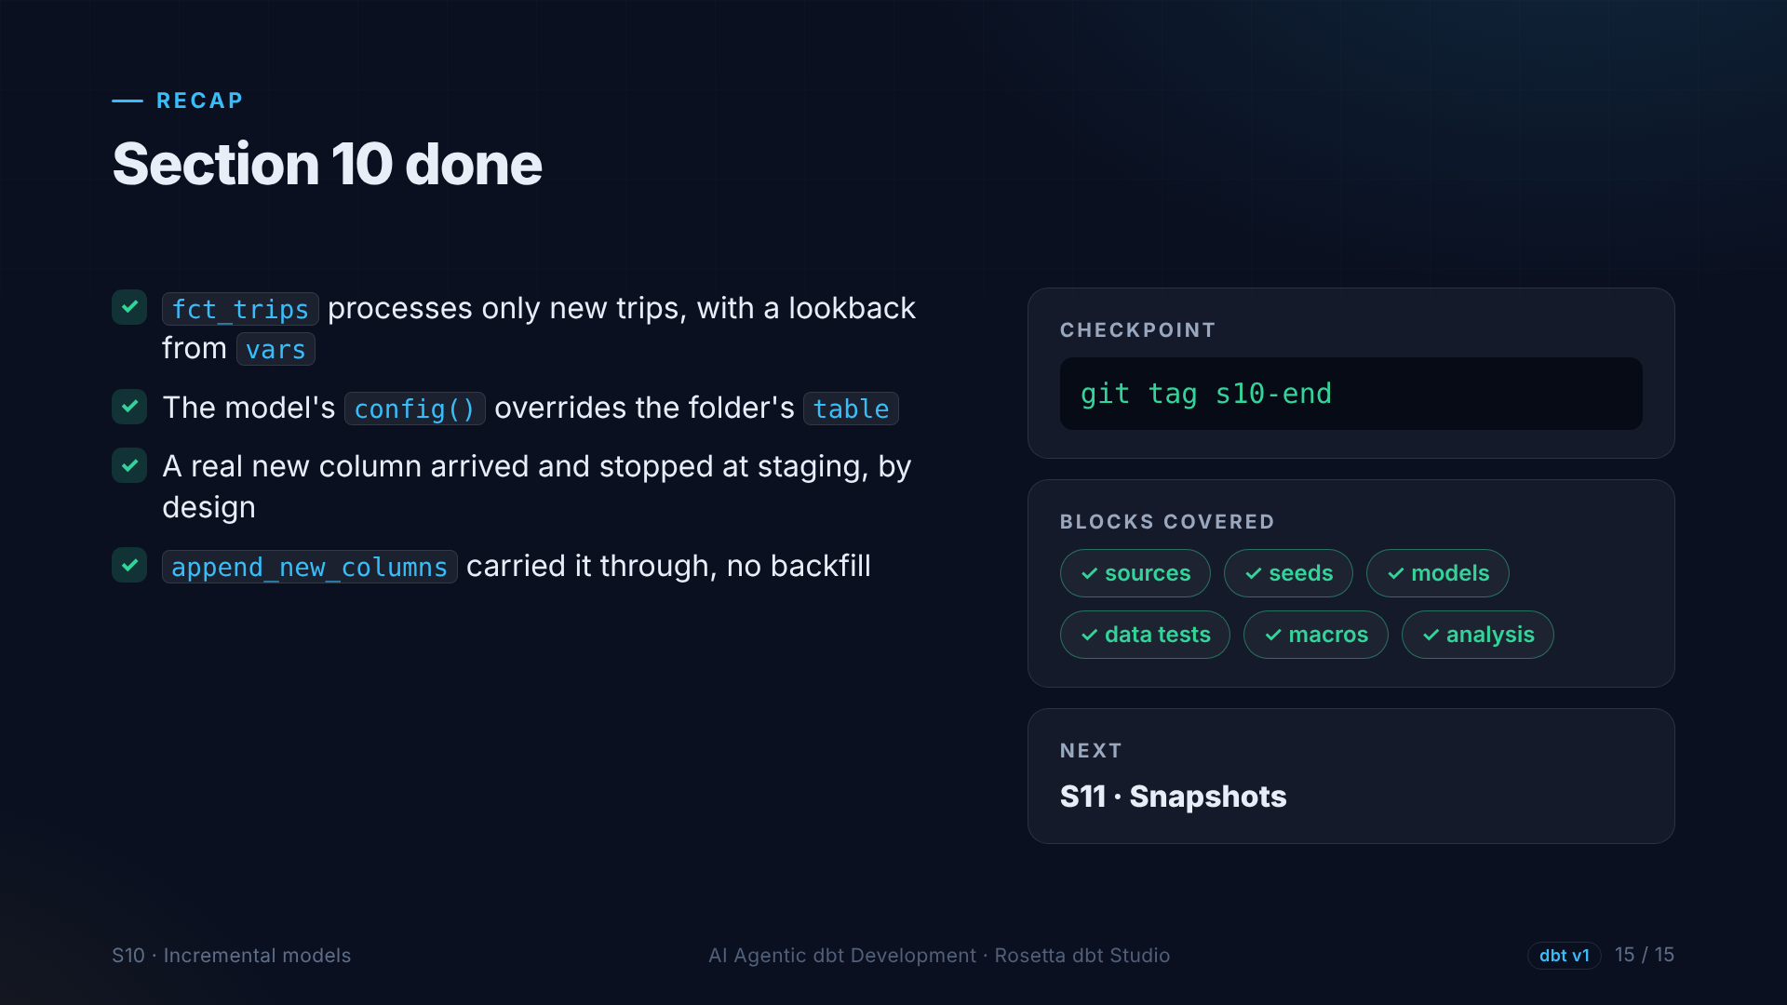
Notes:
That is section ten. The fact table is incremental, with a lookback variable, and a real schema change arrived and was carried through on purpose. Next: snapshots.

