Slide 1
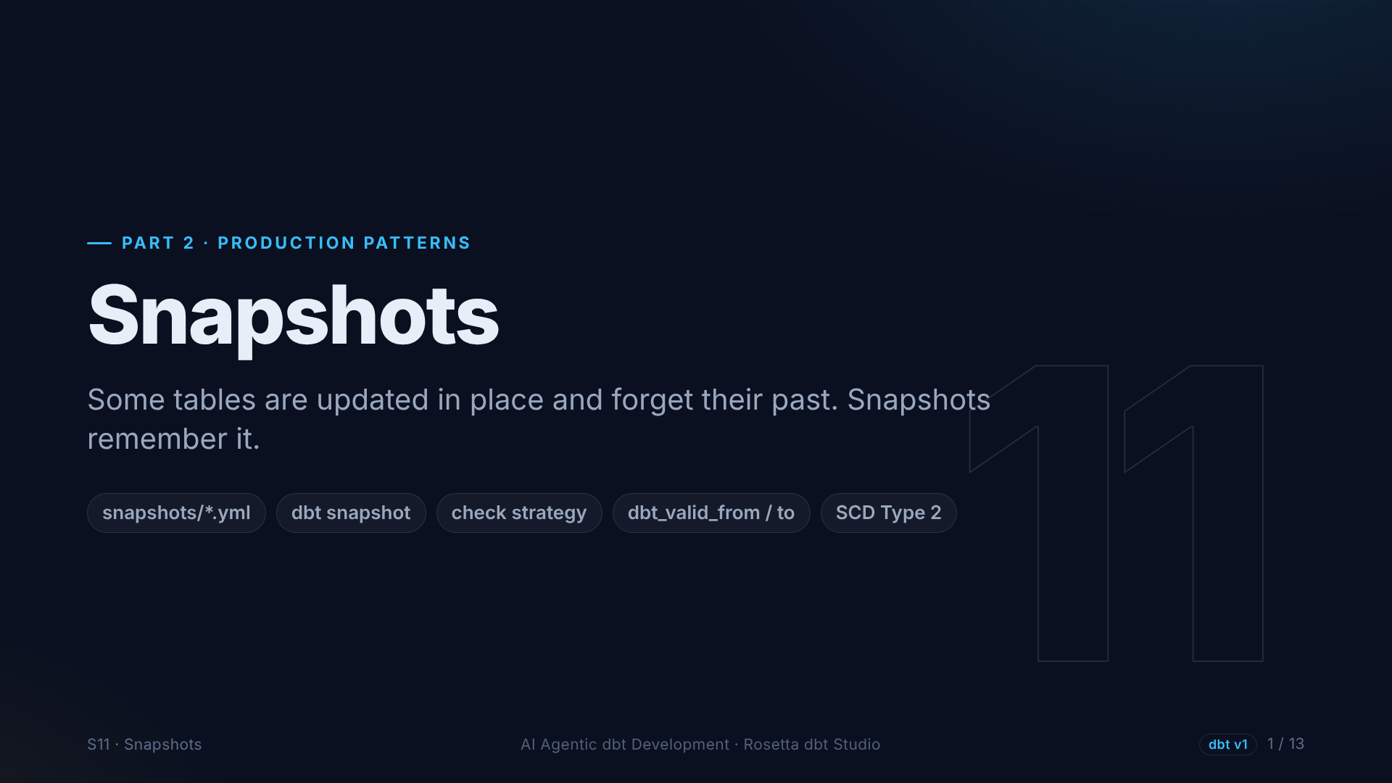
Notes:
Section eleven: snapshots. Trips never change once they happen. But some data is updated in place, and when that happens, the old value is gone. Snapshots keep it.

Slide 2
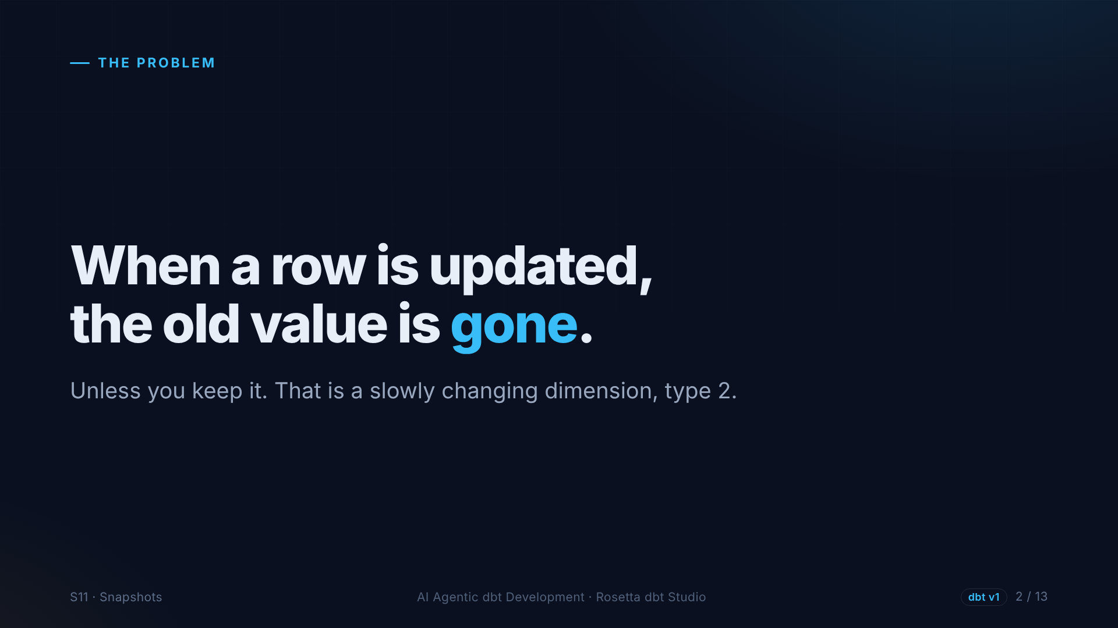
Notes:
Think of an address, a price, or a vendor name. The source system overwrites it, and yesterday's value is lost, unless we keep one row per version, with the dates each version was valid. That is a slowly changing dimension, type two.

Slide 3
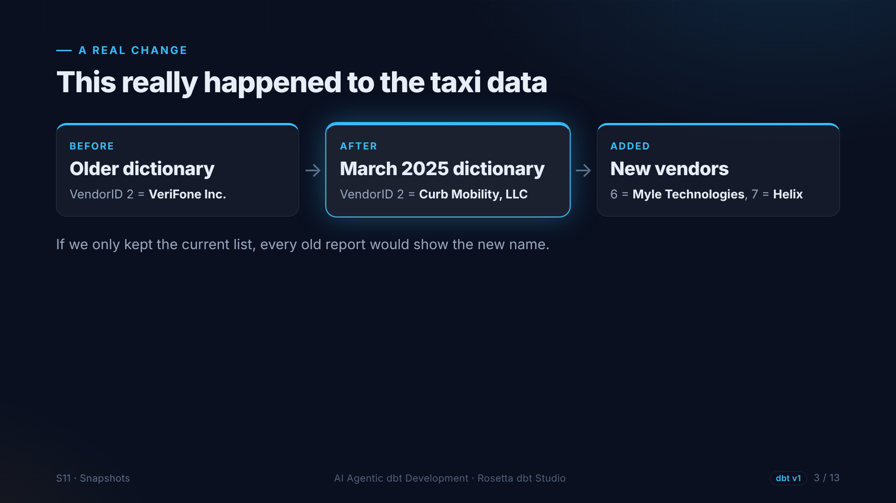
Notes:
This really happened in our data. Older versions of the taxi data dictionary say vendor two is VeriFone. The current one says Curb Mobility. And two new vendors appeared, Myle and Helix.

Slide 4
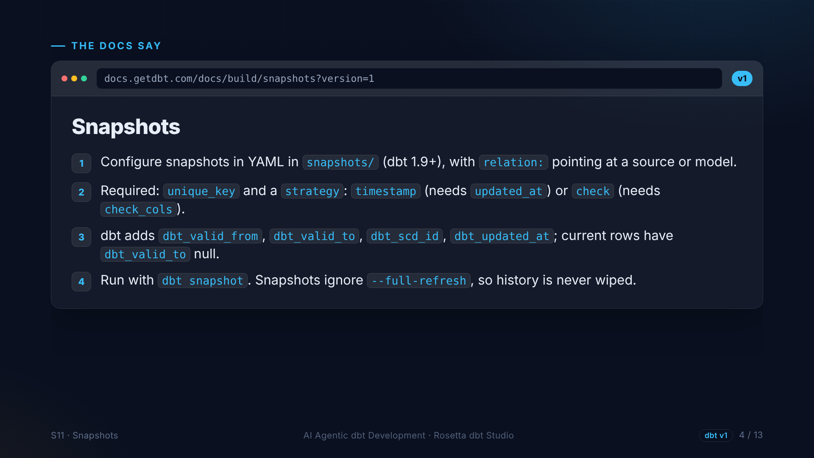
Notes:
The snapshots page, version one. Since dbt one point nine, a snapshot is a YAML file pointing at a source or model. It needs a unique key and a strategy. dbt adds valid from and valid to columns, and snapshots ignore full refresh, so history is never wiped.

Slide 5
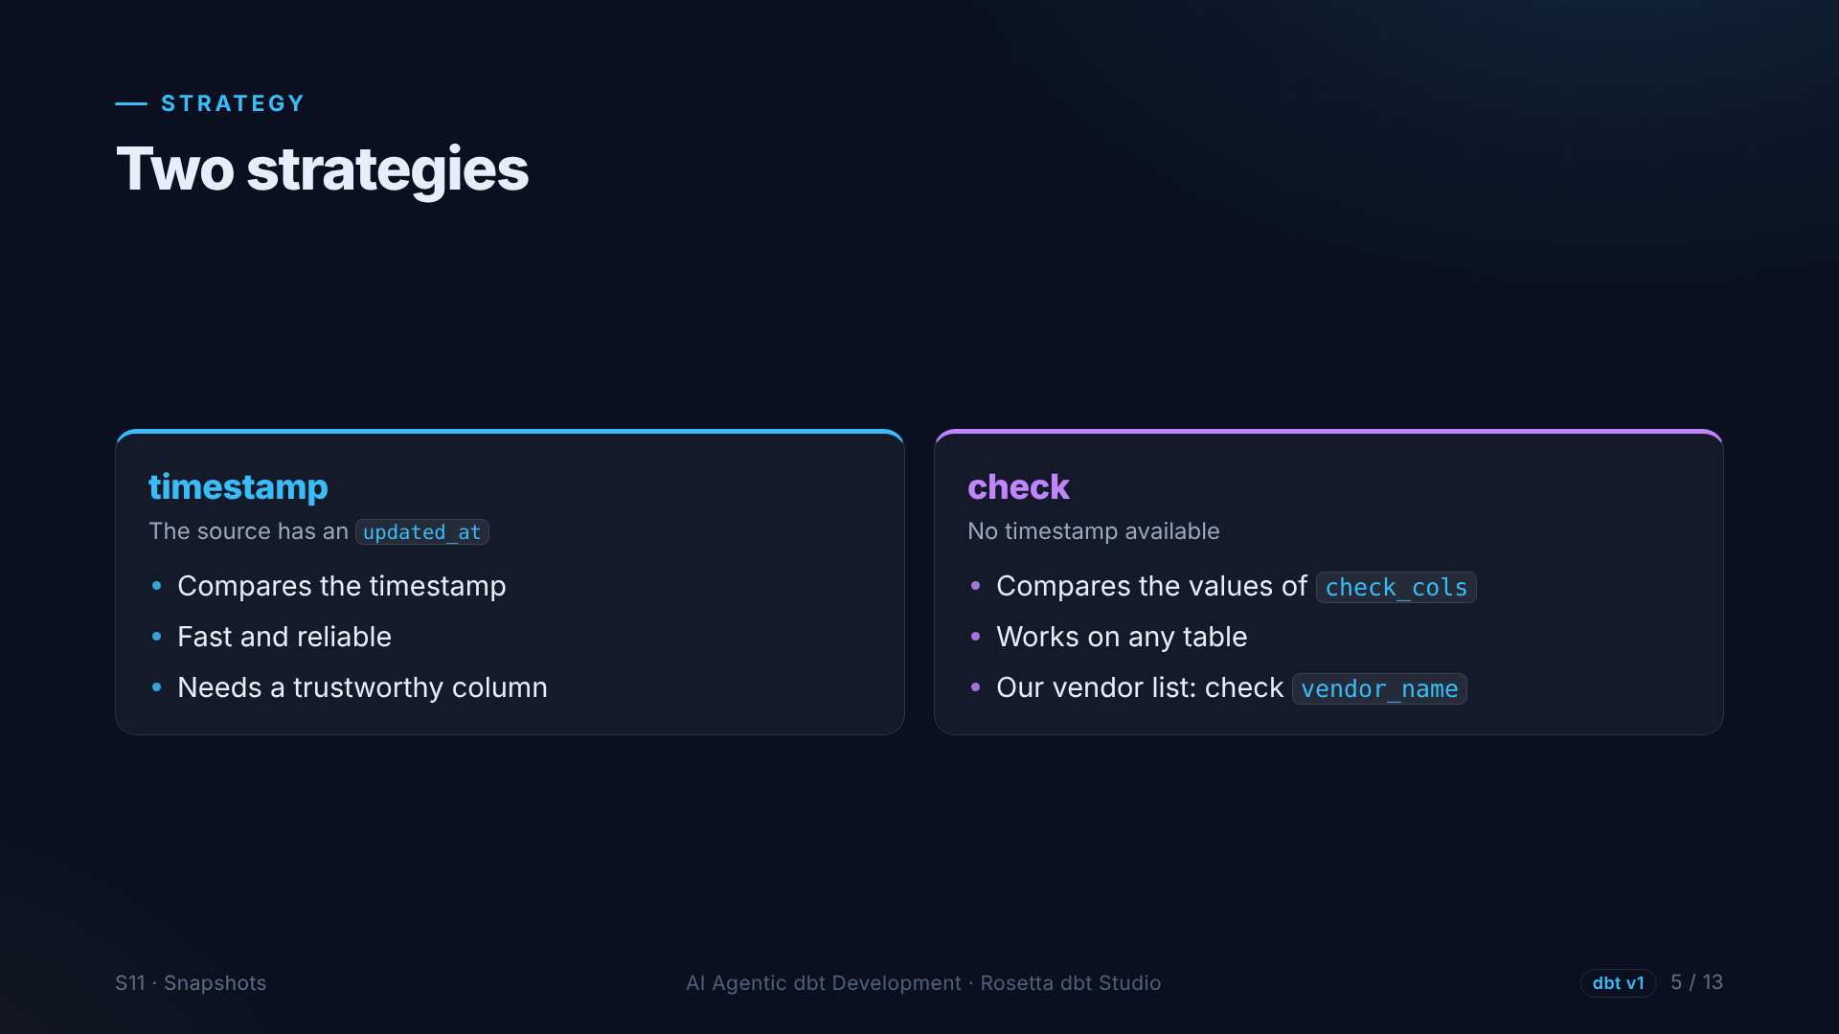
Notes:
Two strategies. Timestamp compares an updated at column, when the source has a reliable one. Check compares the actual values of the columns you list. Our vendor list has no timestamp, so we check the vendor name.

Slide 6
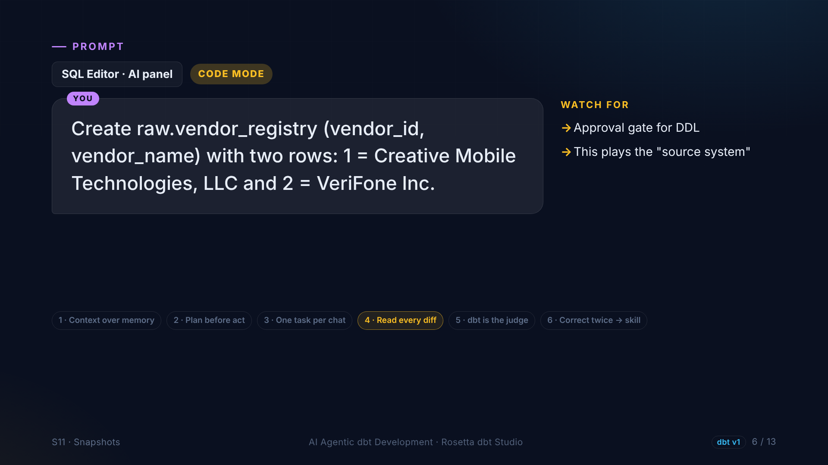
Notes:
First we need a source system that changes. In the demo, the agent creates a small vendor registry table with the old list: Creative Mobile Technologies, and VeriFone.

Slide 7
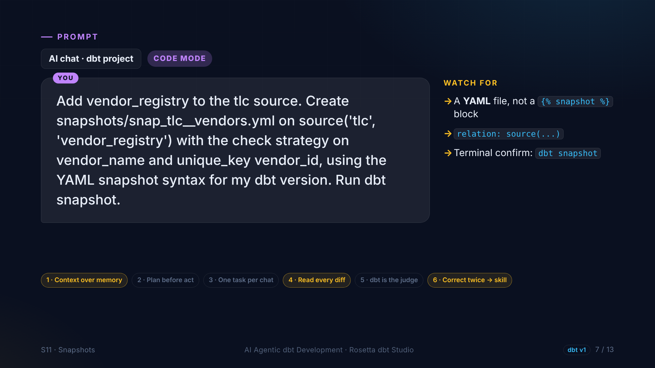
Notes:
Then the agent adds the table to our source, creates the snapshot in YAML with the check strategy, and runs dbt snapshot. Many examples online use an older syntax. Our skill says YAML.

Slide 8
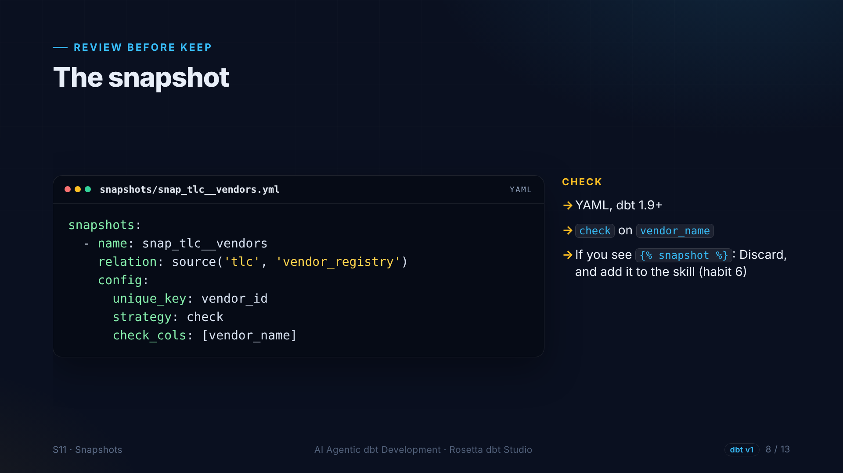
Notes:
Seven lines: a name, the source it reads, a unique key, the check strategy, and the column to check. If the agent writes the old syntax, we discard it, and add the rule to the skill.

Slide 9
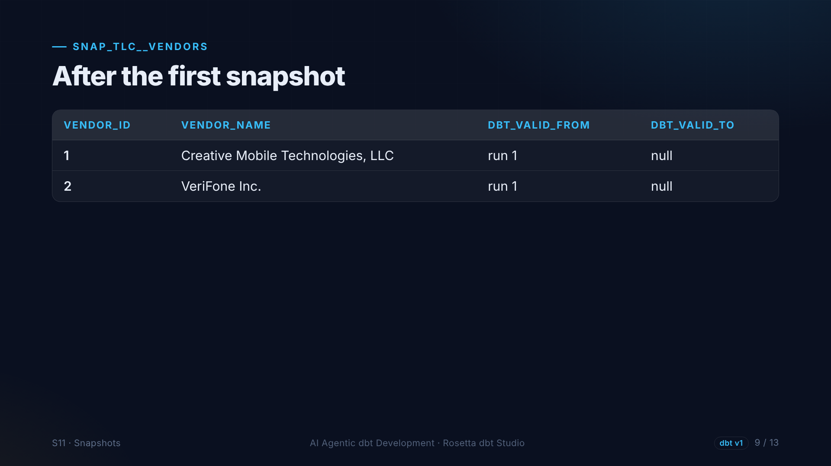
Notes:
After the first snapshot, both vendors are current, and their valid to column is empty.

Slide 10
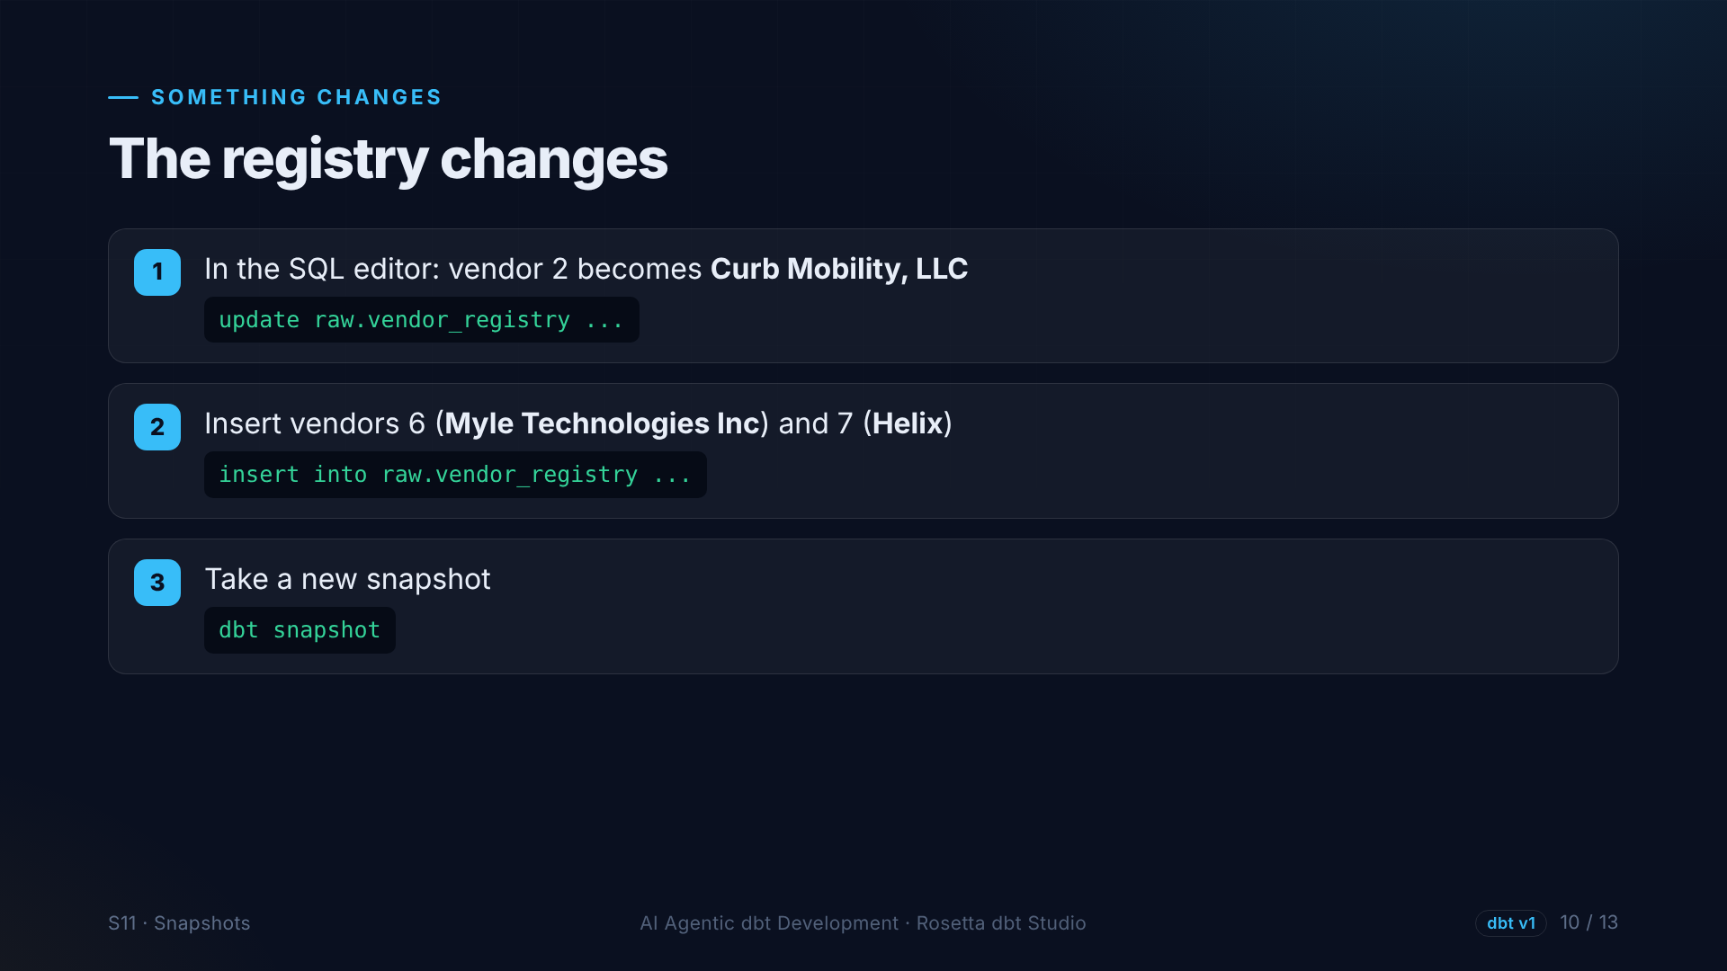
Notes:
Then someone updates the vendor system. Vendor two becomes Curb Mobility, and vendors six and seven are added, exactly as in the real dictionary. We run dbt snapshot again.

Slide 11
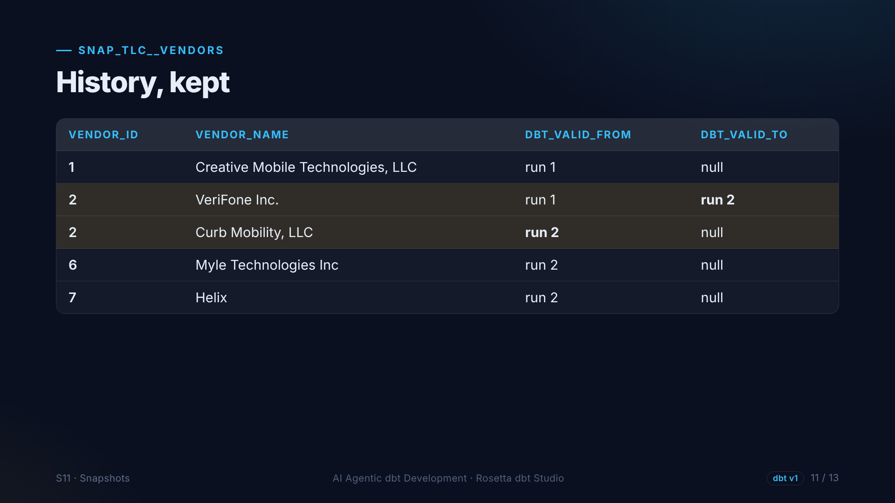
Notes:
History, kept. Vendor two now has two rows: VeriFone, valid until the second run, and Curb Mobility, valid from then on. Any report can now ask what a vendor was called at the time of a trip.

Slide 12
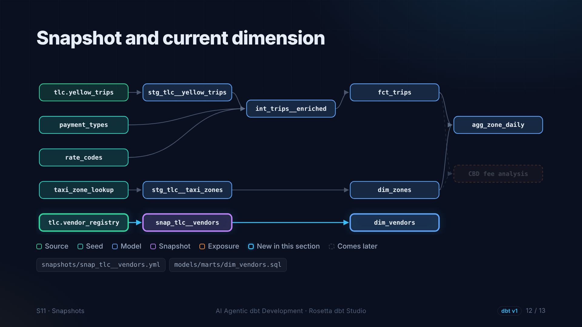
Notes:
On the graph: the new source, the snapshot, and a vendor dimension built from the current rows of the snapshot.

Slide 13
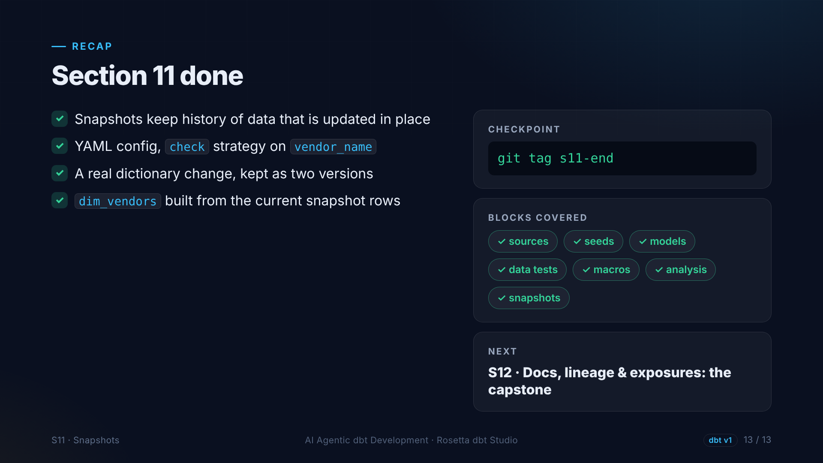
Notes:
That is section eleven. Snapshots keep history, and we used one on a real change from the taxi data dictionary. Next: documentation, lineage, and a real answer.

