Slide 1
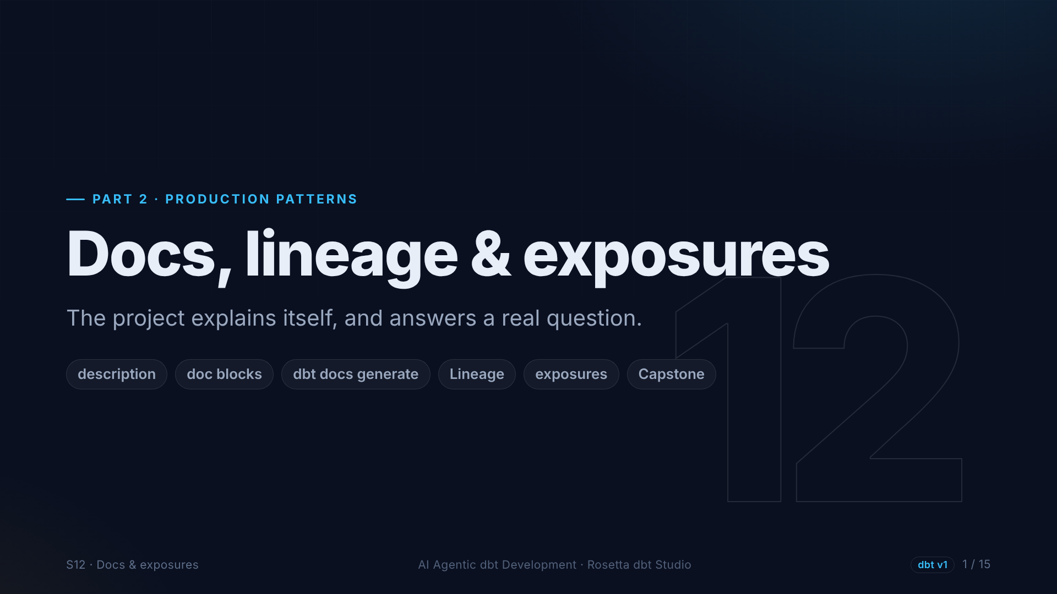
Notes:
Section twelve, the capstone. We make the project explain itself, ask it questions, answer a real question about congestion pricing, and declare who uses our work.

Slide 2
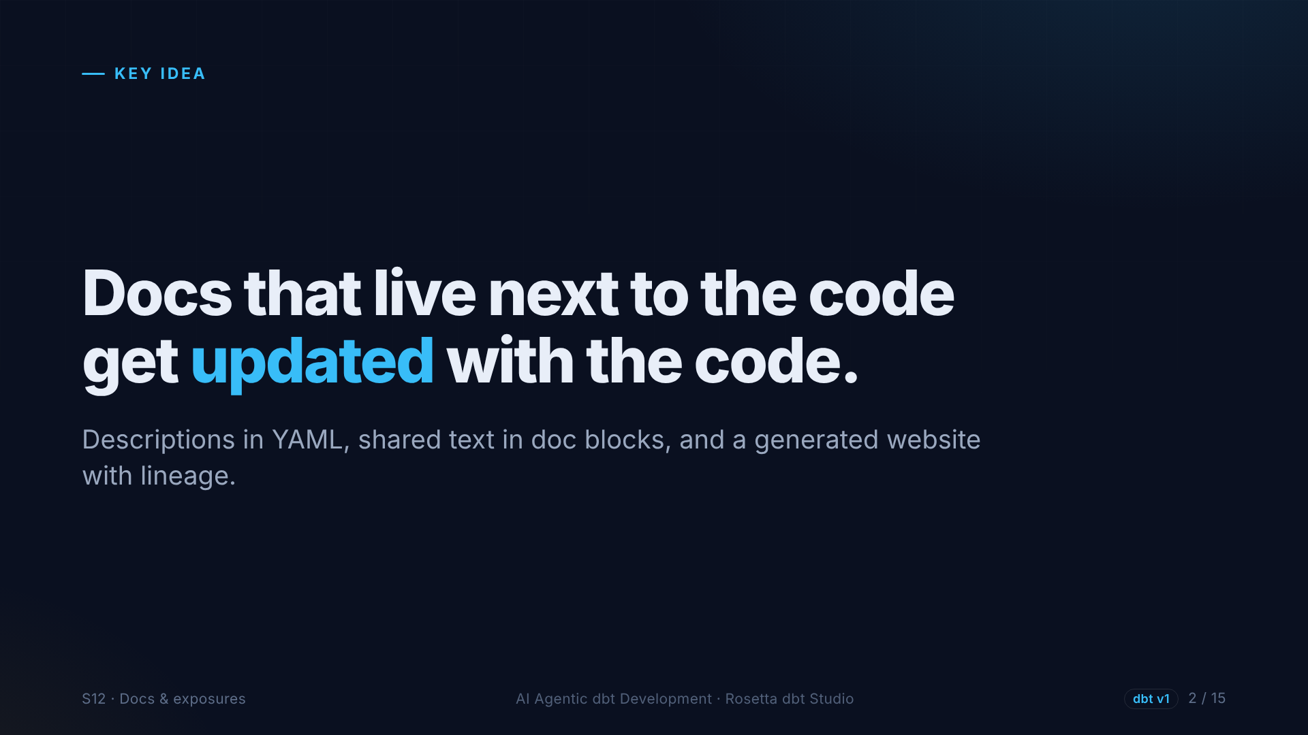
Notes:
Documentation in a wiki goes stale. In dbt, it lives in the same YAML files as the tests, in the same change as the code, and dbt turns it into a website with a lineage graph.

Slide 3
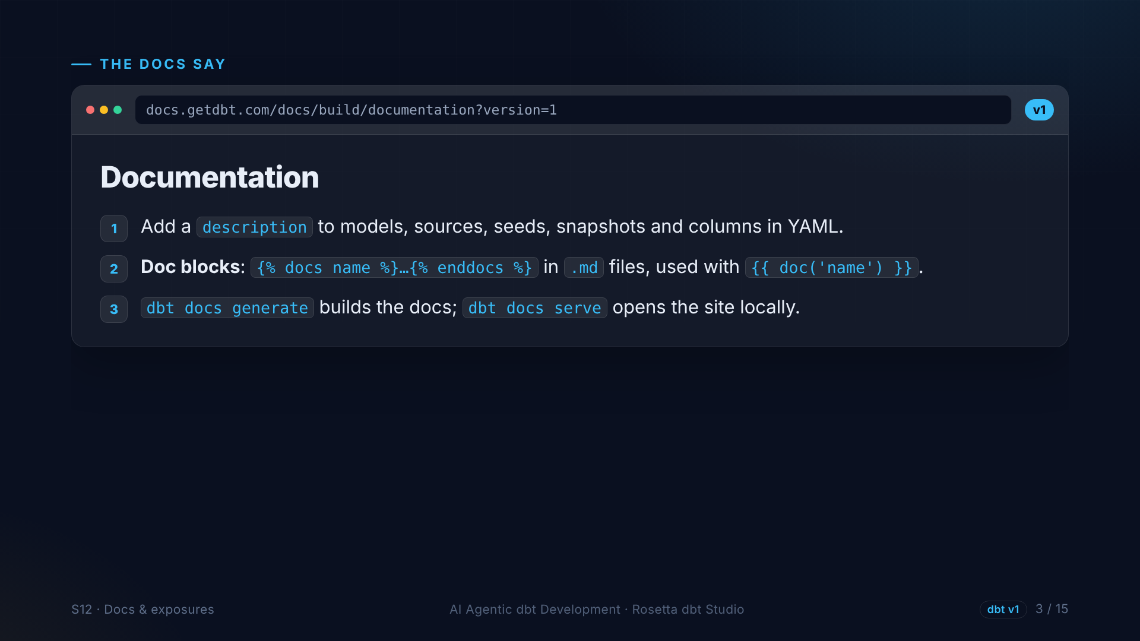
Notes:
The documentation page, version one. Descriptions go in YAML. Text needed in many places goes in a doc block, written once and used everywhere. dbt docs generate builds the documentation, and dbt docs serve opens it as a website.

Slide 4
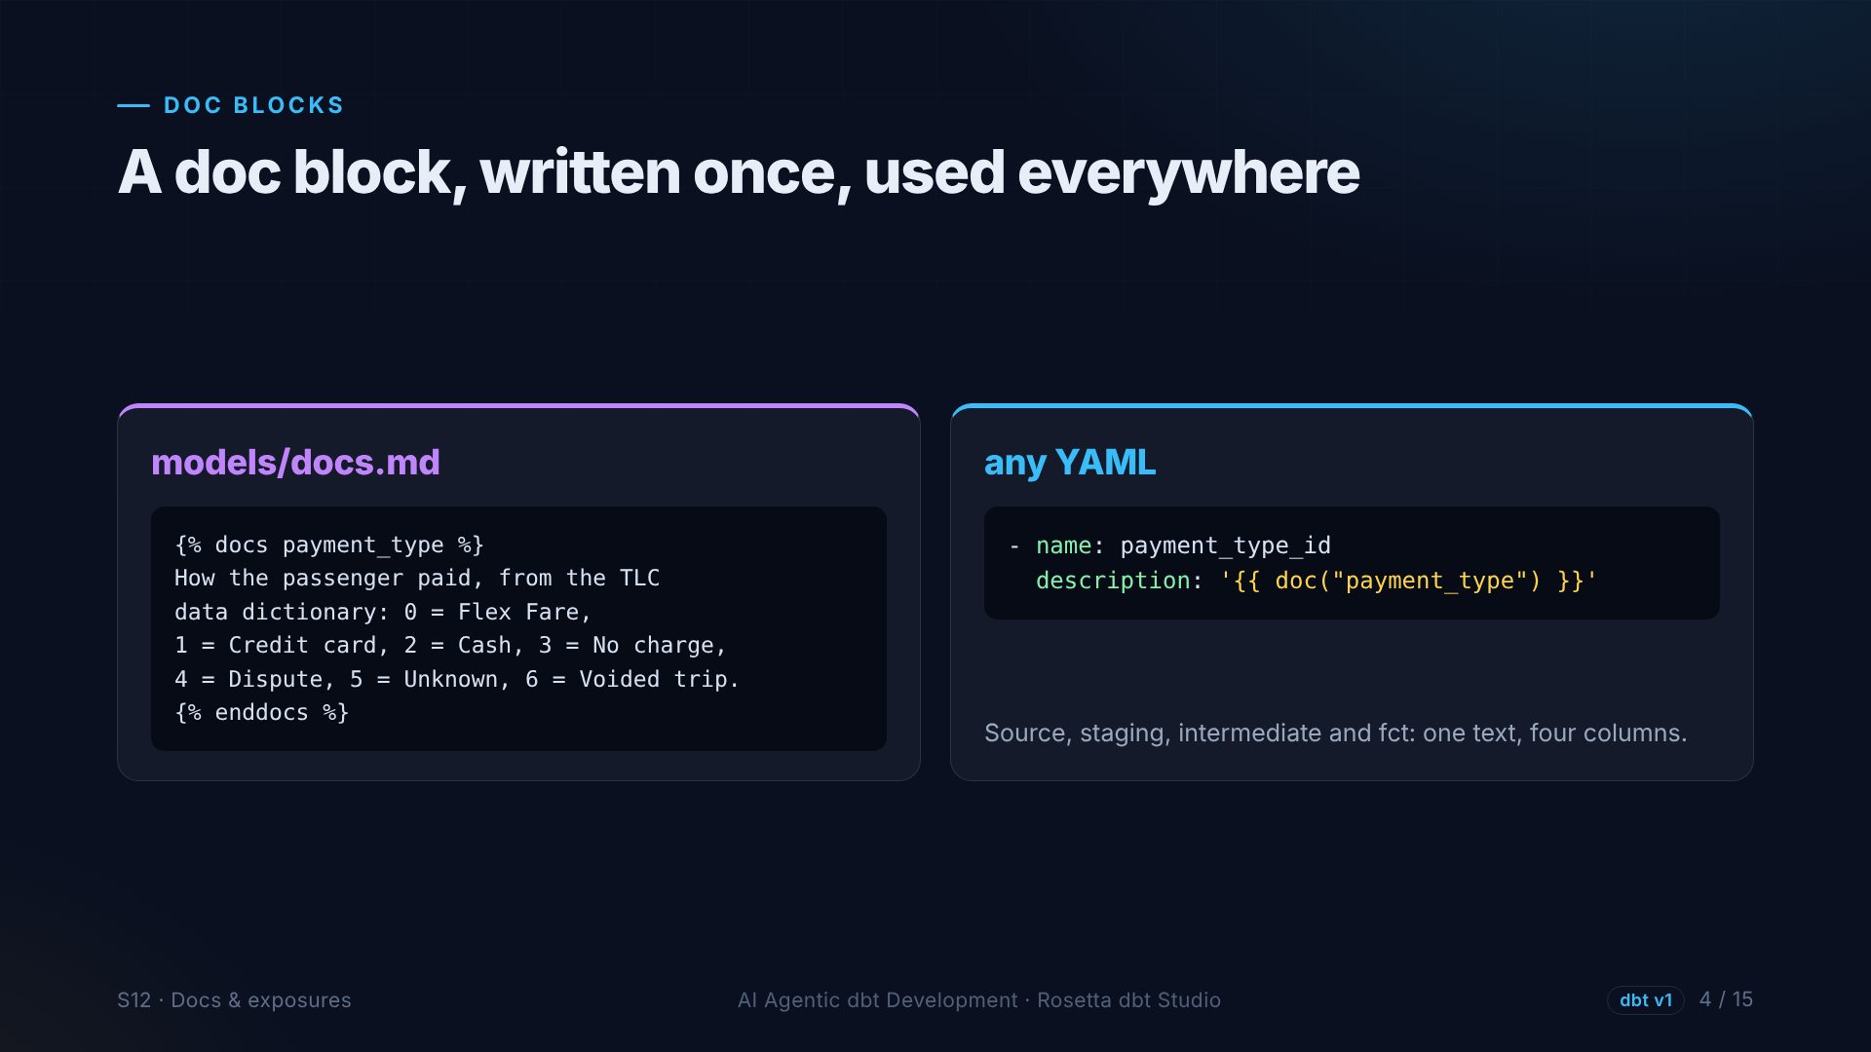
Notes:
A doc block in a Markdown file explains payment types once. Every YAML file that has a payment type column points to it. One text, four columns, always consistent.

Slide 5
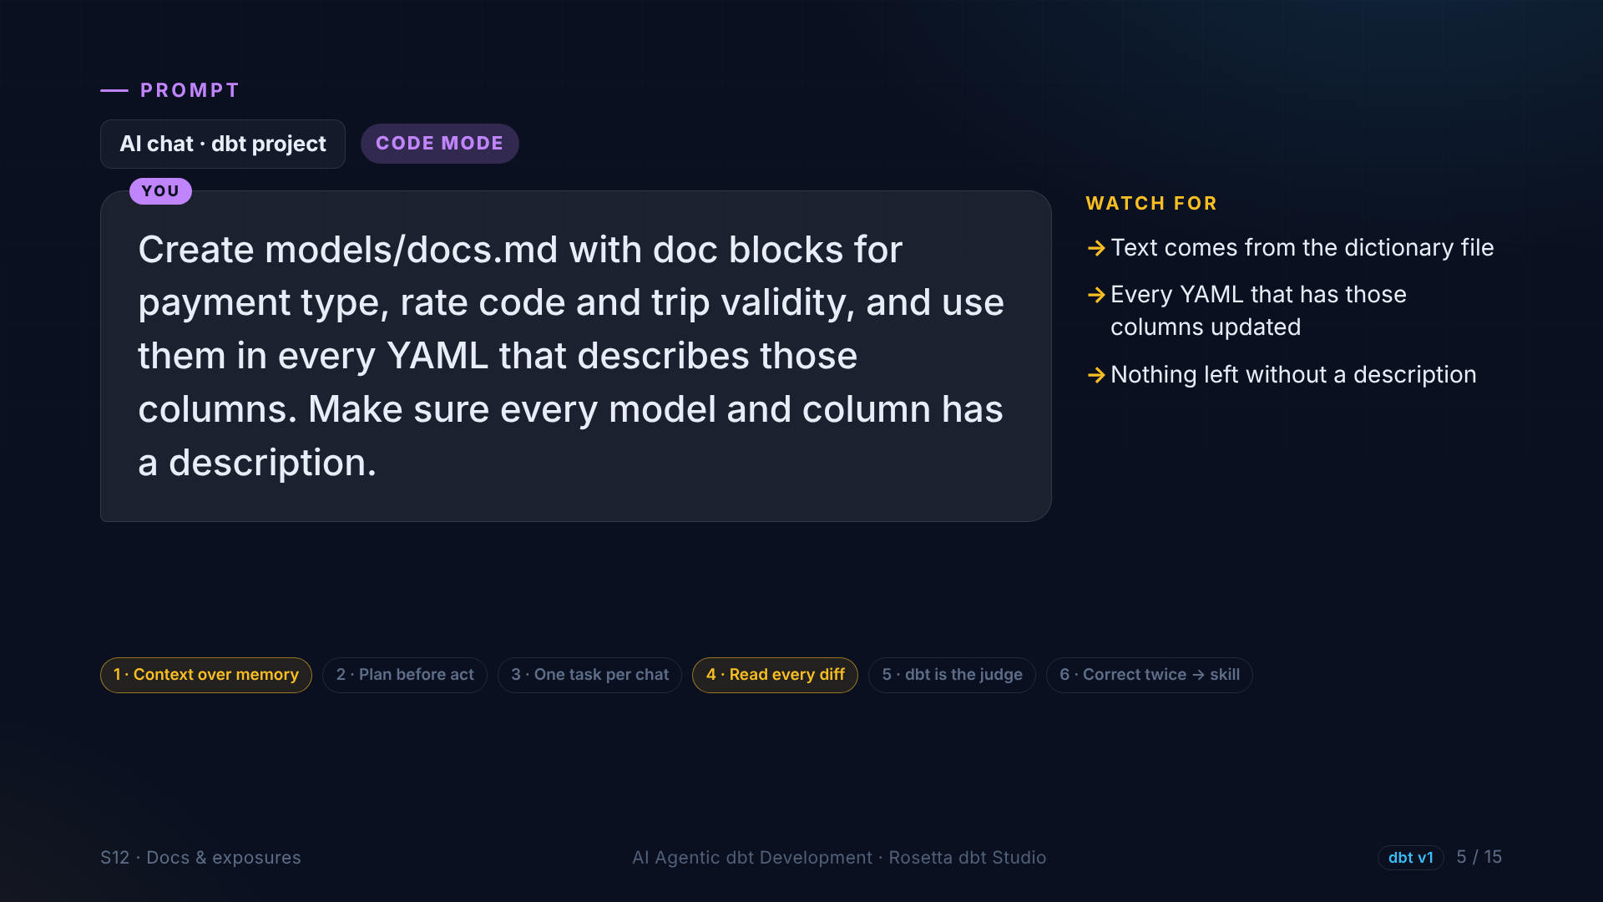
Notes:
In the demo, the agent creates doc blocks for payment type, rate code and trip validity, uses them everywhere, and makes sure every model and column has a description. Tedious work across many files, perfect for an agent.

Slide 6
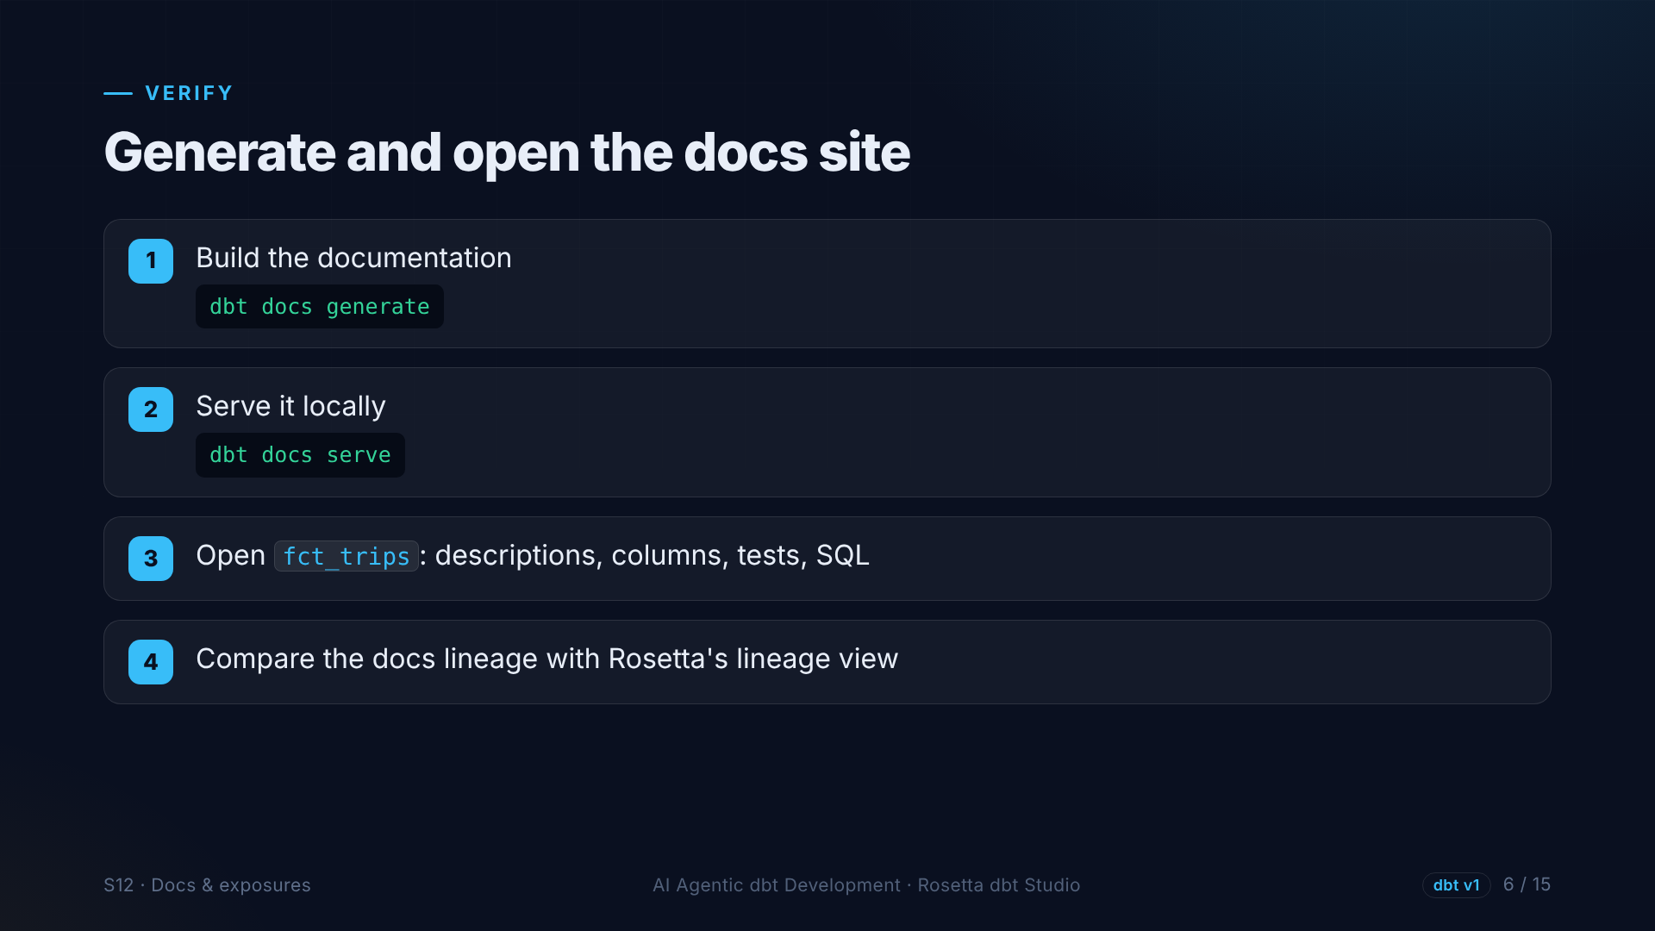
Notes:
Then we generate the docs and open the site. Every model, column, test and query is there, with a lineage graph that matches the one in Rosetta.

Slide 7
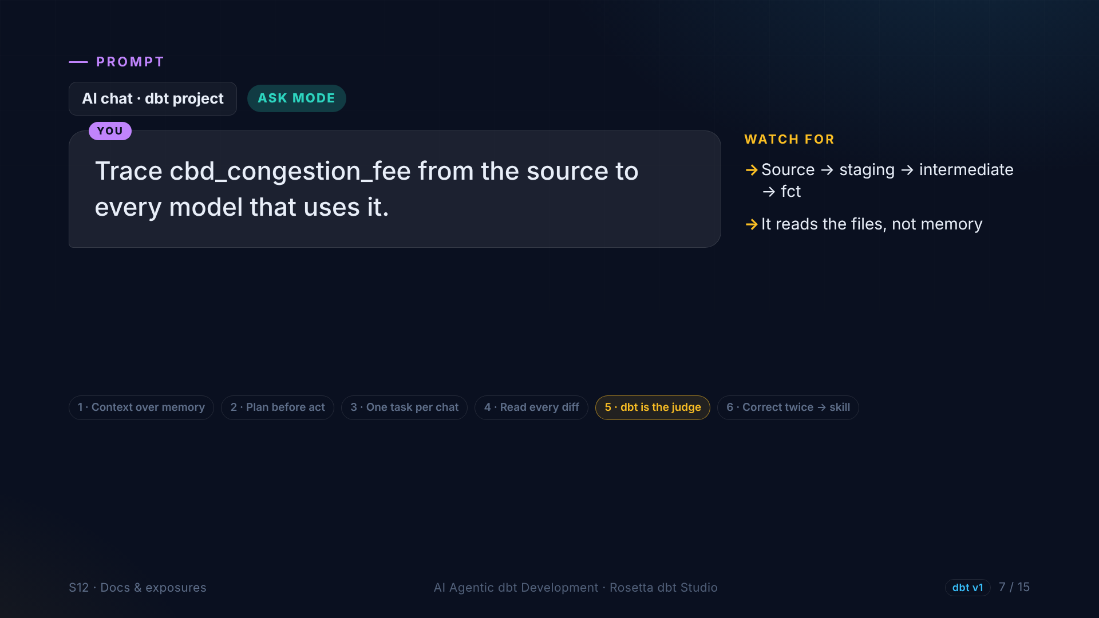
Notes:
Now the project explains itself. In Ask mode, we ask the agent to trace the congestion fee from the source to every model that uses it. It reads the files and gives the path.

Slide 8
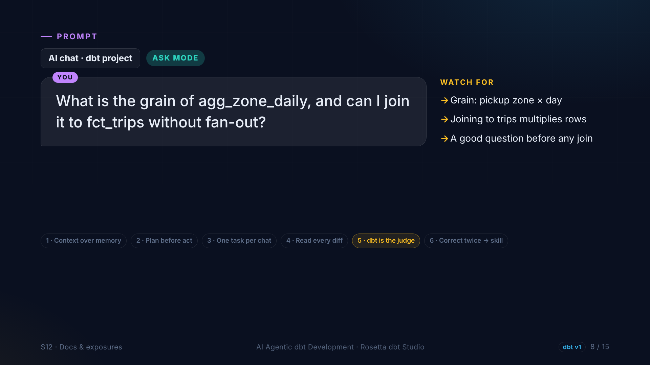
Notes:
Another good question before any join: what is the grain of the daily summary, and can we join it to trips without multiplying rows? One row per zone per day, so joining it to trips repeats rows. The agent should warn us.

Slide 9
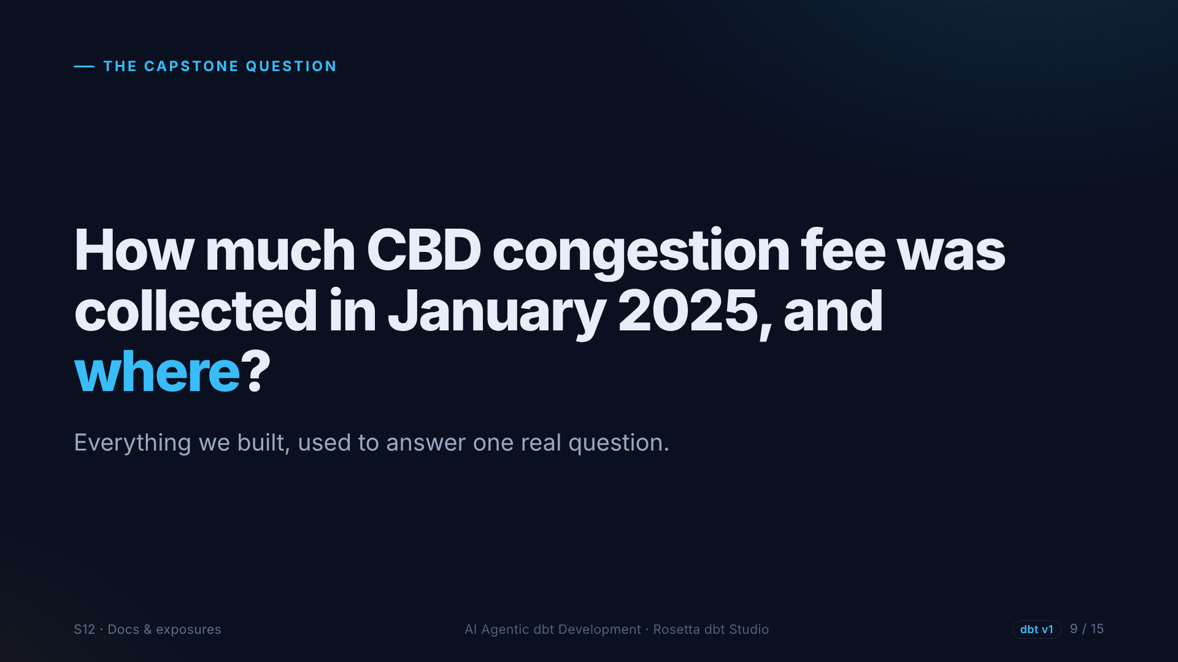
Notes:
And now the question the whole project was building towards. January twenty twenty-five was the first month of congestion pricing in New York. How much fee was collected, and where?

Slide 10
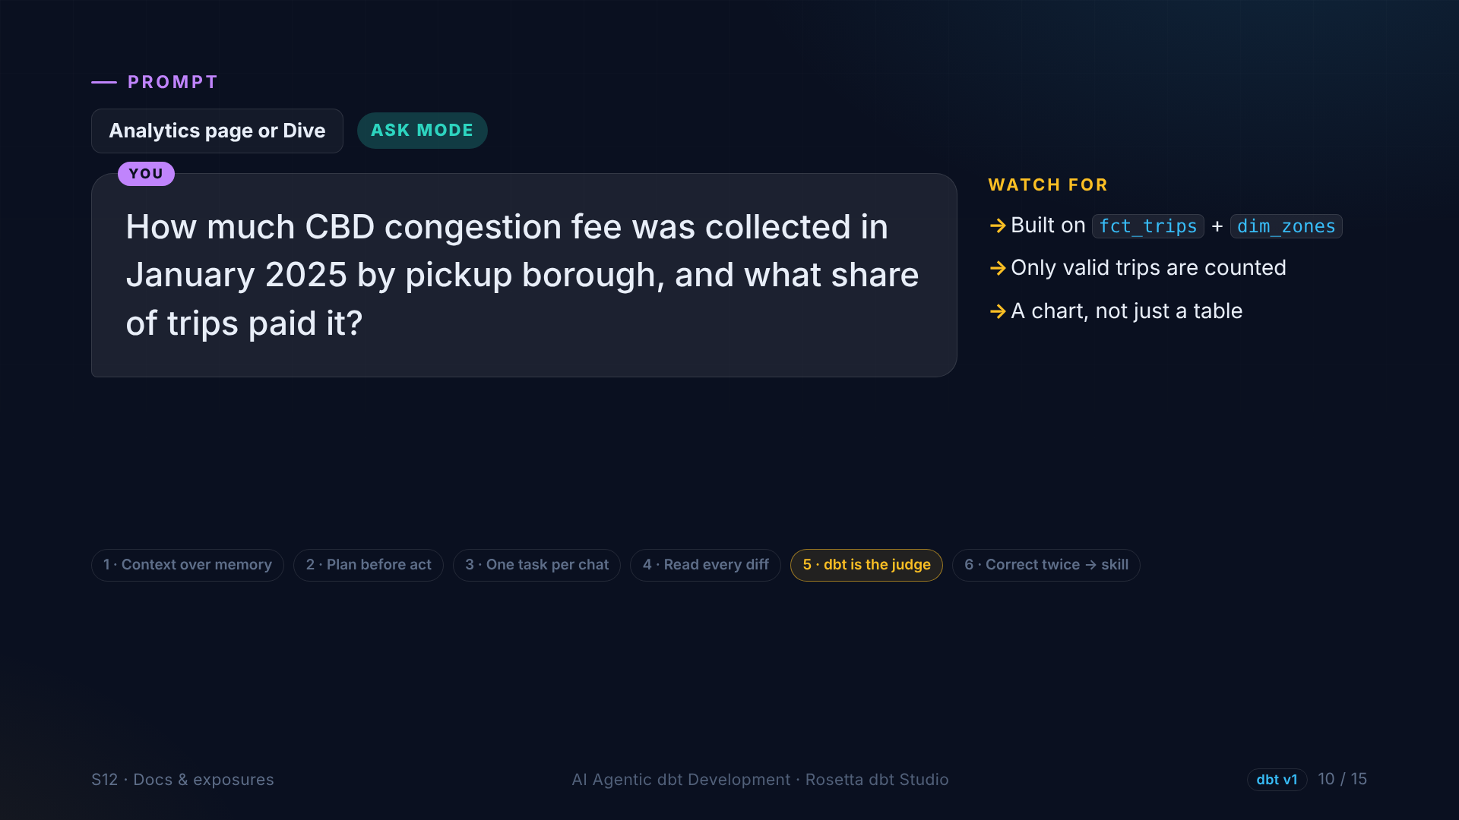
Notes:
We ask it in Rosetta's analytics, on top of our marts. Only valid trips count, and we see boroughs instead of IDs. Everything we built is inside this answer.

Slide 11
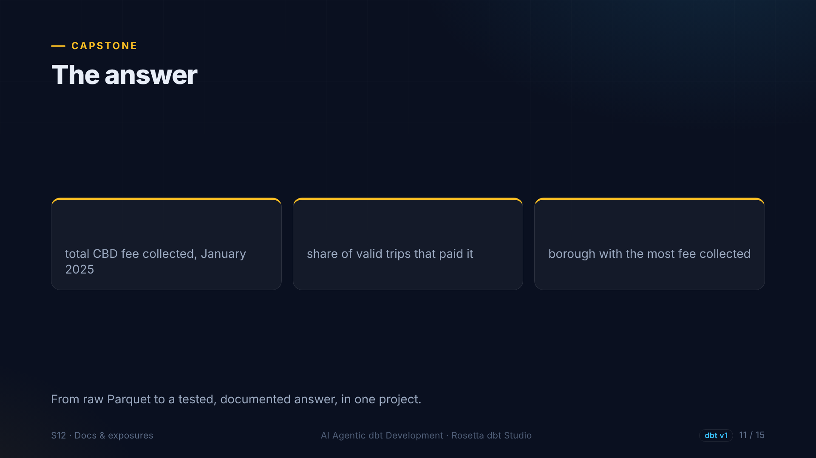
?
?
?
Notes:
Here is the answer on screen: the total fee collected in January, the share of valid trips that paid it, and the borough that collected the most. From raw files to a tested, documented answer.

Slide 12
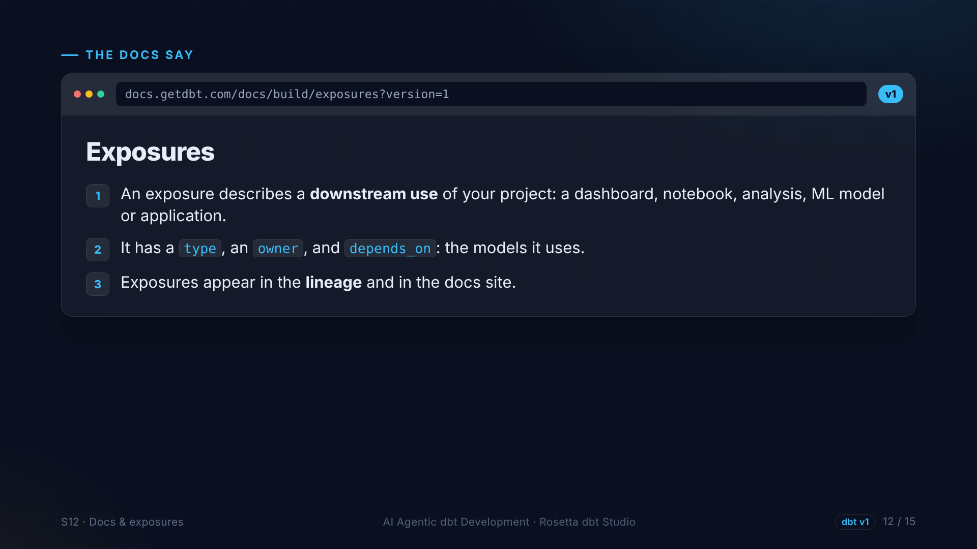
Notes:
The last block: exposures. An exposure tells dbt that something downstream depends on our models, like this analysis. If someone changes the fact table tomorrow, they see the analysis in the lineage.

Slide 13
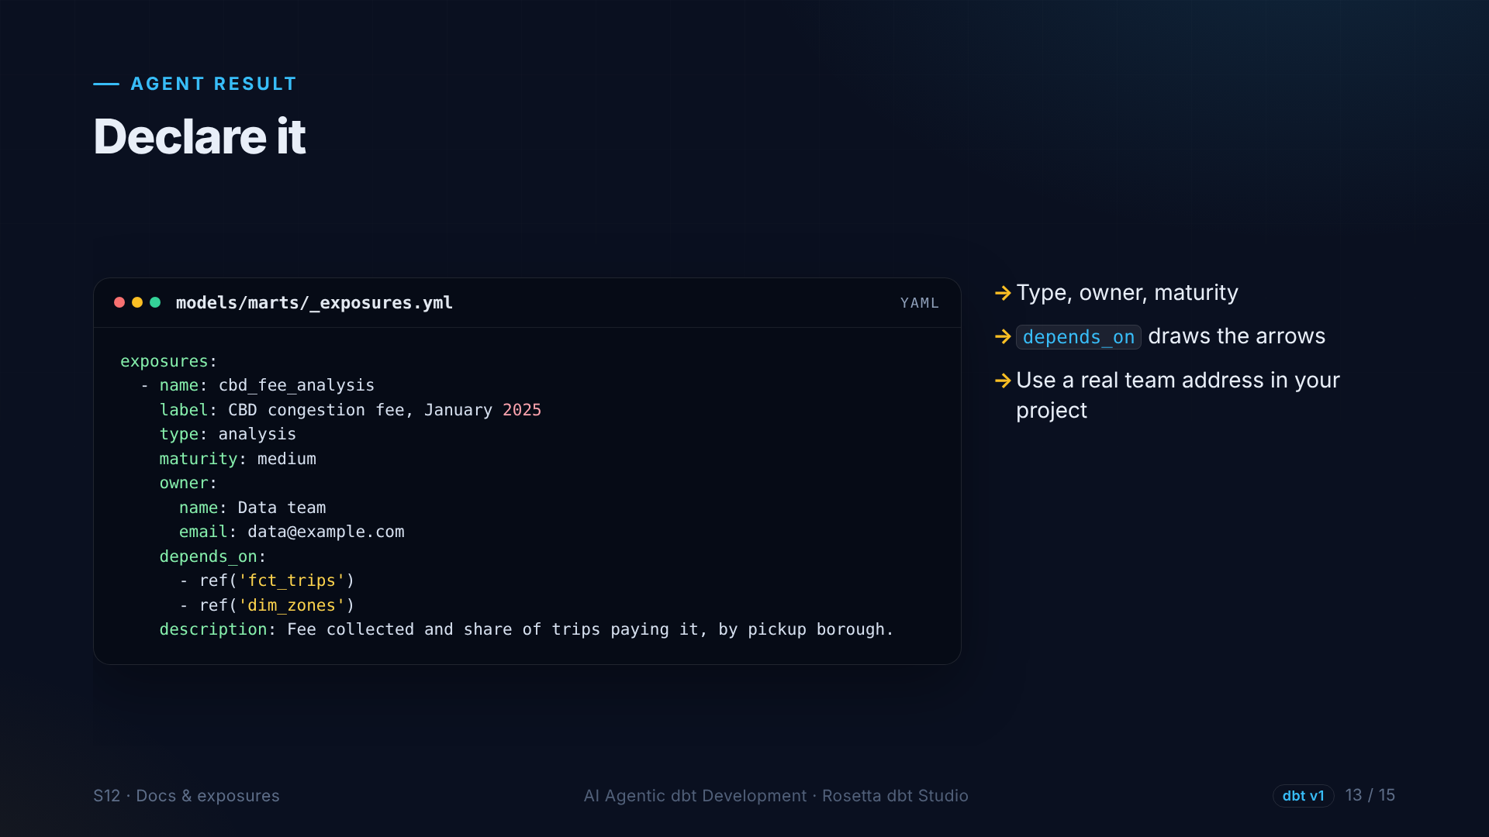
Notes:
The agent declares it: a name, a label, the type analysis, an owner, and the two marts it depends on.

Slide 14
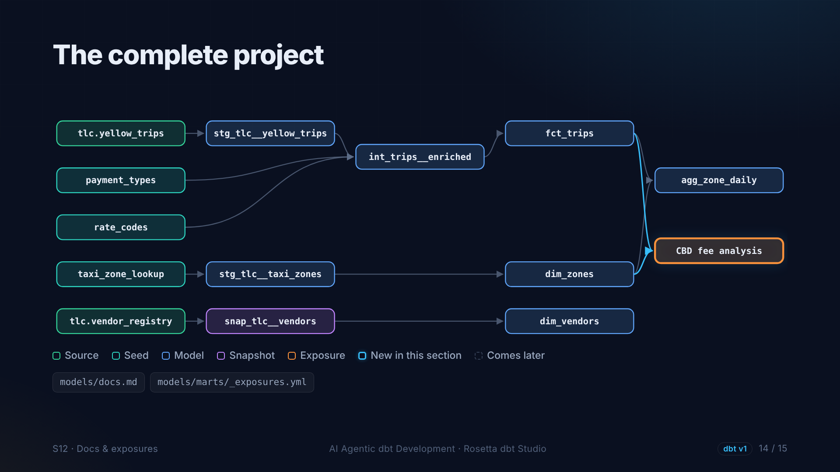
Notes:
And here is the complete project, every node built, with our analysis on the far right. From two Parquet files to this.

Slide 15
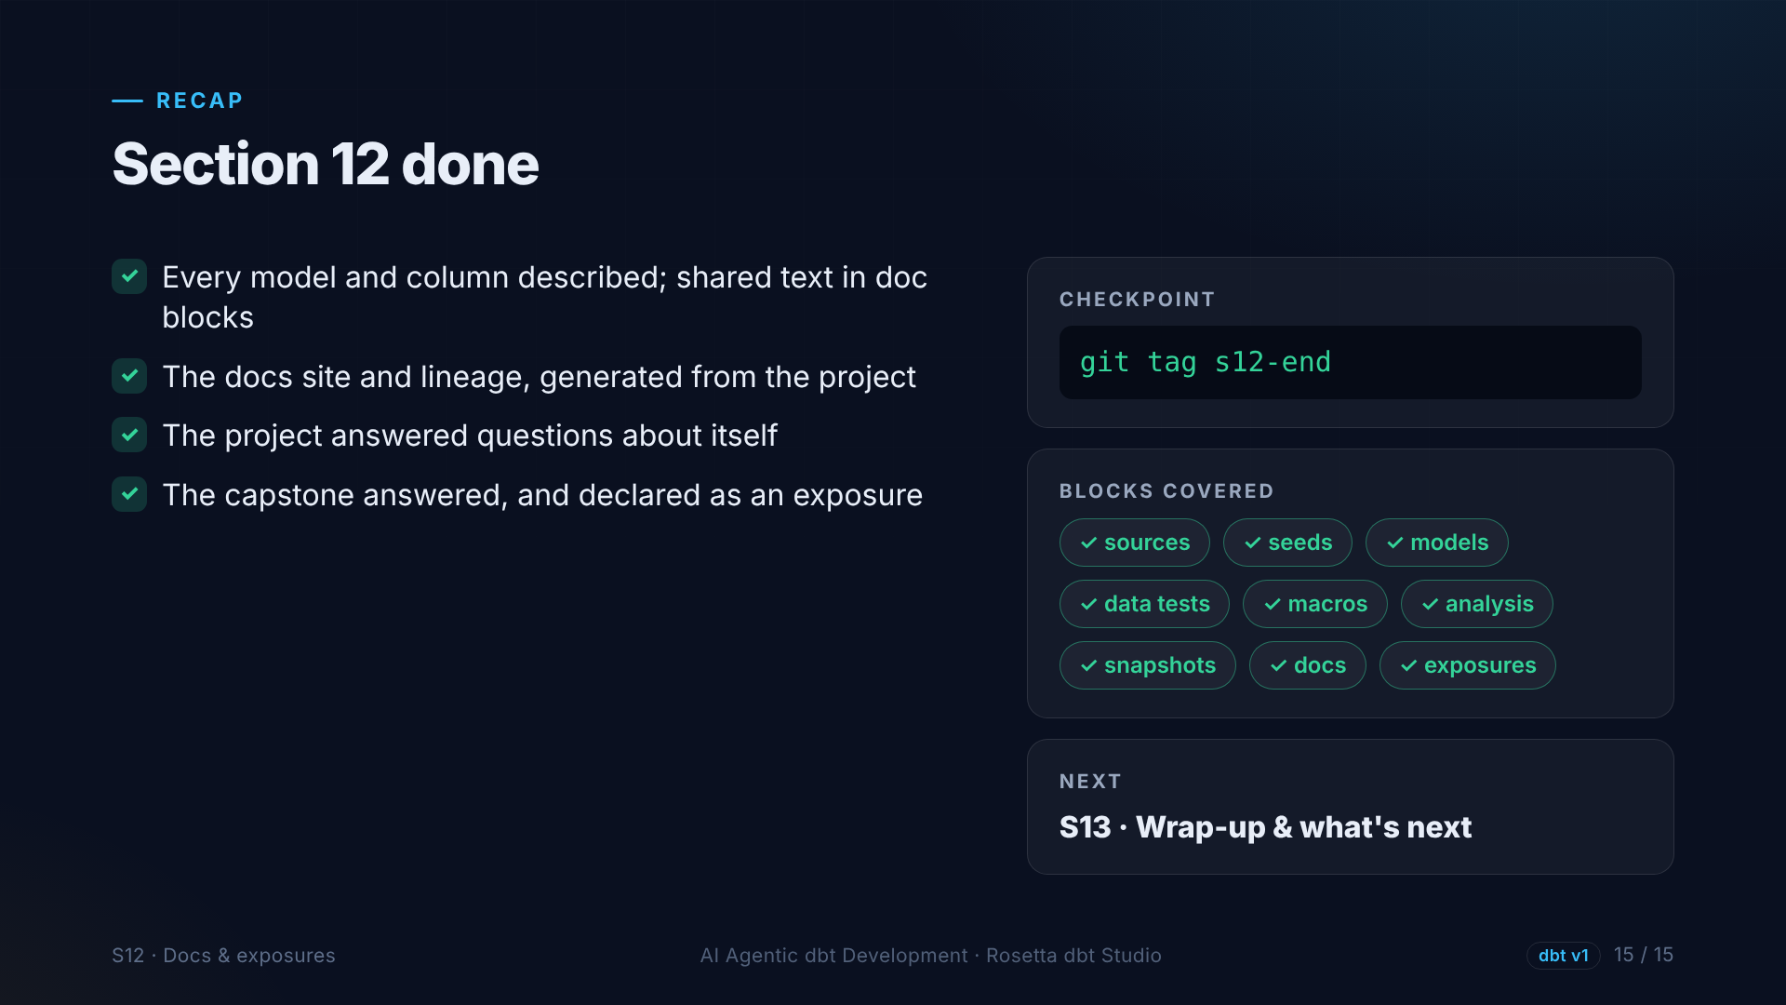
Notes:
That is section twelve. Fully documented, a docs website, a project that explains itself, and a real answer, declared as an exposure. One short section left.

