Slide 1
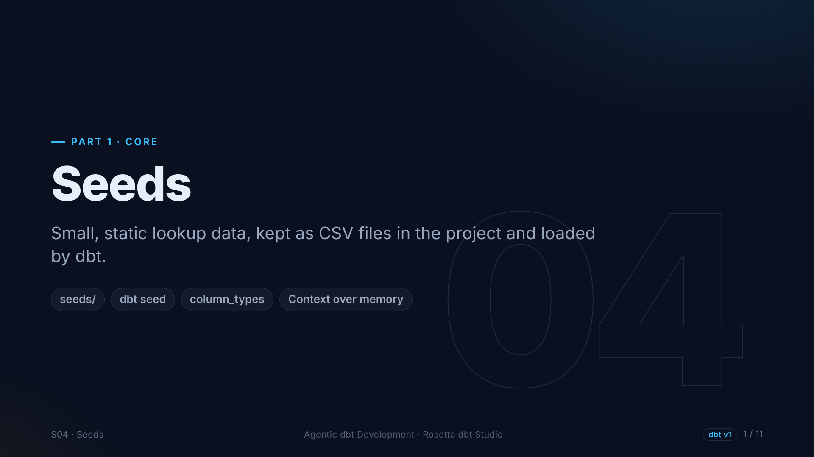
Notes:
Section four: seeds. Some data is not in any source system. It is a small list we maintain ourselves, like codes and their names. That is what seeds are for.

Slide 2
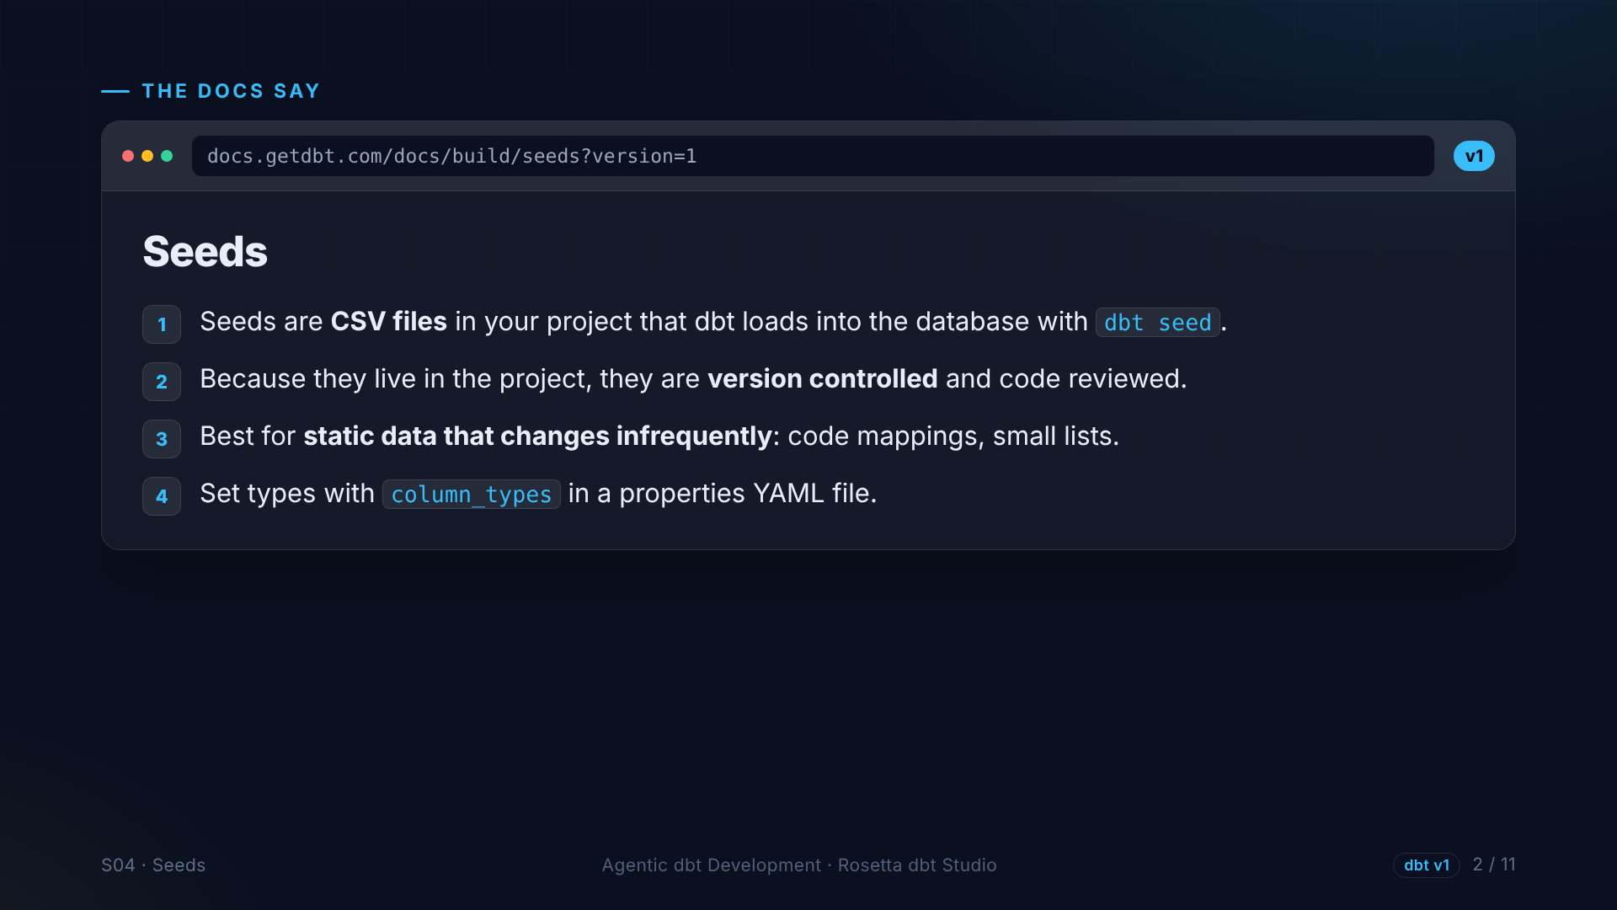
Notes:
The seeds page, version one. A seed is a CSV file in the project. dbt seed loads it as a table. Because it is a file in the project, it is version controlled and reviewed. Seeds are best for static data that changes rarely.

Slide 3
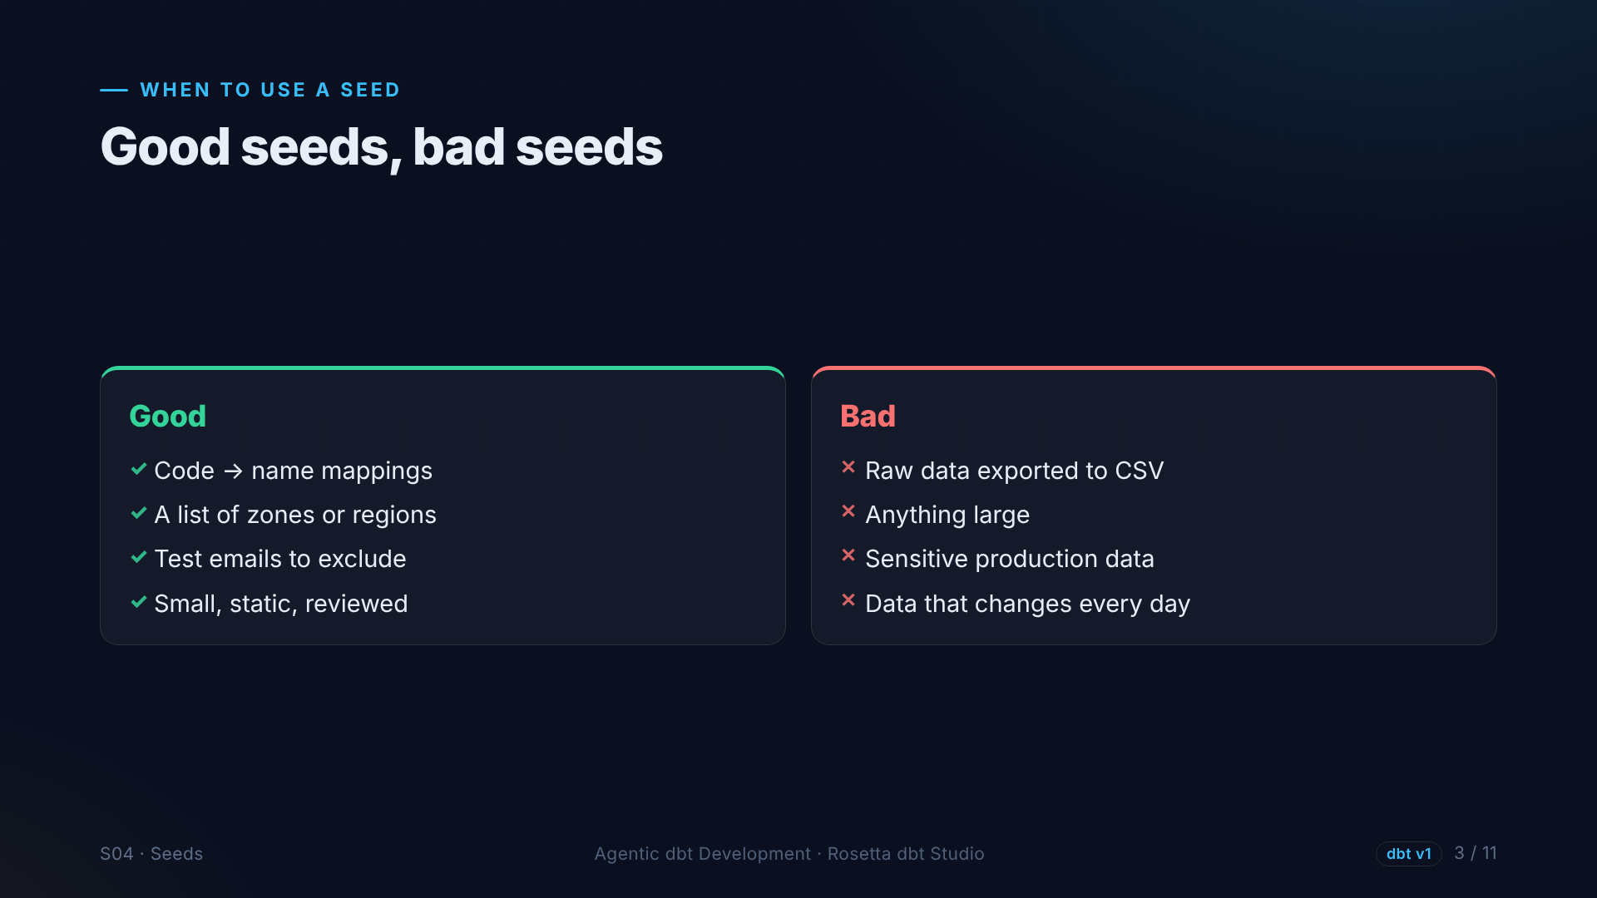
Notes:
Good seeds are small, static lists: code mappings, regions, test accounts to exclude. Bad seeds are raw data exported to CSV, anything large or sensitive, and anything that changes every day.

Slide 4
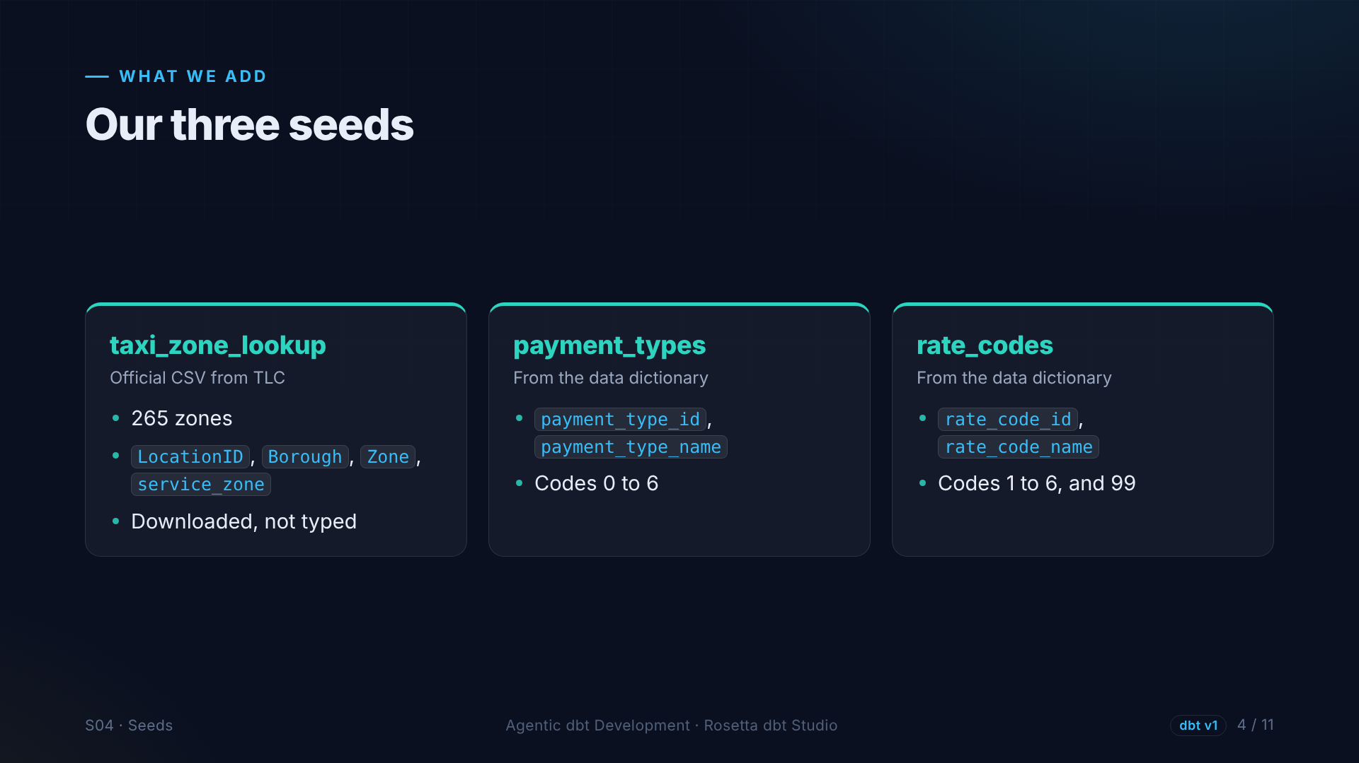
Notes:
We need three seeds. The official zone lookup from the Taxi Commission, with two hundred sixty-five zones. And two lists we create from the dictionary: payment types and rate codes. They turn numbers in the trip data into readable names.

Slide 5
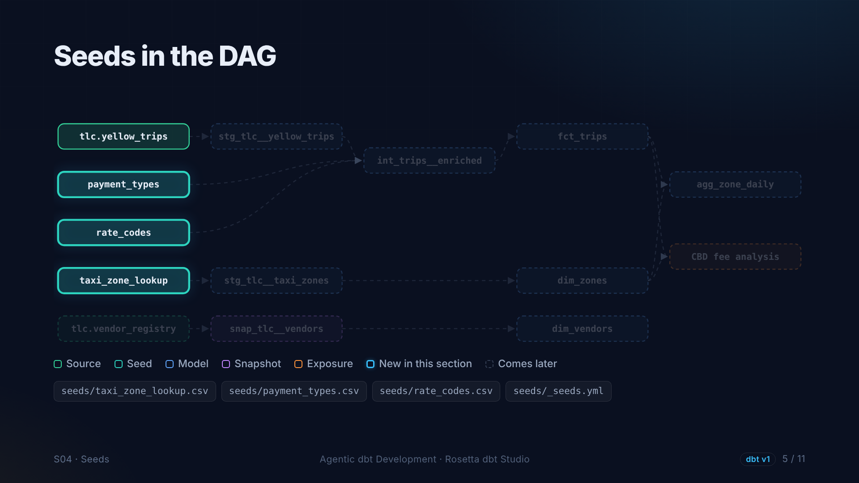
Notes:
On the graph, three new nodes on the left, next to the source. Like sources, seeds are where data enters the project.

Slide 6
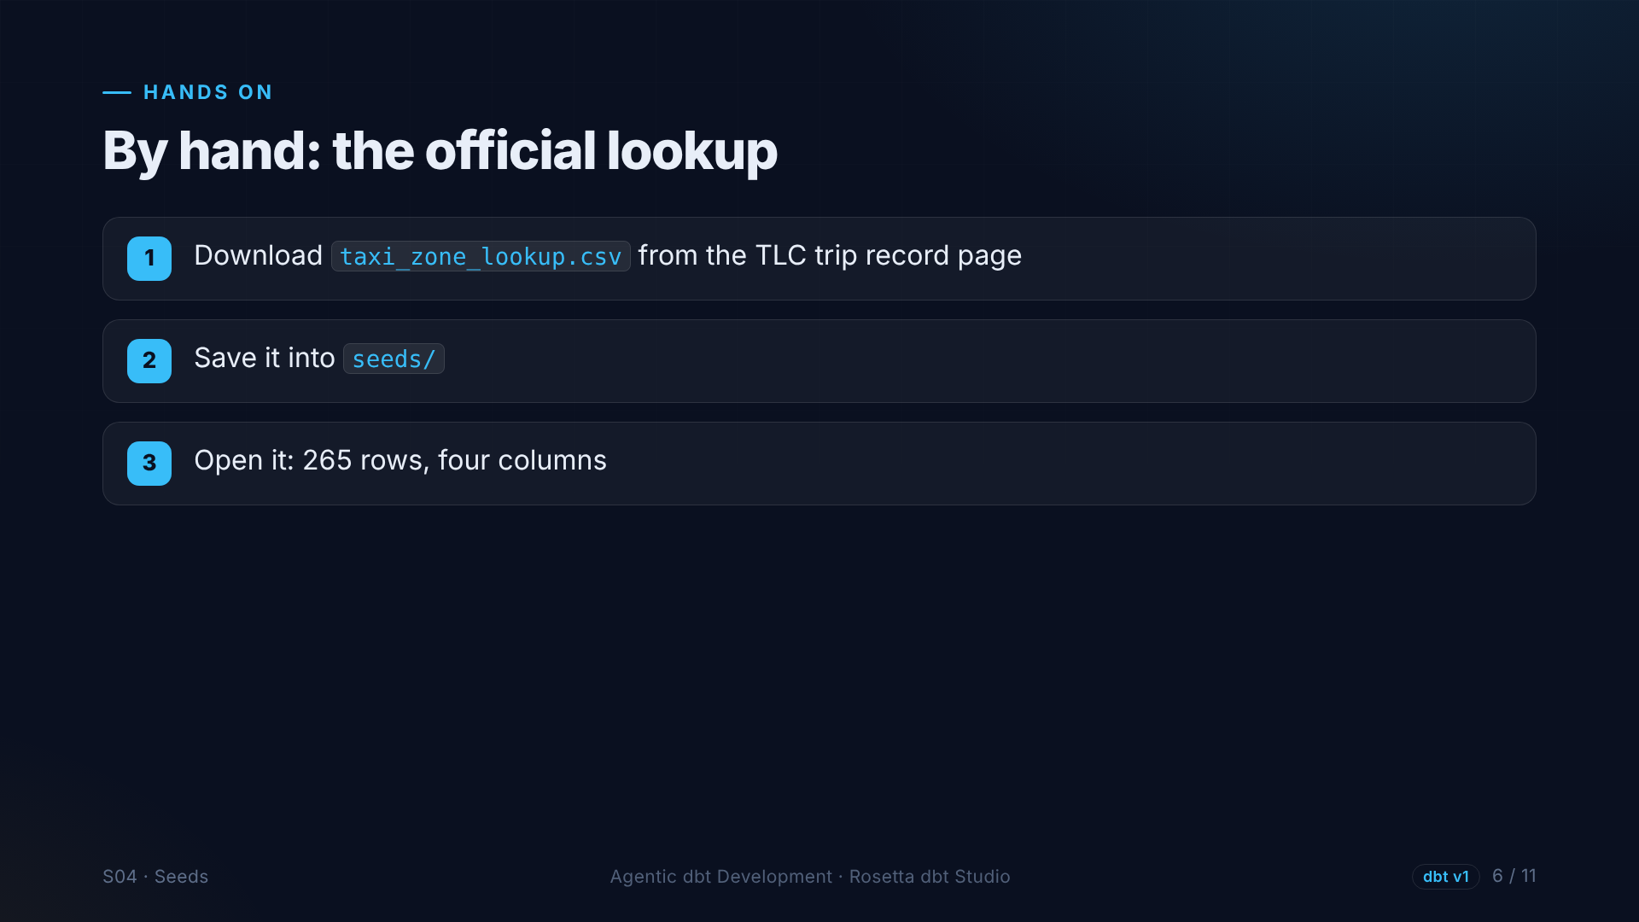
Notes:
The zone lookup is an official file, so nobody should retype it. In the demo, we download it from the Taxi Commission page and drop it into the seeds folder. Notice the column names are not snake case yet. We fix that in staging.

Slide 7
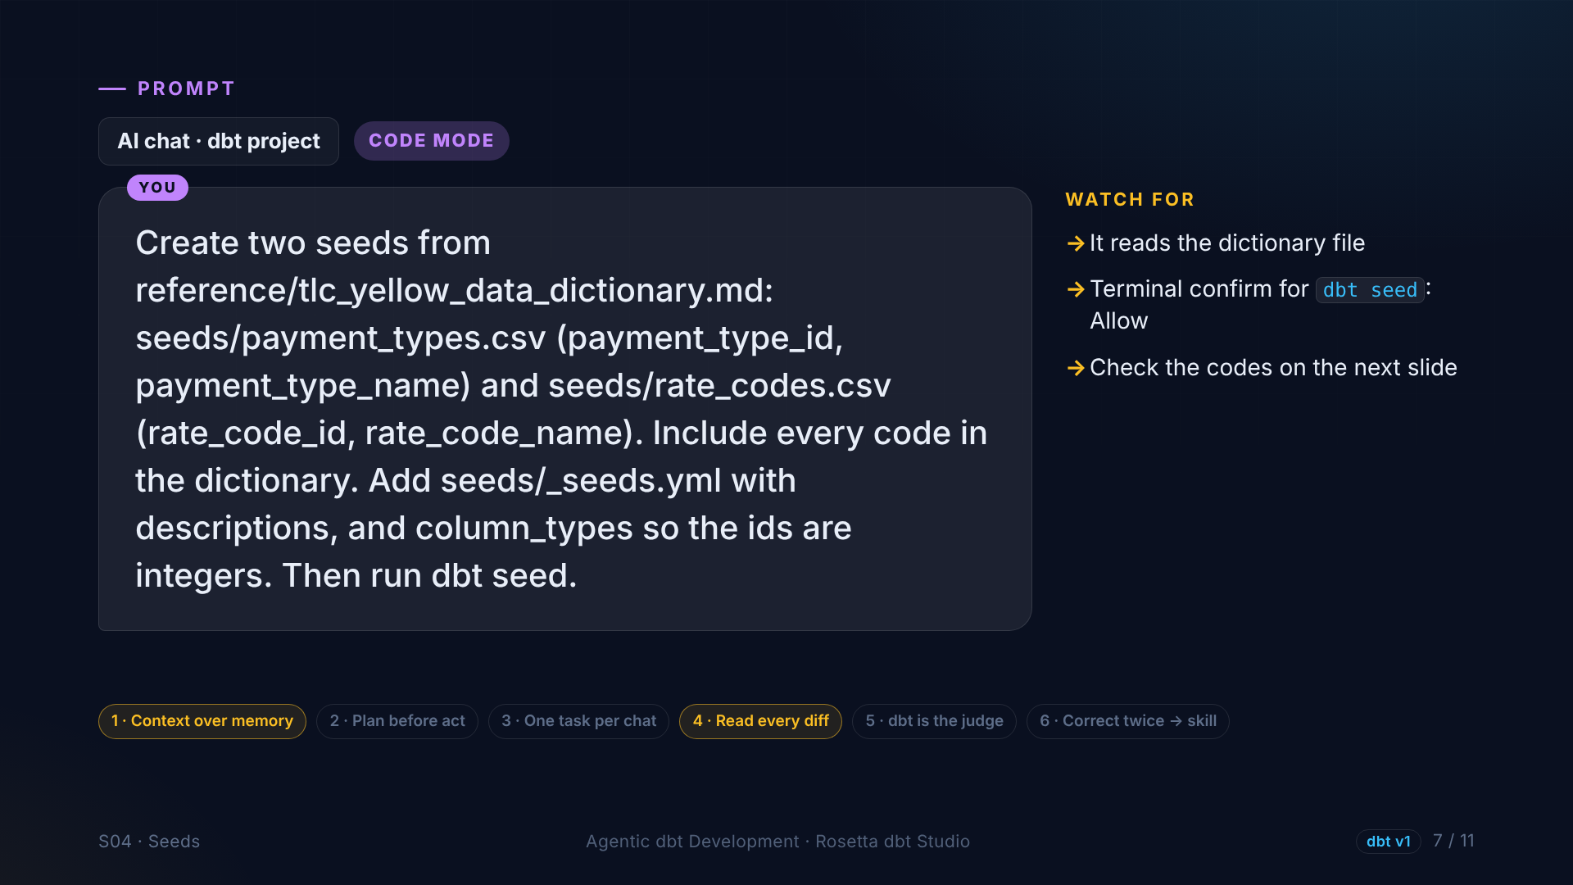
Notes:
The other two seeds, the agent creates from the dictionary file: every payment type, every rate code, a YAML file with descriptions, and integer types for the IDs. Then it asks to run dbt seed, and waits for our approval.

Slide 8
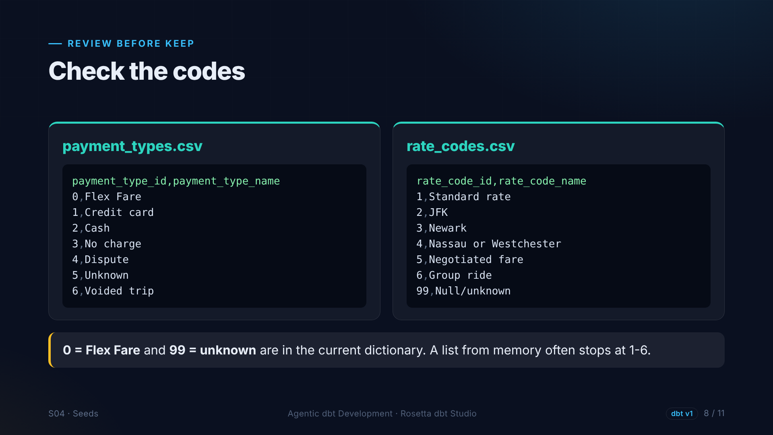
Notes:
The review. Payment types must start at zero, Flex Fare, and include six, voided trip. Rate codes must include ninety-nine, unknown. Older versions of the dictionary did not have these, so a list from memory would be wrong. We gave the agent the file, so it got the current list.

Slide 9
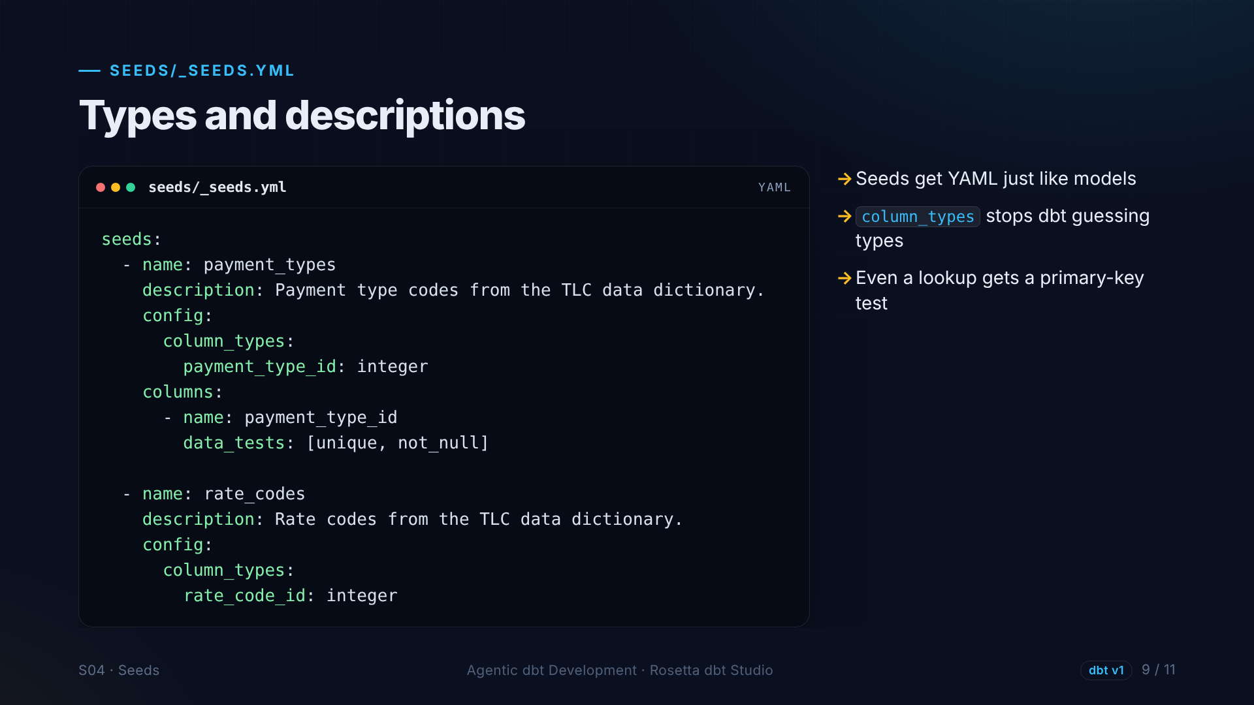
Notes:
Seeds get YAML just like models. Descriptions, and column types, so the IDs are integers instead of guessed types. Even a small lookup gets a primary key test.

Slide 10
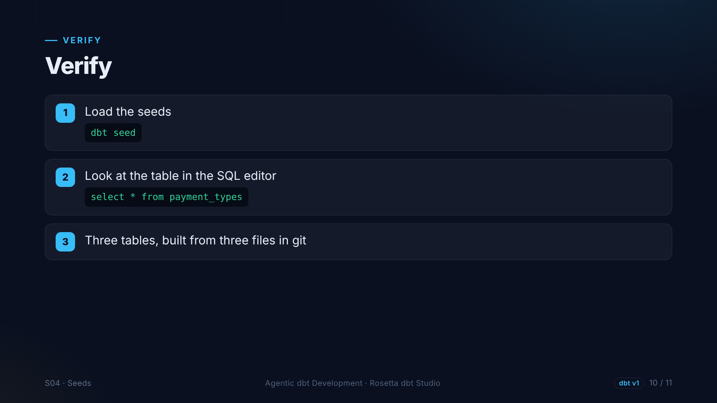
Notes:
We load the seeds with dbt seed and look at the table in the SQL editor. Seven payment types, built from a file in git.

Slide 11
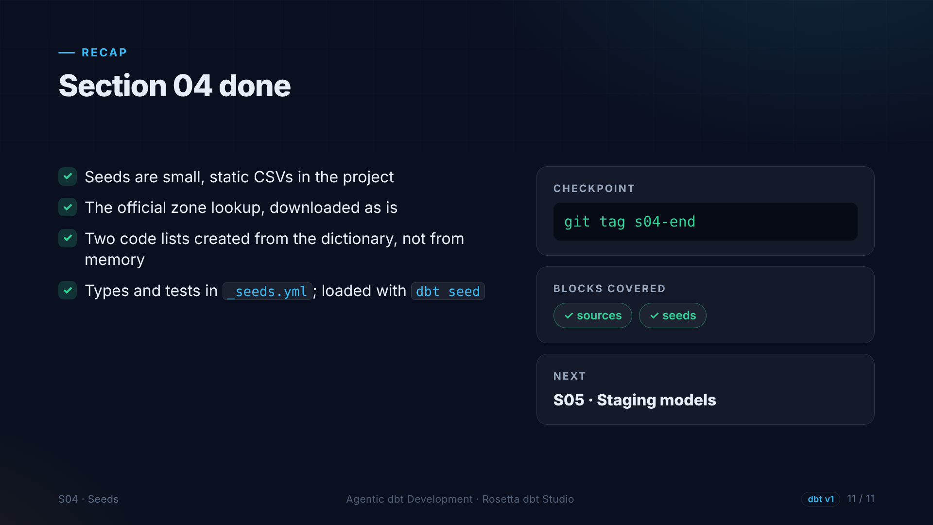
Notes:
That is section four. Three seeds: one official file, two created from the dictionary, checked and loaded. Next, our first models: staging.

